Slide 1
Machine Learning Applied in Product Classification
Jianfu Chen
Computer Science Department
Stony Brook University

Slide 2

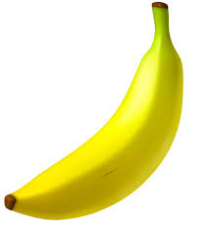
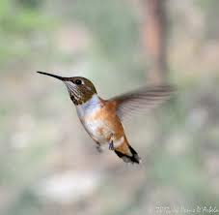






Machine learning learns an idealized model of the real world.
$$+$$
$$=$$
$$+$$
$$=$$
1 + 1 = 2
?
$$+$$
$$=$$
Notes:
abstraction, generalization

Slide 3
Prod1 -> class1
Prod2 -> class2
...
f(x) -> y
Prod3 -> ?
X: Kindle Fire HD 8.9" 4G LTE Wireless
0 ... 1 1 ... 1 ... 1 ... 0 ...

Slide 4
Compoenents of the magic box f(x)
Representation
Give a score to each class
Inference
Predict the class with highest score
$$f\left(x\right)=\arg{\max_{y}{s(y;x)}}$$
𝑓(𝑥)=arg⁡max_𝑦⁡〖𝑠(𝑦;𝑥)〗
Learning
Estimate the parameters from data
s(y; x) = $w_{}^{T}x=w_{1}x_{1}+⋯+w_{n}x_{n}$
s(y; x) = 𝑤_^𝑇 𝑥=𝑤_1 𝑥_1+⋯+𝑤_𝑛 𝑥_𝑛
Notes:
reprentation: conceptual choice, learning: implementation

Slide 5
Representation
Given an example, a model gives a score to each class.
Linear Model
s(y;x)=$w_{y}^{T}x$
s(y;x)=𝑤_𝑦^𝑇 𝑥
Probabilistic Model
P(x,y)
P(y|x)
Algorithmic Model
Decision Tree
Neural Networks
Naive Bayes
Logistic Regression
Notes:
a model is an idealized view about how to rank classes in the real world.

Slide 6
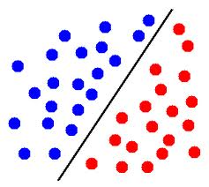




Linear Model
a linear comibination of the feature values.
a hyperplane.
Use one weight vector to score each class.
$$s\left(y;x\right)=w_{y}^{T}x=w_{y,1}x_{1}+⋯+w_{y,n}x_{n}$$
$$w_{1}$$
$$w_{3}$$
$$w_{2}$$
Notes:
linear combination, hyperplane

Slide 7
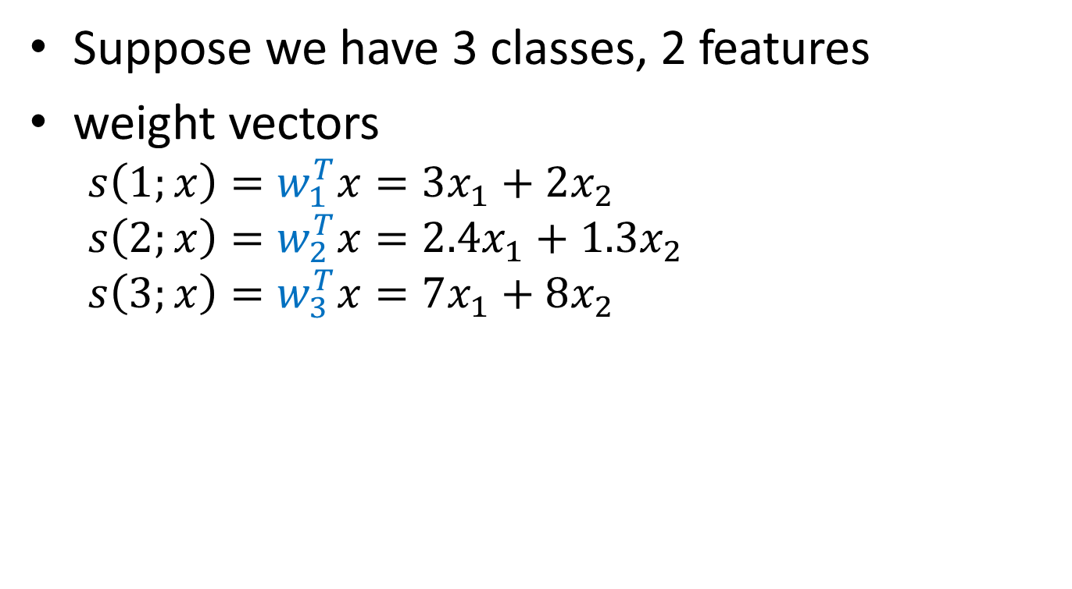
Example
Suppose we have 3 classes, 2 features
weight vectors
$$s\left(1;x\right)=w_{1}^{T}x=3x_{1}+2x_{2}$$
$$s\left(2;x\right)=w_{2}^{T}x=2.4x_{1}+1.3x_{2}$$
$$s\left(3;x\right)=w_{3}^{T}x=7x_{1}+8x_{2}$$

Slide 8
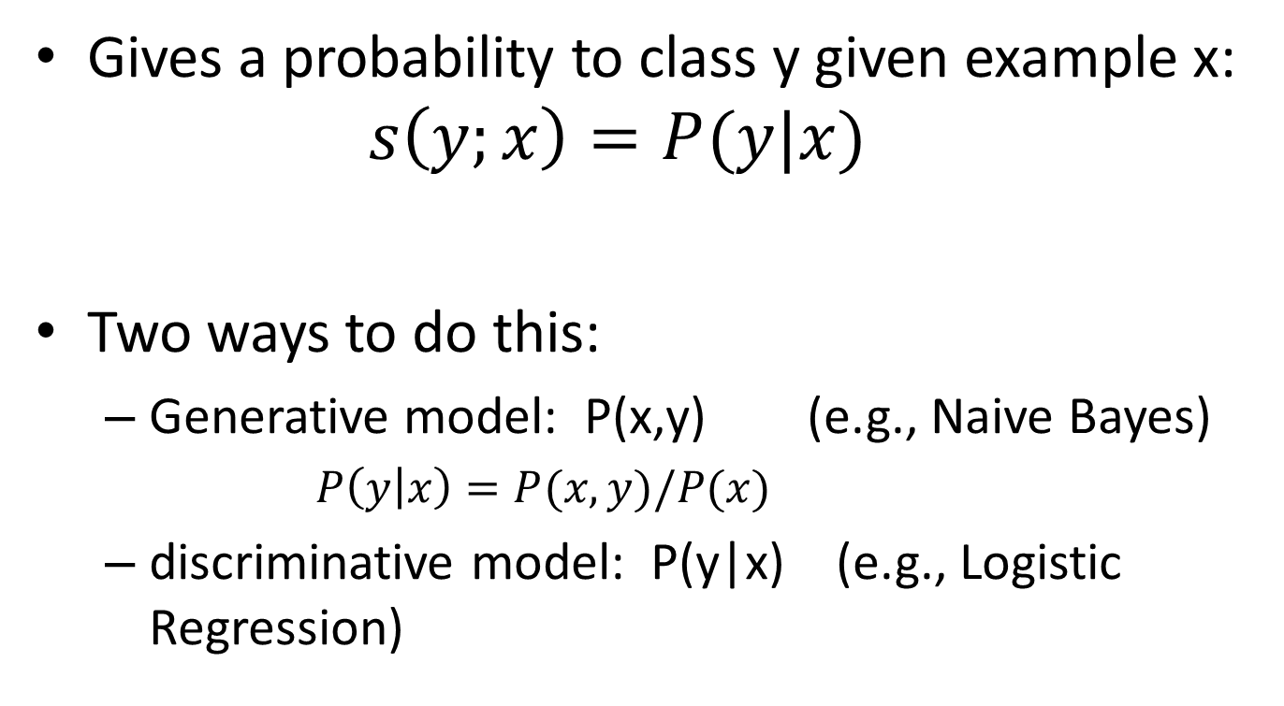
Probabilistic model
Gives a probability to class y given example x:
$$s\left(y;x\right)=P(y|x)$$
Two ways to do this:
Generative model: P(x,y) (e.g., Naive Bayes)
$P\left(y | x\right)=P(x,y)/P(x)$
discriminative model: P(y|x) (e.g., Logistic Regression)

Slide 9
Compoenents of the magic box f(x)
Representation
Give a score to each class
Inference
Predict the class with highest score
$$f\left(x\right)=\arg{\max_{y}{s(y;x)}}$$
𝑓(𝑥)=arg⁡max_𝑦⁡〖𝑠(𝑦;𝑥)〗
Learning
Estimate the parameters from data
s(y; x) = $w_{}^{T}x=w_{1}x_{1}+⋯+w_{n}x_{n}$
s(y; x) = 𝑤_^𝑇 𝑥=𝑤_1 𝑥_1+⋯+𝑤_𝑛 𝑥_𝑛

Slide 10
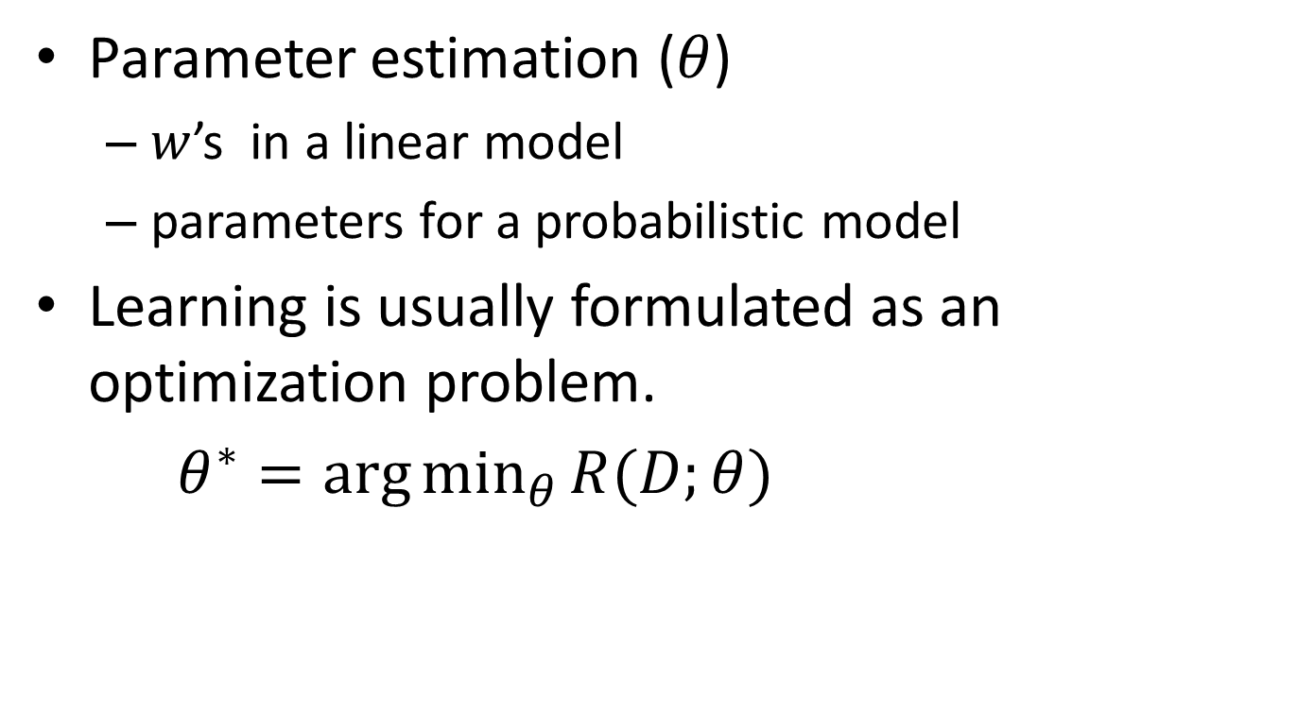
Learning
Parameter estimation ($θ$)
$w$’s in a linear model
parameters for a probabilistic model
Learning is usually formulated as an optimization problem.
$θ^{∗}=\arg{\min_{θ}{R(D;θ)}}$
Notes:
define an objective, minimize the objective function

Slide 11
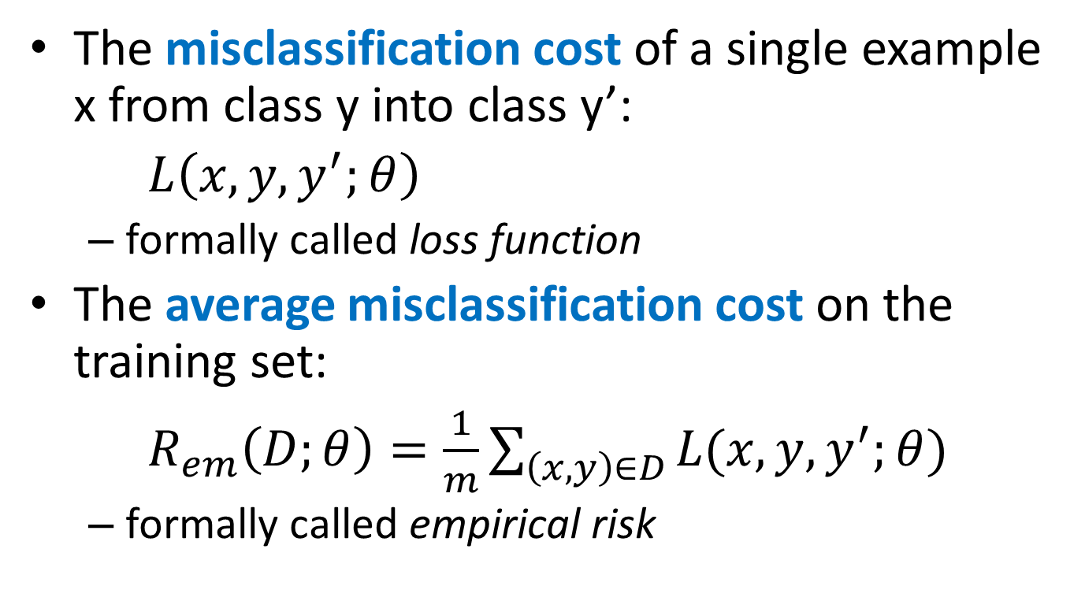
Define an optimization objective - average misclassification cost
The misclassification cost of a single example x from class y into class y’:
$L\left(x,y,y^{′};θ\right)$
formally called loss function
The average misclassification cost on the training set:
$R_{em}\left(D;θ\right)=\frac{1}{m}\sum_{\left(x,y\right)∈D}{L(x,y,y^{′};θ)}$
formally called empirical risk

Slide 12
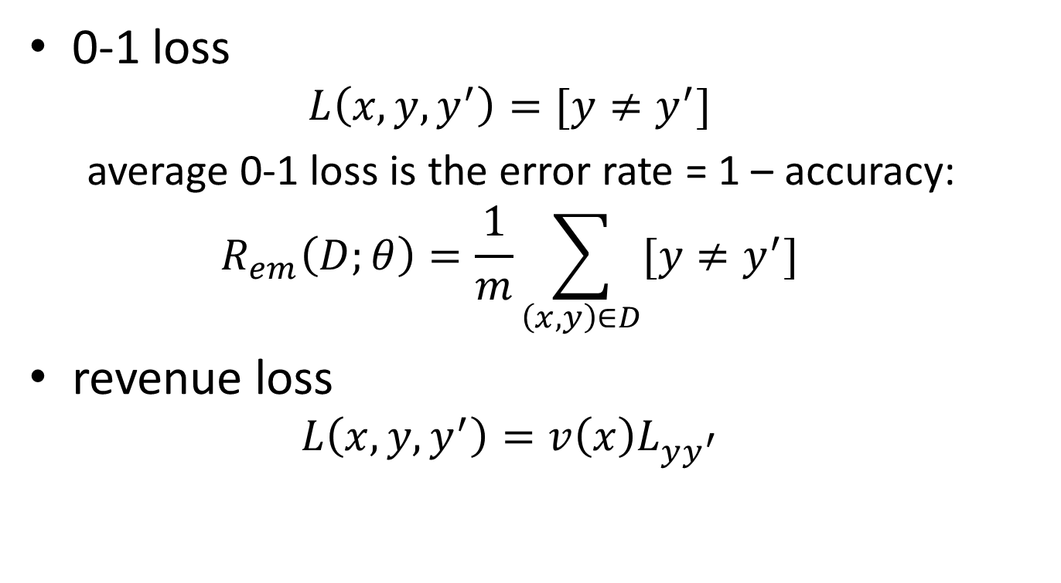
Define misclassification cost
0-1 loss
$$L\left(x,y,y^{′}\right)=[y≠y^{′}]$$
average 0-1 loss is the error rate = 1 – accuracy:
$$R_{em}\left(D;θ\right)=\frac{1}{m}\sum_{\left(x,y\right)∈D}{[y≠y^{′}]}$$
revenue loss
$$L\left(x,y,y^{′}\right)=v\left(x\right)L_{yy^{′}}$$

Slide 13

Do the optimization - minimizes a convex upper bound of the average misclassification cost.
Directly minimizing average misclassificaiton cost is intractable, since the objective is non-convex.
$$R_{em}\left(D;θ\right)=\frac{1}{m}\sum_{\left(x,y\right)∈D}{[y≠y^{′}]}$$
minimize a convex upper bound instead.

Slide 14
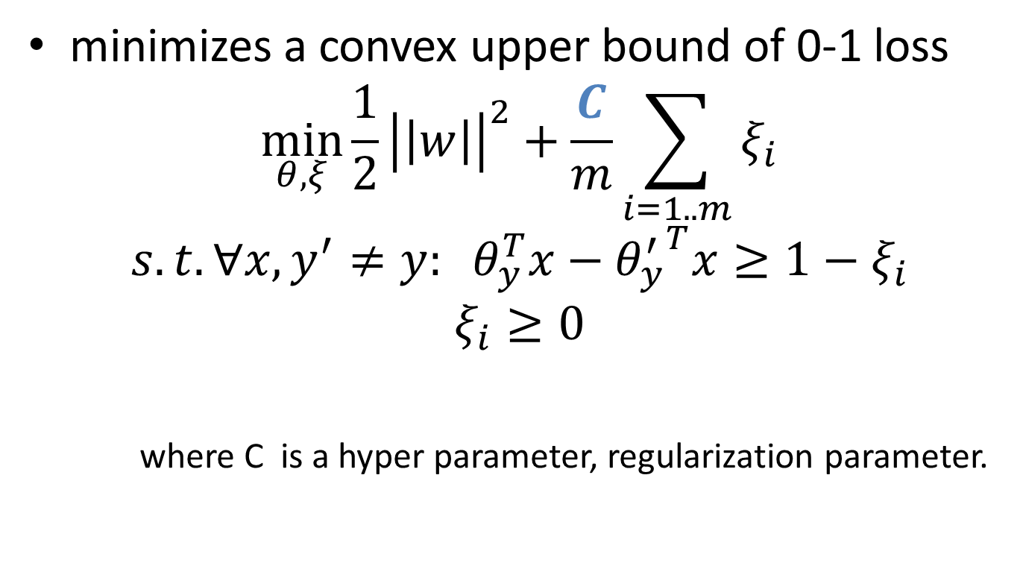
A taste of SVM
minimizes a convex upper bound of 0-1 loss
$$\min_{θ,ξ}{\frac{1}{2}{\left|\left|w\right|\right|}^{2}+\frac{C}{m}}\sum_{i=1..m}{ξ_{i}}$$
$$s.t. ∀x, y^{′}≠y: θ_{y}^{T}x−{θ_{y}^{′}}^{T}x≥1−ξ_{i}$$
$$ξ_{i}≥0$$
where C is a hyper parameter, regularization parameter.

Slide 15
Machine learning in practice
feature extraction
{ (x, y) }
Setup experiment
training:development:test
4 : 2 : 4
select a model/classifier
SVM
call a package to do experiments
LIBLINEAR
http://www.csie.ntu.edu.tw/~cjlin/liblinear/
find best C in developement set
test final performance on test set

Slide 16
Cost-sensitive learning
Standard classifier learning optimizes error rate by default, assuming all misclassification leads to uniform cost
In product taxonomy classification
IPhone5
Nokia 3720 Classic
truck
car
mouse
keyboard

Slide 17
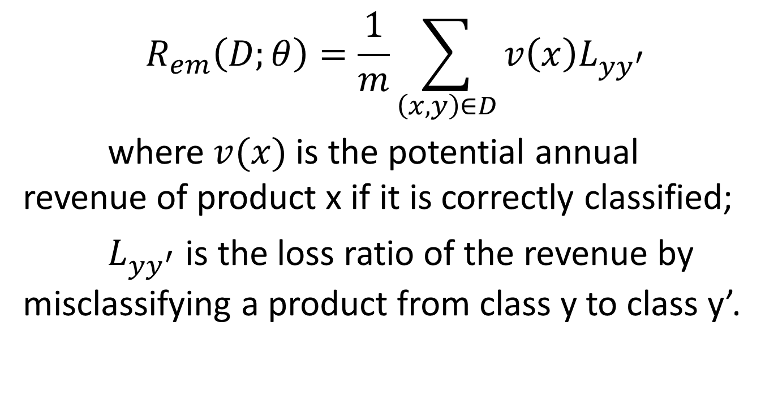
Minimize average revenue loss
$$R_{em}\left(D;θ\right)=\frac{1}{m}\sum_{\left(x,y\right)∈D}{v\left(x\right)L_{yy^{′}}}$$
where $v(x)$ is the potential annual revenue of product x if it is correctly classified;
$L_{yy^{′}}$ is the loss ratio of the revenue by misclassifying a product from class y to class y’.

Slide 18
Conclusion
Machine learning learns an idealized model of the real world.
The model can be applied to predict unseen data.
Classifier learning minimizes average misclassification cost.
It is important to define an appropriate misclassification cost.

