Slide 1
Digital Bank Demo Application
2583177 – Jakkam Supriya (SIGN IN)
2583442 - Koduru Venkata Tharun (SIGNUP)
2583963 – Doddam Kavyasree (transfer)
2583150 – Dodda harika (checking)
2582948 – Kilari Harini (withdraw)
2583311 – Monisha MUTHUKUMAR (savings)
2584164 – Vunishe Deepika (deposits)

Slide 2
Contents:
Introduction
Technologies used
Modules – Test cases
Conclusion

Slide 3
Digital Demo Bank Feature:
It is a simulated bank that allows you to test Tink products without using real bank credentials.
This site has many features which includes Depositing money into your account and withdrawing money from your account and transferring money from one account to another account and it also has features as saving accounts and checking accounts.
We can see the total amount in our account also.

Slide 4
Automation Testing
Automation testing is a process of using specialized software tools to automate the execution of tests.
It helps in improving the efficiency and effectiveness of software testing

Slide 5
Technologies Used
Selenium
Cucumber
Testng
IRetryAnalyzer
ITestListener
Logs
Jira

Slide 6
Cucumber:
Cucumber is a testing tool that supports Behavior-Driven Development (BDD), allowing test cases to be written in a human-readable format. It uses the Gherkin syntax to describe application behavior in plain English, improving collaboration between teams.
Cucumber can be used in:
Automated Acceptance Testing
Collaboration between Teams
Test Automation Integration
Regression Testing
Continuous Integration and Continuous Delivery (CI/CD)

Slide 7
How Cucumber is used for Automation?
Cucumber helps in automation testing by allowing the creation of executable specifications in a human-readable format called Gherkin. It promotes collaboration between team members and ensures that tests accurately reflect the desired behavior of the application.

Slide 8
Scenario in Cucumber:
A scenario in Cucumber is a concise description of a single test case written in Gherkin syntax.
It typically consists of Four sections: Given, When, And, Then, which describe the initial context, the action being taken, and the expected outcome, respectively.
Scenarios are used for automated acceptance testing and are a key part of Behavior-Driven Development (BDD).
They help teams ensure that software meets the desired behavior specified by stakeholders, fostering better communication and alignment on project goals.

Slide 9
Given: It is used to setup the initial state
When: It is used to perform an action
And: This keyword is used to continue the previous without repeating the context.
Then: It is used to verify the outcome, providing a clear and structured approach to defining test cases.

Slide 10
POM Framework:
The Page Object Model (POM) framework is a design pattern used in test automation to create an object repository for web UI elements. It helps in improving test maintenance and reducing code duplication by separating the UI locators and methods to interact with the UI elements from the actual test logic.
In a POM framework, each web page is represented as a class, and the elements on the page are defined as variables in the class. Methods are created to perform actions on these elements. This way, if there are any changes to the UI, you only need to update the corresponding Page Object class, rather than updating all your test cases.

Slide 11
Selenium:
Selenium is a tool for automating web browsers, used to test web applications by simulating user interactions.
It can be used in :
1. Web Testing Automation
2. Cross-Browser Testing
3. Web Scraping
4. Repetitive Task Automation
5. Performance Testing
6. Browser Compatibility Testing
7. Automated Regression Testing

Slide 12
How is selenium used in Automation?
Selenium is used for automating testing by writing test scripts in programming languages such as Java, Python, or C#. These scripts use Selenium's APIs to interact with web elements on a website, performing actions like clicking buttons, entering text, and verifying the content displayed.

Slide 13
TestNG:
TestNG (Test Next Generation) is a testing framework for Java that is inspired by JUnit and NUnit but introduces new functionalities that make it more powerful and easier to use.
It is commonly used for unit testing, integration testing, and end-to-end testing in Java-based projects.
TestNG uses annotations to define and control the flow of test execution. Annotations such as @Test, @BeforeSuite, @AfterSuite, @BeforeTest, @AfterTest, etc., help in specifying the setup, teardown, and test methods.
TestNG is used in Test Automation, unit Testing, Integration testing, end to end testing and regression testing and many more as it is very versatile.

Slide 14
How TestNG is used for Automation?
TestNG simplifies automation testing by providing a framework for creating test suites, defining test methods, setting up dependencies, and generating detailed test reports for analysis.

Slide 15
IRetryAnalyzer:
It is an interface in TestNG that allows you to implement custom logic for retrying failed test cases. By implementing this interface, you can specify how many times a test should be retried before marking it as a failure. This is useful for handling tests that occasionally fail due to external factors.

Slide 16
IListeners
It in testing frameworks like TestNG or JUnit enable customizing test execution behavior, such as logging or reporting, without modifying test code, by providing interfaces or classes for actions at different stages of the test lifecycle.

Slide 17
Logs:
Logs in testing capture events, actions, and messages during automated test execution, aiding in debugging and analyzing results. They provide insights into the application's behavior and are implemented using logging frameworks like Log4j or Logback.

Slide 18
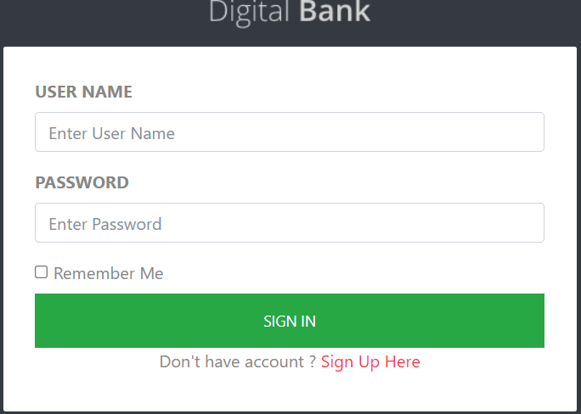
Module – Sign_in (Test Cases)
User Sign in with Valid Credentials
User Sign in with Invalid Username
User Sign in with Invalid Password
User Sign in with Empty Username
User Sign in with Empty Password
Remember me Option

Slide 19
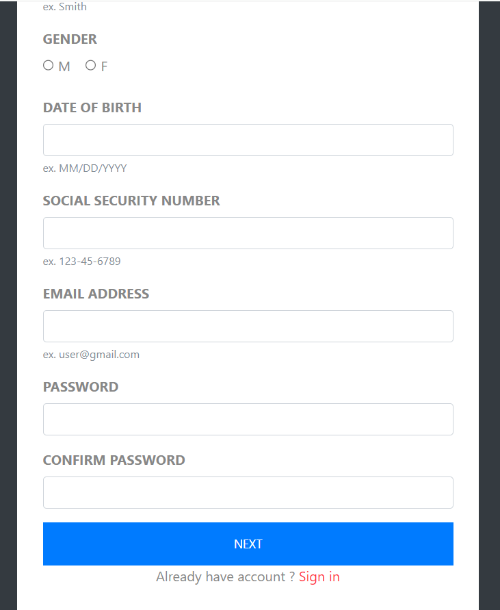
Module – Sign_Up (Test Cases)
user sign up with missing fields
user enters invalid DOB
user registers with existing mail
user enters mismatched passwords
user enters invalid information
user enters information correctly and then the account is created

Slide 20
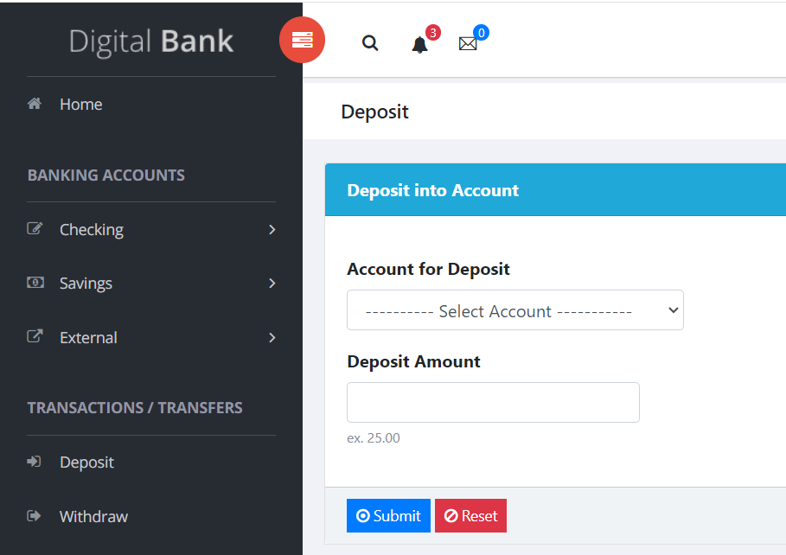
Module – Deposit (Test Cases)
To check Deposit to account fields with valid credentials(checking account)
To check Deposit to account field with invalid credentials
To check Deposit to account fields with valid credentials(saving accounts)
To check Reset button

Slide 21
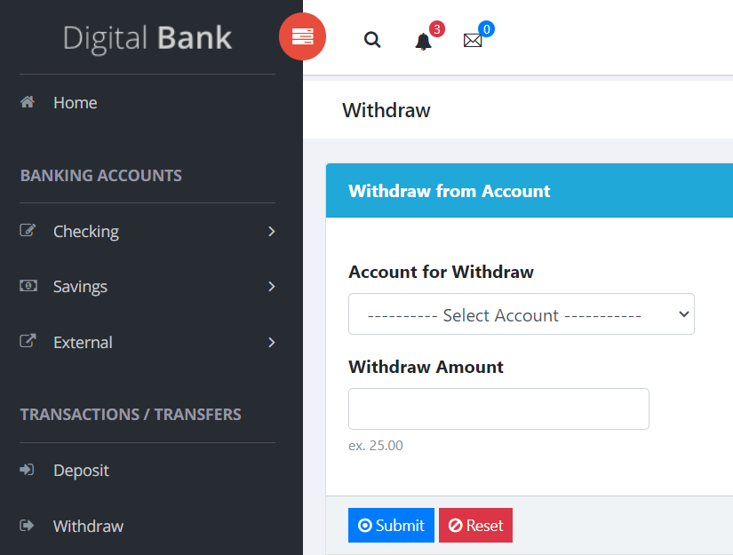
Module – Withdraw (Test Cases)
Click on the "Select Account" option and "Select saving account“
Click on the "Withdraw Amount input text area box" and enter Amount greater than balance amount in text area box and click submit
Click on the "Withdraw Amount input text area box" and leave the text area box empty and click submit

Slide 22
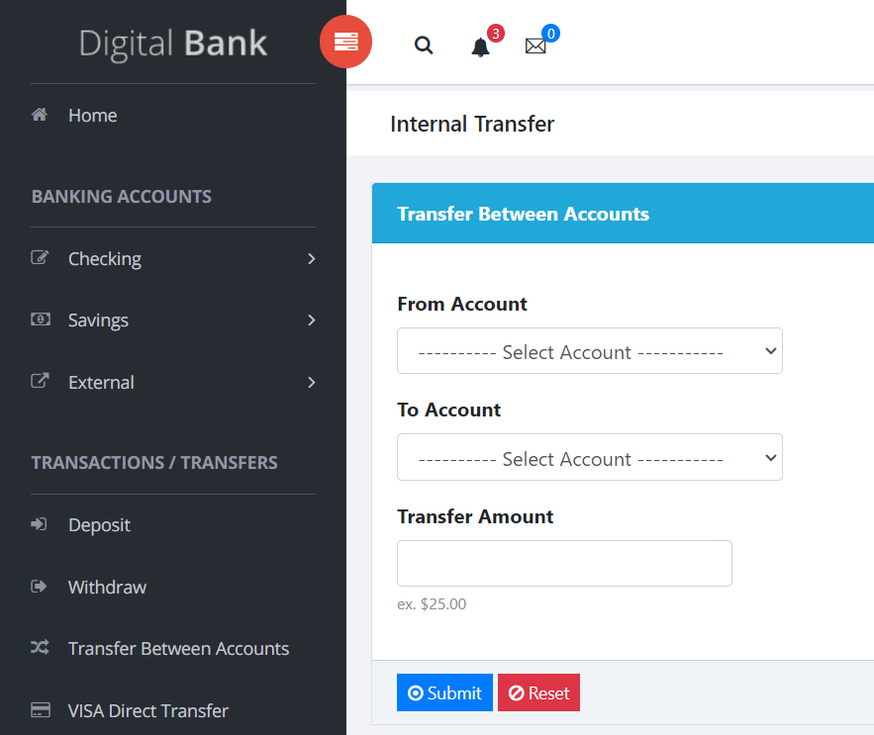
Module- Transfer (Test Cases)
Enter Valid From Account and To Account and avaliable minimum amount
Enter Valid From Account and To Account and avaliable maximum amount
Enter Valid From Account and To Account and unavaliable amount
Enter Valid From Account and To Account and empty amount
Enter Valid From Account and To Account and zero amount

Slide 23
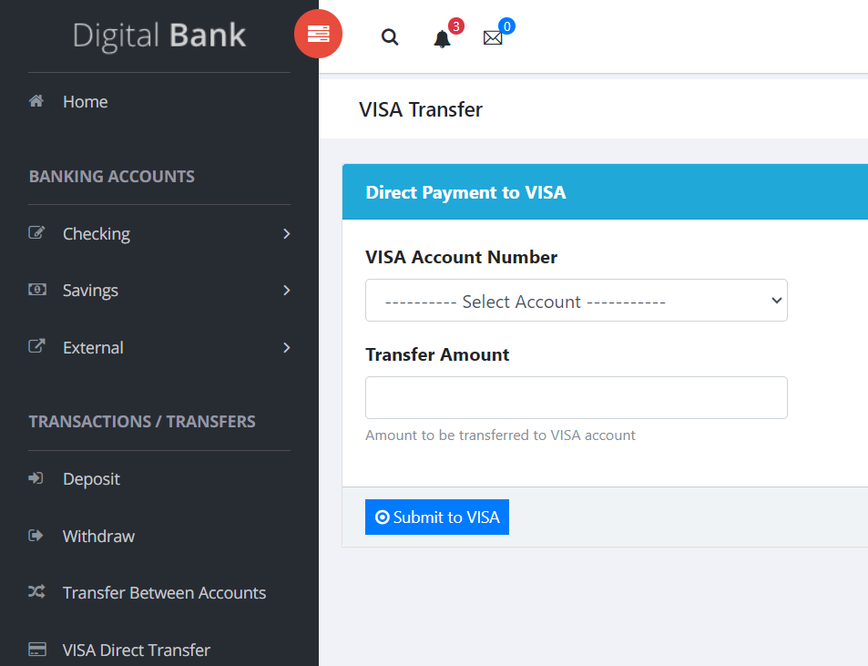
Module – Direct Payment to VISA(Test Cases)
User can access the account number and add amount
User can access the account number and if didn’t fill any amount
User can access the account number and if we add alphabet instead of numbers
User can’t choose account number and can’t fill amount
User can access the amount number and if we add special character in amount

Slide 24
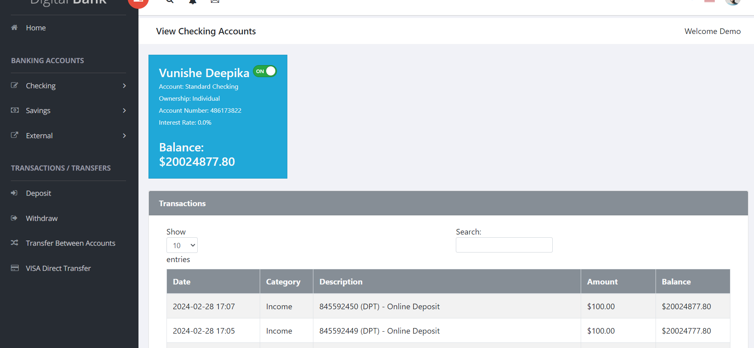
Module - Search By TRN no on View Checking (Test Cases)
User is Searching for correct TRN
User is Searching for incorrect TRN
User gives Empty TRN field
User Search TRN with Spaces

Slide 25
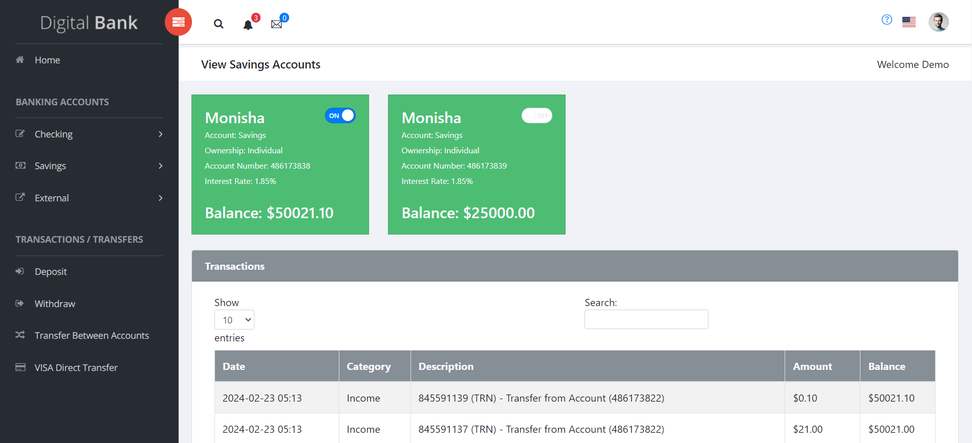
Module - Search by TRN no on View Savings Accounts(Test Cases)
Search for validate search box with amount
Search for search box with negative TRN
Search for search box with category
Search for search box with date

Slide 26
Extent Reports:
Extent Reports is a reporting library for test automation that creates detailed and visually appealing reports, integrating with frameworks like TestNG and JUnit to provide comprehensive insights into test execution results.
The reports generated by Extent Reports are interactive, providing collapsible sections, tooltips, and other features that make it easy to navigate and understand the test results.

Slide 27
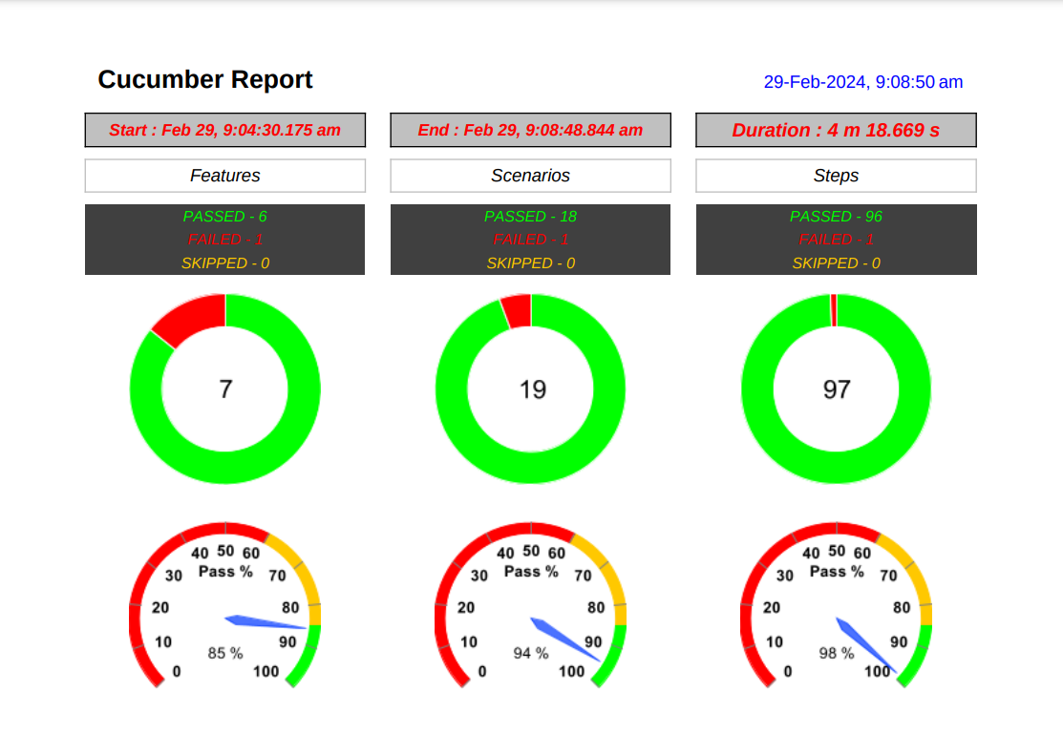

Slide 28
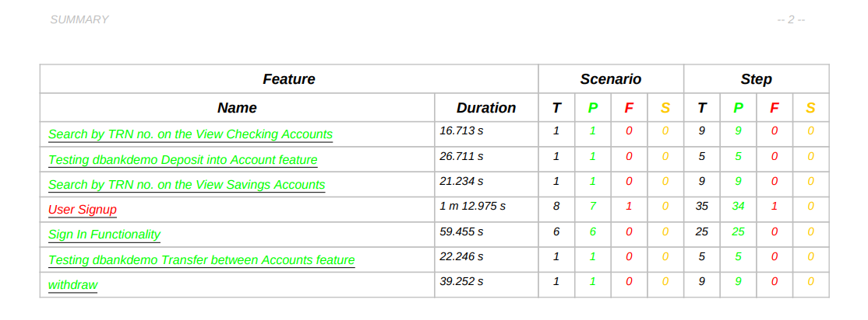

Slide 29
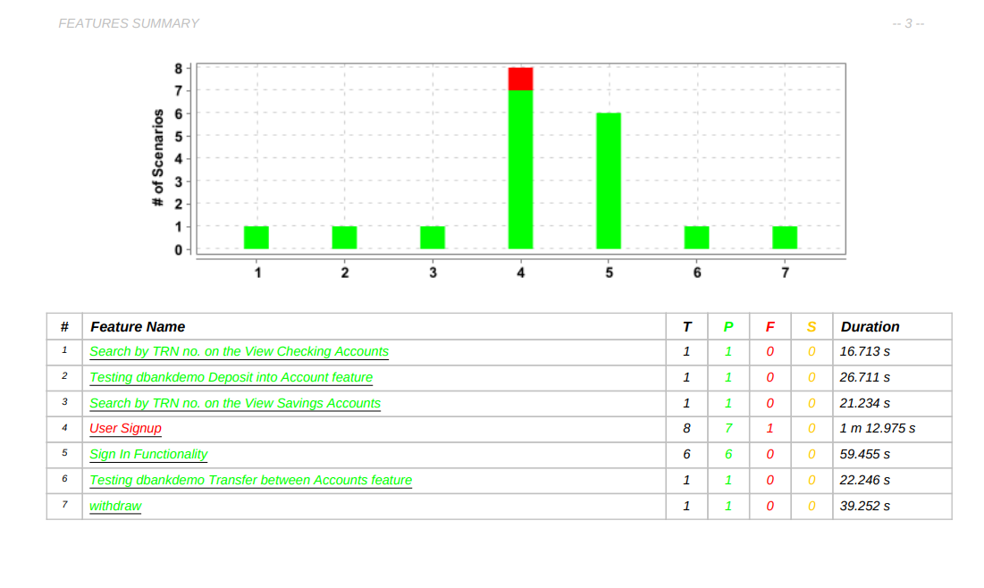

Slide 30
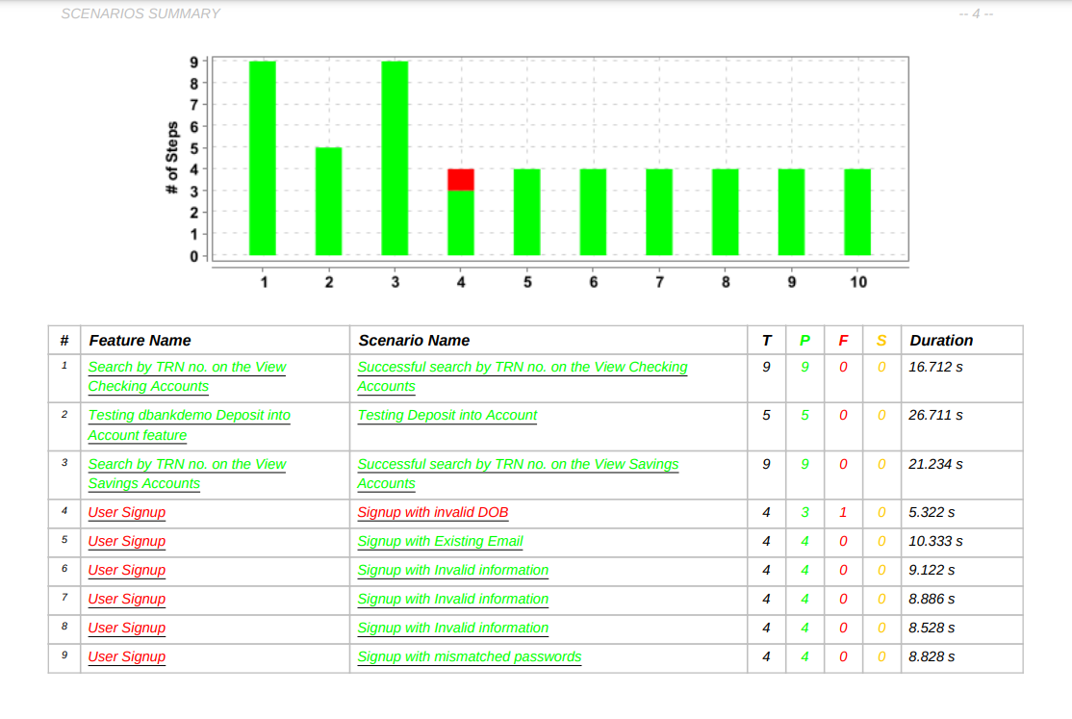

Slide 31
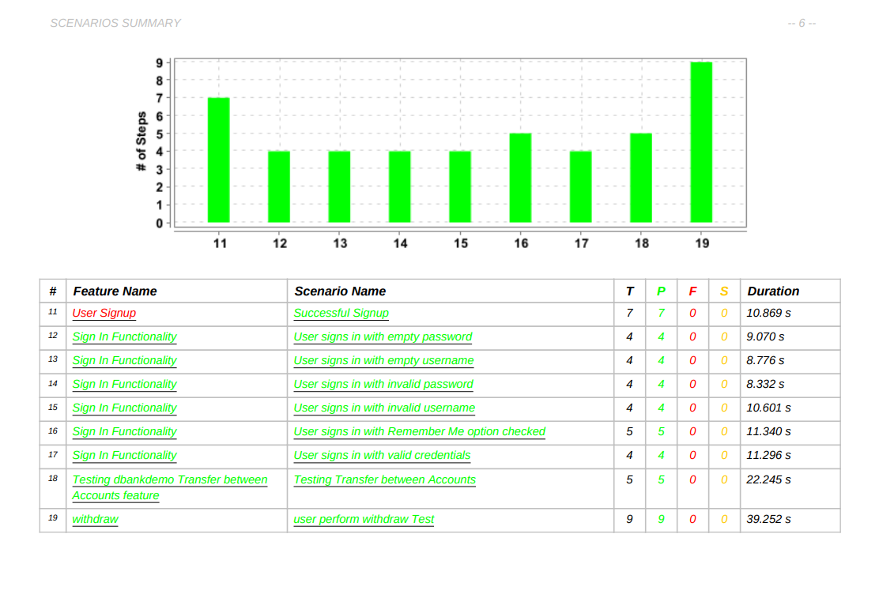

Slide 32
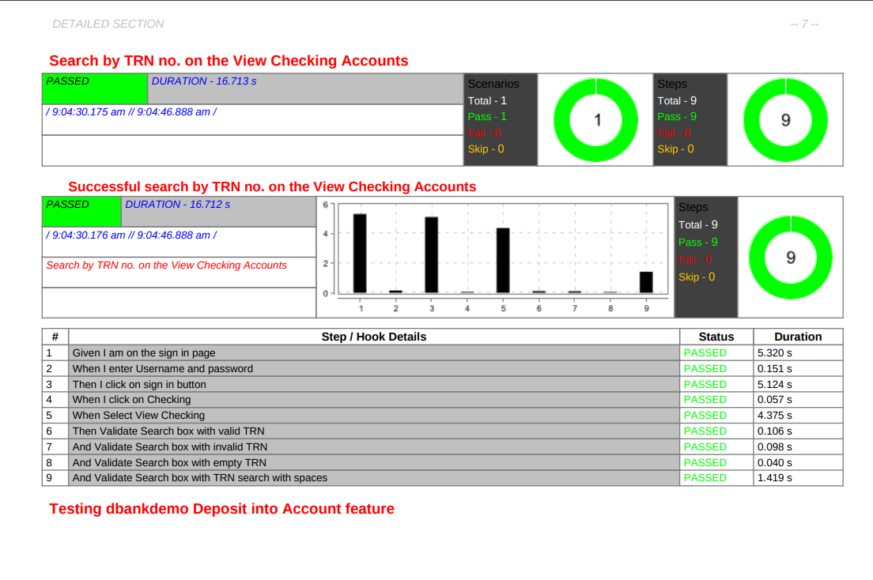

Slide 33
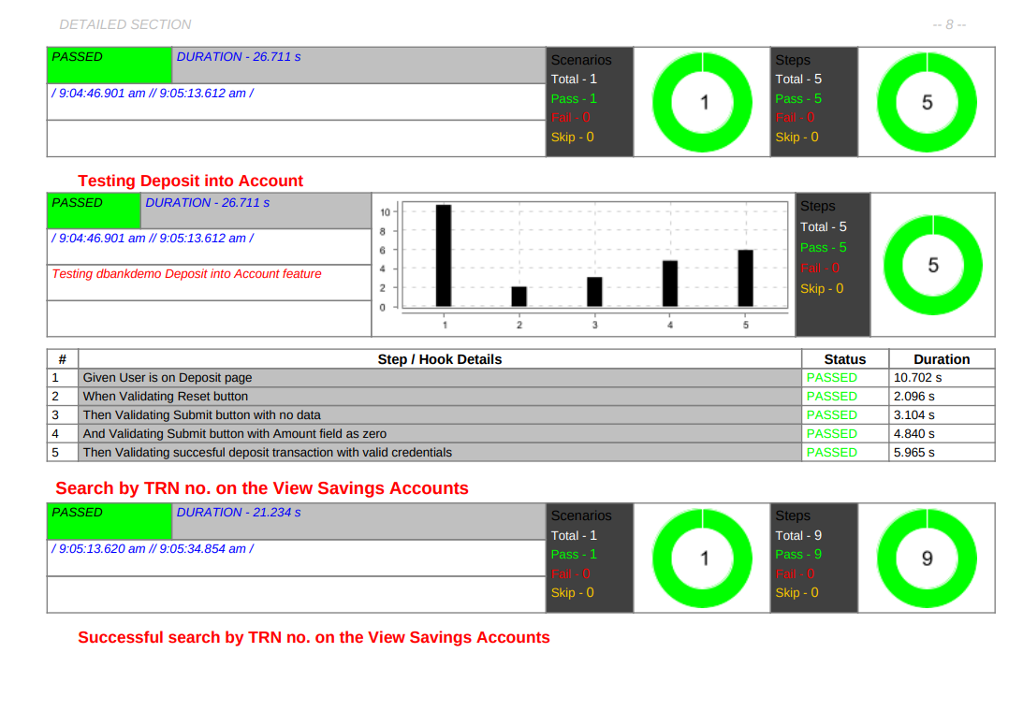

Slide 34
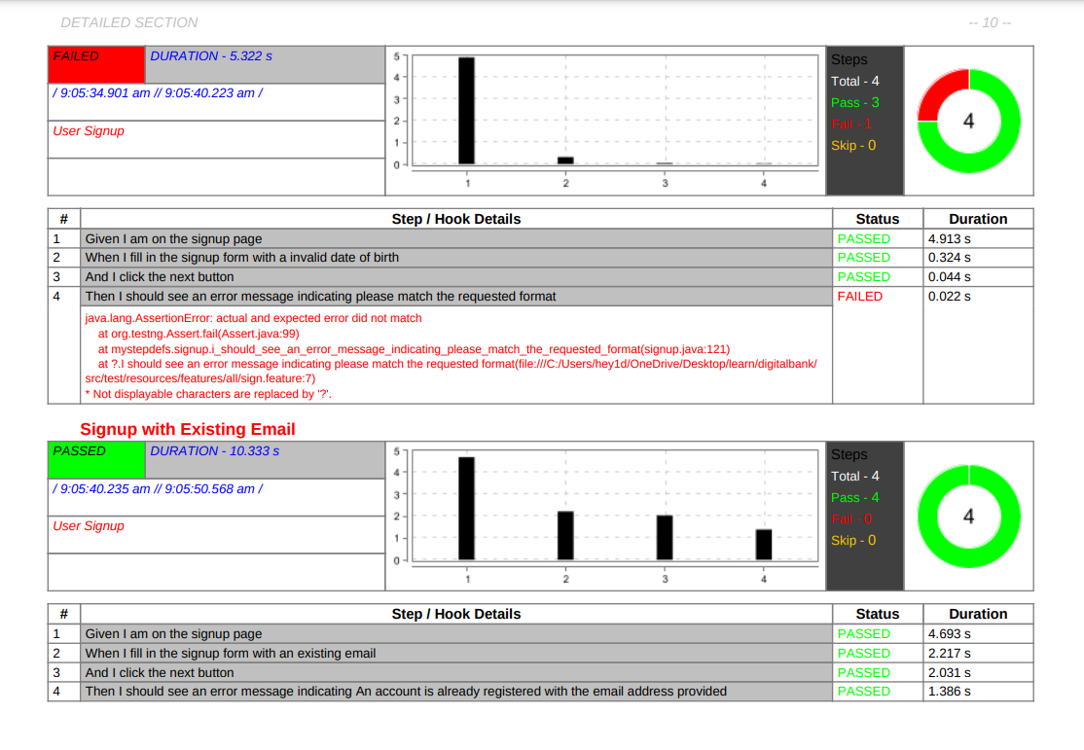

Slide 35
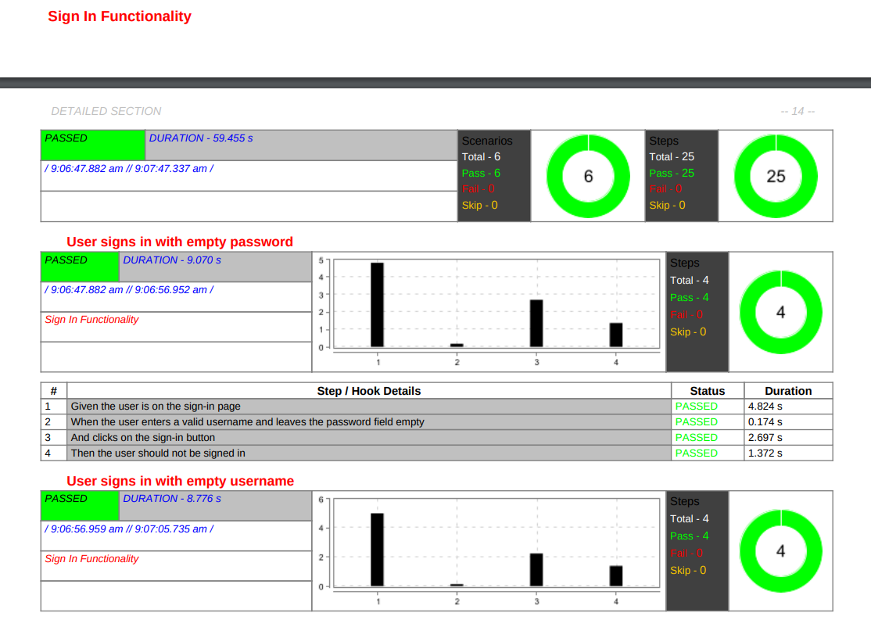

Slide 36
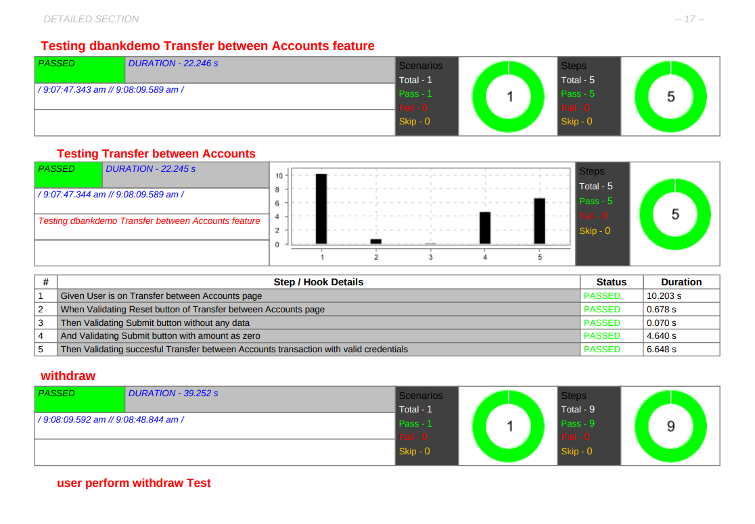

Slide 37
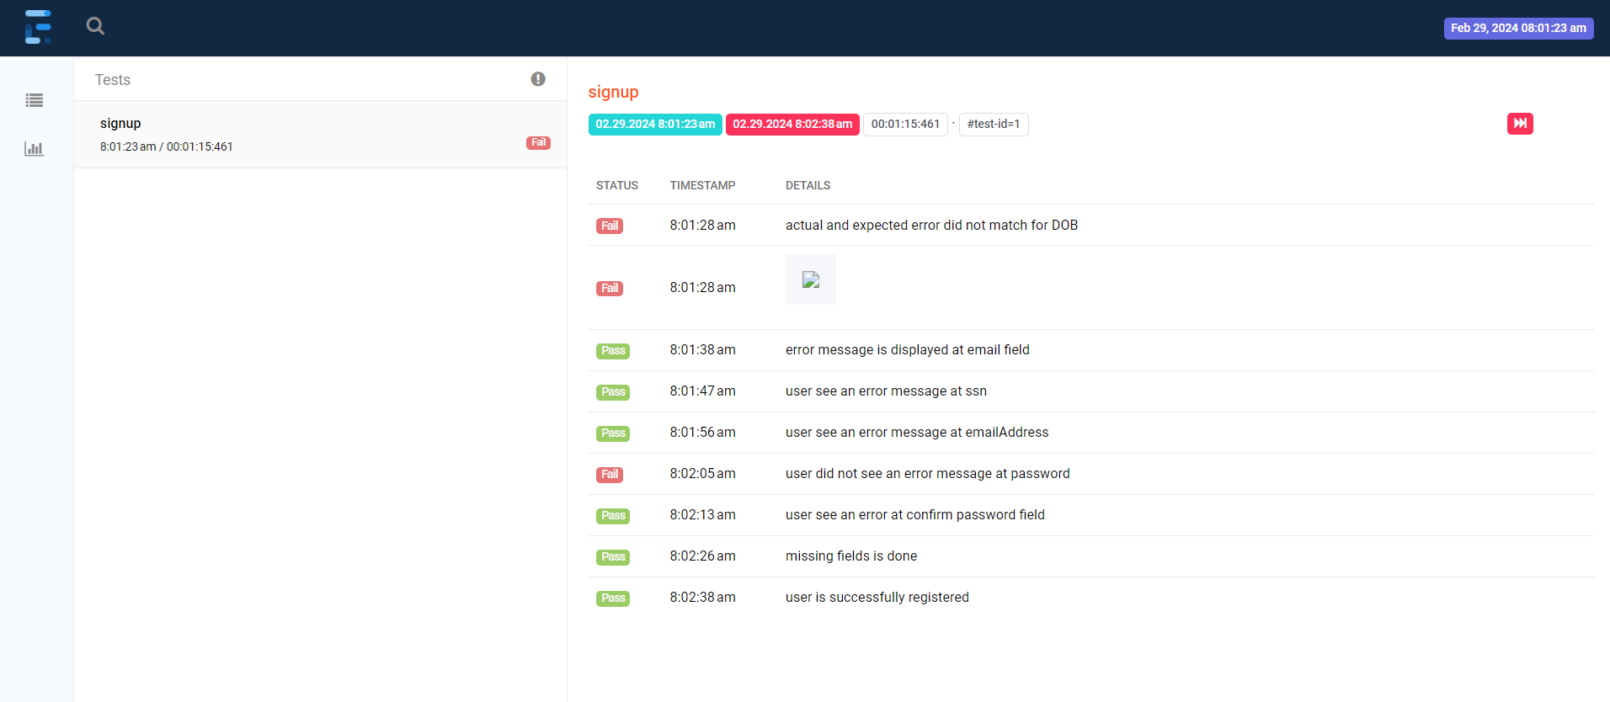

Slide 38
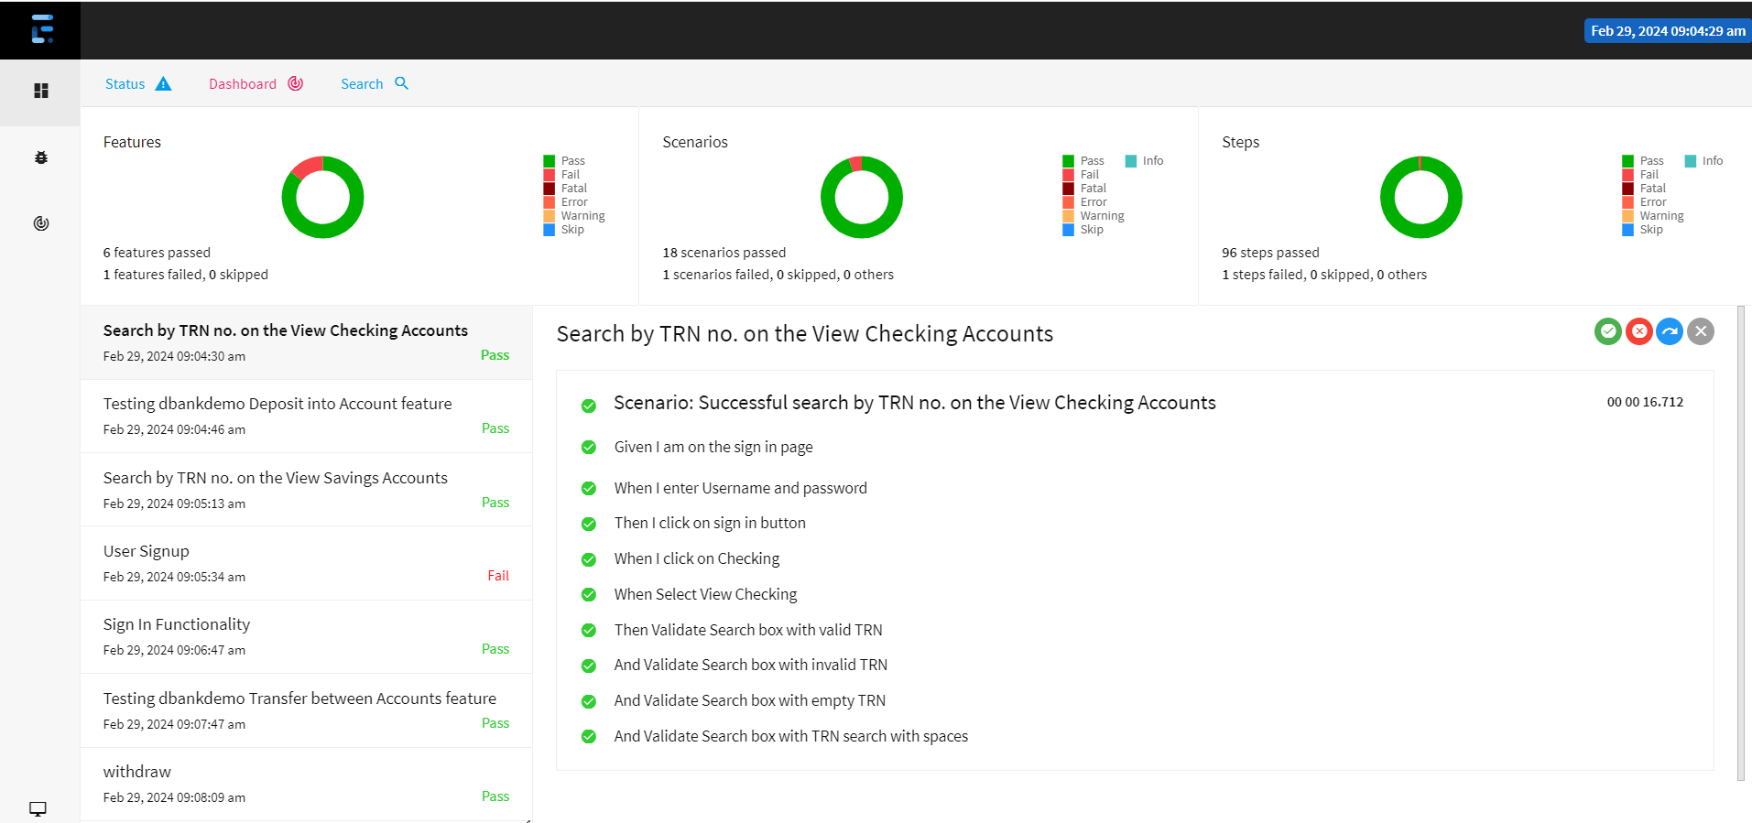

Slide 39
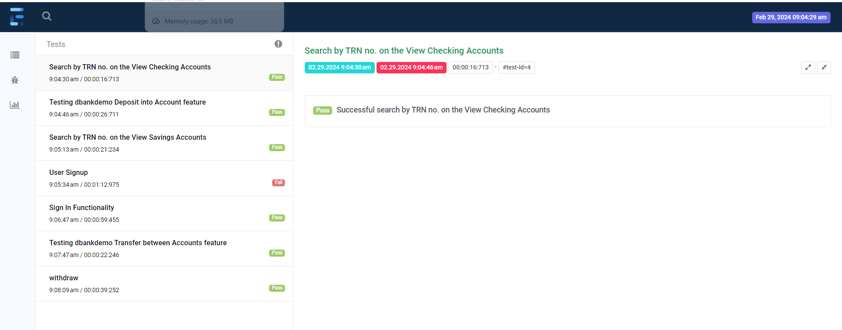

Slide 40
Jenkins:
Jenkins is an automation server used for building, testing, and deploying software. In testing, Jenkins automates test execution, integrates with testing frameworks, provides reporting, and integrates with version control systems to enhance the testing process.

Slide 41
Jira:
Jira is a popular project management tool developed by Atlassian, commonly used for issue tracking, bug tracking, and agile project management. It allows teams to plan, track, and manage software development projects efficiently. Jira provides features for creating and prioritizing tasks, assigning work to team members, tracking progress through workflows, and generating reports to analyze project metrics. It is widely used in software development teams to streamline collaboration and improve productivity.

Slide 42
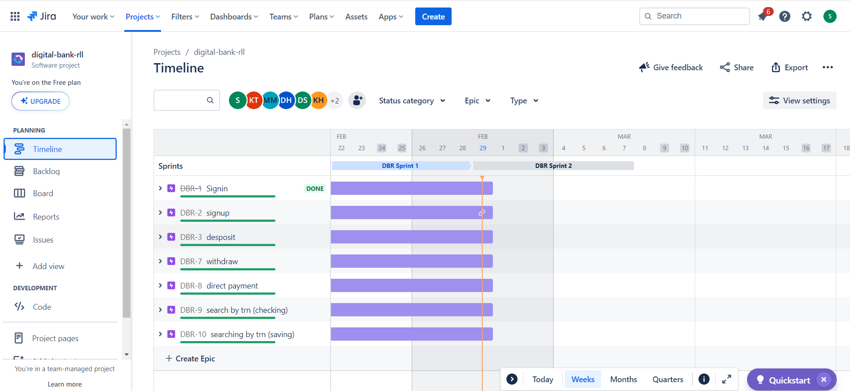

Slide 43
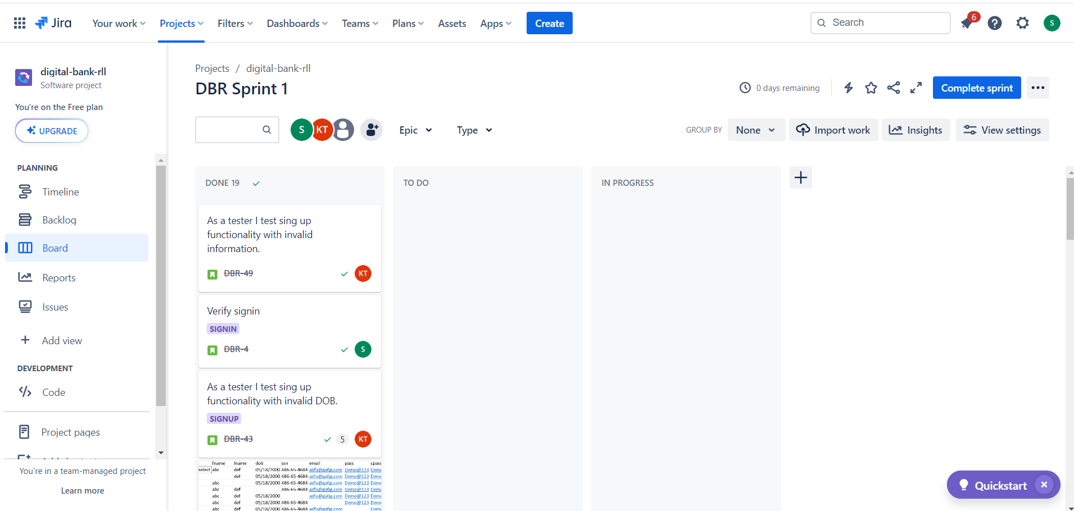

Slide 44
Thank You

