Slide 1



Event Mate
AI Based Event Planner and Scheduler
Mentor
Esaki Rahul Sir
Team Members
Supriya
Gobikha
Harish
LOKESH
A Django-based Complaint Resolution Platform

Slide 2
Project Overview & Objectives
Event Mate is an AI-powered platform that simplifies event planning by combining event creation, calendar scheduling, and task management into one dashboard. With real-time synchronization and smart AI recommendations,
it reduces manual effort, improves collaboration, and enhances productivity for personal, academic, and professional use.
Automate event creation, scheduling, and task assignment
Provide an intuitive dashboard for quick insights
Enable real-time synchronization across modules
Improve productivity, collaboration, and accuracy in event management

Slide 3





Technology Stack
Backend
SpringBoot
REST APIs (For web communication)
Database
PostgreSQL
REACT
Responsive and dynamic user experience
Frontend
Git (Version Control) / GitHub
For Collaboration
Version Control

Slide 4
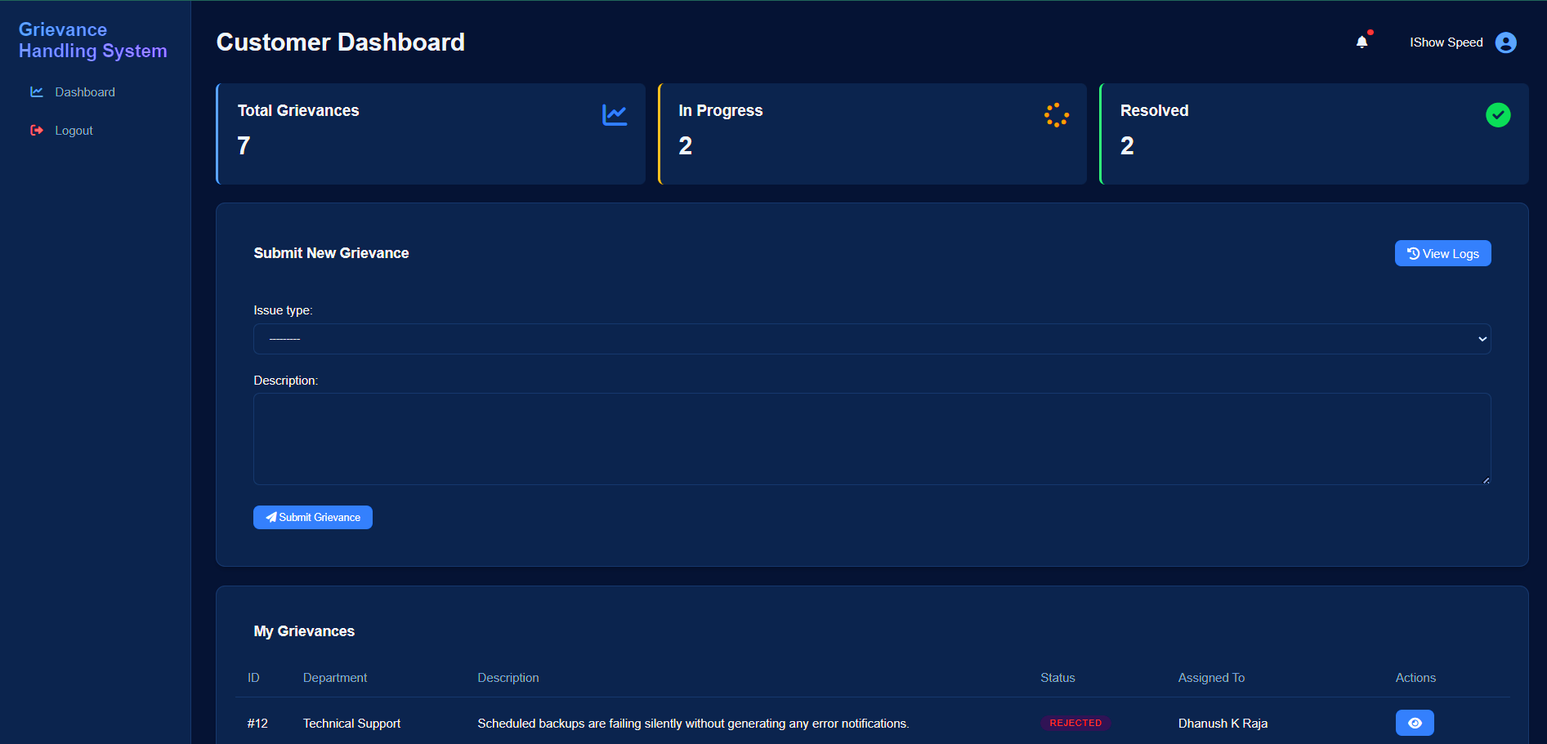
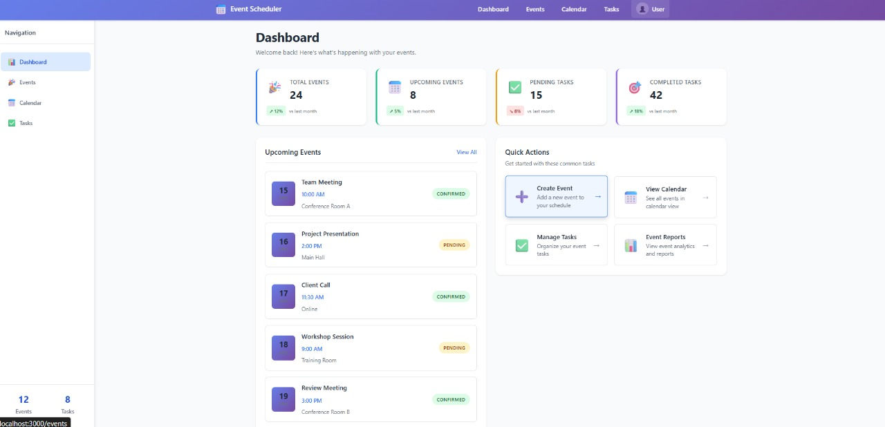
User Dashboard
Enable transparent grievance submission and tracking for end-users
COMPREHENSIVE TRACKING INTERFACE
Track the status of grievances from submission to resolution effortlessly.
1
UI - Main Dashboard
Central hub with navigation & widgets
Sidebar for quick access (Events, Calendar, Tasks)
Real-time overview (upcoming events, pending tasks)
Consistent layout across pages
INTUITIVE SUBMISSION PORTAL
Users can easily submit grievances through a user-friendly interface.
USER FEEDBACK MECHANISM
Collects user feedback post-resolution to enhance service quality.
VISUAL STATUS PIPELINE
Grievances are displayed in a visual status pipeline: Received - In Progress Resolved.

Slide 5
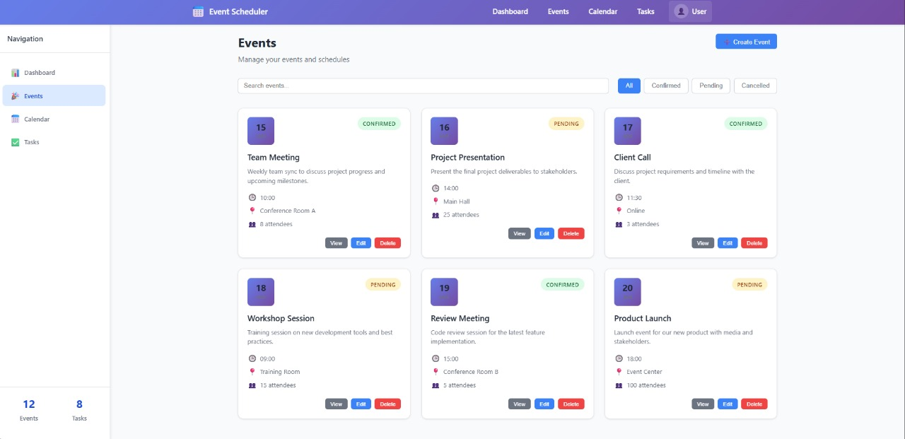
Event Dashboard
Enable transparent grievance submission and tracking for end-users
COMPREHENSIVE TRACKING INTERFACE
Track the status of grievances from submission to resolution effortlessly.
2
Event Management
UI – Event Management
Event list with cards & details
Add/Edit forms with validation
CRUD operations integrated
Search & filter for events
INTUITIVE SUBMISSION PORTAL
Users can easily submit grievances through a user-friendly interface.
USER FEEDBACK MECHANISM
Collects user feedback post-resolution to enhance service quality.
VISUAL STATUS PIPELINE
Grievances are displayed in a visual status pipeline: Received - In Progress Resolved.

Slide 6
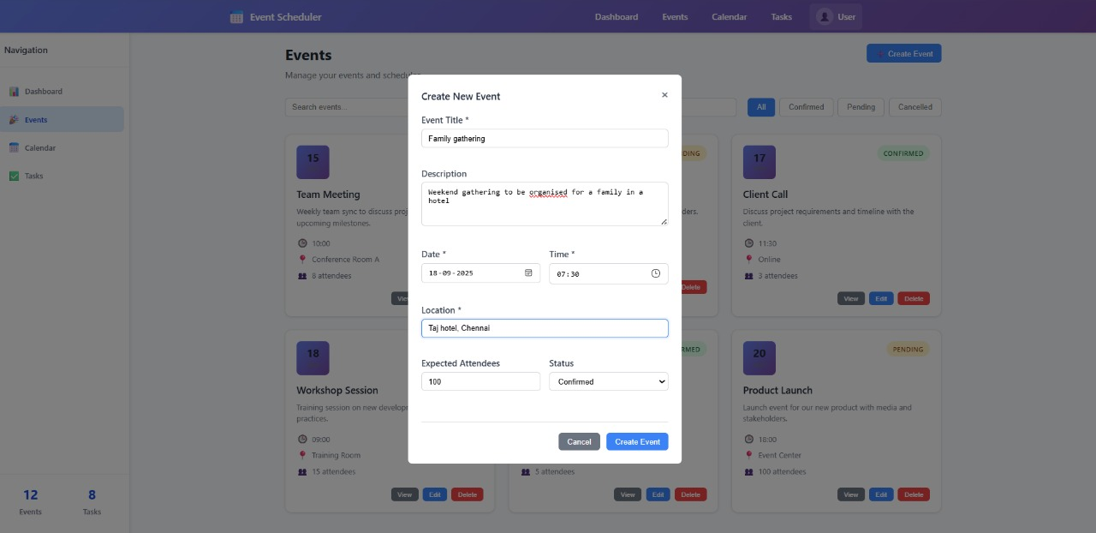
Add New Event
Enable transparent grievance submission and tracking for end-users
COMPREHENSIVE TRACKING INTERFACE
Track the status of grievances from submission to resolution effortlessly.
3
Add New Event
Event Form (Add/Edit)
Input fields: Title, Date, Time, Venue, Description
Dropdowns for Category & Priority
Validation for mandatory fields
Edit option to update existing event
INTUITIVE SUBMISSION PORTAL
Users can easily submit grievances through a user-friendly interface.
USER FEEDBACK MECHANISM
Collects user feedback post-resolution to enhance service quality.
VISUAL STATUS PIPELINE
Grievances are displayed in a visual status pipeline: Received - In Progress Resolved.

Slide 7
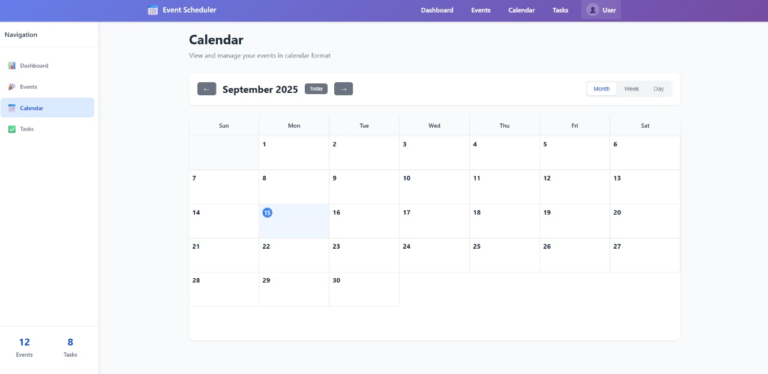
Calendar Dashboard
Enable transparent grievance submission and tracking for end-users
COMPREHENSIVE TRACKING INTERFACE
Track the status of grievances from submission to resolution effortlessly.
4
Calendar Dashboard
Calendar & Scheduling
Interactive calendar (day/week/month)
Tooltips for quick event details
Date selector for navigation
Sync with events in real-time
INTUITIVE SUBMISSION PORTAL
Users can easily submit grievances through a user-friendly interface.
USER FEEDBACK MECHANISM
Collects user feedback post-resolution to enhance service quality.
VISUAL STATUS PIPELINE
Grievances are displayed in a visual status pipeline: Received - In Progress Resolved.

Slide 8
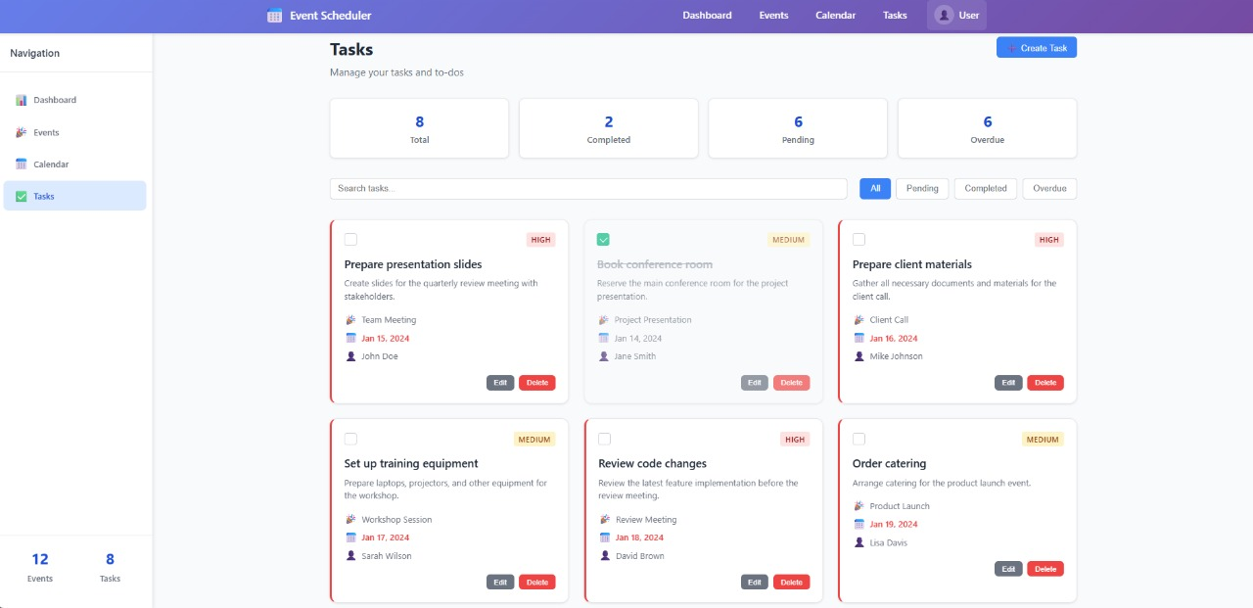
Tasks Dashboard
Enable transparent grievance submission and tracking for end-users
COMPREHENSIVE TRACKING INTERFACE
Track the status of grievances from submission to resolution effortlessly.
5
Tasks Dashboard
Task Management
Task list & status indicators
Task cards with priority/deadlines
Add/Edit task form
Linked with global state & events
INTUITIVE SUBMISSION PORTAL
Users can easily submit grievances through a user-friendly interface.
USER FEEDBACK MECHANISM
Collects user feedback post-resolution to enhance service quality.
VISUAL STATUS PIPELINE
Grievances are displayed in a visual status pipeline: Received - In Progress Resolved.

Slide 9
Event Lifecycle
Update
P3
Modify event details anytime
Create
Delete
User adds event details via form
Remove event when no longer needed
View
Event displayed in dashboard & calendar
P1
P2
Sync
Real-time updates across modules (tasks, calendar)

Slide 10
Backend Overview And Stack
Core Backend Functions
The backend manages user login, event creation, task management, and scheduling for smooth application operations.
REST API Communication
  REST APIs enable secure and efficient communication between the frontend and the PostgreSQL database.
Backend Framework
  Spring Boot is utilized to create RESTful APIs for efficient backend operations and integration.
Database Management
  PostgreSQL configured as 'event scheduler' handles event data storage and management reliably.
Event Mate is an AI-powered platform that simplifies event planning by combining event creation, calendar scheduling, and task management into one dashboard. With real-time synchronization and smart AI recommendations,
it reduces manual effort, improves collaboration, and enhances productivity for personal, academic, and professional use.
.

Slide 11
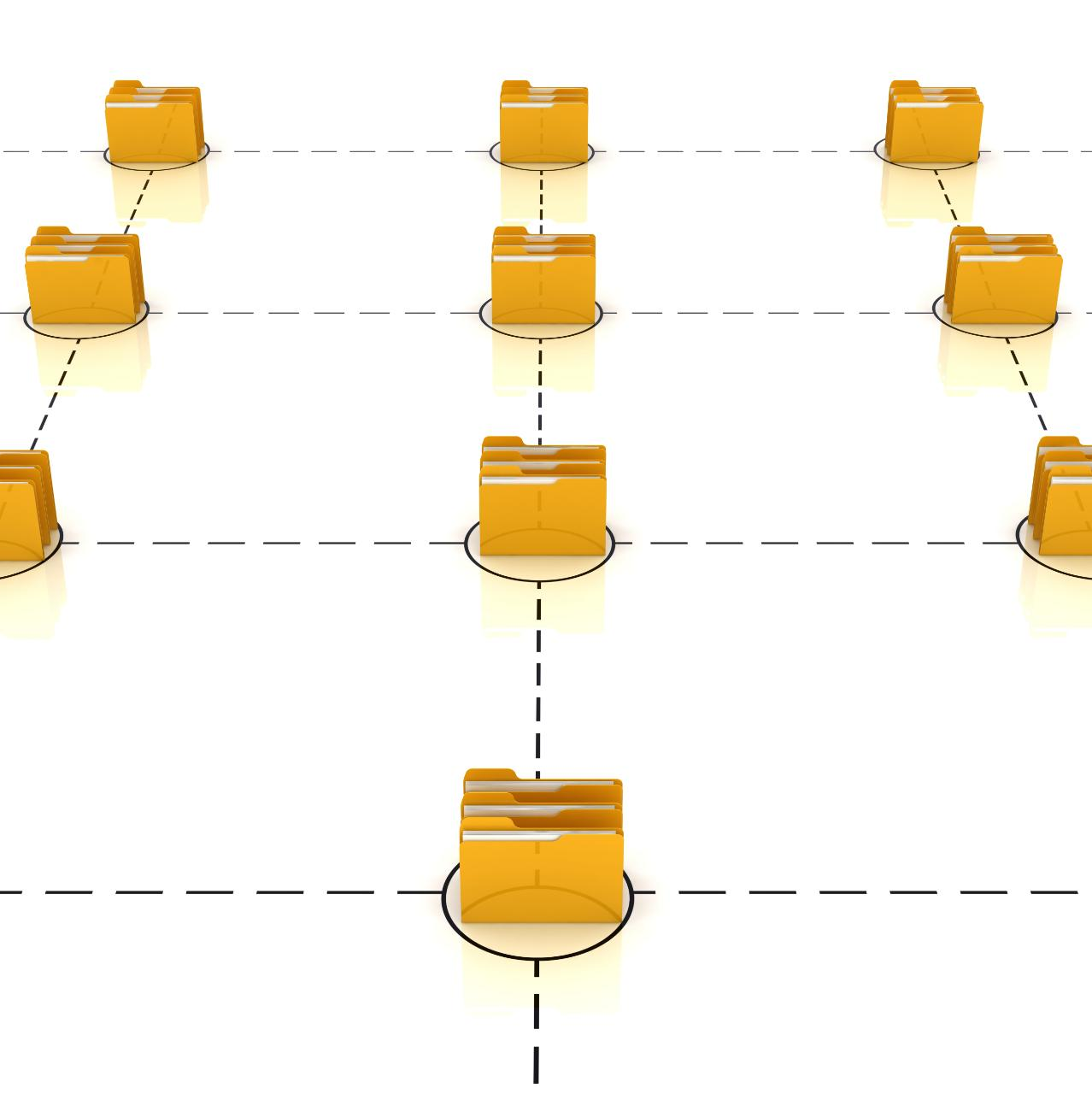
Database Design
User Data Management
  The Users table stores key information like ID, email, password, username, and full name for each user.
Event Details Capturing
  The Events table records event-specific data including event ID, title, date, time, venue, description, and user association.
Task Tracking Structure
  The Tasks table maintains task information linked to events, including task ID, name, deadline, status, and user ID.
Relational Database Schema
  The design defines relationships: one user has many events, and one event has many tasks, ensuring data integrity.
Event Mate is an AI-powered platform that simplifies event planning by combining event creation, calendar scheduling, and task management into one dashboard. With real-time synchronization and smart AI recommendations,
it reduces manual effort, improves collaboration, and enhances productivity for personal, academic, and professional use.
.

Slide 12

User Authentication
Secure Credential Storage
  User credentials are safely stored in PostgreSQL with hashed passwords to prevent unauthorized access.
Safe Registration & Login
  The system supports secure registration and login, protecting user data throughout the process.
Authentication Tokens
  Authentication tokens maintain secure sessions, allowing continuous login without risking security.
Event Mate is an AI-powered platform that simplifies event planning by combining event creation, calendar scheduling, and task management into one dashboard. With real-time synchronization and smart AI recommendations,
it reduces manual effort, improves collaboration, and enhances productivity for personal, academic, and professional use.
.

Slide 13
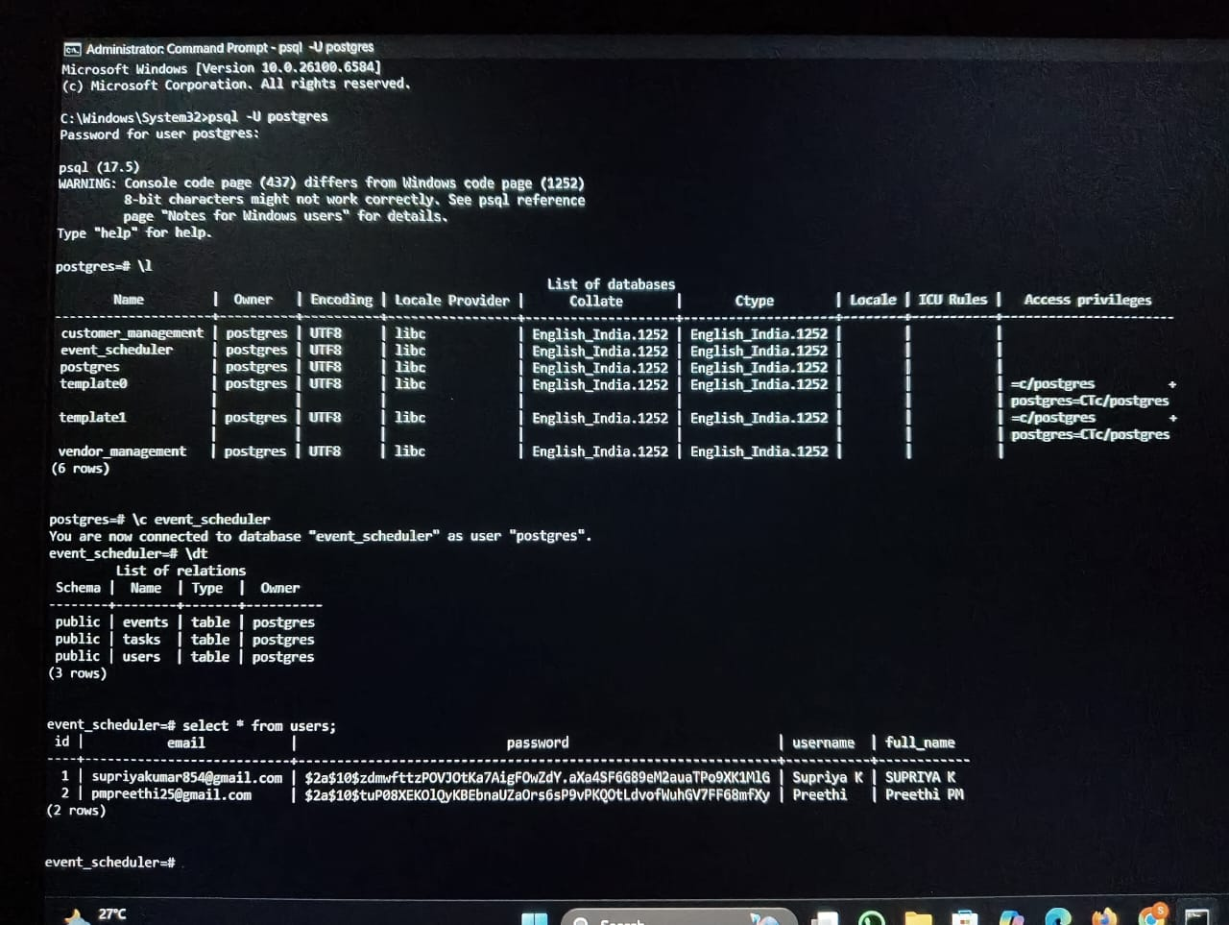
Database Implementation
Event Mate is an AI-powered platform that simplifies event planning by combining event creation, calendar scheduling, and task management into one dashboard. With real-time synchronization and smart AI recommendations,
it reduces manual effort, improves collaboration, and enhances productivity for personal, academic, and professional use.
.

Slide 14
System Validation
Database Creation and Operation
  The 'event scheduler' PostgreSQL database has been successfully created and is fully operational for backend support.
Functional Tables
  Users, Events, and Tasks tables are fully functional, ensuring accurate data storage and retrieval.
Secure User Data
  The Users table stores account information securely using hashed passwords to protect user data.
Visual Proof of Functionality
  Screenshots and logs provide visual confirmation of backend operations working as intended.
Event Mate is an AI-powered platform that simplifies event planning by combining event creation, calendar scheduling, and task management into one dashboard. With real-time synchronization and smart AI recommendations,
it reduces manual effort, improves collaboration, and enhances productivity for personal, academic, and professional use.
.

Slide 15
AI Integration Overview
Event Mate is an AI-powered platform that simplifies event planning by combining event creation, calendar scheduling, and task management into one dashboard. With real-time synchronization and smart AI recommendations,
it reduces manual effort, improves collaboration, and enhances productivity for personal, academic, and professional use.
.
Purpose: Enhance user experience through intelligent recommendations.
Features:
• Suggests best event timings based on availability.
• Prioritizes tasks using deadlines and importance.
• Recommends venues based on event category and user data.
Approach: Integrated AI logic module with backend using Spring Boot APIs.

Slide 16
How AI Works in Event Mate!
Event Mate is an AI-powered platform that simplifies event planning by combining event creation, calendar scheduling, and task management into one dashboard. With real-time synchronization and smart AI recommendations,
it reduces manual effort, improves collaboration, and enhances productivity for personal, academic, and professional use.
.
User enters event details (title, type, time preferences).
AI analyzes data to find optimal schedule & resources.
Generates smart suggestions (time, venue, task priority).
Displays recommendations dynamically on dashboard.

Slide 17
API Integration Overview
Event Mate is an AI-powered platform that simplifies event planning by combining event creation, calendar scheduling, and task management into one dashboard. With real-time synchronization and smart AI recommendations,
it reduces manual effort, improves collaboration, and enhances productivity for personal, academic, and professional use.
.
Frontend: React | Backend: Spring Boot | Database: PostgreSQL
RESTful API communication via Axios and JSON.
CRUD operations for Events, Tasks, and Users.
Real-time synchronization between UI and database.

Slide 18
Major API Endpoints
Event Mate is an AI-powered platform that simplifies event planning by combining event creation, calendar scheduling, and task management into one dashboard. With real-time synchronization and smart AI recommendations,
it reduces manual effort, improves collaboration, and enhances productivity for personal, academic, and professional use.
.
Users – /api/users (POST, GET) → Register & Fetch User Data
Events – /api/events (CRUD) → Manage Events
Tasks – /api/tasks (CRUD) → Manage Tasks
AI Suggestions – /api/ai/recommend (POST) → Generate AI Recommendations

Slide 19
Integration Flow
Event Mate is an AI-powered platform that simplifies event planning by combining event creation, calendar scheduling, and task management into one dashboard. With real-time synchronization and smart AI recommendations,
it reduces manual effort, improves collaboration, and enhances productivity for personal, academic, and professional use.
.
React Frontend → REST API → Spring Boot Backend → PostgreSQL Database
+ AI Recommendation Engine connected with backend module.
Ensures real-time data consistency and intelligence-driven responses.

Slide 20
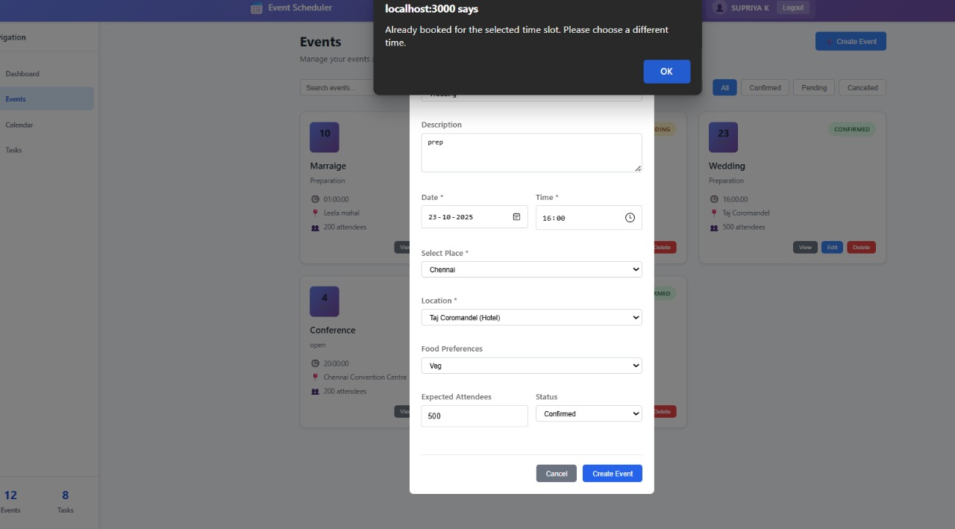
Smart Validation on Event Creation
Description:
When users attempt to book an event at a time slot already occupied, the system shows an alert.
Feature Purpose:
Prevents double bookings by checking date/time conflicts before event creation.
Integration:
Frontend → API → Database validation flow.
Real-time alert ensures accurate scheduling.
Event Mate is an AI-powered platform that simplifies event planning by combining event creation, calendar scheduling, and task management into one dashboard. With real-time synchronization and smart AI recommendations,
it reduces manual effort, improves collaboration, and enhances productivity for personal, academic, and professional use.
.

Slide 21
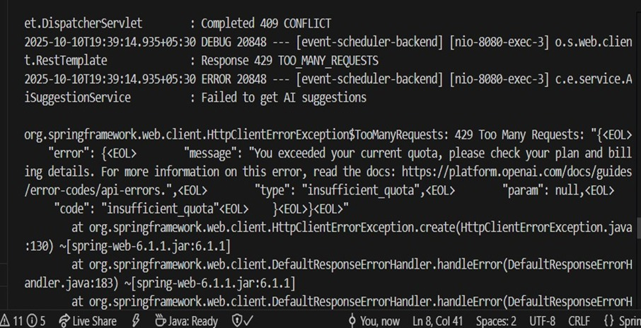
API INTEGRATION
Frontend: Sends user input to the backend API.
Backend:Receives request, calls the OpenAI API and gets AI-generated suggestions.
Backend send AI response back and frontend displays it

Slide 22
Testing & Validation
Event Mate is an AI-powered platform that simplifies event planning by combining event creation, calendar scheduling, and task management into one dashboard. With real-time synchronization and smart AI recommendations,
it reduces manual effort, improves collaboration, and enhances productivity for personal, academic, and professional use.
.
Tools Used: Postman, Browser Dev Tools.
Verified CRUD API calls and AI outputs.
Validated CORS configuration and JSON data consistency.
Placeholder: Insert API Testing & Dashboard Screenshots Here.

Slide 23
Results
Event Mate simplifies event planning with AI-driven solutions
✅ AI-driven event and task recommendations.
✅ Frontend and backend fully synchronized.
✅ Real-time updates across all dashboards.
✅ Enhanced efficiency and user experience.
Event Mate is an AI-powered platform that simplifies event planning by combining event creation, calendar scheduling, and task management into one dashboard. With real-time synchronization and smart AI recommendations,
it reduces manual effort, improves collaboration, and enhances productivity for personal, academic, and professional use.
.

Slide 24
Future Scope
Advanced AI for predictive event success analysis.
Integration with Google Calendar API.
Role-based access control for users and admins.
Voice assistant for event creation and reminders.

Slide 25

Conclusion
Event Mate simplifies event planning with AI-driven solutions
Provides centralized management of events, tasks, and schedules
Enhances productivity and reduces manual errors
Scalable and adaptable for personal, academic, and enterprise use

