Slide 1

Project Title – Seasonal Agriculture Performance Analysis
Student Name: Supriya Enjam
College Name: Swarna Bharathi Institute of Science and Technology, Khammam
AICTE STU ID : STU6644d969637b71715788137

Slide 2

PROBLEM STATEMENT
Agricultural activities are influenced by seasonal variations in environmental conditions, farming practices, resource availability and market conditions. As a result, agricultural performance may differ from one season to another. However, raw agricultural data does not clearly explain how agricultural performance changes across seasons or what patterns can be observed in different seasonal conditions. The problem is to analyze the given agricultural dataset and investigate seasonal differences in agricultural performance by identifying meaningful patterns, trends, relationships and variations within the available data.

Slide 3
Project Description
The project focuses on analyzing agricultural performance across different seasons using a dataset containing 4,000 observations and 28 variables.
The analysis covers:
1)Crop and seasonal performance
2)Farm and geographical characteristics
3)Rainfall, temperature, humidity, and sunlight
4)Soil conditions and nutrient usage
5)Irrigation and resource utilization
6)Yield and production
7)Market price, cost, revenue, and profit
8)Water usage and water efficiency
9)Disease and pest risk
The project uses data cleaning, exploratory data analysis, statistical analysis, correlation analysis, and visualizations to identify meaningful patterns and support evidence-based agricultural planning.

Slide 4

WHO ARE THE END USERS?
The analysis can be useful for:
Farmers – to understand seasonal crop and resource performance.
Agricultural planners – to support seasonal planning and crop selection.
Agricultural departments – to identify seasonal and regional patterns.
Agribusiness organizations – to evaluate production and profitability.
Researchers and analysts – to study relationships between environmental conditions and agricultural outcomes.
Decision-makers – to support data-driven agricultural strategies.

Slide 5

Technology Used
Programming & Analysis
Python
Pandas
NumPy
SciPy
Data Visualization
Matplotlib
Seaborn
Development Environment
Google Colab
Jupyter Notebook
Statistical Analysis
Correlation Analysis
One-Way ANOVA
Outlier Analysis
Version Control
GitHub

Slide 6
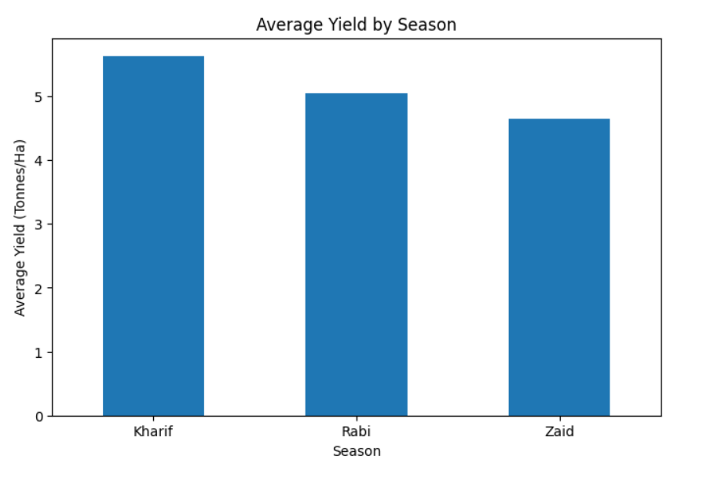
RESULTS
Seasonal Performance
The analysis compared agricultural performance across Kharif, Rabi, and Zaid seasons.
Key Findings
Kharif recorded the highest average yield: 5.63 tonnes/ha.
Rabi recorded an average yield of 5.04 tonnes/ha.
Zaid recorded an average yield of 4.64 tonnes/ha.
Kharif also recorded the highest average profitability.
Seasonal differences were observed descriptively, but the ANOVA test did not find the differences in mean yield to be statistically significant.
Insight
Kharif showed the strongest overall descriptive performance among the three seasons.

Slide 7
RESULTS
Crop and Irrigation Analysis
Crop Performance
Sugarcane showed substantially higher yield levels than the other crops across seasons.
Crop performance varied across different seasons.
Crop-season comparison helps identify combinations with stronger performance.
Irrigation Performance
Irrigation methods showed differences in yield and water efficiency.
Drip irrigation demonstrated strong average yield and water-efficiency performance.
Rainfed farming recorded the highest average water efficiency.
Insight
Irrigation decisions should consider both crop yield and water efficiency, rather than yield alone.

Slide 8
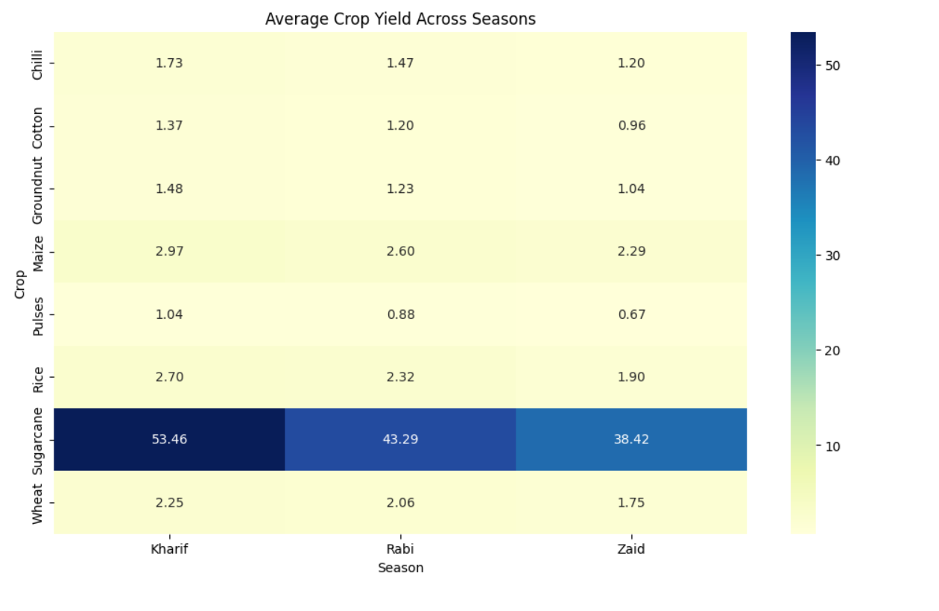
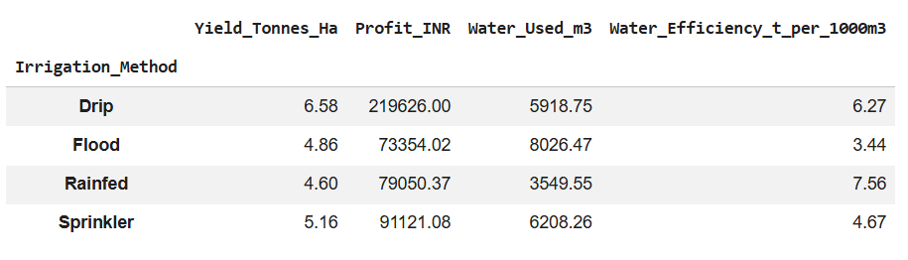
RESULTS

Slide 9
RESULTS
Environmental & Correlation Analysis
The project investigated relationships between environmental conditions and agricultural yield.
Variables analyzed
Rainfall
Temperature
Humidity
Soil conditions
Nutrient usage
Water usage
Water efficiency
Key Finding
Water efficiency showed the strongest positive correlation with yield among the numerical variables analyzed, with a correlation of approximately 0.913.
Other environmental variables showed varying strengths of relationship with yield.
Insight
Efficient water utilization appears to be an important factor associated with higher agricultural yield in the dataset.

Slide 10
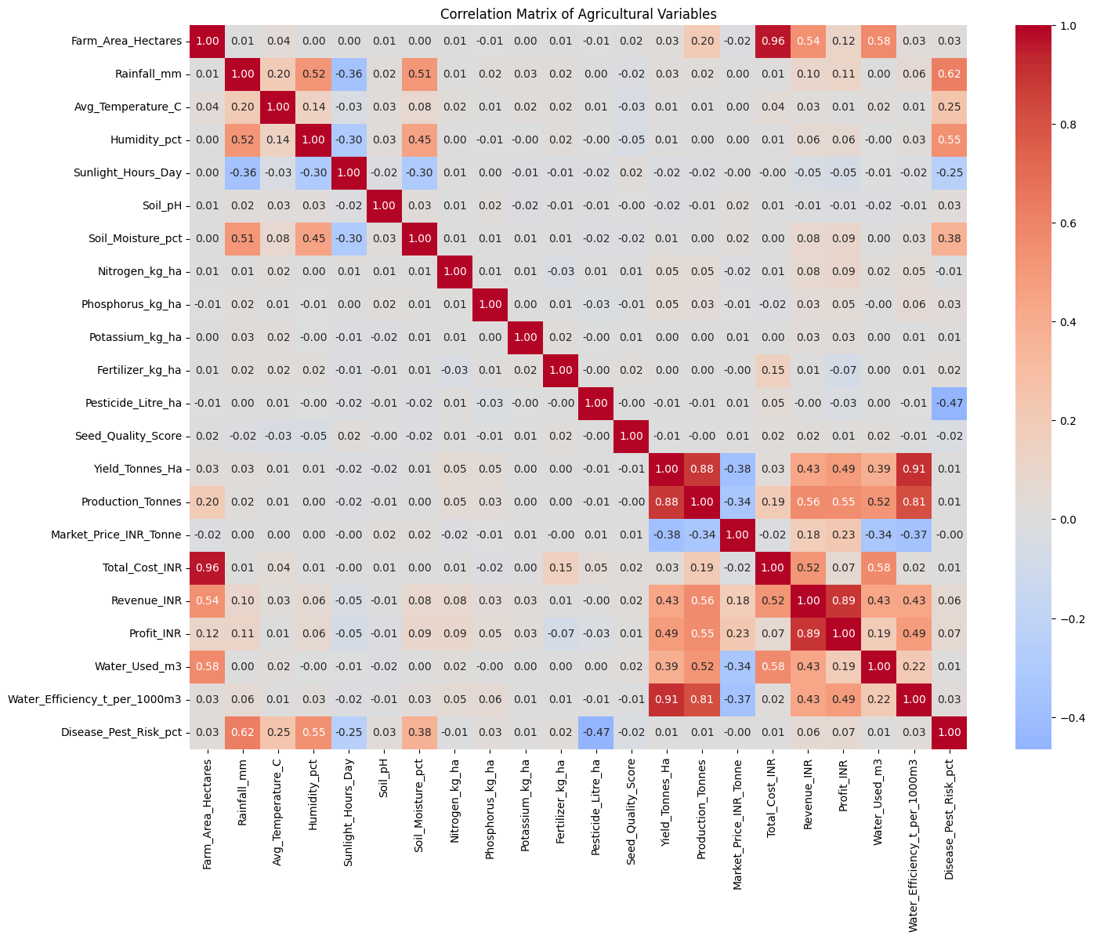
RESULTS

Slide 11
RESULTS
Statistical Analysis
One-Way ANOVA
The ANOVA test was performed to determine whether average agricultural yield differed significantly across Kharif, Rabi, and Zaid seasons.
F-statistic: 1.5438804542488311
p-value: : 0.21367813841792296
Significance level: 0.05
Interpretation
Since p > 0.05, the test does not provide sufficient evidence to conclude that the mean yield differs significantly across seasons.
Overall Findings
Kharif had the highest descriptive average yield.
Sugarcane showed substantially higher yield performance.
Water efficiency had the strongest positive correlation with yield.
Profitability varied considerably across seasons.
Outlier analysis identified unusual yield observations.

Slide 12
Future scope
The project can be extended by:
Incorporating agricultural data from multiple years.
Developing machine learning models for crop-yield prediction.
Building seasonal yield forecasting models.
Studying long-term weather and climate patterns.
Developing interactive dashboards for agricultural monitoring.
Analyzing market-price fluctuations and their effect on profitability.
Applying advanced statistical and machine learning techniques to identify major factors influencing agricultural performance.

Slide 13
GitHub Link
https://github.com/Supriya-2604/Seasonal_Agriculture_Performance_Analysis.git

Slide 14

VOIS Course completion certificate -
Course name- Data Visualization

Slide 15
Thank you
.
.

