Slide 1
Data Storytelling & Statistical Validation
Apex Planet Internship – Task 4
Sales & Customer Analysis
Presented by: Sriramoju Tejaswini
ApexPlanet Internship • Task 4 • 1

Slide 2
Business Objective
Transform sales and customer data into meaningful business insights.
Analyze sales performance and customer purchasing behavior.
Define important business KPIs and segment customers by value.
Validate an important business question using statistical evidence.
Translate findings into practical, data-driven recommendations.
ApexPlanet Internship • Task 4 • 2

Slide 3
Dataset Overview
Dataset: ApexPlanet_DataAnalytics_Dataset.csv
Transaction and customer-level sales information.
Key fields: Order ID, Order Date, Customer ID, Customer Name, Age, Gender.
Sales fields: City, Product, Category, Quantity, Unit Price, Total Sales.
Analysis areas: sales performance, customer behavior, products/categories, cities, and trends.
ApexPlanet Internship • Task 4 • 3

Slide 4
Core Business KPIs
Total Sales — Sum of Total_Sales — measures overall revenue generated.
Total Orders — Count of unique Order_ID — measures order volume.
Total Customers — Count of unique Customer_ID — measures customer base.
Average Order Value — Total Sales ÷ Total Orders — measures average value per order.
Total Quantity — Sum of Quantity — measures products sold.
ApexPlanet Internship • Task 4 • 4

Slide 5
Key Business Findings
Sales performance was analyzed across products, categories, cities, and time.
Customer purchasing patterns were examined to identify differences in contribution.
Monthly and geographic views help reveal changes in sales activity.
Product and category analysis highlights areas for business planning.
These findings provided the foundation for deeper customer analysis.
ApexPlanet Internship • Task 4 • 5

Slide 6
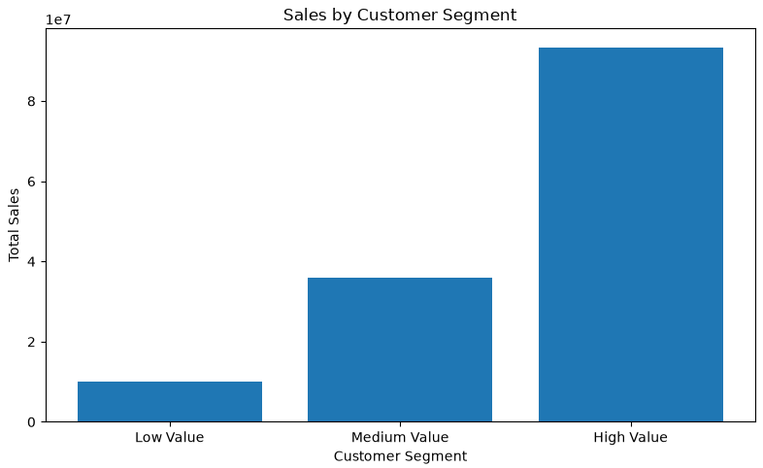
Customer Segmentation
Customers were grouped using Customer_ID and analyzed at customer level.
Metrics used: Total Sales, Total Orders, and Total Quantity.
Segments: High Value, Medium Value, and Low Value.
Segmentation helps identify differences in customer contribution and behavior.
Recommended visual: sales_by_customer_segment
ApexPlanet Internship • Task 4 • 6

Slide 7
Business Question & Hypothesis
Business Question: Is there a statistically significant difference in average sales between male and female customers?
Null Hypothesis (H₀): There is no statistically significant difference in average sales.
Alternative Hypothesis (H₁): There is a statistically significant difference in average sales.
Significance level: α = 0.05.
ApexPlanet Internship • Task 4 • 7

Slide 8
Hypothesis Testing Results
Statistical test: Independent two-sample t-test.
Male Mean Sales: 141807.3397847358
Female Mean Sales: 136883.20862985688
T-Statistic: 0.6826103913380815
P-Value: 0.49501147851458344
Decision: Fail to reject the null hypothesis. There is not enough statistical evidence to conclude that average sales differ between male and female groups.
ApexPlanet Internship • Task 4 • 8

Slide 9
Statistical Interpretation
If p-value < 0.05: reject H₀; there is statistically significant evidence of a difference.
If p-value ≥ 0.05: fail to reject H₀; there is not enough statistical evidence to conclude a difference.
Statistical significance should be considered together with business context.
Gender alone should not be the only basis for business decisions.
ApexPlanet Internship • Task 4 • 9

Slide 10
Business Recommendations
Focus retention and loyalty efforts on high-value customers.
Develop suitable engagement strategies for medium-value customers.
Study lower-value customers to identify opportunities for stronger engagement.
Monitor high-performing products, categories, and cities regularly.
Use KPI trends and statistical evidence together with business context.
ApexPlanet Internship • Task 4 • 10

Slide 11
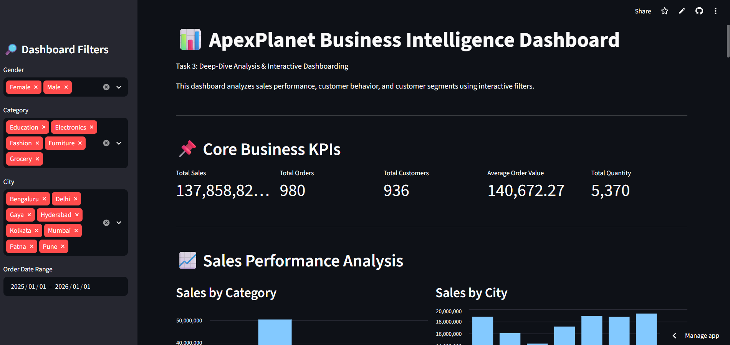
Interactive Business Intelligence Dashboard
Interactive Streamlit dashboard developed in Task 3.
Filters: Gender, Category, City, and Date.
Visuals: sales by category, sales by city, monthly sales trend, customer segmentation, and product analysis.
Includes filtered dataset preview and CSV download functionality.
Recommended visual: insert a screenshot of your live Streamlit dashboard.
ApexPlanet Internship • Task 4 • 11

Slide 12
From Data to Decision
DATA → Sales & Customer Analysis → KEY INSIGHTS → Customer Segmentation
→ HYPOTHESIS → Statistical Validation → BUSINESS ACTION
Main takeaway: Data analysis becomes valuable when insights are translated into measurable business actions.
ApexPlanet Internship • Task 4 • 12

Slide 13
Conclusion
Analyzed sales and customer data.
Defined five core business KPIs.
Performed customer segmentation.
Identified important business patterns.
Formulated and tested a business hypothesis.
Interpreted statistical evidence and developed recommendations.
ApexPlanet Internship • Task 4 • 13

Slide 14
Thank You!
Apex Planet Software Pvt. Ltd. Internship
Task 4 – Data Storytelling & Statistical Validation
Live Dashboard:https://apexplanettask3deepdiveanalysisgit-3dh98zecwbq7zbf2abzrrc.streamlit.app/
ApexPlanet Internship • Task 4 • 14

