Slide 1

Professor : Farid Alizadeh Team: Annapoorna Kadur Supriya Nanjundaswamy
HR Analytics Employee Attrition & Performance

Slide 2
Introduction to dataset
The dataset was taken from Kaggle.com
The data was clean and no actions were required
No null values were present
Columns were renamed to make them meaningful
The dataset consists of about 15,000 employee observations and 10 features

Slide 3
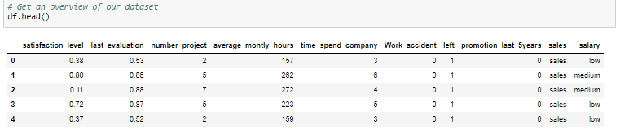
Overview of the dataset

Slide 4
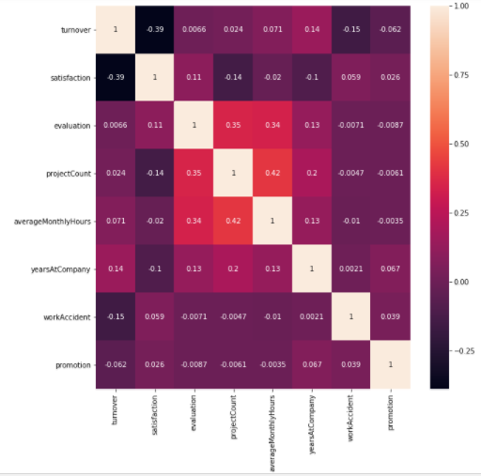
Correlation Matrix & Heatmap
Positively Correlated Features
projectCount vs evaluation: 0.349333
projectCount vs averageMonthlyHours: 0.417211
averageMonthlyHours vs evaluation: 0.339742
Negatively Correlated Feature
satisfaction vs turnover: -0.388375

Slide 5
Exploratory Data Analysis

Slide 6
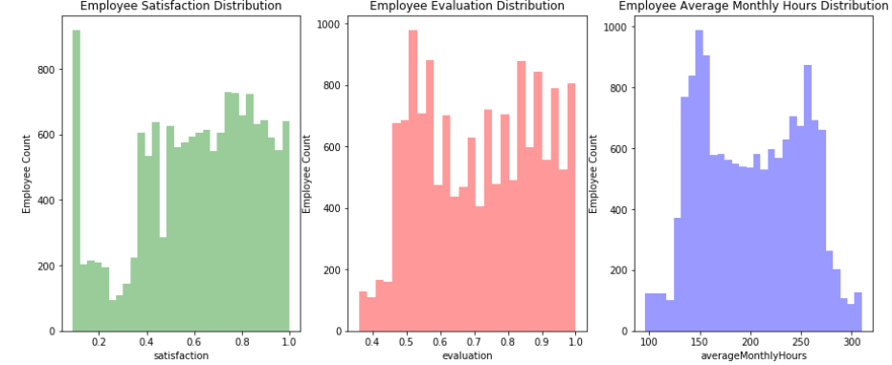
Satisfaction - Evaluation - AverageMonthlyHours versus Employee Count
Satisfaction:
There is a huge spike for employees with low satisfaction and high satisfaction.
Evaluation:
There is a bimodal distribution of employees for low evaluations (less than 0.6) and high evaluations (more than 0.8)
AverageMonthlyHours:
There is another bimodal distribution of employees with lower and higher average monthly hours (less than 150 hours & more than 250 hours)
The evaluation and average monthly hour graphs both share a similar distribution.
Employees with lower average monthly hours were evaluated less and vice versa.

Slide 7
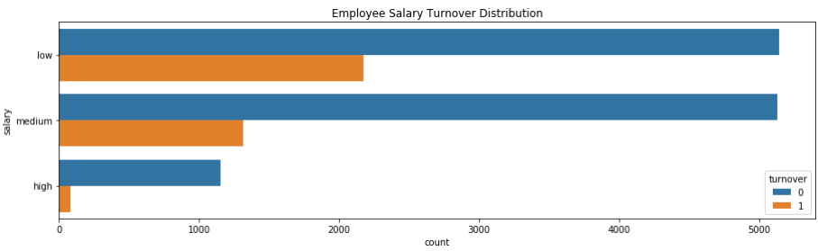
Salary versus Turnover
Majority of employees who left either had low or medium salary.
Barely any employees left with high salary
Employees with low to average salaries tend to leave the company.

Slide 8
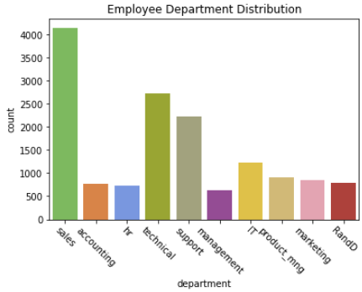
Department versus Turnover
The sales, technical, and support department were the top 3 departments to have employee turnover
The management department had the smallest amount of turnover

Slide 9
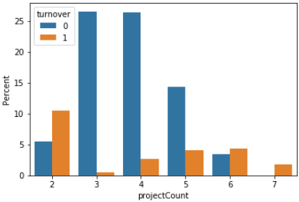
Turnover versus ProjectCount
More than half of the employees with 2, 6, and 7 projects left the company
Majority of the employees who did not leave the company had 3, 4, and 5 projects
All of the employees with 7 projects left the company
There is an increase in employee turnover rate as project count increases

Slide 10
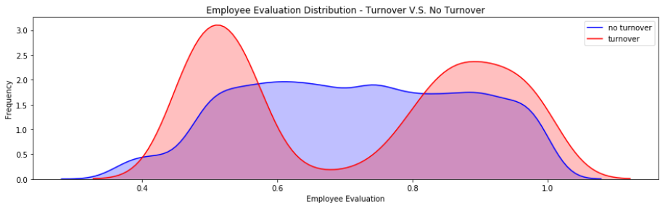
Turnover versus Evaluation
There is a bimodal distribution for those that had a turnover.
Employees with low performance tend to leave the company more
Employees with high performance tend to leave the company more
The sweet spot for employees that stayed is within 0.6 - 0.8 evaluation

Slide 11
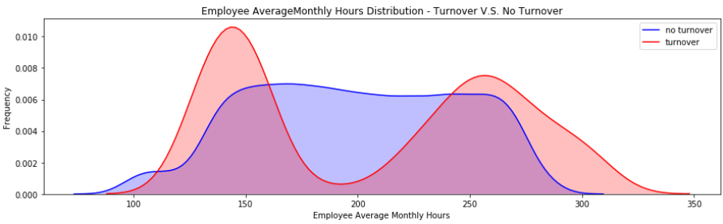
Turnover versus AverageMonthlyHours
Another bimodal distribution for employees that had a turnover
Employees who had less hours of work (~150hours or less) left the company more
Employees who had too many hours of work (~250 or more) left the company
Employees who left generally were underworked or overworked

Slide 12
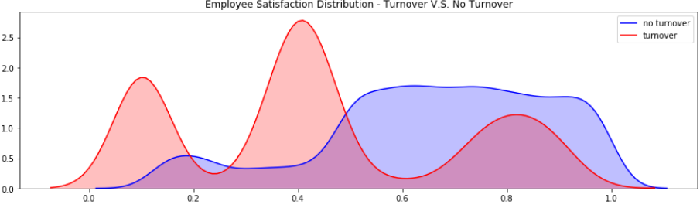
Turnover versus Satisfaction
There is a tri-modal distribution for employees that had a turnover
Employees who had really low satisfaction levels (0.2 or less) left the company more
Employees who had low satisfaction levels (0.3~0.5) left the company more
Employees who had really high satisfaction levels (0.7 or more) left the company more

Slide 13
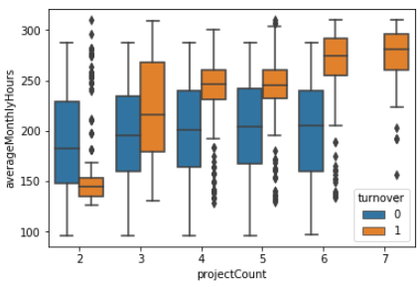
ProjectCount versus AverageMonthlyHours
As project count increased, so did average monthly hours
Looks like employees who did not have a turnover had consistent averageMonthlyHours, despite the increase in projects
In contrast, employees who did have a turnover had an increase in averageMonthlyHours with the increase in projects

Slide 14
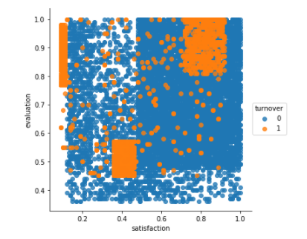
Satisfaction versus Evaluation
Cluster 1 (Hard-working and Sad Employee)
Cluster 2 (Bad and Sad Employee)
Cluster 3 (Hard-working and Happy Employee)

Slide 15
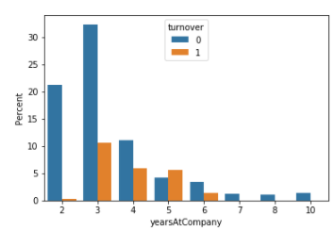
Turnover versus YearsAtCompany
More than half of the employees with 4 and 5 years left the company.

Slide 16
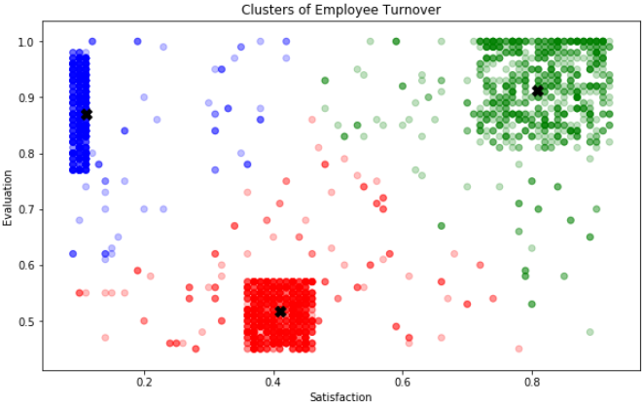
K-Means Clustering of Employee Turnover
Cluster 1 (Blue): Hard-working and Sad Employees
Cluster 2 (Red): Bad and Sad Employee
Cluster 3 (Green): Hard-working and Happy Employee

Slide 17
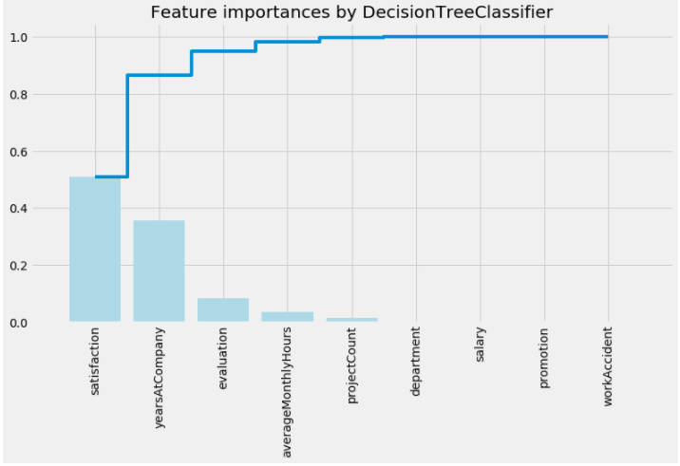
Feature Selection
By using a decision tree classifier, it could rank the features used for the prediction. The top three features were employee satisfaction,yearsAtCompany, and evaluation. This is helpful in creating our model for logistic regression because it’ll be more interpretable to understand what goes into our model when we utilize less features.
Top 3 Features:
Satisfaction
YearsAtCompany
Evaluation

Slide 18
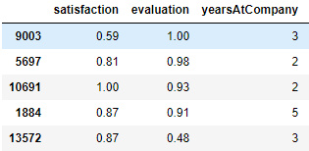
Logistic Regression Analysis
Logistic Regression commonly deals with the issue of how likely an observation belongs to each group. This model is commonly used to predict the likelihood of an event occurring. The output of logistic regression is transformed with a logit function. This makes the output either 0 or 1.
The figure shows the inputs to training set.

Slide 19
Continued…
Using Logistic Regression Coefficients
satisfaction -3.769022
evaluation 0.207596
yearsAtCompany 0.170145
int 0.181896
The employee would have a 14% chance of leaving the company.

Slide 20
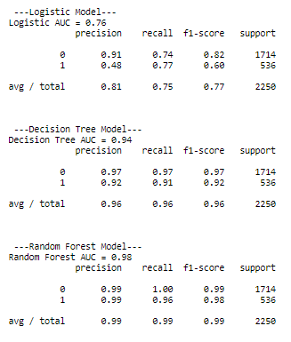
Logistic Regression versus Random Forest versus Decision Tree
The best model performance out of the three (Decision Tree Model, Logistic Regression Model, Random Forest Model) is Random Forest.

Slide 21
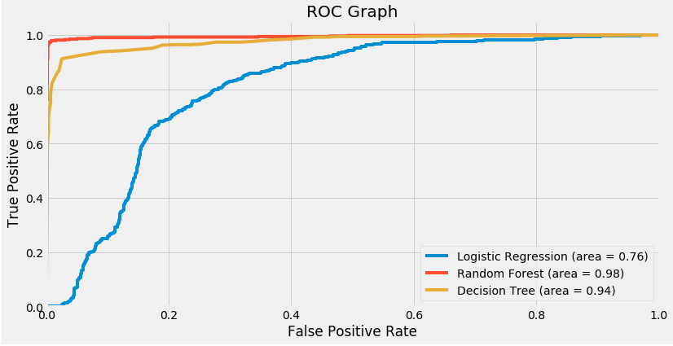
ROC Graph
From the roc curve, it confirms that random forest performs the best followed by decision tree and logistic regression.

Slide 22
Conclusion
Employees generally left when they are underworked (less than 150hr/month or 6hr/day) or overworked (more than 250hr/month or 10hr/day)
Employees with either really high or low evaluations should be taken into consideration for high turnover rate
Employees with low to medium salaries are the bulk of employee turnover
Employees that had 2, 6, or 7 project count was at risk of leaving the company
Employee satisfaction is the highest indicator for employee turnover.
Employee that had 4 and 5 yearsAtCompany should be taken into consideration for high turnover rate
Employee satisfaction, yearsAtCompany, and evaluation were the three biggest factors in determining turnover.

Slide 23
Thank you!!!

