Slide 1
Mongo DB Relations

Slide 2
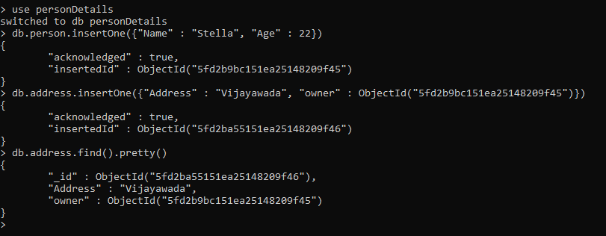
One to One

Slide 3
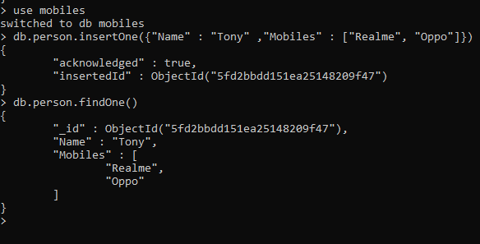
One to Many

Slide 4
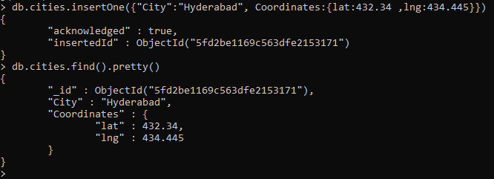
Second example of one to many

Slide 5

Third example of one to many

Slide 6
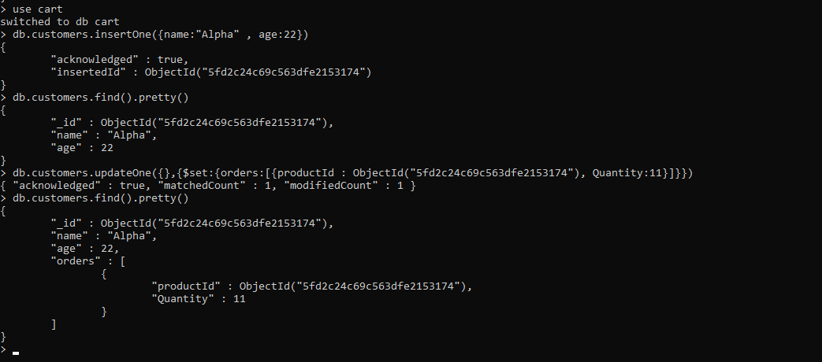
Fourth example of one to many

Slide 7
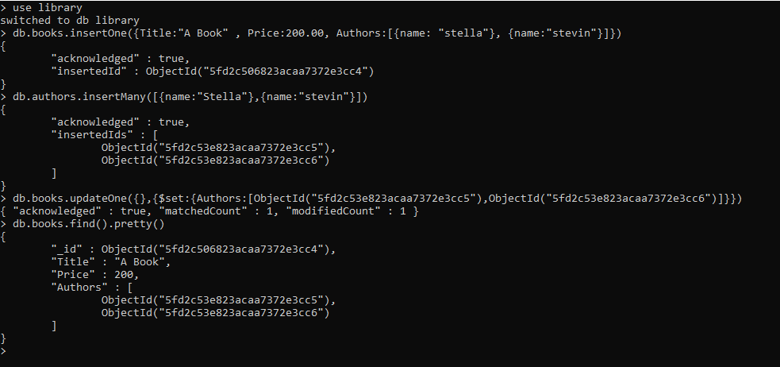
Many to Many

Slide 8
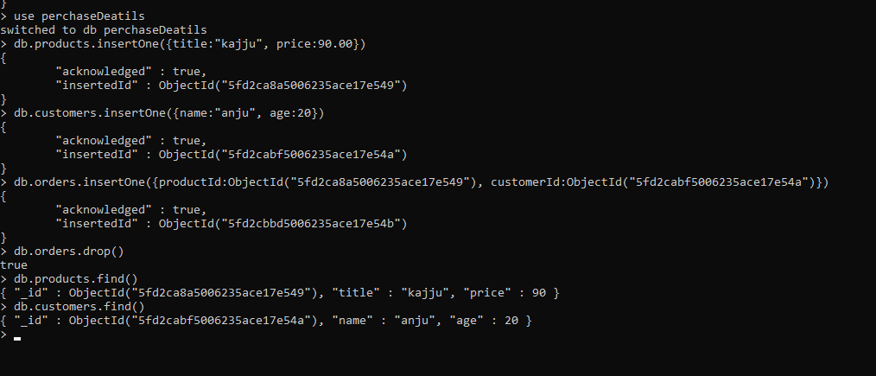
Second example

Slide 9
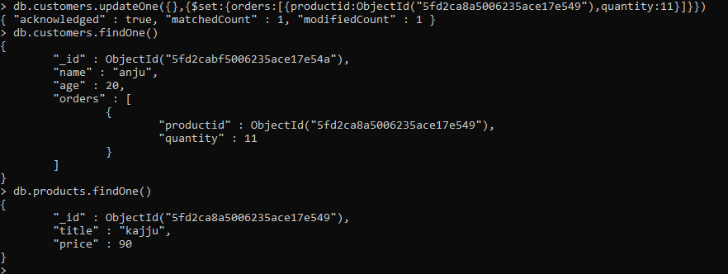

Slide 10

JOINING $lookup

Slide 11
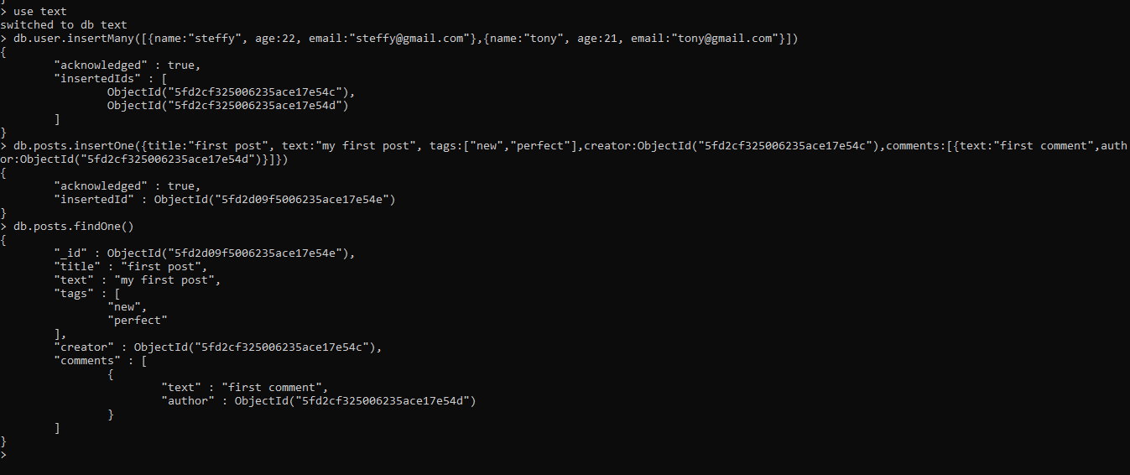
Example of Blog

Slide 12
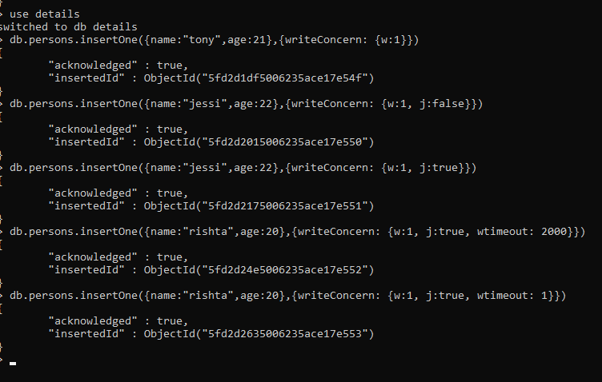
Insert – Write Concern

Slide 13
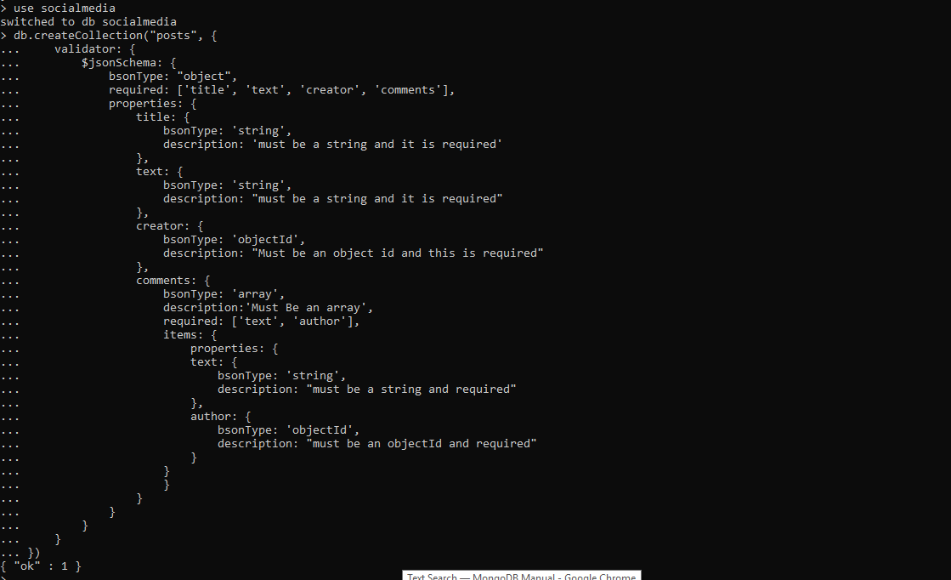
Validator

Slide 14


Slide 15
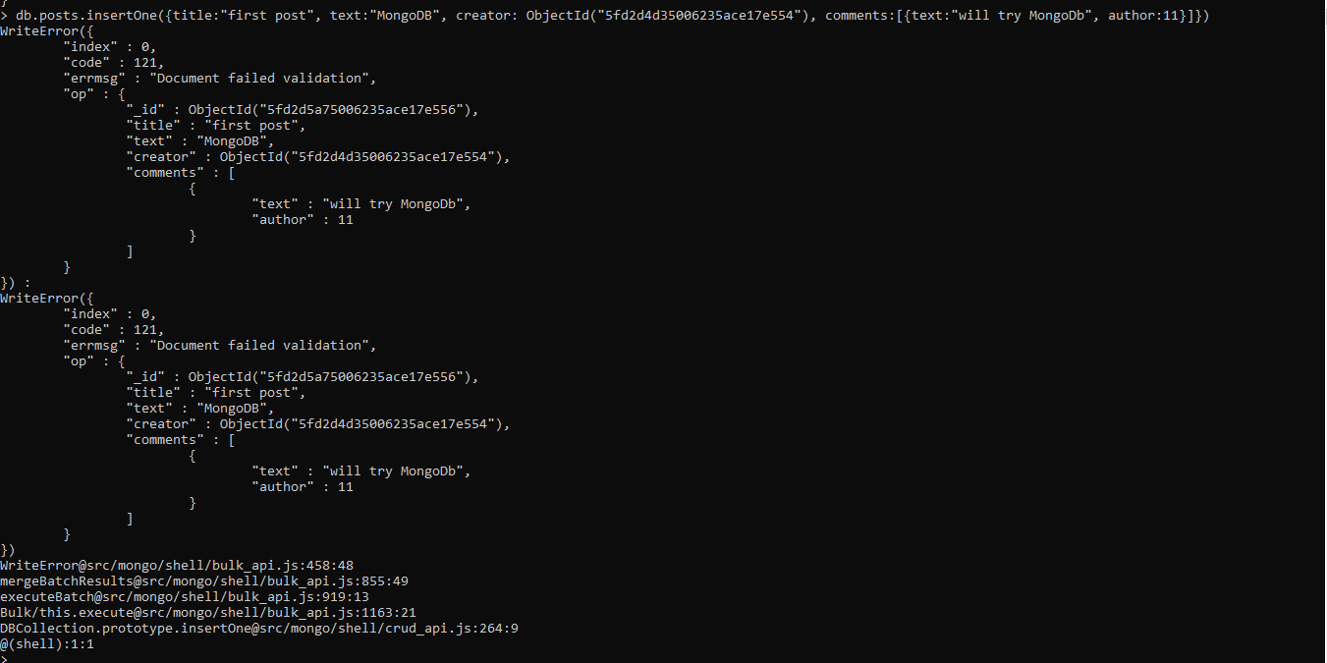
Validator Schema Test

Slide 16


