Slide 1
Avoid Relapse Stay Sober Android Application
Team Number: M13
Team Members:
Shivani C Guranalli 502 01FE19BCS265
Madhura Nagaraj Nayak 517 01FE19BCS285
Soumya Jakkali 520 01FE19BCS288
Supriya Khemalapure 522 01FE19BCS290
Guide : Dr. P.G Sunitha Hiremath

Slide 2

Problem Statement
Develop an android application that helps people to find a way to avoid alcohol, calculate their risk level, find information regarding rehabilitation camps, helpline numbers, trigger avoidance techniques and track their sober days.

Slide 3
Remarks of Review 1
Brief description of existing systems.

Slide 4
Project Overview / Summary
Domain/Problem Space :
This is android development project.
Helps sober people to avoid relapse
and even helps people who wants to lead sober life.
Provides rehabilitation centers details, finding sobriety period and risk calculation using the alcohol content consumed.
Goals / Objectives :
To develop app in different languages to help rural people.
To develop risk calculator using formula provided by WHO.
To find sober period to motivate sober people.
To provide rehab centers details in one component so that it helps rural people.
Problem Definition :
Develop an android application that helps people to avoid alcohol, calculate their risk level, find information regarding rehabilitation camps, helpline numbers, trigger avoidance techniques and track their sober days.
Technical Challenges :
Finding the features of app so that those help in providing way toward sober life.
Understanding the requirements of people who are alcoholics and wants to lead sober life.
Application needs to work on version 11 and higher versions of android

Slide 5
Functionalities
Language
The app provides user to change the app in 5 languages.
This helps the rural people to change the app to their known language.

Slide 6
Risk tracker
This component is helpful to calculate the ethanol content in the alcohol.
Based on the ethanol content risk level will be calculated.Ethanol content is calculated using formula.This helps the user to keep track of their risk level and help them to quit drinking slowly.
Average ethanol content in the alcohol consumed till date is calculated this helps to know his/her history of ethanol consumption.

Slide 7
Risk Tracker Functionalities
User shall be able to enter type and quantity of alcohol consumed.
User shall be able to submit the information entered.
User shall be able to view the ethanol content in the alcohol consumed and risk level based on the ethanol content in the alcohol consumed.
User shall be able to reset if user clicks on “Reset” button information entered by the user will be erased.
User shall be able to view the average ethanol content in the alcohol consumed till that date.

Slide 8
Sobriety Tracker
It is the one of the components in the app which can help the sober people to keep track of their sobriety period.
It is required because sober person may get relapsed at any point of time but the count of sober days may motivate him to continue a sober life.
In this component user can reset the time if he/she is unable to avoid relapse and start the timer again.
Motivational quotes are displayed to motivate the user to lead a sober life whenever user resets the time.

Slide 9
Sobriety Tracker functionalities
User shall be able to set the timer.
User shall be able to view his/her sobriety period by clicking on the “Get Count” button.
User shall be able to reset the time if he relapse.
User shall be able to view the motivational quotes if he/she relapse.
If user clicks on reset without setting the time he will get message “You have not set the timer yet”.

Slide 10
Helpline
Helpline component helps the people to get contact details of coordinators of SDM camp and other rehabilitation details based on district.
This helps the rural people to findi rehabilitation details very easily.
SDM camps are the one which specially helps rural people to come out of the life as alcoholic and help them to quit drinking and lead sober life.
SDM camps are separately mentioned here as this not only helps the alcoholics to lead sober life but also helps in leading the better life after becoming a sober person.

Slide 11
Helpline Functionalities
There are two sub parts in helpline in that one is SDM and other one is
other Rehabilitation details.
On selecting the SDM user gets the list of districts.Selecting any district gives the contact details of the SDM rehabilitation camp coordinator of that district.
Call button is provided onclick on the button call connects to the coordinator of that district.
On selecting the other rehabilitation user gets list of districts. Selecting any one district gives list of the rehabilitation center names in that district. Selecting any one rehab center name gives the address of the rehab center and contact number of that rehab center.User can directly call using call button.

Slide 12
Relapse Trigger Avoidance
Relapse Trigger Avoidance component is helpful for user to avoid the triggers which cause relapse.
It has two parts audios and videos.
Both audios and videos have sub-categories Aatmavalokhana talks, Motivational speeches, prayers and Bhajans.
Aatmavalokana talks is the method used in JJ Vedhike to treat the alcoholics.This talks will help in self analysing.
These audios and videos increases the spirituality, concentration and firmness in the users decision.

Slide 13
Relapse Trigger Avoidance functionalities
User shall be provided with Audios and videos option.
User shall be able to view sub-categories in audios and videos.
User shall be able to watch the videos, which is of having play and pause options.
User shall be able to choose the clips based on their interest.

Slide 14
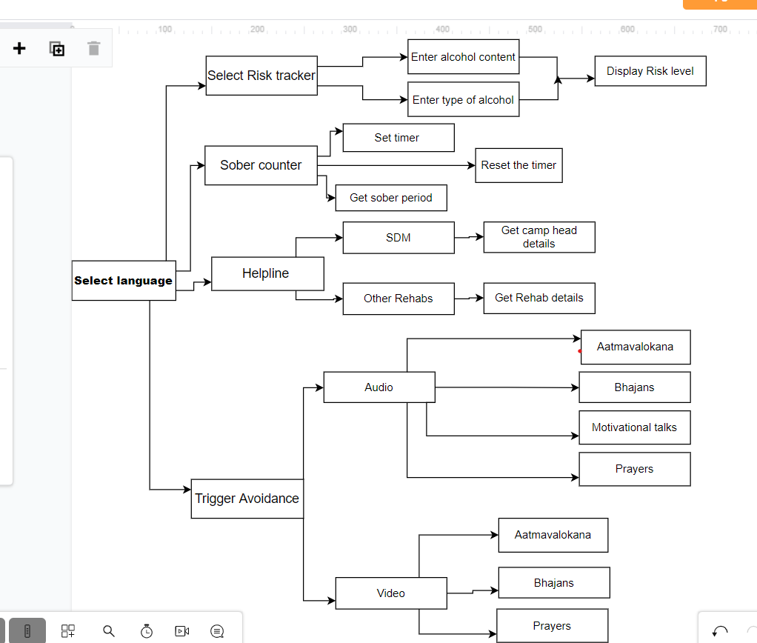
Proposed system / Solution
Block Diagram : Flow of solution

Slide 15
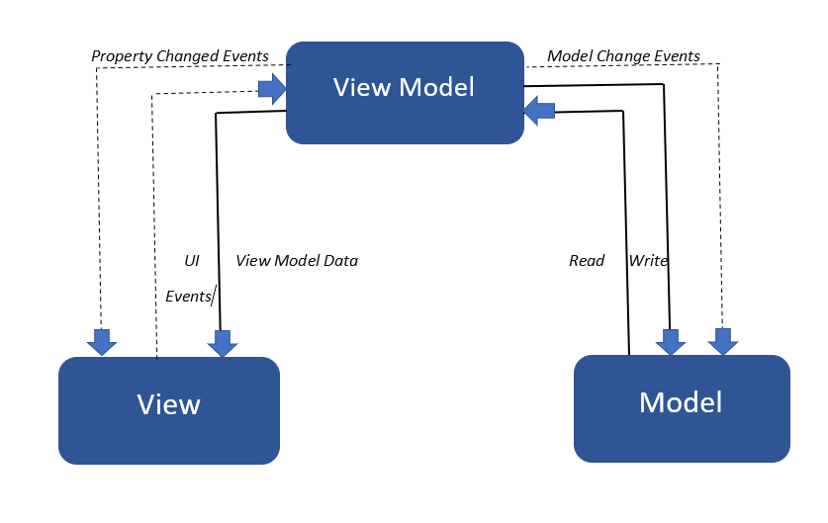
MVVM Architecture
It is best suitable architecture for using new technologies in android development.

Slide 16
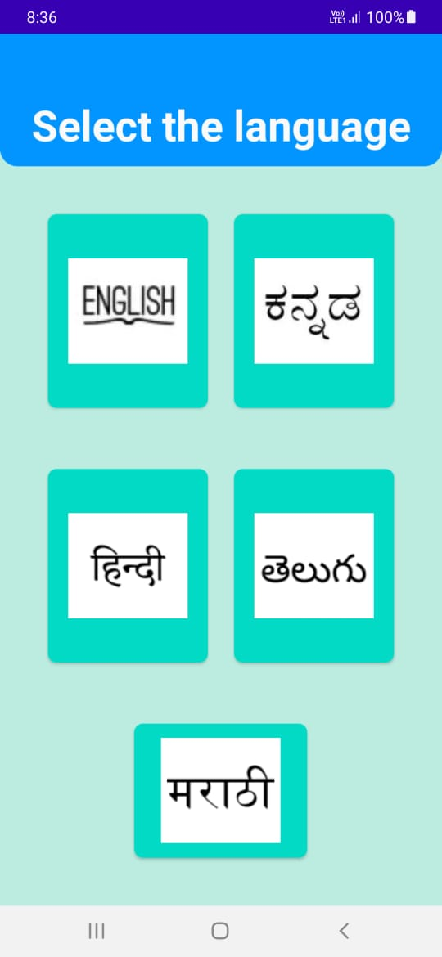
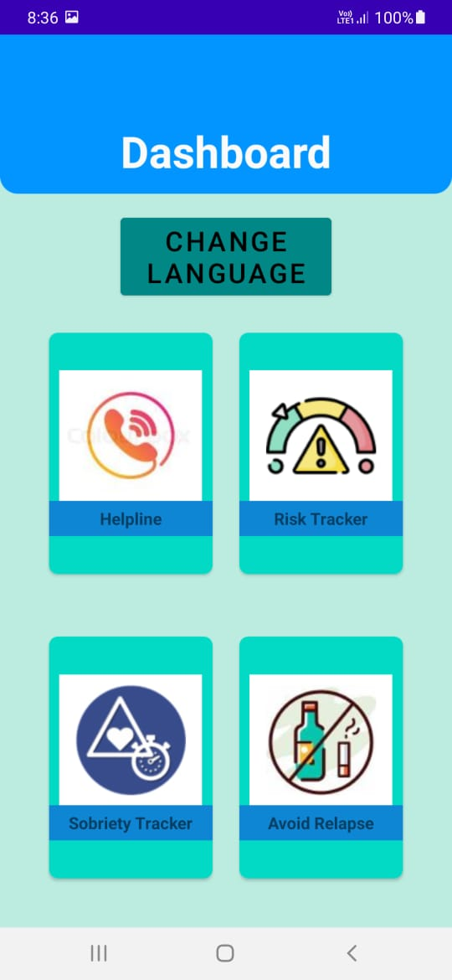
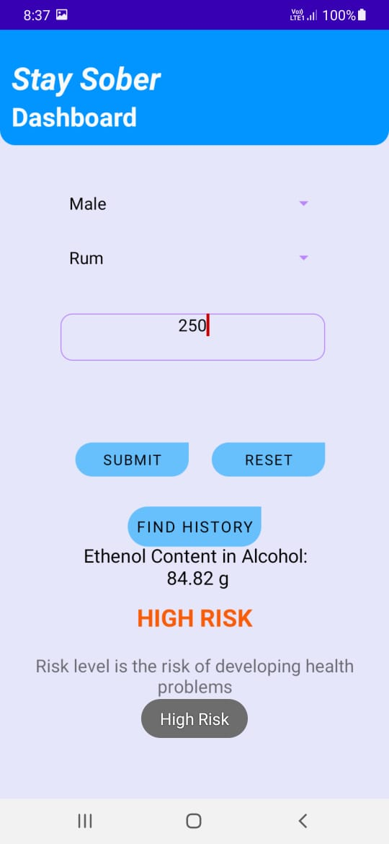
Expected Results / measurable Outputs/
Key performance indicators :

Slide 17
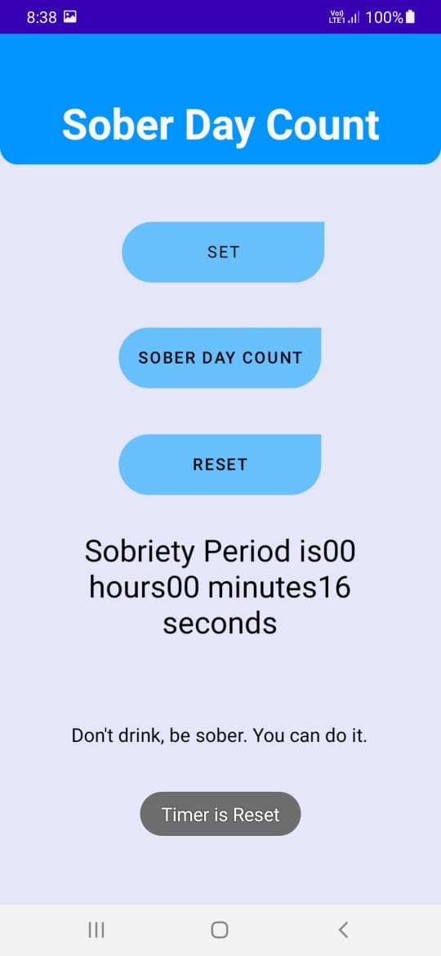
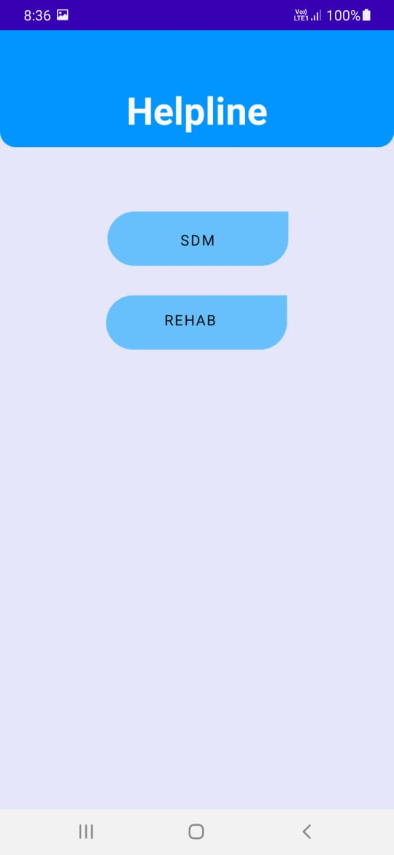
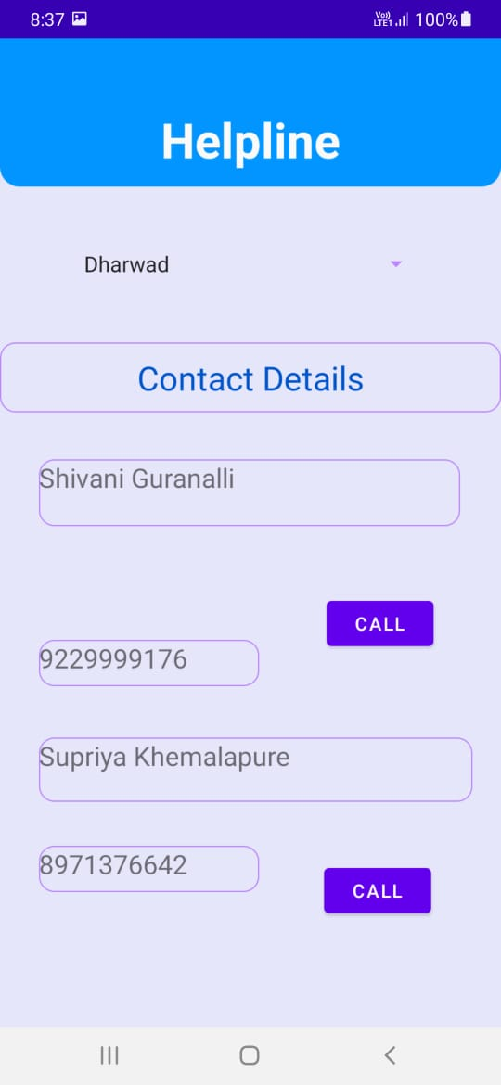

Slide 18
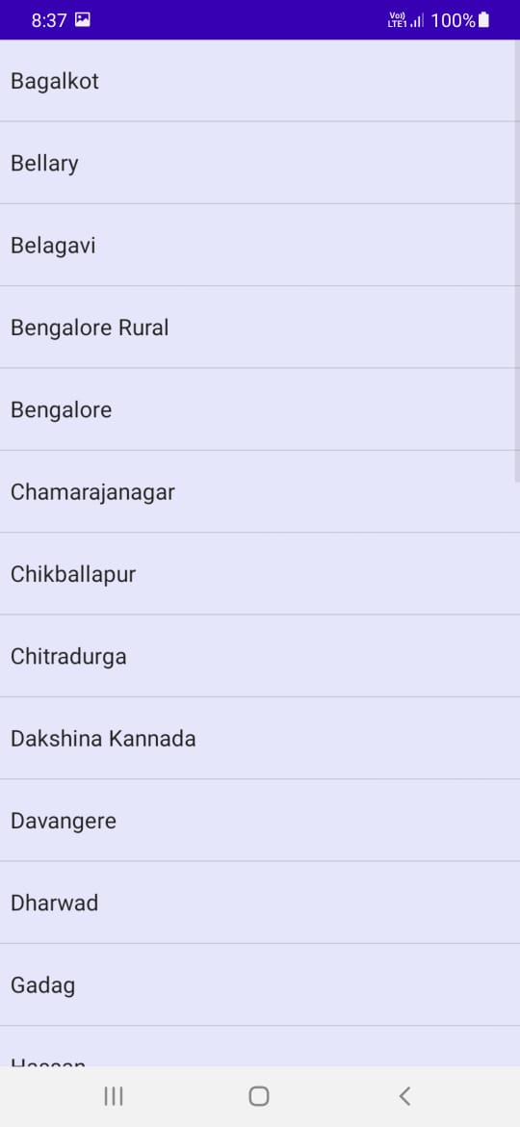
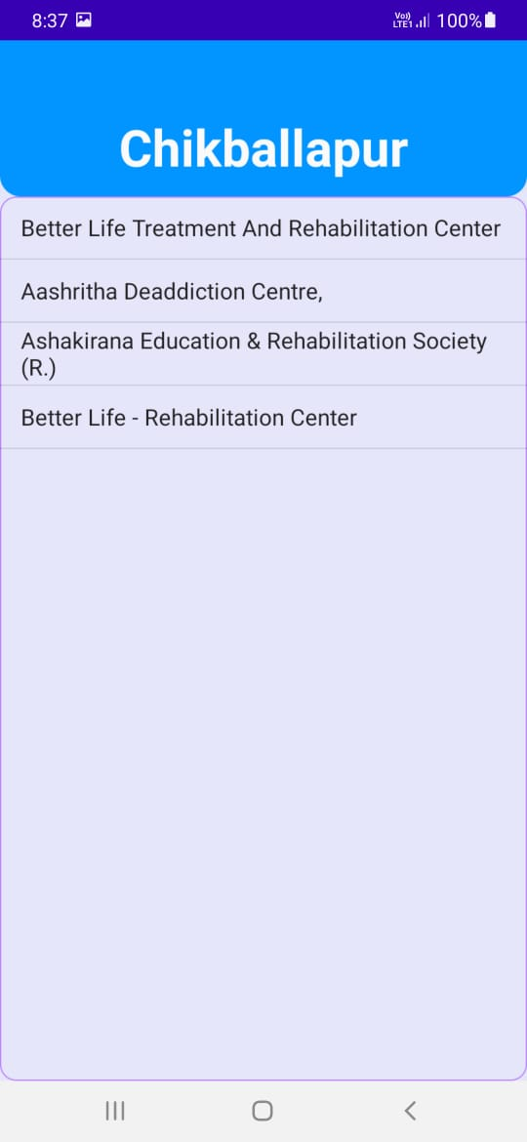
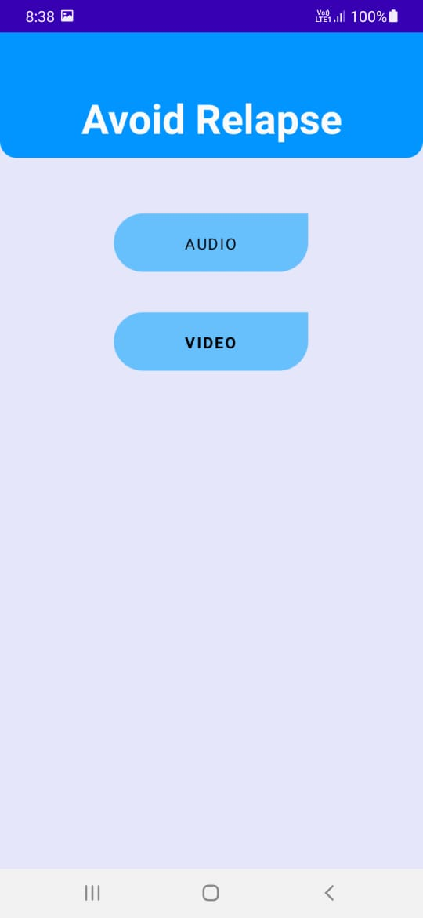

Slide 19
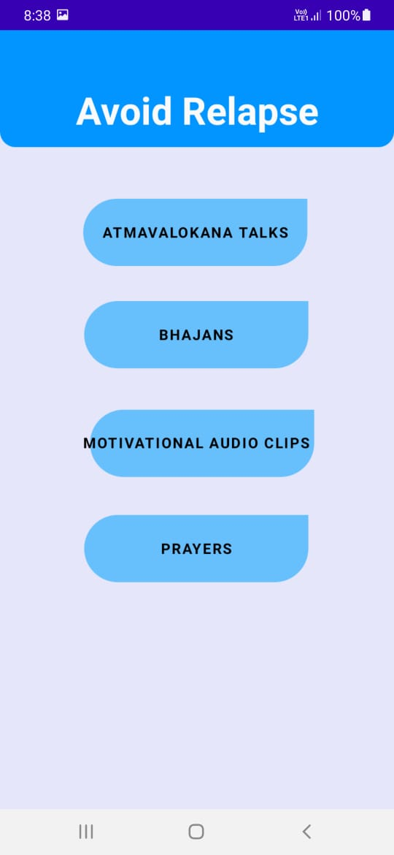
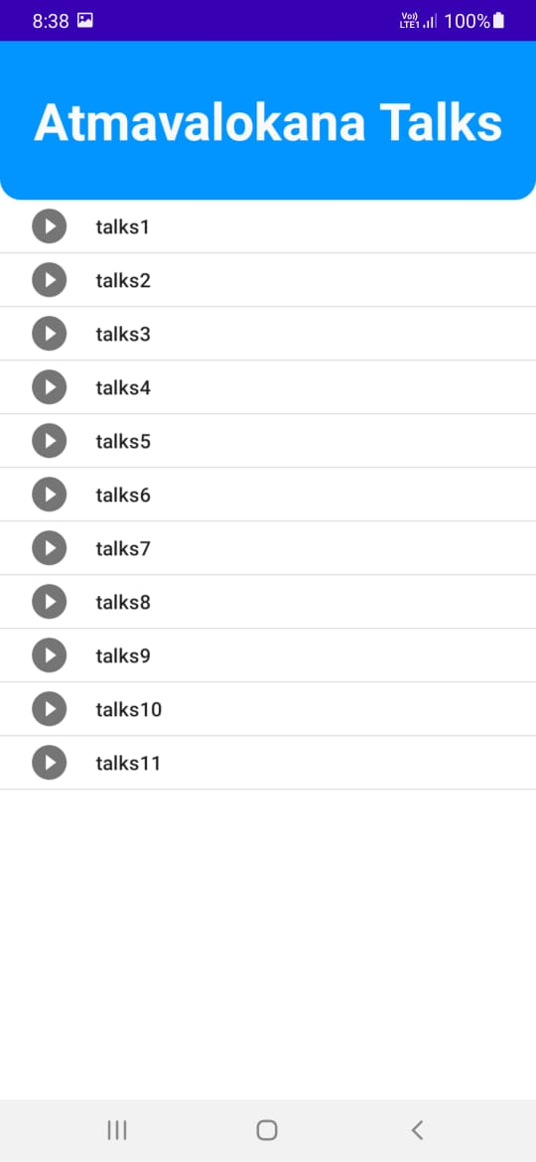
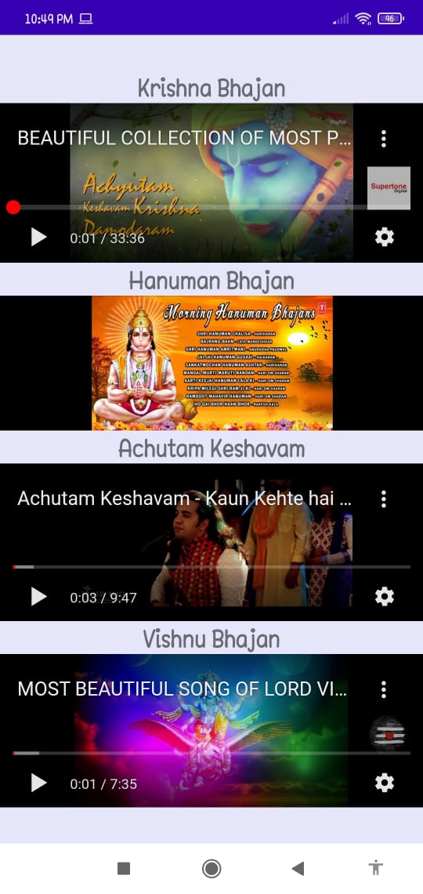

Slide 20
Status of Application components
Sl.No | Component | Status
1 | Language | Completed
2 | Login Page | Yet to be completed
3 | Risk Tracker | Completed
4 | Sobriety Tracker | Completed
5 | Helpline | Completed
6 | Avoid Relapse | Completed

Slide 21
Conclusion :
User can get their risk level based on alcohol consumption so that they can take some measures to reduce the consumption of alcohol.
User can get their sober days count, so that this count keep them motivated and help to continue the sober life.
User can reset the time if he gets relapsed.
Most of rural people unaware about rehab center details. So rehab details are given in this app.
Suddenly quitting the consumption of alcohol leads to triggers. So some trigger avoidance techniques such as bhajans, aatmavalokan talks, motivational speeches and prayers are provided in the app.
This app provides different features which are required for both alcoholics and sober people.

Slide 22
Plan to Complete Project
Final Probable Deliverables :
Login page to develop multi-user application.
Completion Plan :
Week 1 to 2
Step 1 login page completion
Step 2 risk tracker modification
Week 2 to 4
Step 1 sobriety tracker modification
Step 2 Adding sdm data
Week 5 to 6
Step 1 Modifying UI
Step 2 Adding sdm aa records
Week 7 to 8
Step 1 testing application
Step 2 Checking portability

Slide 23
Thank You

