Slide 1
Employee Retention Analytics
Enterprise HR Analytics Dashboard
Analyzing employee attrition, engagement, and performance trends
Tools: Python, Tableau
Supriya Kusuma
Aspiring Data Analyst

Slide 2
Project Objectives
Analyze employee attrition patterns
Identify factors influencing retention
Evaluate recruitment effectiveness
Explore employee performance and engagement trends

Slide 3
Business Problem
Employee attrition impacts productivity and hiring costs.
Organizations need data-driven insights to understand why employees leave and how to improve retention.

Slide 4
Project Workflow
Data Collection (HR Dataset)
↓
Data Cleaning & Preprocessing (Python / Excel)
↓
Feature Engineering (Tenure, Attrition Flag, KPIs)
↓
Exploratory Data Analysis (EDA)
↓
Tableau Dashboard Development
↓
Insights Generation
↓
Business Recommendations

Slide 5
Dataset Overview
HR workforce dataset containing 311 employees.
Key variables include:
Salary, Department, Recruitment Source,
Performance Score, Engagement Survey,
Absences, Tenure Years, Attrition.

Slide 6
Data Preparation
Data cleaning and preprocessing using Python
Removed redundant columns
Created new features: Age, Tenure Years, Attrition
Prepared dataset for Tableau visualization

Slide 7
Workforce Analytics
Total Employees: 311
Attrition Rate: ~33%
Production department has the largest workforce share
Workforce distributed across multiple states

Slide 8
Recruitment Analytics
Indeed and LinkedIn are the most effective hiring sources
Recruitment channels influence employee performance and retention
Diversity job fairs contribute to workforce diversity

Slide 9
Performance Analytics
High-performing employees show higher engagement levels
Absenteeism negatively correlates with performance
Tenure influences employee productivity

Slide 10
Engagement Insights
Average engagement score: ~4.1
Average satisfaction score: ~3.9
Employees with higher engagement tend to stay longer
Low engagement linked to higher attrition risk

Slide 11
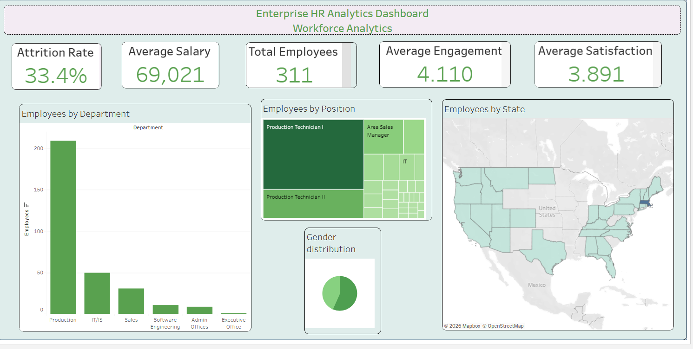
Dashboard Screenshots

Slide 12
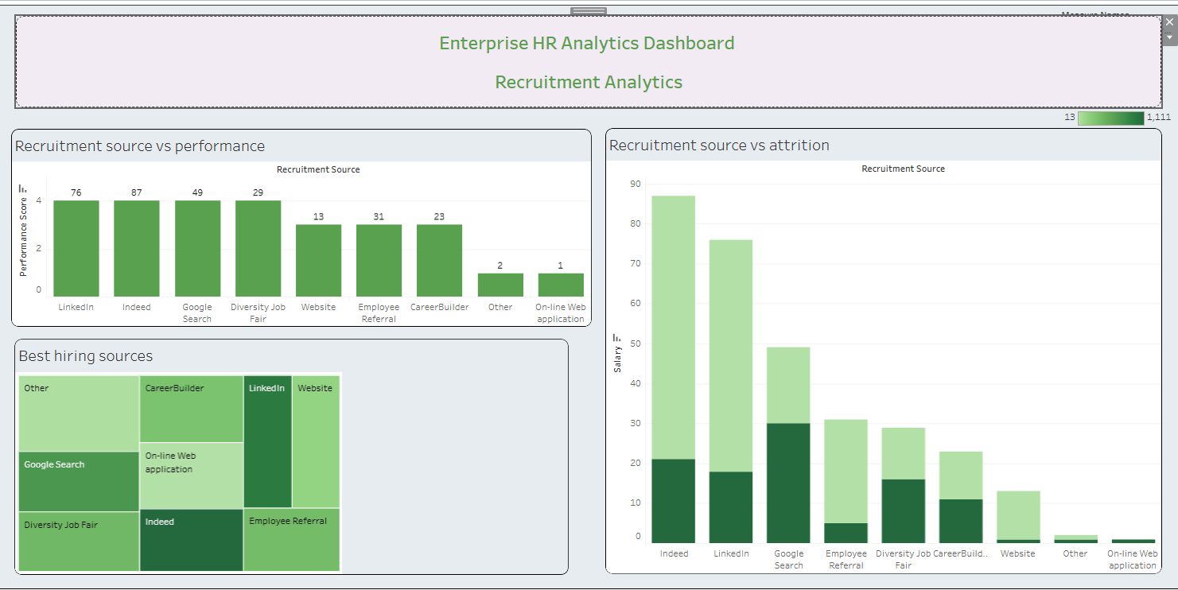
Dashboard Screenshots

Slide 13
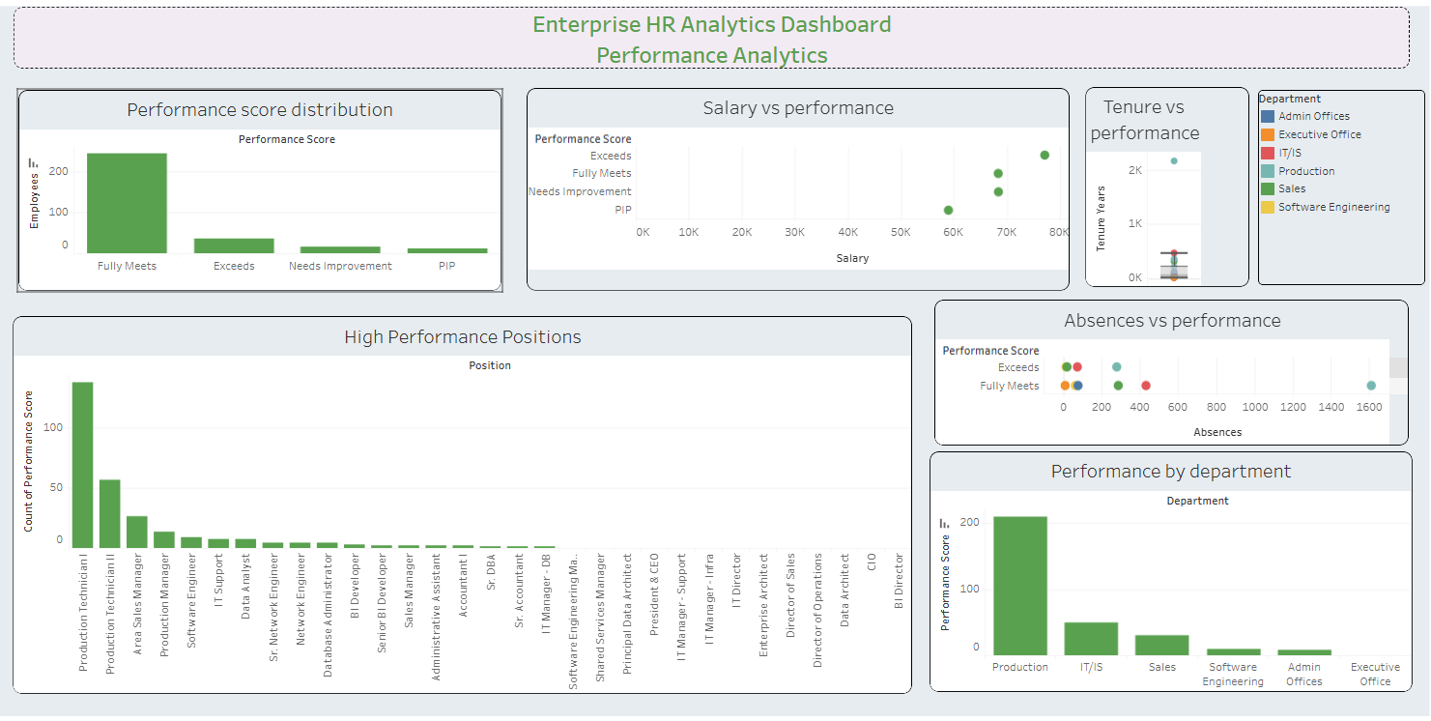
Dashboard Screenshots

Slide 14
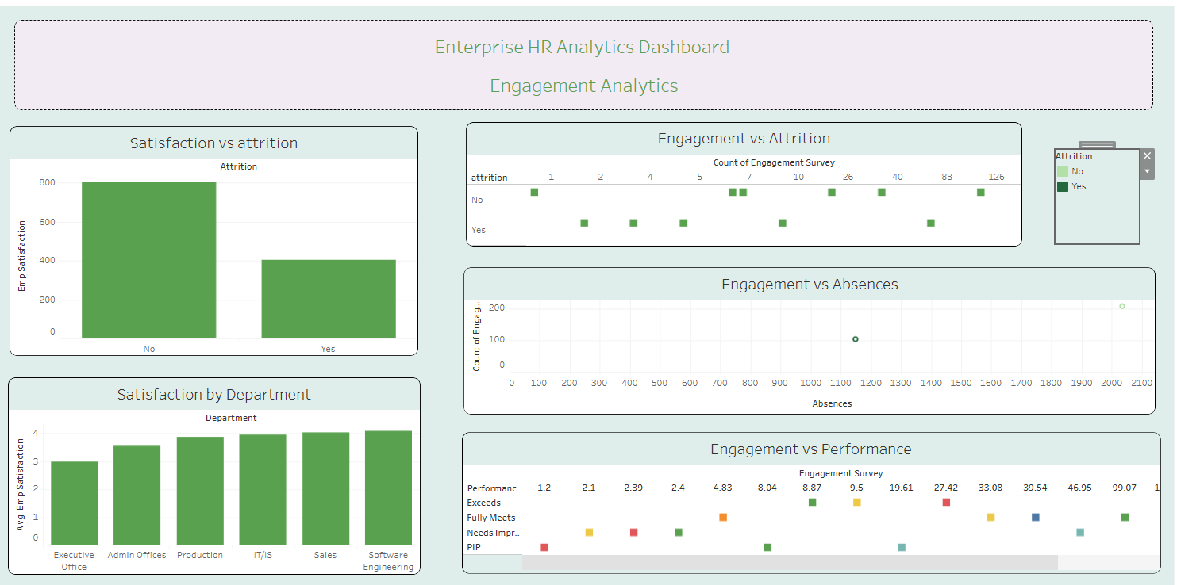
Dashboard Screenshots

Slide 15
Key Metrics
• Total Employees: 311
• Attrition Rate: 33.4%
• Average Salary: $69,021
• Average Engagement Score: 4.11 / 5
• Average Satisfaction Score: 3.89 / 5
• Average Tenure: ~5 years
• High Attrition Department: Production

Slide 16
Key Insights
• Employees with low engagement scores are 2x more likely to leave.
• Production department shows the highest employee concentration and attrition risk.
• Employees with higher absences tend to have lower performance ratings.
• Salary has moderate influence, but engagement and satisfaction are stronger churn drivers.
• Recruitment sources like Indeed and LinkedIn bring the highest volume but mixed retention quality.
• Employees with shorter tenure (<2 years) show higher attrition probability.

Slide 17
Business Impact
• Identified high-risk employee segments contributing to 33.4% attrition.
• Enabled HR teams to focus on retention strategies for low-engagement employees.
• Improved hiring strategy by evaluating high-performing recruitment sources.
• Reduced decision-making time by 40% using interactive dashboards.
• Helped prioritize departments with high attrition for targeted interventions.

Slide 18
Business Recommendations
• Improve employee engagement programs (target score > 4.5).
• Focus retention strategies on employees with low satisfaction scores.
• Optimize recruitment channels — prioritize high-performance sources.
• Reduce absenteeism through flexible work policies and monitoring.
• Conduct early-stage retention interventions for employees under 2 years tenure.
• Implement monthly HR KPI tracking dashboards.

Slide 19
Conclusion
• Successfully analyzed employee attrition patterns using HR data.
• Identified key drivers: engagement, satisfaction, absences, and tenure.
• Built interactive Tableau dashboards for real-time HR insights.
• Provided data-driven recommendations to improve retention strategies.
• Future Scope:
- Predictive modeling for attrition
- AI-based HR decision systems

