Slide 1
SBI Customer Churn Analytics
An End to End Data Analytics Project
Customer Behavior Analysis for Banking Retention Strategy
Tools Used: Python | Pandas | Power BI | Data Visualization
Supriya Kusuma
Aspiring Data Analyst

Slide 2
Project Overview
Objective: Analyze customer churn patterns.
Dataset: Bank Customer Churn dataset.
Tools: Python, Power BI, Data Visualization.

Slide 3
Business Problem
Banks lose revenue when customers churn.
Goal: Identify patterns and factors influencing churn.

Slide 4
Project Workflow
Data Collection ↓ Data Cleaning (Python) ↓ Exploratory Data Analysis ↓ Feature Engineering ↓ Power BI Dashboard Development ↓ Business Insights & Recommendations

Slide 5
Dataset Summary
Total Records: 10,000 Total Features: 11
Target Variable: Churn (0 = Stayed, 1 = Left)
Countries Included: France, Germany, Spain

Slide 6
Dataset Description
Key fields:
- Age
- Balance
- Estimated Salary
- Credit Score
- Country
- Gender
- Tenure
- Products Number
- Active Member
- Churn

Slide 7
Data Preparation
Data cleaning in Python.
Handling missing values.
Categorizing features.
Exporting cleaned dataset to Power BI.

Slide 8
Dashboard Overview
Power BI dashboard built with:
- KPI cards
- Distribution charts
- Scatter plots
- Heatmap
- Customer segmentation visuals.

Slide 9
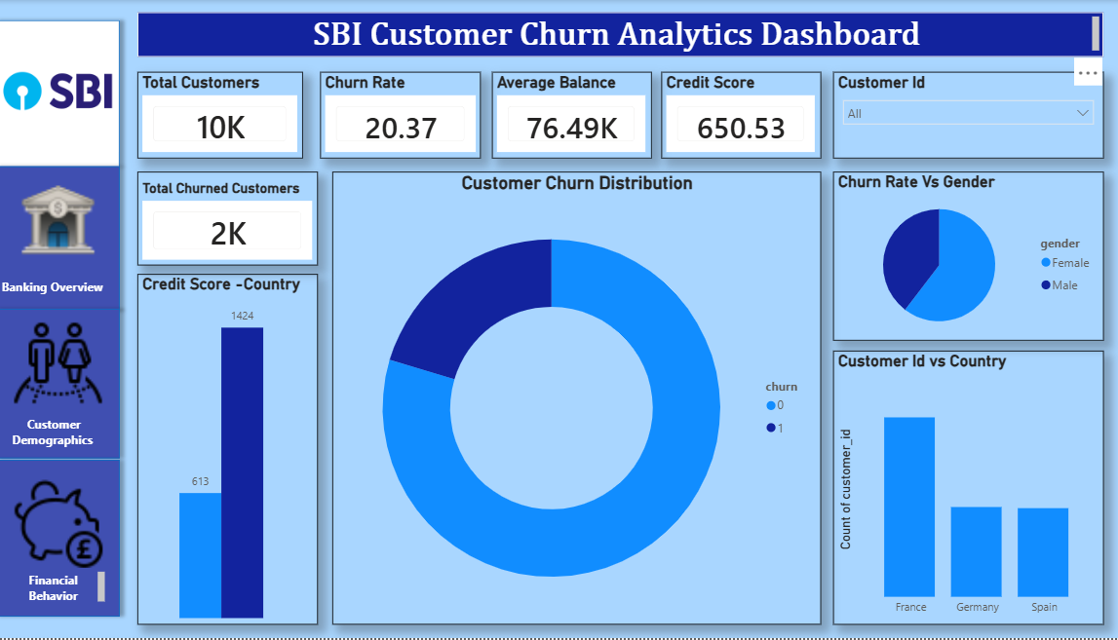
DASHBOARD SCREENSHOTS
Banking Overview Dashboard

Slide 10
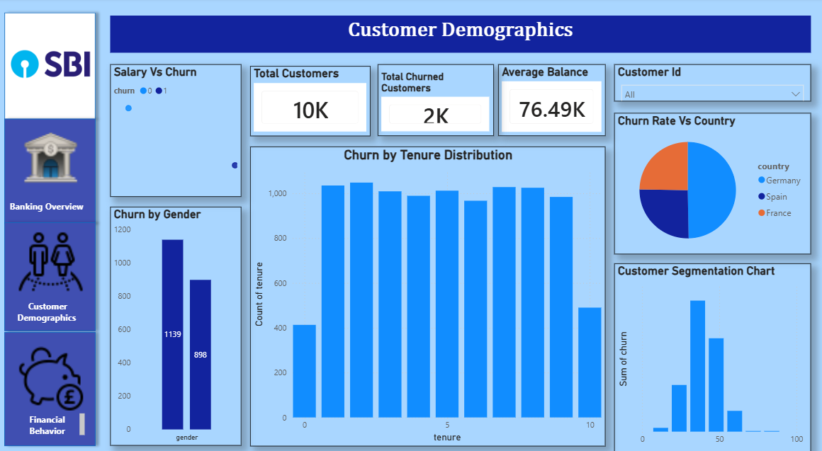
DASHBOARD SCREENSHOTS
Customer Demographics

Slide 11
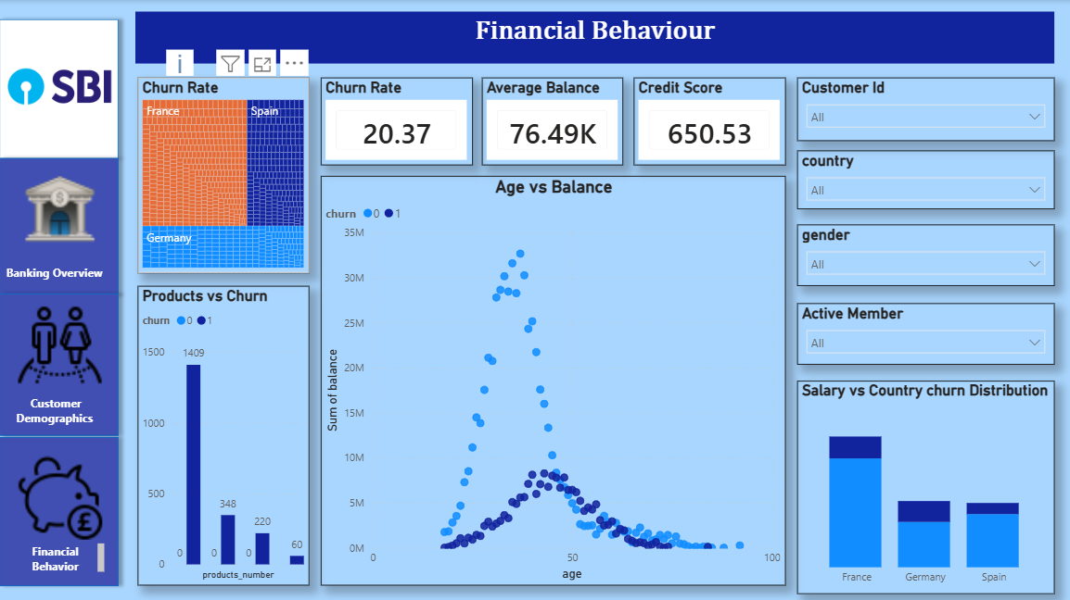
DASHBOARD SCREENSHOTS
Financial Behaviour

Slide 12
Key Metrics
Total Customers: 10K
Churn Rate: 20.37%
Average Balance: 76.49K
Average Credit Score: 650

Slide 13
Key Insights
Overall churn rate: 20.37% (≈1 in 5 customers leave the bank)
Germany shows the highest churn (~32%) among all regions.
Customers with only one product contribute to the majority of churn cases.
Customers aged 40–60 with higher balances demonstrate higher churn probability.
Estimated salary shows minimal correlation with churn.

Slide 14
Business Impact
Helps banks identify high-risk customers.
Supports targeted retention campaigns.
Improves customer lifetime value.
Enables data-driven decision making.

Slide 15
Business Recommendations
Improve retention strategies for high-balance customers.
Offer incentives for customers with only one product.
Focus retention campaigns in high-churn regions.

Slide 16
Conclusion
Customer churn patterns were successfully identified.
Key drivers of churn include product usage and region.
Interactive dashboard enables quick decision making.
Future Scope: Implement machine learning models for churn prediction.

