Slide 1
APPLIED DATA SCIENCE
Stock price prediction
Team Leader: Supriya . A(211521104163)
Team Members:
Priyadharshini . Y(211521104119)
Srinidhi . E(211521104157)
Getsy Jacinth .S(211521104043)
Saranya . C(211521104143)
TEAM: TG-06

Slide 2
Problem Definition
The problem is to build a predictive model that forecasts stock prices based on historical market data.
The goal is to create a tool that assists investors in making well-informed decisions and optimizing their investment strategies.
This project involves data collection, data preprocessing, feature engineering, model selection, training, and evaluation.

Slide 3
Design Thinking
Data Collection: Collect historical stock market data, including features like date, open price, close price, volume, and other relevant indicators.
Data Preprocessing: Clean and preprocess the data, handle missing values, and convert categorical features into numerical representations.
Feature Engineering: Create additional features that could enhance the predictive power of the model, such as moving averages, technical indicators, and lagged variables.
Model Selection: Choose suitable algorithms for time series forecasting (e.g., ARIMA, LSTM) to predict stock prices.
Model Training: Train the selected model using the preprocessed data.
Evaluation: Evaluate the model's performance using appropriate time series forecasting metrics (e.g., Mean Absolute Error, Root Mean Squared Error).

Slide 4
Project Objective:
Stock analysis involves comparing a company's current financial statement to its financial statements in previous years to give an investor a sense of whether the company is growing, stable, or deteriorating
Tools and Technologies:
The project employs various tools and technologies, including:
Python programming language
Libraries such as NumPy, Matplotlib, SciPy, scikit-learn, TensorFlow, Keras, and Streamlit
SVR, Random Forest, KNN, LSTM, and GRU models for stock price prediction

Slide 5
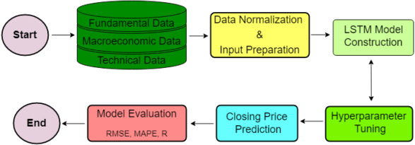
Design thinking Process:

Slide 6
STEP 1: Data Collection
The dataset used for Stock price prediction can vary widely, and there
are several publicly available datasets that researchers and developers have used
for training and evaluating Stock price for large companies. These datasets are
essential for building and testing machine learning models that can predict the future stock price of the company.
The current dataset is obtained from Kaggle. Kaggle is a popular platform for
data science competitions, and it hosts several fake news datasets. One well-
known dataset from Kaggle is the “Microsoft Lifetime stocks Datset" dataset, which contain Stock history of the company from 1986 to till date.
Dataset Link: https://www.kaggle.com/datasets/prasoonkottarathil/microsoft-lifetime-stocks-dataset

Slide 7
STEP 2: Data Preprocessing
Data preprocessing is a crucial step in building a stock price prediction model. The quality of your data and how it's prepared can significantly impact the accuracy and effectiveness of your predictions.
It involves steps like Data cleaning and data transformation.

Slide 8
Data Cleaning:
Check for missing data points and outliers in your dataset. Common techniques for dealing with missing data include imputation (replacing missing values with reasonable estimates) or removing incomplete rows. Outliers may be handled through statistical methods or domain knowledge.
Data Transformation:
Transform the data into a format suitable for analysis, typically as a time series. Ensure that the date/time column is the index of your dataset.
Calculate additional features, such as moving averages, relative strength index (RSI), and other technical indicators relevant to stock price prediction.

Slide 9
STEP 3:Feature Engineering
It involves creating and selecting relevant features (input variables) from the available data that can be used to train the model. Effective feature engineering can significantly improve the model's predictive performance.

Slide 10
Historical Price Data:
Close Price: The closing price of the stock on a given day.
Open Price: The opening price of the stock on a given day.
High and Low Prices: The highest and lowest prices of the stock during a trading day.
Time Series Features:
Lagged Returns: The returns of the stock in the previous days, which can capture trends and momentum.
Moving Averages: Simple moving averages (SMA) or exponential moving averages (EMA) to capture short-term and long-term trends.

Slide 11
After selecting and creating these features, it's important to preprocess the data, handle missing values, and potentially scale or normalize the features as needed before using them to train your stock price prediction model. Additionally, feature selection techniques (e.g., feature importance analysis or correlation analysis) can help identify the most relevant features and improve the model's efficiency and interpretability.

Slide 12
STEP 4:Model Selection
The LSTM model provides better results when the data set is large and has fewer Nan values.
Whereas, despite providing better accuracy than LSTM, the ARIMA model requires more time in terms of processing and works well when all the attributes of the data set provide legitimate values.

Slide 13
Different LSTM variants (e.g., Bidirectional LSTM, stacked LSTM).Attention mechanisms to focus on important time steps or features.
Incorporating other types of neural networks like CNNs for feature extraction.
Hybrid models that combine LSTMs with other architectures like Transformer models.
Reinforcement Learning for dynamic trading strategies.

Slide 14
LSTM is a type of recurrent neural network (RNN) that is well-suited for handling sequential data, making it a popular choice for time series forecasting tasks like stock price prediction
Some key points to note while selecting the LSTM model for a stock price prediction
Model Architecture:
Define the architecture of your LSTM model. You can experiment with various configurations, including the number of LSTM layers, the number of neurons in each layer, and the use of dropout or recurrent dropout layers to prevent overfitting.
You can also stack LSTM layers to create a deep LSTM network.

Slide 15
Activation Functions:
Consider using appropriate activation functions for LSTM units. Common choices are 'tanh' for the recurrent activation and 'sigmoid' for the input and output gates.
Loss Function and Optimization Algorithm:
For regression tasks like stock price prediction, use a loss function like Mean Squared Error (MSE) to measure the model's prediction error.
Choose an optimization algorithm, such as Adam, RMSprop, or stochastic gradient descent (SGD), and experiment with different learning rates.

Slide 16
STEP 5:Model Training
Model Training:
Train the model using the training data. Use the fit() method, specifying the training data, target values, batch size, and the number of training epochs.
Python
Model Evaluation:
After training, evaluate the model's performance on the testing dataset using the evaluate() method. This will give you metrics like Mean Squared Error (MSE) and Mean Absolute Error (MAE).
Python
Code:
model.fit(X_train, y_train, batch_size=32, epochs=100, verbose=1)
Prediction:
Use the trained model to make predictions on new or unseen data. You can use the predict() method.
python

Slide 17
Visualization:
Visualize the model's predictions against the actual stock prices to assess its performance. Matplotlib or other plotting libraries can be helpful.
Hyperparameter Tuning:
If the model's performance is not satisfactory, consider experimenting with different hyperparameters, such as the number of LSTM layers, units, learning rate, or batch size.
Regularization and Dropout:
To prevent overfitting, consider adding dropout layers or applying L1 or L2 regularization to the LSTM layers.
Ensemble Methods:
Experiment with ensemble techniques by combining predictions from multiple LSTM models or combining LSTM with other models.

Slide 18
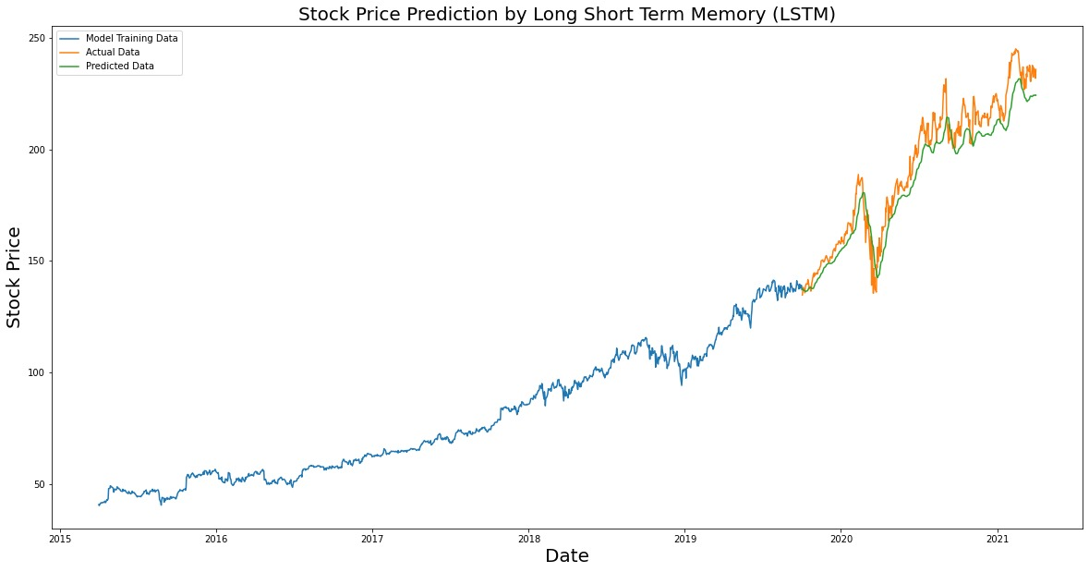
Expected Output:

Slide 19
STEP 6:Evaluation
In stock price prediction, the evaluation of a model's performance is crucial to assess its accuracy and effectiveness. Common evaluation metrics include:
Mean Squared Error (MSE): Measures the average squared difference between predicted and actual stock prices. Lower MSE indicates better accuracy.
Mean Absolute Error (MAE): Calculates the average absolute difference between predicted and actual prices. It provides a straightforward measure of prediction error.
Root Mean Squared Error (RMSE): RMSE is the square root of MSE, providing a measure in the same unit as the target variable. Lower RMSE suggests better predictive performance.

Slide 20
It's essential to choose evaluation metrics that align with your specific objectives and problem formulation, as well as to consider the limitations and assumptions of each metric. Additionally, backtesting and risk management strategies should be part of a comprehensive evaluation process when considering the practical application of stock price prediction models.

Slide 21
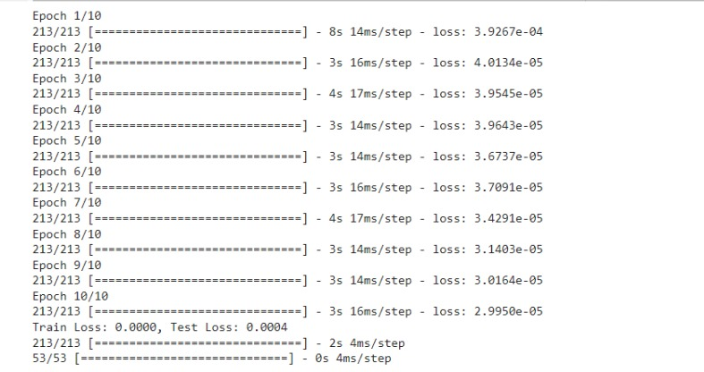
Expected Output:

Slide 22
