Slide 1
Tcp/Ip Protocal

Slide 2
Requirement Of Tcp/Ip Protocal
Scalability: There are millions of devices and networks in the internet. So to connect them efficiently scalability is used.
Reliable Communication: Data must be transferred accurately and without loss, especially in applications like web browsing, email, and file transfers.
Security: Secure communication is necessary to protect data from unauthorized access, tampering, or interception.

Slide 3
What Is Tcp/Ip Protocal?
The TCP/IP protocol is a set of rules that dictate how computers communicate over a network. It serves as the standard protocol for the internet. An interesting and important aspect of the TCP/IP protocol is that it combines two distinct layers of the OSI model: the Transport Layer (Layer 4) and the Network Layer (Layer 3).

Slide 4
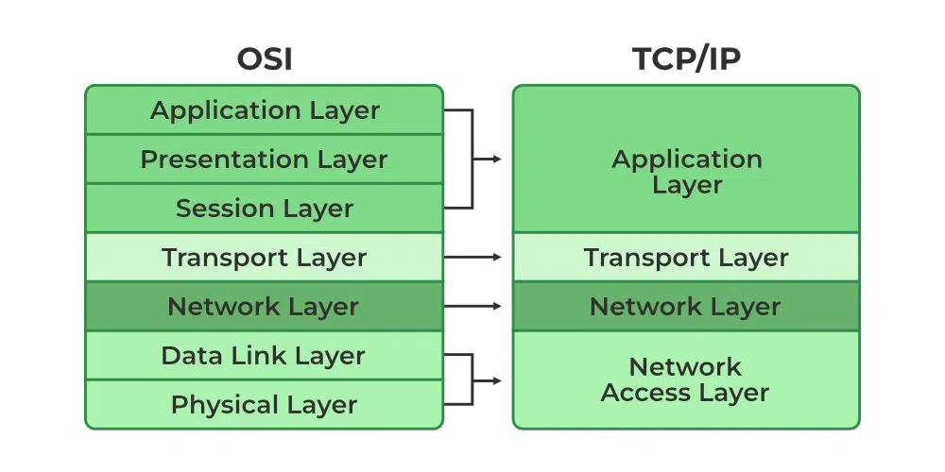
Theoretical Model
Practical Model

Slide 5
The two main protocols within TCP/IP are:
Transmission Control Protocol (TCP):
Purpose: TCP ensures reliable communication between devices by managing data packets.
How it works: TCP breaks down large data into smaller packets, sends them to the destination, and ensures the packets arrive correctly by:
Establishing a connection before data transmission (three-way handshake).
Ensuring packets are in the correct order.
Retransmitting lost packets.
Verifying that data is received correctly via checksums.
Key Features: Reliable, connection-oriented, guarantees delivery, error-checking.

Slide 6
2. Internet Protocol (IP):
Purpose: IP handles the addressing and routing of data packets.
How it works: IP provides logical addresses (IP addresses) for devices on the network, allowing packets to be routed from the source to the destination device across different networks.
Types of IP:
IPv4: The most common version (32-bit addresses, e.g., 192.168.1.1).
IPv6: Newer version (128-bit addresses, e.g., 2001:0db8::ff00:0042:8329) to address the limitations of IPv4 due to the growing number of devices connected to the internet.

Slide 7
3. Other Protocols in the TCP/IP Suite:
UDP (User Datagram Protocol): Provides a faster, connectionless alternative to TCP, but without the guarantee of reliability or delivery.
HTTP (Hypertext Transfer Protocol): Used for transferring web pages and web content.
FTP (File Transfer Protocol): Used for transferring files between computers.
SMTP (Simple Mail Transfer Protocol): Used for sending emails.
DNS (Domain Name System): Resolves human-readable domain names (like www.example.com) into IP addresses.

Slide 8
How TCP/IP Works:
Layered Approach: The TCP/IP model has four layers, each responsible for different aspects of communication:
Application Layer: Deals with application-level protocols like HTTP, FTP, SMTP.
Transport Layer: Ensures end-to-end communication and reliability, includes protocols like TCP and UDP.
Internet Layer: Responsible for routing and IP addressing, includes the IP protocol.
Network Access Layer: Handles the physical transmission of data on the network.

Slide 9
THANK YOU

