Slide 1

COVID-19 TRACKER APP
RNS INSTITUTE OF TECHNOLOGY
BENGALURU - 98
DEPARTMENT OF INFORMATION SCIENCE & ENGINEERING
Presentation on Internship
Supriya Alavala
USN: 1RN18IS110
ENMAZ Engineering Services Pvt. Ltd.
Internal Guide
Ms. Shwetha G N
Asst. Prof, Dept of ISE, RNSIT
External Guide
Mr. Akshay D R
Co-Founder & CEO of ENMAZ
Bengaluru, Karnataka, India

Slide 2
AGENDA
Abstract
About the Company
Introduction
Literature Survey
Requirements
System Design
Detailed Design
Implementation
Testing
Results
Conclusion
Future Enhancements
References
Q & A

Slide 3
ABSTRACT
In 2020, the WHO declared the outbreak of Coro-virus world wide as a pandemic. COVID-19 has become biggest impediment for the survival of the human race.
In a densely populated country like India, the attempt to contain the virus and ensure every citizen follows the guild lines and precautions was next to impossible.
As mobile and web technology is now an important component of human life, hence it is possible to use the power of these technologies against the treat of COVID-19.
Every nation is now trying to deploy an interactive platform for creating public awareness and share the important information related to COVID-19. It is also being extended to treat COVID-19 through online consultations.
As an attempt to deploy an interactive cross-platform (web/mobile) application COVID-19 TRACKER for the ease of the users. The application is featured with all the real-time attributes about the novel coronavirus disease and its measures and controls.
To achieve all these functionalities, flutter framework has been used. The API’s are being used to extract the real-time data.
The system purposely aims to maintain the digital protection of the society, create public awareness, and not create any agitation situation among the individuals of the society.

Slide 4
ABOUT THE COMPANY
Enmaz has a simple yet robust solution that helps any Industry / Factory digitise their work-floor in no time. The products offered will help in remote monitoring, controlling and also analysing any machinene parameter or process.
The company’s moto - Where Industrial IoT Solution development is made quick, easy, simple and robust.
At ENMAZ they provide end to end solution development services for Industrial IoT requirements.
ENMAZ is specialised in:
* Embedded H/W Development
* Embedded Firmware Development
* Cloud support
* Big Data Analysis and Reporting
* Dashboard UX/UI design and development
* Model Analysis

Slide 5
INTRODUCTION
In Wuhan city of China, due to some unknown causes a local outbreak of pneumonia was notice in December 2019. Originally, the disease got named serious acute respiratory syndrome coronavirus 2 (SARS-COV-2). Corona Virus Disease 19 (COVID-19) caused by the novel coronavirus is confirmed officially later by the World Health Organization (WHO) and they also declare COVID-19 as the Public Health Emergency of International Concern (PHEIC).
Keeping all of these complexity in mind we have used all the promising technologies to build the mobile application as well as a web application. The application is capable to provide real-time worldwide cases. The application also provides information on different preventive measures to be taken by users and symptoms of COVID-19.
In this pandemic situation, fake news prevention and distribute genuine information, i.e., information regarding public awareness, test centers, geo-tracking, etc. to everyone in every time with minimum expense, it is perhaps the biggest challenge to any administration all over the world. Mobile technology is the only one stop solution for everything above mentioned problem.

Slide 6
INTRODUCTION
Existing System:
In this pandemic condition, a couple of mobile applications are introduced by government institutions and others, which are providing valuable information to the people to aware of the pandemic situation, like the number of confirmed cases, number of recovered, number of deaths as of now, etc. APOLLO, one of the biggest medical giants in India, developed a risk assessment scanner for COVID-19 outbreak in INDIA and named it “covid. apollo247”.
The Government of India took the initiative and developed a mobile application named AarogyaSetu to connect essential health services with the people of INDIA.
Proposed System:
An application with a lot of information may be confusing for the user with less knowledge on how to use mobile/web. We propose a simple Covid-19 Tracker which provides most important functionalities. The application uses API to fetch the real-time number of active cases, number of recovered and deaths. It provides means to find any country of his choice and allow the user to set a default country for frequent updates.
The application provides users information on top COVID-19 symptoms and precautions to be taken to prevent from getting affected. It also tries to burst some myths related to COVID-19 and provides important information about the virus.

Slide 7
LITERATURE SURVEY
In paper [1], the problem of infodemia (an overload of information about a problem, usually false and unverified) created by declaring a COVID-19 pandemic is considered. A list of Web services has been formed that provide reliable pandemic data from relevant sources, and as such, in the fight against the COVID-19 infodemia can be used.
In paper [2], presents development of smart e-health system for Covid-19 pandemic. It is a smart Telemedicine system where patient can consult with doctors staying at home. Real-time online Doctor-Patient interaction and prescription are the main features.
In paper [3], the work was to build an android platform to layout mindfulness about the pandemic and furthermore to help the world population by providing them the useful information regarding the coronavirus. An android app which will be helpful in displaying all the data of Covid19 (such as number of total cases worldwide, number of active cases, covid19 hospitals around the covid19 victims, medical facilities near them and many more things).
In paper [4], nowadays Internet has become the most prominent source of information for searching the data in health sector for medical purpose fulfilments. However, in this present time this task is like a herculean task by lack of implementation of the proper skill framework and complexities that lies in Computer science and Engineering era.
In paper [5], flutter is a popular UI framework for developing mobile applications by Google. It has caught traction in recent years. However, Flutter developers have to deal with a state management issue when developing their applications. In order to solve this problem, multiple architectures have been developed. This paper proposes a new Flutter architecture based on the Clean Architecture by Uncle Bob.

Slide 8
REQUIREMENTS
HARDWARE REQUIREMENTS
Processor: INTEL CORE i3
Speed : 2.33 GHz
RAM : 4 GB (min)
SOFTWARE REQUIREMENTS
Operating system: Windows 7 and above versions
Flutter
Git
Android Studio / Code Editor
Chrome/ Firefox/ Internet Explorer / Android Emulator

Slide 9
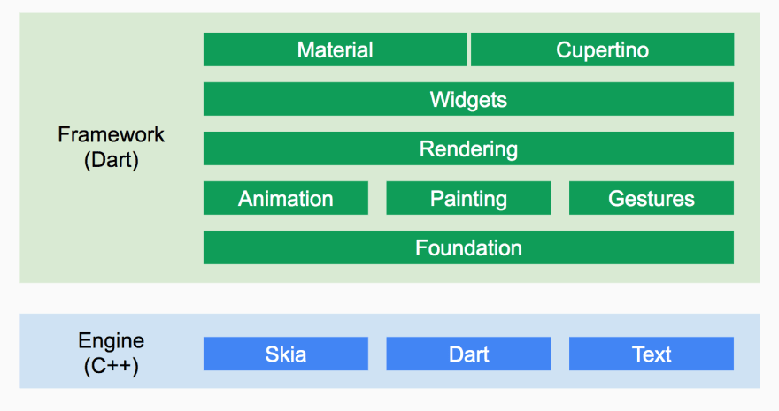
SYSTEM DESIGN
Flutter is organized around layers. Each layer is built upon the previous.
From the diagram we can see the low-level part of Flutter is an Engine built in C++. It provides low-level rendering support using Google’s Skia graphics library.
The high-level part of the diagram is the Framework written in Dart. It provides libraries to handle animation, gestures, rendering, widgets and more.
Everything is a widget
In Flutter, everything is a widget nested inside another widget. It comes with beautiful, customizable widgets and we can control the behavior of each widget and also styling becomes easy.
Flutter comes with a suite of powerful basic widgets, of which the following are commonly used- text, row, columns, stack, container, Appbar.
Material is an adaptable design system, backed by open-source code, that helps developers easily build high-quality, digital experiences.

Slide 10
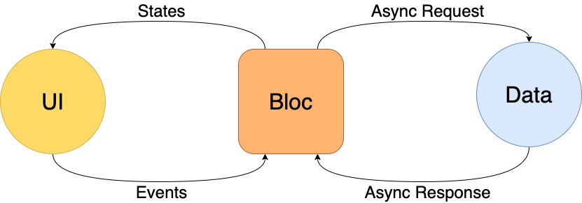
SYSTEM DESIGN
Flutter delivers the basic architecture that can be applied to application and manage its state easily. The architecture that is used in Flutter is called the Business Logic Component (BLOC). It is an event-state based approach that allows you to trigger events and handle state changes based on them. The BLOC is a good approach that separates your business logic from the user interface and oversees business logic key points by testing. The core ideas that were used for BLOC architecture are simplicity, scalability, and testability, and all these goals were definitely achieved within the BLOC architecture.

Slide 11
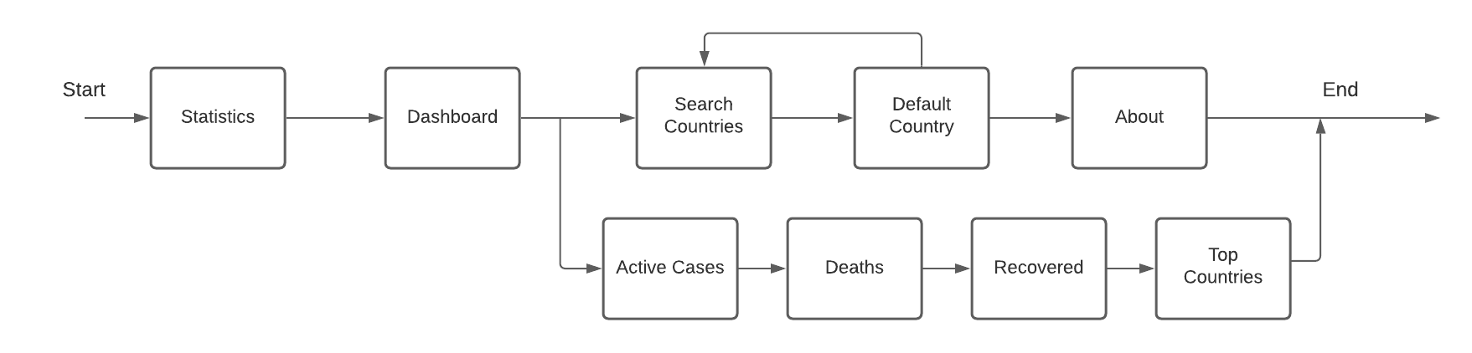
DETAILED DESIGN
The user is provided with many options to choose like View the Statistics, read about the Symptoms of COVID-19, read about Precautions to be taken, Myths regarding the virus and more information About the virus. The user can choose any of the options in any random way.
Statistics screen consists of many components. The user is provided with the information on global statistics of COVID-19 spread. The user can view the number of active cases, deaths and recovered cases of any country from the dashboard. The dashboard also contains top countries with highest number of active cases. The Search feature allows the user to search any country of his choice to view information. The user can choose a default country. When the default country is to be selected it navigates to search screen. About screen provides brief information on what the app does to the user.

Slide 12
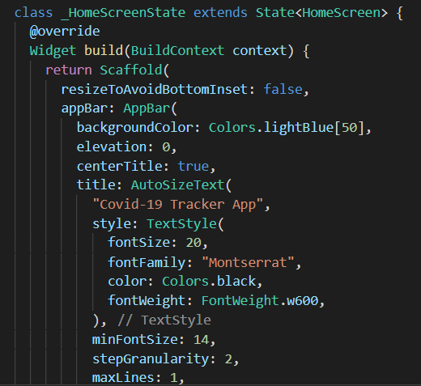
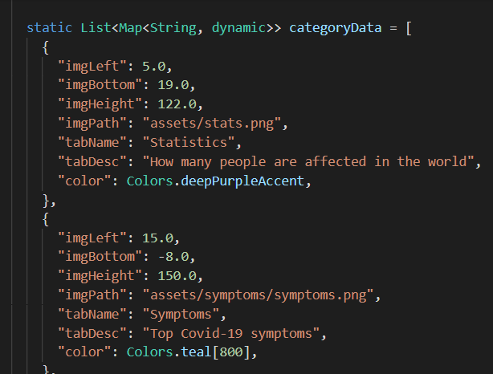
IMPLEMENTATION / CODING
The snippet is used to include basic design to the home page like AppBar, font, colors, and other necessary widgets.
The snippet is used to display different features that the app provides on the home screen. Statistics, Symptoms, Precautions, Virus, Myths.

Slide 13
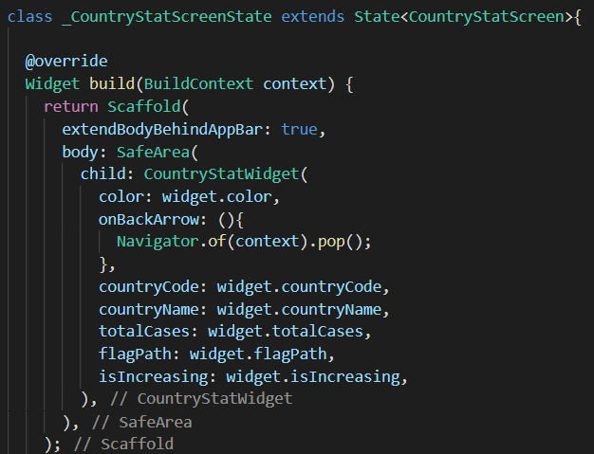
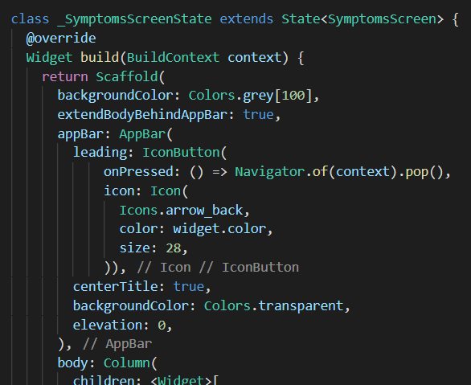
IMPLEMENTATION / CODING
The snippet is implemented to display different statistics of the country and uses mainly Scaffold.
The snippet is used to design the screen using AppBar and Column components to display the necessary information.

Slide 14
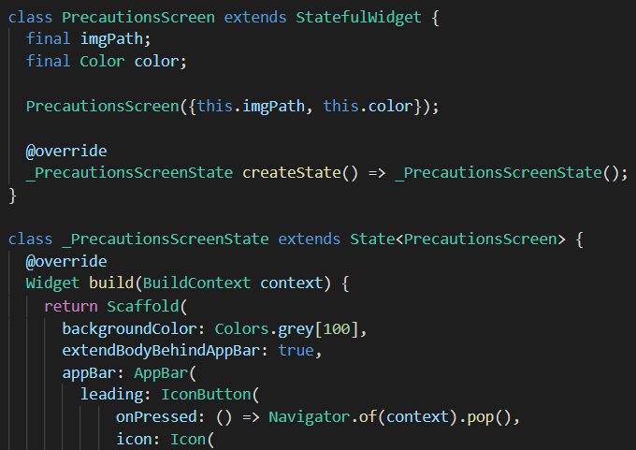
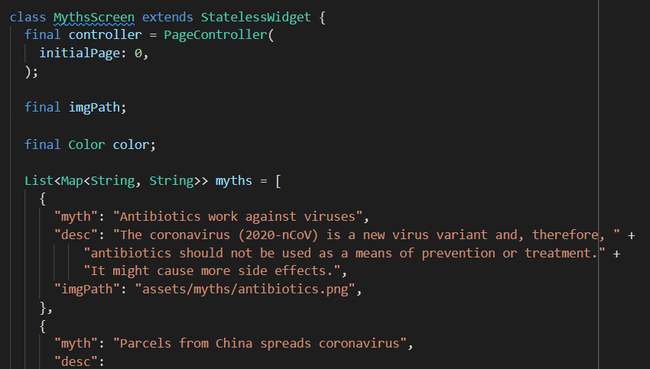
IMPLEMENTATION / CODING
The snippet initializes the first page using page controller and implements list to store the information that is to be displayed to the user.
The snippet to design the screen using AppBar and Column components to display the necessary information to prevent the spread of the virus.

Slide 15
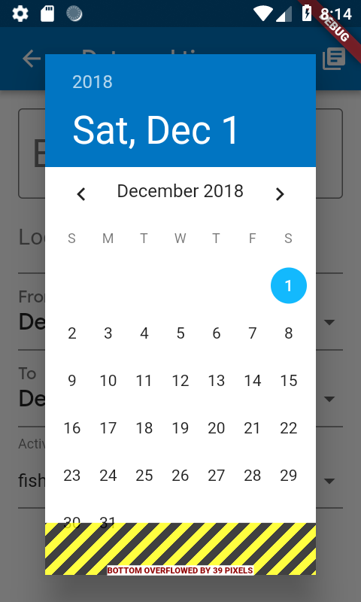
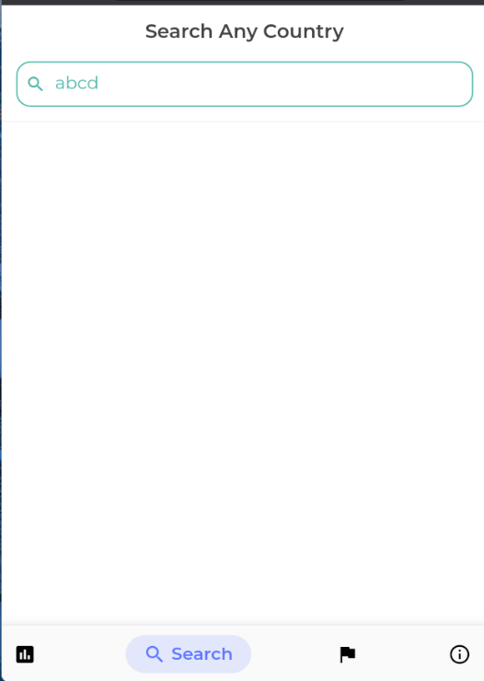
TESTING Testing is the process of evaluating and verifying that a software product or application does what it is supposed to do.
Render-Flex overflowed
Render-Flex overflow is one of the most frequently encountered Flutter framework errors. When it happens, you’ll see yellow & black stripes indicating the area of overflow in the app UI. The error often occurs when a Column or Row has a child widget that is not constrained in its size.
The screen displays the scenario when the user enters a non-existing country name. As we expect, no country is displayed until the correct input is provided.

Slide 16
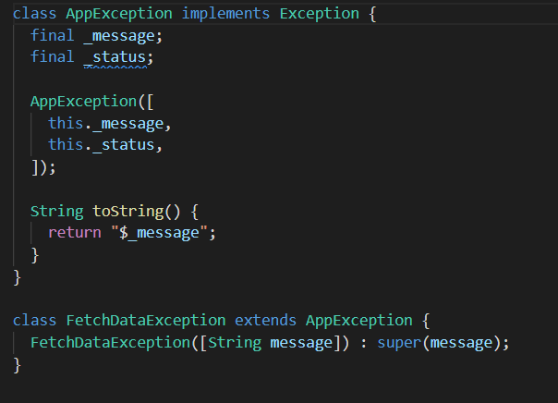
TESTING
Here are some common response codes:
400 Bad Request – client sent an invalid request, such as lacking required request body or parameter
401 Unauthorized – client failed to authenticate with the server
403 Forbidden – client authenticated but does not have permission to access the requested resource
404 Not Found – the requested resource does not exist
412 Precondition Failed – one or more conditions in the request header fields evaluated to false
500 Internal Server Error – a generic error occurred on the server
503 Service Unavailable – the requested service is not available
The snippet shows how the exceptions that are thrown is handled.

Slide 17
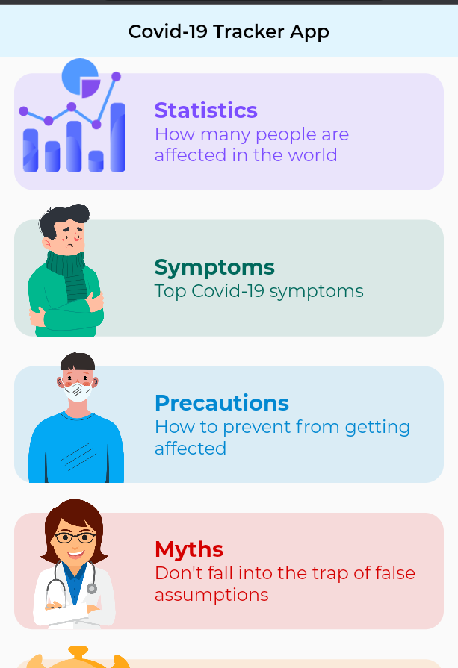
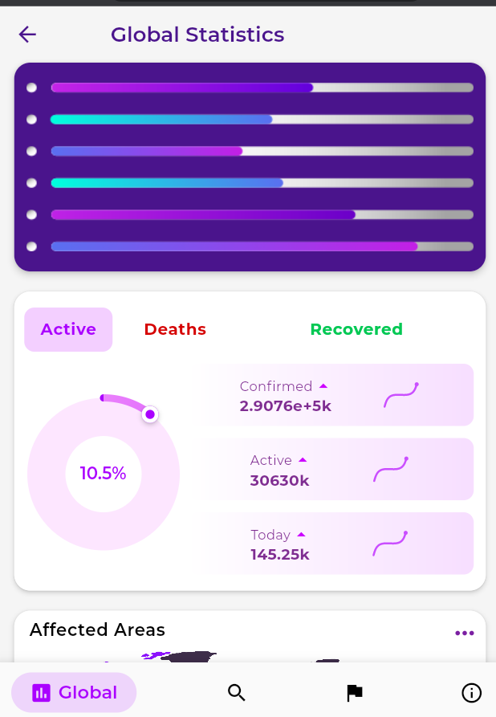
RESULTS
The above screen represent the front screen containing the statistics, symptoms, precautions, Myths and Virus options.
The above screens represent the option statistics, where we can view the active and deaths statistics of the cases.

Slide 18
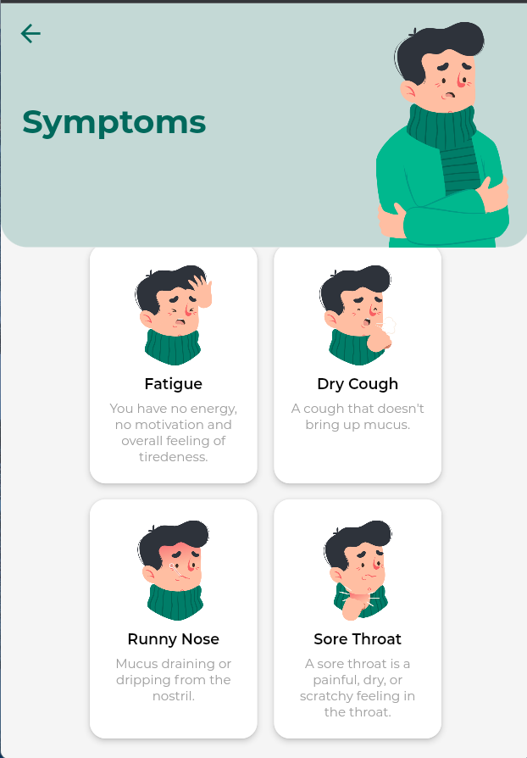
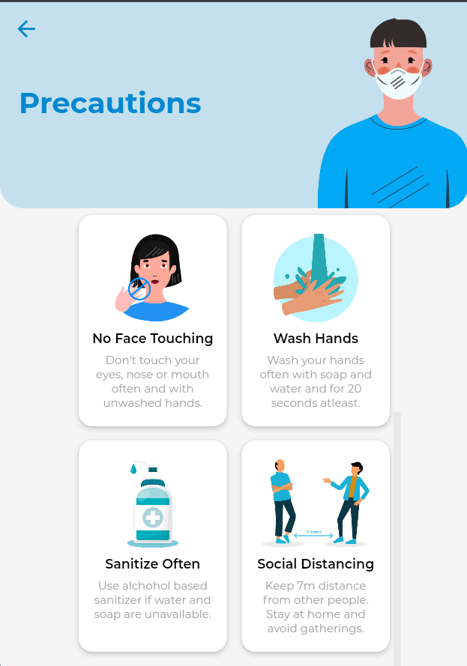
RESULTS
The above screens represent the symptoms option - details of symptoms of covid which will help the user analyse himself.
The above screens represent the Precautions options - the various precautions that need to be taken care to avoid getting effected by covid.

Slide 19
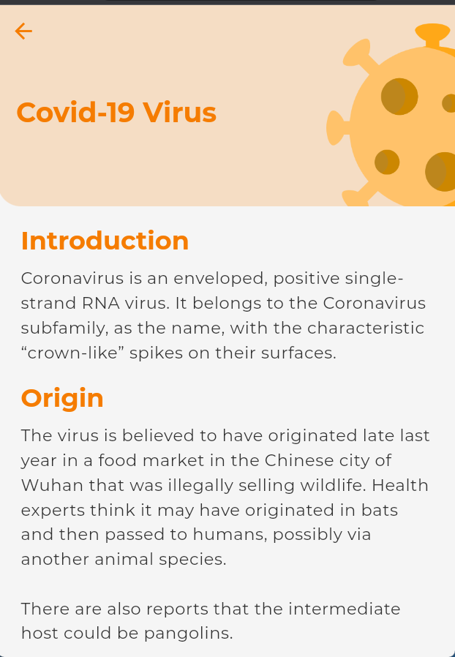
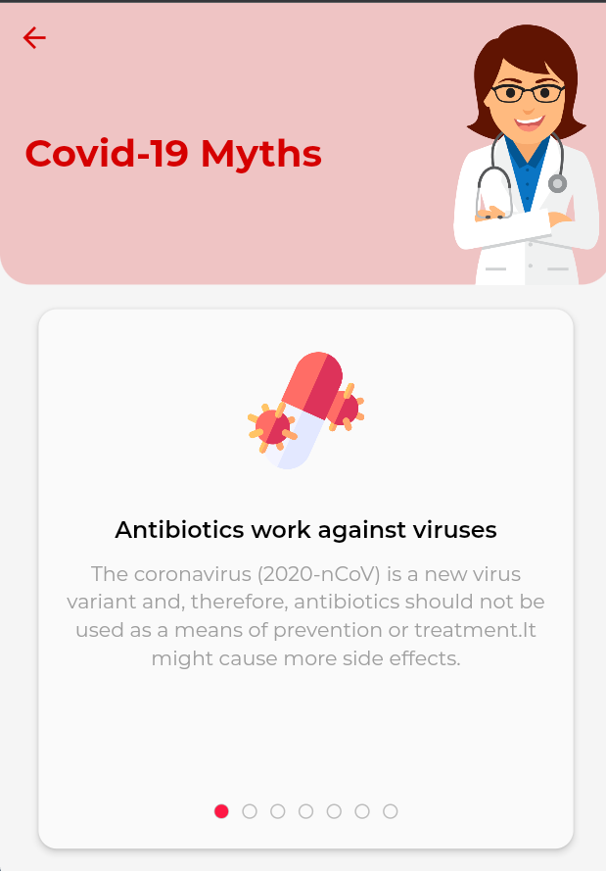
RESULTS
The above screen represent the Virus Information option- which displays the information about the virus for the awareness of the public.
The above screen represent the Myths - which mentions the various misconceptions that exist about the virus which is required to be cleared for the betterment of the public.

Slide 20
CONCLUSIONS
Covid-19 will stay with us for a long time and we as responsible citizens should be aware about the related information for the new way of survival.
The app provides efficient means to find information related to COVID-19 by displaying the basic statistics of the cases and other necessary details to the user and is beginner friendly.
It successfully provides the digital protection of the society, creates public awareness, and helps users to be up to date with essential details.

Slide 21
FUTURE ENHANCMENTS
The app can be extended to:
Make the app more accurate.
Provide geo-locations.
Provide information on nearby containment zones.
Make it contact covid-19 centers.
Allow the users to book vaccination slots.
Take basic self-assessment tests by users.
Provide the near by online consultation Information.

Slide 22
REFERENCES
https://fluttertutorial.in/
https://www.geeksforgeeks.org/flutter-material-design/
https://docs.flutter.dev/reference/tutorials
REFERENCE PAPERS:
Velickovic, Z. S., Velickovic, M. Z., & Milivojevic, Z. N. (2021). Application of a Reliable Web API’s in the Fight Against COVID-19 Infodemia. 2021 25th International Conference on Information Technology (IT).
Mohammad Monirujjaman Khan, Rezaul Karim(2020). Development of Smart e-Health System for Covid-19 Pandemic. 2020 23rd International Conference on Computer and Information Technology (ICCIT).
Keshav Kulsresth; Shivam Shasheesh; Chandan Mishra; K P Arjun. Covid 19 Tracker Using REST API Android App. 2021 Fourth International Conference on Computational Intelligence and Communication Technologies (CCICT).
Sukanya Chatterjee School of Computer Science and Engineering Lovely Professional University, Punjab, India; Mir Mohammad Yousuf; Manan Rasool; Ankit Chaurasiya; Mohammad Faisal; Vivek Pandey. Covid-19 Outbreak Cases and Healthcare Database. 2021 2nd International Conference on Intelligent Engineering and Management (ICIEM).
Shady Boukhary; Eduardo Colmenares. A Clean Approach to Flutter Development through the Flutter Clean Architecture Package. 2019 International Conference on Computational Science and Computational Intelligence (CSCI).

Slide 23
QUESTION AND ANSWER

Slide 24
THANK YOU

