Slide 1
A Final Year Project Presentation On Image Steganography
Team Members:
Aakash Shrestha
Sandhya Khadka
Simran Dhoju
Supriya Amatya
Project Supervisor:
Mr. Bhupendra Luhar

Slide 2
Outlines
Introduction
Problem Statement
Objectives
Scope and Limitations
Literature Review
Functional Requirements
- Use-Case Diagram
Process Model
- Data Flow Diagram
System Design
LSB Replacement Algorithm
Software Tools Used
Testing
Conclusion
References

Slide 3
Introduction To Image Steganography
Due to advances in ICT, most information is kept electronically.
Consequently, the security of information has become a fundamental issue.
Steganography : a technique of hiding information in digital media,in such a way that it is insensible to human eyes.
Cryptography: process of converting ordinary plain text into unintelligible text and vice-versa.
Together cryptography and steganography can provide a powerful basis for data security by providing double layered security.

Slide 4
Problem Statement
No matter how large or small a company is, there is a need to have a plan to ensure the security of your information assets.
Throughout history Steganography has been used to secretly communicate information between people.
In the past, means of steganography were carried out using traditional methods of pen and paper, using invisible ink, shaving of head, etc.
Because of growing digitization in every field, the need for security using digital methods is increasing.

Slide 5
Objectives
To produce security tool based on steganography and cryptography techniques combined.
To avoid drawing suspicion to the existence of a hidden message.

Slide 6
Scope
The scope of this project is to limit unauthorized access and provide better security during message transmission.
To meet the requirements, simple and basic- LSB approach of steganography has been used.
In this project, the proposed approach will be able to embed data(message) in an image using steganography for sending over the network.
The system will also provide the feature for extracting the hidden data from the corresponding stego image file.

Slide 7
Limitations
While this project will provide a way to hide text data into a cover image file, it will be limited only to data of the mentioned types i.e., text data onto image data.

Slide 8
Literature Review
The word steganography is derived from the Greek words stegos meaning cover and grafia meaning writing[1].
For more secure data transfer, cryptography is used along with steganography. The grouping of these two approaches enhances the security of data.
The Least Significant Bit (LSB) Replacement Algorithm is a commonly used straightforward steganographic algorithm used to embed secret information inside a cover medium.
In the LSB method, the least significant bits of the original data in the cover medium are altered based on the secret message.
In the case of digital images, the alteration is done only at the least significant bits of the original image, so that the perceptibility of the original image is not much affected [2].
This system implements the image steganography technique of LSB replacement algorithm along with AES encryption for cryptography.

Slide 9
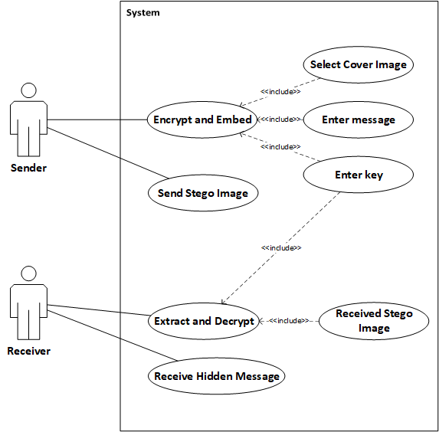
Use-Case Diagram:
Notes:
Here, sender and receiver are the primary actor who provide required information and data to the system and receive the required output.
Sender’s inputs include cover image file, text message to be hidden and a secret key for message encryption.
After receiving all valid inputs, the system generates a stego-image which consist of the text message embedded inside it.
The sender can then either email the stego-image to the receiver or save the stego image to transfer it over a different media.
On receiver’s side, the inputs include the received stego image and associated secret key.
The system processes the provided inputs and generate the hidden message in text form.
If needed, the receiver can save the generated message as text file.
Our application also includes the client/server model, where both server and client can act as sender or receiver. Along with text messages, they can also send stego-images to one another and save or extract messages upon receiving them.

Slide 10
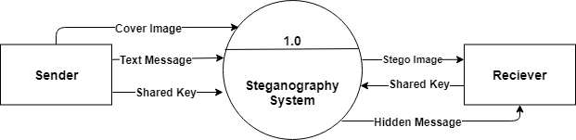
Level-0 DFD:
Notes:
takes the input as cover image (original image) and a secret text message from the sender.
also uses a secret shared key for encryption.
With these inputs provided by the sender, the application generates a stego image which is sent to the receiver.
The system then takes the associated key from the receiver and displays the hidden message to the receiver.

Slide 11
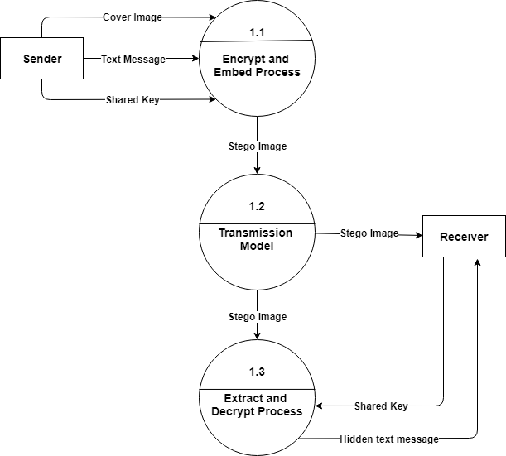
Level – 1 DFD:
Notes:
main task preformed in this level is that the text message is encrypted using AES encryption,
and that encrypted message is embedded to the image by replacing least significant bits of the image using LSB technique.
Then the generated stego image is sent to receiver through a data transmission channel.
This system then takes the stego image and shared key from the receiver
First it extracts the cipher text message (encrypted hidden message) from the image and with the provided key it decrypts the cipher message and displays the original hidden message to the receiver.

Slide 12
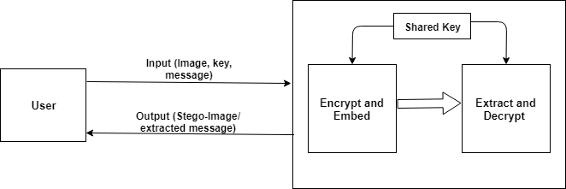
System Architecture:
Notes:
system is divided into two parts: normal mode and client/server mode.
starting the program normally, the user needs to provided necessary input to get necessary output which is either stego-image (when embedding a cover image) or extracted message (when extracting a stego-image for hidden message).
When starting the program in client/server model, firstly a TCP server socket needs to be started.
user provides port number to be associated to the server. When a client connects to the server socket on particular port, the client-server connection starts.
Then the client and server can communicate with each other through associated port and IP as the communication medium.
For communicating sensitive information, stego-image can also be used.
sender side can generate a stego-image containing a hidden message and a key shared by both ends. Then the receiver can use the shared key to extract the hidden message from the received stego-image.

Slide 13
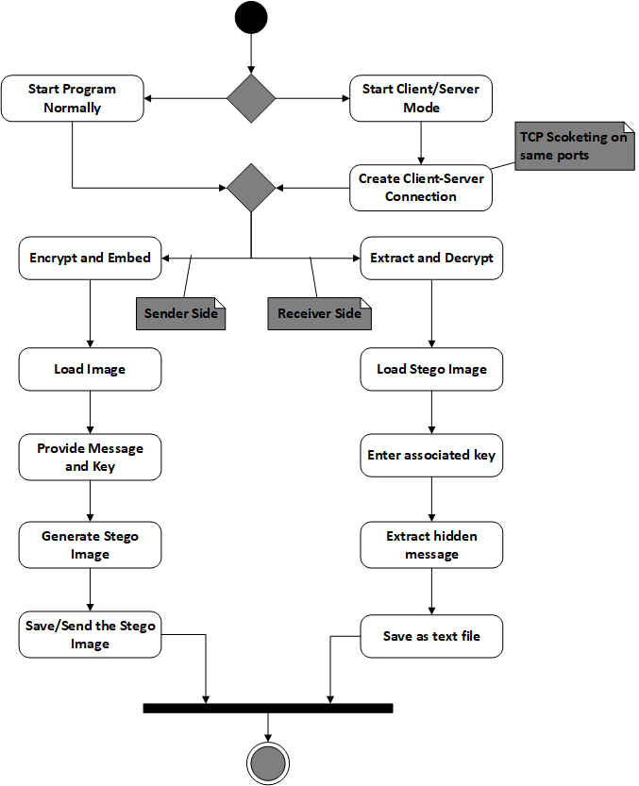
Activity Diagram:
Notes:
program can either be started in regular mode or client server mode. Either of the modes will support image steganography procedures.
In client server mode, firstly a TCP server socket needs to be started. The user provides port number to be associated to the server.
When a client connects to the server socket on particular port, the client-server connection starts. Then the client and server can communicate with each other
The ‘encrypt and embed’ option takes a cover image, secret key and the message to be hidden as input. Then provides a stego-image as output
the ‘extract and decrypt’ option takes the generated stego image and associated key the extracts the hidden message. Then message can be saved as a file.

Slide 14
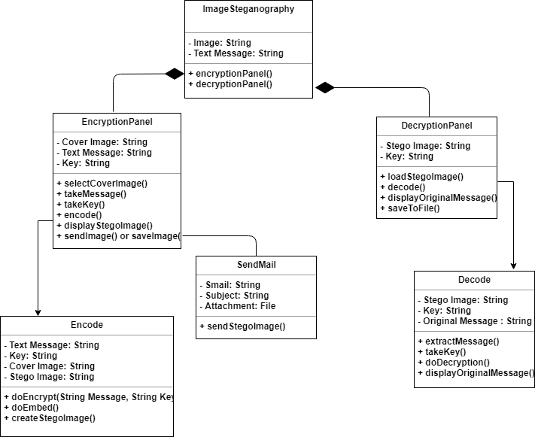
Class Diagram:
Notes:
Different classes’ instances are created and used whenever necessary. Some major classes involved in the system process are:
ImageSteganography: main class of the system which is accessed first when starting the system. Then, preferred mode of the program can be chosen.
EncryptionPanel: This class contains the panel for encrypting and embedding the cover image file. It takes cover image file, secret message and shared key as inputs, then calls necessary functions from different classes to reach the goal.
Encode: contains the necessary functions for encrypting the given input string and embedding the encrypted string onto provided cover image. It can be accessed from the EncryptionPanel class, which may create and use instance of this class whenever stego-image is to be created.
SendMail: This class is responsible for sending the stego-image given by the Encode class, via email. It contains the frame consisting of the user interface.
DecryptionPanel: This is the class that contains the panel for extracting and decrypting the hidden message from the stego image file. It takes the stego image file and shared secret key as inputs, then calls necessary functions from different classes to reach the goal.
Decode: This class contains the necessary functions for extracting the encrypted text from the stego image as well as decrypting the encrypted text to receive the original message. It can be accessed from the DecryptionPanel class, which may create and use instance of this class whenever hidden message is to be extracted.

Slide 15
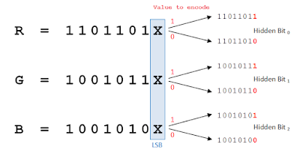
Least Significant Bit(LSB) Replacement Algorithm
A method for embedding data into cover image.
It is a simple approach in which message bits are embedded in the least significant bits of cover image [3].
The least significant bit of each pixel of an image is altered to a bit of a message that is to be hidden [4].
Figure : LSB replacement
Notes:
technique in which we hide messages inside an image by replacing Least significant bit of image with the bits of message to be hidden.
By modifying only the first most right bit of an image we can insert our secret message and it also make the picture unnoticeable, but if our message is too large it will start modifying the second right most bit and so on and an attacker can notice the changes in picture.
1 pixel(RGB) – 3 bytes (R-1byte, G-1,B-1) – 24 bits

Slide 16
Message Embedding Algorithm:
Read the cover image and secret text information which is to be embedded into the image.
Convert the secret information into encrypted text by using AES algorithm and secret key shared by receiver and sender.
Add the value of encrypted text’s length at the beginning of the text along with a ‘/’ character.
Convert encrypted text message into binary form – which will give the text message’s characters’ bits.
Find LSBs of each RGB pixels of the cover image.
Embed the bits obtained on step IV into LSBs of RGB pixels of step V.
Continue the procedure until the secret information is fully hidden in cover image file.

Slide 17
Message Extraction Algorithm
Read the stego image and secret key.
Retrieve LSBs of each RGB pixels of the stego image.
Convert binary strings formed by every 8 RGB pixels of step II to character and append the characters to a string builder.
Upon finding the first ‘/’ character from string builder of step III, save its previous characters as text length and delete all characters till that index.
Continue the process for more (text length obtained on step 4 * 8) times to fully extract the hidden encrypted text.
Using the secret key and AES decryption, decrypt secret information obtained on step IV to get original information.

Slide 18
Software Tools Used
IDE: NetBeans 8.0.2.
Programming Language: Java programming language.
Swing- GUI widget toolkit for java: Used for creating GUI.
Java AWT packages: For event handling and working with files and images.
Java Mail jar file: Used to send stego image via Email.
Java AES encryption/decryption API: Used to generate cipher text.
Additionally, various java packages and libraries were also used.

Slide 19
Unit Testing
Message encryption and embedding module:
Test Cases | Input | Expected Output | Output | Remarks
String encryption | Message string, key string | Encrypted string | Encrypted string | Encrypted successfully
Image’s LSB replacement | Image, any string | Image with changed LSBs | Image with changed LSBs | String embedded to image successfully

Slide 20
Unit Testing
Emailing process module:
Test Cases | Input | Expected Output | Output | Remarks
Email Send | An image file, email attributes | Image file sent | Authentication error | Error because of gmail’s security issue
Email Send | An image file, correct email attributes | Image file sent | Image file sent | Image sent successfully via email

Slide 21
Unit Testing
Message extraction and decryption module:
Test Cases | Input | Expected Output | Output | Remarks
String Extraction from Image | Random image file | Encrypted string | Input error | Image not a valid stego file
String Extraction from Image | Stego image file | Encrypted string | Encrypted string | Encrypted string extracted successfully
Decryption of encrypted string | Encrypted string, associated key string | Decrypted string | Decrypted string | String decrypted successfully

Slide 22
Integration Testing
Integration testing for encryption and embedding module
Test Cases | Input | Expected Output | Output | Remarks
Encryption and LSB replacement process integration | Message String, Key String, image file | Stego image file | Stego image file | Message successfully hidden in image

Slide 23
Integration Testing
Integration testing for message extraction and decryption module
Test Cases | Input | Expected Output | Output | Remarks
Message Extraction and Decryption integration | Random image, key string | Hidden message in decrypted form | Input error | Invalid image or key
Message Extraction and Decryption integration | Stego image, associated key | Hidden message in decrypted form | Hidden message in decrypted form | Hidden message extracted successfully

Slide 24
System Testing
A cover image file, a key and a message to be hidden were provided as inputs to the system and stego image was successfully generated.
Sending the generated stego image file over email was also successfully tested.
Stego image was tested for message extraction by choosing the extract and decrypt option in the program.
The program was able to extract the hidden message from the stego image in decrypted form.

Slide 25
Conclusion
The final product is a system that can take a cover image file, hidden message and a secret key as input and provide a stego-image.
The system can also extract the secret message hidden in the stego-image when provided with stego image and the associated key.

Slide 26
References
[1] A. Soni, J. Jain and R. Roshan, "Image steganography using discrete fractional Fourier transform," Intelligent Systems and Signal Processing (ISSP), 2013.
[2] S. Sugathan, "An Improved LSB Embedding Technique for Image Steganography," in 2nd International Conference on Applied and Theoretical Computing and Communication Technology (iCATccT), 2016.
[3] M. R. Garg, "Comparison Of Lsb & Msb Based Steganography In Gray-Scale Images," International Journal of Engineering Research and Technology (IJERT), vol. 1, no. 8, 2012.
[4] P. J. N. Dr. Ekta Walia, "“An Analysis of LSB & DCT based Steganography," Global Journal of Computer Science and Technology, vol. 10, no. 1, 2010.

Slide 27
Demo

Slide 28
Thank You!!

