Slide 2
Introduction To Image Steganography
Due to advances in ICT, most information is kept electronically.
Consequently, the security of information has become a fundamental issue.
Steganography is a technique of hiding information in digital media in such a way that it is insensible to human eyes.
Cryptography is a technique associated with the process of converting ordinary plain text into unintelligible text and vice-versa.
Together cryptography and steganography can provide a powerful basis for data security by providing double layered security.

Slide 3
Problem Statement
No matter how large or small a company is, there is a need to have a plan to ensure the security of your information assets.
Throughout history Steganography has been used to secretly communicate information between people.
In the past, means of steganography were carried out using traditional methods of pen and paper, using invisible ink, shaving of head, etc.
Because of growing digitization in every field, the need for security using digital methods is increasing.

Slide 4
Objectives
To produce security tool based on steganography and cryptography techniques combined.
To avoid drawing suspicion to the existence of a hidden message.

Slide 5
Scope
The scope of this project is to limit unauthorized access and provide better security during message transmission.
To meet the requirements, simple and basic- LSB approach of steganography has been used.
In this project, the proposed approach will be able to embed data(message) in an image using steganography for sending over the network.
The system will also provide the feature for extracting the hidden data from the corresponding stego image file.

Slide 6
Limitations
Steganography techniques can be used to hide data such as text, image, audio, video etc. within a cover image, video etc.
While our project will provide a way to hide text data into a cover image file, it will be limited only to data of the mentioned types i.e., text data onto image data.

Slide 7
Use-Case Diagram:

Slide 8
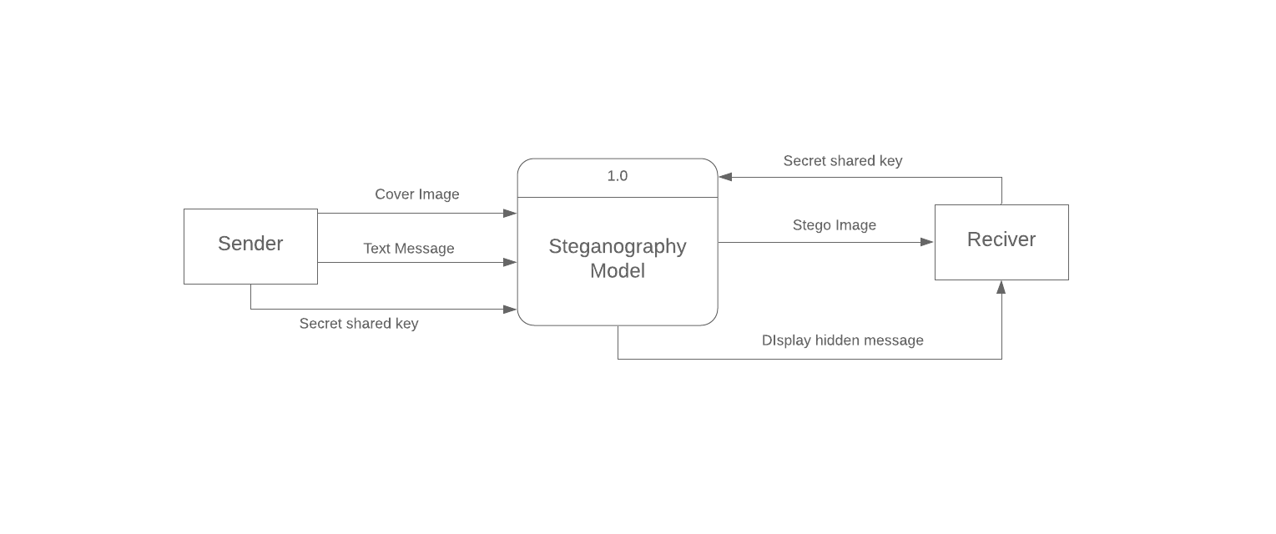
Level-0 DFD:

Slide 9
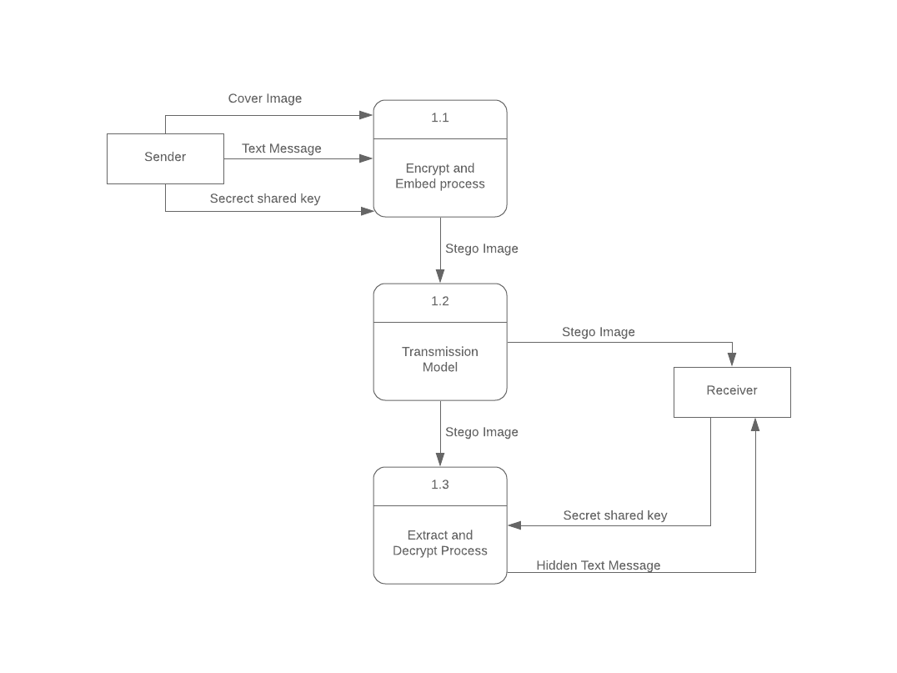
Level – 1 DFD:

Slide 10
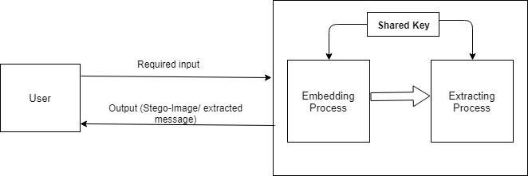
System Architecture:

Slide 11
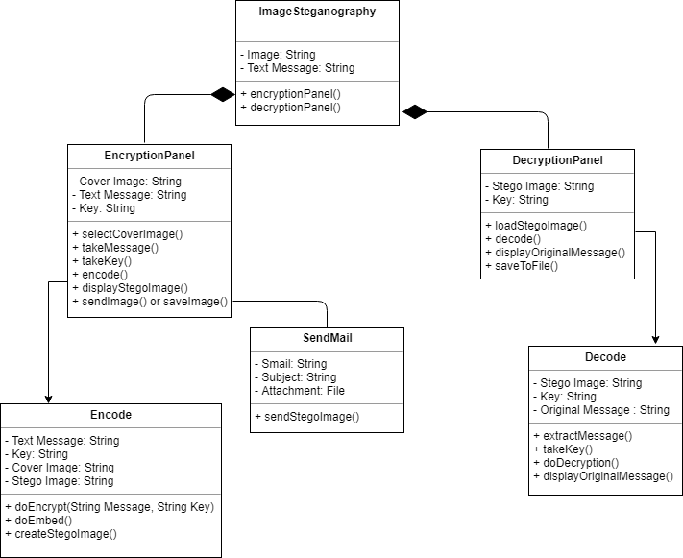
Class Diagram:

Slide 12
Activity Diagram:

Slide 13
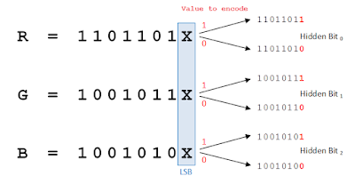
Least Significant Bit(LSB) Replacement Algorithm
A method for embedding data into cover image.
It is a simple approach in which message bits are embedded in the least significant bits of cover image.
The least significant bit of each pixel of an image is altered to a bit of a message that is to be hidden.
Figure : LSB replacement

Slide 14
Message Embedding Procedure:
Read the cover image and secret text information which is to be embedded into the image.
Convert the secret information into encrypted text by using AES algorithm and secret key shared by receiver and sender.
Add the value of encrypted text’s length at the beginning of the text along with a ‘/’ character.
Convert encrypted text message into binary form – which will give the text message’s characters’ bits.
Find LSBs of each RGB pixels of the cover image.
Embed the bits obtained on step 4 into LSBs of RGB pixels of step 4.
Continue the procedure until the secret information is fully hidden in cover image file.

Slide 15
Message Extraction Algorithm
Read the stego image and secret key.
Retrieve LSBs of each RGB pixels of the stego image.
Convert binary strings formed by every 8 RGB pixels of step 2 to character and append the characters to a string builder.
Upon finding the first ‘/’ character from string builder of step 3, save its previous characters as text length and discard all characters till that index.
Continue the process for more (text length obtained at step 4 * 8) times to fully extract the hidden encrypted text.
Using the secret key and AES decryption, decrypt secret information obtained on step 4 to get original information.

Slide 16
Software Tools Used
IDE: NetBeans 8.0.2.
Programming Language: Java programming language.
Swing- GUI widget toolkit for java: Used for creating GUI.
Java AWT packages: For event handling and working with files and images.
Java Mail bean: Used to send stego image via Email.
Java AES encryption/decryption API: Used to generate cipher text.
Additionally, various java packages and libraries were also used.

Slide 17
Conclusion
The final product is a system that can take a cover image file, hidden message and a secret key as input and provide a stego-image.
The system can also extract the secret message hidden in the stego-image when provided with stego image and the associated key.
The embedding process follows image’s LSB replacement algorithm. Message is hidden in the least significant bits of the image.
To extract the hidden message from the stego image, LSBs are extracted then shown as string.

Slide 18
Thank You!!

