Slide 1
Online BOOK Reading Website
PROJECT TITLE
BrightReads

Slide 2
OVERVIEW
BrightReads is an Online Book Reading Website that enables the readers to have access to the novels at their fingertips and easily read online.
This website offers numerous novels divided into various genres for readers to choose among them based on their preference.

Slide 3
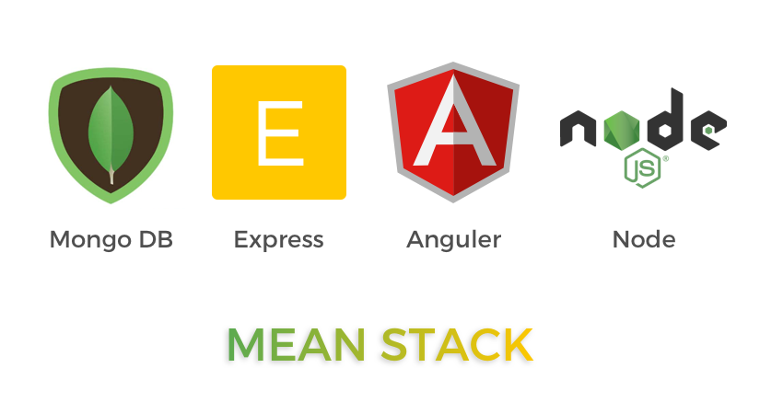
TECHNOLOGY STACK
(v5.0.5) (^4.17.2) (13.1.4) (v14.17.6)

Slide 4
ROLES AND FEATURES
Visitor
Authenticated Reader
ADMIN-Authorised user
Can create an account using Signup option.
Can view the list of books available and their details in the website.
Can surf through the books based on various genres and based on search.
Can login to their account using Login option.
Can view the list of books available
Can read and review all the books in the website.
Can surf through the books based on various genres and search filter.
Can add a book of their choice to their library.
Can update the status of their reading activity of the books that belong to their library.
Can login to their account using Login option.
Can create,update,delete the books in the website.
Can create and delete the various genres of books.

Slide 5
Architecture diagram

Slide 6
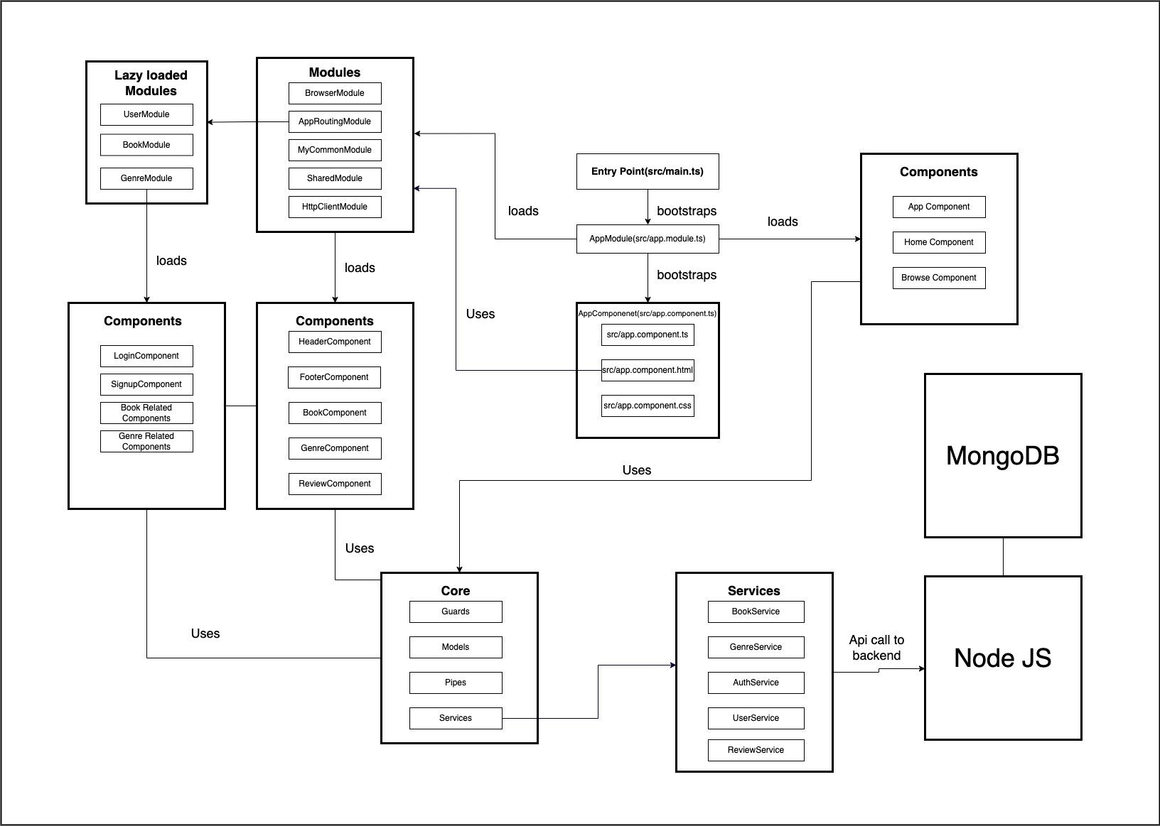

Slide 7
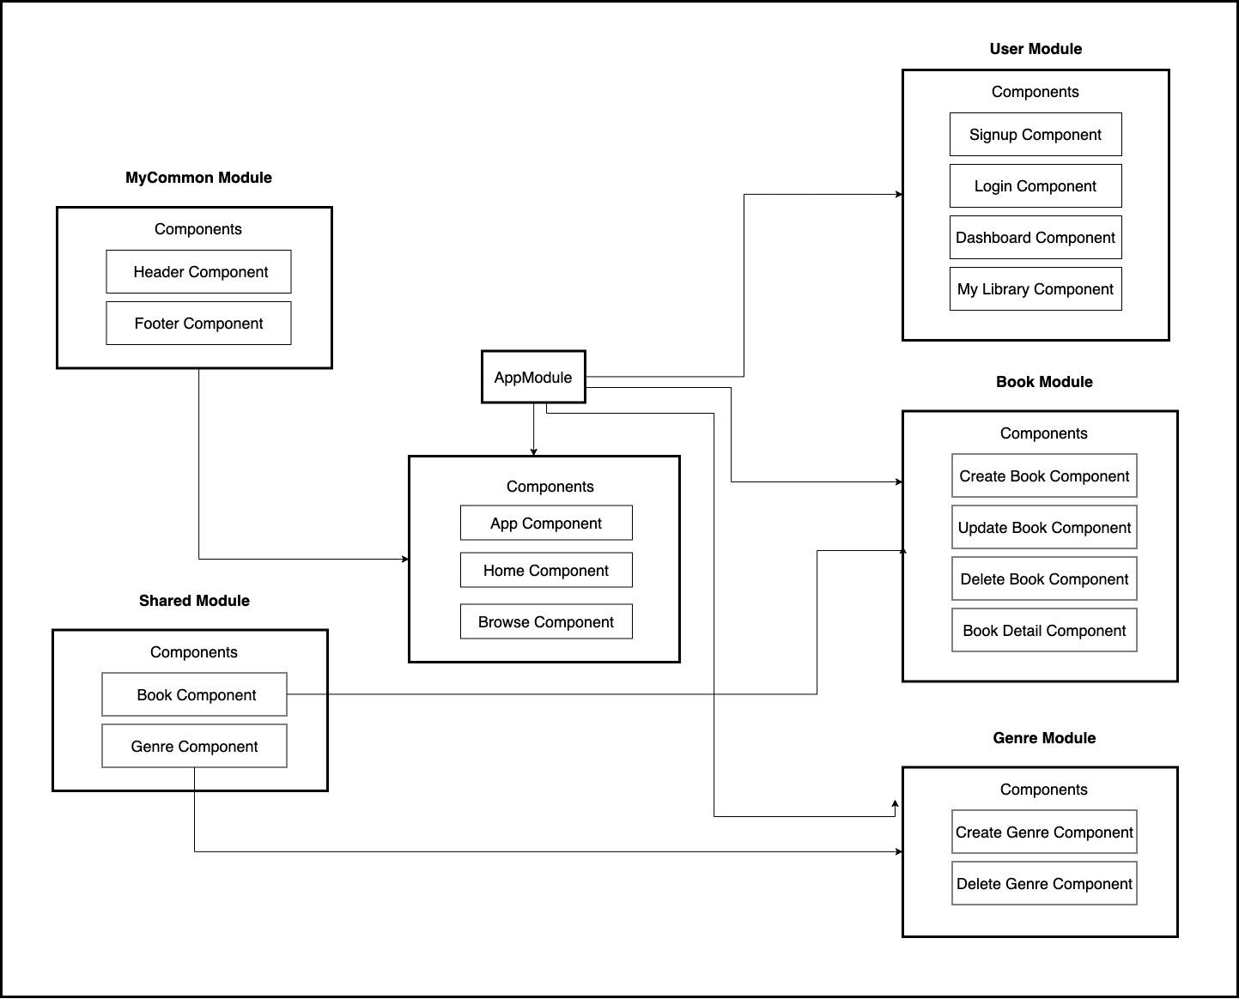
COMPONENT LEVEL DIAGRAM

Slide 8
By
K Chandana
(BFL)
THANK YOU !

