Slide 1

Microsoft Presidio
An open-source framework for detecting and protecting sensitive information in text-based systems.

Slide 2

What Presidio Does
Presidio scans text data to identify personally identifiable information (PII) before it gets stored or shared. Think of it as a filter that catches sensitive details like names, phone numbers, and credit card data.
It's built for systems that handle large volumes of unstructured text—AI models, chatbots, log files, and document processors.
Privacy Protection
Multi-Language Support
AI Integration
Stops sensitive data from reaching unsafe storage or third-party systems
Works across different languages and custom entity types
Fits directly into ML pipelines and NLP workflows

Slide 3

DEPLOYMENT
How You Run It
Presidio isn't a desktop app or a ready-made SaaS platform. It's a Python-based framework you deploy yourself.
01
02
03
Local Development
On-Premise Servers
Cloud Environments
Run on your laptop during testing and prototyping
Deploy within your own infrastructure for full data control
Host on AWS, Azure, or GCP using containerized services
This self-hosted model means your data never leaves your environment—critical for regulated industries like healthcare and finance.

Slide 4
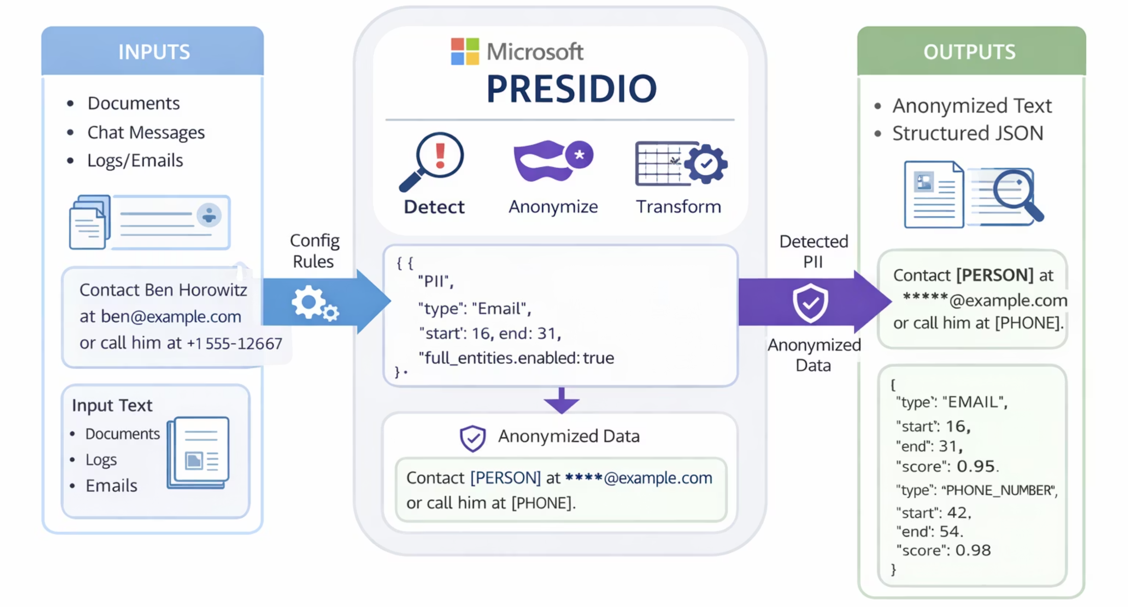
Inputs and Outputs

Slide 5



Working With Presidio
Presidio runs as a backend service, not a point-and-click interface. Developers integrate it using code and APIs.
Python Scripts
REST APIs
Docker Containers
Import the library and call detection functions directly in your code
Deploy analyzer and anonymizer services for HTTP-based integration
Package services for consistent deployment across environments
Expect to write configuration files and API calls. Basic Python knowledge makes integration smoother, especially when building custom recognizers.
Why Choose Presidio
When Alternatives Win
No licensing fees or vendor lock-in
Need managed services with minimal DevOps
Full transparency into detection logic
Want native integration with cloud providers
Deploy anywhere without cloud dependency
Require compliance dashboards out of the box
Customize recognizers for niche use cases

Slide 6

Alternatives to Consider
Presidio competes with both commercial platforms and open-source tools. Each has trade-offs.
Google DLP
AWS Macie
Strong if you're already on Google Cloud. Easier setup but locks you into their ecosystem.
Works well for S3 data discovery. Less flexible for custom text processing pipelines.
Privacera
OneTrust
Enterprise-grade governance platform. Higher cost, more features for compliance teams.
Focused on privacy management and auditing. Less technical, more policy-oriented.

