Slide 1


  Public Health Insights
  Challenges in Environment
  -Presented by DATA DELVERS

Slide 2

WHO ARE DATA DELVERS?
SUPRIYA
SAI ESWARI
VAISHNAVI
TEAM MEMBER
TEAM MEMBER
TEAM MEMBER

Slide 3
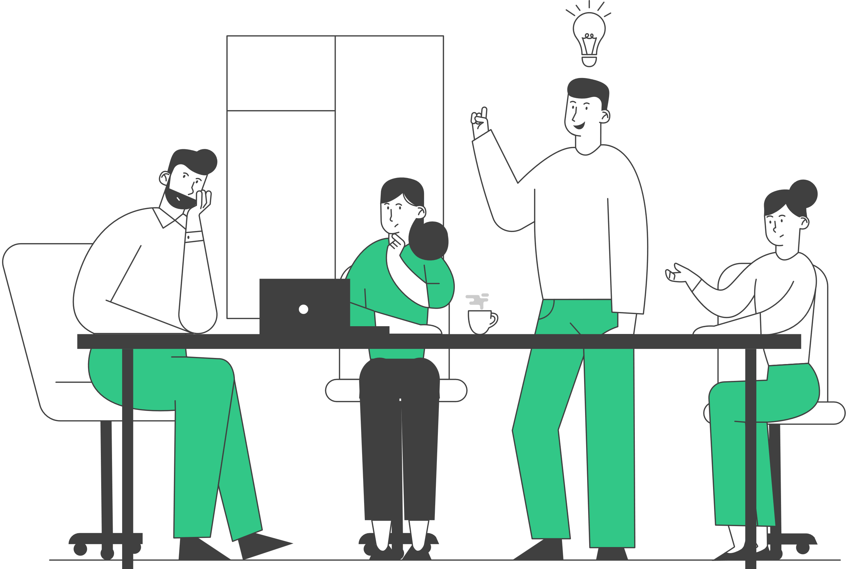
  ABSTRACT
  This project’s main goal is to provide health insights based on health datasets and environmental data sets.
  Why did we select this project? Typically, health analysis focus solely on health datasets. However, considering the significant impact of the environment on health, we've decided to include environmental datasets as well.
  we will provide visualizations and preventions for an particular disease.

Slide 4

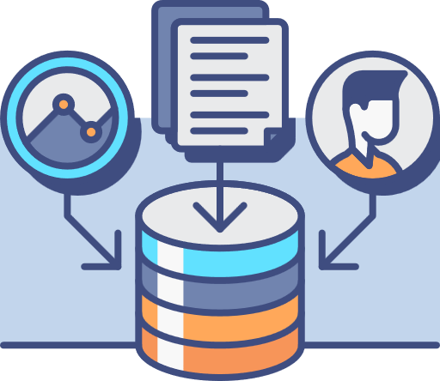
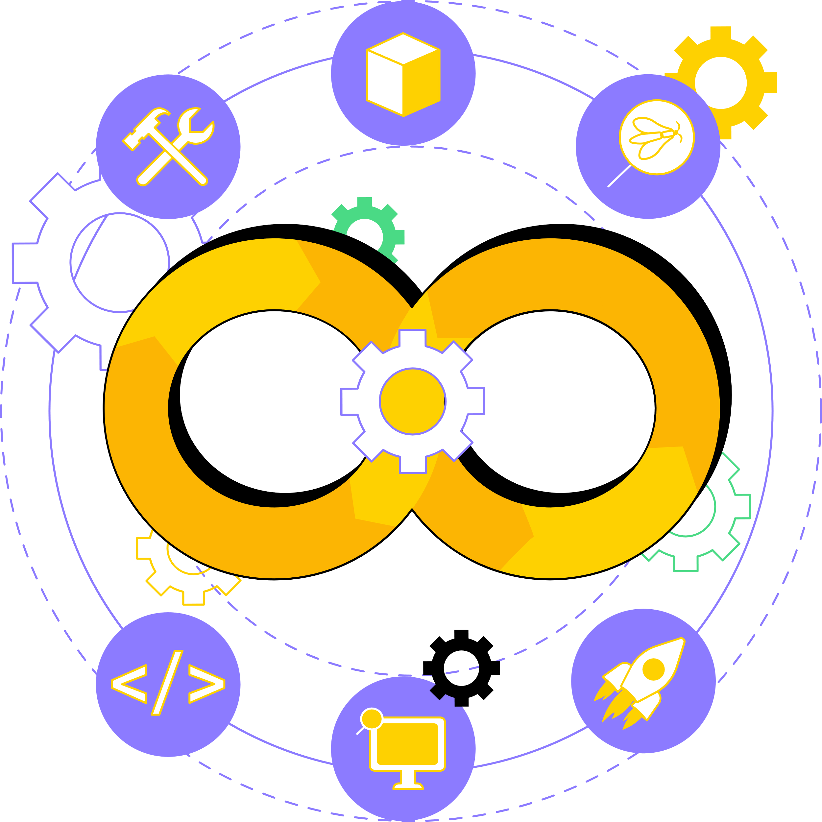
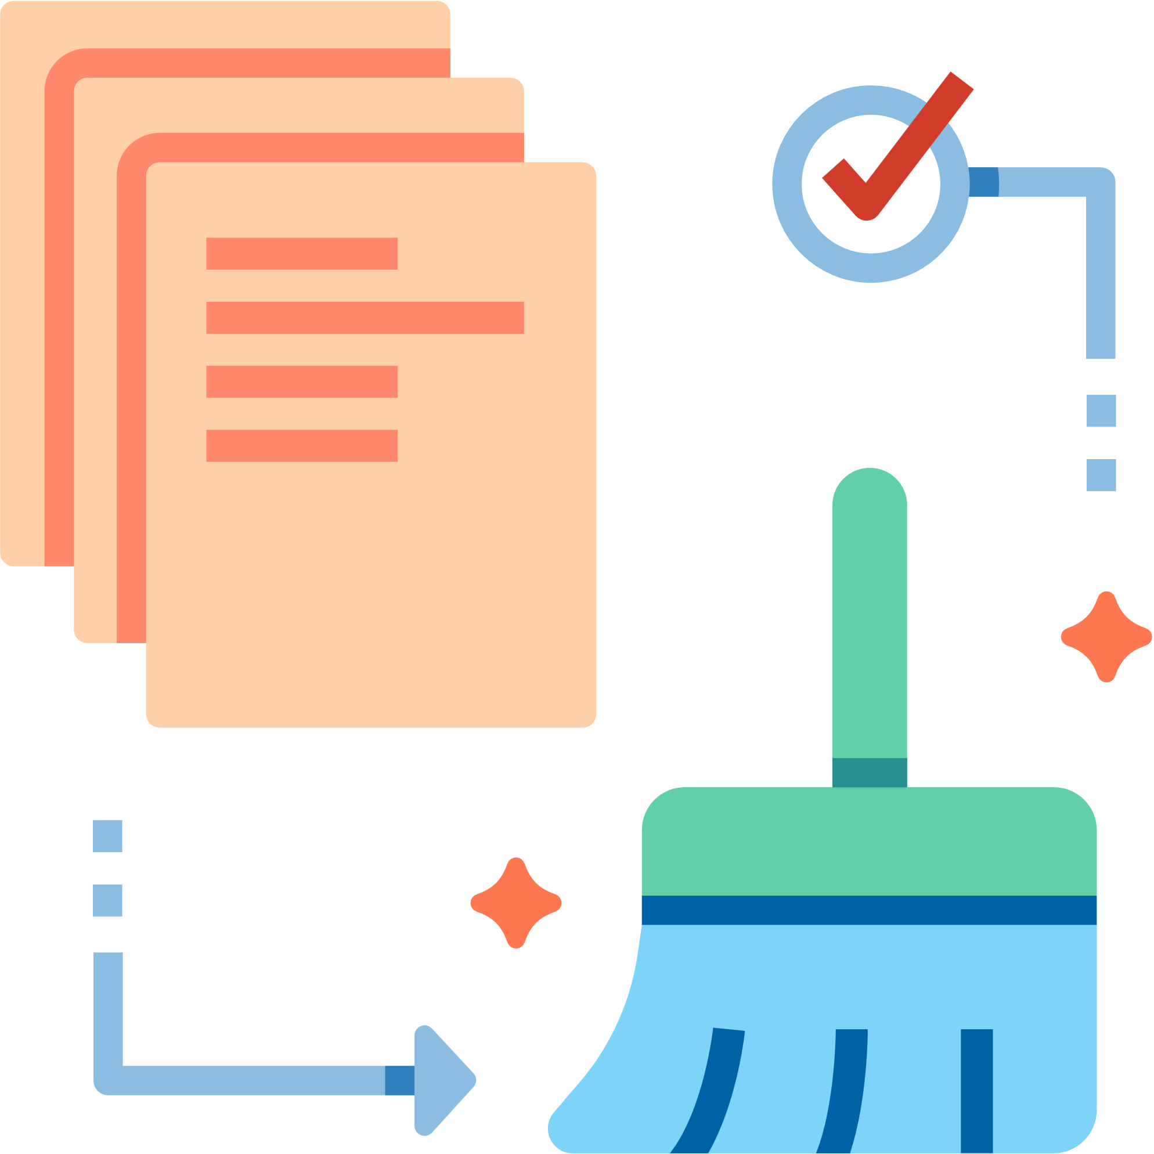

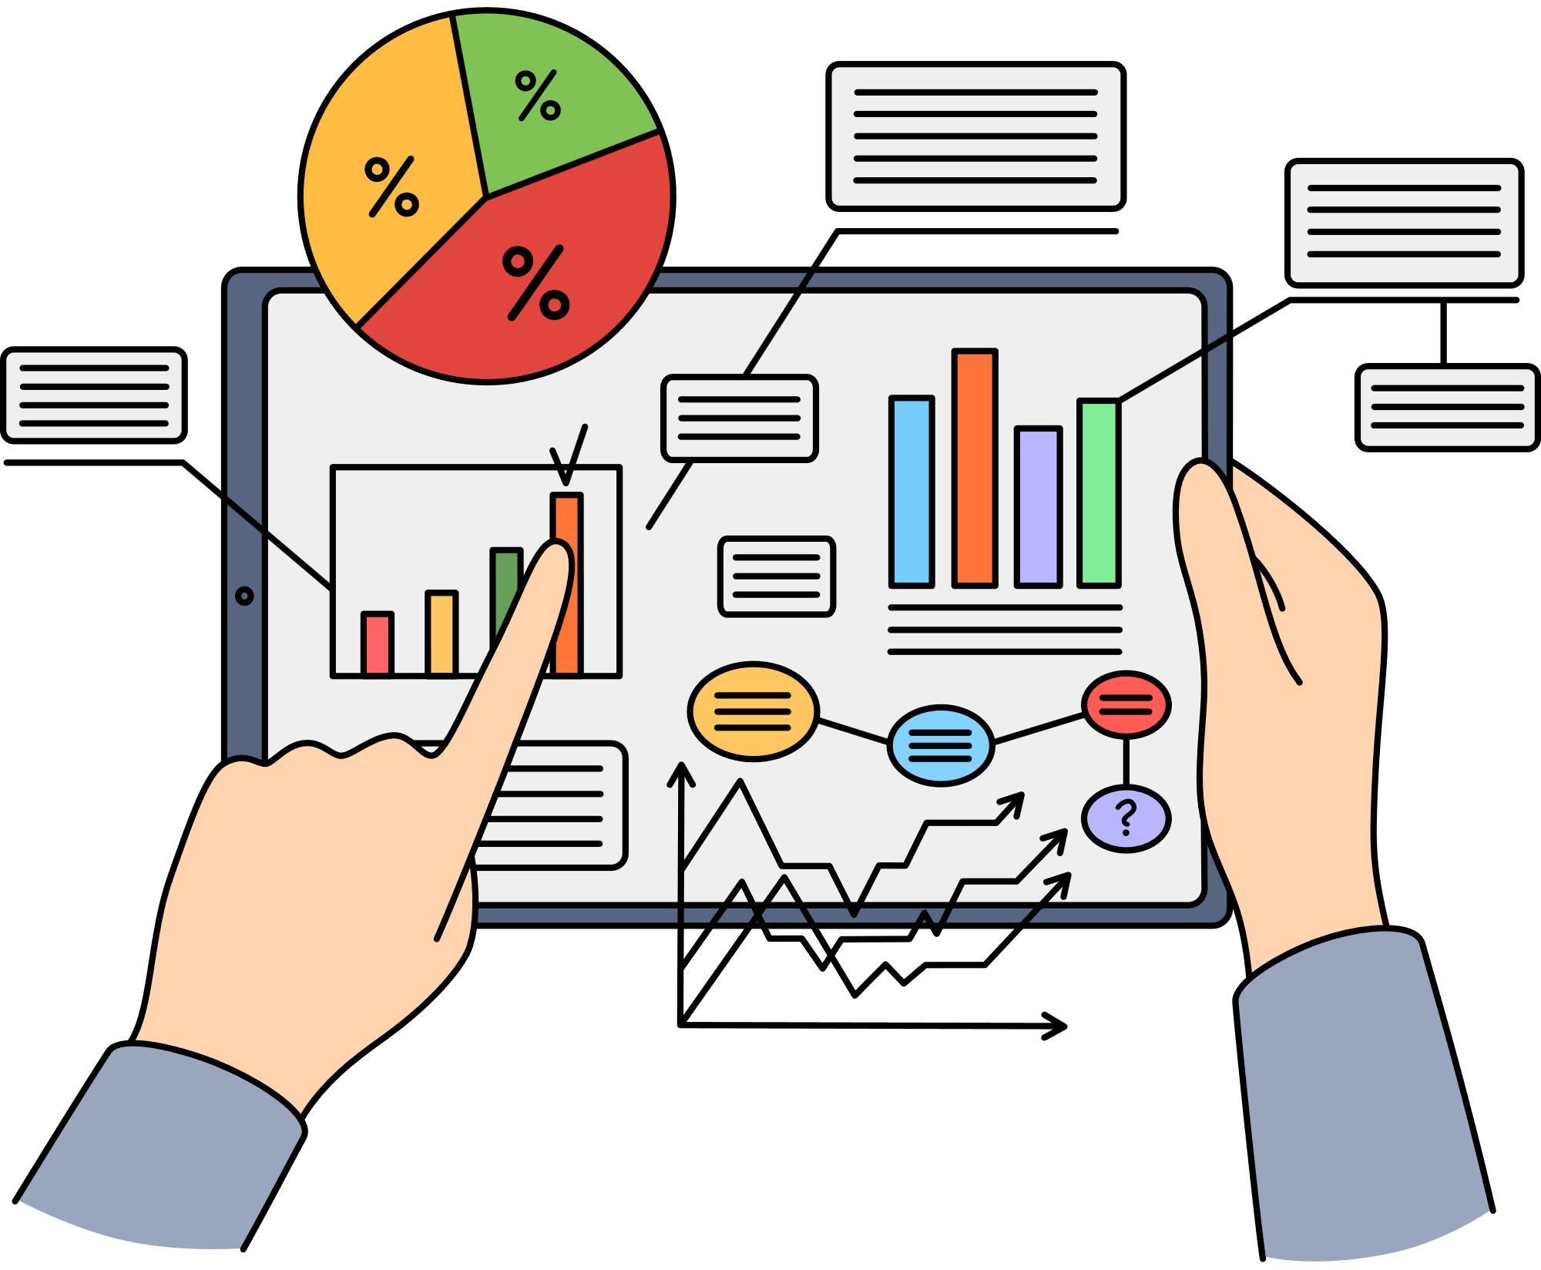


Project
MODULES
Data Collection
Deployment
Big Data
Analytics
Data pre-processing
Model Evaluation
DataVisualization
Model Selection

Slide 5
  DATA COLLECTION
HEALTH
  01.
  02.
  03.
  Dataset Sources
  Properties of Dataset
  Features of Dataset
We have collected data from government websites and international organization websites like
  data.gov
  who.int.
  Size of the Dataset: 83,99,221 bytes
  pdf size : 100MB
  Total Records: 55,500
  Total Fields: 15
  Type of Dataset: .csv file and pdf
  Name of the person
  Age
  Gender
  Blood group
  Medical Condition
  Date of Admission
  Discharge date

Slide 6
  DATA COLLECTION
ENVIRONMENT
  01.
  02.
  03.
  Dataset Sources
  Properties of Dataset
  Features of Dataset
We have collected data from government websites and international organization websites like
  data.gov.in
  opencity website
  Size of the Dataset: 62,000,000 bytes(62 MB)
  Total Records: 4,35,740
  Total Fields: 13
  Type of Dataset: .csv file
  State code
  Sampling date
  State
  Location
  SO2
  NO2
  Type

Slide 7
  DATA PRE-PROCESSING
  01.
  02.
  03.
  Clean & Preprocess Data
  Application & Tools
  Data Cleansing steps
  Handle missing values, outliers, and inconsistencies to improve data quality.
  Example: Impute missing values in blood pressure data using statistical methods.
  Alteryx Application
  Input data Tool
  data Cleansing Tool
  Select Tool
  Filter Tool
  Removes null values
  Removes Missing values
  Removes white Spaces
  Select and removes the records if they are unneccesary

Slide 8
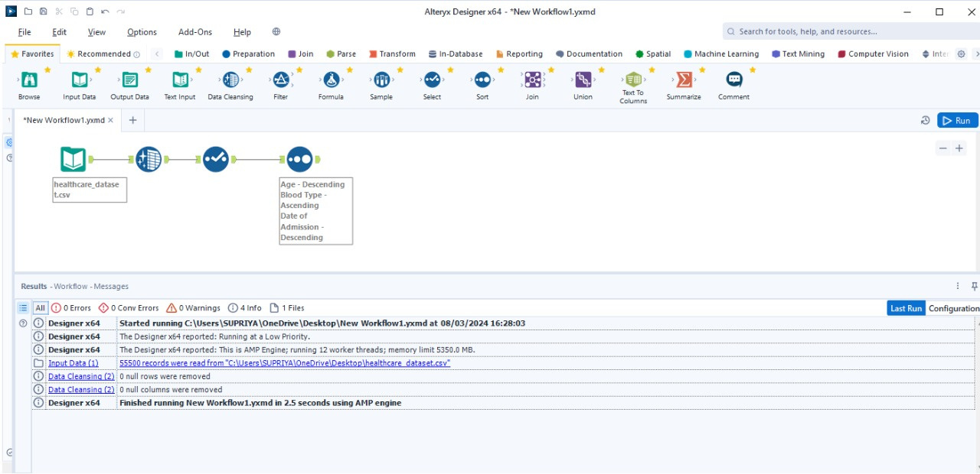
  DATA PRE-PROCESSING

Slide 9
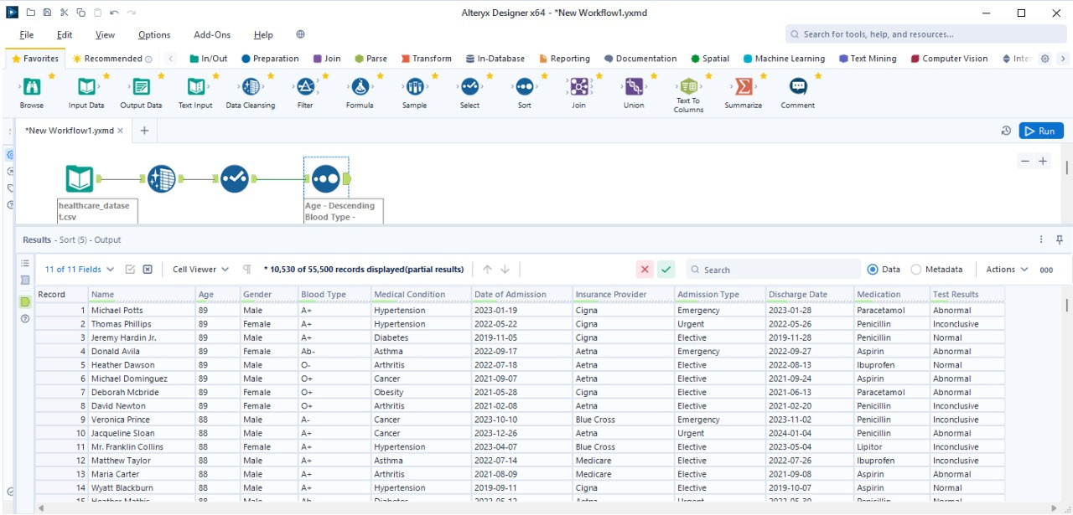
  DATA PRE-PROCESSING
After Sorting & Filltering the Data

Slide 10
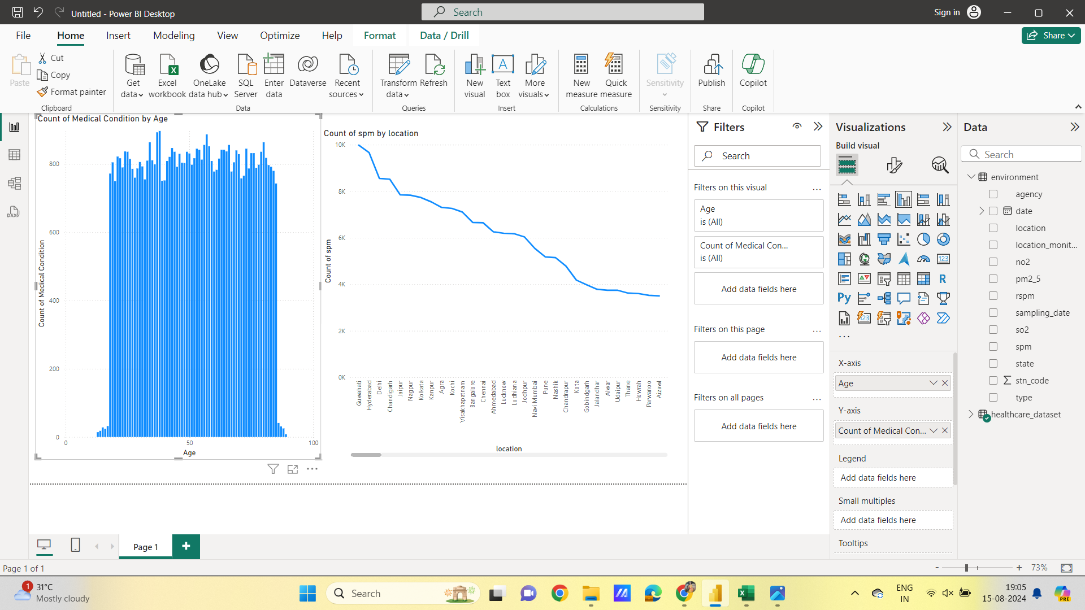
  DATA VISUALIZATION
  Representing data graphically to make it easier to analyze, understand.

Slide 11

  Analysis of visualization
Healthcare dataset:
  A count of medical conditions by age would show the number of people with various health issues at different age groups.
  On the x-axis, you would see the age ranges, and on the y-axis, you would observe the frequency of each medical condition within those age groups.
  In our visualization mostly 19-30 and 60-65 age group people have huge medical condition
Environment dataset:
  A visualization of SPM pollution levels by location would illustrate the distribution of particulate matter across different areas.
  The x-axis would represent the locations, while the y-axis would show the corresponding SPM concentrations.
  This graph would enable a clear comparison of pollution levels in various regions.
  In this visualization highest polluted locations are Guwahathi, Hyderabad, Delhi &Vizag

Slide 12

  MODEL SELECTION
In this process, we have key steps:
  Model Selection & Model Building.
When it comes to model selection, we consider various types of models:
  Classification Models
  Regression Models
  Clustering Models
  Deep Learning Models
  NLP models
Here we are using Classication Model:
Random Forest Classifier : we are using a Random Forest Classifier to predict the medical condition based on environmental factors such as SO2, NO2,SPM etc.

Slide 13
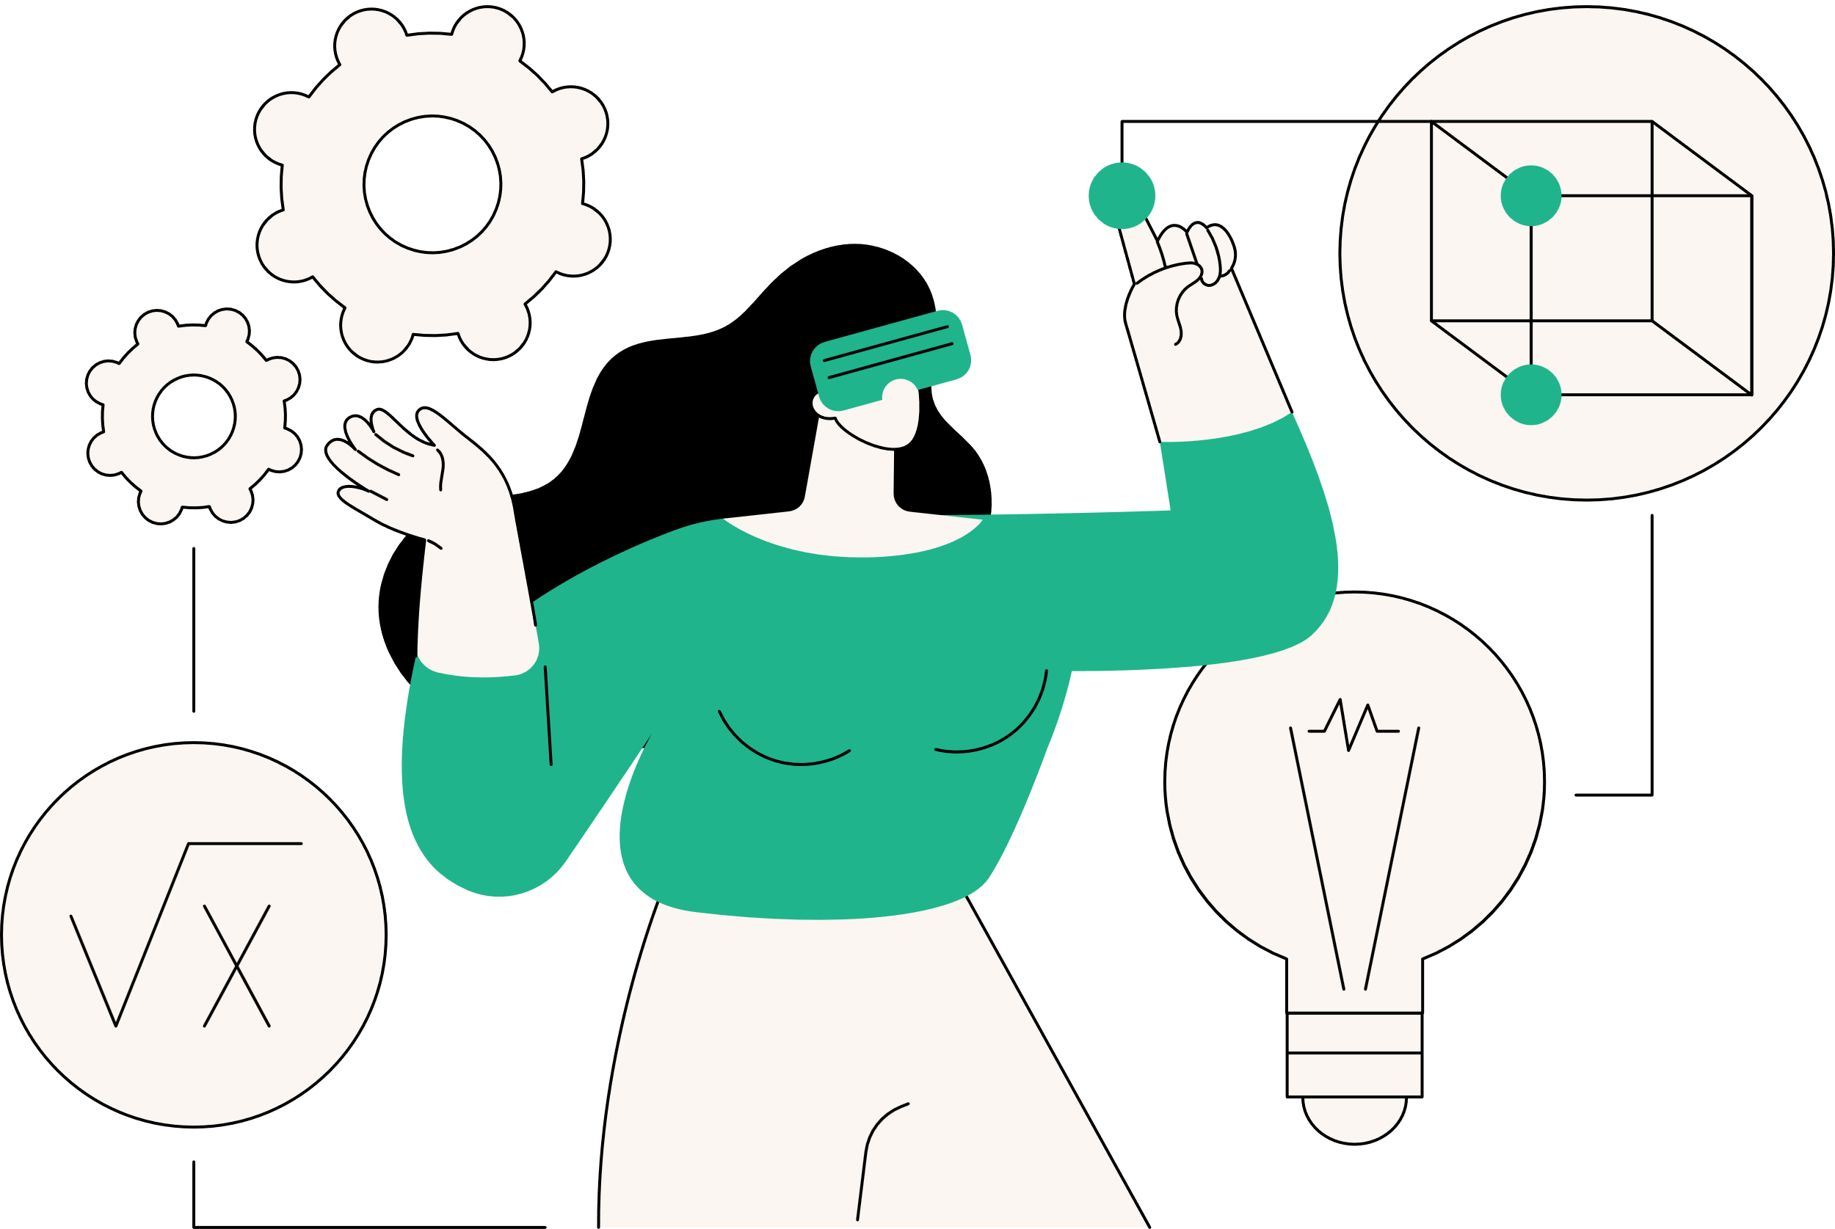
  MODEL BUILDING
Here are four key points regarding your model building approach:
1.Feature Selection and Target Definition:
  We selected medical condition as the target variable.
2. Preprocessing Steps:
  Describe the specific preprocessing steps taken, such as handling missing values, scaling features, or encoding categorical variables.
3. Model Selection and Training:
  The model was trained on standardized features using the fit() method.
4. Evaluation and Model Persistence:
  The model's performance was evaluated using accuracy, precision, recall
and F1-score (as provided by the classification_report function).

Slide 14

  MODEL EVALUATION
Here are four key metrics for evaluating your classification model's performance:
  Accuracy Score: Measures the overall proportion of correct predictions made by the model.
  Classification Report: Provides a detailed breakdown of the model's performance for each class, including:
    Precision: positive predictive value
    Recall: sensitivity
  Support: The total number of true positives (actual positives) and true negatives (actual negatives) for each class. This is particularly relevant for imbalanced datasets, where some classes might have fewer examples.
  Macro and Weighted Averages:
    Macro Average: Calculates the unweighted mean of precision, recall, and F1-score across all classes. This treats each class equally regardless of its size.
    Weighted Average: Takes into account class imbalances by assigning more
weight to larger classes.This provides a better overall picture of performance
when dealing with skewed datasets.

Slide 15

  DEPLOYMENT
It involves making the model accessible and operational in a real-world setting:
1. Model Saving with Joblib:
  After training the Random Forest model, it is saved using joblib.dump() as public_health_insights_classifier_model.pkl. This preserves the trained model's state for future use.
2. Model Loading for Inference:
  To deploy the model in a production environment, the saved model can be loaded using joblib.load(). This allows the model to be used for real-time or batch predictions on new healthcare and environmental data without requiring retraining.
Improvements:
  Clarity: More concise and direct explanations for each step.
  Specificity: Emphasized the preservation of the model's state when saving.
  Conciseness: Removed unnecessary repetitions.

Slide 16



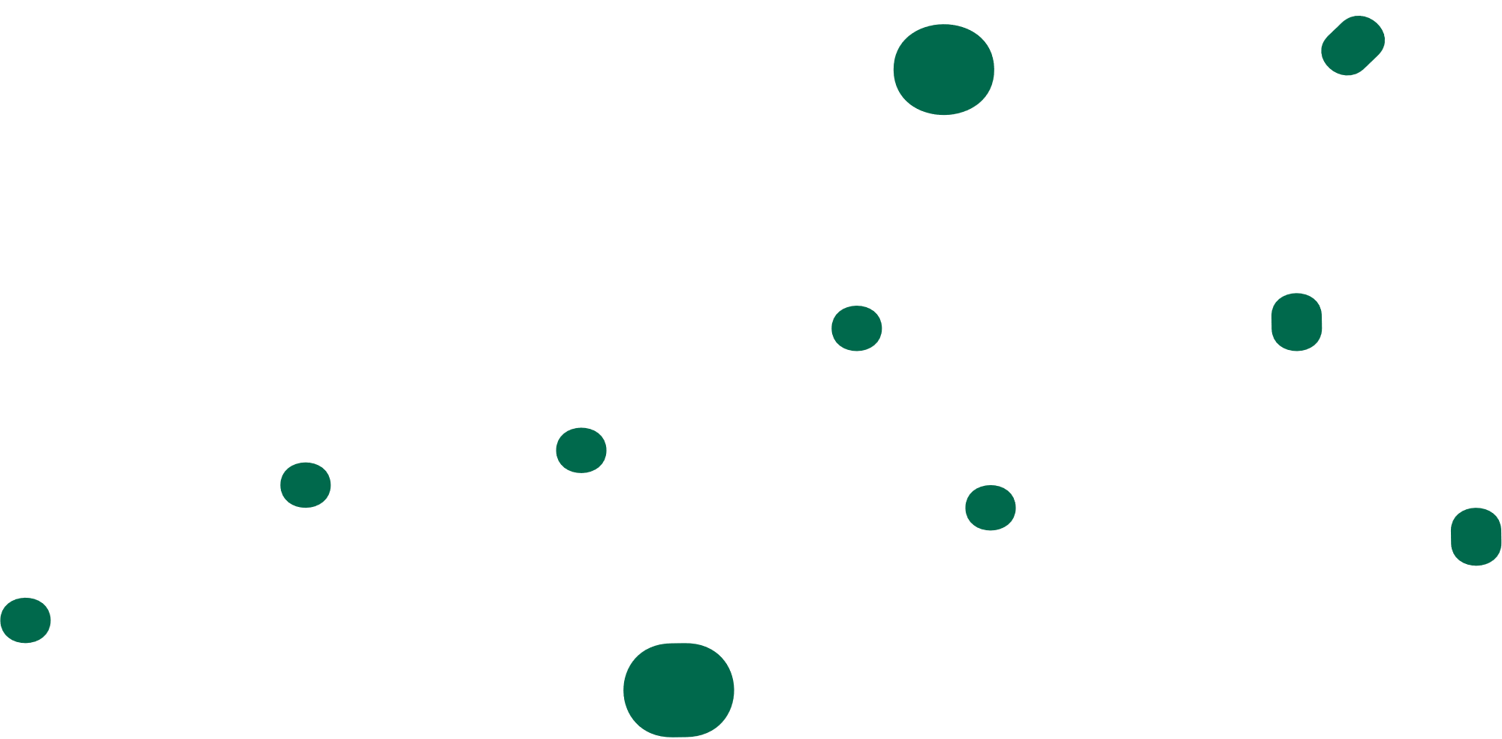


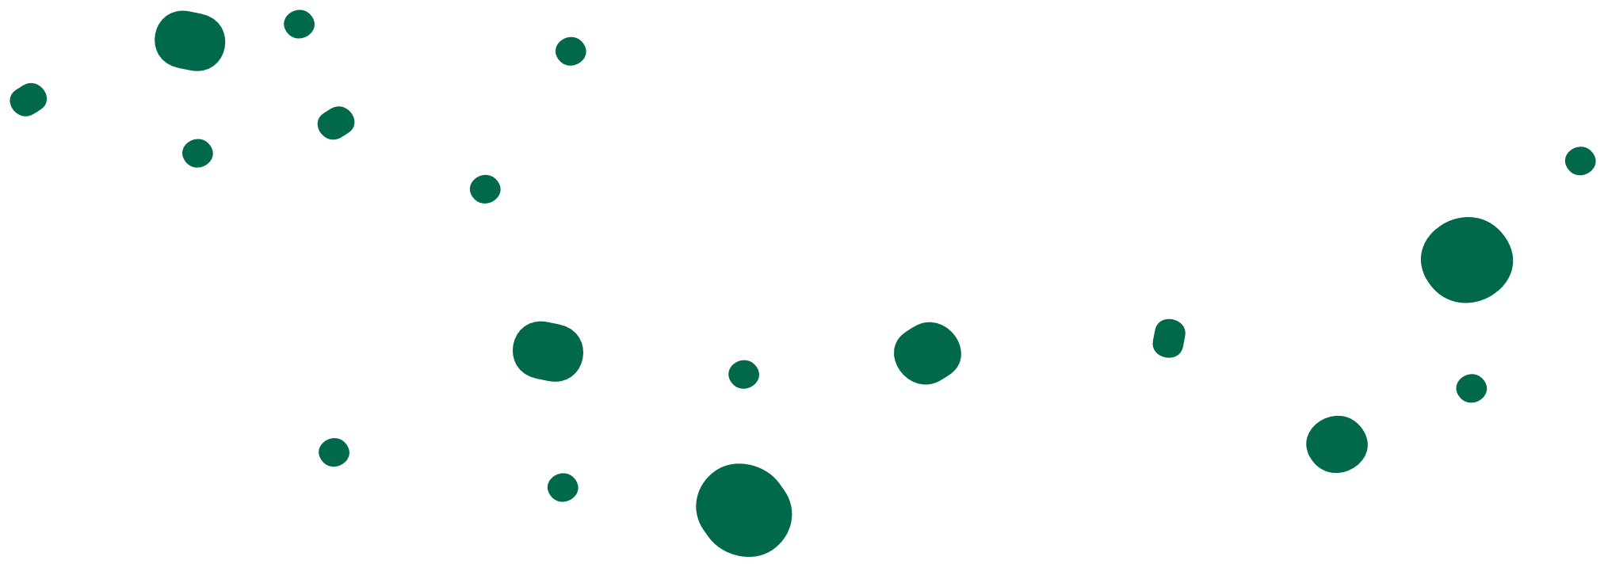

~Data Delvers

