Slide 1
Retail Profit Prediction & Discount Optimization
Superstore Sales Dataset | Regression modelling, SQL findings, EDA and prototype simulator
9,994
$2.30M
$286.4K
18.7%
order lines
total sales
total profit
loss-making lines
Core finding
Discounts beyond 20% rapidly erode profit; Furniture, especially Tables and Bookcases, needs tighter margin control.
Target: Profit (continuous)
Inputs: Sales, Discount, Category, Region
1/10

Slide 2
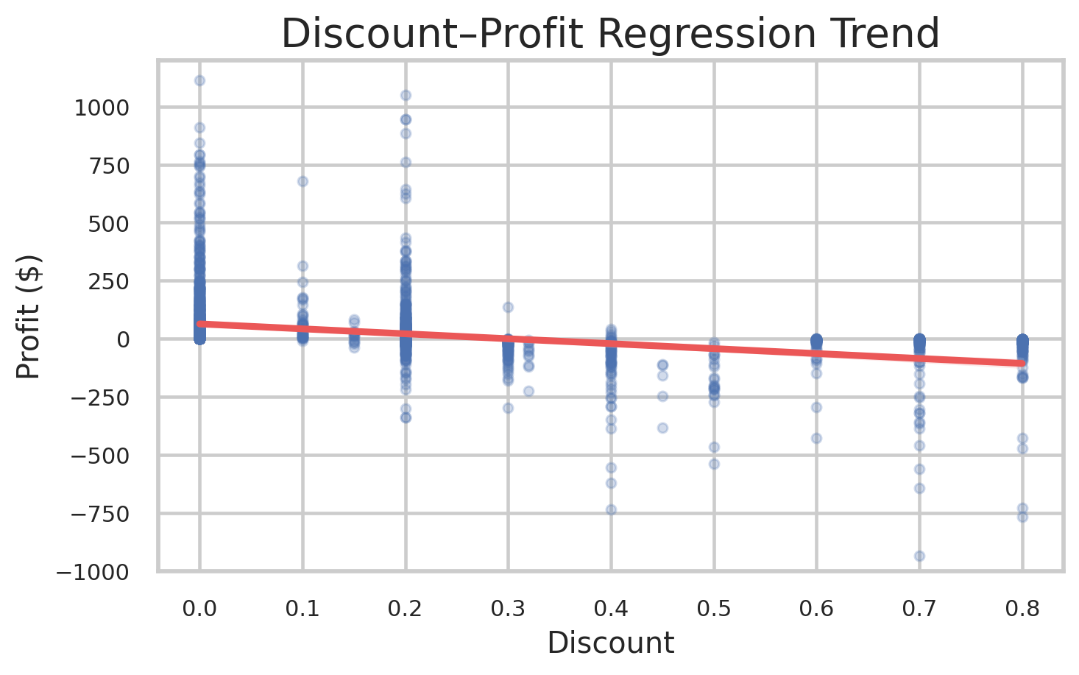
Business Context + Prediction Goal
02
Problem Statement
Business question: Which orders make money, which lose money, and how should discounting be adjusted to protect margin?
Inputs
Model
Output
Action
Sales
Discount
Category
Region
Learn non-linear
profit patterns
Estimated Profit
per order line
Approve, limit or
revise discount
Target variable: Profit — a continuous dollar value, so this is a regression problem.
Retail decision: reduce loss-making discounts without hurting profitable sales volume.
Model requirement: interpretable enough for managers and robust enough to avoid overfitting.
Evaluation focus: R² for explanatory power, MAE for business-friendly average error, RMSE for outlier sensitivity.
Regression trend: higher discounts are linked with weaker profit.
2/10

Slide 3
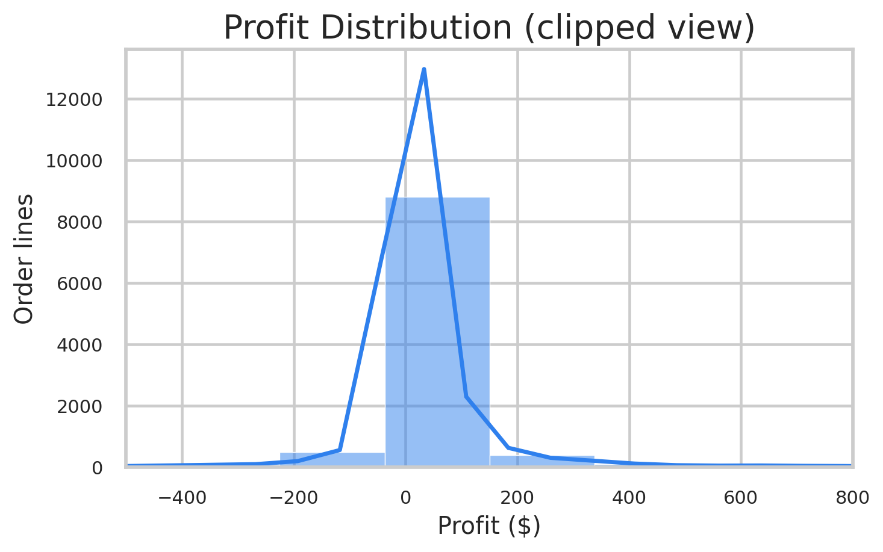
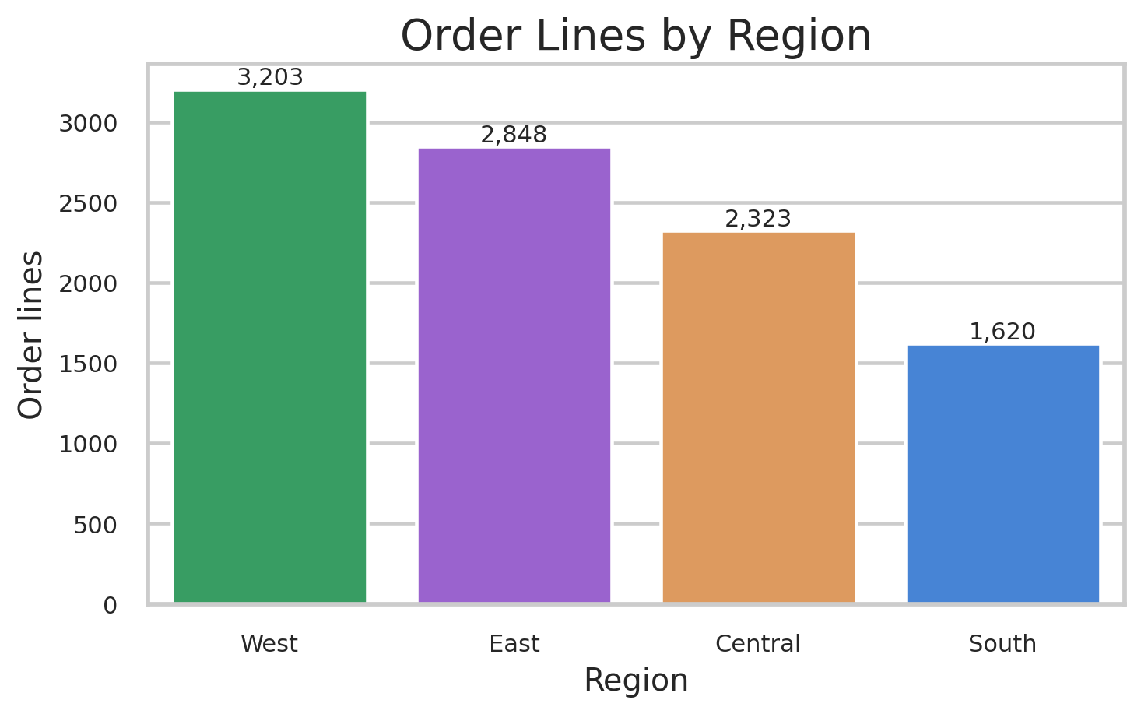
Superstore Sales Dataset
03
Dataset Overview
9,994
22
5,009
0
1,862
rows / order lines
columns
unique orders
missing in model fields
unique products
Variable
Role
Meaning
Profit profile
Profit
Target
Continuous profit/loss value per order line
Min: $-6.60K
Median: $8.67
Mean: $28.66
Max: $8.40K
Highly skewed target
Sales
Numeric predictor
Order-line revenue before margin impact
Extreme profits and losses mean RMSE is sensitive to outliers; MAE is better for operational interpretation.
Discount
Numeric predictor
Discount rate applied to sale
Category, Region
Categorical predictors
Market and product context
Quantity, Segment, Sub-Category
Exploratory variables
Used for EDA and business interpretation
Profit histogram: most order lines cluster near zero.
West has the largest order-line count.
3/10

Slide 4
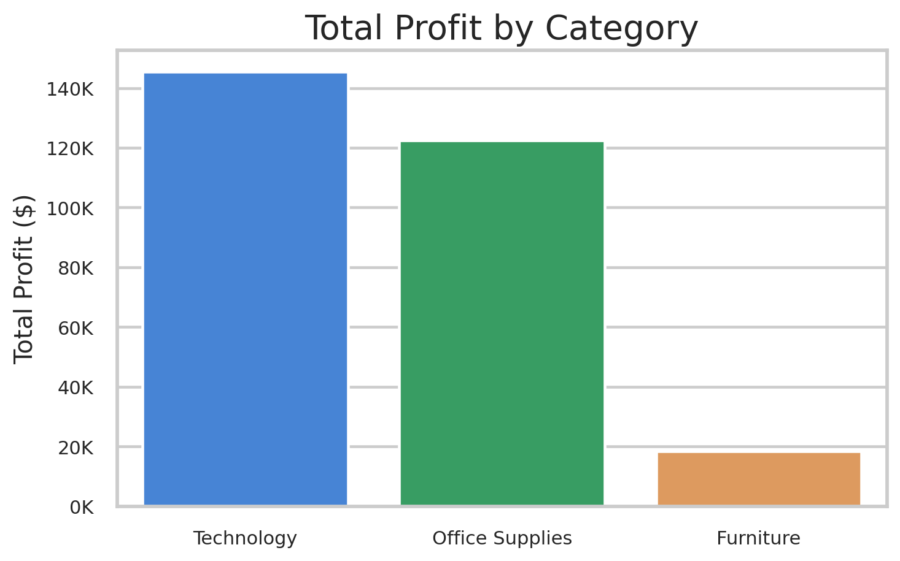
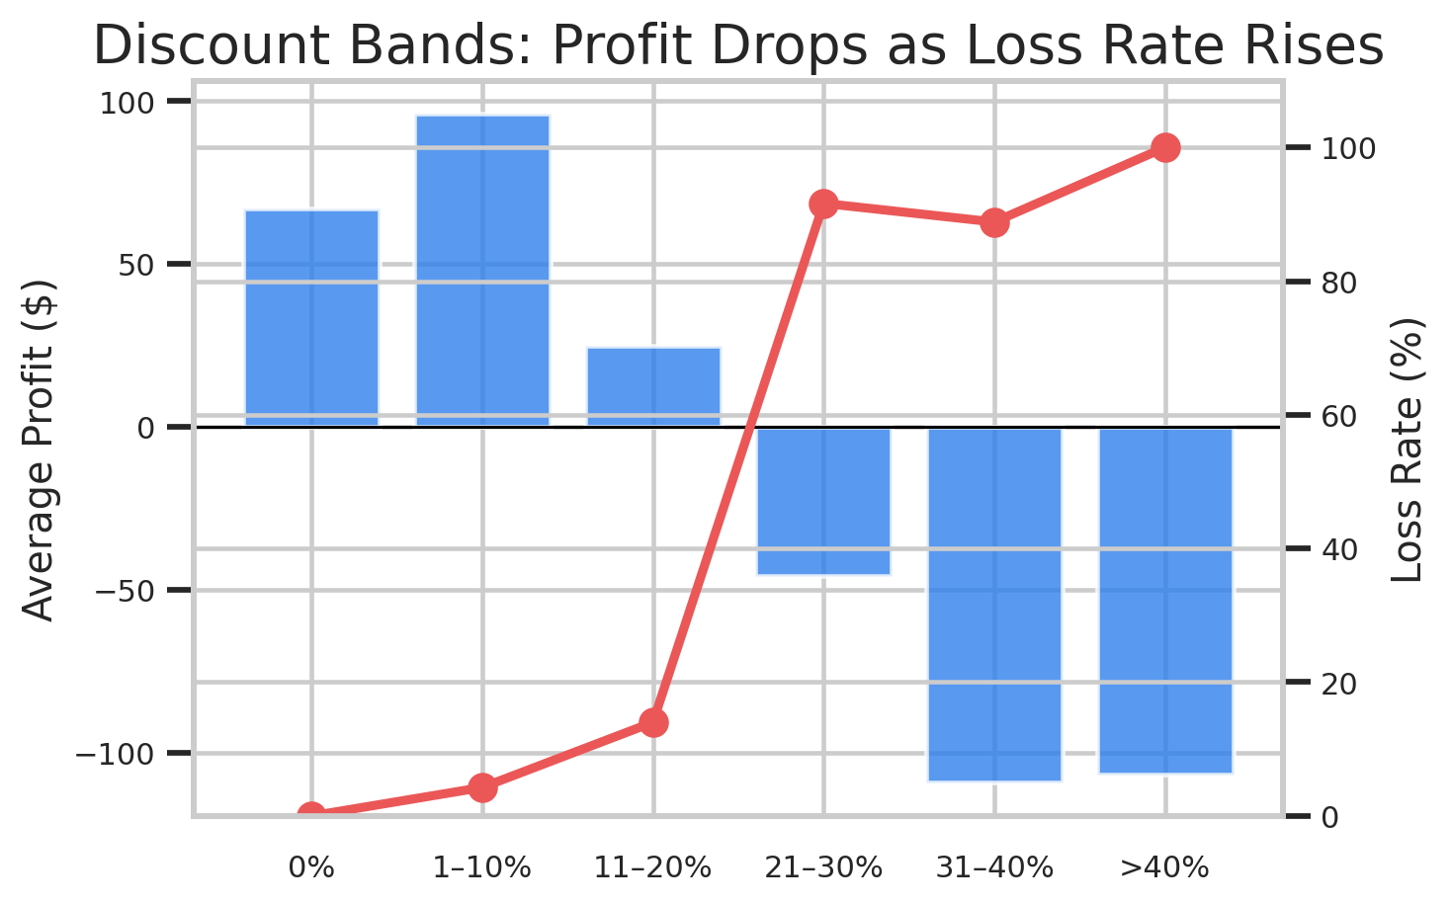
Region, category, sub-category and discounts
04
SQL Findings: Key Business Questions Answered
Region
Sales
Profit
Category
Profit
Loss rate
Negative Avg. Profit
Avg. Profit
West
$725.5K
$108.4K
Technology
$145.5K
14.7%
Tables
$-55.57
East
$678.8K
$91.5K
Office Supplies
$122.5K
14.7%
Bookcases
$-15.23
South
$391.7K
$46.7K
Furniture
$18.5K
33.7%
Supplies
$-6.26
Central
$501.2K
$39.7K
SQL takeaway: Central has decent sales but weak profit; Furniture is the least profitable category; Tables, Bookcases and Supplies have negative average profit.
Furniture profit is visibly weak vs. Technology and Office Supplies.
Discounts over 20% show negative average profit.
4/10

Slide 5
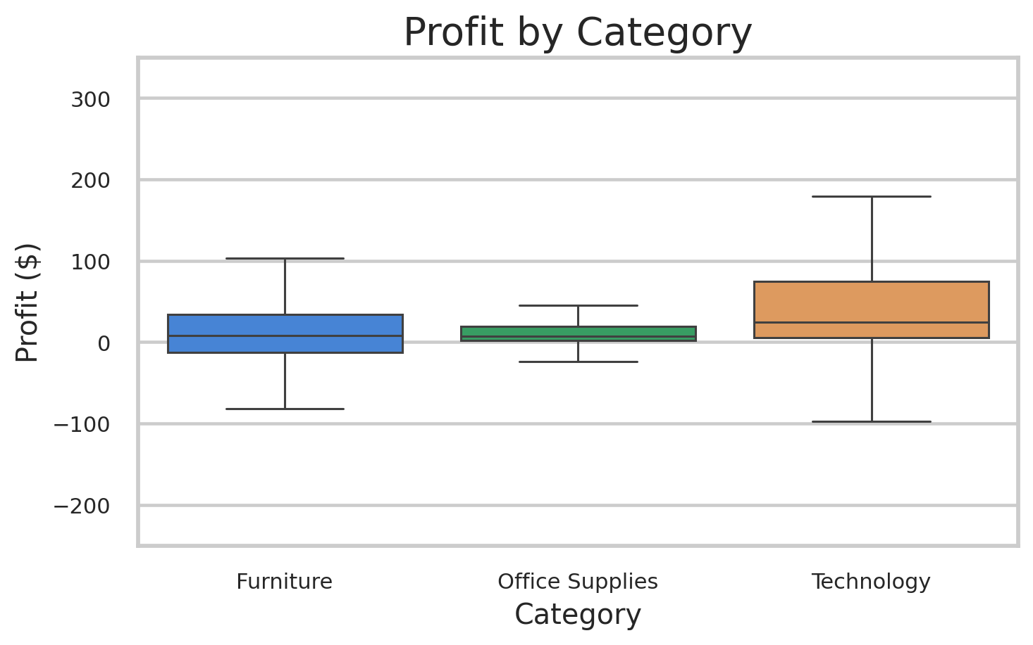
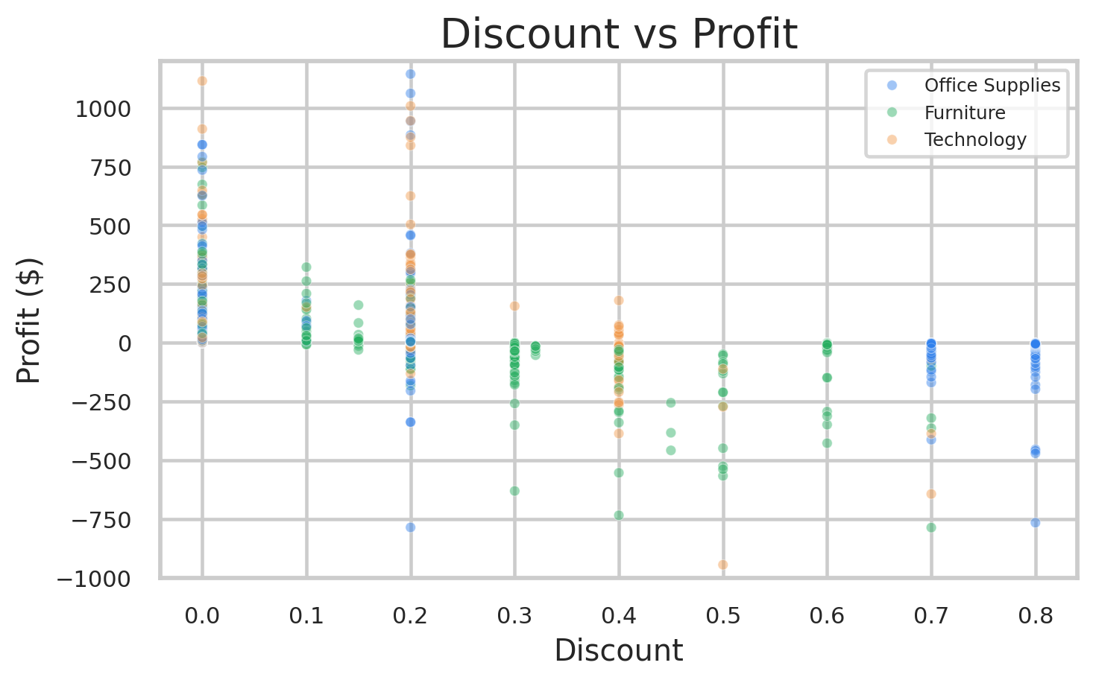
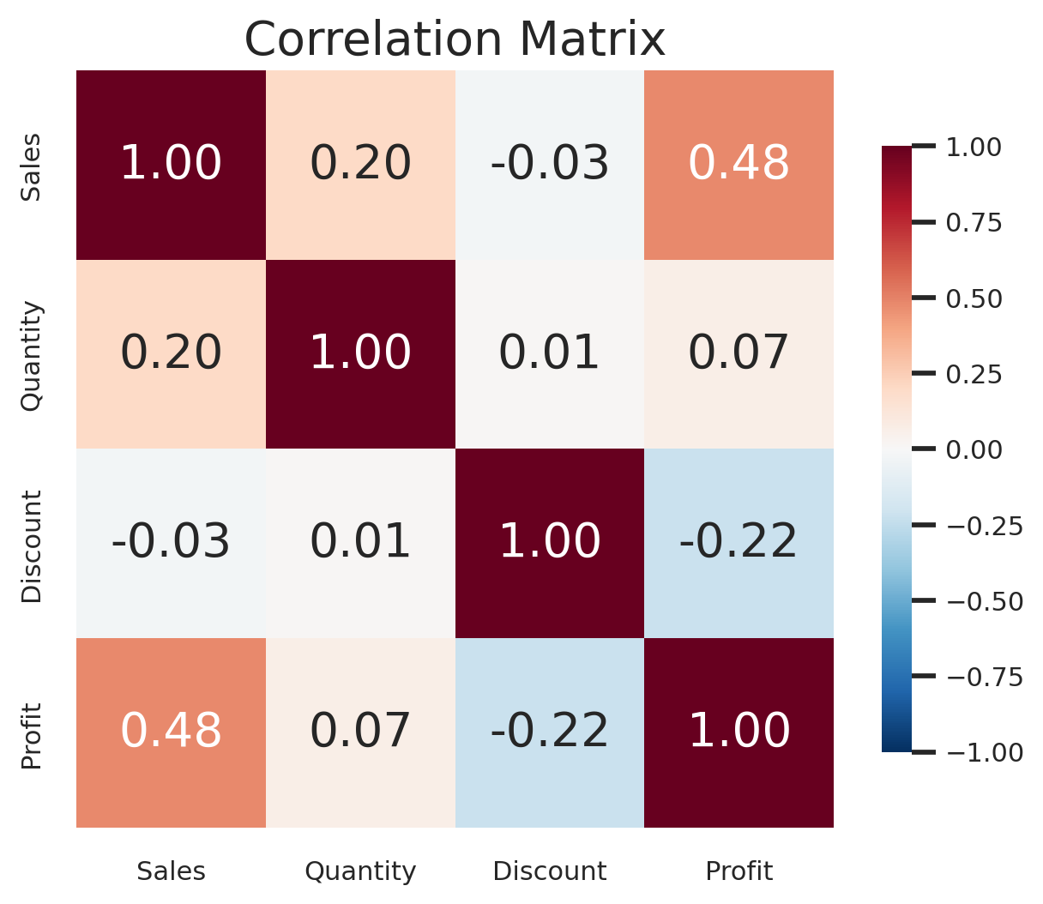
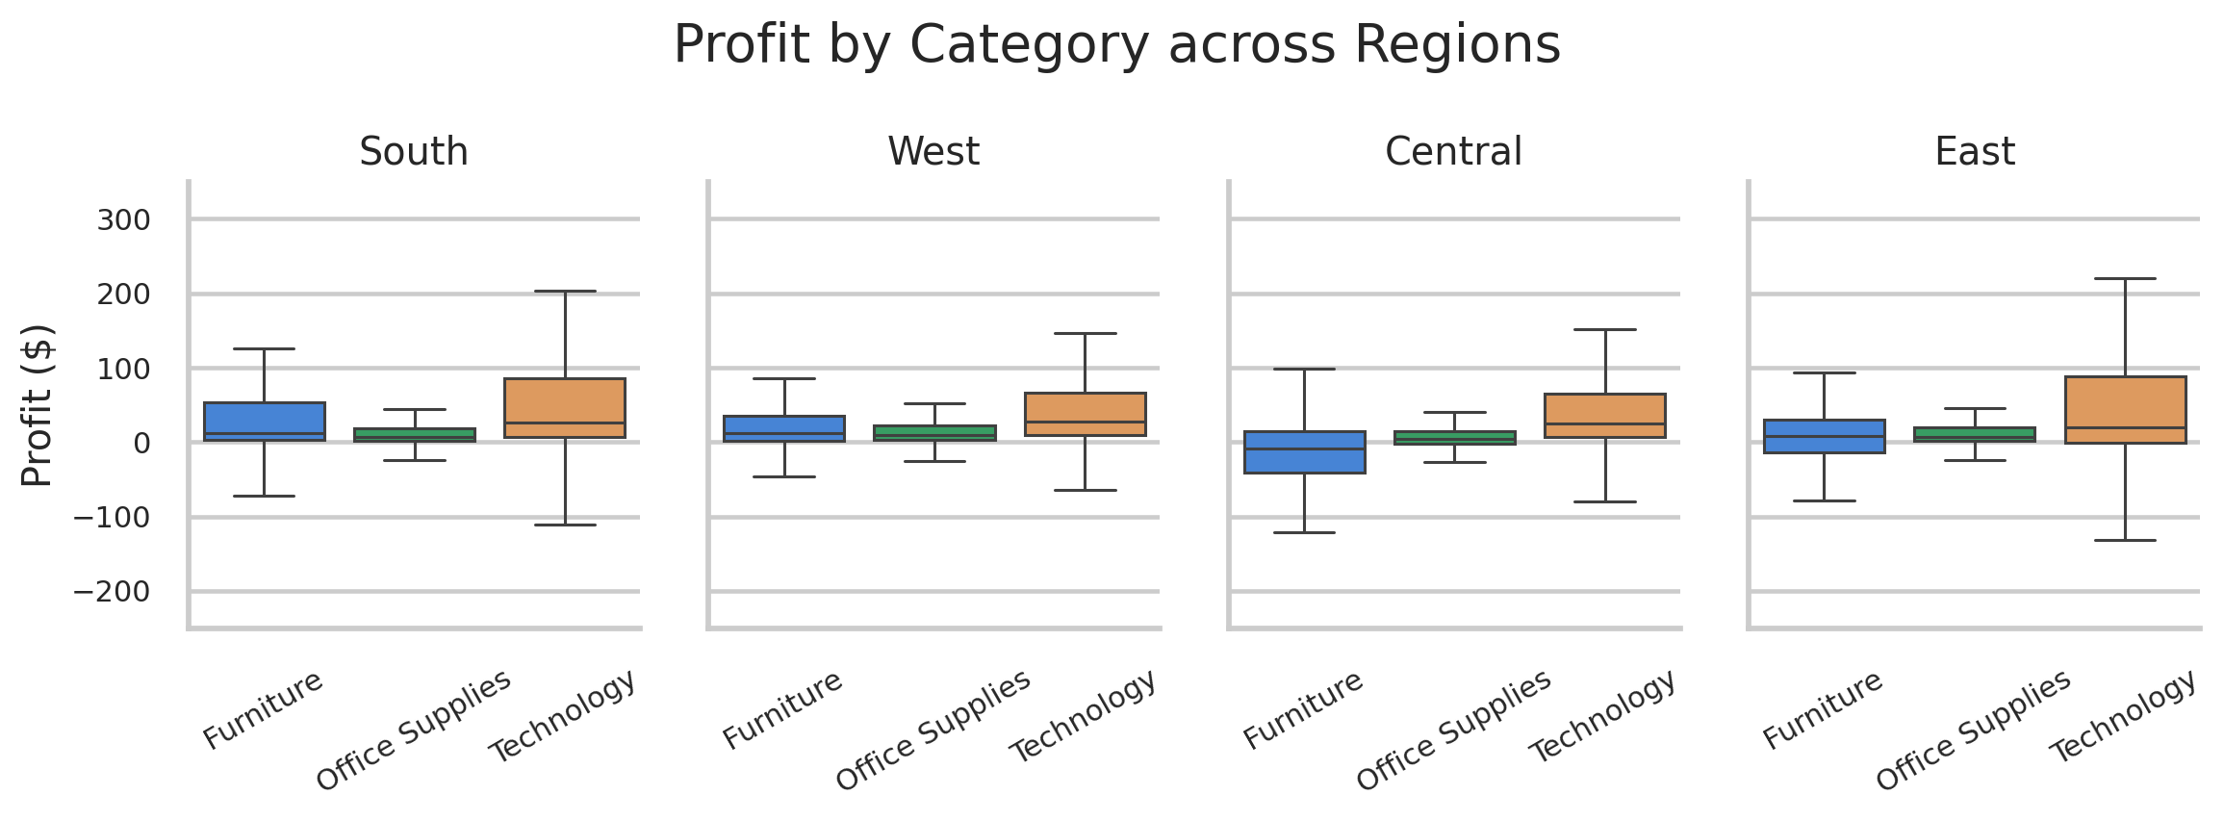
Distribution, relationships and category effects
05
EDA Highlights: Seaborn Charts
Histplot: target is skewed, with losses and large outliers.
Boxplot: Furniture has weaker profit distribution.
Scatterplot: high discounts cluster around losses.
Heatmap: Discount–Profit correlation is negative.
EDA conclusion: profit is not evenly distributed. The data shows a clear operational risk zone once discounts move beyond moderate levels, especially in Furniture.
Regplot: downward discount–profit trend.
Facet boxplot: Furniture weakness appears across regions.
5/10

Slide 6
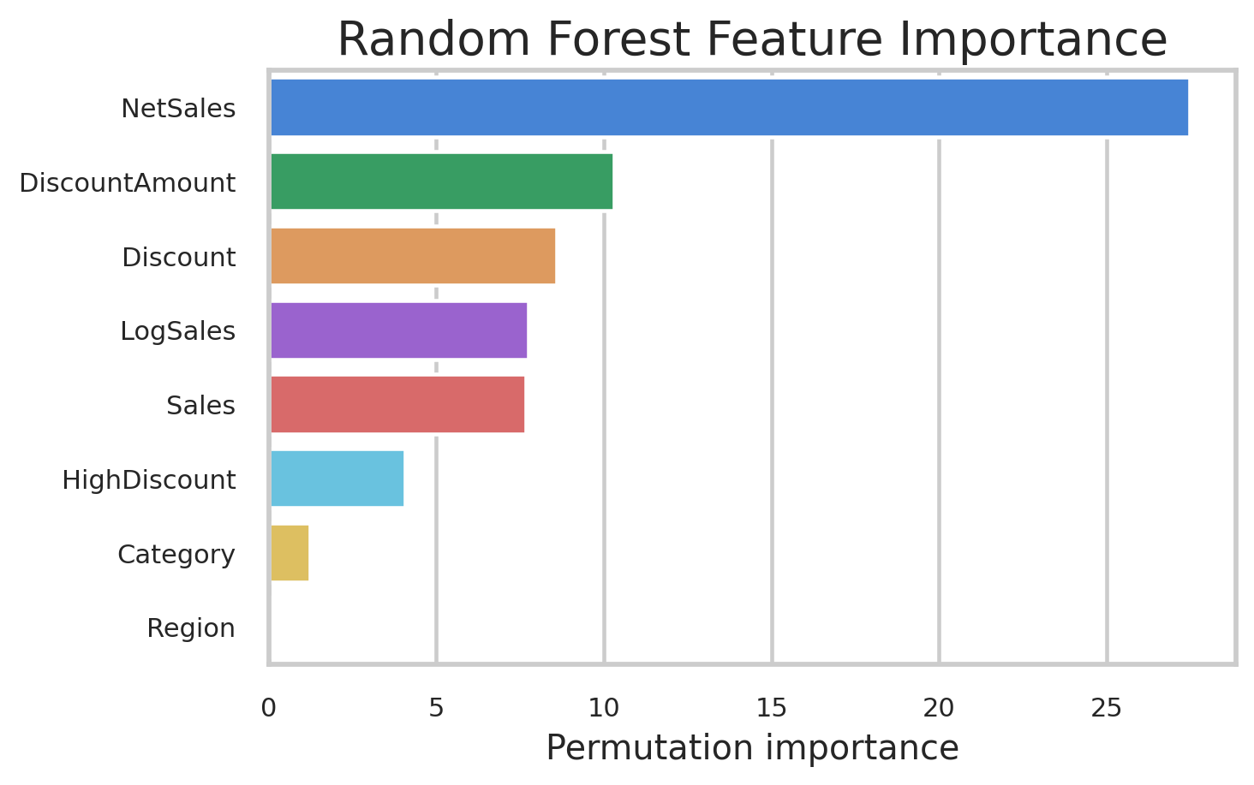
Build reliable inputs without target leakage
06
Feature Engineering & Preprocessing
Raw data
Clean
Encode
Engineer
Model
Sales, Discount, Category, Region
Median / mode imputation
One-hot encoding for categories
NetSales, LogSales, HighDiscount
Scaled LR; tree models unscaled
Important leakage control: ProfitMargin = Profit / Sales is useful for descriptive analysis, but it was not used as a predictor because it directly contains the target variable.
Numeric inputs: imputed and scaled only for Linear Regression.
Categorical inputs: one-hot encoded with unknown-category handling.
Validation design: train/development/test separation with Profit-quantile stratification.
Predictor-only engineered features dominate the Random Forest.
6/10

Slide 7
Baseline, pruned tree and regularized ensemble
07
Models Used & Why
Model
Why included
Overfitting control
Linear Regression
Transparent baseline to test simple linear profit effects.
Regularization and scaled numeric features.
Decision Tree Regressor
Captures threshold rules such as high-discount risk.
Cost-complexity pruning using ccp_alpha, depth and leaf limits.
Random Forest Regressor
Combines many trees for more stable non-linear predictions.
Max depth, min samples, sqrt features and bootstrap aggregation.
Development set
Cross-validation
Gap check
Final test
tune only on training data
compare MAE and R² stability
detect train–test mismatch
one unbiased evaluation
Selection principle: choose the model that generalizes, not the one that only memorizes training orders.
7/10

Slide 8
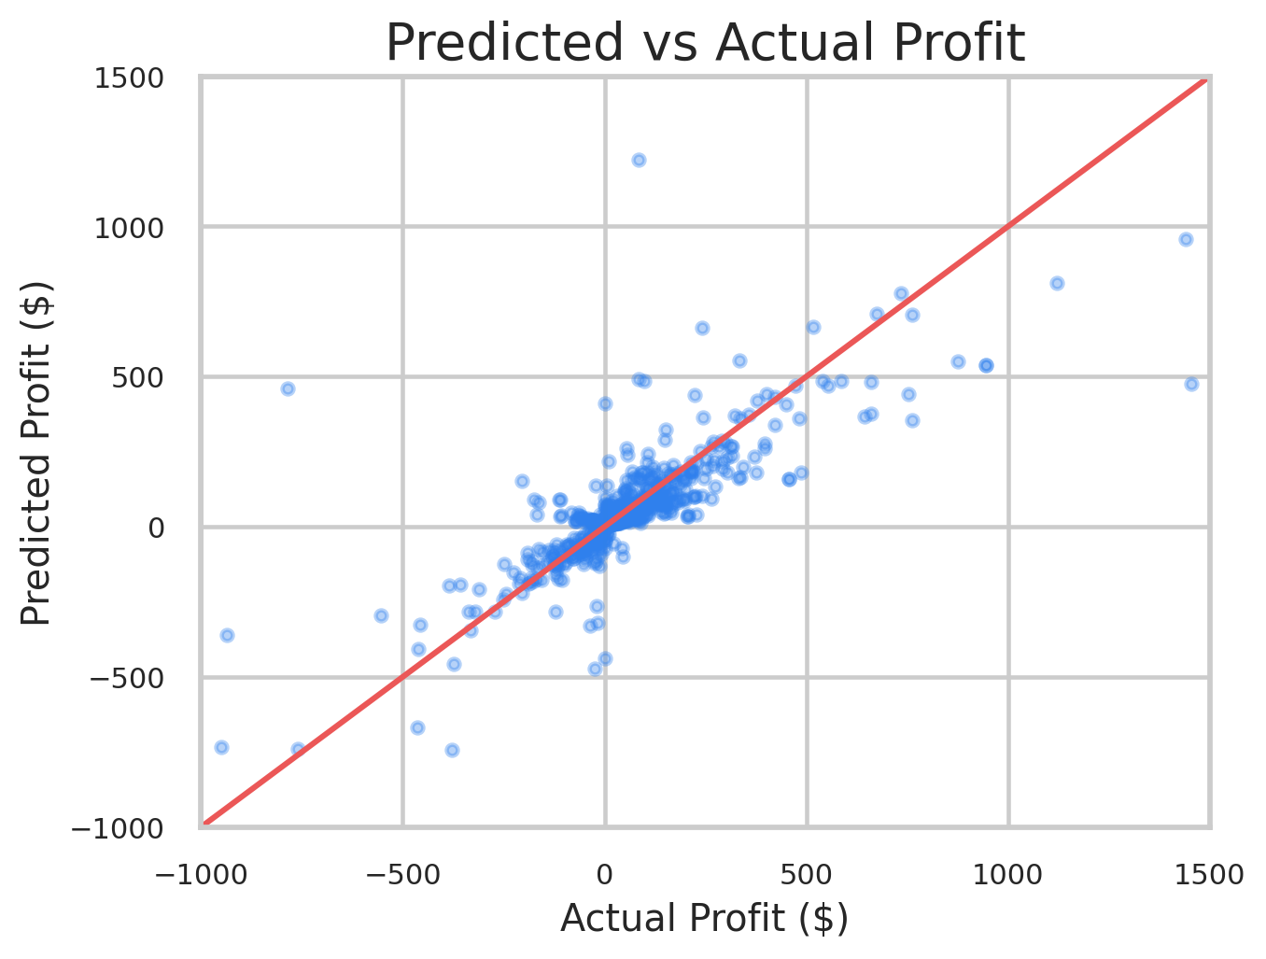
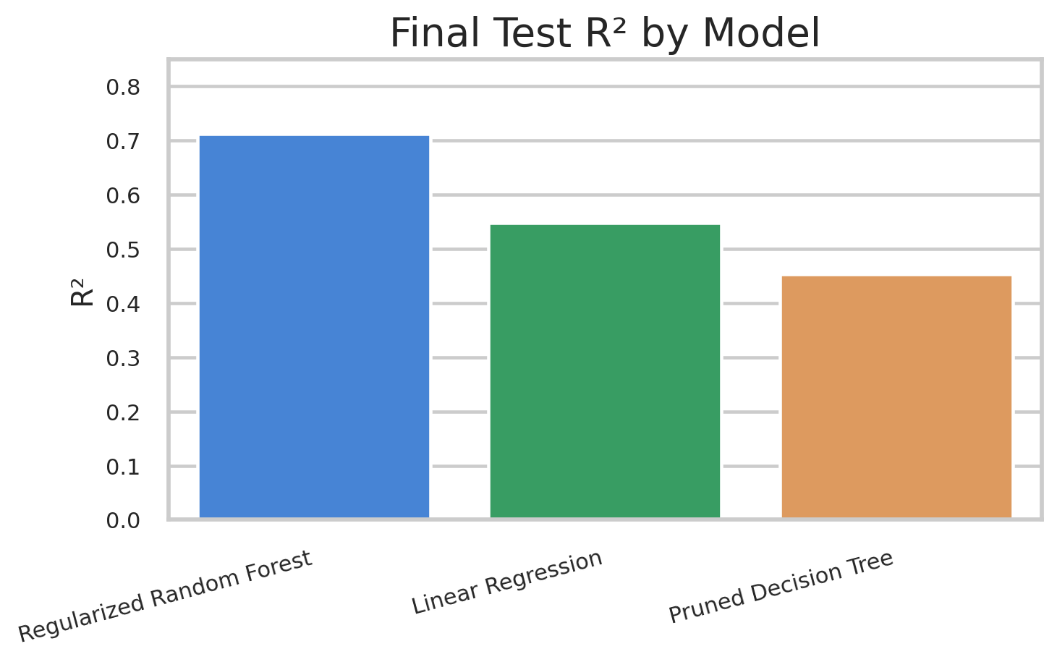
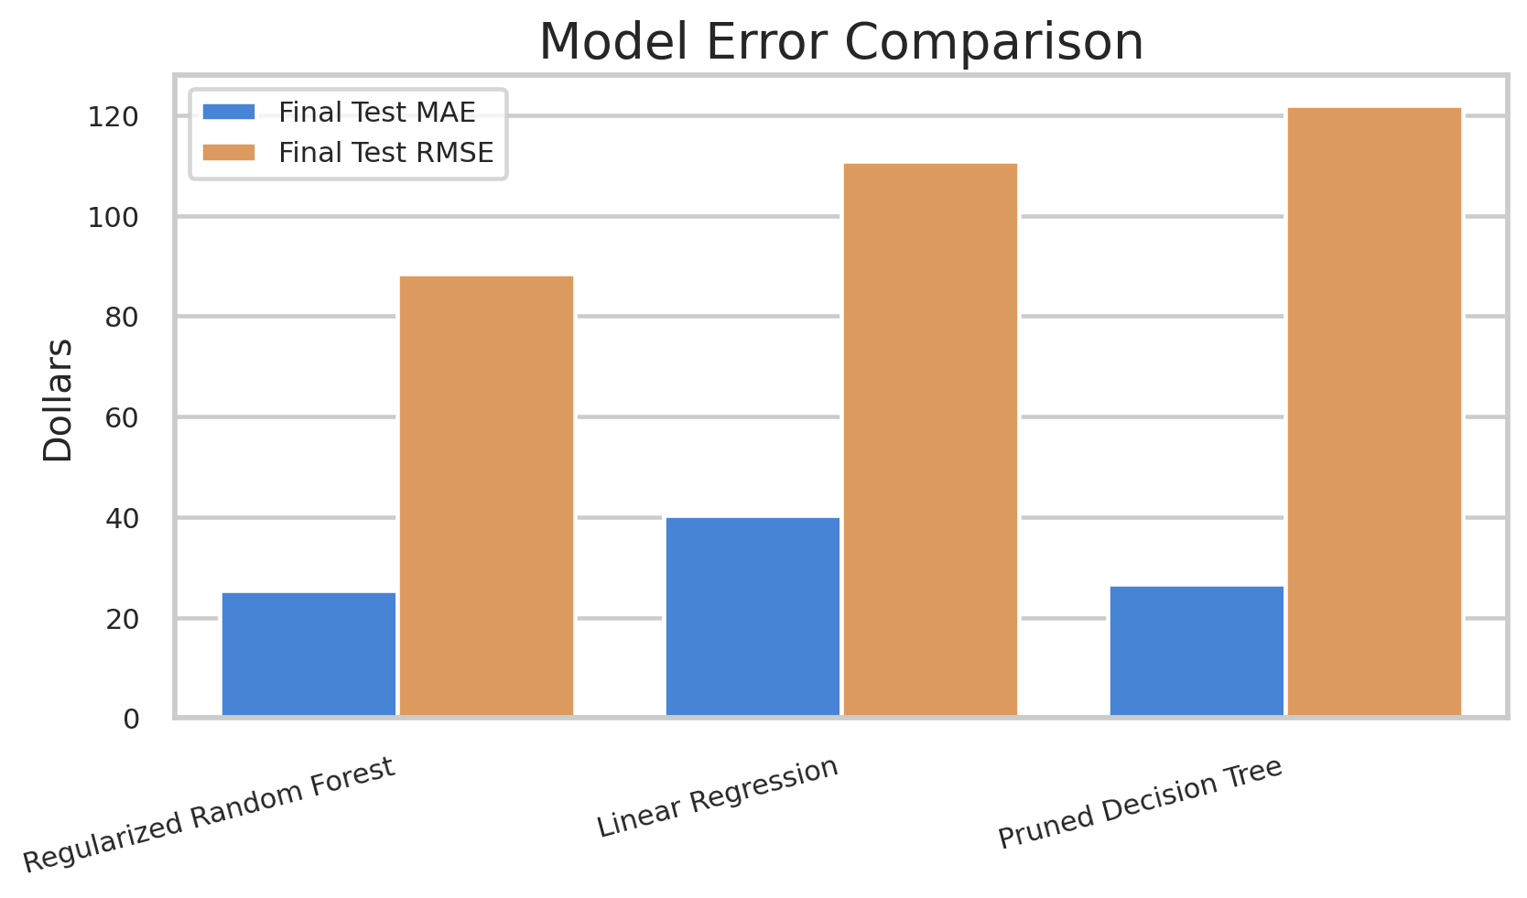
Best model: Regularized Random Forest
08
Model Evaluation & Comparison
Model
Test R²
MAE
RMSE
R² gap
Regularized Random Forest
0.712
$25.50
$88.53
-0.079
Linear Regression
0.548
$40.31
$110.85
0.206
Pruned Decision Tree
0.453
$26.72
$121.95
0.241
Predicted vs actual shows broad alignment, with some extreme residuals.
Random Forest explains the most holdout variation.
Interpretation: Test R² = 0.712 and MAE ≈ $25.50 are strong for a sparse retail-margin model. Remaining errors are driven by extreme profit/loss outliers and missing cost-level features.
Lower error is better; Random Forest has the best MAE/RMSE.
8/10

Slide 9
Move from descriptive insight to discount policy
09
Business Recommendations
Furniture is the least profitable category despite substantial sales.
Policy recommendation: set a default maximum discount of 20%. Discounts above 20% should trigger margin validation; 40%+ should require approval or be blocked.
At >40% discount, average profit is strongly negative and loss rate is near universal.
Prioritize Furniture margin review, especially Tables and Bookcases.
Use predicted profit before approving promotional discounts.
Monitor Central region because sales are sizable but profit lags South.
Track discount bands monthly to see whether policy reduces loss-making orders.
9/10

Slide 10
Profit estimator + discount simulator
10
Prototype Demo, Conclusion & Future Work
def predict_profit(sales, discount, category, region):
new_order = pd.DataFrame([{
"Sales": sales,
"Discount": discount,
"Category": category,
"Region": region
}])
return best_model.predict(new_order)[0]
Discount simulator workflow
Inputs
RF Model
Profit alert
Future work: add product cost, shipping cost and promotion calendar data.
Use Sub-Category and Segment for a richer operational model.
Deploy Streamlit app for managers to test discount scenarios before approval.
Retrain monthly and compare actual vs predicted margin savings.
Conclusion: the model converts historical order-line patterns into a practical margin-control decision aid. The strongest business signal is the discount risk threshold.
Final takeaway
A 20% discount ceiling with exception-based approvals can directly reduce avoidable loss-making orders.
10/10

