Slide 1

Rockbuster Stealth llc
Supriya Shrotriya March 2025

Slide 2
Overview
Rockbuster Stealth LLC, a former global movie rental company, is adapting to the competitive landscape dominated by streaming services like Netflix and Amazon Prime. To remain competitive, the company plans to utilize its existing movie licenses to launch an online video rental service.
Key Questions and Objectives
Which movies contributed the most/least to revenue gain?
● What was the average rental duration for all videos?
● Which countries are Rockbuster customers based i n?
● Where are customers with a high l ifetime value based?
● Do sales figures vary between geographic regions?

Slide 3
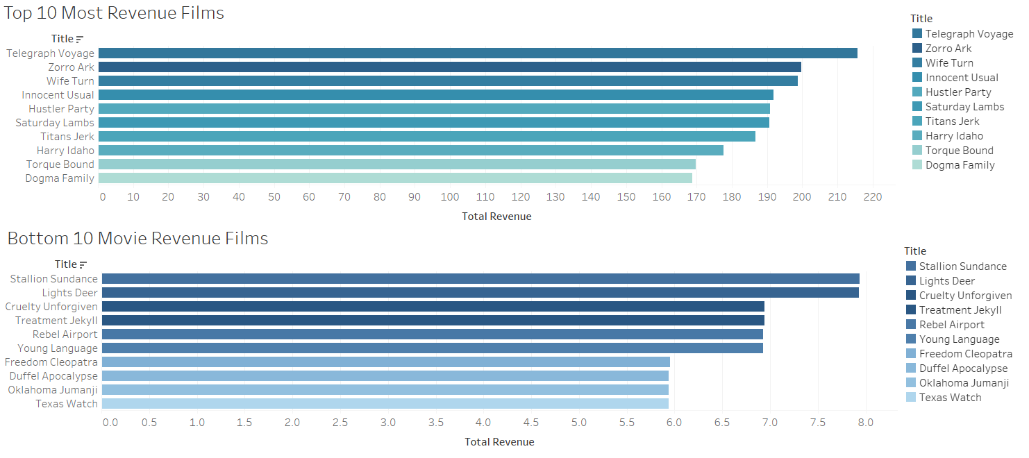
Highest/ Lowest Revenue Generating Films

Slide 4
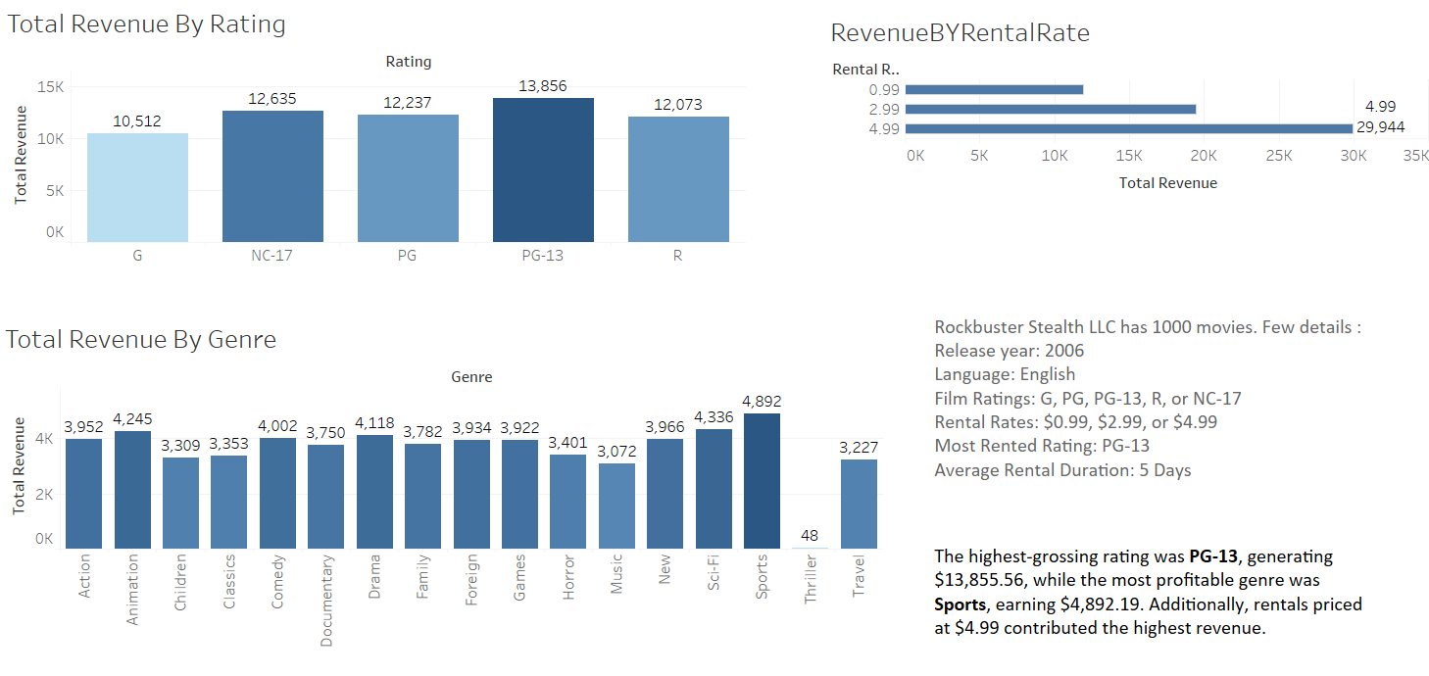
Revenue Analysis

Slide 5
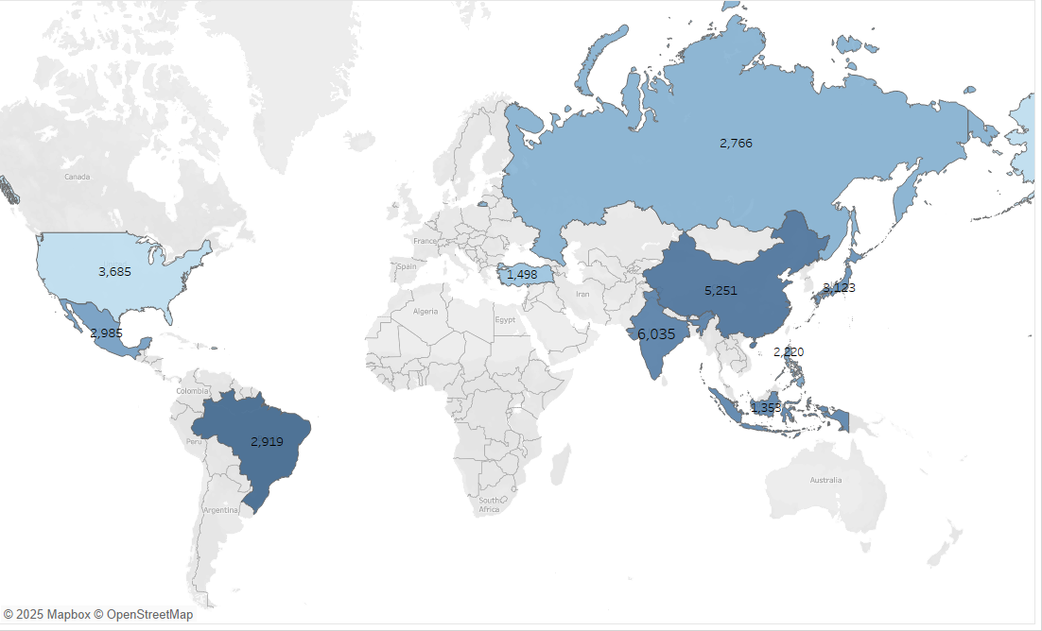
Country wide customer footprint
The map reveals the top ten countries where Rockbuster customers are based.Most customers are based in Asia with India and China being the top two.

Slide 6
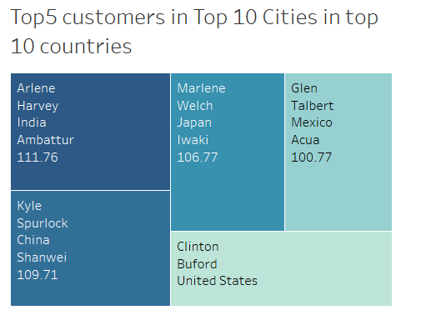
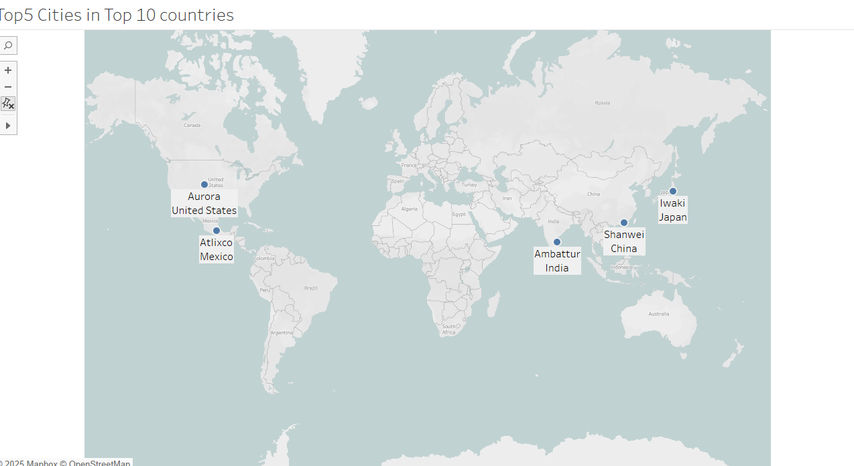
High Lifetime Customers in top 5 cities in the top countries
The map reveals top cities where the top 5 customers reside.
The 5 customers are listed below, out of which three are based in Asia

Slide 7

Key Findings and Recommendations
Key Findings
The top three revenue-generating countries are India, China, and the USA.
The top 5 Rockbuster customers are based in Ambattur, Shanwei, Iwaki, Altixco, Aurora. Out of the five three are based in Asia.
Asia is the most revenue generating region.
The best-performing genres are Sports and Sci-Fi, while the top-rated categories are PG-13, followed by NC-17 and PG.
All movies are in English and were released in 2006.
Recommendations
Diversify the film library by adding movies from various languages and time periods to attract a broader international audience and boost revenue.
Launch the online video rental service in the top three countries with the highest customer base to maximize reach and revenue.
Introduce a customer reward program to promote the online rental service and offer exclusive perks for top-paying customers.
Expand the inventory by focusing on high-demand genres and ratings, ensuring a wider selection for customers.
Tableau Public Link

