Slide 1
SWE2005-SOFTWARE TESTING
Module 3
WHITE BOX TESTING

Slide 2
White Box Testing
Examines the program structure and derives test data from the program logic/code.
Also known as
glass box testing
clear box testing
open box testing
logic driven testing
path driven testing
structural testing

Slide 3
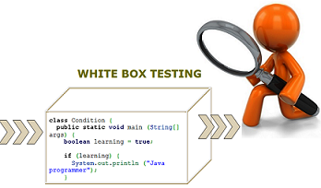

Slide 4
Topics to be covered
White-Box Testing Techniques
Logic Coverage criteria
Basic path testing
Graph matrices
Loop testing
Data flow testing
Mutation testing

Slide 5
1. Logic Coverage Criteria

Slide 6
Logic Coverage Criteria
Structural or White-Box Testing considers the program code and test cases are designed based on the logic of the program such that every element of the logic is covered.

Slide 7
Forms of Logic Coverage Criteria
Statement Coverage
Decision or Branch Coverage
Condition Coverage
Multiple condition Coverage

Slide 8
1.1 Statement Coverage
Statement coverage technique is used to design white box test cases.
This technique involves execution of all statements of the source code at least once.
It is used to calculate the total number of executed statements in the source code out of total statements present in the source code.

Slide 9
Example
print (int a, int b) {
int sum = a+b;
if (sum>0)
print ("This is a positive result")
else
print ("This is negative result")
}
Take input of two values like a=0 and b=1.
Find the sum of these two values.
If the sum is greater than 0, then print "This is the positive result."
If the sum is less than 0, then print "This is the negative result."

Slide 10
Now, let's see the two different scenarios and calculation of the percentage of Statement Coverage for given source code.
Scenario 1: If a = 5, b = 4
In scenario 1, we can see the value of sum will be 9 that is greater than 0 and as per the condition result will be "This is a positive result." The statements highlighted in yellow color are executed statements of this scenario.
To calculate statement coverage of the first scenario, take the total number of statements that is 7 and the number of used statements that is 5.
Total number of statements = 7
Number of executed statements = 5
Statement coverage = 5/7*100= 500/7= 71%

Slide 11
Scenario 2: If A = -2, B = -7
In scenario 2, we can see the value of sum will be -9 that is less than 0 and as per the condition, result will be "This is a negative result." The statements highlighted in yellow color are executed statements of this scenario.
To calculate statement coverage of the first scenario, take the total number of statements that is 7 and the number of used statements that is 6.
Total number of statements = 7 Number of executed statements = 6
Statement coverage = 6/7*100 = 600/7 = 85%
But, we can see all the statements are covered in both scenario and we can consider that the overall statement coverage is 100%.

Slide 12

1.2 Decision Coverage
Decision coverage technique comes under white box testing which gives decision coverage to Boolean values. This technique reports true and false outcomes of Boolean expressions.
Whenever there is a possibility of two or more outcomes from the statements like do while statement, if statement and case statement (Control flow statements), it is considered as decision point because there are two outcomes either true or false.

Slide 13
Example
Test (int a)
{
If(a>4)
a=a*3;
Print (a);
}

Slide 14
Scenario 1: Value of a is 7 (a=7)
Test (int a=7)
{ if (a>4)
a=a*3 ;
print (a) ;
}
Decision Coverage = ½*100 (Only "True" is exercised) =100/2 = 50
Decision Coverage is 50%
The outcome of this code is "True" if condition (a>4) is checked.

Slide 15
Scenario 2: Value of a is 3 (a=3)
Test (int a=3)
{ if (a>4)
a=a*3 ;
print (a) ;
}
= ½*100 (Only "False" is exercised) =100/2 = 50
Decision Coverage = 50%
The outcome of this code is ?False? if condition (a>4) is checked.

Slide 16
Result table of Decision Coverage:
Test Case | Value of A | Output | Decision Coverage
1 | 3 | 3 | 50%
2 | 7 | 21 | 50%

Slide 17
Practice Questions
scanf(“%d%d”,&x,&y);
while(x!=y)
{
if(x>y)
x=x-y;
else y=y-x;
}
printf(“x=%d y=%d”,x,y);

Slide 18
1.1 Statement Coverage
It is assumed that if all the statements of the module are executed once, every bug will be notified.
Test case 1: x = y = n, where n is any number
Test case 2: x = n, y = n’, where n and n’ are different numbers.
Test case 3: x>y
Test case 4: x<y
scanf(“%d%d”,&x,&y);
while(x!=y)
{
if(x>y)
x=x-y;
else y=y-x;
}
printf(“x=%d y=%d”,x,y);

Slide 19
1.3 Condition Coverage
Conditional coverage or expression coverage will reveal how the variables or subexpressions in the conditional statement are evaluated.
In this coverage expressions with logical operands are only considered.
For example, if an expression has Boolean operations like AND, OR, XOR, which indicated total possibilities.

Slide 20
Example
For the above expression, we have 4 possible combinations
TT
FF
TF
FT

Slide 21
Consider the following input:
X=3 Y=4 | (x<y) | TRUE | Condition Coverage is ¼ = 25%
A=3 B=4 | (a>b) | FALSE

Slide 22
1.4 Multiple Condition/Decision Coverage
Condition coverage is correlated to decision coverage as whenever any decision is to be taken, focus will be on number of possible conditions.
Condition Coverage is also known as ‘Predicate Coverage’.

Slide 23
Example
If {(X or Y) and Z} then
To fulfil condition coverage, Boolean expression X, Y and Z will be evaluated in TRUE and FALSE form, at least once.
The test case for condition coverage is given by:
Test Case1: X=TRUE, Y=TRUE, Z=TRUE
Test Case2: X=FALSE, Y=FALSE, Z=FALSE
To satisfy decision coverage, we need to evaluates IF statements in TRUE and FALSE form. Therefore, the test set is expressed as:
Test Case1: X=TRUE, Y=TRUE, Z=TRUE
Test Case2: X=False, Y=FALSE, Z=FALSE

Slide 24
2. Basic Path Testing

Slide 25
The guidelines for effective path testing are:
Path Testing is based on control structure of the program for which flow graph is prepared. It requires complete knowledge of the program’s structure.
It is closer to the developer and used to test his module.
The effectiveness of path testing is reduced with the increase in size of software under test.
Choose enough paths in a program such that maximum logic coverage is achieved
Basis Path Testing (BPT) is the oldest structural testing technique .
The technique is based on the control structure of the program.

Slide 26
2.1 Control Flow Graph
Graphical representation of control structure of a program.
Flow graph can be prepared as a directed graph.
A Directed graph (V,E) consists of set of vertices V and edges E. Flow graph notations are:
Node, Edges or links, Decision Node
Junction node :A node with more than one arrow entering it is called junction node
Regions: Areas bounded by edges and nodes

Slide 27
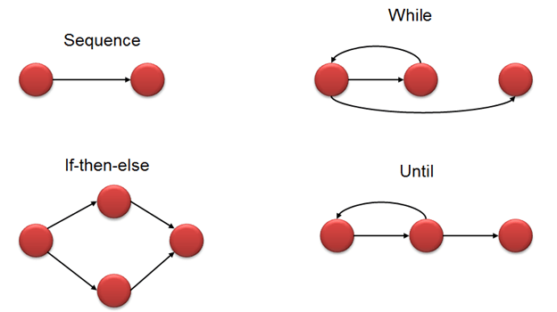
2.2 Flow Graph Notations
Flow graph is also known as Decision to Decision (D&D) graph.
Sequence
If Then Else
Do while
While Do
Switch case

Slide 28
2.3 Path Testing Terminology
Path
Segment
Path Segment
Length of a Path
Independent Path

Slide 29
2.4 Cyclomatic Complexity
Quantitative measure of the logical complexity of a program
Defines the number of independent paths in the basis set
Provides an upper bound for the number of tests that must be conducted to ensure all statements have been executed at least once
Can be computed three ways
The number of regions
V(G) = E – N + 2,
E is the number of edges
N is the number of nodes
in graph G
V(G) = P + 1,
P is the number of predicate
nodes in the flow graph G

Slide 30
Guidelines for BPT
Draw the flow graph using the code provided for which we have to write test cases.
Determine the cyclomatic complexity of the flow graph.
Cyclomatic complexity provides the number of independent paths.
Based on every independent path, choose the data such that this path is executed

Slide 31
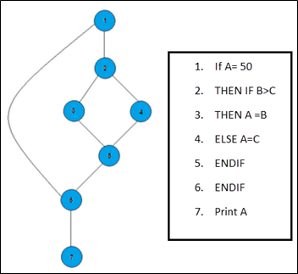
Example BPT
Cyclomatic Complexity:
V(G) = 8 - 7 + 2 = 3
V(G) = 2 + 1 = 3 (Condition nodes are 1,2)
A set of possible execution path of a program
Path 1: 1,2,3,5,6, 7
Path 2: 1,2,4,5,6, 7
Path 3: 1, 6, 7

Slide 32
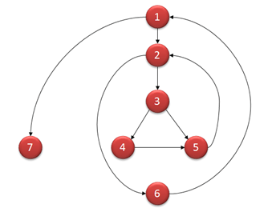
Example BPT
Computing mathematically,
V(G) = 9 - 7 + 2 = 4
V(G) = 3 + 1 = 4 (Condition nodes are 1,2 and 3 nodes)
Basis Set - A set of possible execution path of a program
Path1: 1, 7
Path2: 1, 2, 6, 1, 7
Path3: 1, 2, 3, 4, 5, 2, 6, 1, 7
Path4: 1, 2, 3, 5, 2, 6, 1, 7
i = 0;
n=4; //N-Number of nodes present in the graph
while (i<n-1) do
j = i + 1;
while (j<n) do
if
A[i]<A[j] then
swap(A[i], A[j]);
end do;
i=i+1;
end do;

Slide 33
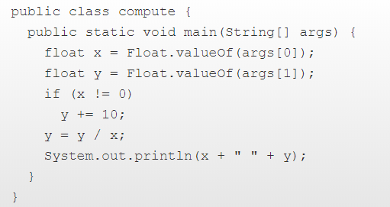
Practice Question-BPT

Slide 34
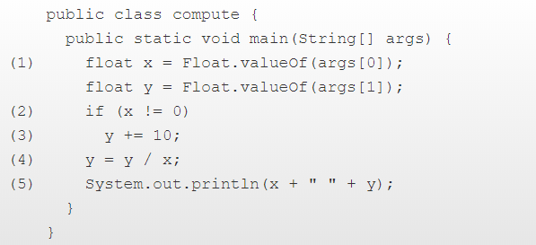
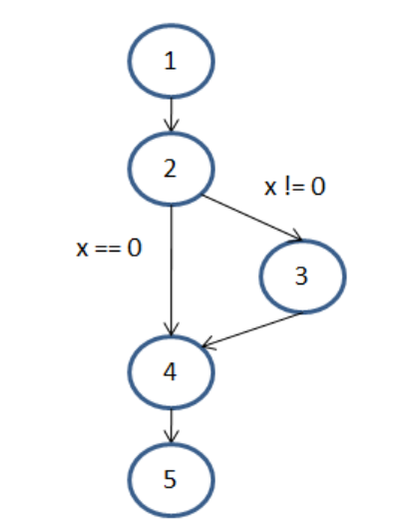
Solution
Control Flow Graph
Cyclomatic Complexity:
V(G)=5-5+2=2
V(G)=1+1=2
Paths:
1245
12345

Slide 35
Path Testing Concepts
Path is a sequence of statements starting at an entry, junction or decision and ending at another, or possibly the same junction or decision or an exit point.
Link is a single process (block) in between two nodes.
Node is a junction or decision.
Segment is a sequence of links. A path consists of many segments.
Path segment is a succession of consecutive links that belongs to the same path. (3,4,5)
Length of a path is measured by # of links in the path or # of nodes traversed.
Name of a path is the set of the names of the nodes along the path.
Path-Testing Path is an “entry to exit” path through a processing block.

Slide 36
_{U2}
Creation of Control Flow Graph from a program
One statement to one element translation to get a Classical Flow chart
Add additional labels as needed
Merge process steps
A process box is implied on every junction and decision
Remove External Labels
Represent the contents of elements by numbers.
We have now Nodes and Links
INPUT X, Y
Z := X + Y
V := X - Y
IF Z >= 0 GOTO SAM
JOE: Z := Z + V
SAM: Z := Z - V
FOR N = 0 TO V
Z := Z - 1
NEXT N
END
_{Z >= 0 ?}
_{NO}
_{INPUT X, Y}
_{Z := X + Y}
_{V := X - Y}
_{JOE}
_{Z := Z - 1}
_{LOOP}
_{N := 0}
_{Z := Z - V}
_{SAM}
_{Z := Z + V}
_{N = V ?}
_{NO}
_{N := N+1}
_{YES}
_{END}
_{One to One Flow Chart}

Slide 37
_{U2}
Creation of Control Flow Graph from a program
One statement to one element translation to get a Classical Flow chart
Add additional labels as needed
Merge process steps
A process box is implied on every junction and decision
Remove External Labels
Represent the contents of elements by numbers.
We have now Nodes and Links
INPUT X, Y
Z := X + Y
V := X - Y
IF Z >= 0 GOTO SAM
JOE: Z := Z + V
SAM: Z := Z - V
FOR N = 0 TO V
Z := Z - 1
NEXT N
END
_{Z >= 0 ?}
_{NO}
_{P1}
_{JOE}
_{P4}
_{LOOP}
_{P3}
_{SAM}
_{P2}
_{N = V ?}
_{NO}
_{P5}
_{YES}
_{END}
_{Simplified Flow Graph}

Slide 38
_{U2}
Creation of Control Flow Graph from a program
One statement to one element translation to get a Classical Flow chart
Add additional labels as needed
Merge process steps
A process box is implied on every junction and decision
Remove External Labels
Represent the contents of elements by numbers.
We have now Nodes and Links
INPUT X, Y
Z := X + Y
V := X - Y
IF Z >= 0 GOTO SAM
JOE: Z := Z + V
SAM: Z := Z - V
FOR N = 0 TO V
Z := Z - 1
NEXT N
END
₁
₂
₃
₄
₅
₆
₇
_{Simplified Flow Graph}

Slide 39
Linked List Notation of a Control Flow Graph
Node Processing, label, Decision Next-Node
1 (BEGIN; INPUT X, Y; Z := X+Y ; V := X-Y) : 2
2 ( Z >= 0 ? ) : 4 (TRUE)
: 3 (FALSE)
3 (JOE: Z := Z + V) : 4
4 (SAM: Z := Z – V; N := 0) : 5
5 (LOOP; Z := Z -1) : 6
6 (N = V ?) : 7 (FALSE)
: END (TRUE)
7 (N := N + 1) : 5
₁
₂
₃
₄
₅
₆
₇

Slide 40
Complete Path Testing prescriptions:
Exercise every path from entry to exit.
Exercise every statement or instruction at least once.
Exercise every branch and case statement in each direction, at least once.
♦ Point 1 => point 2 and 3. ♦ Point 2 & 3 are not the same
♦ Point 1 is impractical. ♦ For a structured language, Point 3 => Point 2

Slide 41
Path Testing Criteria
_{U2}
Path Testing (P∝ ):
Execute all possible control flow paths thru the program; but typically restricted to entry-exit paths.
Implies 100% path coverage. Impossible to achieve.
Statement Testing ( P₁) :
Execute all statements in the program at least once under the some test.
100% statement coverage => 100% node coverage.
Denoted by C1
C1 is a minimum testing requirement in the IEEE unit test standard: ANSI 87B.
Branch Testing (P₂) :
Execute enough tests to assure that every branch alternative has been exercised at least once under some test.
Denoted by C2
Objective: 100% branch coverage and 100% Link coverage.
For well structured software, branch testing & coverage include statement coverage

Slide 42
Picking enough (the fewest) paths for achieving C1+C2
₂
₁
_{Z >= 0 ?}
_{NO}
_{f}
_{P1}
_{a}
_{b}
_{NO}
_{c}
_{END}
_{YES}
_{N = V ?}
_{LOOP}
_{SAM}
_{g}
_{e}
_{d}
₆
₄
₃
₅
Does every decision have Y & N (C2)?
Has every case of all case statement been marked (C2)?
Is every three way branch covered (C2)?
Is every link covered at least once (C1)?
Make small changes in the path changing only 1 link or node at a time.
Paths | Decisions |  | Process-link
 | 2 | 5 | a | b | c | d | e | f | g
abdeg | Y | Y | Y | Y |  | Y | Y |  | Y
acdeg | N | Y | Y |  | Y | Y | Y |  | Y
abdefeg | Y | N | Y | Y |  | Y | Y | Y | Y
acdefeg | N | Y | Y |  | Y | Y | Y | Y | Y

Slide 43
Control Flow Graphs and Path Testing
Revised path selection Rules
Pick the simplest and functionally sensible entry/exit path
Pick additional paths as small variations from previous paths. (pick those with no loops, shorter paths, simple and meaningful)
Pick additional paths but without an obvious functional meaning (only to achieve C1+C2 coverage).
Be comfortable with the chosen paths. play hunches, use intuition to achieve C1+C2
Don’t follow rules slavishly – except for coverage

Slide 44
Graph Matrices Testing

Slide 45
3.Graph Matrices Testing
Graph matrix, a data structure, is the solution that can assist in developing a tool for automation of path tracing because the properties of graph matrices are fundamental to test tool building.
Graph Matric ,a data structure is the solution which can assist in developing a tool for automation of path tracing.

Slide 46
3.1 Graph Matrix
A square matrix whose size is equal to the number of nodes on the flow graph.
Each row and column corresponds to an identified node, and matrix entries correspond to connections between nodes.

Slide 47
3.2 Connection Matrix
If we add link weights to each cell entry, then graph matrix can be used as a powerful tool in testing.
The links between two nodes are assigned a link weight which becomes the entry in the cell of matrix.
The link weight provides information about control flow..

Slide 48
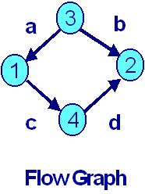
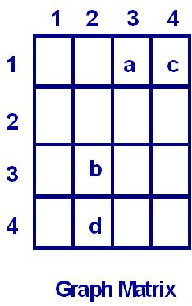
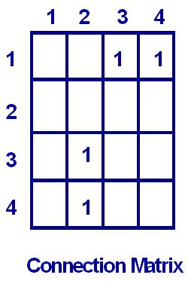
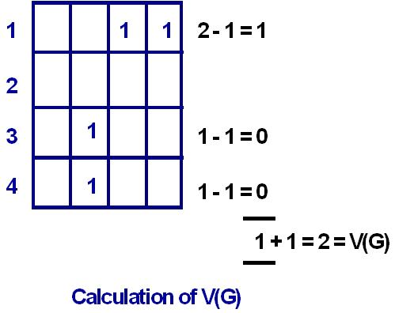
Example 1

Slide 49
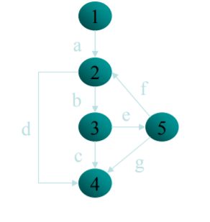
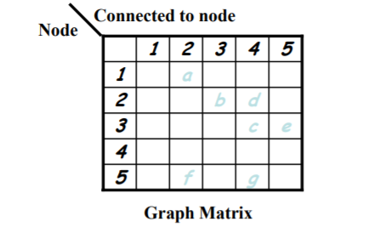
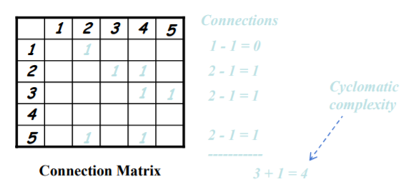
Practice Question

Slide 50
Loop Testing

Slide 51
_{U2}
Testing of Paths involving loops
Bugs in iterative statements apparently are not discovered by C1+C2.
But by testing at the boundaries of loop variable.
Types of Iterative statements
Single loop statement.
Nested loops.
Concatenated Loops.
Horrible Loops
Let us denote the Minimum # of iterations by nmin
the Maximum # of iterations by nmax
the value of loop control variable by V
the #of test cases by T
the # of iterations carried out by n
Later, we analyze the Loop-Testing times

Slide 52
_{U2}
Testing of path involving loops…
Testing a Single Loop Statement (three cases)
Case 1. nmin = 0, nmax = N, no excluded values
1. Bypass the loop.
If you can’t, there is a bug, nmin ≠ 0 or a wrong case.
2. Could the value of loop (control) variable V be negative?
could it appear to specify a –ve n ?
3. Try one pass through the loop statement: n = 1
4. Try two passes through the loop statement: n = 2
To detect initialization data flow anomalies:
Variable defined & not used in the loop, or
Initialized in the loop & used outside the loop.
5. Try n = typical number of iterations : nmin < n < nmax
6. Try n = nmax -1
7. Try n = nmax
8. Try n = nmax + 1.
What prevents V (& n) from having this value?
What happens if it is forced?
1
2

Slide 53
_{U2}
Testing of path involving loops…
Case 2. nmin = +ve, nmax = N, no excluded values
1. Try nmin - 1
Could the value of loop (control) variable V be < nmin?
What prevents that ?
2. Try nmin
3. Try nmin + 1
4. Once, unless covered by a previous test.
5. Twice, unless covered by a previous test.
4. Try n = typical number of iterations : nmin < n < nmax
5. Try n = nmax -1
6. Try n = nmax
7. Try n = nmax + 1.
What prevents V (& n) from having this value?
What happens if it is forced?
Note: only a case of no iterations, n = 0 is not there.
1
2

Slide 54
_{U2}
Path Testing Concepts…
Case 3. Single loop with excluded values
1. Treat this as single loops with excluded values as two sets.
2. Example:
V = 1 to 20 excluding 7,8,9 and10
Test cases to attempt are for:
V = 0,1,2,4,6,7 and V = 10,11,15,19,20,21
(underlined cased are not supposed to work)
1
2

Slide 55
_{U2}
Testing of path involving loops…
Testing a Nested Loop Statement
Multiplying # of tests for each nested loop => very large # of tests
A test selection technique:
Start at the inner-most loop. Set all outer-loops to Min iteration parameter values: V_{min}.
Test the V_{min,} V_{min} + 1, typical V, V_{max} - 1, V_{max} for the inner-most loop. Hold the outer-loops to V_{min.} Expand tests are required for out-of-range & excluded values.
If you have done with outer most loop, Go To step 5. Else, move out one loop and do step 2 with all other loops set to typical values.
Continue outward in this manner until all loops have been covered.
Do the five cases for all loops in the nest simultaneously.
1
2
3
4

Slide 56
_{U2}
Testing of path involving loops…
Compromise on # test cases for processing time.
Expand tests for solving potential problems associated with initialization of variables and with excluded combinations and ranges.
Apply Huang’s twice thorough theorem to catch data initialization problems.
1
2
3
4

Slide 57
_{U2}
Testing of path involving loops…
Testing Concatenated Loop Statements
Two loops are concatenated if it’s possible to reach one after exiting the other while still on the path from entrance to exit.
If these are independent of each other, treat them as independent loops.
If their iteration values are inter-dependent & these are same path, treat these like a nested loop.
Processing times are additive.
1
2
3
4

Slide 58
_{U2}
Testing of path involving loops…
Testing Horrible Loops
Avoid these.
Even after applying some techniques of paths, resulting test cases not definitive.
Too many test cases.
Thinking required to check end points etc. is unique for each program.
Jumps in & out of loops and intersecting loops etc, makes test case selection an ugly task.
etc. etc.
1
2
3
4
5
6

Slide 59
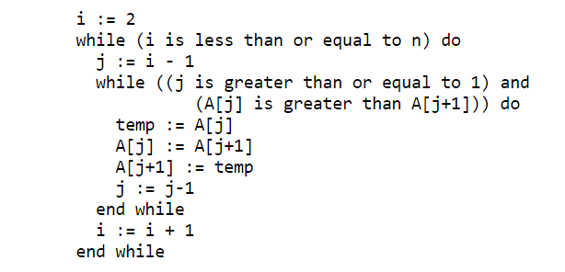
Example
The following sorting algorithm will be used as an example. It uses an array A of n integers A[1], A[2], ..., A[n] as input, and returns the same array output, with its contents rearranged in sorted (increasing) order.

Slide 60
Predicates, Predicate Expressions and
Achievable Paths

Slide 61
_{U2}
Predicates, Predicate Expressions
Path
A sequence of process links (& nodes)
Predicate
The logical function evaluated at a decision : True or False. (Binary , boolean)
Compound Predicate
Two or more predicates combined with AND, OR etc.
Path Predicate
Every path corresponds to a succession of True/False values for the predicates traversed on that path.
A predicate associated with a path.
“ X > 0 is True “ AND “W is either negative or equal to 122” is True
Multi-valued Logic / Multi-way branching

Slide 62
_{U2}
Predicates, Predicate Expressions…
Predicate Interpretation
The symbolic substitution of operations along the path in order to express the predicate solely in terms of the input vector is called predicate interpretation.
An input vector is a set of inputs to a routine arranged as a one dimensional array.
Example:
INPUT X, Y INPUT X
ON X GOTO A, B, C IF X < 0 THEN Y:= 2
A: Z := 7 @ GOTO H ELSE Y := 1
B: Z := -7 @ GOTO H IF X + Y*Y > 0 THEN …
C: Z := 0 @ GOTO H
H: DO SOMETHING
K: IF X + Z > 0 GOTO GOOD ELSE GOTO BETTER
Predicate interpretation may or may not depend on the path. IF -7 > 3 ..
Path predicates are the specific form of the predicates of the decisions along the selected path after interpretation.

Slide 63
_{U2}
Predicates, Predicate Expressions…
Process Dependency
An input variable is independent of the processing if its value does not change as a result of processing.
An input variable is process dependent if its value changes as a result of processing.
A predicate is process dependent if its truth value can change as a result of processing.
A predicate is process independent if its truth value does not change as a result of processing.
Process dependence of a predicate doesn’t follow from process dependence of variables
Examples: X + Y = 10 Increment X & Decrement Y.
X is odd Add an even # to X
If all the input variables (on which a predicate is based) are process independent, then predicate is process independent.

Slide 64
_{U2}
Predicates, Predicate Expressions…
Correlation
Two input variables are correlated if every combination of their values cannot be specified independently.
Variables whose values can be specified independently without restriction are uncorrelated.
A pair of predicates whose outcomes depend on one or more variables in common are correlated predicates.
Every path through a routine is achievable only if all predicates in that routine are uncorrelated.
If a routine has a loop, then at least one decision’s predicate must be process dependent. Otherwise, there is an input value which the routine loops indefinitely.

Slide 65
_{U2}
Predicates, Predicate Expressions…
Path Predicate Expression
Every selected path leads to an associated boolean expression, called the path predicate expression, which characterizes the input values (if any) that will cause that path to be traversed.
Select an entry/exit path. Write down un-interpreted predicates for the decisions along the path. If there are iterations, note also the value of loop-control variable for that pass. Converting these into predicates that contain only input variables, we get a set of boolean expressions called path predicate expression.
Example (inputs being numerical values):
If X ₅ > 0 .OR. X ₆ < 0 then
X1 + 3X2 + 17 >= 0
X3 = 17
X4 – X1 >= 14 X2

Slide 66
_{U2}
Predicates, Predicate Expressions…
A: X ₅ > 0 E: X ₆ < 0
B: X1 + 3X2 + 17 >= 0 F: X1 + 3X2 + 17 >= 0
C: X3 = 17 G: X3 = 17
D: X4 – X1 >= 14 X2 H: X4 – X1 >= 14 X2
Converting into the predicate expression form:
A B C D + E B C D ⇒ ( A + E ) B C D
If we take the alternative path for the expression: D then
(A + E ) B C D

Slide 67
_{U2}
Predicates, Predicate Expressions…
Predicate Coverage:
If all possible combinations of truth values corresponding to selected path have been explored under some test, we say predicate coverage has been achieved.
Stronger than branch coverage.
If all possible combinations of all predicates under all interpretations are covered, we have the equivalent of total path testing.

Slide 68
_{U2}
Testing blindness
Coming to the right path – even thru a wrong decision (at a predicate). Due to the
interaction of some statements makes a buggy predicate work, and
the bug is not detected by the selected input values.
Calculating wrong number of tests at a predicate
by ignoring the # of paths to arrive at it.
Cannot be detected by path testing and need other strategies

Slide 69
Testing blindness
Assignment blinding: A buggy Predicate seems to work correctly as the specific value chosen in an assignment statement works with both the correct & buggy predicate.
Correct Buggy
X := 7 X := 7
IF Y > 0 THEN … IF X + Y > 0 THEN … (check for Y=1)
Equality blinding:
When the path selected by a prior predicate results in a value that works both for the correct & buggy predicate.
Correct Buggy
IF Y = 2 THEN … IF Y = 2 THEN ..
IF X + Y > 3 THEN … IF X > 1 THEN (check for any X>1)
Self-blinding
When a buggy predicate is a multiple of the correct one and the result is indistinguishable along that path.
Correct Buggy
X := A X := A
IF X - 1 > 0 THEN … IF X + A -2 > 0 THEN … (check for any X,A)
_{U2}

Slide 70
Achievable Paths
Objective is to select & test just enough paths to achieve a satisfactory notion of test completeness such as C1 + C2.
Extract the program’s control flow graph & select a set of tentative covering paths.
For a path in that set, interpret the predicates.
Trace the path through, multiplying the individual compound predicates to achieve a boolean expression. Example: (A + BC) ( D + E)
Multiply & obtain sum-of-products form of the path predicate expression:
AD + AE + BCD + BCE
Each product term denotes a set of inequalities that, if solved, will yield an input vector that will drive the routine along the selected path.
A set of input values for that path is found when any of the inequality sets is solved.
A solution found => path is achievable. Otherwise the path is unachievable.
_{U2}

Slide 71
_{U2}
Path Sensitization
It’s the act of finding a set of solutions to the path predicate expression.
In practice, for a selected path finding the required input vector is not difficult. If there is difficulty, it may be due to some bugs.
Heuristic procedures:
Choose an easily sensitizable path set, & pick hard-to-sensitize paths to achieve more coverage.
Identify all the variables that affect the decisions. For process dependent variables, express the nature of the process dependency as an equation, function, or whatever is convenient and clear. For correlated variables, express the logical, arithmetic, or functional relation defining the correlation.
Identify correlated predicates and document the nature of the correlation as for variables. If the same predicate appears at more than one decision, the decisions are obviously correlated.
Start path selection with uncorrelated & independent predicates. If coverage is achieved, but the path had dependent predicates, something is wrong.

Slide 72
_{U2}
Path Sensitization… Heuristic procedures: contd..
If the coverage is not achieved yet with independent uncorrelated predicates, extend the path set by using correlated predicates; preferably process independent (not needing interpretation)
If the coverage is not achieved, extend the path set by using dependent predicates (typically required to cover loops), preferably uncorrelated.
Last, use correlated and dependent predicates.
For each of the path selected above, list the corresponding input variables. If the variable is independent, list its value. For dependent variables, interpret the predicate ie., list the relation. For correlated variables, state the nature of the correlation to other variables. Determine the mechanism (relation) to express the forbidden combinations of variable values, if any.
Each selected path yields a set of inequalities, which must be simultaneously satisfied to force the path.

Slide 73
Data Flow Testing

Slide 74
Data-Flow Testing
Data-flow testing uses the control flowgraph to explore the unreasonable things that can happen to data (i.e., anomalies).
Consideration of data-flow anomalies leads to test path selection strategies that fill the gaps between complete path testing and branch or statement testing.

Slide 75
Data-Flow Testing (Cont’d)
Data-flow testing is the name given to a family of test strategies based on selecting paths through the program’s control flow in order to explore sequences of events related to the status of data objects.
E.g., Pick enough paths to assure that:
Every data object has been initialized prior to its use.
All defined objects have been used at least once.

Slide 76
Data Object Categories
(d) Defined, Created, Initialized
(k) Killed, Undefined, Released
(u) Used:
(c) Used in a calculation
(p) Used in a predicate

Slide 77
(d) Defined Objects
An object (e.g., variable) is defined when it:
appears in a data declaration
is assigned a new value
is a file that has been opened
is dynamically allocated
...

Slide 78
(u) Used Objects
An object is used when it is part of a computation or a predicate.
A variable is used for a computation (c) when it appears on the RHS (sometimes even the LHS in case of array indices) of an assignment statement.
A variable is used in a predicate (p) when it appears directly in that predicate.

Slide 79
Example: Definition and Uses
What are the definitions and uses for the program below?
1. read (x, y);
2. z = x + 2;
3. if (z < y)
4 w = x + 1;
else
5. y = y + 1;
6. print (x, y, w, z);

Slide 80
Example: Definition and Uses
Def | C-use | P-use
x, y
z | x
 |  | z, y
w | x
y | y
 | x, y, w, z
1. read (x, y);
2. z = x + 2;
3. if (z < y)
4 w = x + 1;
else
5. y = y + 1;
6. print (x, y, w, z);

Slide 81
DATA FLOW ANOMALIES
An anomaly is denoted by a two-character sequence of actions.
For example, ku means that the object is killed and then used, where as dd means that the object is defined twice without an intervening usage.

Slide 82
Two-Letter Anomalies
There are nine possible two-letter combinations for d, k and u. some are bugs, some are suspicious, and some are okay.
dd :- probably harmless but suspicious. Why define the object twice without an intervening usage?
dk :- probably a bug. Why define the object without using it?
du :- the normal case. The object is defined and then used.
kd :- normal situation. An object is killed and then redefined.
kk :- harmless but probably buggy. Did you want to be sure it was really killed?
ku :- a bug. the object doesn't exist.
ud :- usually not a bug because the language permits reassignment at almost any time.
uk :- normal situation.
uu :- normal situation.

Slide 83
Single Letter Anomalies
In addition to the two letter situations, there are six single letter situations.
We will use a leading dash to mean that nothing of interest (d,k,u) occurs prior to the action noted along the entry-exit path of interest.
A trailing dash to mean that nothing happens after the point of interest to the exit.
They possible anomalies are:
-k :- possibly anomalous because from the entrance to this point on the path, the variable had not been defined. We are killing a variable that does not exist.
-d :- okay. This is just the first definition along this path.
-u :- possibly anomalous. Not anomalous if the variable is global and has been previously defined.
k- :- not anomalous. The last thing done on this path was to kill the variable.
d- :- possibly anomalous. The variable was defined and not used on this path. But this could be a global definition.
u- :- not anomalous. The variable was used but not killed on this path. Although this sequence is not anomalous, it signals a frequent kind of bug. If d and k mean dynamic storage allocation and return respectively, this could be an instance in which a dynamically allocated object was not returned to the pool after use.

Slide 84
DATA FLOW ANOMALY STATE GRAPH:
Data flow anomaly model prescribes that an object can be in one of four distinct states:
K :- undefined, previously killed, does not exist
D :- defined but not yet used for anything
U :- has been used for computation or in predicate
A :- anomalous

Slide 85
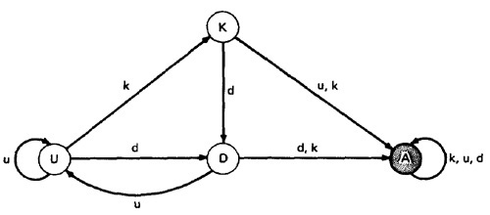
DATA FLOW ANOMALY STATE GRAPH:
These capital letters (K,D,U,A) denote the state of the variable and should not be confused with the program action, denoted by lower case letters.
Unforgiving Data - Flow Anomaly Flow Graph:

Slide 86
STATIC Vs DYNAMIC ANOMALY DETECTION
Static analysis is analysis done on source code without actually executing it. For example: source code syntax error detection is the static analysis result.
Dynamic analysis is done on the fly as the program is being executed and is based on intermediate values that result from the program's execution. For example: a division by zero warning is the dynamic result.
If a problem, such as a data flow anomaly, can be detected by static analysis methods, then it does not belongs in testing - it belongs in the language processor.

Slide 87
There is actually a lot more static analysis for data flow analysis for data flow anomalies going on in current language processors.
For example, language processors which force variable declarations can detect (-u) and (ku) anomalies.
But still there are many things for which current notions of static analysis are INADEQUATE.

Slide 88
Why Static Analysis isn't enough?
Dead Variables
Arrays
Records and Pointers
Dynamic Subroutine and Function Names in a Call
Concurrency, Interrupts, System Issues

Slide 89
Data-Flow Modeling
Data-flow modeling is based on the control flowgraph.
Each link is annotated with:
symbols (e.g., d, k, u, c, p)
sequences of symbols (e.g., dd, du, ddd)
that denote the sequence of data operations on that link with respect to the variable of interest.

Slide 90
Components of the model:
To every statement there is a node, whose name is unique. Every node has at least one outlink and at least one inlink except for exit nodes and entry nodes.
Exit nodes are dummy nodes placed at the outgoing arrowheads of exit statements (e.g., END, RETURN), to complete the graph. Similarly, entry nodes are dummy nodes placed at entry statements (e.g., BEGIN) for the same reason.
The outlink of simple statements (statements with only one outlink) are weighted by the proper sequence of data-flow actions for that statement. Note that the sequence can consist of more than one letter.

Slide 91
Predicate nodes (e.g., IF-THEN-ELSE, DO WHILE, CASE) are weighted with the p - use(s) on every outlink, appropriate to that outlink.
Every sequence of simple statements (e.g., a sequence of nodes with one inlink and one outlink) can be replaced by a pair of nodes that has, as weights on the link between them, the concatenation of link weights.
If there are several data-flow actions on a given link for a given variable, then the weight of the link is denoted by the sequence of actions on that link for that variable.
Conversely, a link with several data-flow actions on it can be replaced by a succession of equivalent links, each of which has at most one data-flow action for any variable

Slide 92
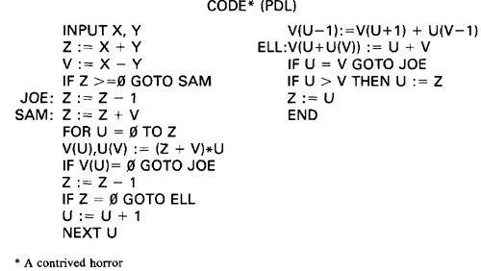
Example

Slide 93
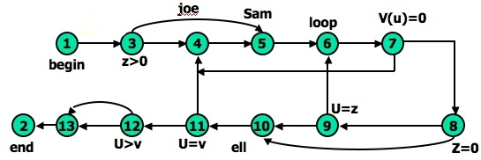
Unannotated flowgraph

Slide 94
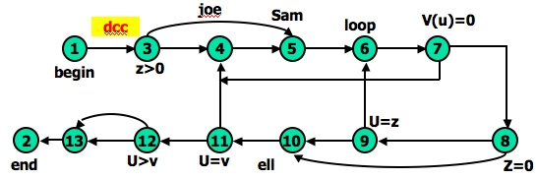
Control flowgraph annotated for X and Y data flows.

Slide 95
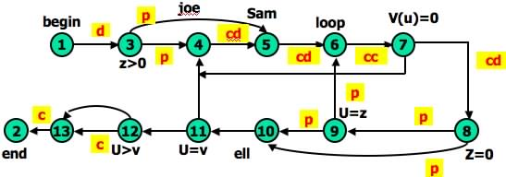
Control flowgraph annotated for Z data flow.

Slide 96
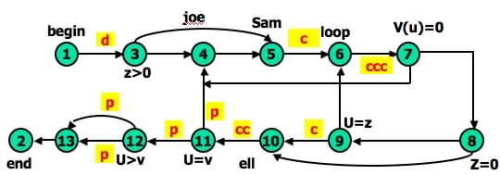
Control flowgraph annotated for V data flow.

Slide 97
Simple Path Segments
A Simple Path Segment is a path segment in which at most one node is visited twice.
E.g., (7,4,5,6,7) is simple.
Therefore, a simple path may or may not be loop-free.

Slide 98
Loop-free Path Segments
A Loop-free Path Segment is a path segment for which every node is visited at most once.
E.g., (4,5,6,7,8,10) is loop-free.
path (10,11,4,5,6,7,8,10,11,12) is not loop-free because nodes 10 and 11 are visited twice.

Slide 99
du Path Segments
A du Path is a path segment such that if the last link has a use of X, then the path is simple and definition clear.

Slide 100
def-use Associations
A def-use association is a triple (x, d, u,), where: x is a variable, d is a node containing a definition of x, u is either a statement or predicate node containing a use of x, and there is a sub-path in the flow graph from d to u with no other definition of x between d and u.

Slide 101
Example: Def-Use Associations
1
read (x, y)
Some Def-Use Associations:
(x, 1, 2), (x, 1, 4), …
(y, 1, (3,t)), (y, 1, (3,f)), (y, 1, 5), …
(z, 2, (3,t)),...
2
z = x + 2
3
z < y
T
F
w = x + 1
4
5
y = y + 1
6
print (x,y,w,z)

Slide 102
Example: Def-Use Associations
What are all the def-use associations for the program below?
read (z) x = 0 y = 0 if (z ≥ 0) {
x = sqrt (z) if (0 ≤ x && x ≤ 5) y = f (x) else y = h (z)
}
y = g (x, y)
print (y)

Slide 103
Example: Def-Use Associations
read (z) x = 0 y = 0 if (z ≥ 0) {
x = sqrt (z) if (0 ≤ x && x ≤ 5) y = f (x) else y = h (z)
}
y = g (x, y)
print (y)
def-use associations for variable z.

Slide 104
Example: Def-Use Associations
read (z) x = 0 y = 0 if (z ≥ 0) {
x = sqrt (z) if (0 ≤ x && x ≤ 5)
y = f (x) else y = h (z)
}
y = g (x, y)
print (y)
def-use associations for variable x.

Slide 105
Example: Def-Use Associations
read (z) x = 0 y = 0 if (z ≥ 0) {
x = sqrt (z) if (0 ≤ x && x ≤ 5) y = f (x) else y = h (z)
}
y=g (x, y)
print (y)
def-use associations for variable y.

Slide 106
Definition-Clear Paths
A path (i, n₁, ..., n_{m}, j) is called a definition-clear path with respect to x from node i to node j if it contains no definitions of variable x in nodes (n₁, ..., n_{m} , j) .
The family of data flow criteria requires that the test data execute definition-clear paths from each node containing a definition of a variable to specified nodes containing c-use and edges containing p-use of that variable.

Slide 107
Dynamic Data-Flow Testing Strategies
All du Paths (ADUP)
All Uses (AU)
All p uses/some c uses(APU+C)
All c uses/some p uses(ACU+P)
All Predicate Uses(APU)
All Computational Uses(ACU)
All Definition(AU)

Slide 108
All du Paths Strategy (ADUP)
ADUP is one of the strongest data-flow testing strategies.
ADUP requires that every du path from every definition of every variable to every use of that definition be exercised under some test All du Paths Strategy (ADUP).

Slide 109
An example: All-du-paths
What are all the du-paths in the following program ?
read (x,y);
for (i = 1; i <= 2; i++)
print (“hello”);
S_{a};
if (y < 0)
S_{b};
else
print (x);

Slide 110
An example: All-du-paths
1
6
y < o
2
read (x, y) i = 1
T
F
print x
S_{b}
7
8
3
i <= 2
T
F
print(“hello”)
i = i + 1
4
5
S_{a}
9
6
y < o

Slide 111
Example: pow(x,y)
/* pow(x,y)
This program computes x to the power of y, where x and y are integers.
INPUT: The x and y values.
OUTPUT: x raised to the power of y is printed to stdout.
*/
void pow (int x, y)
{
float z;
int p;
if (y < 0)
p = 0 – y;
else p = y;
z = 1.0;
while (p != 0)
{
z = z * x;
p = p – 1;
}
if (y < 0)
z = 1.0 / z;
printf(z);
}
b
g
a
d
f
i
1
5
8
9
14
16
17
c
e
h

Slide 112
du-Path for Variable x
/* pow(x,y)
This program computes x to the power of y, where x and y are integers.
INPUT: The x and y values.
OUTPUT: x raised to the power of y is printed to stdout.
*/
1
void pow (int x, y)
2
{
3
float z;
4
int p;
b
g
5
if (y < 0)
6
p = 0 – y;
a
d
f
i
7
else p = y;
1
5
8
9
14
16
17
8
z = 1.0;
9
while (p != 0)
c
h
10
{
e
11
z = z * x;
12
p = p – 1;
13
}
14
if (y < 0)
15
z = 1.0 / z;
16
printf(z);
17
}

Slide 113
du-Path for Variable x
/* pow(x,y)
This program computes x to the power of y, where x and y are integers.
INPUT: The x and y values.
OUTPUT: x raised to the power of y is printed to stdout.
*/
1
void pow (int x, y)
2
{
3
float z;
4
int p;
b
g
5
if (y < 0)
6
p = 0 – y;
a
d
f
i
7
else p = y;
1
5
8
9
14
16
17
8
z = 1.0;
9
while (p != 0)
c
h
10
{
e
11
z = z * x;
12
p = p – 1;
13
}
14
if (y < 0)
15
z = 1.0 / z;
16
printf(z);
17
}

Slide 114
du-Path for Variable y
/* pow(x,y)
This program computes x to the power of y, where x and y are integers.
INPUT: The x and y values.
OUTPUT: x raised to the power of y is printed to stdout.
*/
1
void pow (int x, y)
2
{
3
float z;
4
int p;
b
g
5
if (y < 0)
6
p = 0 – y;
a
d
f
i
7
else p = y;
1
5
8
9
14
16
17
8
z = 1.0;
9
while (p != 0)
c
h
10
{
e
11
z = z * x;
12
p = p – 1;
13
}
14
if (y < 0)
15
z = 1.0 / z;
16
printf(z);
17
}

Slide 115
du-Path for Variable y
/* pow(x,y)
This program computes x to the power of y, where x and y are integers.
INPUT: The x and y values.
OUTPUT: x raised to the power of y is printed to stdout.
*/
1
void pow (int x, y)
2
{
3
float z;
4
int p;
b
g
5
if (y < 0)
6
p = 0 – y;
a
d
f
i
7
else p = y;
1
5
8
9
14
16
17
8
z = 1.0;
9
while (p != 0)
c
h
10
{
e
11
z = z * x;
12
p = p – 1;
13
}
14
if (y < 0)
15
z = 1.0 / z;
16
printf(z);
17
}

Slide 116
du-Path for Variable y
/* pow(x,y)
This program computes x to the power of y, where x and y are integers.
INPUT: The x and y values.
OUTPUT: x raised to the power of y is printed to stdout.
*/
1
void pow (int x, y)
2
{
3
float z;
4
int p;
b
g
5
if (y < 0)
6
p = 0 – y;
a
d
f
i
7
else p = y;
1
5
8
9
14
16
17
8
z = 1.0;
9
while (p != 0)
c
h
10
{
e
11
z = z * x;
12
p = p – 1;
13
}
14
if (y < 0)
15
z = 1.0 / z;
16
printf(z);
17
}

Slide 117
All Uses Strategy (AU)
AU requires that at least one path from every definition of every variable to every use of that definition be exercised under some test.
Hence, at least one definition-clear path from every definition of every variable to every use of that definition be exercised under some test.
Clearly, AU < ADUP.

Slide 118
All p uses/some c uses(APU+C)
APU+C requires that for every variable and every definition of that variable include at least one definition-free path from the definition to every predicate use.
If there are definitions of the variable that are not covered by the above prescription, then add computational-use test cases to cover every definition.

Slide 119
All c-uses/Some p-uses Strategy (ACU+P)
ACU+P requires that for every variable and every definition of that variable include at least one definition-free path from the definition to every computational use.
If there are definitions of the variable that are not covered by the above prescription, then add predicate-use test cases to cover every definition.

Slide 120
All Definitions Strategy (AD)
AD requires that for every variable and every definition of that variable include at least one definition-free path from the definition to a computational or predicate use.
AD < ACU+P and AD < APU+C.

Slide 121
All p-uses (APU) All c-uses (ACU)
APU is the same as APU+C without the C requirement.
APU < APU+C.
ACU is the same as ACU+P without the P requirement.
ACU < ACU+P.

Slide 122
Effectiveness of Strategies
Ntafos compared Random, Branch, and All uses testing strategies on 14 Kernighan and Plauger programs.
Kernighan and Plauger programs are a set of mathematical programs with known bugs that are often used to evaluate test strategies.
Ntafos conducted two experiments:

Slide 123
Results of 2 of the 14 Ntafos Experiments
Mean Number
of Test Cases
Percentage of
Bugs Found
Strategy
Random
Branch
All Uses
35
3.8
11.3
93.7
91.6
96.3
Mean Number
of Test Cases
Percentage of
Bugs Found
Strategy
Random
Branch
All Uses
100
34
84
79.5
85.5
90.0

Slide 124
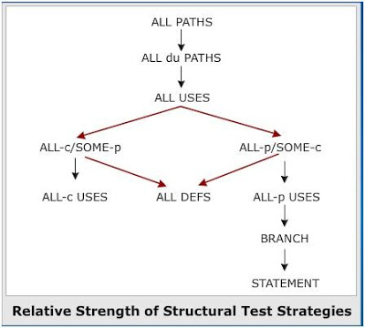
Ordering the Strategies in Data Flow Testing

Slide 125
Summary
AU has the best payoff for the money. It seems to be no worse than twice the number of required test cases for branch testing, but the results are much better.
Path testing with Branch Coverage and Data-flow testing with AU is a very good combination.

Slide 126
5.Mutation Testing

Slide 127
Mutation Testing
Process of mutating some segment of code and then testing this mutated code with some test data.
Helps a user create test data by interacting with the user to iteratively strengthen the quality of test data.
During mutation testing, faults are introduced into a program by creating many versions of the program, each of which contains one fault.

Slide 128
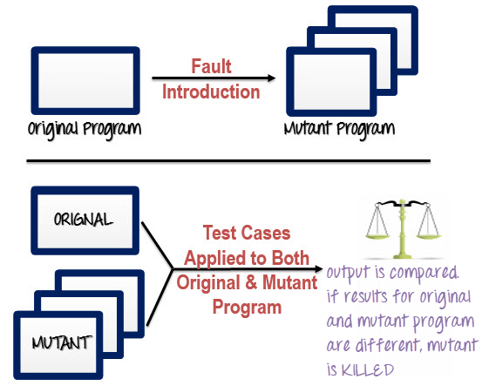

Slide 129
Mutation Testing Process
Following are the steps to execute mutation testing(mutation analysis):
Step 1: Faults are introduced into the source code of the program by creating many versions called mutants. Each mutant should contain a single fault, and the goal is to cause the mutant version to fail which demonstrates the effectiveness of the test cases.
Step 2: Test cases are applied to the original program and also to the mutant program. A Test Case should be adequate, and it is tweaked to detect faults in a program.
Step 3: Compare the results of an original and mutant program.
Step 4: If the original program and mutant programs generate the different output, then that the mutant is killed by the test case. Hence the test case is good enough to detect the change between the original and the mutant program.
Step 5: If the original program and mutant program generate the same output, Mutant is kept alive. In such cases, more effective test cases need to be created that kill all mutants.

Slide 130
Types of Mutants
Primary Mutants:
When the mutant is created by performing the single modification of initial program by using some operator then these mutant are called primary mutant.
Secondary Mutants:
When mutant is created by performing multiple levels of mutation or performing more than single modification it is called secondary mutant.
Higher order mutants :
When the mutant is created by more than two modifications in the initial program it is called higher order mutant. Higher Order Mutants become difficult to manage, control and trace. Hence are not preferred.

Slide 131
Types of Mutation Testing
In Software Testing, Mutation testing could be fundamentally categorized into 3 types– statement mutation, decision mutation, and value mutation.
Statement Mutation - developer cut and pastes a part of a code of which the outcome may be a removal of some lines.
Example:
Initial Code: if(a < b) c = 10; else c = 20; Changed Code: if(a < b) d = 10; else d = 20;

Slide 132
2. Value Mutation- values of primary parameters are modified
Example:
Initial Code: int mod = 1000000007; int a = 12345678; int b = 98765432; int c = (a + b) %
mod;
Changed Code: int mod = 1007; int a = 12345678; int b = 98765432; int c = (a + b) % mod;
3. Decision Mutation- control statements are to be changed
Example:
Initial Code: if(a < b) c = 10; else c = 20; Changed Code: if(a > b) c = 10; else c = 20;

Slide 133
Examples
Primary Mutants
Example:
if(a>b) x = x+y;
else x=x-y;
printf(“%d”,x);
Example mutants are:
M1: x = x – y;
M2: x = x / y;
M3: x = x+1;
M4: printf(“%d”,y);
Secondary Mutants:
Example:
if(a<=b-1)
c=a;
M1: if(a<=b-1) c=a;
M2: if(a+1 <=b) c=a;
M3: if(a==b) c=a+1;

