Slide 1
SWE2005-SOFTWARE TESTING
Verification and Validation Testing
Module 4
Dr. Shivani Gupta,
VIT Chennai

Slide 2
OUTLINE
Introduction to Verification and Validation Testing
Verification Testing(Static Testing)
Inspection
Structured walkthrough
Technical reviews
Validation Testing
Unit testing
Integration testing
System testing
Acceptance testing
System testing

Slide 3
Introduction to Verification Testing
Verification is the process of checking that a software achieves its goal without any bugs.
It is the process to ensure whether the product that is developed is right or not.
It verifies whether the developed product fulfills the requirements that we have. Verification is static testing.
Verification means Are we building the product right?

Slide 4
Introduction to Validation Testing
Validation is the process of checking whether the software product is up to the mark or in other words product has high level requirements.
t is the process of checking the validation of product i.e. it checks what we are developing is the right product.
It is validation of actual and expected product. Validation is the dynamic testing.
Validation means Are we building the right product?

Slide 5
Inspection
Inspections are conducted by a team of four to six members for any model development work product such as requirements specification, design specification, or code.
The team consists of:
Author
Inspector
Moderator
Recorder

Slide 6
Inspection Phases
An inspection goes through six distinct phases:
1.Planning
2. Overview:
3. Individual Preparation
4. Inspection meeting
5. Rework:
6. Follow-up:

Slide 7
Structured Walkthroughs
The Walkthrough Team consists of a moderator, model developer, and 3 to 6 other members.
Except the model developer, all other members should not be directly involved in the model development effort.

Slide 8
Roles of the team members in a structured walkthrough:
Presenter: most often is the model developer.
Coordinator: Organizes, moderates, and follows up the walkthrough activities. Is usually from the SQA department.
Scribe: Documents the events of the meeting.
Maintenance Oracle: Considers long-term implications.
Standards Bearer: Concerned with adherence to standards.
User Representative: Reflects the needs and concerns of the sponsor.
Other Reviewers: (e.g., auditors)
The presenter provides test data and leads the team through a manual simulated execution of the model system.
The test data are walked through the system.
The purpose is to encourage discussions. Most errors are discovered by questioning the developer's decisions at various stages.

Slide 9
Technical Review
The review is conducted in a similar manner as the inspection and walkthrough except in the way the team members are selected.  The review team also involves managers.
The review is intended to:
give management and the sponsor evidence that the model development process is being carried out according to stated requirements and project objectives.
evaluate the model in light of development standards, guidelines, and specifications.
As such, the review is a higher level technique than the inspections and walkthroughs.

Slide 10
Each review team member examines the model documentation prior to the review.
The team then meets to evaluate the model relative to specifications and standards, recording defects and deficiencies.
The result of the review is a document portraying the events of the meeting, deficiencies identified, and review team recommendations.
Appropriate action may then be taken to correct any deficiencies.
As opposed to inspections and walkthroughs, which concentrate on correctness assessment, reviews seek to ascertain that tolerable levels of quality are being attained.

Slide 11
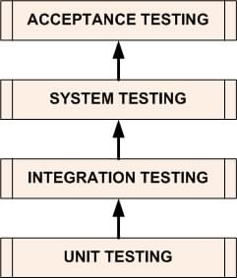
The Four Levels of Software Testing
SOFTWARE TESTING LEVELS are the different stages of the software development lifecycle where testing is conducted.
There are four levels of software testing:
Unit >> Integration >> System >> Acceptance.

Slide 12
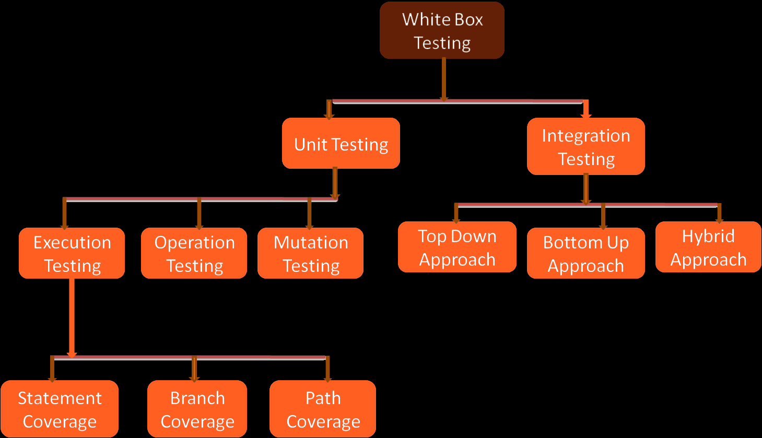

Slide 13
Unit Testing
A level of the software testing process where individual units of a software are tested.
The purpose is to validate that each unit of the software performs as designed.

Slide 14
Unit testing
Also called as component, module, program testing
Verifies functioning of a module.
Stubs, drivers are used to replace the missing software and simulate the interface between the components.

Slide 15
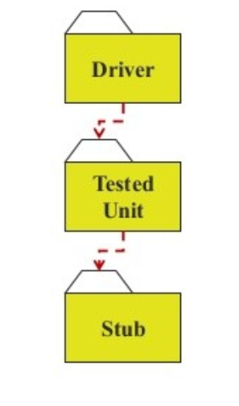
Stubs and Drivers
Stub: Dummy procedure, module or unit that stands in for an unfinished portion of a system.
Driver : Piece of code that passes test cases to another piece of code

Slide 16
Unit Testing Methods
It can be performed in 2 ways :
Manual Testing
Automated Testing

Slide 17
In Manual Testing, the tester manually executes test cases without using any automation tool. Here, each stage of the test is executed manually. Manual Testing is tedious especially for tests that are repetitive and requires more effort to create and execute test cases. Manual Testing does not require knowledge of any testing tool.
In Automated Testing, software testing automation tools are used to automate the tests/test cases. The automation tool can record and save your test and it can be re-played as many times as needed without any further human intervention.

Slide 18
Integration Testing
A level of the software testing process where individual units are combined and tested as a group.
The purpose of this level of testing is to expose faults in the interaction between integrated units.

Slide 19
Types of Integration Testing
Top down integration
Bottom up integration

Slide 20
Top-Down Integration
test
main
Incremental strategy
Start by including highest level modules in test set.
All other modules replaced by stubs or mock objects.
Integrate modules called by called by modules in test set.
Repeat until all modules in test set.
test
main, A, B,C
test
main, A, B, C
D, E, F

Slide 21
Top-Down Integration
test
main
main
A
B
C
test
main, A, C
D
E
F
The integration order can be modified to:
include critical modules first
leave modules not ready to later
test
main, A, C, D, E, F
test
main, A, B, C
D, E, F

Slide 22
Top-Down Integration
Advantages
Fault localization easier
Few or no drivers needed
Different order of testing/implementation possible
Major design flaws found first
Disadvantages
Need lot of stubs
Reusable modules tested inadequately .

Slide 23
Bottom-up Integration
main
Incremental strategy
Test low-level modules, then
Modules calling them until highest level module
A
B
C
D
E
F
test
D
test
D,E,A
test
E
test
main, A, B, C
D, E, F
test
B
test
F
test
C,F

Slide 24
Bottom-up Integration
Advantages
Fault localization easier (than big-bang)
No need for stubs
Logic modules tested thoroughly
Testing can be in parallel with implementation
Dis-advantages
Need drivers
High-level modules tested in the last

Slide 25
System testing
Is concerned with the behavior of the whole product
It includes tests based on requirement specification, business processes , high level description of the system behavior.
Should investigate both functional and non-functional requirements of the system.

Slide 26
Categories of System Testing
Reliability Testing
Security Testing
Performance Testing
Load Testing
Stress Testing
Usability Testing

Slide 27
Acceptance Testing
A level of the software testing process where a system is tested for acceptability.
The purpose of this test is to evaluate the system’s compliance with the business requirements and assess whether it is acceptable for delivery.

Slide 28
Types of Acceptance Testing
Alpha Testing
Beta Testing

