Slide 1
SWE2005-SOFTWARE TESTING
Module 5
Maintenance and Management

Slide 2
Topics to be covered
Regression testing
Objectives
Types
Test Organization
Structure of test group
Test Planning
Test Design Specifications

Slide 3
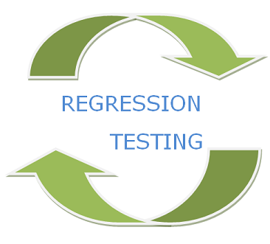

Slide 4
Regression Testing
The process of retesting software that has been modified to insure that no defects have been introduced by the modification, and that the software is still able to meet its specification.

Slide 5
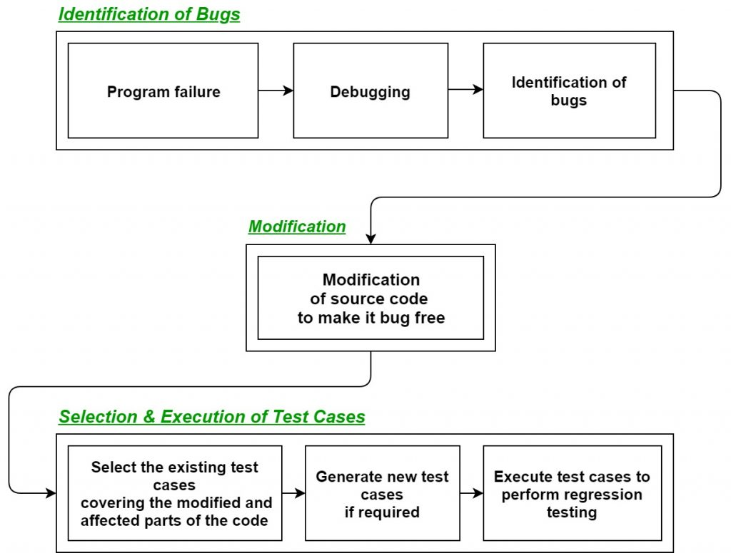

Slide 6
Regression Testing
Regression testing is not a level of testing
No new defects have been introduced due to the changes.
Important when multiple software releases are developed.
Regression testing can occur at any level of test.

Slide 7
Need/Objective of Regression Testing
Change in requirements and code is modified according to the requirement
New feature is added to the software
Defect fixing
Performance issue fix

Slide 8
Retesting and Regression Testing
Retesting means testing the functionality or bug again to ensure the code is fixed. If it is not fixed, Defect needs to be re-opened. If fixed, Defect is closed.
Regression testing means testing your software application when it undergoes a code change to ensure that the new code has not affected other parts of the software.

Slide 9
How is Regression Testing done?
Regression Testing
Regression test selection
Prioritization of test cases
Re-Test All

Slide 10
Complete Regression
In this technique, regression testing is applied to all existing test suites. Although it is the safest way to ensure all bugs are detected and resolved, this method requires substantial time and resources.
That is why the complete regression approach fits better in certain contexts — for example, when the application is adjusted for a new platform or language, or when the operating system gets a major update.

Slide 11
Selective Retest Techniques
Regression Test Selection is a technique in which some selected test cases from test suite are executed to test whether the modified code affects the software application or not. Test cases are categorized into two parts, reusable test cases which can be used in further regression cycles and obsolete test cases which can not be used in succeeding cycles.

Slide 12
Selecting test cases for regression testing
It was found from industry data that a good number of the defects reported by customers were due to last minute bug fixes creating side effects and hence selecting the Test Case for regression testing is an art and not that easy. Effective Regression Tests can be done by selecting the following test cases -
Test cases which have frequent defects
Functionalities which are more visible to the users
Test cases which verify core features of the product
Test cases of Functionalities which has undergone more and recent changes

Slide 13
Selective Retest Techniques Types
Minimization Techniques
Dataflow Techniques
Safe Techniques
Ad-hoc Techniques

Slide 14
Regression Test Prioritization Techniques
Prioritize the test cases depending on business impact, critical & frequently used functionalities. Selection of test cases based on priority will greatly reduce the regression test suite.

Slide 15
Test Management
Test Organization
Structure of Testing Group
Test Planning
Detailed Test Design
Test Specifications

Slide 16
Test Management
Test management, process of managing the tests.
A test management is also performed using tools to manage both types of tests, automated and manual, that have been previously specified by a test procedure.

Slide 17

Test Organization
A test organization defines who is responsible for what activity in the test process. The organization defines the test functions, test facilities and test activities. It defines the competencies and knowledge of the people involved.

Slide 18
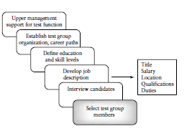
Steps for forming Test group

Slide 19
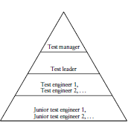
Structure of Test Group

Slide 20
Structure of Test Group
The test manager does:
Policy making,
Customer interaction
Test planning
Test documentation
Controlling
Monitoring
Inspections
Walkthroughs
Reviewing test work
Test repository
Staffing issues
The test lead :
Assists test manager works with a team of test engineers.
Individual projects.

Slide 21
Structure of Test Group(Contd..)
The test engineers:
design, develop, and execute
tests, develop test harnesses
set up test laboratories and environments.
The junior test engineers :
new hires
gain experience

Slide 22
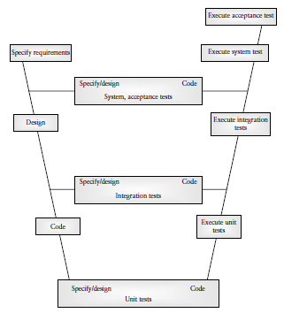
Testing integrated in V Model

Slide 23


Slide 24
Test Planning
A plan is a document that provides a framework or approach for achieving a set of goals.

Slide 25
Test Planning
A plan also contains milestones.
Milestones are tangible events that are expected to occur at a certain time in the project’s lifetime. Managers use them to determine project status.

Slide 26
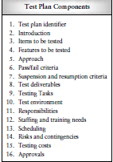
Components of Test Plan

Slide 27
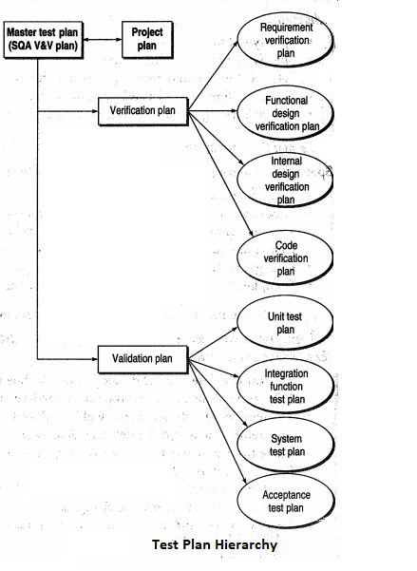
Hierarchy of Test Plan

Slide 28
Detailed Test Design and Test Specifications

Slide 29


Slide 30
Test Design Specifications
IEEE Standard format for design specification which has
Test Design specification Identifier
Features to be tested
Approach refinements
Test case Identification
Pass/Fail Criteria

Slide 31
Test Case Specifications
IEEE Standard format for test case specification which has:
Test case specification identifier
Test Items
Input specifications
Output Specification
Special environmental needs
Special Procedural requirements
Intercase dependencies

Slide 32
Test Procedure Specifications
Sequence of procedure carried for a task
IEEE Standard format
Test procedure specification identifier
Purpose
Specification requirements
Procedure step (setup,start,proceed,measure,shutdown,restart,stop,wrapup,contigencies)

Slide 33
Test Result Specifications
It is used to record and report the testing events during or after the test execution.
It Includes:
Test Log
Test incident report
Test summary report.

Slide 34
Summary
This lecture has given a clear picture about the types regression testing.
Vast information about the test plan, test group, test procedures and specifications.
Detailed description about the format used for test design, test case and test procedure specifications

