Slide 1
SWE2005-SOFTWARE TESTING
Object Oriented Testing
Module 6
Dr. Shivani Gupta,
VIT Chennai

Slide 2
OO Testing
Research confirms that testing methods proposed for procedural approach are not adequate for OO approach
Ex. Statement coverage
OO software testing poses additional problems due to the distinguishing characteristics of OO
Ex. Inheritance
Testing time for OO software found to be increased compared to testing procedural software

Slide 3
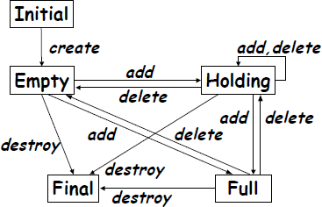
Characteristics of OO Software
15.2
Typical OO characteristics testing …
software impact
that
State dependent behavior
Encapsulation
Inheritance
Polymorphism and dynamic binding
Abstract and generic classes
Exception handling
They simplify developing but complicate Testing!

Slide 4
OO definitions of unit and integration testing
Procedural software
unit = single program, function, or procedure
Object oriented software
unit = class
unit testing = intra-class testing
integration testing = inter-class testing
cluster of classes
dealing with single methods separately is usually too expensive (complex scaffolding), so methods are usually tested in the context of the class they belong to
4

Slide 5
State-based Testing (1)
Natural representation
with
States correspond to certain
finite
values
state
of the
machines
attributes
Transitions correspond to methods
FSM can be used as basis for testing
e.g. “drive” the class through all transitions, and verify the response and the resulting state
Test cases are sequences of method calls that traverse the state machine
6

Slide 6
State-based Testing (2)
State machine model can be derived from:
specification
code
also using reverse engineering techniques
or both …
Accessing the state
add inspector method, e.g. getState()

Slide 7
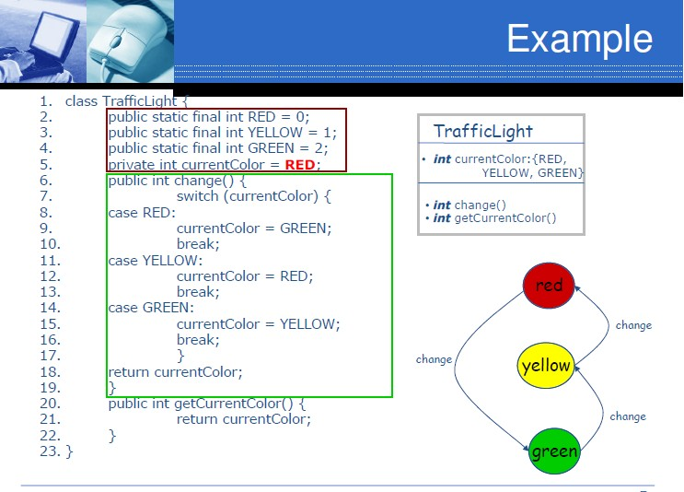
FSM derived by code

Slide 8
Example Stack
States:
Initial: before creation
Empty: number of elements = 0
Holding: number of elements >0, but less than the max Capacity
Full: number elements = max
Final: after destruction
Transitions:
create, destroy
actions that triggers the transition
ex. Add, delete
9

Slide 9
Examples of transitions
Initial -> Empty: action = “create”
e.g. “s = new Stack()” in Java
Empty -> Holding: action = “add”
Empty -> Full: action = “add”
if MAXcapacity=1
Empty -> Final: action = “destroy”
e.g. destructor call in C++, collection in Java
garbage
Holding -> Empty: action = “delete”
if s.size() = 1

Slide 10
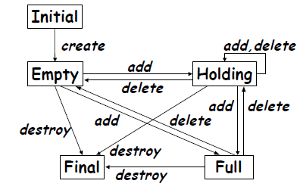
Finite State Machine for a Stack

Slide 11
Coverage methods
Writing testcases such that:
Each state is covered
Each transition is covered
Each path is covered
Often infeasible
Ex. State coverage
T1: Create, add, add, add [full]
T2: Create, destroy [final]

Slide 12
FSM-based Testing
Each valid transition should be tested
Verify the resulting state using a state inspector that has access to the internals of the class
e.g., getState()
Each invalid transition should be tested to ensure that it is rejected and the state does not change
e.g. Full -> Full is not allowed: we should call add on a full stack
Exception “stack is full”
add

Slide 13
Junit Testcase: valid transitions
// only three elements ... public void testStackFull() {
Stack aStack = new Stack();
assertEqual(“empty”, aStack.getState()); aStack.push(10);
assertEqual(“holding”, aStack.getState());
aStack.push(1); aStack.push(7);
assertEqual(“full”, aStack.getState());
}
To have transitions coverage adding other testcases to “drive” the class through all transitions!
14

Slide 14
Junit Testcase: invalid transition
// only three elements ... public void testStackFull() {
Stack aStack = new Stack();
aStack.push(10); aStack.push(-4); aStack.push(7);
assertEqual(“full”, aStack.getState());
try {
aStack.push(10)
fail(“method should launch the exception!!");
} catch(StackFull e){ assertTrue(true); // OK
}
}
15

Slide 15
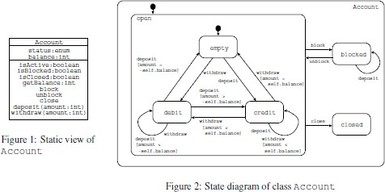
Example 2: Current account

Slide 16
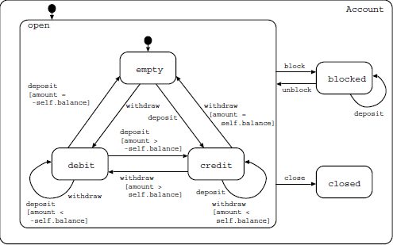
Testcases for account
getState()
TC1: a=account(new); a.withdraw(5); a.close()
TC2: a=account(new); a.withdraw(5); a.deposit(5); a.close()
TC3: a=account(new); a.withdraw(2); a.deposit(5); a.close()
-- debit
-- empty
-- credit

Slide 17
ModelJUnit
ModelJUnit is a Java library that extends JUnit to support model-based testing
Helpful for programmers:
Write models in Java
Focus on unit testing since it integrates well with JUnit
Already available algorithms
Ex. randomwalk
test generation

Slide 18
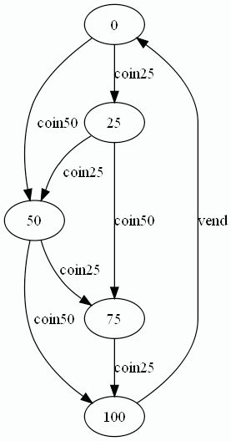
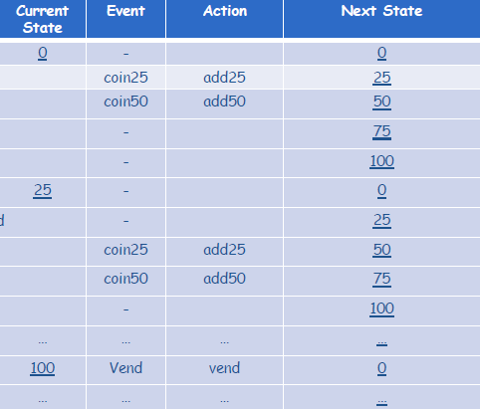
SUT: simple vending machine
The system under test is illustrated by the following state diagram:

Slide 19
To define the model
// require junit.jar and modeljunit.jar import net.sourceforge.czt.modeljunit.*
import net.sourceforge.czt.modeljunit.coverage.*
class VendingMachineModel implements FsmModel { def state = 0 // 0,25,50,75,100
void reset(boolean testing) {state = 0}
boolean vendGuard() {state == 100}
@Action void vend() {state = 0}
boolean coin25Guard() {state <= 75} @Action void coin25() {state += 25}
boolean coin50Guard() {state <= 50} @Action void coin50() {state += 50}
For each state <=75 create
a new transition “coin25”
going in state+25
}
20

Slide 20
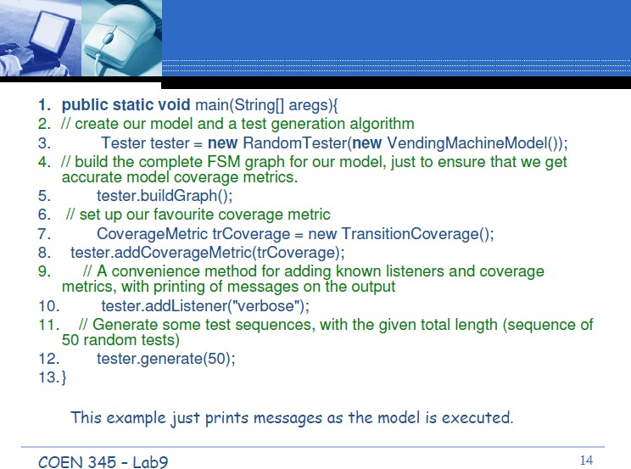
Testcases generation
Choosing the generation algorithm

Slide 21
reset(true)
done (0, coin50, 50)
done (50, coin25, 75)
done (75, coin25, 100)
done (100, vend, 0)
reset(true)
Output
done (0, coin25, 25)
done (25, coin50, 75)
done (75, coin25, 100)
done (100, vend, 0)
reset(true)
done (0, coin25, 25)
done (25, coin50, 75)
done (75, coin25, 100)
done (100, vend, 0)
reset(true)
done (0, coin50, 50)
done (50, coin50, 100)
done (100, vend, 0)
Metrics Summary: Action Coverage was 3/3 State Coverage was 5/5
Transition Coverage was 7/8
reset(true)
done (25, coin50, 75)
done (75, coin25, 100)
done (100, vend, 0)
....

Slide 22
Tests execution in Junit
The test generation code within the above main method is usually written within the TestXYZ() methods of JUnit classes
So that each time you run your Junit test suite, you will generate a suite of tests from your FSM model
public void TestVendingMachine() { vendingMachine v = new VendingMachine();
v.reset();
v.coin50();
assertEqual(50, v.getState());
v.coin25();
assertEqual(75, v.getState());
...
}
done (0, coin50, 50)
done (50, coin25, 75)
done (75, coin25, 100)
done (100, vend, 0)
23

Slide 23

Inheritance
People thought that inheritance will reduce the need for testing
superclass
Claim 1: “If we have a well-tested superclass, we can reuse its code in subclasses without retesting inherited code”
Claim 2: “A good-quality test suite used for a superclass will also be good for a subclass”
Both claims are wrong!!!
subclass

Slide 24
Problems with inheritance
Incorrect initialization of superclass attributes by the subclass
Missing overriding methods
Typical example: equals and clone
Direct access to superclass fields from the subclass code
Can create subtle side effects that break unsuspecting superclass methods
A subclass violates an invariant from the superclass, or creates an invalid state
…

Slide 25



Testing of Inheritance (1)
Superclass
--------------
m()
Principle: inherited methods should be retested in the context of a subclass
Example 1: if we change some method m() in a superclass, we need to retest m() inside all subclasses that inherit it
changed
Subclass’
Subclass’’
Subclass’’’
Retest m()!

Slide 26


Testing of Inheritance (2)
Example 2: if we add or change a subclass, we need to retest all methods inherited from a superclass in the context of the new/changed subclass
Superclass
-------------- m’()
m’’()
subclass
Subclass’
Retest m’() and m’’()!

Slide 27
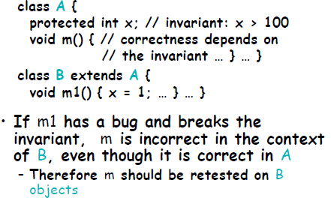
Example

Slide 28
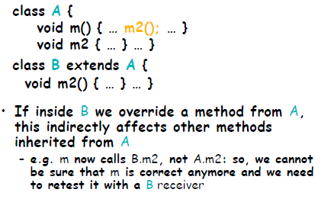
Another example
override

Slide 29
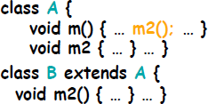
Testing of Inheritance
Test cases for a method m defined in class X are not necessarily good for retesting m in subclasses of X
e.g., if m calls m2 in A, and then some subclass overrides m2, we have a completely new interaction
Testcases for m() in A test m() that call A.m2()
Instead testcases for m() in B should test the call B.m2()
The interaction is different
Still, it is essential to run all superclass tests on a subclass
Goal: check behavioural conformance of the subclass w.r.t. the superclass (LSP)

Slide 30
Combinatorial explosion problem
abstract class Credit {
...
abstract boolean validateCredit( Account a, int amt, CreditCard c);
...
}
EduCredit BizCredit IndividualCredit
USAccount UKAccount EUAccount JPAccount OtherAccount
VISACard AmExpCard StoreCard
concrete
The combinatorial problem: 3 x 5 x 3 = 45 possible combinations of dynamic bindings (just for this one method!)

Slide 31
The combinatorial approach
Account Credit creditCard
USAccount USAccount USAccount UKAccount UKAccount UKAccount EUAccount EUAccount EUAccount JPAccount JPAccount JPAccount OtherAccount OtherAccount OtherAccount
EduCredit BizCredit individualCredit EduCredit BizCredit individualCredit EduCredit BizCredit individualCredit EduCredit BizCredit individualCredit EduCredit BizCredit individualCredit
VISACard AmExpCard ChipmunkCard AmExpCard VISACard ChipmunkCard ChipmunkCard AmExpCard VISACard VISACard ChipmunkCard AmExpCard ChipmunkCard VISACard AmExpCard
We have to test validateCredit in all the context!!!
There are some techniques to Reduce it …

Slide 32


Test of “Exceptions”

Slide 33

We expect an exception …
Good practice: test each exception!
try {
// we call the method with wrong parameters
object.method(null);
fail(“method should launch the exception!!");
} catch(PossibleException e){ assertTrue(true); // OK
}
class TheClass {
public void method(String p) throws PossibleException
{ /*... */ }
}
“null launch the exception …”

Slide 34

We expect a normal behavior …
try {
// We call the method with correct parameters object.method(“Parameter"); assertTrue(true); // OK
} catch(PossibleException e){
fail (“method should not launch the exception !!!");
}
class TheClass {
public void method(String p) throws PossibleException
{ /*... */ }
}

Slide 35
Integration/interaction Testing
Until now we only talked about testing of individual classes
Class testing is not sufficient!
OO design: several classes collaborate to implement the desired functionality
A variety of methods for interaction testing
Consider testing diagrams
Sequence diagrams
based on UML interaction

Slide 36
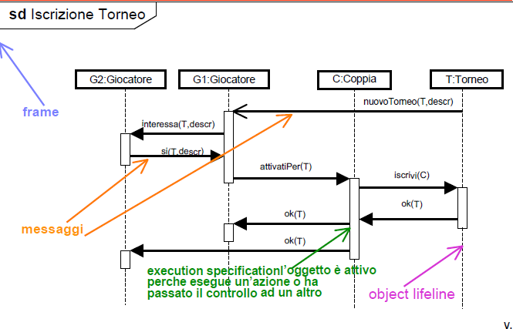
Sequence diagram

Slide 37
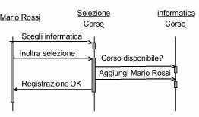
UML Interaction Diagrams for Testing
UML interaction diagrams: sequences of messages among a set of objects
There may be several diagrams showing different variations of the interaction
Basic idea:
run tests that cover all diagrams, and
all messages and conditions inside each diagram

Slide 38
Normal scenarios and alternatives
Run enough tests to cover all messages and conditions
Normal scenarios
Alternatives
To cover each one: pick a particular path in the diagram and “drive” the objects through that path

Slide 39
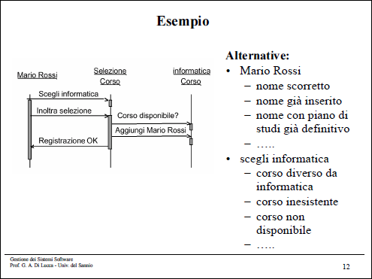
University course registration system

Slide 40

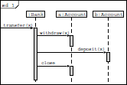
Integration Testing example
Testing method transfer that call two objects Account

Slide 41
Bank
recoverAccount(...) transfer(...)
....
Junit Testcase
public class BankTester extends TestCase {
public void testTransfer() { Bank bank = new Bank();
Account a = bank.recoverAccount(“a”);
Account b = bank.recoverAccount(“b”); Euro balanceA = a.getBalance();
Euro balanceB = b.getBalance(); bank.transfer(50, a, b);
assertTrue((balanceA-50).equalTo (a.getBalance()));
assertTrue((balanceB+50).equalTo (b.getBalance()));
}
}
Class Euro
46

Slide 42
Possible exercises at the exam
Class testing
Given the implementation of a class:
Recover the FSM and writing testcases for having state, transition or/and path coverage
Given a FSM and the interface of a class (fields+methods)
writing Junit testcases to cover valid and invalid transitions
Ex. Stack
Integration testing
Given some classes (interfaces) and one or more sequence diagrams deriving testcases
Valid and alternative sequences
Given two/three classes deriving a sequence diagram and writing the testcases

