Slide 1
AI-Generated Text (AIGT) Detector
bloomz-560m-academic-detector

Slide 2
Bloomz-560m-academic-detector: Pre-trained

Slide 3
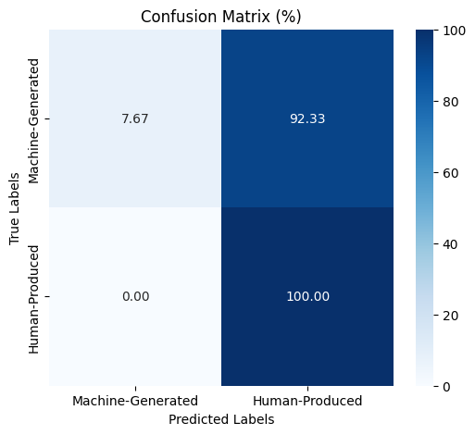
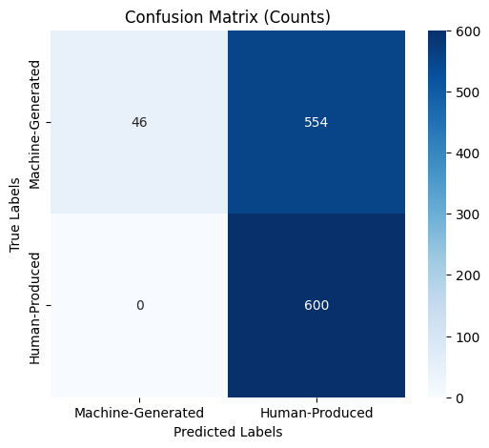
Arxiv_bloomz_test:
Accuracy: 0.5383
Precision: 1.0000
Recall: 0.0767

Slide 4
arxiv_bloomz_paraphrased_test:
Accuracy: 0.5383
Precision: 1.0000
Recall: 0.0767

Slide 5
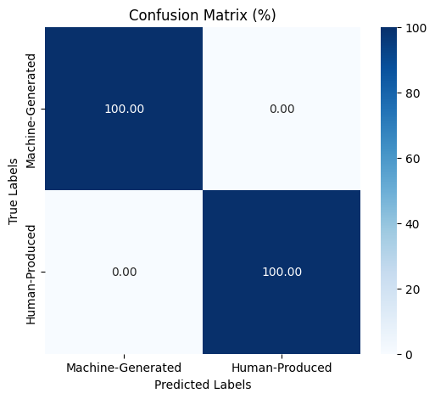
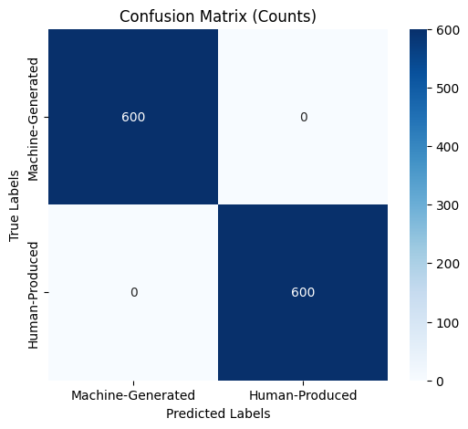
arxiv_chatGPT_test:
Accuracy: 1.0000
Precision: 1.0000
Recall: 1.0000

Slide 6
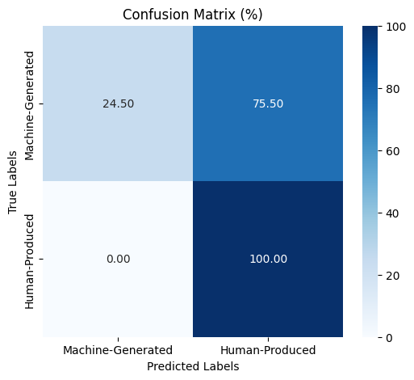
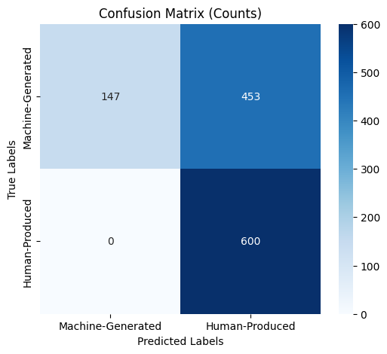
arxiv_cohere_test:
Accuracy: 0.6225
Precision: 1.0000
Recall: 0.2450

Slide 7
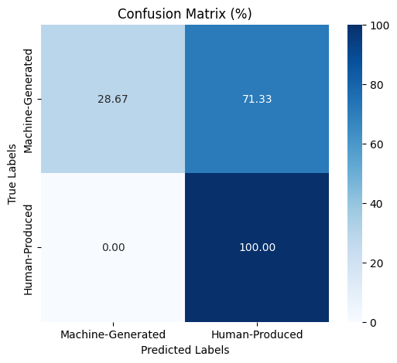

arxiv_davinci_test:
Accuracy: 0.6433
Precision: 1.0000
Recall: 0.2867

Slide 8
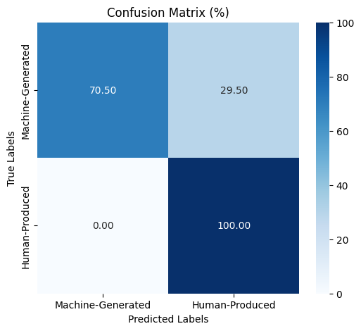

arxiv_flant5_test:
Accuracy: 0.8525
Precision: 1.0000
Recall: 0.7050

Slide 9
Bloomz-560m-academic-detector:
Fine-tuned using arxiv_bloomz

Slide 10

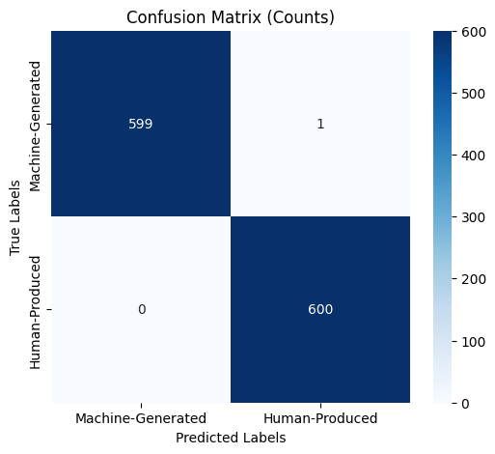
arxiv_bloomz_test:
Accuracy: 0.9992
Precision: 1.0000
Recall: 0.9983

Slide 11
arxiv_bloomz_paraphrased_test:
Accuracy: 0.9992
Precision: 1.0000
Recall: 0.9983

Slide 12
arxiv_chatGPT_test:
Accuracy: 1.0000
Precision: 1.0000
Recall: 1.0000

Slide 13


arxiv_cohere_test:
Accuracy: 0.9975
Precision: 1.0000
Recall: 0.9950

Slide 14
arxiv_flant5_test:
Accuracy: 1.0000
Precision: 1.0000
Recall: 1.0000

Slide 15
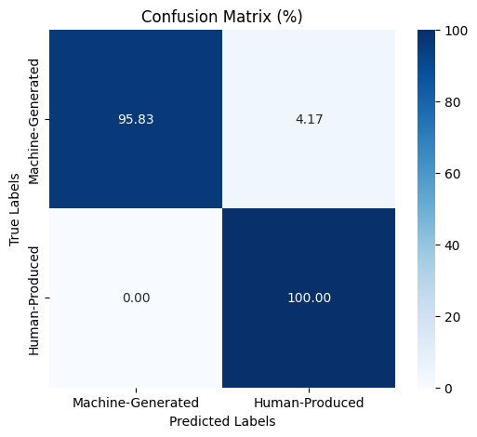
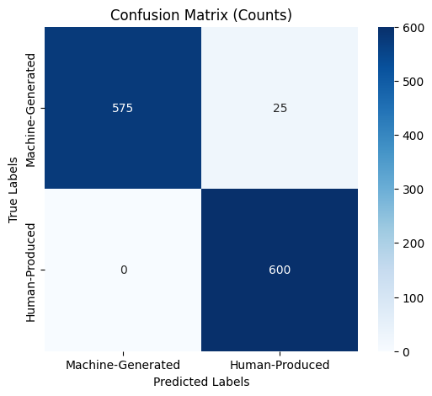
arxiv_davinci_test:
Accuracy: 0.9792
Precision: 1.0000
Recall: 0.9583

Slide 16
Bloomz-560m-academic-detector:
Fine-tuned using arxiv_bloomz
TESTING WITH \N REMOVED

Slide 17
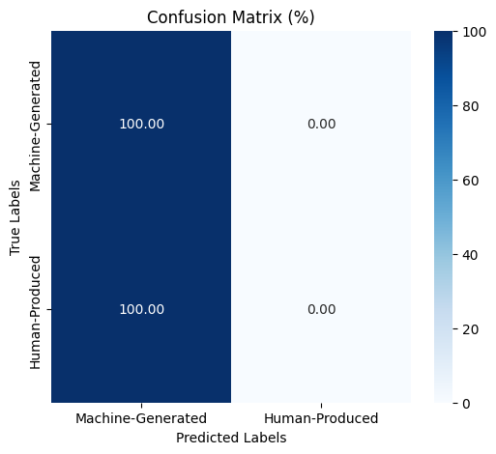
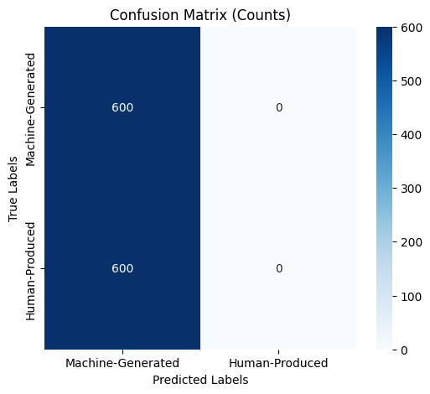
arxiv_bloomz_test:
Accuracy: 0.5000
Precision: 0.5000
Recall: 1.0000

Slide 18
arxiv_chatGPT_test:
Accuracy: 0.5000
Precision: 0.5000
Recall: 1.0000

Slide 19
arxiv_cohere_test:
Accuracy: 0.5000
Precision: 0.5000
Recall: 1.0000

Slide 20
arxiv_davinci_test:
Accuracy: 0.5000
Precision: 0.5000
Recall: 1.0000

Slide 21
arxiv_flant5_test:
Accuracy: 0.5000
Precision: 0.5000
Recall: 1.0000

Slide 22
Bloomz-560m-academic-detector:
Fine-tuned using arxiv_bloomz
TESTING WITH M4 WIKI

Slide 23
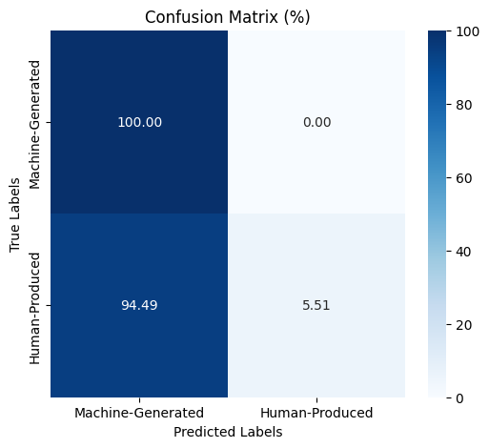

wikipedia_chatgpt_test:
Accuracy: 0.5275
Precision: 0.5142
Recall: 1.0000

Slide 24
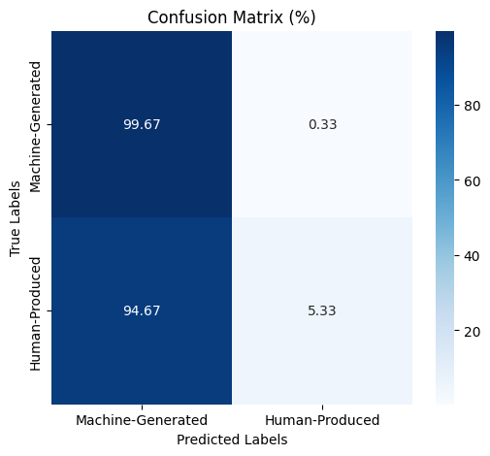
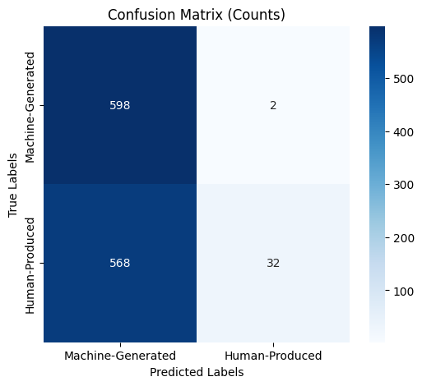
wikipedia_bloomz_test:
Accuracy: 0.5250
Precision: 0.5129
Recall: 0.9967

Slide 25


wikipedia_cohere_test:
Accuracy: 0.5288
Precision: 0.5149
Recall: 1.0000

Slide 26


wikipedia_davinci_test:
Accuracy: 0.5250
Precision: 0.5128
Recall: 1.0000

Slide 27
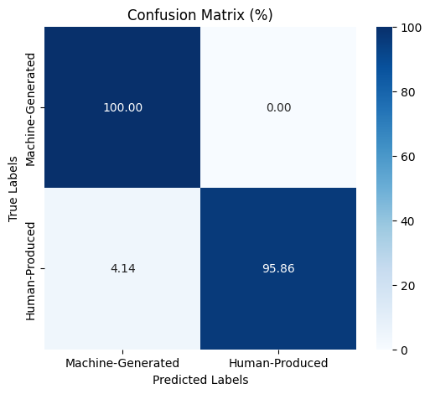
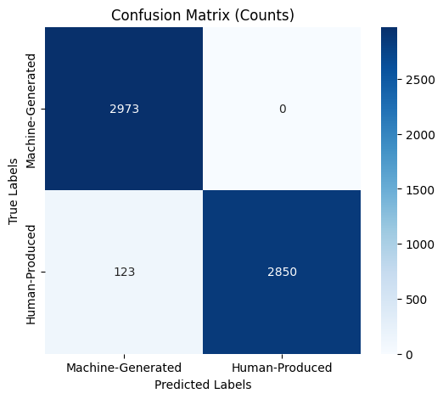
Testing with ML dataset:
Accuracy: 0.9793
Precision: 0.9603
Recall: 1.0000

Slide 28
FINETUNING & TESTING WITH \N REMOVED DATASETS

Slide 29
Bloomz-560m-academic-detector:
Fine-tuned arxiv_bloomz_\n_removed
Test using \n_removed_(chatGPT,cohere,flant5,davinci,chatGPT_para,bloomz_para)_test_set

Slide 30
Testing with arxiv_bloomz_\n_removed held-out test_dataset:
Accuracy: 1.0000
Precision: 1.0000
Recall: 1.0000

Slide 31
Testing with arxiv_\n_removed test_data from ChatGPT:
Accuracy: 1.0000
Precision: 1.0000
Recall: 1.0000

Slide 32
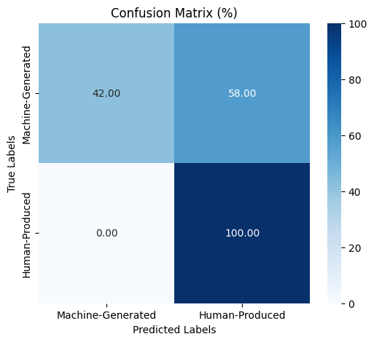
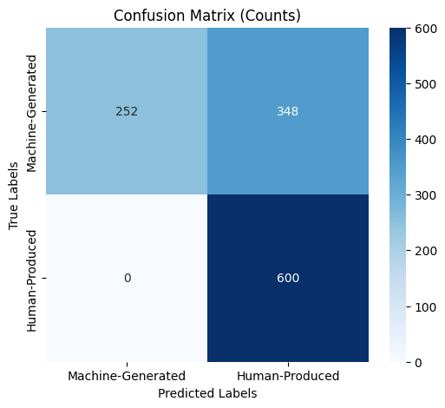
Testing with arxiv_\n_removed test_data from Cohere:
Accuracy: 0.7100
Precision: 1.0000
Recall: 0.4200

Slide 33
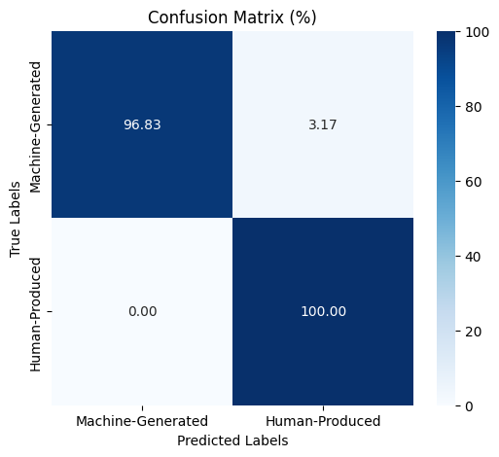
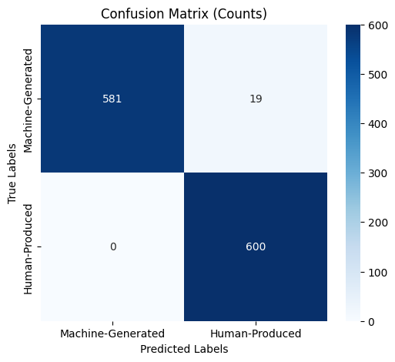
Testing with arxiv_\n_removed test_data from Davinci:
Accuracy: 0.9842
Precision: 1.0000
Recall: 0.9683

Slide 34
Testing with arxiv_\n_removed test_data from Flant5:
Accuracy: 0.9992
Precision: 1.0000
Recall: 0.9983

Slide 35
Testing with arxiv_\n_removed test_data from Flant5:
Accuracy: 0.9992
Precision: 1.0000
Recall: 0.9983

Slide 36
Testing with arxiv_\n_removed test_data from bloomz_paraphrased:
Accuracy: 1.0000
Precision: 1.0000
Recall: 1.0000

Slide 37
Testing with arxiv_\n_removed test_data from chatGPT_paraphrased:
Accuracy: 1.0000
Precision: 1.0000
Recall: 1.0000

Slide 38
Bloomz-560m-academic-detector:
Fine-tuned arxiv_bloomz_\n_removed + wikipedia_bloomz_\n_removed
Test using \n_removed_wiki_(chatGPT,cohere,davinci)_test_set

Slide 39


Testing with wikipedia_bloomz_\n_removed held-out test_dataset:
Accuracy: 0.9967
Precision: 0.9934
Recall: 1.0000

Slide 40

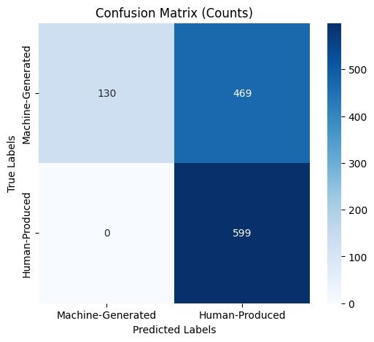
Testing with wikipedia_chatgpt_test_\n_removed test_dataset:
Accuracy: 0.6085
Precision: 1.0000
Recall: 0.2170

Slide 41
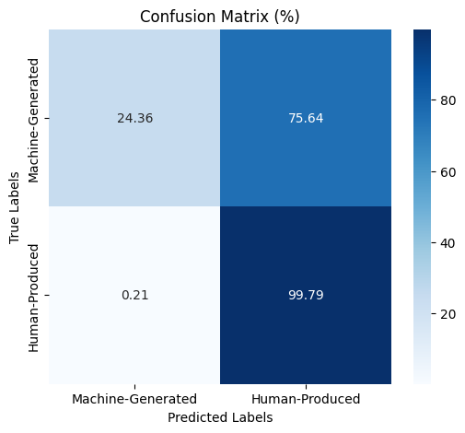

Testing with wikipedia_cohere_test_\n_removed:
Accuracy: 0.6207
Precision: 0.9913
Recall: 0.2436

Slide 42
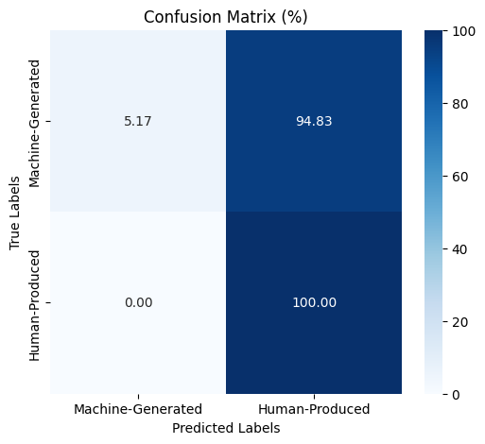
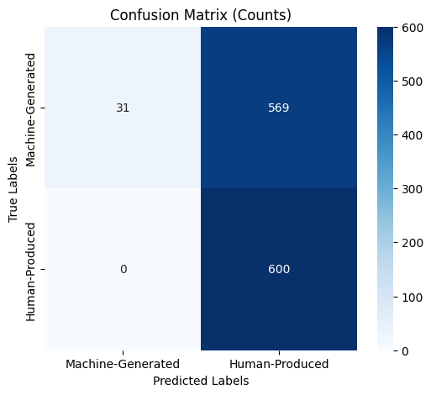
Testing with wikipedia_davinci_test_\n_removed:
Accuracy: 0.5258
Precision: 1.0000
Recall: 0.0517

Slide 43
Bloomz-560m-academic-detector:
Fine-tuned arxiv_bloomz_\n_removed + wikipedia_bloomz_\n_removed + ML_dataset_\n_removed
Test using ML_data_test_set_\n_removed

Slide 44
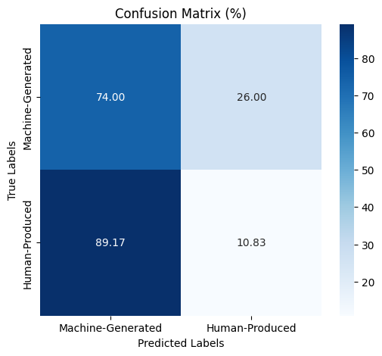
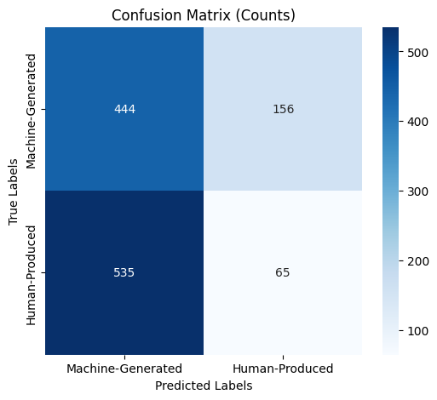
Testing with ML_dataset_\n_removed held-out test_dataset:
Accuracy: 0.4242
Precision: 0.4535
Recall: 0.7400

Slide 45
Bloomz-560m-academic-detector: finetune using ML_dataset_\n_removed
Test using ML_data_test_set_\n_removed

Slide 46
Testing with ML_dataset_\n_removed held-out test_dataset:
Accuracy: 0.9992
Precision: 1.0000
Recall: 0.9983

Slide 47
Bloomz-560m-academic-detector: finetune using arxiv_bloomz_\n_removed
Test using wiki_(chatGPT,cohere,davinci,bloomz)_test_set_with_\n_without_unicode

Slide 48


Testing with wikipedia_bloomz_test_with_\n_without_unicode
Accuracy: 0.5025
Precision: 0.5013
Recall: 1.0000

Slide 49


Testing with wikipedia_chatgpt_test_with_\n_without_unicode
Accuracy: 0.5008
Precision: 0.5004
Recall: 1.0000

Slide 50
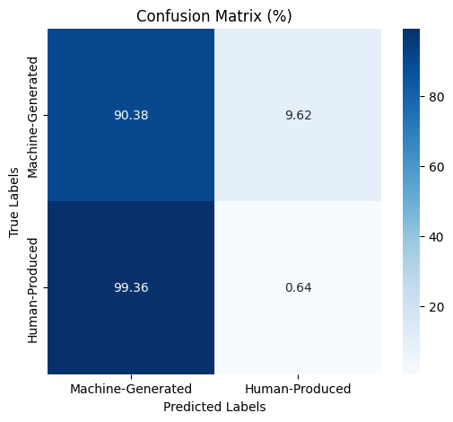
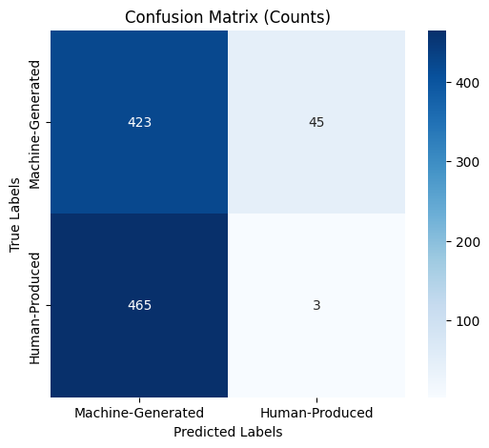
Testing with wikipedia_cohere_test_with_\n_without_unicode
Accuracy: 0.4551
Precision: 0.4764
Recall: 0.9038

Slide 51

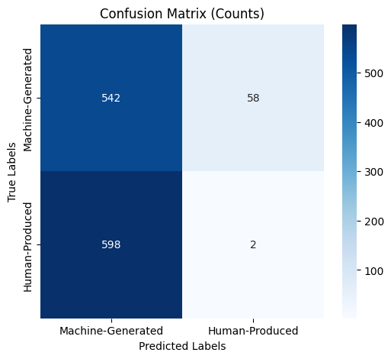
Testing with wikipedia_davinci_test_with_\n_without_unicode
Accuracy: 0.4533
Precision: 0.4754
Recall: 0.9033

Slide 52
Bloomz-560m-academic-detector: finetune using arxiv_bloomz_\n_removed + wikipedia_bloomz_with_\n
Test using: arxiv_\n_removed_(chatGPT,cohere,flant5,davinci,bloomz)_test_set

Slide 53

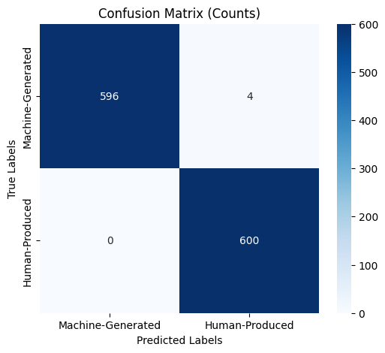
Testing with wikipedia_bloomz_with_\n held-out test_dataset
Accuracy: 0.9967
Precision: 1.0000
Recall: 0.9933

Slide 54
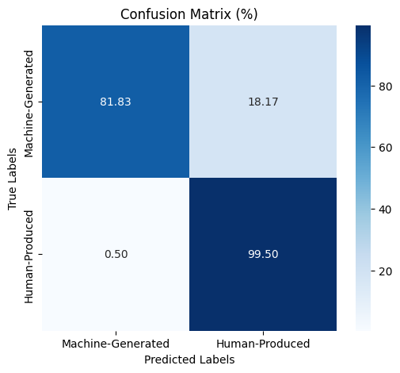
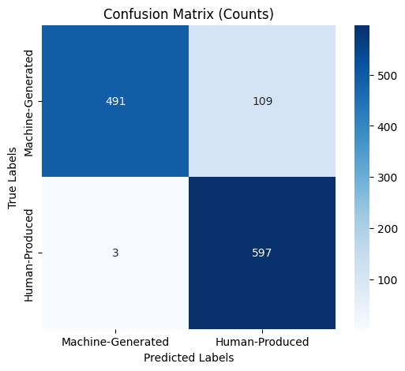
Testing with arxiv_bloomz_\n_removed_test
Accuracy: 0.9067
Precision: 0.9939
Recall: 0.8183

Slide 55


Testing with arxiv_ChatGPT_\n_removed_test
Accuracy: 0.9808
Precision: 0.9949
Recall: 0.9667

Slide 56
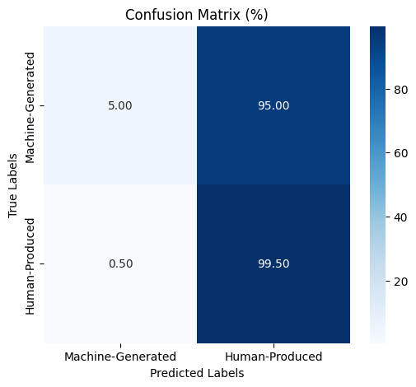

Testing with arxiv_cohere_\n_removed_test
Accuracy: 0.5225
Precision: 0.9091
Recall: 0.0500

Slide 57
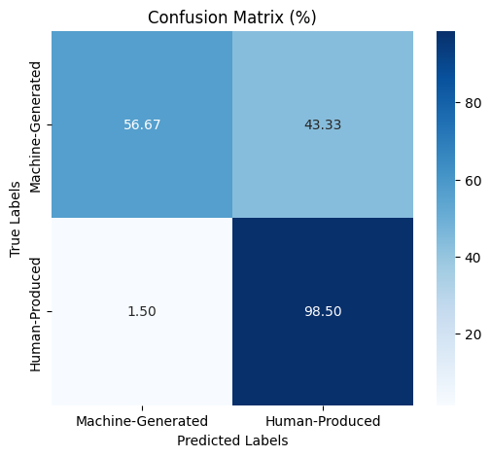
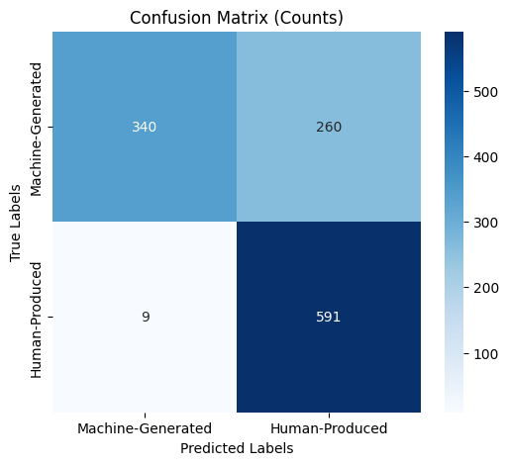
Testing with arxiv_davinci_\n_removed_test
Accuracy: 0.7758
Precision: 0.9742
Recall: 0.5667

Slide 58
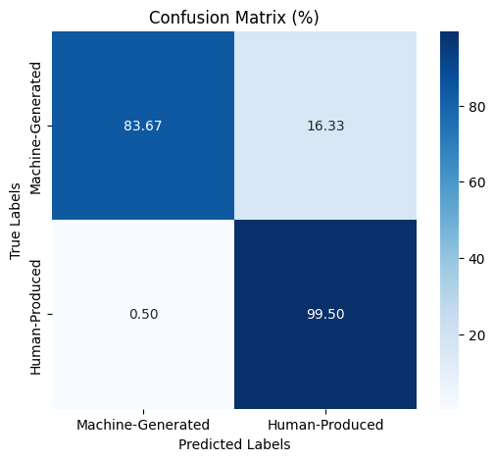

Testing with arxiv_flant5_\n_removed_test
Accuracy: 0.9158
Precision: 0.9941
Recall: 0.8367

Slide 59
Testing with arxiv_bloomz_paraphrased_\n_removed_test
Accuracy: 0.9067
Precision: 0.9939
Recall: 0.8183

Slide 60
Testing with arxiv_chatGPT_paraphrased_\n_removed_test
Accuracy: 0.9808
Precision: 0.9949
Recall: 0.9667

