Slide 1

Exploratory Data Analysis
Cab Industry Analysis
“Yellow Cab vs. Pink Cab”
21.09.2023

Slide 2

Agenda
Introduction
Transaction Volume
Profit Analysis
User Trends Over Time
Payment Methods
Pricing Distribution
Average User Income
City Presence
User-to-Population Ratio
Profit by City
Recommendations

Slide 3
Introduction
Client: XYZ is a private firm in US. Due to remarkable growth in the Cab Industry in last few years and multiple key players in the market, it is planning for an investment in Cab industry and as per their Go-to-Market(G2M) strategy they want to understand the market before taking final decision.
Objective: Our objective is to perform Exploratory data analysis on given datasets that contain information on 2 cab companies and provide valuable insights to client and help in decision making.
Datasets: We are using 4 individual data sets. Time period of data is from 31/01/2016 to 31/12/2018.
Below are the list of datasets which are provided for the analysis:
Cab_Data.csv – this file includes details of transaction for 2 cab companies
Customer_ID.csv – this is a mapping table that contains a unique identifier which links the customer’s demographic details
Transaction_ID.csv – this is a mapping table that contains transaction to customer mapping and payment mode
City.csv – this file contains list of US cities, their population and number of cab users

Slide 4
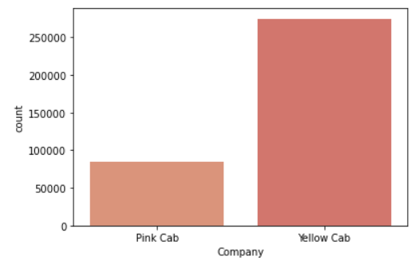
Transaction Volume
Yellow Cab consistently outperforms Pink Cab in terms of transaction volume, indicating a stronger market presence.

Slide 5
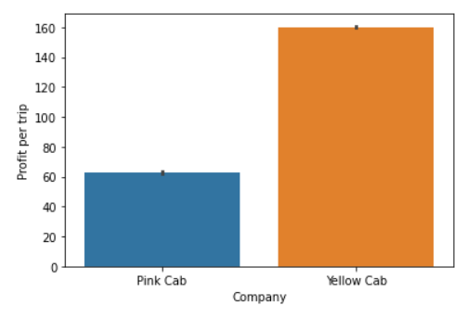
Profit Analysis
Huge difference in Average profit per trip is observed between both companies. Yellow Cab boasts a substantial advantage with an average profit per trip of $160 compared to Pink Cab's $60, emphasizing its superior profitability.

Slide 6
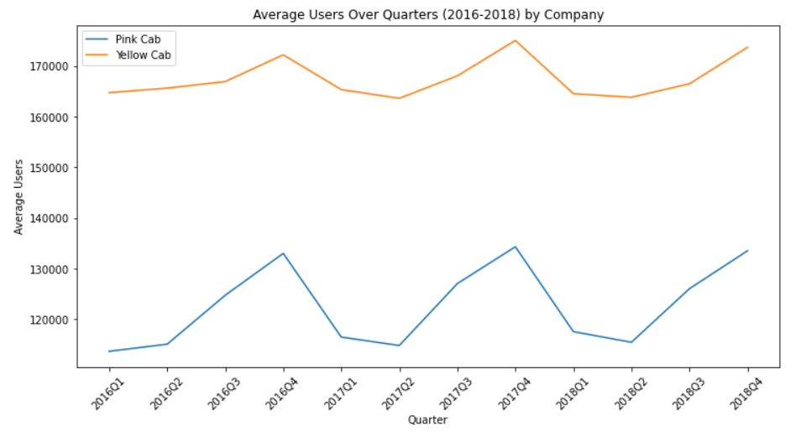
User Trends Over Time
1) Average users over the years is highest for Yellow cab 2) Seasonal pattern is observed for both companies * Average users count increase from Q2 to Q4 and peak is observed at Q4 * Average users count decrease from Q4 to Q1 and stay stable from Q1 to Q2

Slide 7
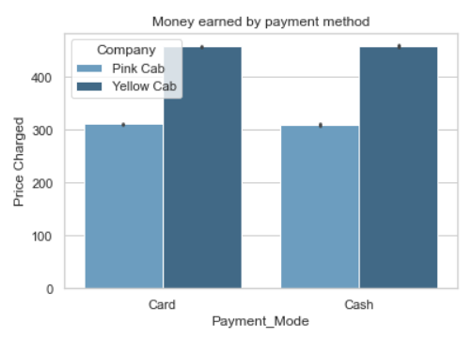
Payment Methods
Money earned by Yellow cab is highest compared to money early by Pink cab. However, Money earned through card and cash payments is nearly equivalent for both companies, highlighting customer payment preferences.

Slide 8
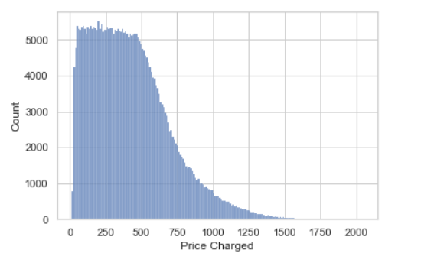
Pricing Distribution
The right-skewed price charged distribution suggests that most trips are priced lower, aligning with market demand.

Slide 9
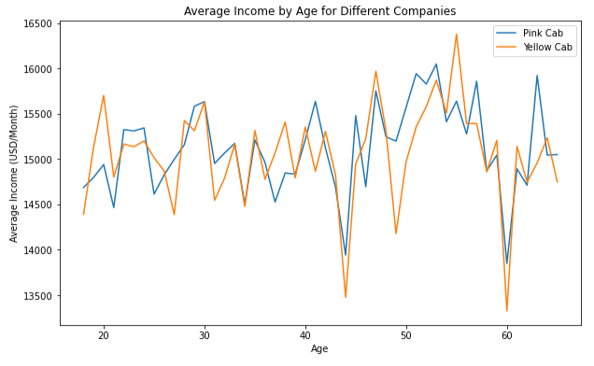
Average User Income
Both companies cater to users with similar average incomes, implying similar target demographics.

Slide 10
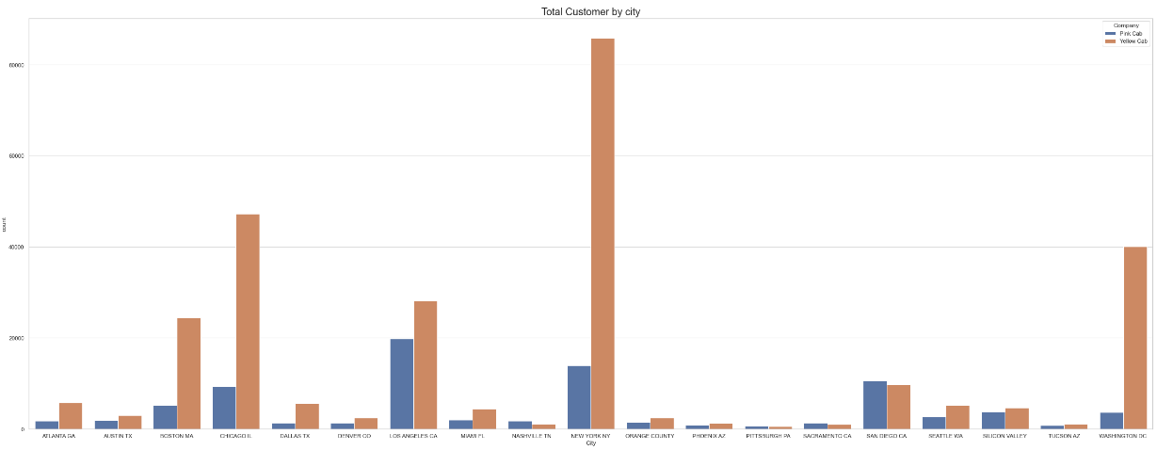
City Presence
Yellow Cab operates in a more extensive network, serving 16 cities, whereas Pink Cab dominates in three cities.

Slide 11
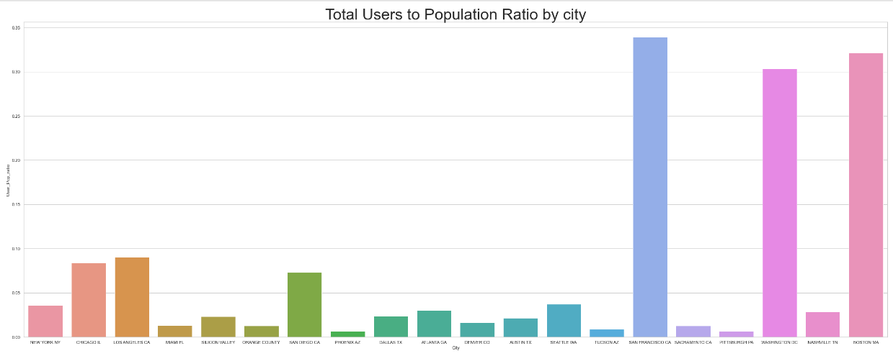
User-to-Population Ratio
San Francisco CA, Washington Dc, Boston MA has highest user to population ratio. High user-to-population ratios in cities present strategic growth opportunities.

Slide 12
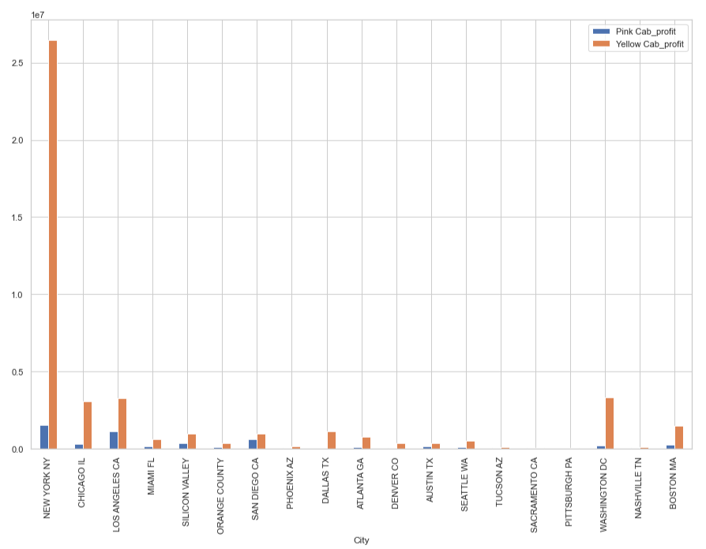
Profit by City
Yellow Cab consistently outperforms Pink Cab in terms of profitability across all cities.

Slide 13
Recommendation
In conclusion, our analysis has provided a comprehensive view of the cab industry, with a particular focus on Yellow Cab and Pink Cab. The data-driven insights reveal clear distinctions between the two companies in terms of transaction volume, profitability, city coverage, and user behavior. These insights serve as the foundation for strategic recommendations tailored to XYZ's investment decision.
We recommend considering Yellow Cab as the preferred choice for investment due to its robust transaction volume and higher profitability. Furthermore, focusing efforts on cities with high user-to-population ratios, optimizing pricing strategies, and maintaining a balance between payment methods can drive long-term success in the cab industry.
By leveraging these findings and recommendations, XYZ can make a well-informed and strategic investment decision that capitalizes on the growth and potential within the cab industry. We appreciate your attention and welcome any questions or further discussions on this matter.

Slide 14
Thank You

