Slide 1
PROJECT TITLE: Secure Data Hiding in Image Using Steganography
CAPSTONE PROJECT
Presented By: Supriya D
Student Name : Supriya D
College Name & Department : PESITM, Shimoga - ISE

Slide 2
OUTLINE
Problem Statement
Technology used
Wow factor
End users
Result
Conclusion
Git-hub Link
Future scope

Slide 3
Problem Statement
In the digital age, secure data transmission is crucial due to rising cyber threats. Traditional encryption methods attract attention, making them susceptible to attacks. This project focuses on image steganography to hide data within images, ensuring confidentiality while maintaining image quality. The goal is to enhance security, prevent unauthorized access, and improve resistance to detection techniques.

Slide 4
Technology used
Libraries Used:
Tkinter - A standard Python library for creating graphical user interfaces (GUI).
tkinter.filedialog - Provides file selection dialogs.
tkinter.messagebox - Used to display alert messages.
PIL (Pillow) - A Python Imaging Library used for image processing.
Image - Handles image loading and manipulation.
ImageTk - Converts images into a format that Tkinter can use.
io (BytesIO) - Used for handling byte-stream data (saving images in memory).
os - Provides functions for interacting with the operating system (e.g., file handling).
Platform:
The script is designed to run on Windows, Linux, or macOS as long as Python and the required libraries are installed.

Slide 5
Wow factors
Enhanced Security – Uses advanced encryption alongside steganography to increase data protection.
High Imperceptibility – Embeds data with minimal distortion, making detection difficult.
Adaptive Embedding – Dynamically adjusts embedding based on image characteristics for better concealment.
Multi-Layered Encoding – Supports multiple layers of steganographic techniques for added security.
Robustness Against Steganalysis – Designed to resist common detection and extraction techniques.
Support for Multiple Image Formats – Works with various image formats like PNG, JPEG, and BMP.
User-Friendly Interface – Simple and intuitive design for easy use without technical expertise.

Slide 6
End users
Government and intelligence agencies
Cybersecurity professionals
Journalists and whistleblowers
Military and defense organizations
Law enforcement and forensic experts
Corporations and businesses
Research institutions
Cybercriminals and hackers

Slide 7
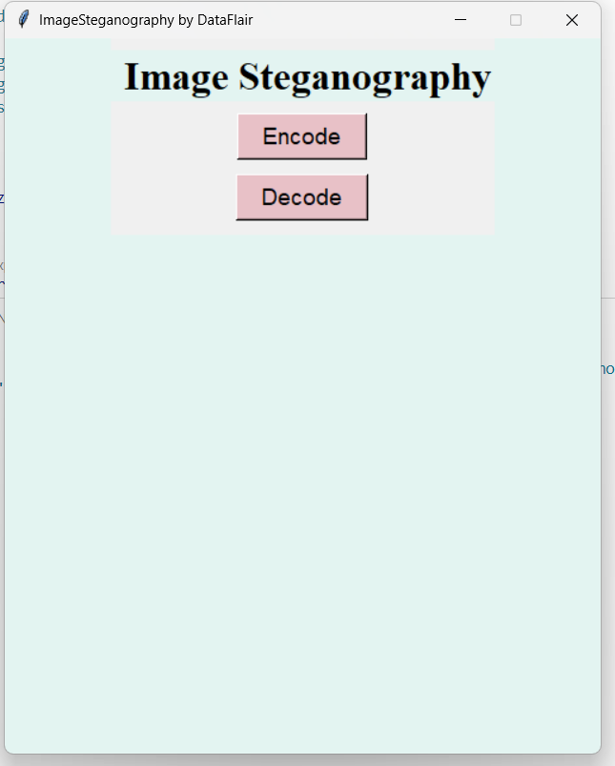
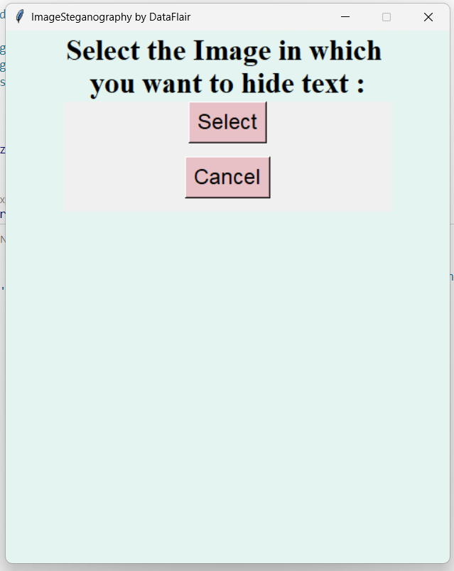
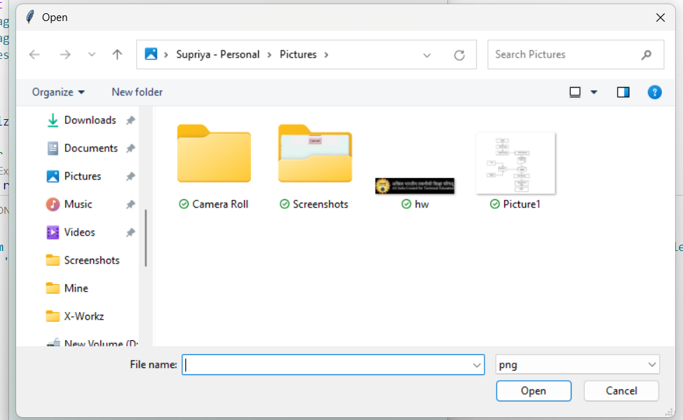
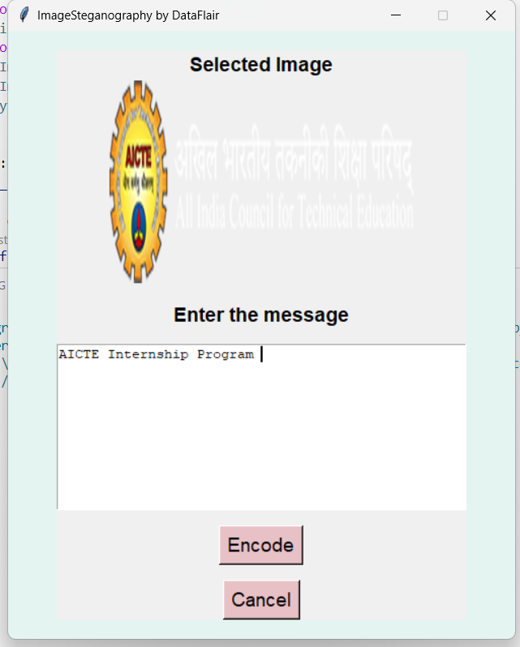
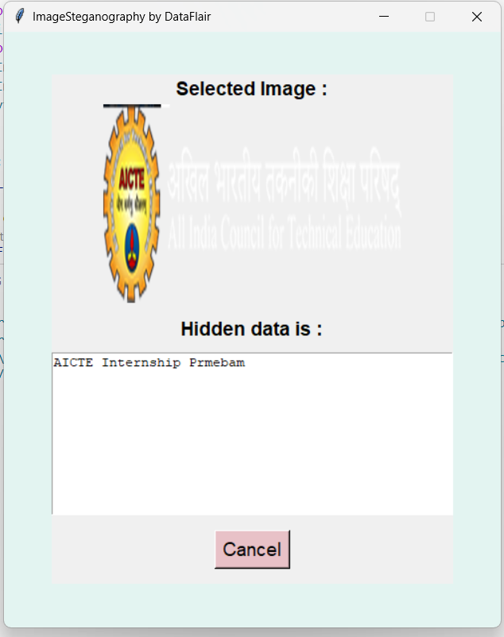
Results

Slide 8
Conclusion
Image steganography is an essential method for secure communication and data protection. While it provides a discreet way to transmit sensitive information, advancements in detection techniques require continuous improvements in steganographic algorithms to ensure secrecy and robustness. The balance between data embedding capacity and imperceptibility remains a key challenge. Future research focuses on AI-driven steganography and adaptive techniques to enhance security and resistance against steganalysis.

Slide 9
GitHub Link
https://github.com/Supriyad16/Image_Steganography

Slide 10
Future scope
AI and Machine Learning Integration – Enhancing steganographic techniques using AI to improve security and detection resistance.
Quantum Steganography – Leveraging quantum computing for unbreakable steganographic methods.
Real-Time Steganography – Developing faster and more efficient algorithms for instant data hiding and extraction.
Increased Resistance to Steganalysis – Advancing techniques to counteract evolving detection methods.
Cloud-Based Steganography – Implementing secure cloud storage and communication using steganographic encryption.
Blockchain-Based Steganography – Combining blockchain with steganography for decentralized and tamper-proof data security.
Cross-Platform Compatibility – Enhancing adaptability across different operating systems and devices.
Steganography in IoT Security – Using hidden data transmission to enhance security in IoT devices and smart systems.

Slide 11
THANK YOU

