Slide 1

Optimizing Cloud Performance: Strategies and Azure Services For Scalability Enhancement
Name : Supriya Korimilli
MID: M15397629

Slide 2
PROBLEM
We want to address a problem that organizations face when they perform statistical calculations.
Major companies use cloud services as their primary source to deploy VMs and perform operations in the cloud.
During this process, challenges are encountered while performing calculations, such as heavy CPU usage and lower response time.
To address this, we have built a prototype method of caching utilization while performing calculations and using Python and integrated it with Azure services to reduce the utilization of the resources.
This prototype depicts that the usage of cache tools in the virtual machine leads to the betterment of the performance of the virtual machines.

Slide 3
SOLUTION
Our proposed solution is to use cache tools available in the Azure services.
Initially, we will create a virtual machine and resource group it. Later, we will enable services such as Azure monitoring and Azure insights for the virtual machine.
Once the VM is up and running, we will install the Python 3 version on the machine and later install the Numpy, Pandas, and Matplot libraries. These are used to perform calculations.
We will install modules such as PSUTIL, Cachetools libraries, and Azure CLI to use the cache tools to interact with the Azure portal.
Once the Azure connectivity b/w the VM and the portal is established, we will verify all libraries.

Slide 4
SOLUTION
The main goal of this prototype is to reduce the response time and CPU utilization while performing calculations.
We will write two sets of code, importing all required libraries needed to perform calculations, executing the Python code with and without cache, and generating the data, which will be fed to the metaplot libraries to create the usage graphs
Once the CSV files are generated, we will run the graph code, check the values ' look, and validate in the Azure monitor and insights.
In the end, we will see a change in CPU usage and response time, and the graph presents the same. We can see the difference between using cache and not using cache.
The mot to of the prototype has been achieved as the values for the same calculations performed in the VM will be stored in the cache, and the code will be referring if the same calculation that has been conducted in the past. If yes, then use the values and give the o/p. This helps to reduce the computation power

Slide 5









FLOWCHART
Windows VM
Azure Monitor
Azure Services
Integration of CMD with Azure CLI Services
Azure VM Implementing all libraries and connectivity
Storing the cache results
Results Comparison
Python code without cache
Python code with cache
Result Set via CSV and Graphs

Slide 6
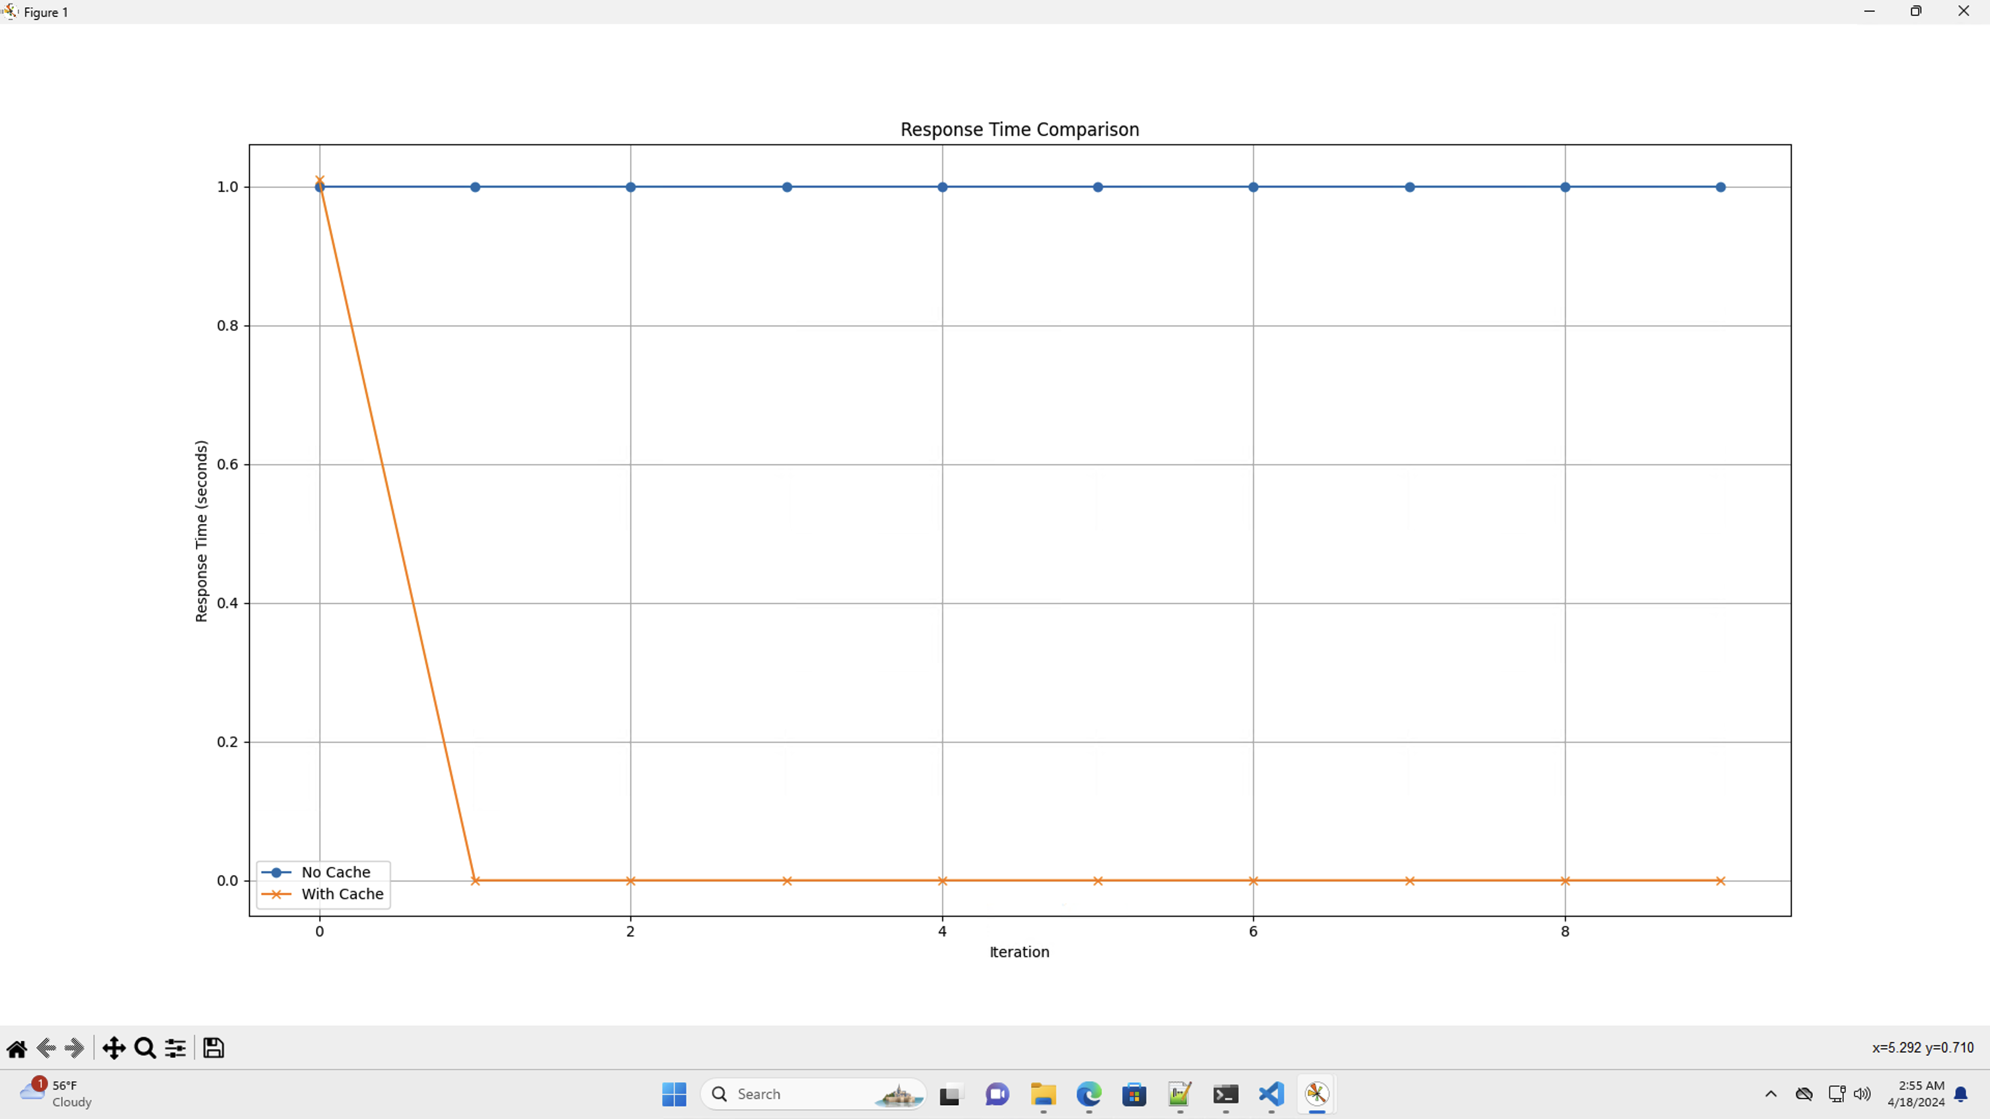
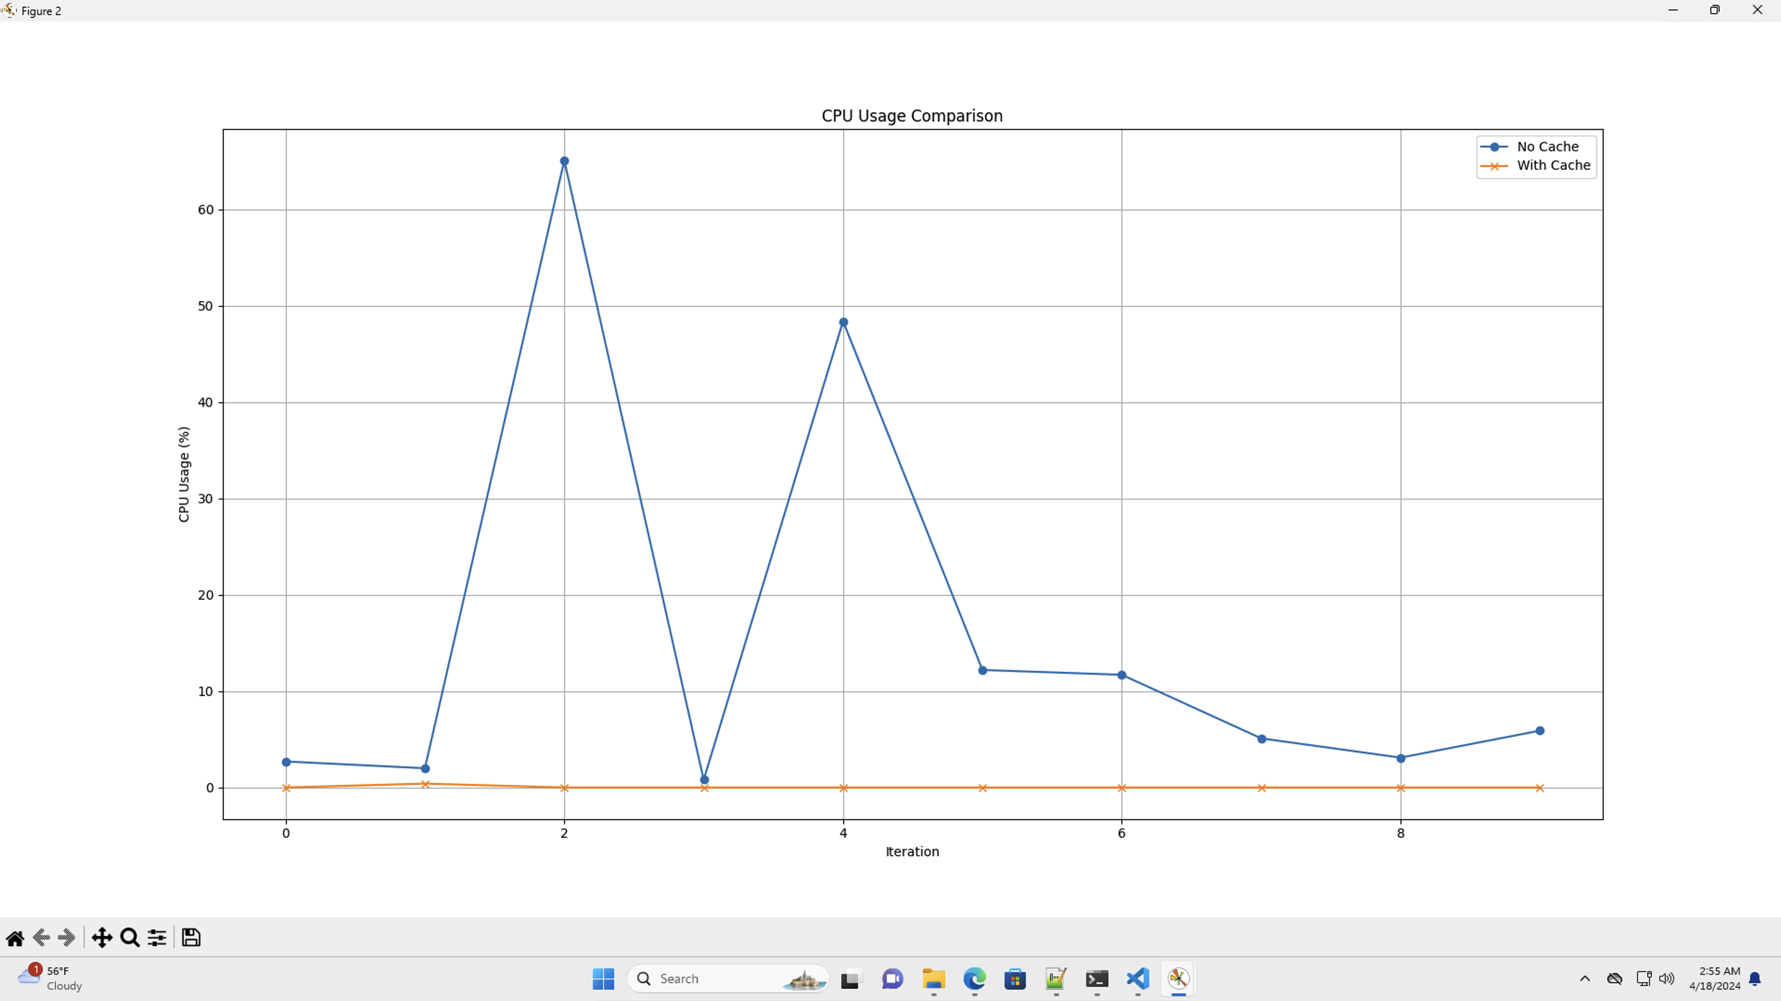
Results
The final results are displayed in the graphical format.
The first graph illustrates the Response Time Comparison with cache(Yellow line) and without cache (Blue Line)
The second graph depicts the CPU usage with cache(Yellow line) and without cache (Blue Line)
We can see there is a notable difference between the usage of cache tools in Azure is resulting in favorable output for the calculations.

Slide 7
Thank You.

