Slide 1


Fuel Consumption Ratings Regression
Team Members:
Supriyam Mishra
Satyam Kumar Meena Vadadoriya
1

Slide 2
Understanding the data
Dataset provides model-specific fuel consumption ratings and estimated carbon dioxide emissions for new light-duty vehicles for retail sale in Canada in 2022.
Fuel consumption: | City and highway fuel consumption ratings are shown in liters per 100 kilometers (L/100 km) - the combined rating (55% city, 45% highway) is shown in L/100 km and in miles per imperial gallon (mpg)
CO2 emissions: | CO2 emissions: the tailpipe emissions of carbon dioxide (in grams per kilometer) for combined city and highway driving
CO2 rating: | CO2 rating: the tailpipe emissions of carbon dioxide rated on a scale from 1 (worst) to 10 (best)
Smog rating: | the tailpipe emissions of smog-forming pollutants rated on a scale from 1 (worst) to 10 (best)
Model year: | Vehicle model year
Make: | Vehicle make
Model type: | Vehicle model type
Vehicle class: | Car vehicle class
Engine size: | Engine size in litres
Cylinders | No. of cylinders
Transmission: | A = automatic; AM = automated manual; AS = automatic with select shift; AV = continuously

Slide 3
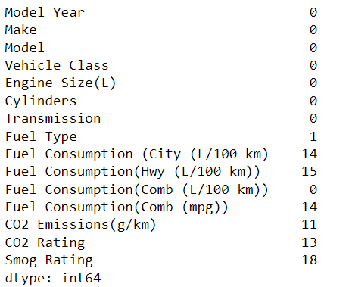
Data Pre-processing
Handling Null Value
Columns
Fuel Consumption (City (L/100 km)
Fuel Consumption(Hwy (L/100 km))
Fuel Consumption(Comb (mpg))
Model Year
Make
Model
Vehicle Class
Replaced with the mode value of the data
3

Slide 4
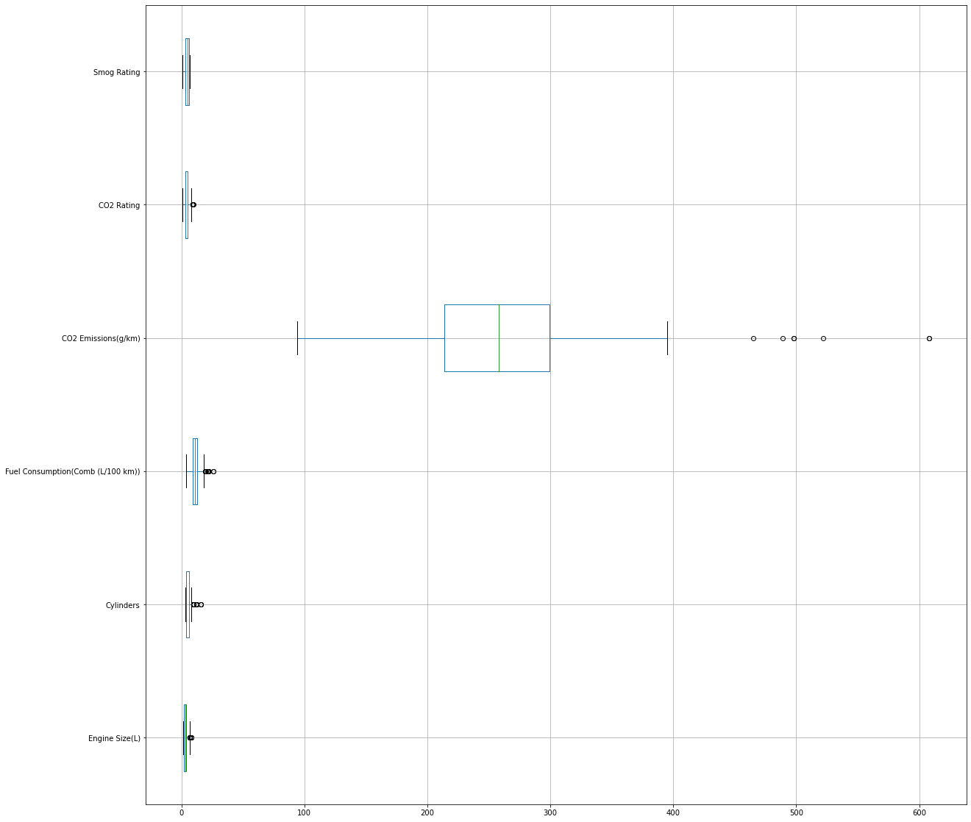
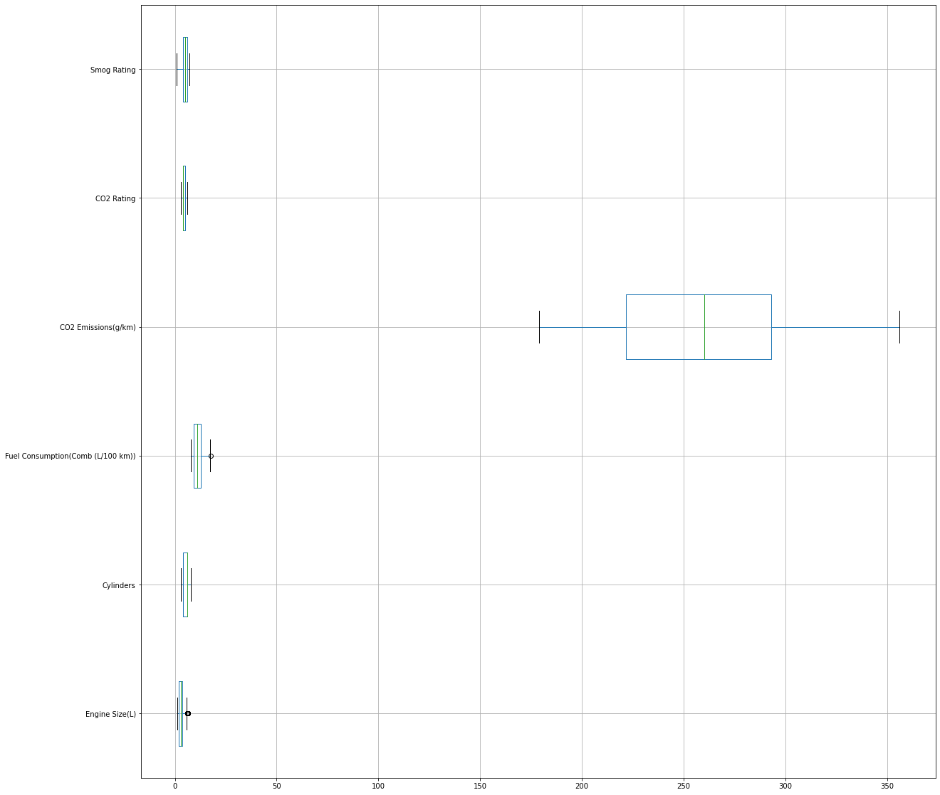
Data Pre-processing
Outliers
Outliers
945 rows
783 rows
4

Slide 5
Modeling
Linear Regression
Lasso Regression
Decision Tree
Random Forest
Support Vector Regression (SVR)

Slide 6
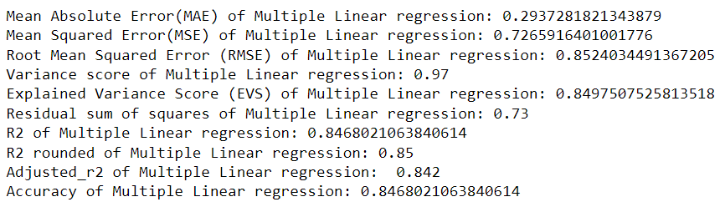
Linear Regression

Slide 7
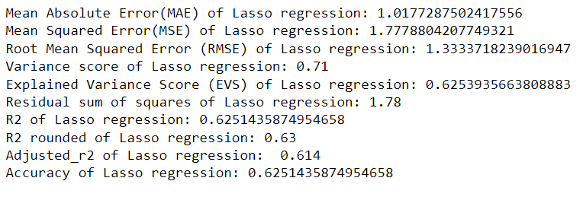
Lasso Regression

Slide 8
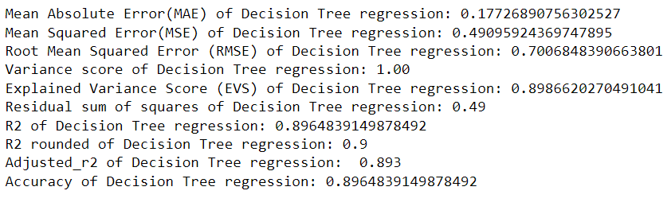
Decision Tree

Slide 9
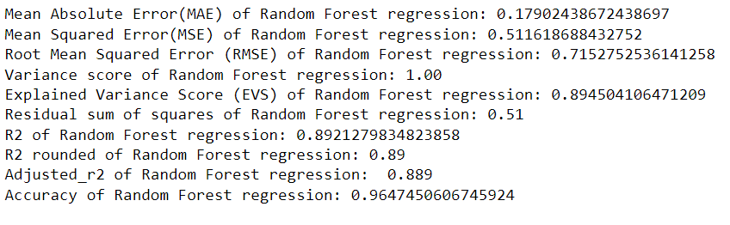
Random Forest

Slide 10
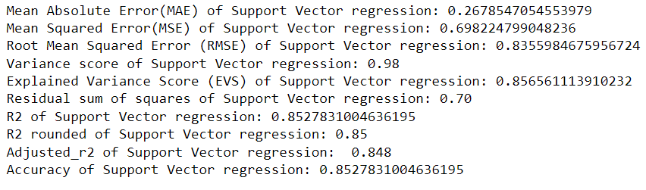
Support Vector Regression

Slide 11
Results

Slide 12
Conclusion
As per all the model performance we can see that the Random Forest has given highest level of Accuracy which is 89%.
After using hyperparameter tunning with Grid Search CV on Random Forest Model the performance has been increased from 89% to 96%.

Slide 13




Tools and Technology
Python
Pandas
Numpy
Visualization
Sklearn
📊

Slide 14
Challenges?
Modelling
Hyperparameter Tuning
New Challenges

Slide 15
How did we overcome?
We learnt the YouTube, Sites and resources given by Masai.
Discussion with the team members.
Task division and regular team meeting.

Slide 16
Thank you

