Slide 1
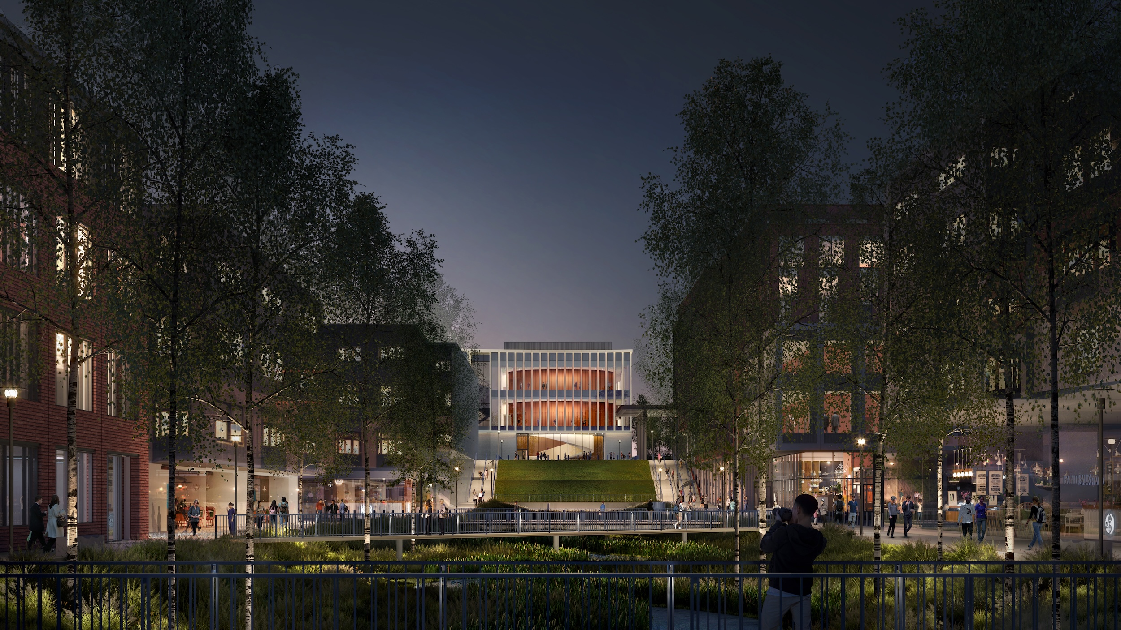
OUR INSTITUTE
Activities, Facilities & Achievements
Skill Development • Quality Training • Bright Future
[Institute Name] :- NSTI (W), ALLAHABAD
Academic/Training Session: 2026–27
Presented by: SUPRIYA

Slide 2

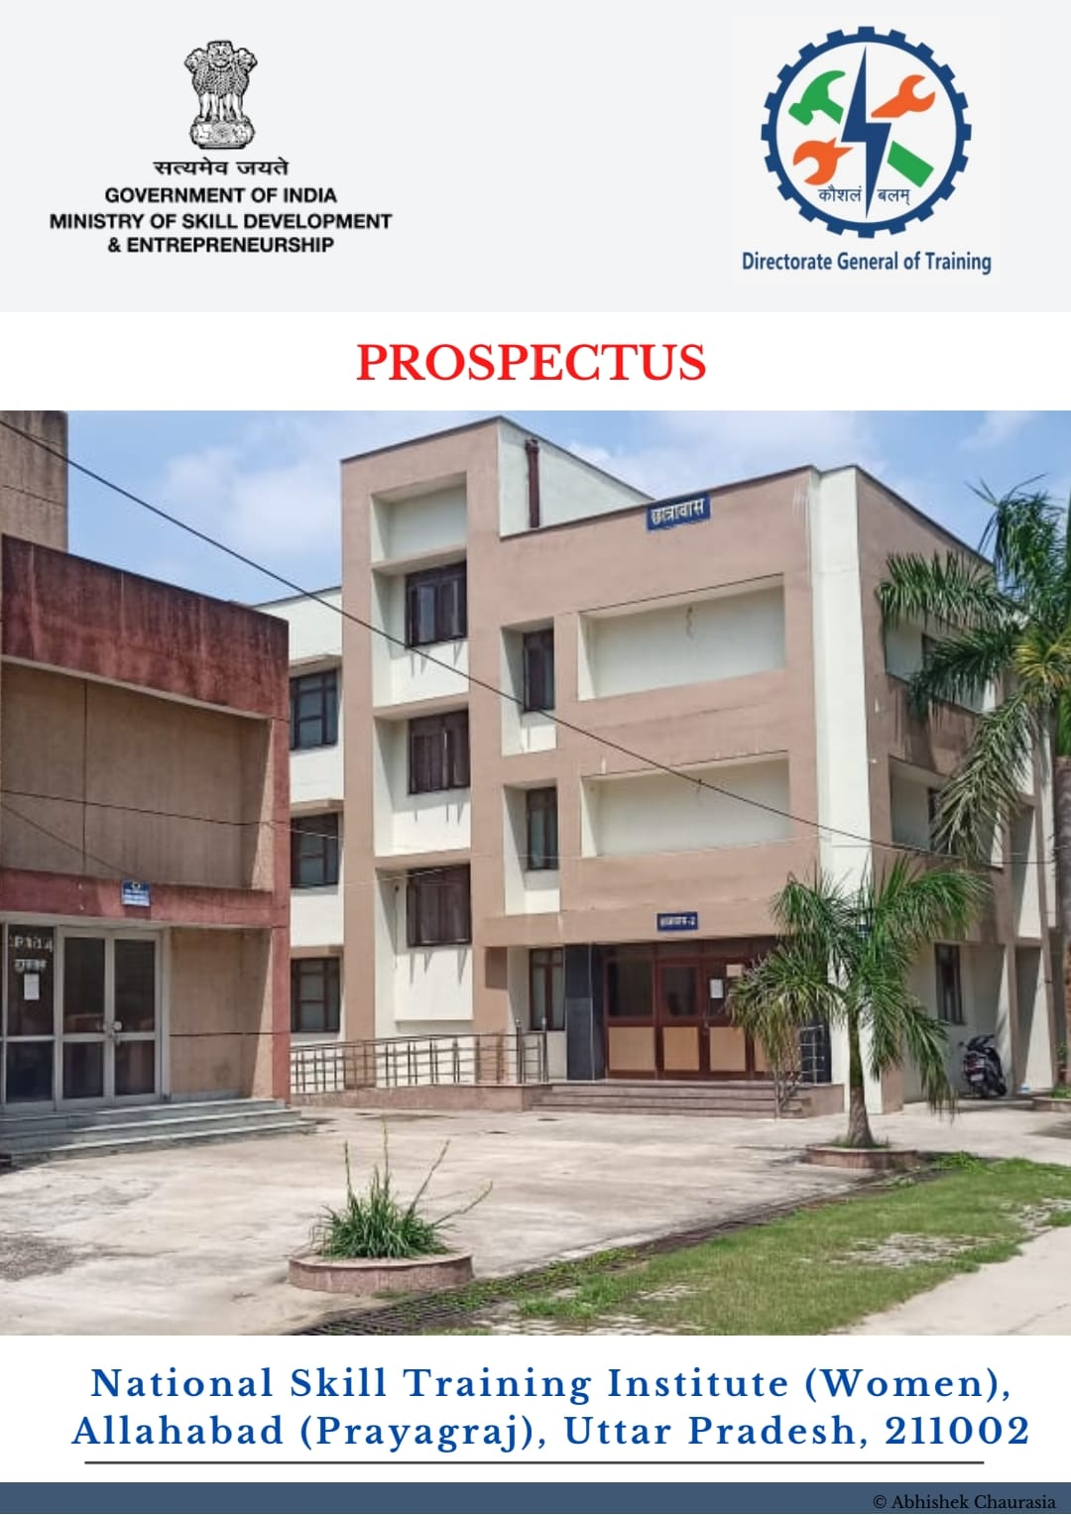
ABOUT OUR INSTITUTE
INTRODUCATION:-
NSTI (W) is committed to providing quality vocational and skill-based education to students and trainees. The institute focuses on developing technical knowledge, practical skills, discipline and employability.

Slide 3
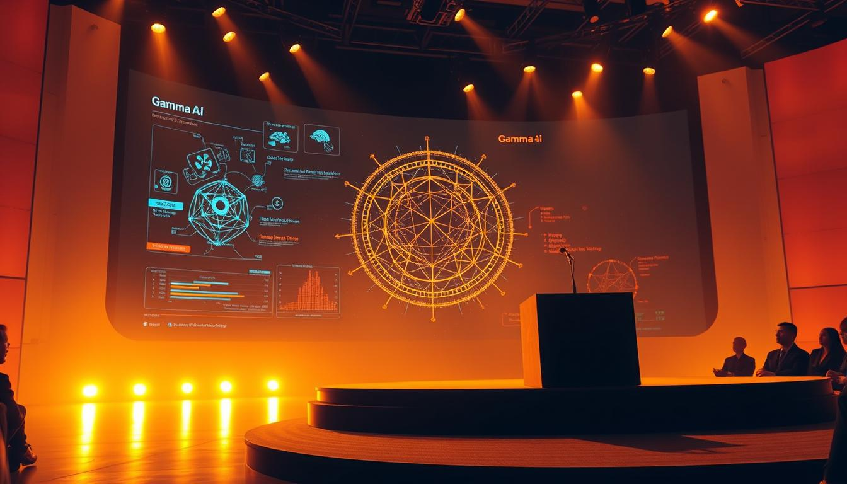
COURSES & TRADES OFFERED
Trade/Course | Major Skills
COPA
Fitter
AI
Computer & digital applications
Learn, Analyses & Solve.
Machine fitting & assembly

Slide 4
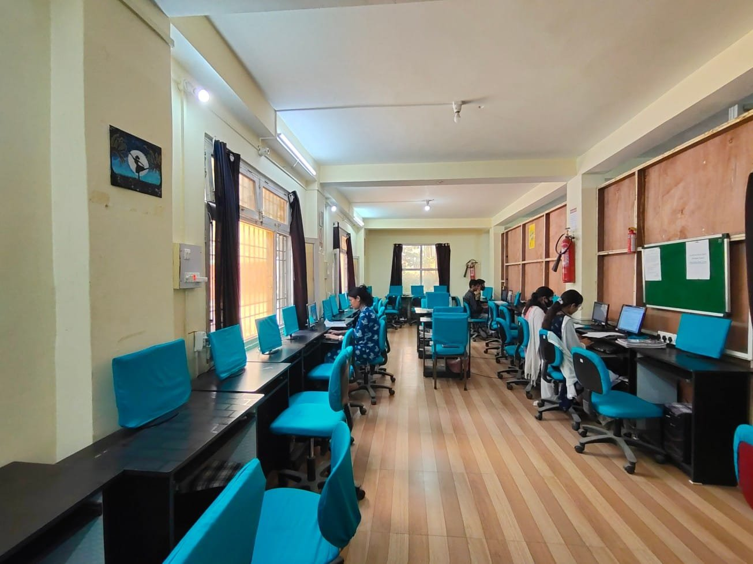
INFRASTRUCTURTE & FACILITIES
Well-equipped practical laboratories
Smart and spacious classrooms
Computer laboratory
Library and learning resources
Workshop and training equipment
Internet and digital learning facilities
Safe and clean campus
Sports and recreational facilities

Slide 5
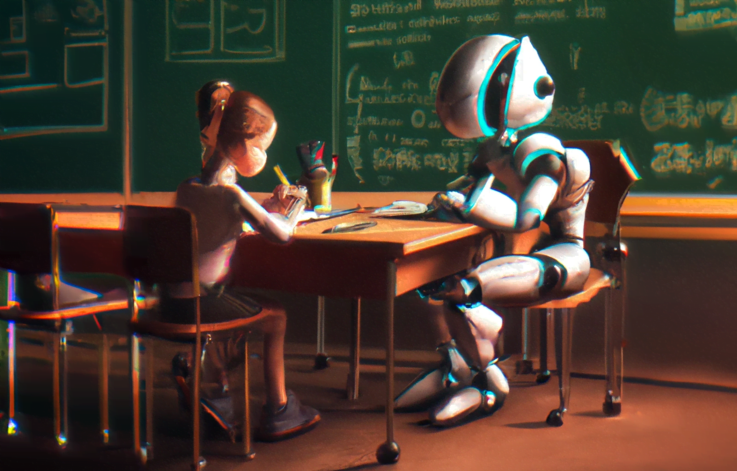
TRAINING ACTIVITIES
Classroom Training | Practical Training
Theory and concept-based learning | Hands-on workshop practice
Interactive discussions | Laboratory experiments
Digital presentations | Equipment handling
Assignments and assessments | Project-based learning

Slide 6
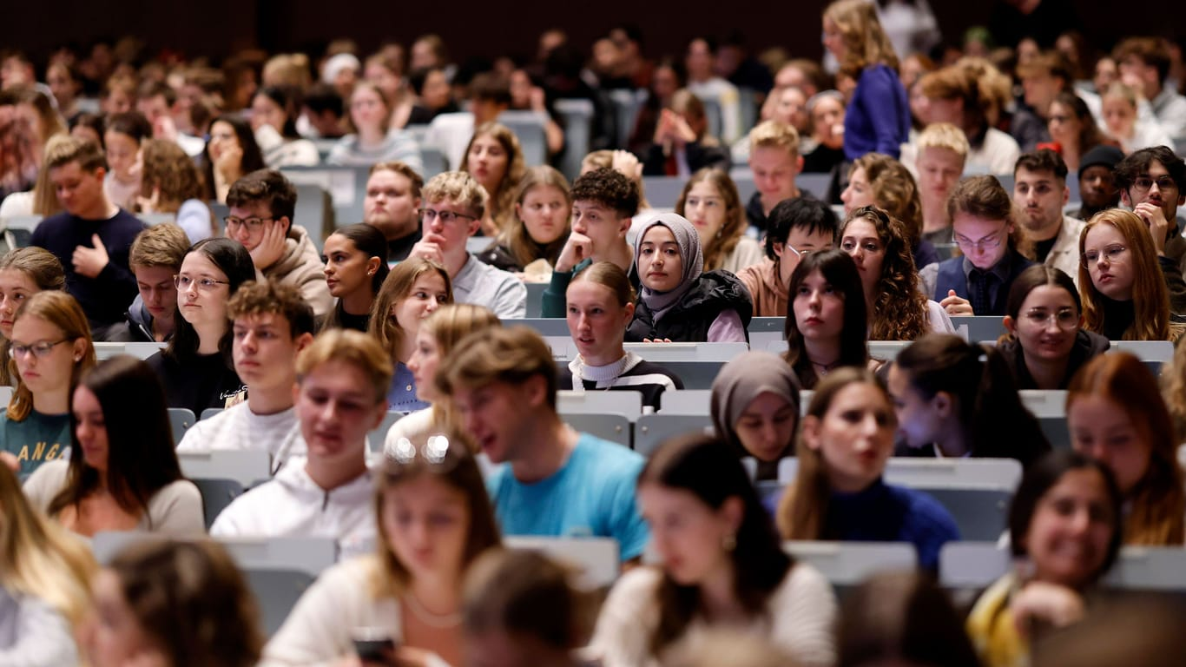
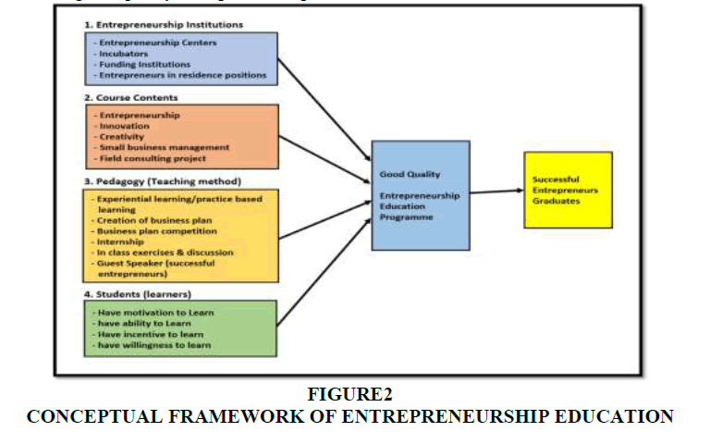
STUDENT & TRAINING ACTIVITIES
Student Development
➡ Technical Training
➡ Practical Projects
➡ Team Activities
➡ Competitions
➡ Industrial Visits
➡ Soft Skills
➡ Career Guidance
Additional points:
Students participate in skill competitions.
Teamwork and leadership skills are encouraged.
Industrial visits provide real-world exposure.
Career guidance helps students understand employment opportunities.
This Photo by Unknown Author is licensed under CC BY

Slide 7
ACHIVEMENTS & PERFORMANCE
Trade | Trainees
Electrician | 80
Fitter | 65
Computer Operator | 90
Welder | 55
Electronics | 70

Slide 8
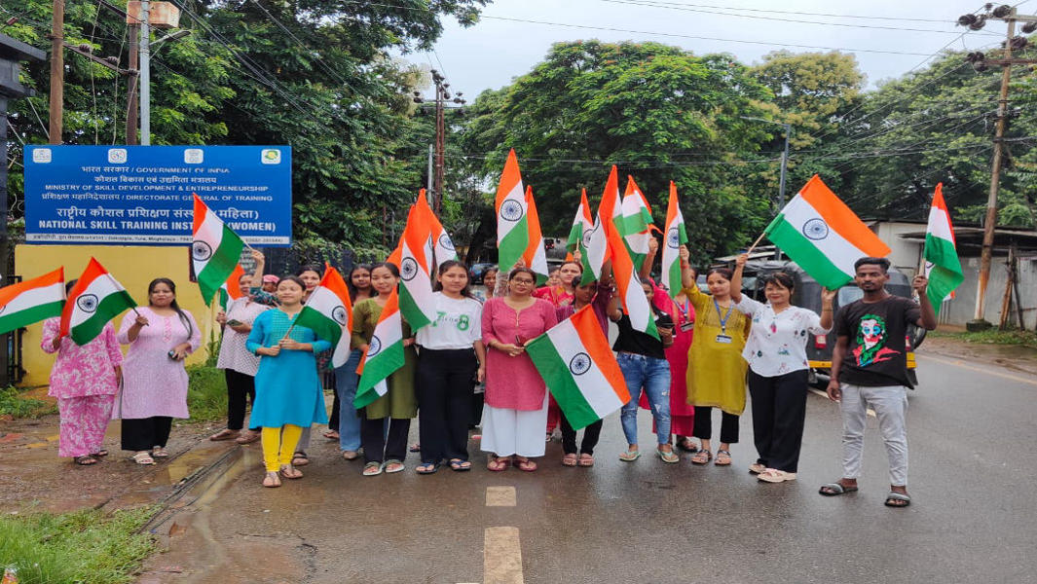
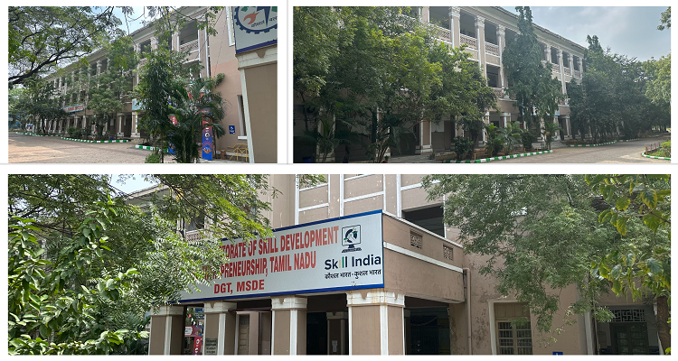
EVENT & CELEBRATIONS
Independence Day Celebration
Republic Day Celebration
Teachers’ Day
Annual Sports Day
Skill Competitions
Awareness Programmes
Workshops & Seminars
Industrial Visits

Slide 9

ROLE OF TECHNOLOGY & AI IN TRAINING
Smart classrooms improve interactive learning.
Digital simulations help students understand complex concepts.
AI tools support personalised learning.
Online resources provide access to updated knowledge.
AI can assist in project ideas, research and problem-solving.
Digital tools improve productivity and technical skills.
https://youtube.com/shorts/UnOhz4fdmI0?si=BdEyuhzF1T4Etybe

Slide 10
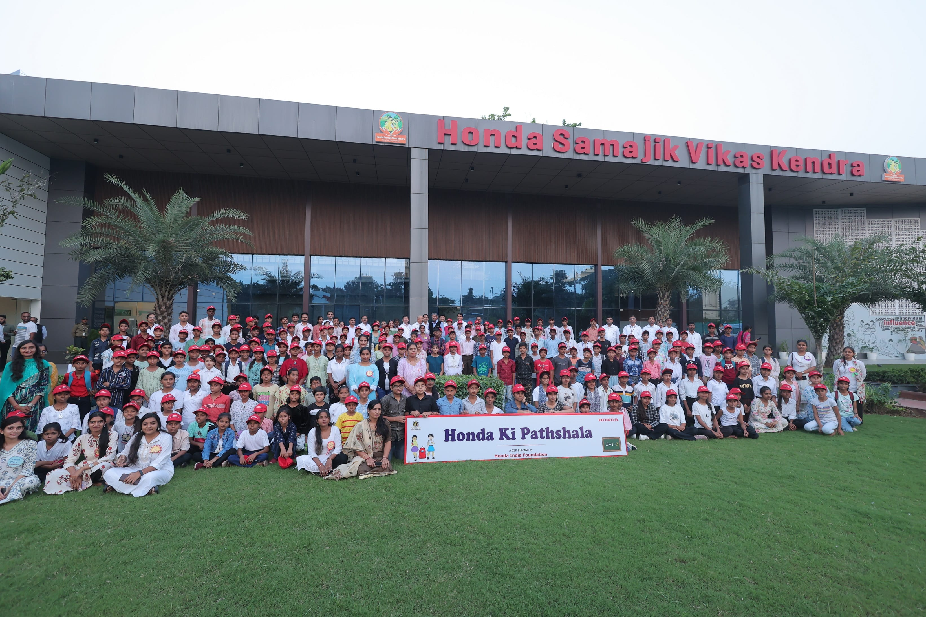
FUTURE PLANS & OPPORTUNITIES
Future Plans
Upgrade laboratories and workshops
Introduce emerging technologies
Strengthen industry collaboration
Increase digital learning
Organise more skill-development programmes
Encourage innovation and entrepreneurship
Opportunities for Students
Employment
Apprenticeships
Entrepreneurship
Higher education
Industry certifications
Competitive skill programmes

Slide 11
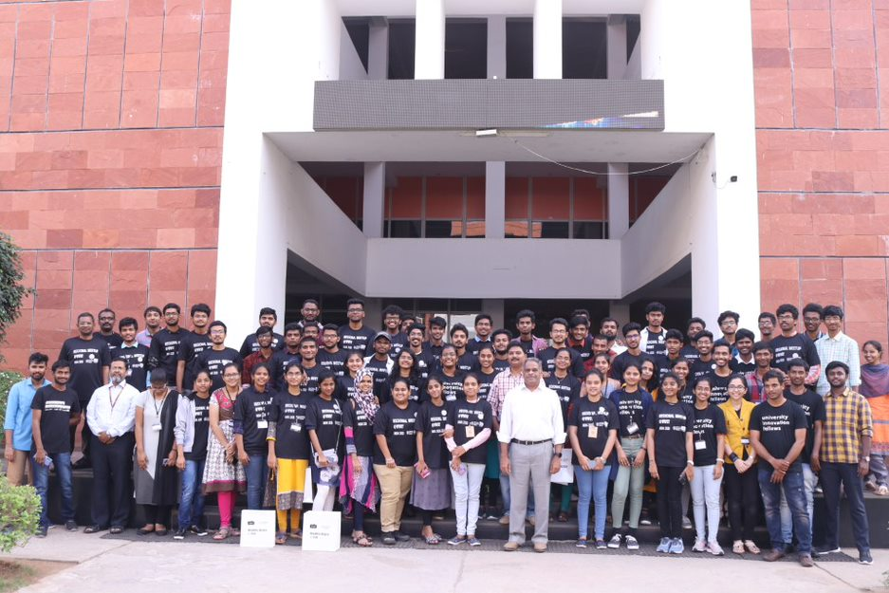
Conclusion
Our institute continues to focus on quality training, practical learning, innovation and overall student development.
Three key points:
Quality Training
Practical Skills
Successful Careers

Slide 12


