Slide 1
IBM CAPSTONE PROJECT – The Battle of Neighborhoods:
Cluster Analysis of London Real Estate Market

Slide 2
Business Problem
London Housing Market is in a rut because of;
Brexit
Hidden price falls
Record-low sales
Homebuilder exodus
Tax hikes addressing overseas buyers of homes in England and Wales.
This analysis provides support to homebuyer clients to purchase a suitable real estate in London in this uncertain economic and financial scenario.

Slide 3
Methodology
We will analyze neighborhoods to recommend real estates where home buyers can make a real estate investment. We will then recommend profitable venues according to amenities and essential facilities surrounding such venues i.e. elementary schools, high schools, hospitals & grocery stores.
Below are the main components of our analysis and predication system
Collect Inspection Data;
Explore and Understand Data;
Data preparation and preprocessing;
Modeling

Slide 4
Data Aquisition
Data on London properties and the relative price paid data were extracted from the HM Land Registry (http://landregistry.data.gov.uk/).
The following fields comprise the address data included in Price Paid Data:
1. Postcode
2. PAON Primary Addressable Object Name. Typically the house number or name
3. SAON Secondary Addressable Object Name. If there is a sub-building, for example, the building is divided into flats, there will be a SAON
4. Street
5. Locality
6. Town/City;
7. District
8. County.

Slide 5
DATA EXPLORATION
To explore and target recommended locations across different venues according to the presence of amenities and essential facilities, we will access data through Four Square API interface and arrange them as a data frame for visualization.
By merging data on London properties and the relative price paid data from the HM Land Registry and data on amenities and essential facilities surrounding such properties from Four Square API interface, we will be able to recommend profitable real estate investments.
Our original dataset consists of over 1020000 rows and 16 features

Slide 6
Data preparation and preprocessing
Accordingly, we performed the following steps:
1. Rename the column names
2. Format the date column
3. Sort data by date of sale
4. Select data only for the city of London
5. Make a list of street names in London
6. Calculate the street-wise average price of the property
7. Read the street-wise coordinates into a data frame, eliminating recurring word London from individual names
8. Join the data to find the coordinates of locations which fit into client's budget
9. Plot recommended locations on London map along with current market prices.

Slide 7
Modeling
After exploring the dataset and gaining insights into it, we used the clustering methodology to analyze real estates. We used the k-means clustering technique as it is fast and efficient in terms of computational cost, is highly flexible to account for mutations in real estate market in London and is accurate.
152 venues were analyzed based on 350 categories of facilities.
After our inspection of venues/facilities/amenities nearby the most profitable real estate investments in London, we performed clustering properties by venues/facilities/amenities nearby into 5 clusters using K-Means.

Slide 8
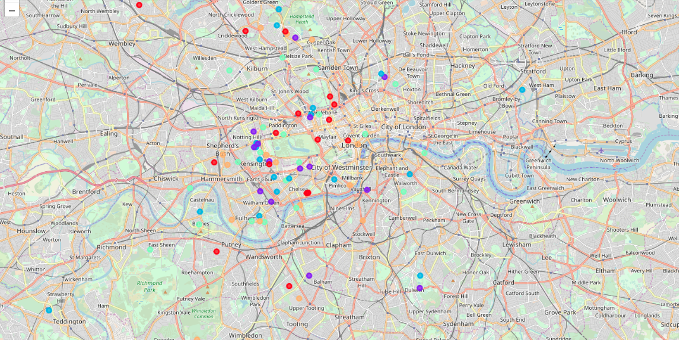
K-Means clustering
Cluster 0
Cluster 1
Cluster 2
Cluster 3
Cluster 4

Slide 9
Outcome/Result
Examination of real estates according to neighborhoods/London areas
West London (Notting Hill, Kensington, Chelsea, Marylebone) and North-West London (Hampsted) might be considered highly profitable venues to purchase a real estate;
South-West London (Wandsworth, Balham) and North-West London (Isliington) are arising as next future elite venues with a wide range of amenities and facilities.
Examination of real estates by clusters
Clusters 0, 2 and 4 may target home buyers prone to live in 'green' areas with parks, waterfronts;
Clusters 1 and 3 may target individuals who love pubs, theatres and soccer.

