Slide 1
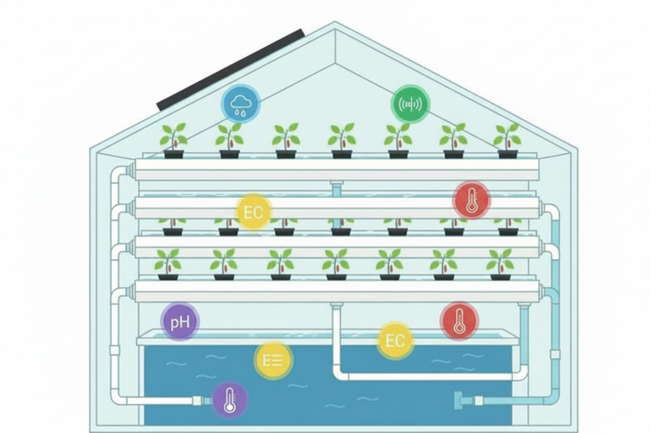
An Energy-Efficient Dual Hydroponic System for Organic/Inorganic Capsicum Chili Farming
CEYLON - HYDRO
25-26J-035

Slide 2
PROBLEM & IMPACT

Slide 3


PROBLEM & IMPACT
Rising fertilizer costs
Climate change & soil limitations
Farmers lack real-time visibility and control
Current systems are costly , energy-hungry, not rural-ready
Nutrient imbalance reduce yield and quality
No clear comparison between organic and inorganic hydroponic methods

Slide 4
Target Group / Who Benefits

Slide 5

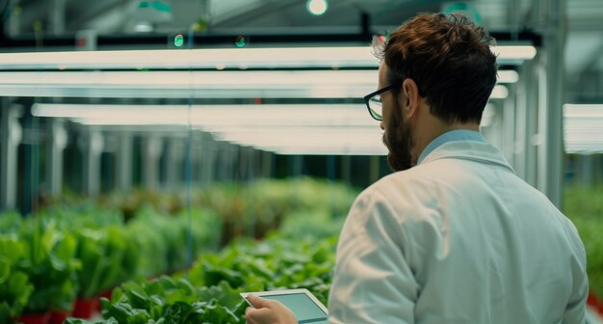
Target Group / Who Benefits
Small & medium-scale farmers
Agricultural researchers
Smart farming solution developers
Educational & research institutions
Urban growers

Slide 6
What Is New / Design Excellence of Overall Solution

Slide 7
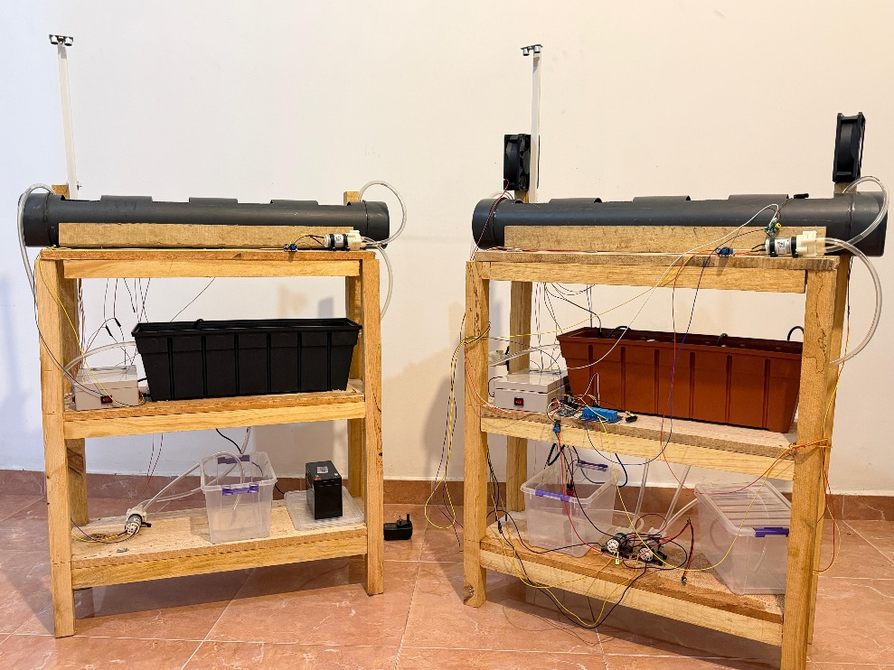
Our Approach
Dual NFT system (Organic + Inorganic)
Real-time IoT-based monitoring
Cloud dashboard + mobile control
Plant growth tracking

Slide 8
INDIVIDUAL COMPONENTS

Slide 9

IT22258762 | P.A.S.S. Weerasekara
INORGANIC NFT HYDROPONIC SYSTEM FOR CAPSICUM CHILI
Computer Systems & Network Engineering

Slide 10
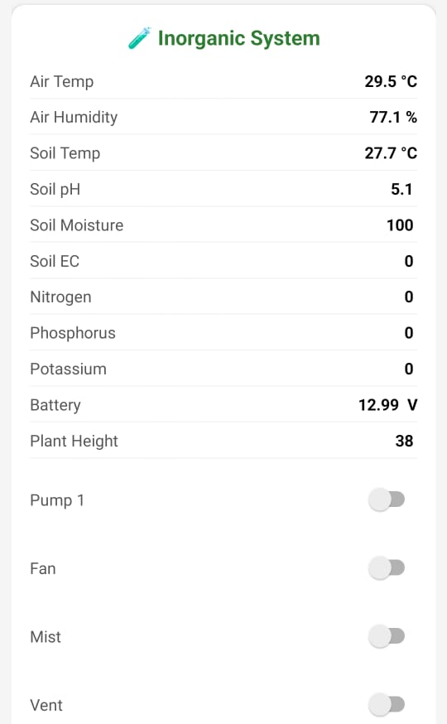
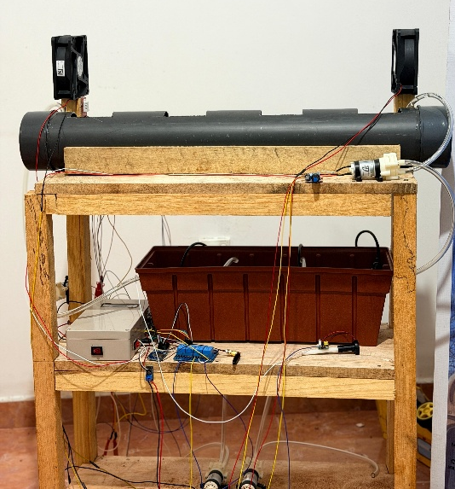
INORGANIC NFT HYDROPONIC SYSTEM FOR CAPSICUM CHILI
How the Solution Addresses the Sub-Problem / Prototype
maintaining stable nutrient strength and pH in an inorganic NFT system
Manual monitoring causes delayed correction and nutrient stress
Implemented a sensor-driven inorganic NFT prototype with real-time monitoring
Ultrasonic sensor-based plant height monitoring for non-contact
Prototype Implementation
Constructed complete inorganic NFT setup
Integrated pH, EC, NPK, water-level, and ultrasonic sensors with ESP32
Safe power control and protection for pumps using relay isolation
User Requirements Addressed by the Solution
Real-time visibility of nutrient conditions
Reduced manual nutrient adjustment
Add growth monitoring without image processing
Remote monitoring and control via mobile app
IT22258762 | P.A.S.S. WEERASEKARA | 25-26J-035

Slide 11
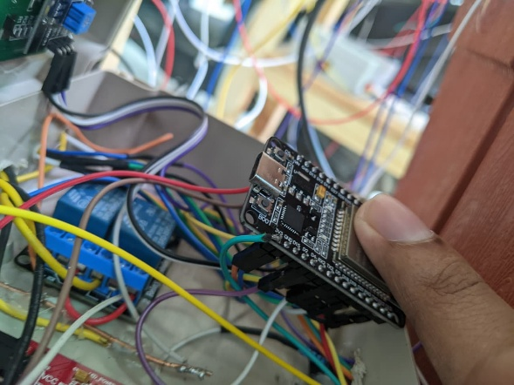
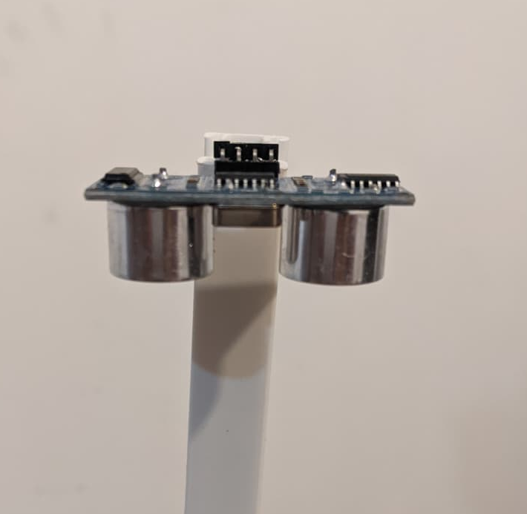
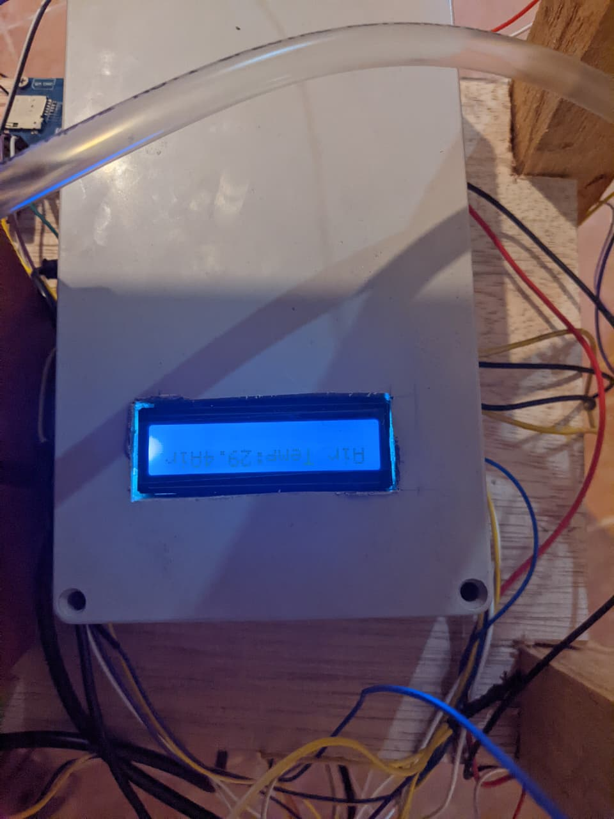
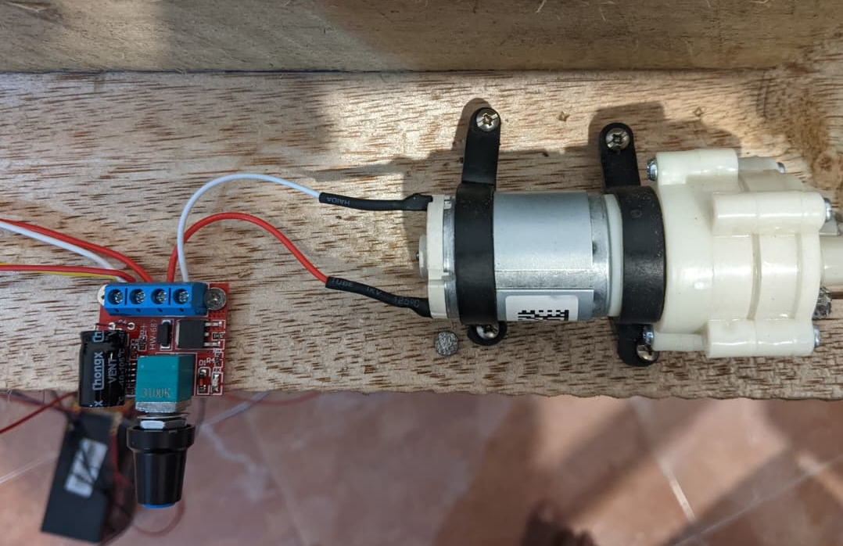
INORGANIC NFT HYDROPONIC SYSTEM FOR CAPSICUM CHILI
Design Excellence / Individual Contribution
RS485 multi-parameter sensor for reliable nutrient monitoring
Ultrasonic sensor-based plant growth tracking (non-contact)
Cloud integration using Firebase for real-time data logging
Mobile dashboard for live monitoring and pump control
User Feedback on Prototype (Early Stage)
System reduces need for frequent manual checking
Mobile dashboard improves visibility and ease of monitoring
Semi-Automated dosing reacts faster than manual adjustment
LCD display helps users quickly verify system status on-site
Relay-based pump control improves electrical safety and reliability
IT22258762 | P.A.S.S. WEERASEKARA | 25-26J-035

Slide 12

IT22355782 | D.S Galappaththi
Low-Power, Resilient Communication System for Hydroponic Monitoring
Computer Systems & Network Engineering

Slide 13
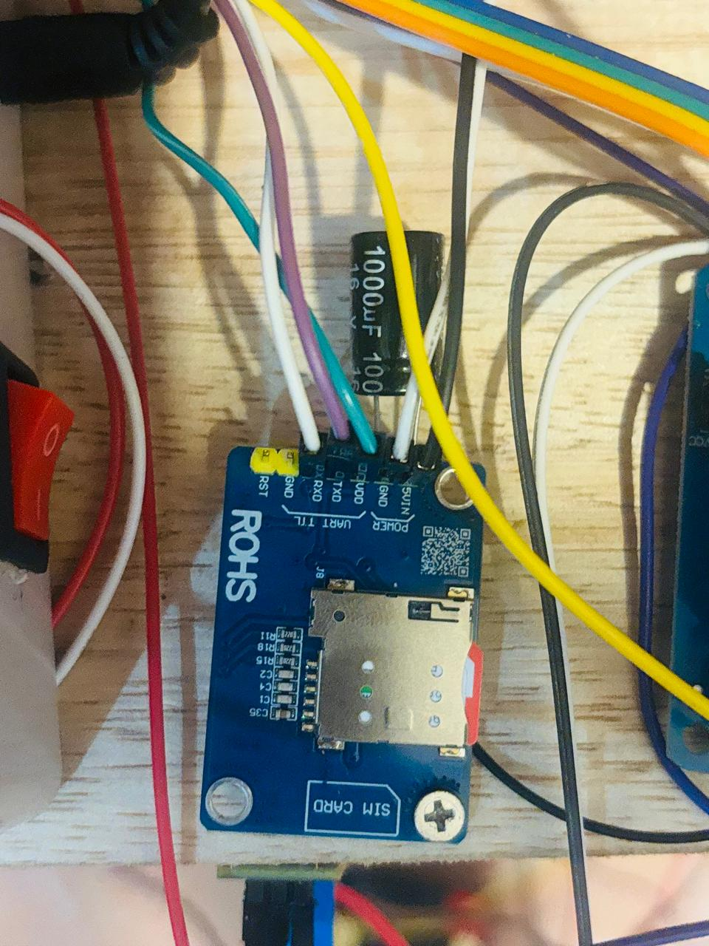
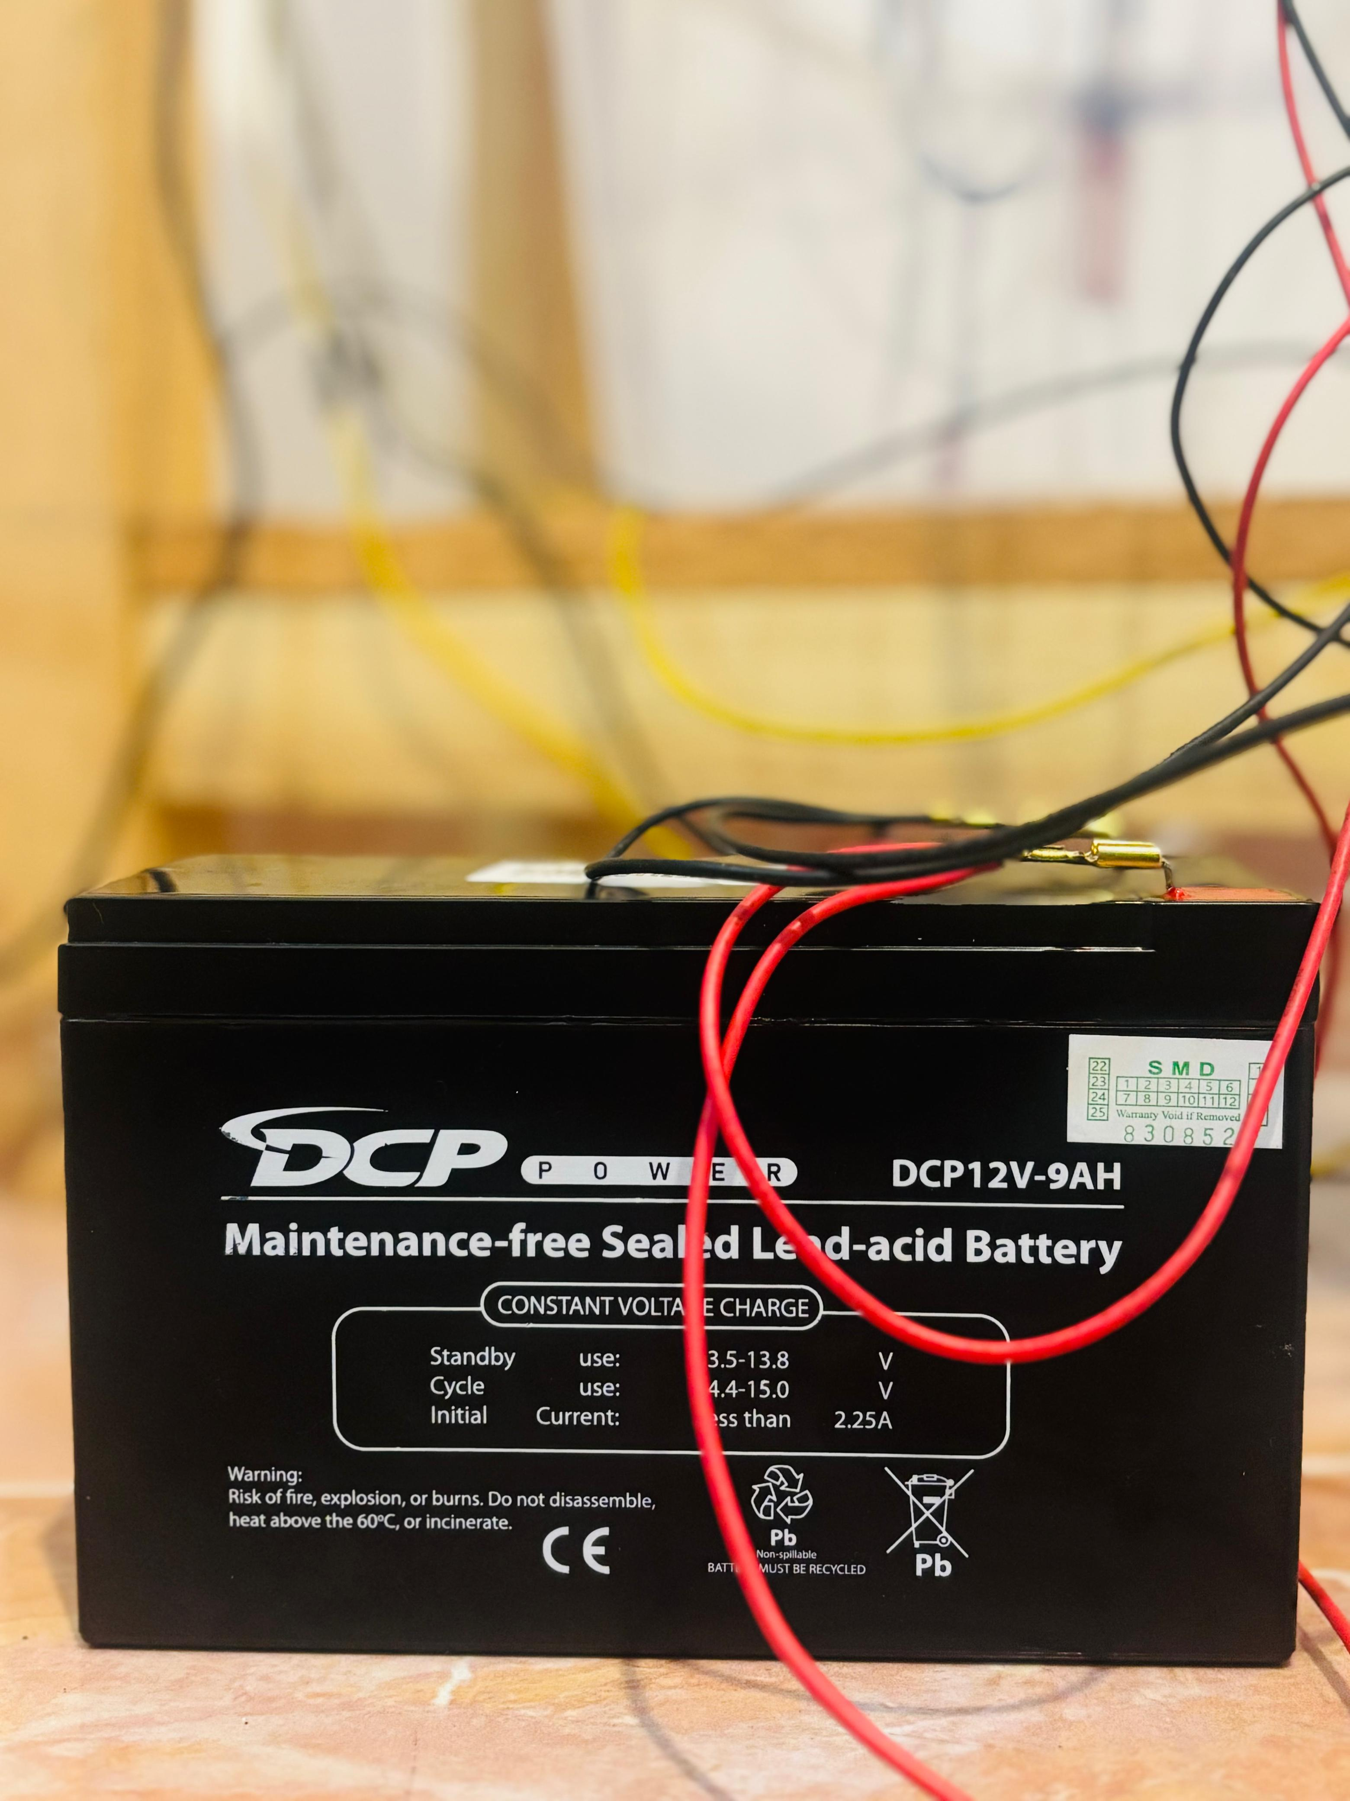
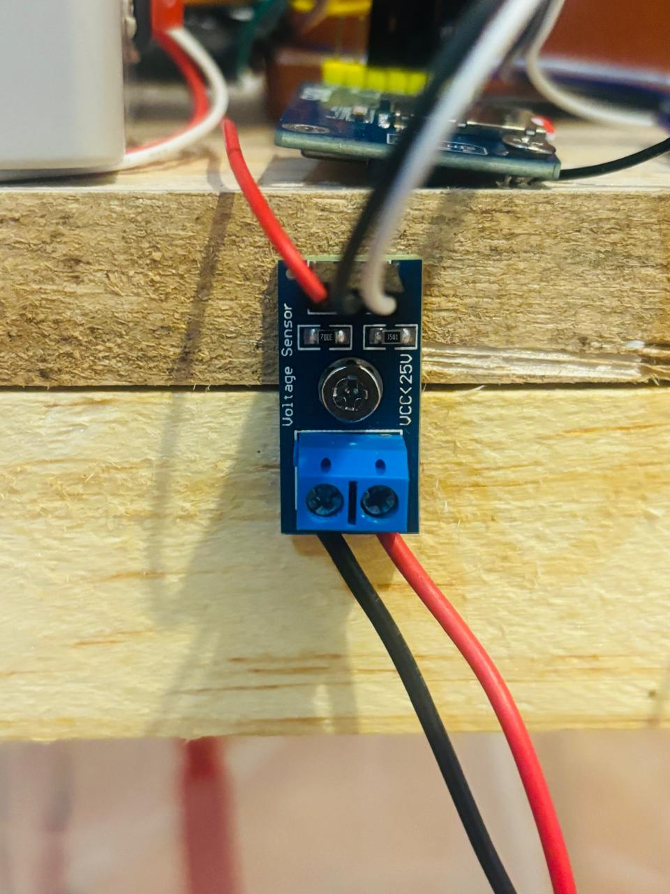
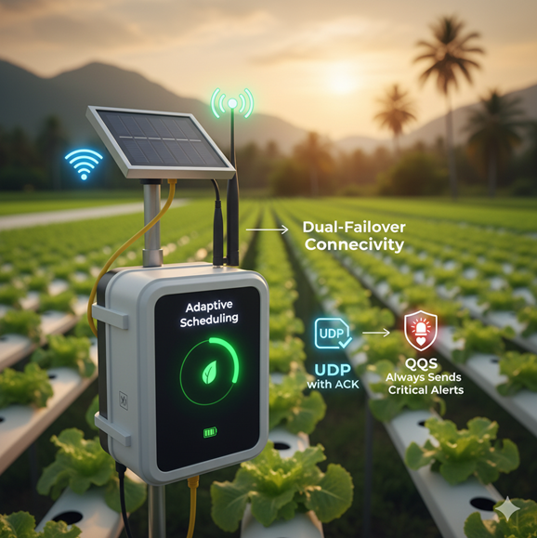
Low-Power, Resilient Communication System for Hydroponic Monitoring
How the Solution will address the Sub-Problem / Prototype
Flask ML server reads Firebase sensor data
Generates predictions and writes results
UDP gateway supports lightweight ingestion
(ESP32 → Gateway → Firebase)
User Requirements
Predictions for decision support:
Battery prediction for power planning
Sleep interval prediction for energy-saving scheduling
Stability prediction for detect inconsistent readings
Energy-efficient architecture option:
UDP gateway supports deployment where sensor nodes must remain lightweight.
IT22355782 | D.S GALAPPATHTHI | 25-26J-035

Slide 14
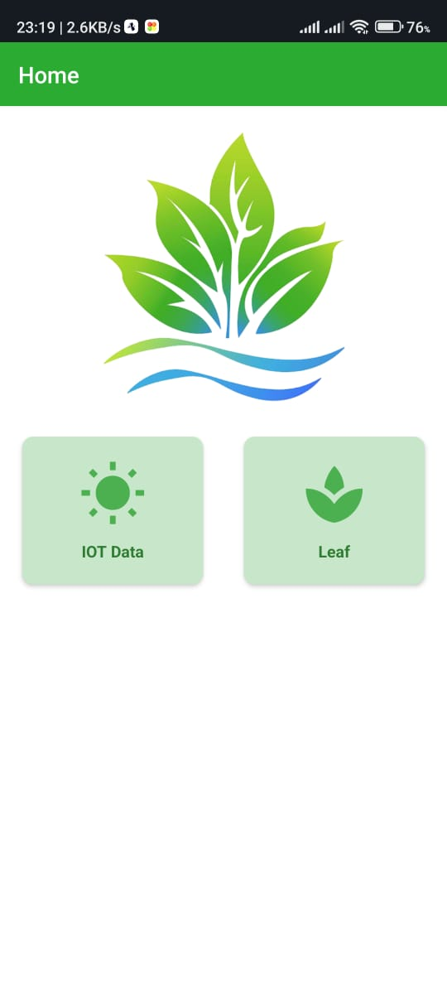
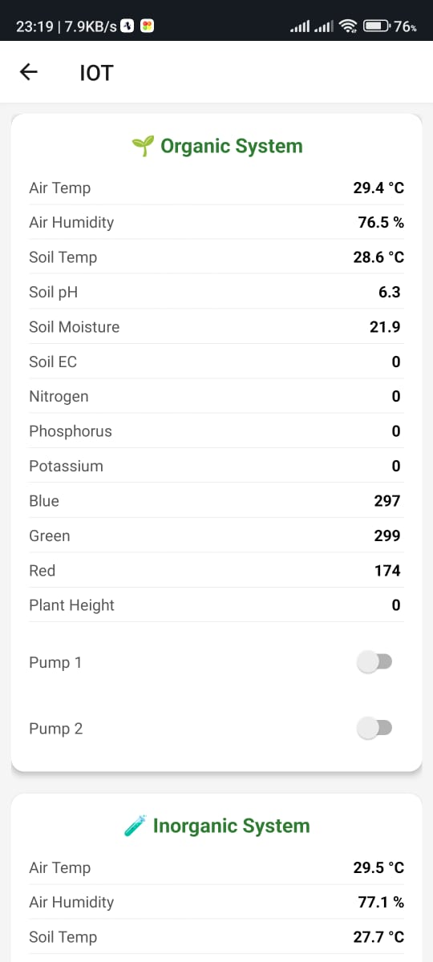
Low-Power, Resilient Communication System for Hydroponic Monitoring
Design Excellence / Contribution
Separated responsibilities clearly:
ESP32 → sensing only
Gateway → ingestion + forwarding
Firebase → central storage
Flask ML server → prediction + write-back
Dashboard → visualization
User feedback on prototype
Predictions improve decision making, not just monitoring
System feels more “smart” and useful
Need clearer warning/alert display (next step)
IT22355782 | D.S GALAPPATHTHI | 25-26J-035

Slide 15

IT22167682 | D.M.I.P Dissanayaka
ORGANIC NFT HYDROPONIC SYSTEM FOR CAPSICUM CHILI
Computer Systems & Network Engineering

Slide 16
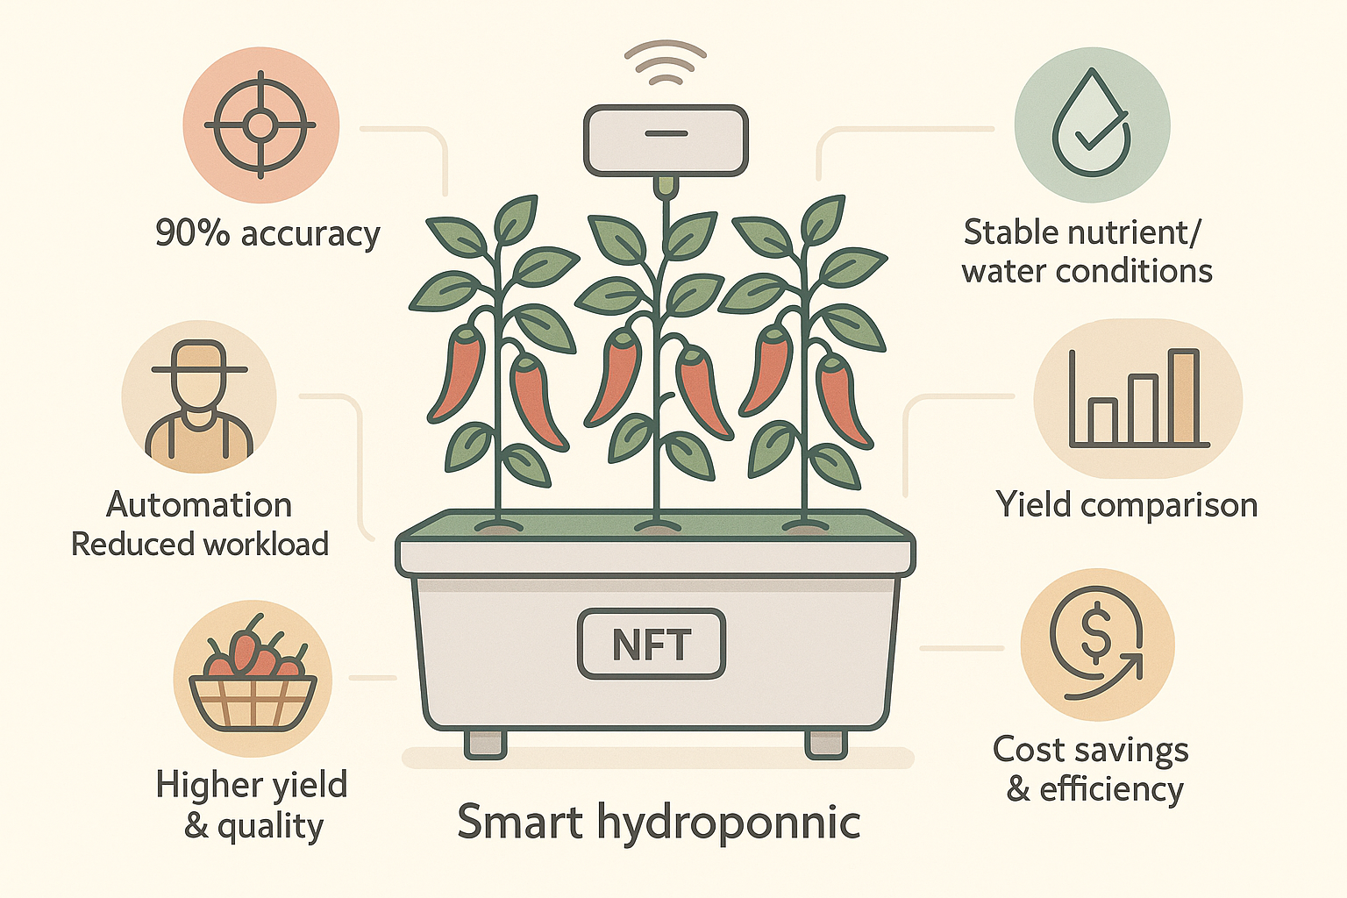
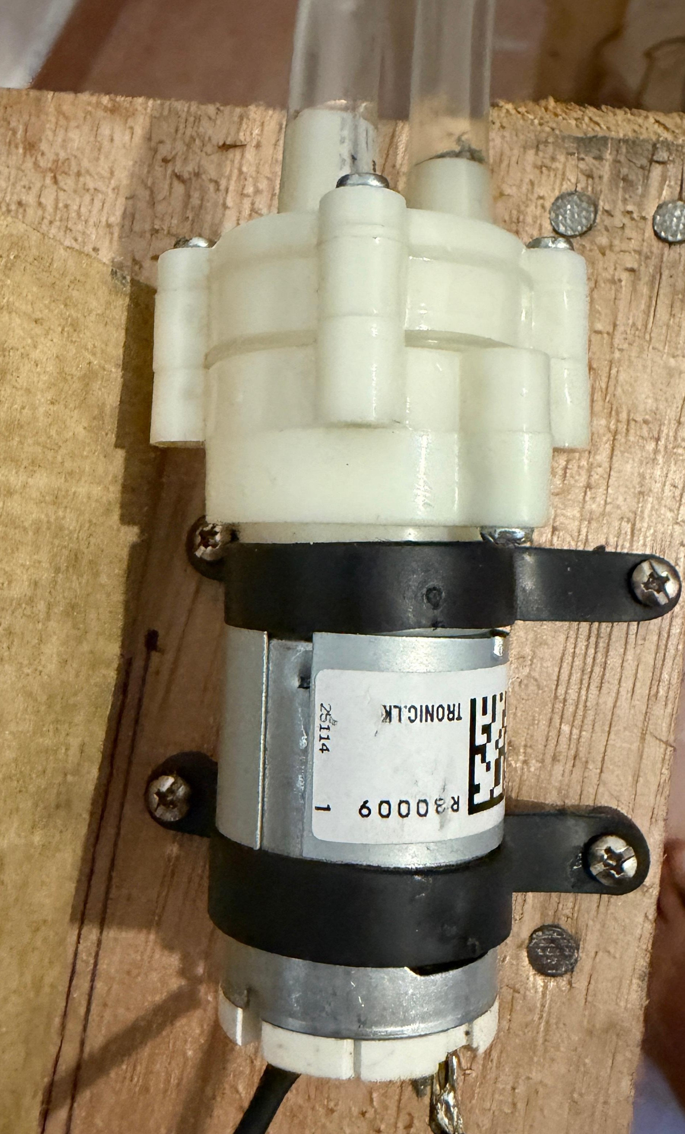
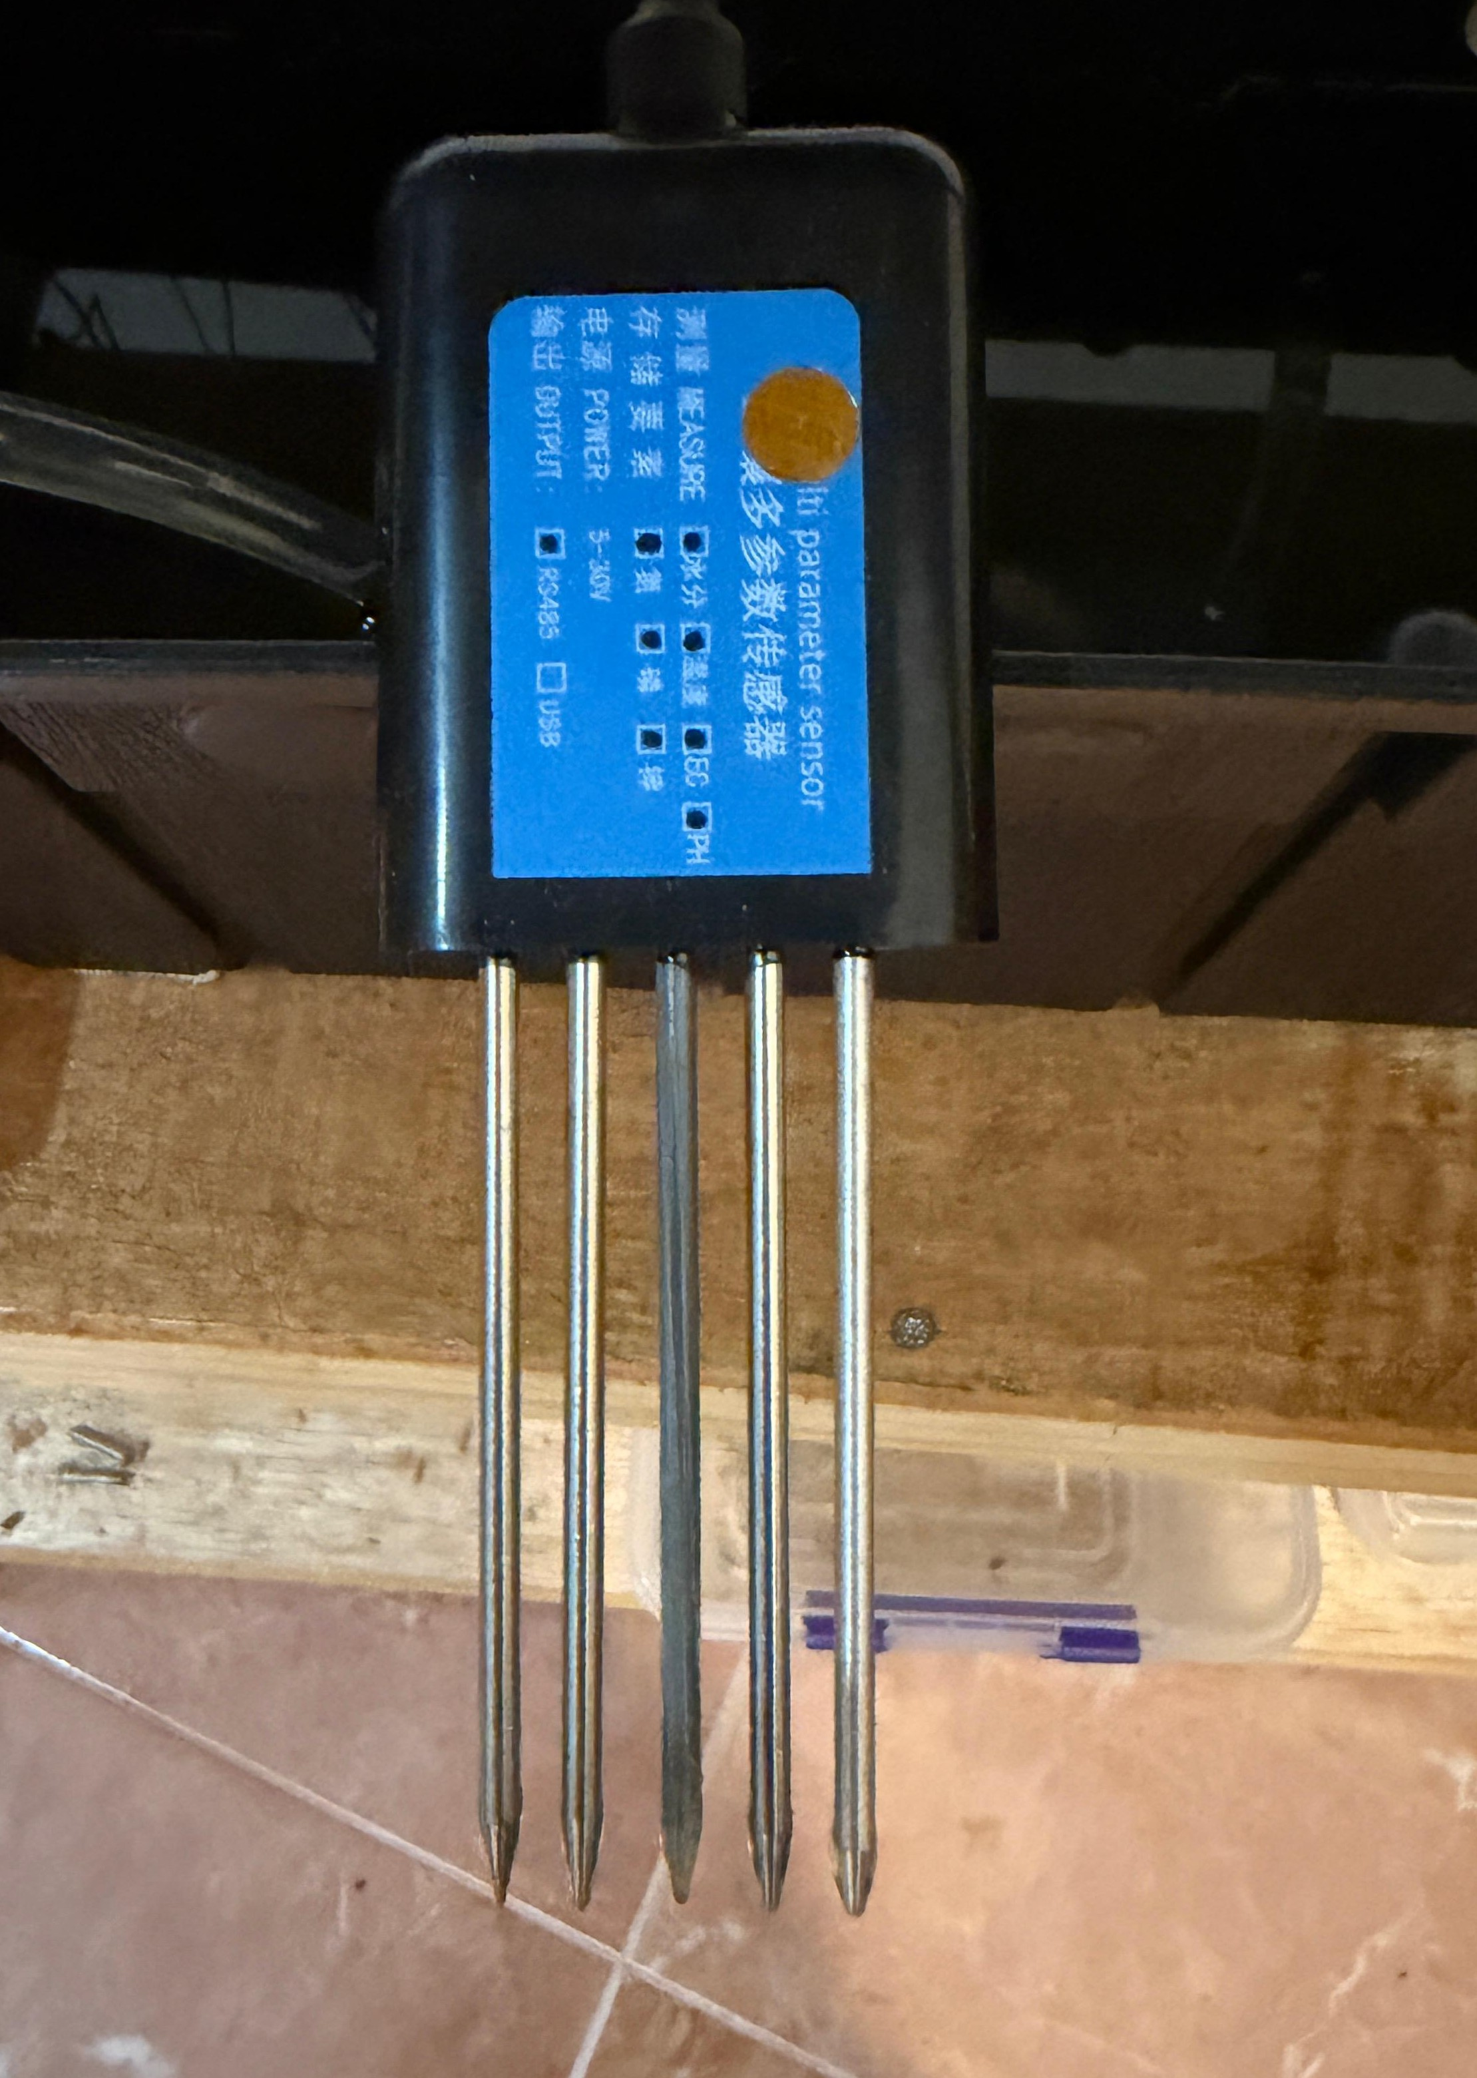
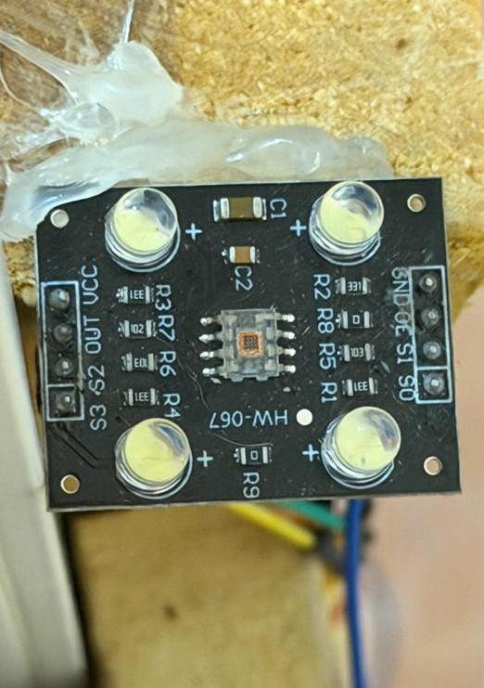
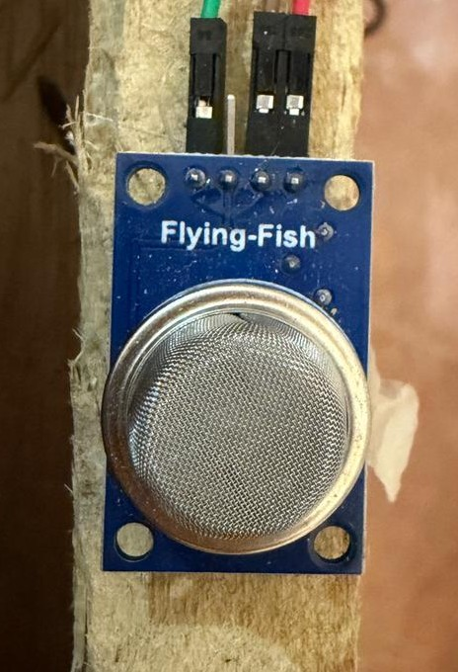
ORGANIC NFT HYDROPONIC SYSTEM FOR CAPSICUM CHILI
How the Solution Addresses the Sub-Problem/ Prototype
Addresses the problem of manual monitoring in organic NFT systems by introducing real-time sensor-based monitoring.
Replaces guesswork with continuous sensing of pH, EC, water level, temperature, gas, and color indicators.
Implements a functional NFT structure with stable water flow and grow channels.
Lays the groundwork for future compost classification and automated nutrient management.
User Requirements Addressed
Real-time viewing of nutrient and environment data
Reduced manual monitoring and intervention
Remote access via mobile dashboard
Safer and more stable plant growth conditions
IT22167682 | D.M.I.P DISSANAYAKA | 25-26J-035

Slide 17
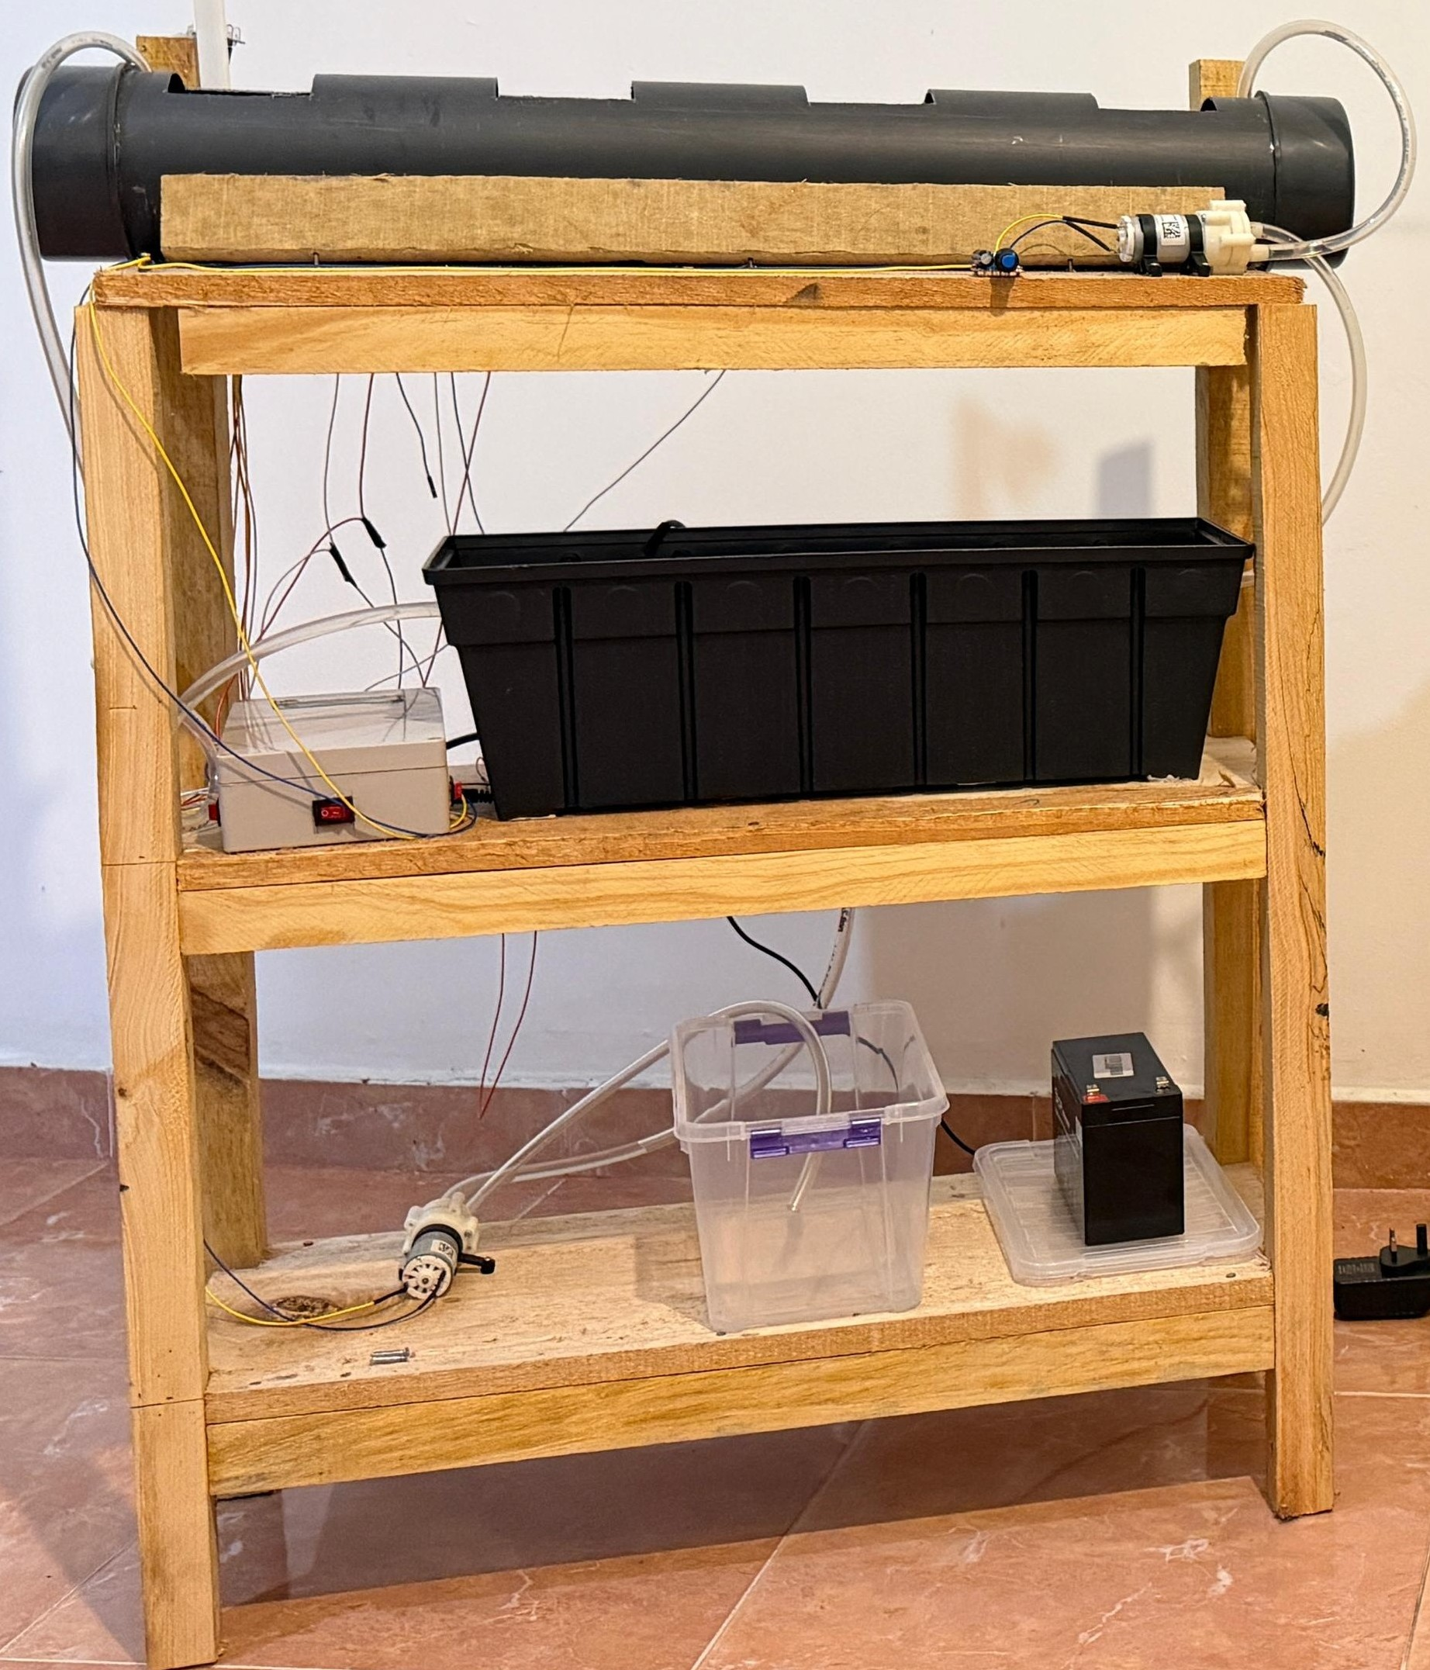
ORGANIC NFT HYDROPONIC SYSTEM FOR CAPSICUM CHILI
Design Excellence / Contribution
Integration of multiple sensors with ESP32 for organic NFT
Real-time data upload to Firebase cloud dashboard
Working hydroponic structure with water flow and grow channels
Designed for future automation (fuzzy logic & compost classification)
User Feedback on Prototype
Sensor readings are clear and easy to understand
Mobile dashboard improves monitoring convenience
System structure and water circulation work reliably
Users prefer automated control in next stage
IT22167682 | D.M.I.P DISSANAYAKA | 25-26J-035

Slide 18

IT22617996 | K.S.T.S.A KARIYAWASAM
Automated Climate Zone for Weather Adaptation and Fungal Risk Prediction
Computer Systems & Network Engineering

Slide 19
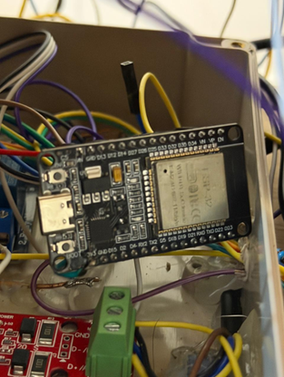
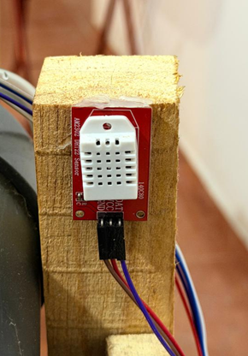
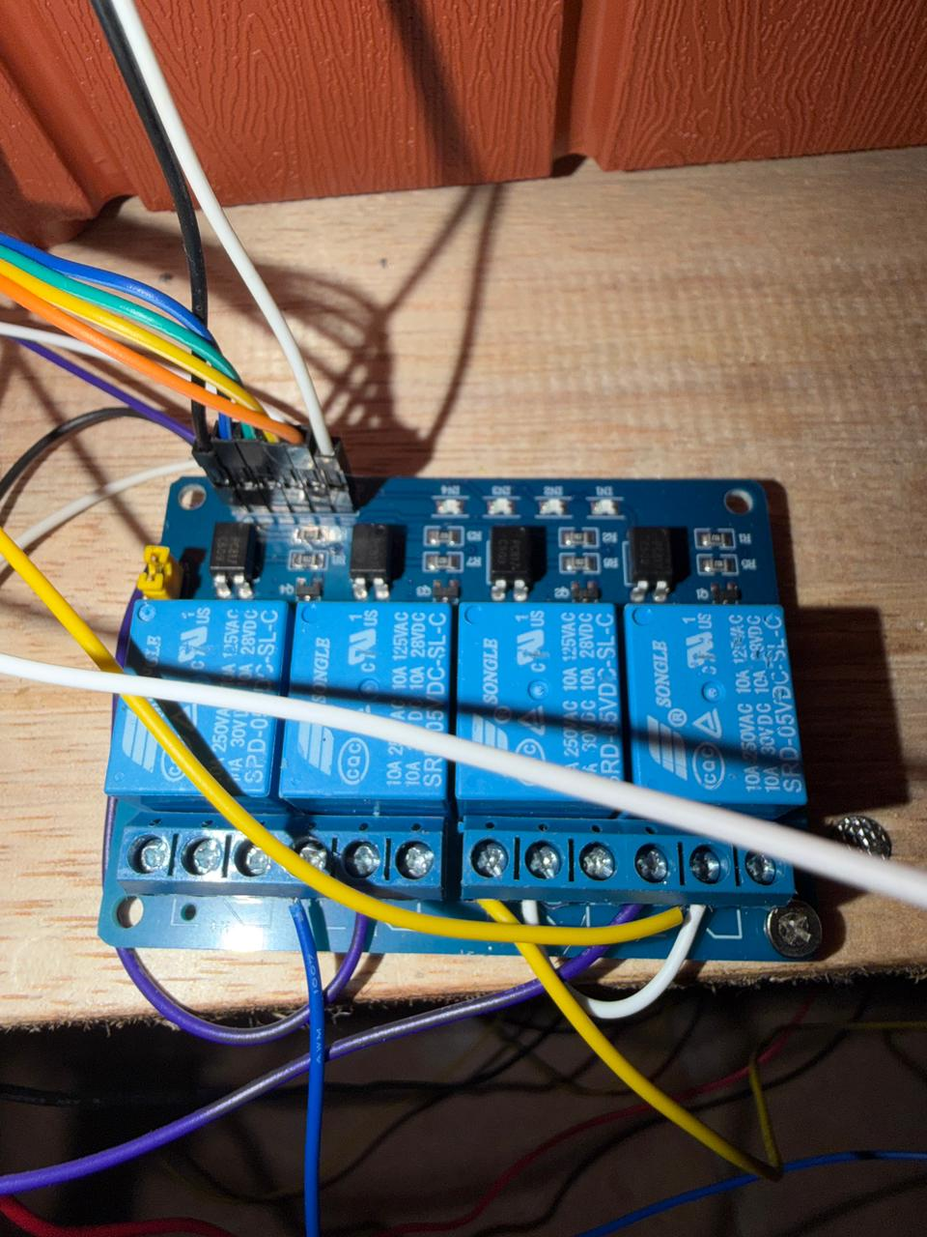
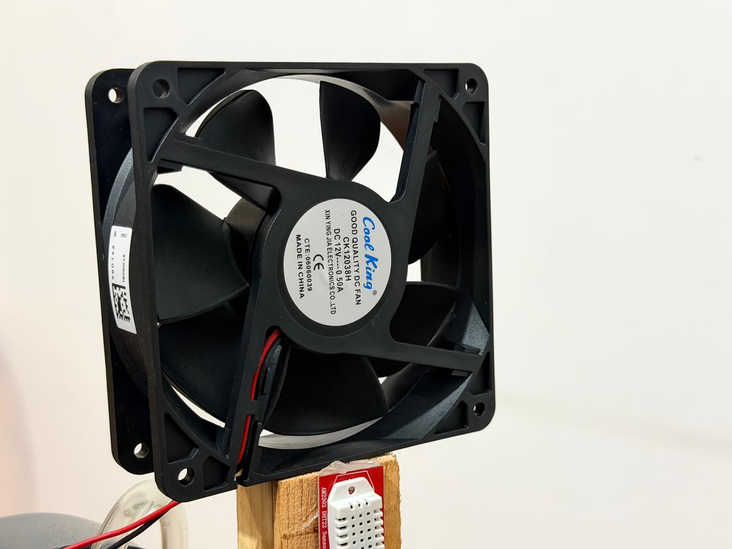
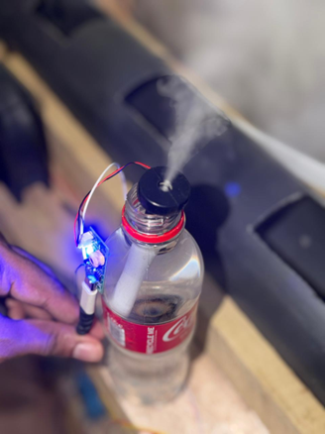
Automated Climate Zone for Weather Adaptation and Fungal Risk Prediction​
How the Solution Helps
Monitors temperature and humidity in the hydroponic zone.
Fans and misting system can be switched ON/OFF to protect plants.
Detects leaf diseases using a mobile app and pre-trained ML model
User Requirements
Helping keep capsicum plants healthy
Providing real-time environmental monitoring
Allowing easy leaf disease detection
Supporting basic automation of fans and misting
IT22617996 | K.S.T.S.A KARIYAWASAM | 25-26J-035

Slide 20
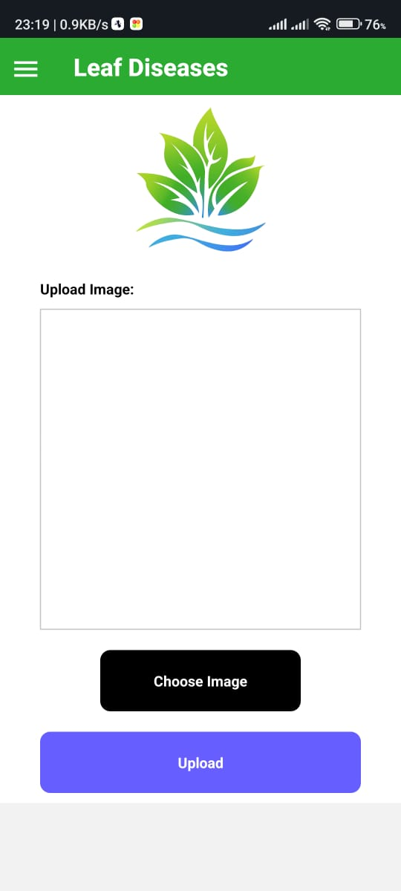
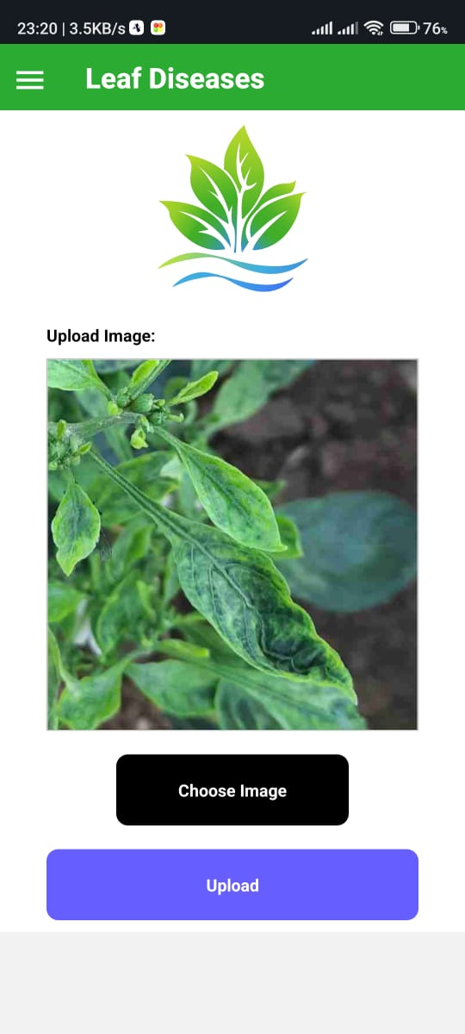
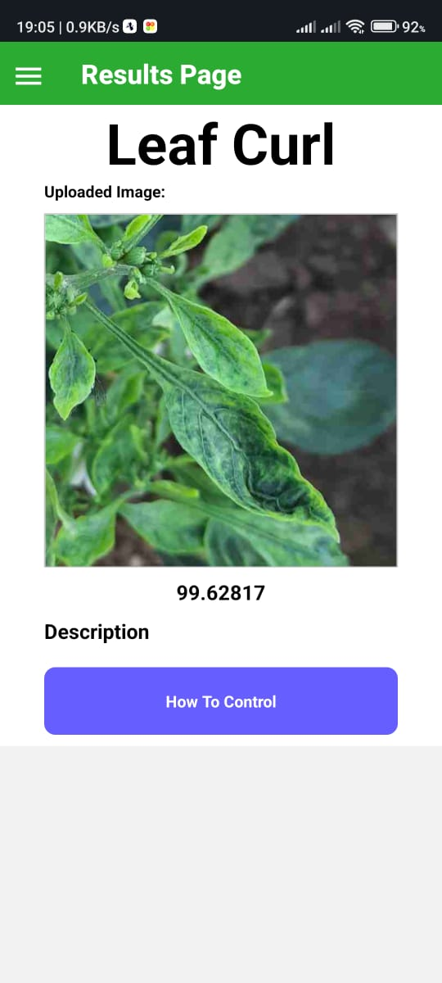
Automated Climate Zone for Weather Adaptation and Fungal Risk Prediction
Design excellence & Contribution
Combines sensors (ESP32 + DHT22) and ML (MobileNet) for smart monitoring.
Modular design allows adding fan logic, leaf wetness, and alerts later.
Helps prevent diseases instead of just reacting after they appear.
User Feedback
Fans/misting work as expected.
Mobile app disease detection is clear and simple.
Users want predictive alerts and automatic fan/mist logic in the future.
IT22617996 | K.S.T.S.A KARIYAWASAM | 25-26J-035

Slide 21
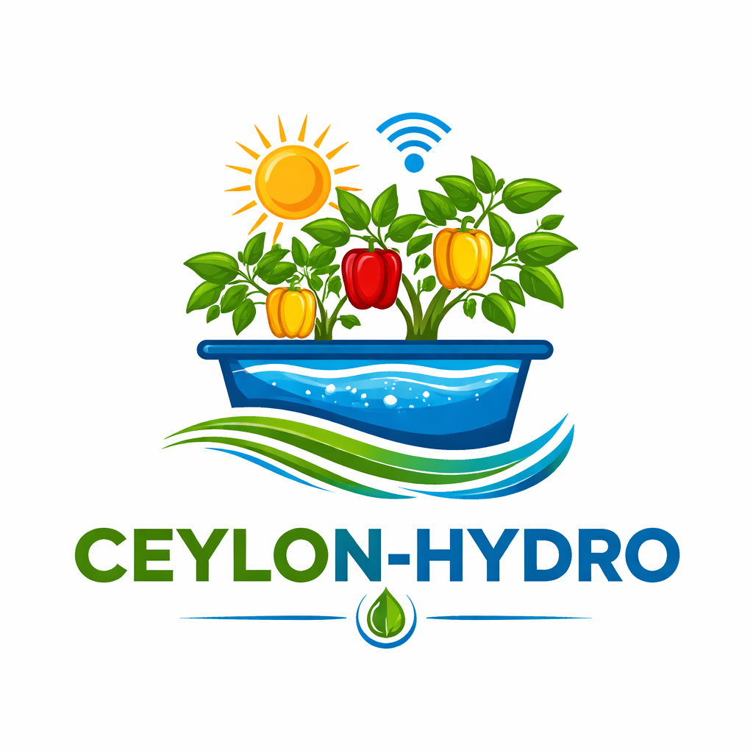
Energy-Efficient Dual Hydroponic System for Organic/Inorganic Capsicum Chili Farming
Commercialization & Sustainability
Smart Dual NFT hydroponic kit for urban and rural farmers
Scalable for research labs, schools, and greenhouses
Strong startup and B2B partnership potential
Energy-efficient design using IoT and solar support.
Customer Persona
Smallholder farmers – Need low-cost automation to improve yield and reduce disease.
Urban home-growers – Want an easy, space-saving smart farming system.
Educational & research institutions – Use the system for learning and experiments.
Commercial greenhouse operators – Require efficient climate control and disease prevention.
Market Size
Growing demand for:
Smart agriculture solutions
Urban farming systems
Climate-resilient food production
High relevance in Sri Lanka and similar tropical countries
Potential to expand into South Asian and developing markets
What Is Unique in Our Solution
Dual organic and inorganic NFT farming in one integrated system
Energy-efficient IoT networking with solar support and GSM failover
Climate-aware control with predictive fungal disease prevention
Compost quality validation and nutrient recycling
Integrated AI-based disease detection
Cost Recovery & Business Model
Prototype cost: ~LKR 55,000 – 65,000
Estimated market price: ~LKR 80,000 – 90,000 per kit
Additional revenue through:
Cloud dashboard subscriptions
Advanced analytics & alerts
Institutional and B2B deployments

Slide 22

Thank YOu

