Slide 1
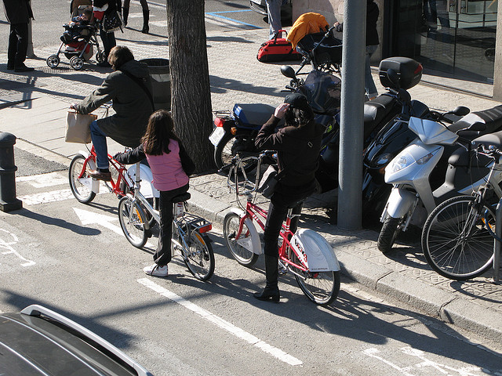
Offline semantic bank construction · TRAIN only
TRAIN captions
POS tagging
+ lemmatization
CLIP text encoder
L2 normalization
Noun bank
5269 × 512
Verb bank
1594 × 512
K = 150, d = 512
Noun aggregator
Verb aggregator
Offline visual feature extraction
CSA encoder
Tₒ
Predicted boxes
producer cache
V₀
Object alignment 1
(V₀, Tₒ) → (V₁, T₁)
Tᵣ
CLIP vision encoder
ViT-B/16
Patch tokens
196 × 768
ROI pooling
N × 768 cache
V₁, T₁
Object alignment 2
(V₁, T₁) → Vₒ
14 × 14 · CLS removed
N × 768
Input image I
Vₒ
N varies per image (max 87)
Empty boxes → full-frame fallback
Visual projection
768 → 512
Relation alignment
(Vₒ, Tᵣ) → Vᵣ
N × 512
Vₒ
Vᵣ
Generated caption
Linear
+ softmax
Parallel adaptive decoder (×3)
CSA adaptation
VALID: beam 5 → CIDEr
Best checkpoint selection
TRAIN: next-token XE
Cached CLIP ROI + global semantic banks
BOS / generated prefix
VALID & inference
Embedding + positions
GT captions (shift right)
TRAIN only
Frozen
Trainable
Notes:
CSA adaptation, current forward model.py SHA256139edbb1b73caf3dadaf5c960b25542e282f88baf2ce9bdf141de922ceacbc09. X051, FULL_XE_10_PROTOCOL.md and full_xe_decode.py; architecture/recipe, not completed training results. Input photograph: COCO_train2014_000000263974.jpg, https://images.cocodataset.org/train2014/COCO_train2014_000000263974.jpg ; exact image and SHA already documented in RID_IMAGE_SEMANTIC_CHECK.json. Photo is an illustrative input, not a detection or caption result. Ground-truth training prefix and BOS/generated validation prefix are alternative modes. Validation has no backward. ROI patches contain global context. Two bank aggregators each have150learnedprototypes512D. Decoder has parallel object/relation cross-attention and separate vector gates; see v2 encoder/decoder zooms for internals.

