Slide 1

CS 492 • Senior Design Project • Spring 2025
Team SürDur
Bora Haliloğlu Burak Oruk Emir Tuğlu
Mustafa Gökalp Gökdoğan Tevfik Emre Sungur

Slide 2
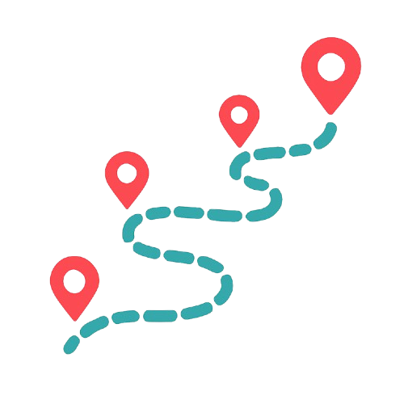
What is SürDur?
SürDur is an app that gives personalized stopover recommendations along your route
Restaurants
Natural Landmarks
Historical Sites
…
Explore, plan, and navigate—all in one app
Make your journey more enjoyable
Discover places you’d otherwise pass by

Slide 3
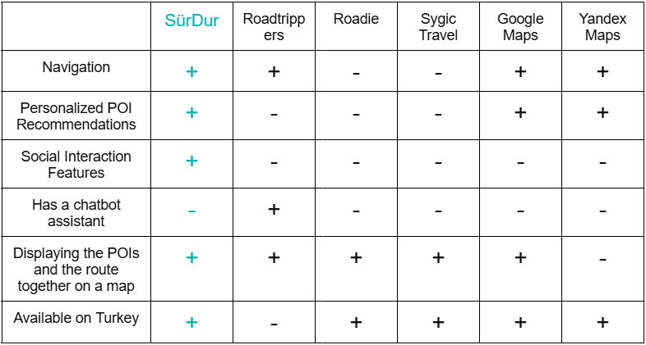
Market Research
No competitor directly solves the problem in Turkey

Slide 4
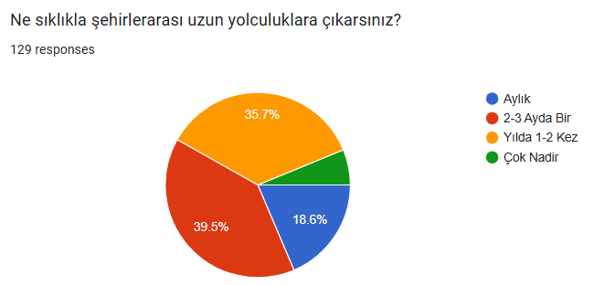
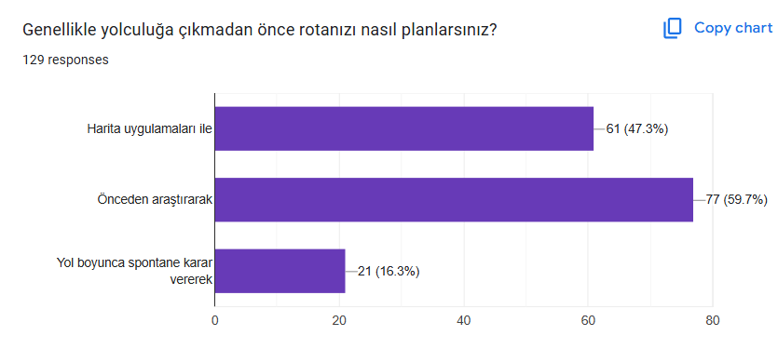

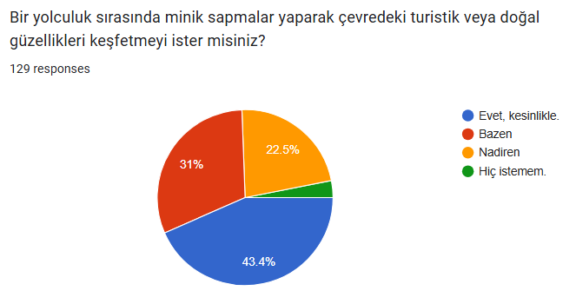
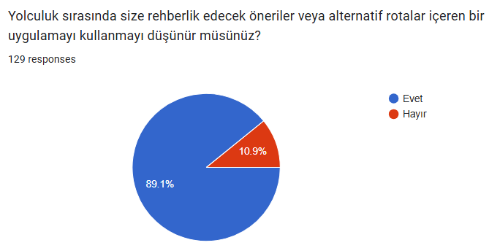
Survey Results

Slide 5
Future Plan & Business Model
App launch
Monetization
In-app adds:
We will show ads in social media page between the posts.
Sponsored recommendations:
We will slightly prioritize promoted places in the recommendation list.
Premium:
Users will be able to disable ads if they pay for the price for premium.
Long term: CarPlay support & expand abroad

Slide 6
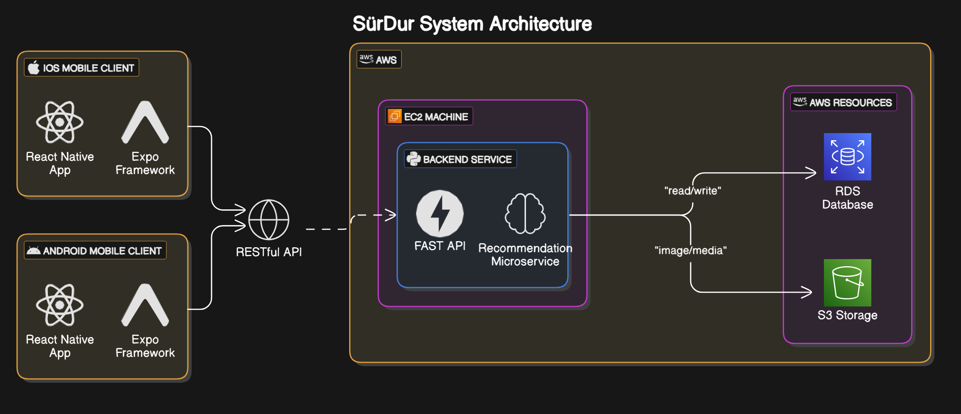
System Architecture

Slide 7
Process & Takeaways
Teamwork:
Weekly sprints → steady progress
Risks:
Foreseen: Bugs and UI/UX issues
Unforeseen: Irrelevant entries in Foursquare data → required extra processing
Lessons:
Validate third-party dependencies early
Build buffer time for unforeseen delays
Planning + Good teamwork = Low stress delivery

Slide 8

Thank you for your attention!
Let’s see SürDur in action 📍🗺️

