Slide 1


Slide 2
TEAM MEMBERS
SURYA NARAYAN – CB.SC.U4AIE23254
MOUNINDRA P -CB.SC.U4AIE23273
RASWANTHKRISHNA M-CB.SC.U4AIE23266
DIVAGAR S-CB.SC.U4AIE23223
ADITHYAN P V-CB.SC.U4AIE23206

Slide 3
INTRODUCTION
Rancidity is the chemical breakdown of fats in rice due to oxidation, resulting in an unpleasant odor and taste. This process negatively impacts food safety, reduces shelf life, and diminishes consumer trust.
In warehouse environments, manual inspection methods are often inefficient, time-consuming, and prone to human error. Detecting rancidity in its early stages remains a significant challenge, leading to potential quality issues and financial losses.
The integration of robotics and mathematical models offers a solution by automating the inspection process and enhancing detection accuracy. Robotics streamlines monitoring, while mathematical techniques such as statistical analysis and machine learning enable precise identification of rancidity through sensor data interpretation.

Slide 4
PROBLEM STATEMENT
Rice storage facilities struggle with early rancidity detection due to time-consuming and manual inspections. This leads to food safety risks, reduced shelf life, and financial losses. An automated, efficient solution using robotics and mathematical models for odor-based spoilage detection can improve accuracy, enhance warehouse efficiency, and ensure better food quality control.

Slide 5
CONCEPTS OF ROBOTICS USED
Odor Sensing:
Robotics in this application includes the use of MOS gas sensors to detect specific volatile organic compounds (VOCs) released during oxidation. The robot’s ability to sample and analyze odors enables the detection of early-stage rancidity.
Autonomous Navigation:
Path Planning: Developing algorithms that enable the robot to plan efficient routes from its current position to a target location, considering the environment and potential obstacles.
Localization: Determining the robot's position within the environment, which can be achieved through Simultaneous Localization and Mapping (SLAM).
Real-Time Monitoring and Alert System:
The robot can communicate with a central system via wireless communication (Wi-Fi, GSM) to send alerts and transmit sensor data. This allows warehouse staff to monitor spoilage conditions in real-time and take action when necessary.

Slide 6
CONCEPTS OF MATH USED
1. Nonlinear State Estimation:
State Vector: The EKF-SLAM algorithm maintains a state vector that includes the robot's pose (position and orientation) and the positions of landmarks in the environment.
Nonlinear Functions: The motion and measurement models in SLAM are often nonlinear. The EKF addresses this by linearizing these models around the current estimate using first-order Taylor expansion.
2. Jacobian Matrices:
Linearization: To linearize the nonlinear motion and measurement models, the EKF computes Jacobian matrices, which contain the partial derivatives of these models with respect to the state variables.
Jacobian of Motion Model (F): Represents how the state changes with respect to the control inputs.
Jacobian of Measurement Model (H): Represents how the expected measurements change with respect to the state variables.

Slide 7
CONCEPTS OF MATH USED
3. Covariance Matrices:
Process Noise Covariance (Q): Represents the uncertainty in the robot's motion model.
Measurement Noise Covariance (R): Represents the uncertainty in the sensor measurements.
State Covariance (P): Represents the uncertainty in the estimated state, encompassing both the robot's pose and the landmark positions.
4. Kalman Gain:
Computation: The Kalman Gain is computed to balance the trust between the predicted state and the new measurements. It determines how much the predictions should be corrected based on the observed data.
5. Update Equations:
Prediction Step: Projects the current state estimate forward in time using the motion model.
Update Step: Incorporates new sensor measurements to correct the predicted state, adjusting both the state estimate and its associated uncertainty.

Slide 8
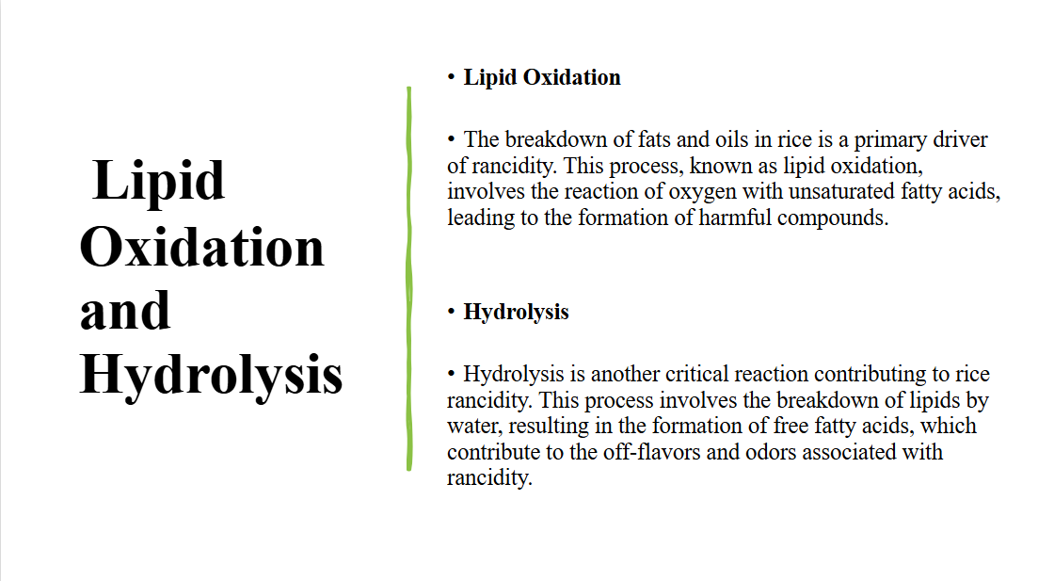

Slide 9
Literature Review
S. No | Title | Authors | Observations
1 | Automated food grain monitoring system for warehouse using IoT | Lydia J et al. | An IoT-based sensor system for food grain storage monitors temperature, humidity, motion, shock, carbon monoxide, fire, and grain levels. Data is transmitted via GSM to a cloud platform, enabling real-time monitoring and control through mobile apps and alerts. Automated responses are triggered for specific conditions to maintain optimal storage conditions.
2 | Electronic nose system for rancidity and insect monitoring of brown rice | N. Neamsorn et al. | An electronic nose system was developed to detect rancidity and insect damaged brown rice. Equipped with eight metal oxide sensors targeting gases like ammonia, alcohol, and carbon monoxide, the system analyzed controlled rice samples. PCA and PLS-DA analysis distinguished normal, rancid, and insect-damaged rice, achieving R² of 0.92 for rancidity and 0.98 for insect damage.
3 | Automated Food Grain Warehouse Monitoring System using IoT and Machine Learning (TINYML) | Karthiga. V. and Thenmozhi T. | The proposed system combines IoT and TinyML for real-time food grain monitoring, using sensors and ESP32 microcontrollers to track temperature, humidity, and gas levels. This system ensures grain preservation and food safety, offering economic and safety benefits.

Slide 10
S. No | Title | Authors | Observations
4 | IoT-Based Smart Food Storage Monitoring and Safety System | S. U. Shariff, M. G. Gurubasavanna, and C. R. Byrareddy, | The proposed system leverages IoT with the GR Peach microcontroller for food storage monitoring. It includes food level tracking, environmental safety monitoring and alert systems using low-cost sensors and GSM modules. Alerts are triggered via SMS when thresholds are breached.
5 | Food Spoilage Detection Using IoT | S. Gogula, G. Kumar, and P. Lahari, | An IoT-based system for detecting food spoilage using MQ-4 gas sensors for methane (solid food) and pH sensors (liquid food). It observes that higher temperatures accelerate spoilage, with cooked food and milk deteriorating within hours at room temperature but lasting longer when refrigerated. Methane and pH shifts effectively indicate spoilage, with real-time monitoring and notifications provided via LCDs, email, and the Blynk app

Slide 11
CHALLENGES
Most existing systems are stationary, limiting their application to fixed locations. This restricts their ability to monitor food storage or safety dynamically across larger or multiple areas.
The monitoring systems detect specific parameters, but may miss other critical indicators, such as certain spoilage gases

Slide 12
METHODOLOGY
Hardware Integration
Sensor Integration: Sensors are tested under controlled conditions to ensure accurate spoilage detection.​​
Navigation System: Motors, wheels, and sensors are integrated with basic motion control and obstacle avoidance.​​
Software Development
Data Processing: The unit is programmed for real-time data acquisition, noise filtering, and standardization.​​​​
Navigation Algorithms: SLAM enables autonomous movement and efficient path planning.​​
Alert System: Spoilage detection alerts are sent via ESP32 , with real-time monitoring via a dashboard or mobile app.​

Slide 13
Testing
Sensor Testing: Rancidity conditions are simulated to evaluate sensor sensitivity, accuracy, and odor classification performance.
Navigation Testing: The robot is tested in a controlled environment to ensure effective obstacle detection and path planning.
Optimization
Sensors are recalibrated for improved accuracy, navigation algorithms are refined for better mapping, and odor classification models are enhanced to reduce false detections.
Final Model
A fully functional robot is built and deployed

Slide 14
Components
DC Motors
Chassis
Wheels
Battery pack
Breadboard
Wires
ESP32
Arduino Nano BLE 33 Sense
MOS Sensors

Slide 15
Timeline
1st review
2nd Review
Final Review
Model Refinement
Literature Review
Hardware Integration
Model Development and Evaluation
Hardware & Basic Software

Slide 16
References
[1] N. Neamsorn, V. Changrue, Y. Chanbang, K. Kunasakdakul, P. Theanjumpol, and P. Kantakaew, "Electronic nose system for rancidity and insect monitoring of brown rice," E3S Web of Conferences, vol. 187, p. 04015, 2020, DOI: 10.1051/e3sconf/202018704015.
[2] Lydia J., S. Leones Sherwin Vimalraj, R. Monisha, and R. Murugan, "Automated food grain monitoring system for warehouse using IoT," Measurement: Sensors, vol. 24, p. 100472, 2022, DOI: 10.1016/j.measen.2022.100472.
[3] Karthiga. V. and Thenmozhi T., "Automated Food Grain Warehouse Monitoring System using IoT and Machine Learning (TINYML)," Journal of Emerging Technologies and Innovative Research, vol. 11, no. 7, pp. c581–c591, July 2024.
[4] S. U. Shariff, M. G. Gurubasavanna, and C. R. Byrareddy, "IoT-Based Smart Food Storage Monitoring and Safety System," in International Conference on Computer Networks and Communication Technologies, Lecture Notes on Data Engineering and Communications Technologies, vol. 15, S. Smys, R. Bestak, J. Z. Chen, and I. Kotuliak, Eds. Singapore: Springer, 2019, pp. 623–638. doi: 10.1007/978-981-10-8681-6_57.
[5] S. Gogula, G. Kumar, and P. Lahari, "Food Spoilage Detection Using IoT," [Online]. Available: https://www.researchgate.net/publication/368659794_Food_Spoilage_Detection_Using_IoT.
[6] J. R. Ortenero, A. E. S. Choi, and M. S. Calingacion, "A Review of the Different Sensors for the Detection of Rice Rancidity Indicators," Chemical Engineering Transactions, vol. 114, pp. 421-426, 2024.
[7] V. R. Sharabiani, A. Khorramifar, H. Karami, J. Lozano, S. Tabor, Y. Darvishi, and M. Gancarz, "Non-destructive test to detect adulteration of rice using gas sensors coupled with chemometrics methods," International Agrophysics, vol. 37, no. 3, pp. 235-244, 2023. DOIi: 10.31545/intagr/166009.

