Slide 1
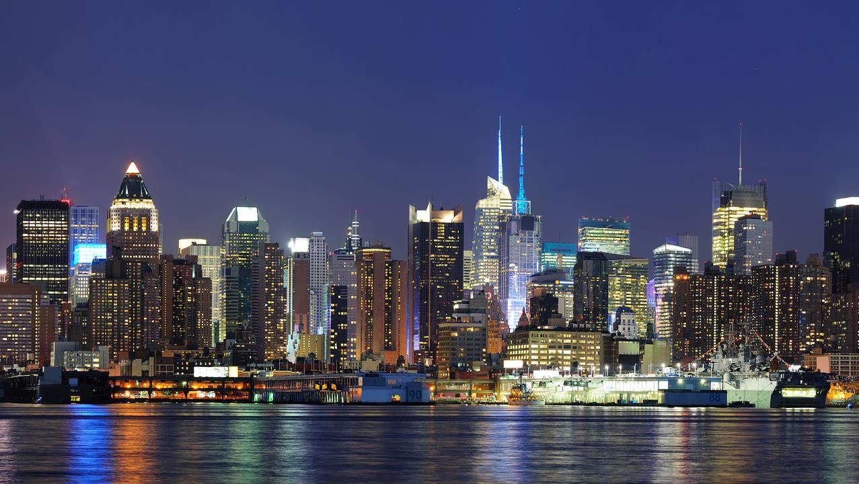

Engineering
The Change
SMART OCR
Digitize to ease communication

Slide 2
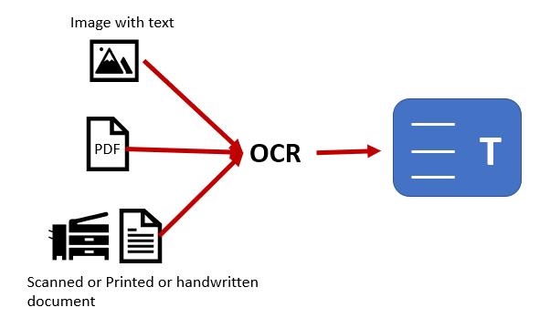
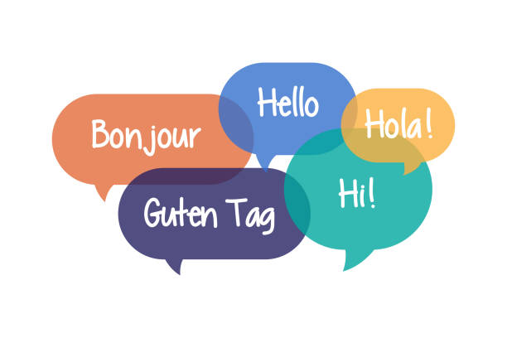




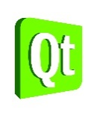

Problem Statement
Overview
To develop modular Artificial Intelligence algorithm with accurate scan which can detect/convert/translate any kind of textual literature understandable to human in desired text format and language
To develop such algorithm so powerful that language translation becomes smooth which can be applied on technology to overcome communication barriers
Translator
Technology
HIGHLIGHTS
Easy to use – Scan/upload, convert and translate
Open-source software/API – For everyone
Optimized Performance using state-of-the-art A.I Algorithms

Slide 3
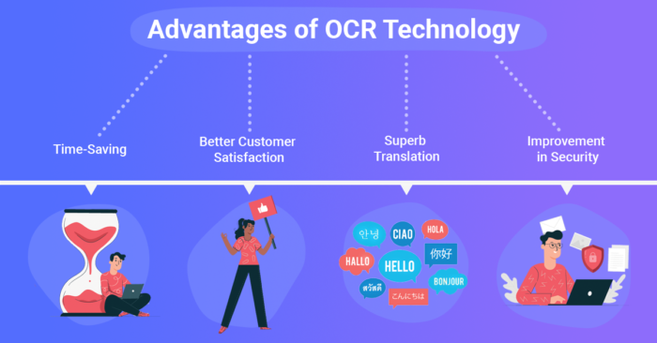
Solution Approach
Acquisition
Segmentation
Overview
Pre-processing
Classifier
A digital solution based on Artificial Intelligence algorithms to scan and recognize text characters which can be then converted and translated
The algorithm has three phases: scanning, converting and translating
End to end use of open-source platforms for scalability
Used cutting edge solution based on current market demand and trends
Conversion
Translation
Frame Capturing
Artificial
Intelligence
Labels
Model Feeding
Desired Output
Semantics
Word mapping
HIGHLIGHTS
Image
Capture
Text segmentation
Text Form Conversion
Translation Model Feeding
Word Mapping
Translated Output

Slide 4
Sample video
The video shows the software/API developed to use the OCR translator with ease. It’s an open-source entity, hence, accessible by anyone

Slide 5
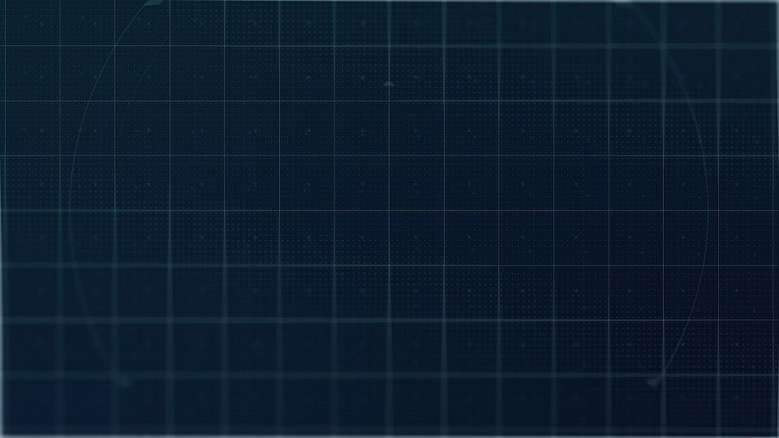
THANK YOU

