Slide 1
CODEFACE
PHP & MySQL Web Development — Common Project Presentation
Real-time coding practice & collaboration platform
526 problems · 12 languages · 15 learn tracks · live pair-programming rooms
Vanilla PHP 8 + MySQL (PDO) · no frameworks · August 2026

Slide 2
CODEFACE · PHP & MYSQL PROJECT PRESENTATION
Team Information
Enrollment No | Name | Role
<Enrollment No> | <Name 1> | Backend / DB
<Enrollment No> | <Name 2> | Frontend / UI
<Enrollment No> | <Name 3> | Testing / Docs
<Enrollment No> | <Name 4> | Content / QA
Project guide: <Guide Name> College: <College Name>
(Replace placeholders with your team details before uploading.)
1

Slide 3
CODEFACE · PHP & MYSQL PROJECT PRESENTATION
Problem Statement
▪ Existing manual/system issues
– Learning is passive: tutorials teach syntax, not fluency — no built-in practice loop.
– Practice is fragmented: separate sites for problems, language help and partners.
– Collaboration is absent: no simple way to share an editor and solve together live.
▪ Need for automation
– Manual checking of solutions is slow and inconsistent — verdicts must be instant.
– Progress, ratings and reports should compute themselves, not be tracked by hand.
▪ Proposed PHP & MySQL web solution
– Codeface — one self-hostable platform: Practice (526 problems × 12 languages with an
– in-browser judge), Learn (15 tracks × 16 lessons, 4 sequential levels), and code-joinable collaboration rooms,
– all state in MySQL, built with vanilla PHP 8 + PDO — no frameworks, runs on any LAMP host.
2

Slide 4
CODEFACE · PHP & MYSQL PROJECT PRESENTATION
Proposed Solution — Overview
▪ High-level: a single website where a learner reads a lesson, immediately solves a matching
▪ problem, and can invite a partner by room code to solve together — progress & ratings tracked.
▪ Core idea: execution stays in the browser (JS/TS in a Web Worker, Python via Pyodide WASM)
▪ so no server-side code execution is ever needed — safe on ordinary shared hosting.
Novelty / innovation
▪ Single source of truth: one neutral signature generates starters for 12 languages — content can’t drift.
▪ Content is machine-verified: 2001/2001 problem tests pass vs reference solutions; every runnable lesson example
▪ byte-verified against real interpreters (Node, CPython, PHP, SQLite, bash).
▪ Radical simplicity: zero build step, database self-seeds on first run — the codebase itself is a study aid.
3

Slide 5
CODEFACE · PHP & MYSQL PROJECT PRESENTATION
Objectives
Automate processes
Instant verdicts, auto-awarded points, auto-generated starters, self-seeding DB.
Improve accuracy
Machine-validated problems & lessons; prepared statements remove data errors.
Secure login
password_hash()/verify (bcrypt), sessions, CSRF tokens on every state change.
Reporting
Leaderboard, ratings, profiles with solve history & learn-track completion.
Better user experience
Monaco editor, scenario-based lessons, live rooms — learn → solve → pair.
4

Slide 6
CODEFACE · PHP & MYSQL PROJECT PRESENTATION
Server Requirements & Technology Stack
Server requirements
Technology stack
▪ Software: PHP 8.x, MySQL / MariaDB, Apache — runs on XAMPP (Windows) or any LAMP host
▪ Dev tools: VS Code · phpMyAdmin (optional)
▪ Browser: any modern browser (Monaco + WASM judge load from CDN)
▪ Hosted on: <your deployment URL / localhost via XAMPP>
▪ GitHub: <repo link> — commit history maintained
▪ Frontend: HTML5, CSS3, vanilla JavaScript + Monaco editor
▪ Backend: PHP 8 (server-rendered pages + JSON APIs)
▪ Database: MySQL via PDO (dual-driver, SQLite for zero-setup)
▪ Tools: phpMyAdmin · XAMPP · Node CLI (content validators)
▪ Honest note: custom CSS design system — no Bootstrap/AdminLTE;
– admin features via is_admin role instead of an external panel template.
Why vanilla? Zero build step and zero Composer means a ZIP upload deploys the whole app — and the codebase stays readable end-to-end for students.
5

Slide 7
CODEFACE · PHP & MYSQL PROJECT PRESENTATION
End User Interface & Admin Features
▪ Custom UI (no template): clean card-based design system in vanilla CSS, responsive grid
▪ Monaco IDE embedded for solving; in-page runnable examples in lessons
▪ Key screens: Home · Problems grid (filter/search) · Problem solver page · Learn tracks ·
▪ Lesson reader · Room (shared pads + chat) · Leaderboard · Profile
Admin features
▪ Role flag: users.is_admin
▪ Content management via versioned seed
– (problems, lessons upsert + prune)
▪ User & report views: leaderboard, ratings,
– submission history, learn progress
▪ CRUD lives in schema + seed tooling
– (auditable, no hidden admin magic)
Problems page
Solver (Monaco)
Room view
↑ paste screenshots of the running app here
6

Slide 8
CODEFACE · PHP & MYSQL PROJECT PRESENTATION
Database Design
▪ 13 tables in MySQL (InnoDB, utf8mb4)
▪ Primary keys: surrogate INT ids; composite PKs on junction tables
▪ Foreign keys: 15 — ON DELETE CASCADE (child data dies with parent) /
– SET NULL (history kept: room owner, chat author)
▪ Constraints: UNIQUE (username, email, slug, room code, queue user);
– ENUM difficulty; NOT NULL defaults
▪ Normalization to 3NF: lookup rows live once (users, problems, lessons);
– M:N relations factored into junction tables (room_members, learn_progress)
users | accounts, rating
problems · submissions | practice & verdicts
learn_lessons · learn_progress | tracks & completion
rooms · room_pads | collab editors
room_members · chat_messages | presence & chat
hackathons + 2 junctions | events
matchmaking_queue | pairing
meta | seed versioning
7

Slide 9
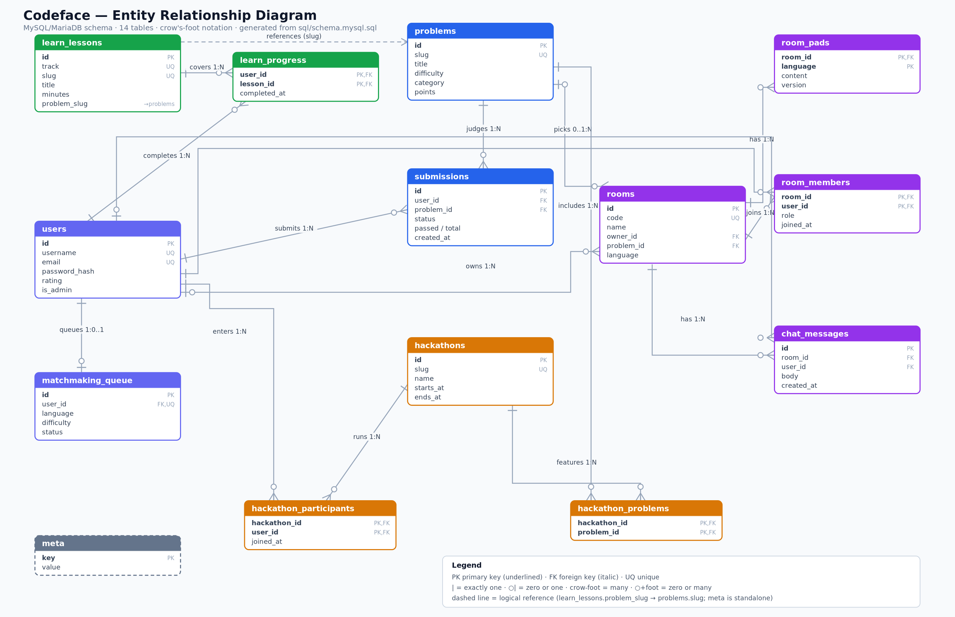
CODEFACE · PHP & MYSQL PROJECT PRESENTATION
ER Diagram
▪ Entities: users, problems, submissions,
– lessons, progress, rooms,
– pads, members, chat,
– queue, meta (+ per-user AI sets)
▪ Relationships: user 1:N
– submissions; rooms M:N
– users via room_members;
– lessons M:N via progress
▪ Dashed = logical ref
– (lesson → problem slug)
8

Slide 10
CODEFACE · PHP & MYSQL PROJECT PRESENTATION
DFD & Project Timeline
Data Flow — Context + Level 1
Gantt timeline (6 weeks)
W1
W2
W3
W4
W5
W6
1.0 Auth & Profile
D1 users
Requirements & design
Database & seed
2.0 Practice & Judge
D2 problems / subs
User
Practice + judge
3.0 Learn Tracks
D3 lessons / progress
Learn content
Rooms + chat
4.0 Rooms & Chat
D4 rooms / pads / chat
Testing & docs
Flows: credentials/solutions/edits in → verdicts, pages, ratings, progress out.
PERT note: DB schema gates every module; content validation ran in parallel with UI work.
9

Slide 11
CODEFACE · PHP & MYSQL PROJECT PRESENTATION
Modules & Features
User module
Practice
Register/login, profile, avatar, rating, session auth
526 problems × 12 languages, in-browser judge, points
Learn
Rooms & chat
15 tracks × 16 lessons in 4 hard-locked levels (Beginner to Pro), runnable examples, progress tracking
Join code (DEMO42), 12 pads/room, presence, matchmaking
Leaderboard & AI generator
Search & reports
Ratings, first-solve points; clearing a section auto-generates 10 more items
Problem filters by topic/difficulty, profile reports
10

Slide 12
CODEFACE · PHP & MYSQL PROJECT PRESENTATION
Challenges & Learning
▪ Session handling: auth + CSRF tokens had to work identically for forms and fetch APIs
– — solved with one session-bound token verified via hash_equals().
▪ Database design: modeling M:N relations (rooms ↔ users) without redundant data
– — junction tables with composite PKs and careful CASCADE rules.
▪ Responsive UI without Bootstrap: built a custom CSS grid/card system from scratch.
▪ PHP & MySQL skills deepened: PDO prepared statements, transactions, upserts, seed versioning,
– dual-driver SQL (MySQL + SQLite) with dialect branching.
▪ Biggest lesson: constraints (no frameworks, no server-side execution) produced a simpler,
– more auditable system — and machine validators > manual checking.
11

Slide 13
CODEFACE · PHP & MYSQL PROJECT PRESENTATION
References
▪ PHP Documentation — php.net/manual (PDO, password_hash, sessions)
▪ MySQL Documentation — dev.mysql.com (InnoDB, foreign keys, utf8mb4)
▪ MDN Web Docs — Web Workers, Fetch API, Monaco/Pyodide integration guides
▪ W3Schools — PHP & SQL tutorials (quick reference during build)
▪ MariaDB Knowledge Base — upsert (INSERT … ON DUPLICATE KEY UPDATE)
▪ SQLite Documentation — dual-driver dialect reference
12

Slide 14
Thank You
Questions & Answers
Live demonstration: alice / password123 · room DEMO42
Deploy: upload files → open URL → MySQL database self-seeds

