Slide 1

Customer Behavior Trend
Data Visualization with Key Take-aways
SURABHI BASAK

Slide 2
About the data
The dataset comprises transaction records of customers worldwide spanning the years 2009 to 2011, encompassing a total of 10,67,371 entries. These entries encompass various details such as invoice number, stock code, description, quantity, invoice date, price, customer ID, and country.
Data inconsistencies include blank values in the description and customer ID fields, as well as negative values for quantity and price.
To prepare the data, several steps were undertaken:
A new column was created to flag canceled invoices based on the presence of 'C' at the end of the StockCode.
The year component from the InvoiceDate was extracted and stored in a separate column to facilitate trend visualization by year.
Rows with blank or NA values were removed to ensure data integrity.
Transactions with a quantity less than 0 were eliminated due to their impracticality.
Similarly, transactions with prices less than 0 were also removed from the dataset.
Year | Data
2009 | 45,228
2010 | 5,22,714
2011 | 4,99,429

Slide 3
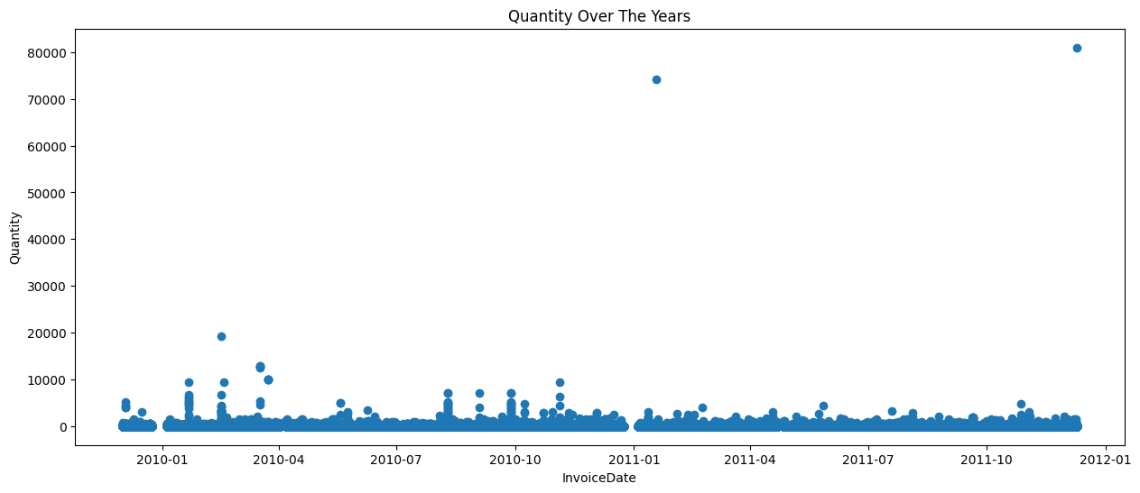
How much quantity of product is sold per year?
The scatter plot reveals that the majority of items were sold between February 2010 and March 2010, with another peak in November 2010. This pattern may be attributed to these months marking the beginning or end of winter, when individuals tend to engage more in sports activities. Therefore, it's advisable to boost our inventory during these periods.

Slide 4
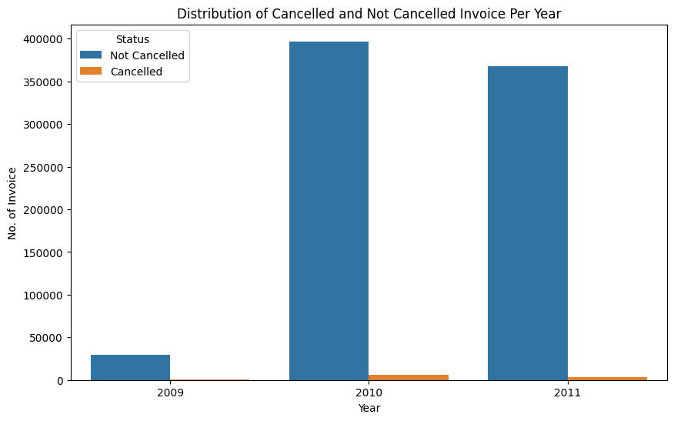
Which year faced more cancellation?
The graph illustrates that 2010 experienced the highest number of cancellations, trailed by 2011 and 2009. Additionally, there's a clear correlation between the number of canceled invoices and the total number of invoices. This implies that as the number of invoices increases, so does sales, consequently leading to more cancellations.

Slide 5
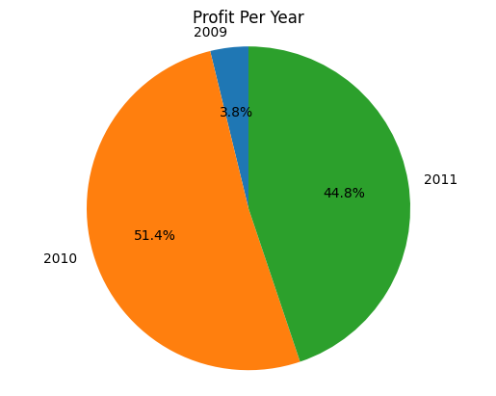
Which year had the most profit?
The data reveals that the highest profit margin occurred in 2010 at 51.4%, followed by 2011 at 44.8%, with the lowest recorded in 2009 at 3.8%.

Slide 6
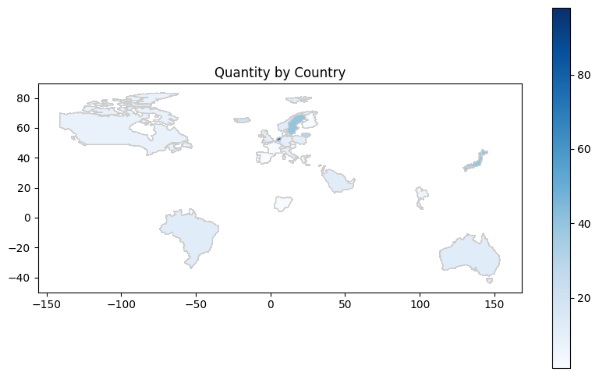
Which Country buys the most from Decathlon?
The graph indicates that European countries make the most purchases, closely followed by Japan.

Slide 7
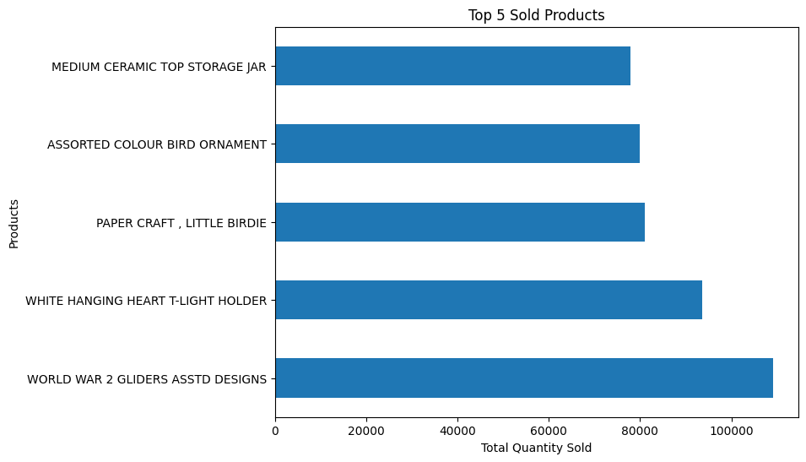
Which product got sold the most?
World War 2 Gliders is the top most product with more than 1,00,000 product sold.

Slide 8
Recommendation
I've identified three crucial areas where we can focus our efforts to enhance our business:
1. Capitalizing on Seasonal Demand: We've noticed a surge in demand for our products at the onset or conclusion of winter, when people are more active in sports. To optimize our sales potential, it's recommended that we increase our inventory during these periods to meet the heightened demand effectively.
2. Introducing Cancellation Charges: Incorporating a cancellation charge policy might help mitigate the number of cancellations we encounter. By implementing this measure, we can encourage more commitment from customers and reduce the instances of canceled orders, thereby enhancing our revenue stream.
3. Expanding Market Reach: Diversifying our market presence by venturing into additional countries can unlock new business opportunities and broaden our customer base. By expanding into new territories, we can tap into previously untapped markets and drive sustained growth for our company.
Stay Sporty!

