Slide 1
Generalized ML Model to select Best Algorithm for a given Dataset
By Surabhi Yadav

Slide 2
“Selecting the right algorithm is the art of turning data into wisdom”
- Doug Cutting

Slide 3
Introduction
Let's delve into the details by exploring the following key points:
In the realm of machine learning, selecting the most suitable algorithm for a given dataset is pivotal for achieving optimal results.
With an ever-expanding repertoire of algorithms, ranging from classical statistical methods to sophisticated deep learning models, the task of algorithm selection can be daunting.
A Generalized ML Model serves as a guiding framework, leveraging the interplay between algorithm characteristics and dataset attributes to identify the most appropriate algorithmic approach.
By understanding the nuances of both data and algorithms, this model aims to streamline the process of algorithm selection, optimizing performance and efficiency.

Slide 4
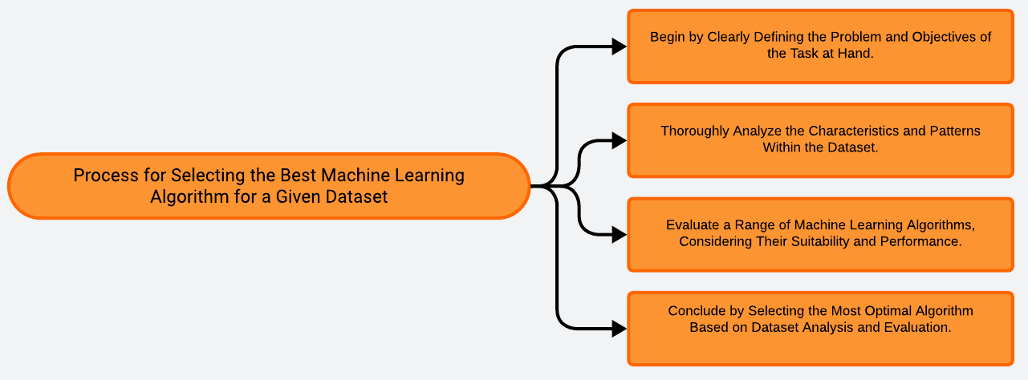
Problem Statement and how to proceed

Slide 5
Solution
Clearly state the task's goals and what needs to be achieved through machine learning.
Conduct a comprehensive analysis of the dataset to understand its characteristics, structure, and patterns.
Identify and study various machine learning algorithms that are applicable to the problem domain.
Assess the performance of different algorithms using appropriate metrics and techniques.
Analyze the features and attributes of the dataset to determine which algorithm is most suitable.
Choose the algorithm that best aligns with the dataset characteristics and task objectives.
Implement the selected algorithm on the dataset, train it, and validate its performance using validation techniques.
Record the chosen algorithm, the reasoning behind its selection, and the results of its performance evaluation for future reference and reporting.
Outline
Define problem and objectives
Explore dataset
Research algorithms
Evaluate performance
Consider dataset attributes
Select optimal algorithm
Train and validate model
Document and report

Slide 6
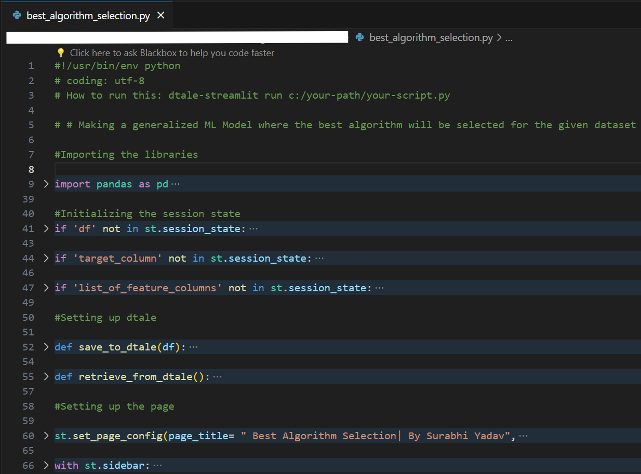
Codebody preview

Slide 7
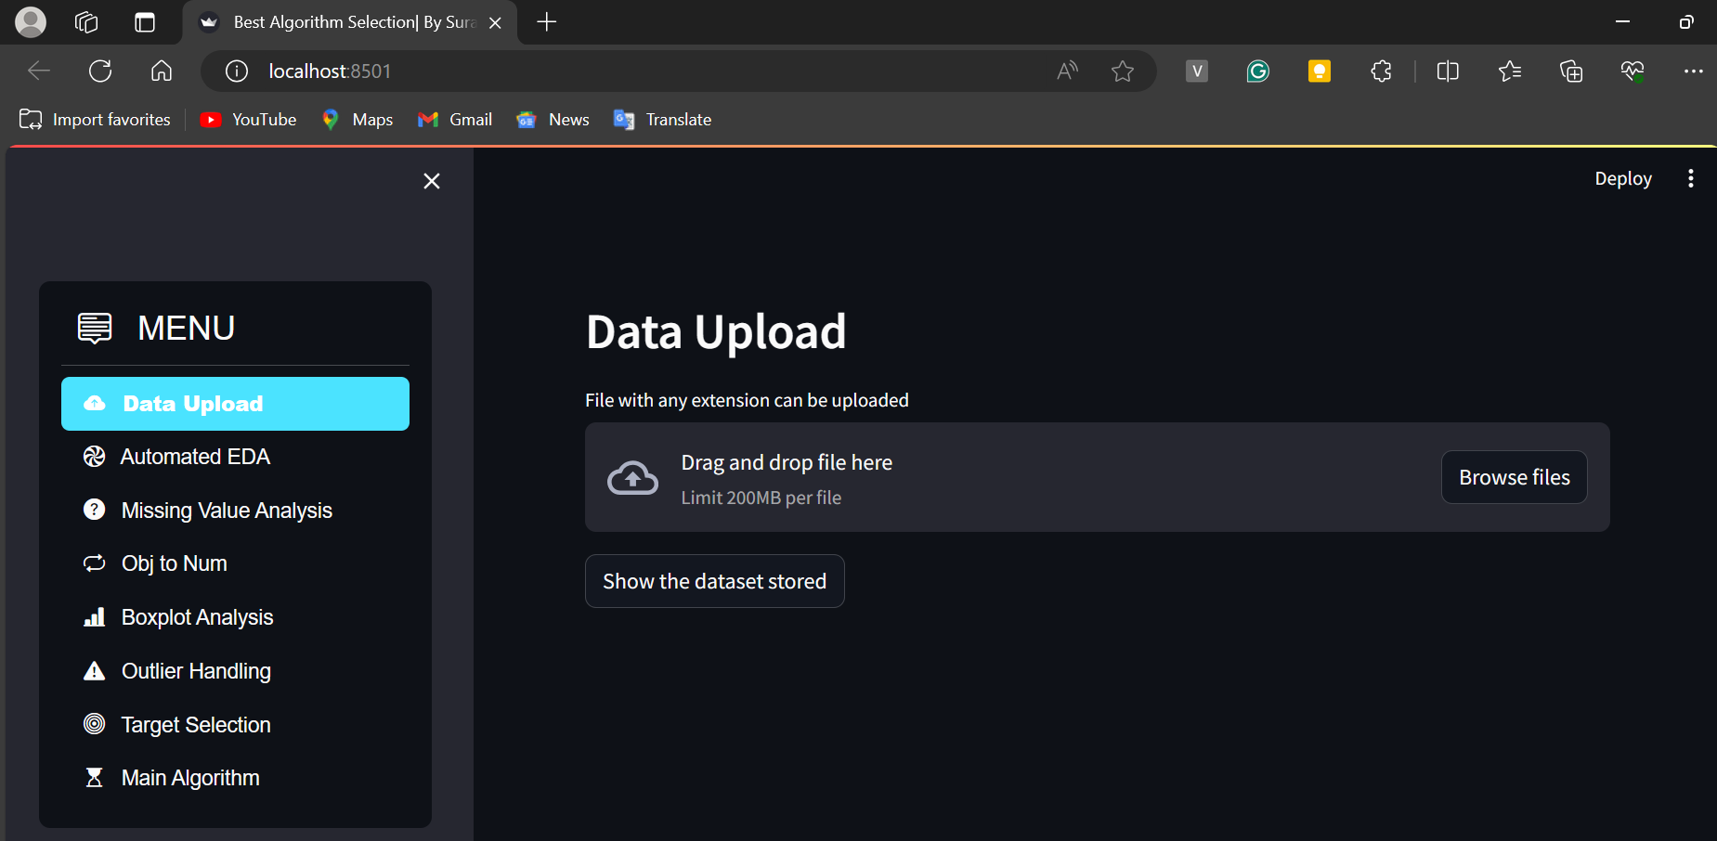
Streamlit preview

Slide 8
Why do we need this?
Future trends of this project
This project is crucial for addressing real-world challenges by harnessing the power of machine learning. In an era where data is abundant, machine learning enables organizations to extract valuable insights, make data-driven decisions, and gain a competitive advantage. Through automation and optimization, machine learning streamlines processes, increases efficiency, and empowers businesses to innovate and adapt. Moreover, by personalizing experiences for users, machine learning fosters customer satisfaction and loyalty, driving sustainable growth and success in today's dynamic marketplace.
The future of machine learning is poised for exponential growth, fueled by advancements in technology and increasing adoption across industries. As algorithms become more sophisticated and data sets grow larger, machine learning will revolutionize various sectors, from healthcare and finance to transportation and entertainment. Additionally, the integration of machine learning with emerging technologies like IoT, edge computing, and quantum computing will unlock new possibilities, paving the way for innovative applications and transformative breakthroughs in the years to come.

Slide 9
70-80%
This is how much percentage of businesses can benefit from this worldwide.

Slide 10
Machine learning presents a transformative opportunity for businesses across industries to drive innovation, enhance efficiency, and unlock new sources of value.
Key takeaway

Slide 11
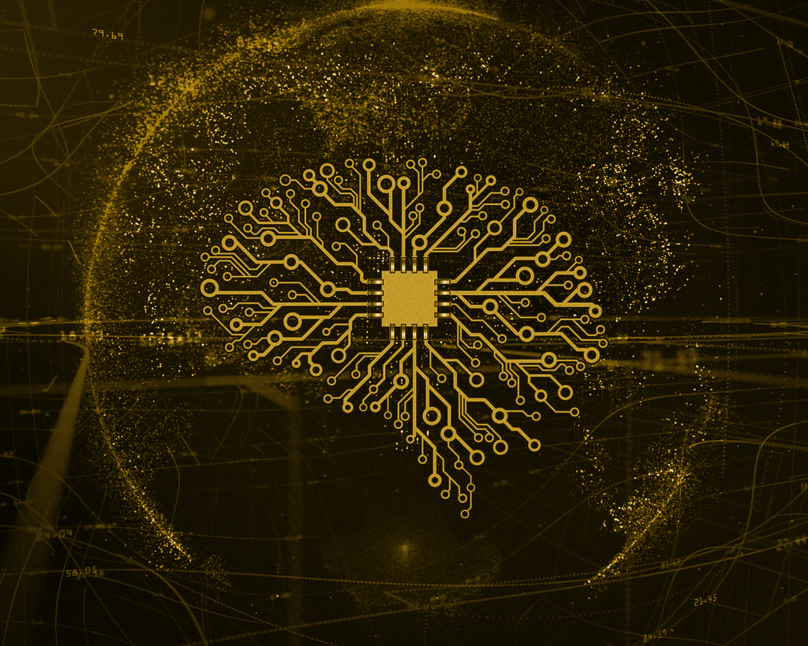
Thanks!
Contact me:
Surabhi Yadav
sy09012000@gmail.com
https://github.com/Surabhi0901
https://www.linkedin.com/in/surabhi-yadav-9100sy/

