Slide 1
YouTube Data Harvesting and Warehousing using SQL and Streamlit
By Surabhi Yadav

Slide 2
“Data is the new oil. It's valuable, but if unrefined, it cannot really be used.”
- Clive Humby

Slide 3
Introduction
Let's delve into the details by exploring the following key points:
YouTube's Data Universe: Explore the vast array of data generated daily on YouTube, from views and likes to comments and user demographics.
Strategic Imperative: Emphasize the critical importance of harvesting YouTube data for informed decision-making, content optimization, and staying ahead in the digital landscape.
Navigating Complexity: Acknowledge challenges like data volume and quality while highlighting the need for efficient processing and storage solutions.
Insights at Scale: Discuss the potential for extracting valuable insights from YouTube data, such as trend identification and audience behavior analysis.
Centralizing Data: Introduce data warehousing as a key strategy for organizing and analyzing YouTube data comprehensively.
Empowering Growth: Highlight how effective data strategies can drive growth and optimize performance on the YouTube platform.
Presentation Goals: Outline objectives, including exploring data harvesting techniques, discussing warehousing strategies, and highlighting business impact.
Interactive Learning: Encourage audience participation to foster engagement and collaboration throughout the presentation.

Slide 4
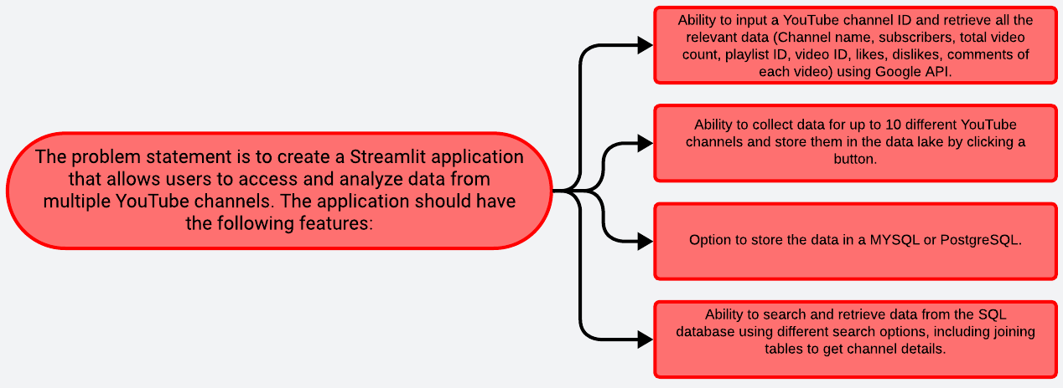
Problem Statement

Slide 5
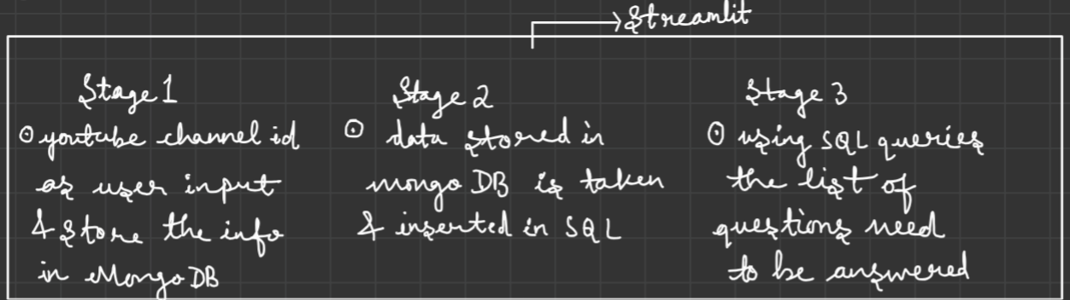
How to proceed with the problem?

Slide 6
Solution
Create user interface for data access.
Input fields for YouTube channel IDs.
Fetch channel data using Google API.
Retrieve channel info, video details, likes, dislikes, comments.
Allow input of up to 10 channel IDs.
Initiate data collection for specific channels.
Store data in MySQL or PostgreSQL.
Ensure data integrity and security.
Implement search functionality within Streamlit.
Query based on various criteria.
Authenticate users securely.
Control data access based on roles.
Thorough testing for functionality and usability.
Optimize performance for large datasets.
Prepare comprehensive usage documentation.
Deploy application and databases for accessibility.
Outline
Streamlit Application Setup
Data Retrieval from YouTube API
Multi-channel Data Collection
Data Storage Options
Search and Retrieval from SQL DB
User Authentication & Authorization
Testing and Optimization
Documentation and Deployment

Slide 7
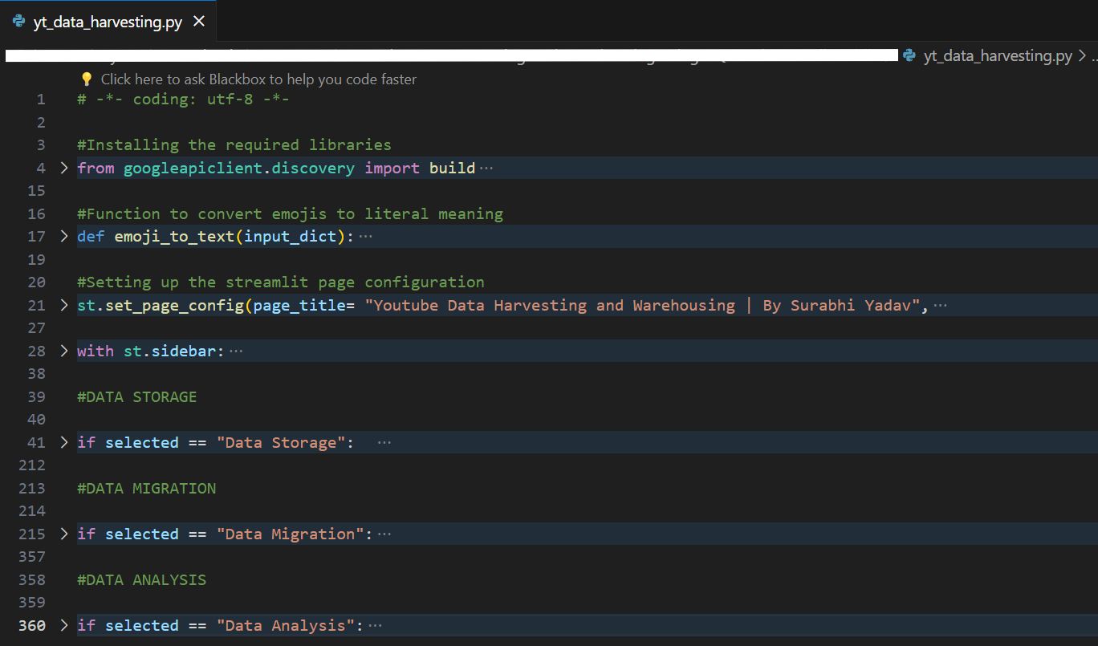
Codebody preview

Slide 8
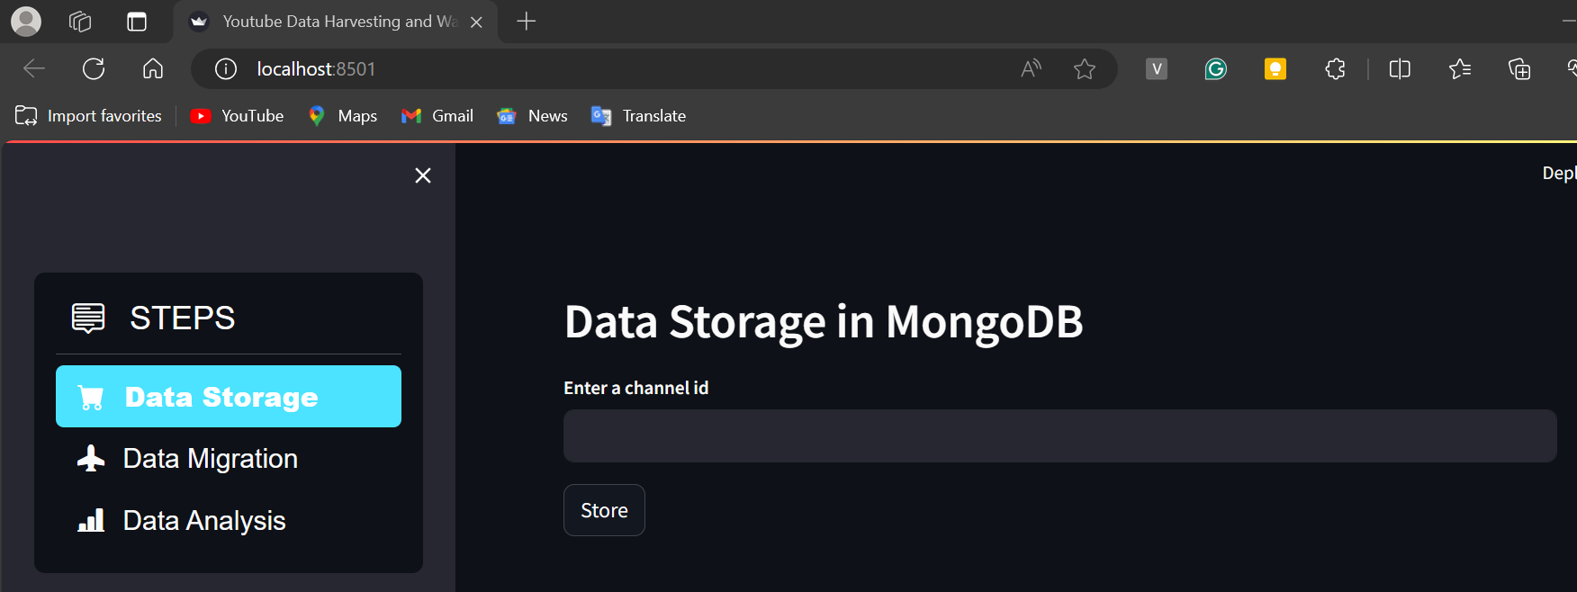
Streamlit preview

Slide 9
Why do we need this?
Future trends of this project
We require this project to develop a streamlined system for accessing, analyzing, and storing data from multiple YouTube channels. By consolidating this data into a centralized platform, we aim to empower decision-makers with comprehensive insights, enabling them to optimize content strategies, understand audience behavior, and drive business growth effectively.
In short, it can be used by a person to understand the reach of their content and increase the reach by understanding what is valued by their audience.
In the future, this project will likely integrate AI for automated analysis and real-time insights, enhancing personalization and cross-platform data integration. Innovations in blockchain, augmented reality, and natural language processing will ensure data security, transparency, and user engagement. Ethical considerations will drive stricter privacy measures. Continuous innovation aims to provide invaluable insights and opportunities for content creators and decision-makers, adapting to the evolving digital landscape while meeting user demands for efficiency, privacy, and personalized experiences.

Slide 10
50-70%
This is by how much a person can increase their reach by using this app.

Slide 11
Data-driven insights from YouTube channels drive content optimization and business growth in a rapidly evolving digital landscape.
Key takeaway

Slide 12

Thanks!
Contact me:
Surabhi Yadav
sy09012000@gmail.com
https://github.com/Surabhi0901
https://www.linkedin.com/in/surabhi-yadav-9100sy/

