Slide 1
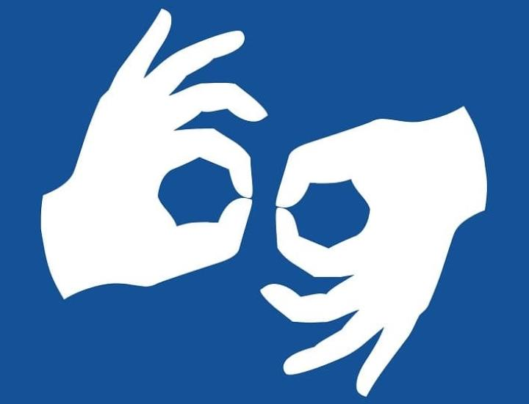
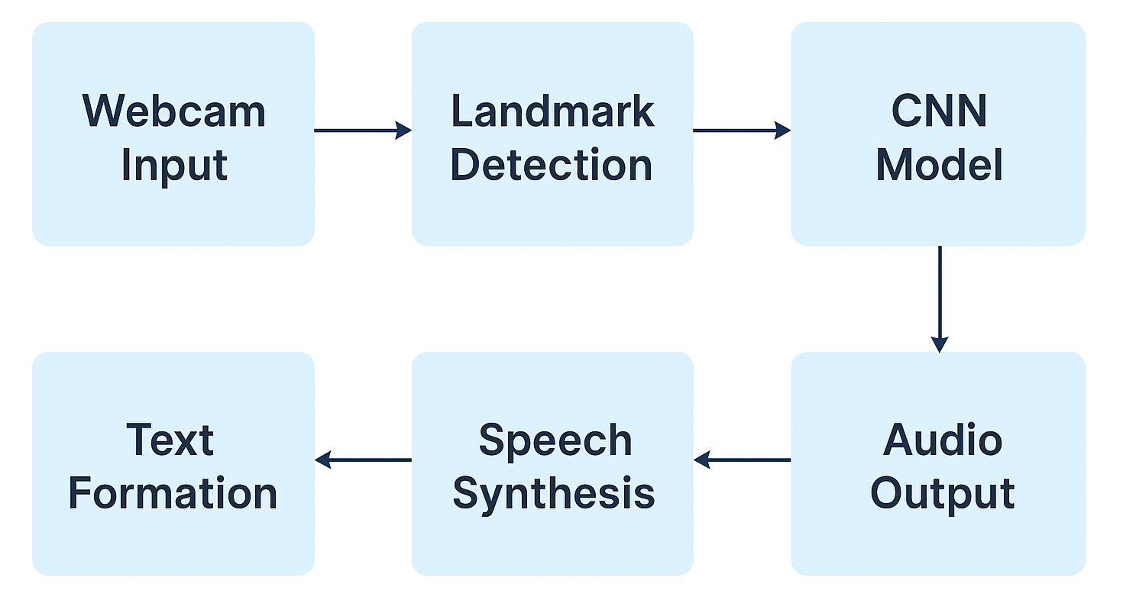
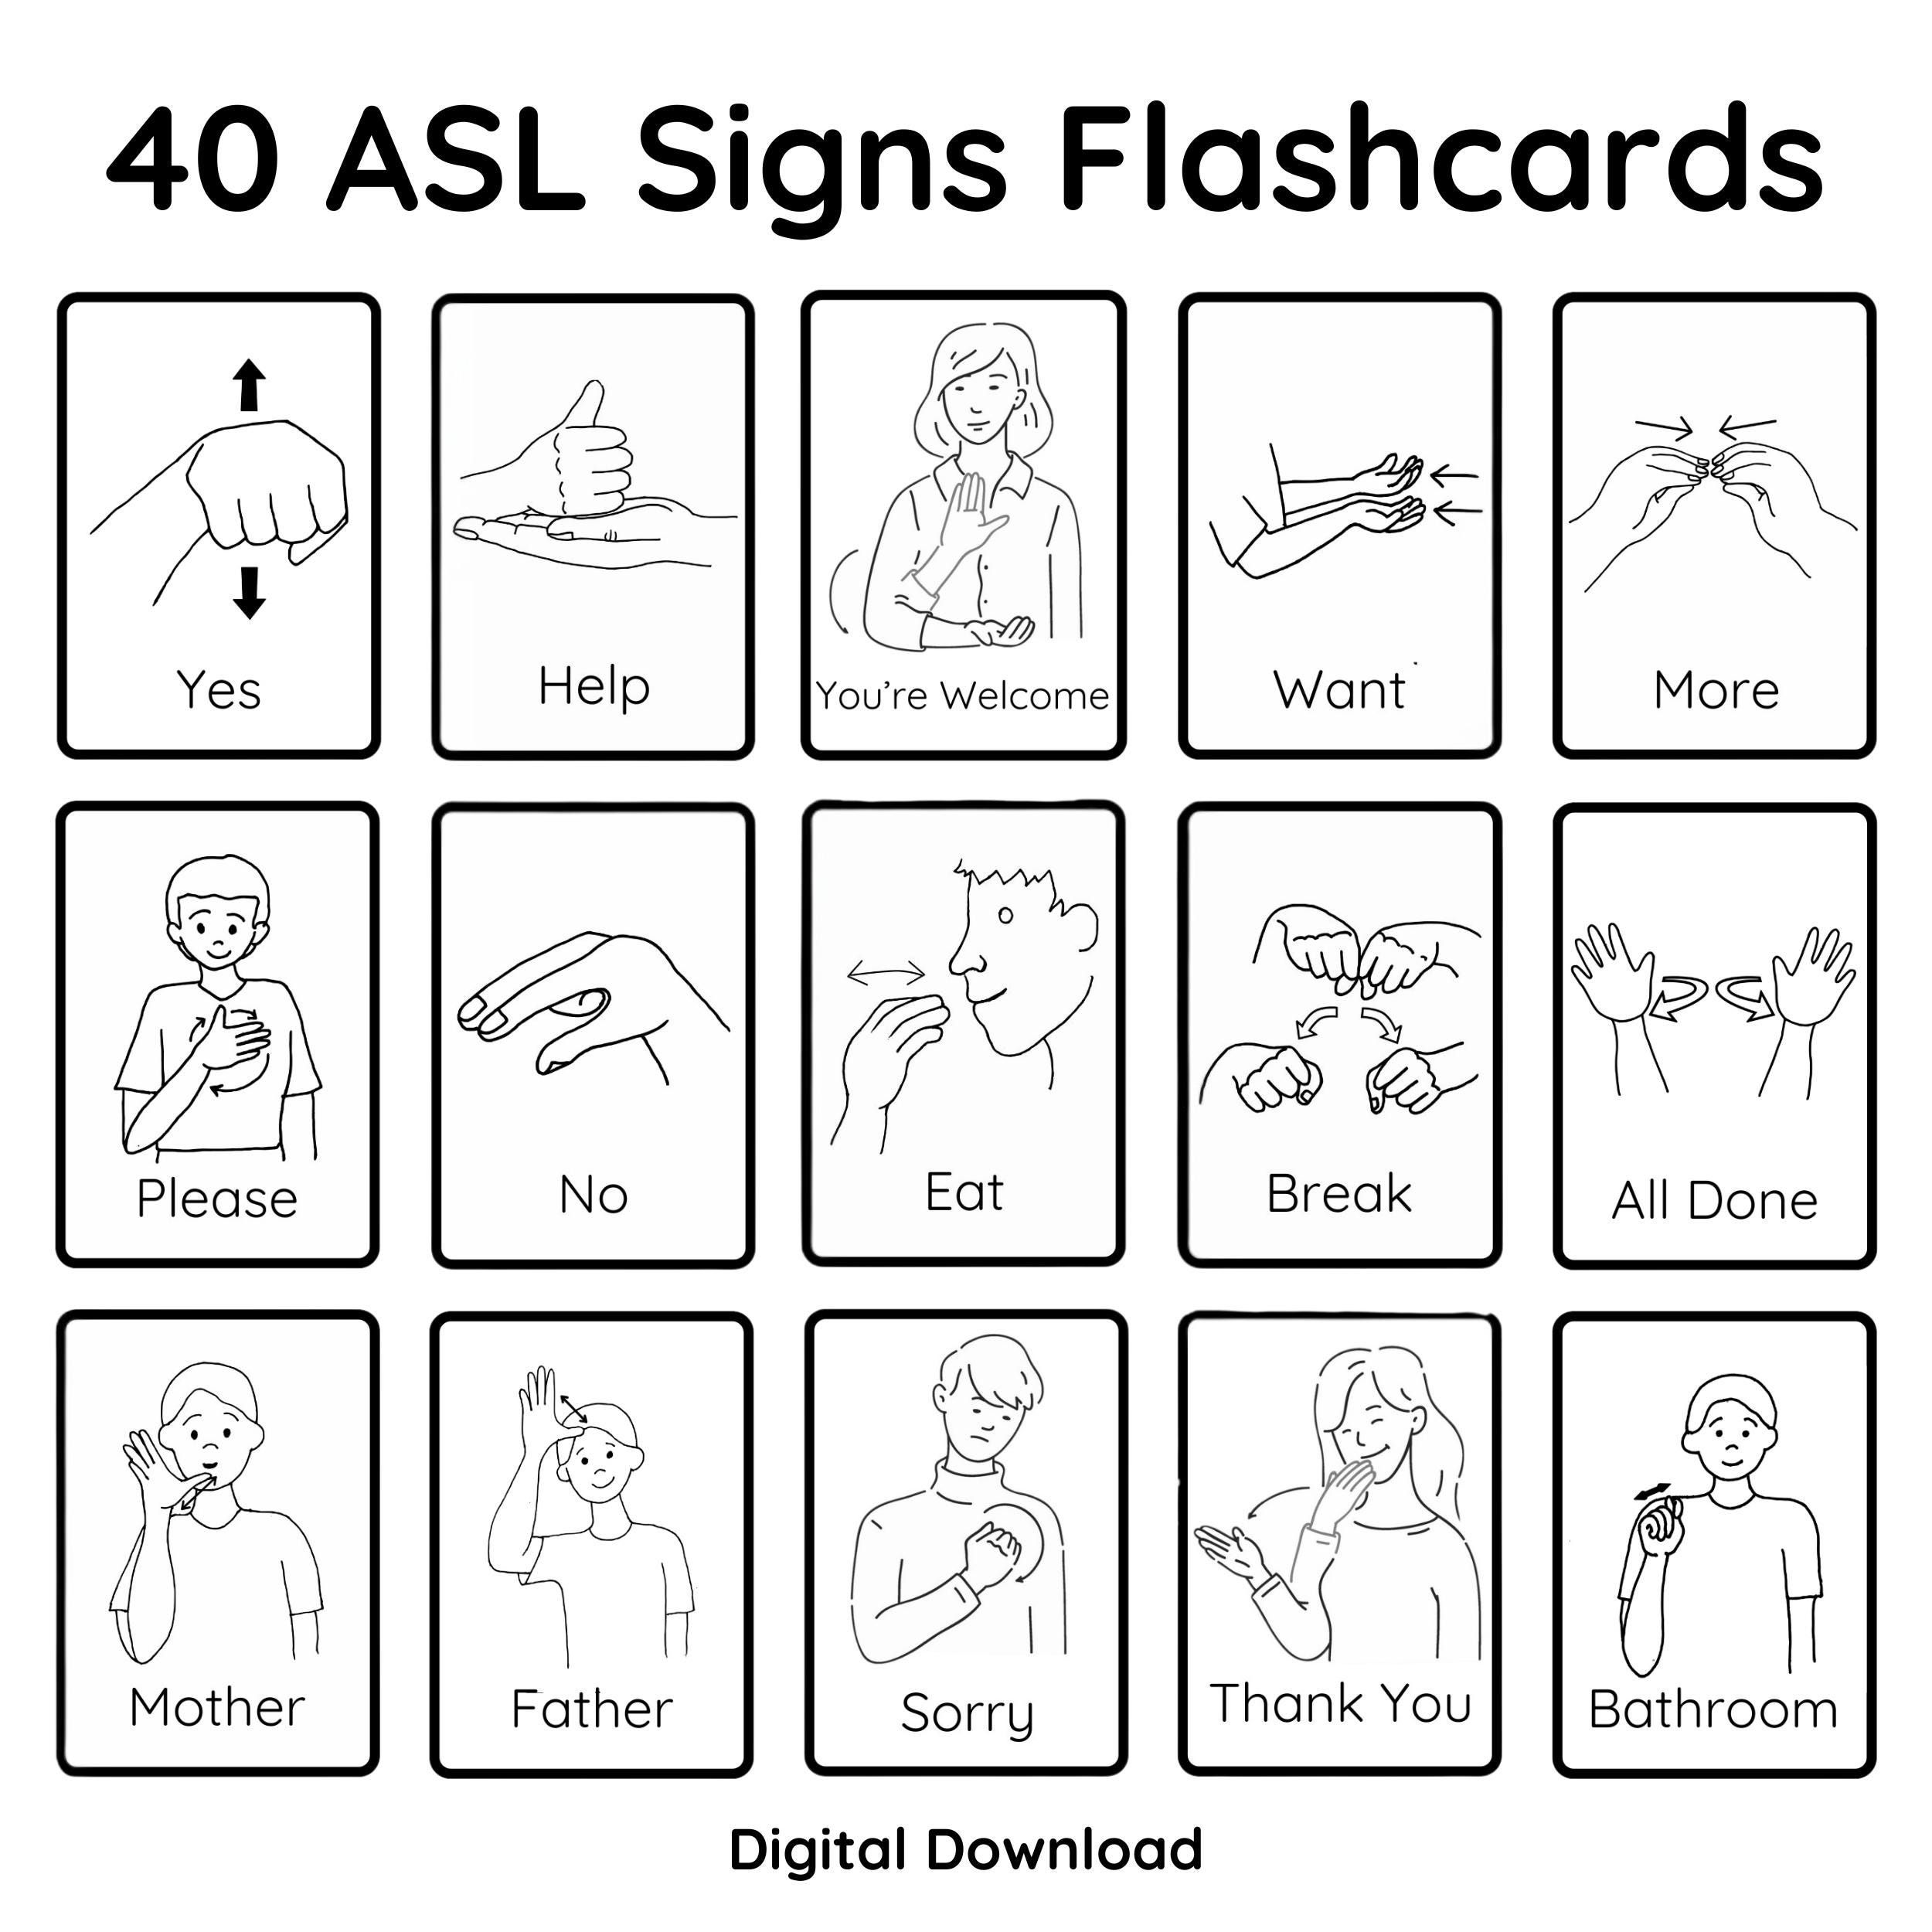
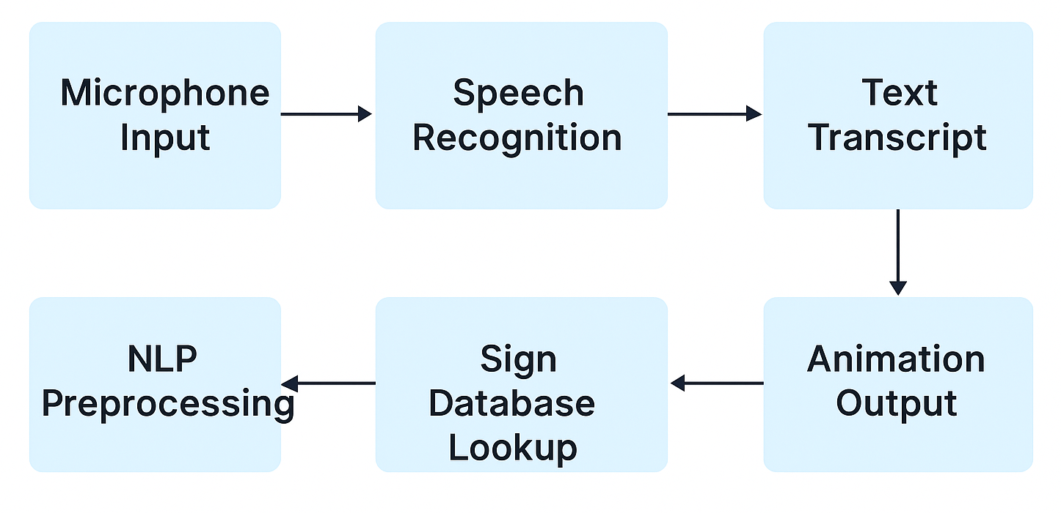
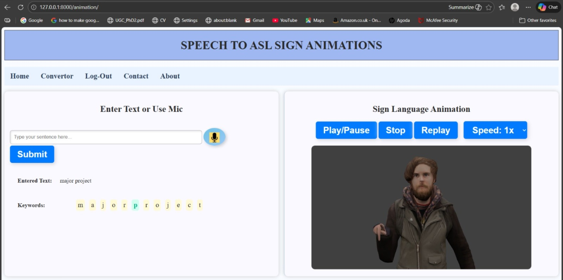
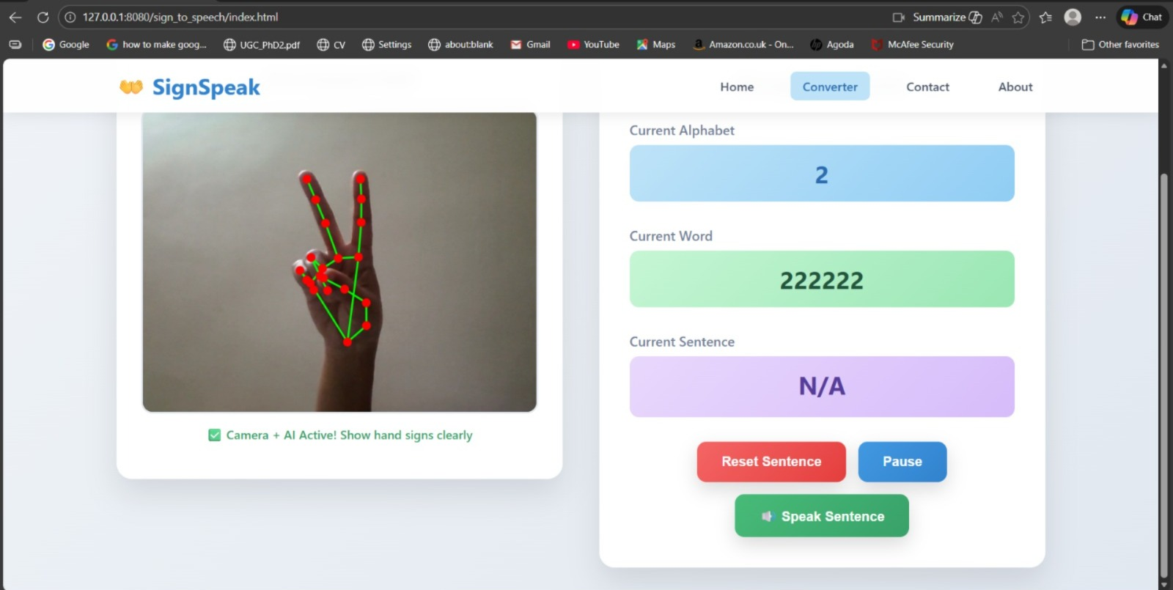
REAL-TIME SIGN-TO-SPEECH AND SPEECH TO ASL ANIMATION CONVERSION
ABSTRACT
OBJECTIVES
Communication is essential, and this project enhances it by converting spoken English into ASL signs using speech recognition, NLP, and computer vision. The system offers smooth speech-to-sign and sign-to-speech translation through a simple desktop app, helping bridge the communication gap and support inclusive interaction for hearing-impaired individuals
Real-time ASL ↔ Speech: Instantly convert ASL gestures to speech and speech to ASL animations.
Two-Way Communication: Enables smooth interaction between deaf and hearing users without interpreters.
Web-Based & Hardware-Free: Works on any laptop using just a webcam and microphone.
FLOWCHART
SIGN-TO-SPEECH
SDG RELEVENCE
OUTPUT
SDG 11: Sustainable Cities and Communities
Promotes inclusive and accessible communication for hearing- and speech-impaired individuals.
Enhances public participation by reducing communication barriers in community spaces, transport, healthcare, and government services.
Supports creation of disability-friendly digital and physical environments through assistive AI technologies.
Contributes to building more socially inclusive, resilient, and equitable communities.
SPEECH-TO-ANIMATION
Mentor:
Prof. Suraj Kadli
Team Members:
Shreya Kallapur (2VD22EC100)
Shrivatsa Deshpande (2VD22EC103)
Sidharth Dindalakopp (2VD22EC104)
Surabhi Kulkarni (2VD22EC110)
The system delivers real-time speech and ASL animation outputs for seamless two-way communication.

