Slide 1
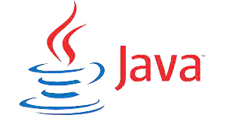
What you learn ?
Introduction to JAVA
What is JRE,JDK,JVM | What is OOP
Java Features | Compiling & Running the Program
Examples
Introduction to JAVA

Slide 2

Scope of Java
1) Business Applications
Java is used to build Bussiness applications like ERP and e-commerce systems.
2) Console Based Application
We can use Java to develop console based applications.
3) Enterprise Applications
Java can be used to create applications which can be used within an Enterprise or an Organization.
There are several types of applications which can be developed using Java
Introduction to Java

Slide 3
Why do people use Java?
1) Easy to Learn and Use
Java is easy to learn and use. It is developer-friendly and high level programming language.
2) Expressive Language
Java language is more expressive means that it is more understandable and readable.
3) Cross-platform Language
Java can run equally on different platforms such as Windows, Linux, Unix and Macintosh etc. So, we can say that Java is a portable language.
4) Free and Open Source
Java language is freely available at offical web address.The source-code is also available. Therefore it is open source.
Introduction to Java

Slide 4
Why do people use Java?
5) Object-Oriented Language
Java supports object oriented language
6) Extensible
It implies that other languages such as C/C++ can be used to compile the code and thus it can be used further in our Java code.
7) Large Standard Library
Java has a large and broad library and provides rich set of module and functions for rapid application development.
8) GUI Programming Support
Graphical user interfaces can be developed using Java.
9) Integrated
It can be easily integrated with languages like C, C++ etc.
Introduction to Java

Slide 5
History of Java
Java was developed by James Gosling, who is known as the father of Java, in 1995.
Introduction to JAVA

Slide 6
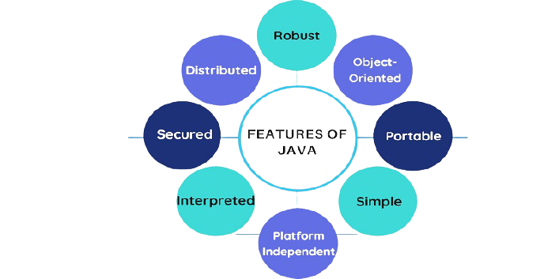
Java Features
Introduction to JAVA

Slide 7
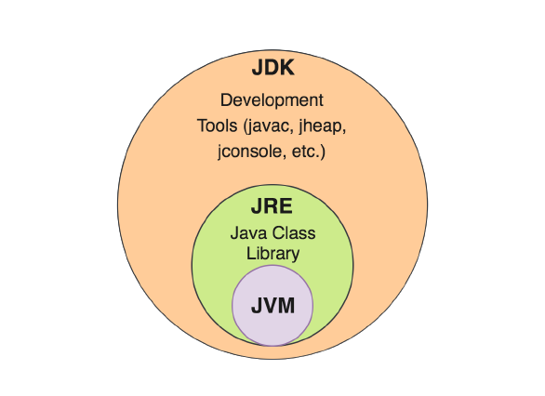
Introduction to JAVA

Slide 8
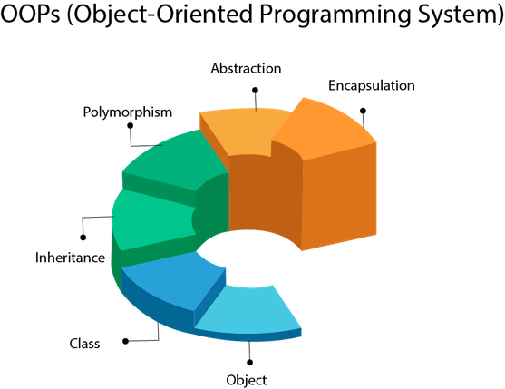
OOP
Introduction to JAVA

Slide 9
OOP
What Is an Object?
An object is a software bundle of related state and behavior. Software objects are often used to model the real-world objects that you find in everyday life. This lesson explains how state and behavior are represented within an object, introduces the concept of data encapsulation, and explains the benefits of designing your software in this manner.
What Is a Class?
A class is a blueprint or prototype from which objects are created. This section defines a class that models the state and behavior of a real-world object. It intentionally focuses on the basics, showing how even a simple class can cleanly model state and behavior.
Introduction to JAVA

Slide 10
OOP
What Is Inheritance?
Inheritance provides a powerful and natural mechanism for organizing and structuring your software. This section explains how classes inherit state and behavior from their superclasses, and explains how to derive one class from another using the simple syntax provided by the Java programming language.
What Is an Interface?
An interface is a contract between a class and the outside world. When a class implements an interface, it promises to provide the behavior published by that interface. This section defines a simple interface and explains the necessary changes for any class that implements it.
Introduction to JAVA

Slide 11
OOP
What Is Abstraction?
Abstraction is the concept of object-oriented programming that "shows" only essential attributes and "hides" unnecessary information. The main purpose of abstraction is hiding the unnecessary details from the users. Abstraction is selecting data from a larger pool to show only relevant details of the object to the user. It helps in reducing programming complexity and efforts.
What Is Encapsulation & Polymorphism?
Introduction to JAVA

Slide 12
Example Program
“First.java”
class First {
public static void main(String args[]) {
System.out.println(“Hello World”);
}
}
Introduction to JAVA

Slide 13
Compiling & Running the Program
Compiling: is the process of translating source code written in a particular programming language into computer-readable machine code that can be executed.
$ javac First.java
This command will produce a file ‘First.class’, which is used for running the program with the command ‘java’.
Running: is the process of executing program on a computer.
$ java First
Introduction to JAVA

Slide 14
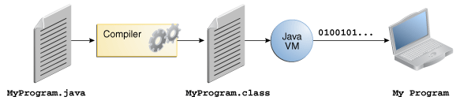
Compiling & Running the Program
Introduction to JAVA

Slide 15
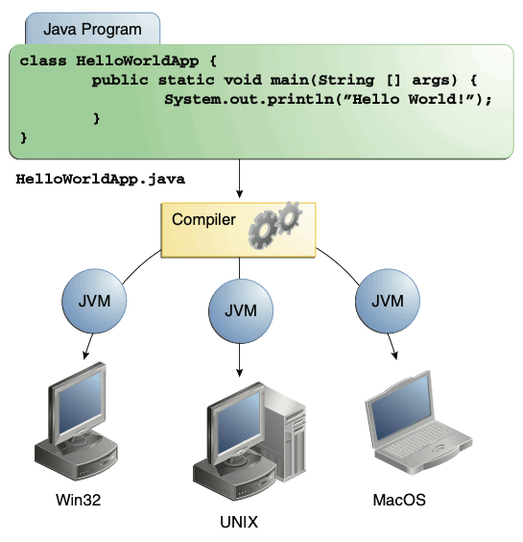
Compiling & Running the Program
Introduction to JAVA

Slide 16
About Printing on the Screen
System.out.println(“Hello World”); – outputs the string “Hello World” followed by a new line on the screen.
System.out.print(“Hello World”); - outputs the string “Hello World” on the screen. This string is not followed by a new line.
Some Escape Sequence –
\n – stands for new line character
\t – stands for tab character
Introduction to JAVA

Slide 17
THANKS
Introduction to JAVA

