Slide 1

Seasonal Agriculture Performance Analysis
MAJOR PROJECT
VOIS AICTE Batch 1 | 2026–2027
Student Name: Surabhi Kushwaha College: Gautam Buddha University AICTE STU ID: STU69a84546249181772635462

Slide 2

PROBLEM STATEMENT
Agricultural performance is influenced by seasonal environmental conditions, farming practices, resource availability and economic factors. As a result, crop productivity, resource use and financial outcomes can differ across seasons. The problem is to analyze the available agricultural data and identify meaningful seasonal patterns, differences, relationships and variations in agricultural performance.

Slide 3
Project Description
The dataset contains 4,000 agricultural records covering different seasons, crops, geographical areas and farming conditions. Project workflow:
Data exploration and quality checking
Data cleaning and preparation
Season-wise agricultural performance comparison
Environmental and resource-use analysis
Economic performance analysis
Visualization, interpretation and recommendations

Slide 4

WHO ARE THE END USERS?
Farmers and farm managers
Agricultural planners
Government and agriculture departments
Agribusiness stakeholders
Researchers
Data analysts

Slide 5

Technology Used
Python
Pandas
NumPy
Matplotlib
Seaborn
Jupyter Notebook

Slide 6
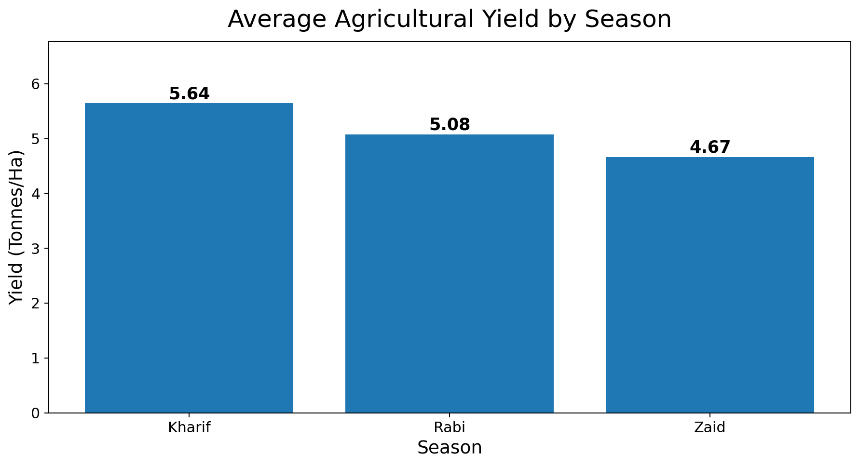

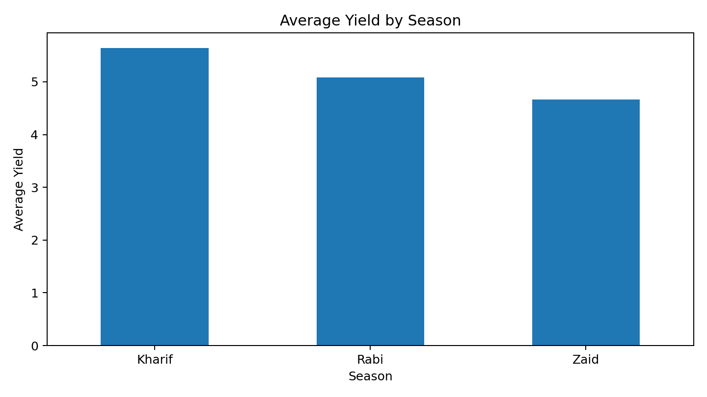
RESULTS — Seasonal Yield Analysis
KEY INSIGHT
Kharif: 5.63 tonnes/ha Rabi: 5.04 tonnes/ha Zaid: 4.64 tonnes/ha Kharif records the highest average yield.

Slide 7
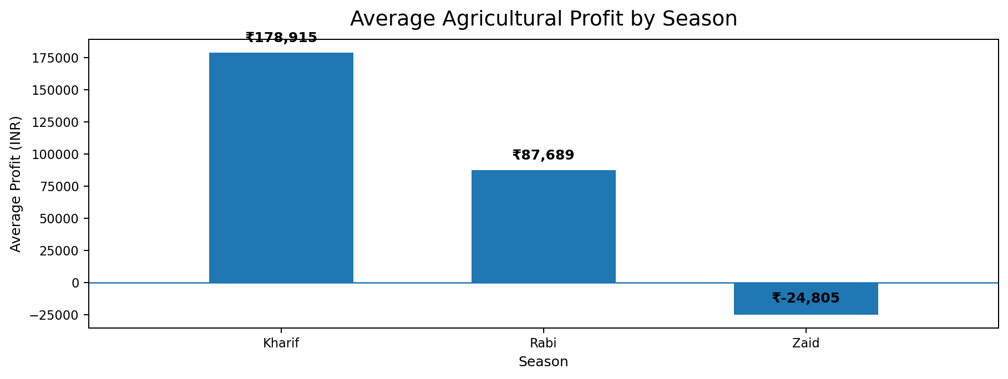
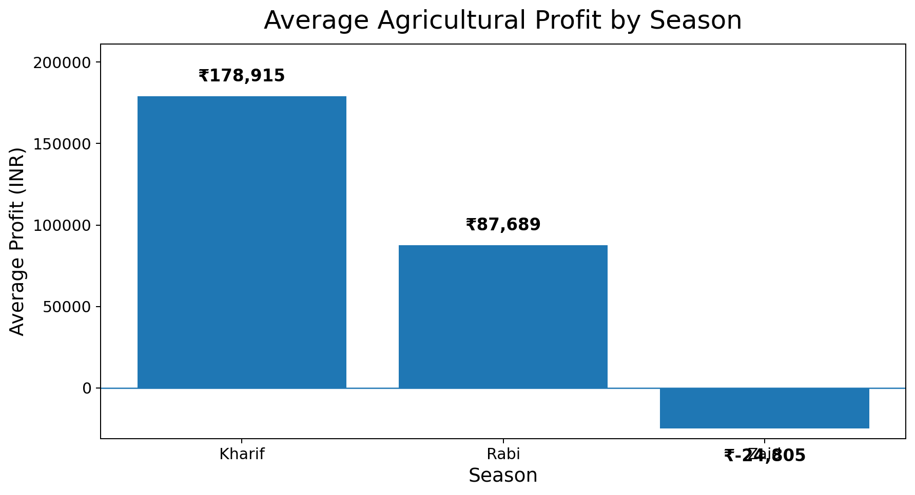
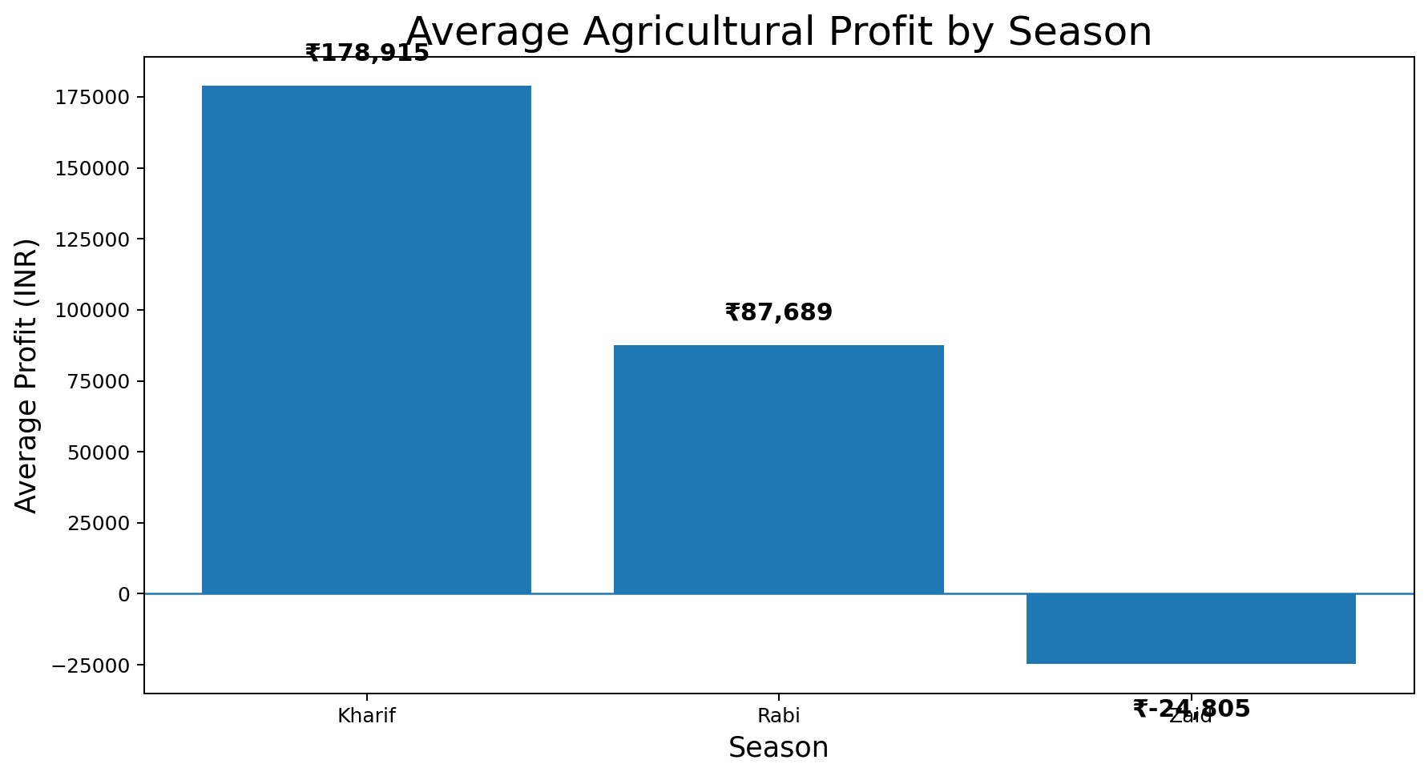
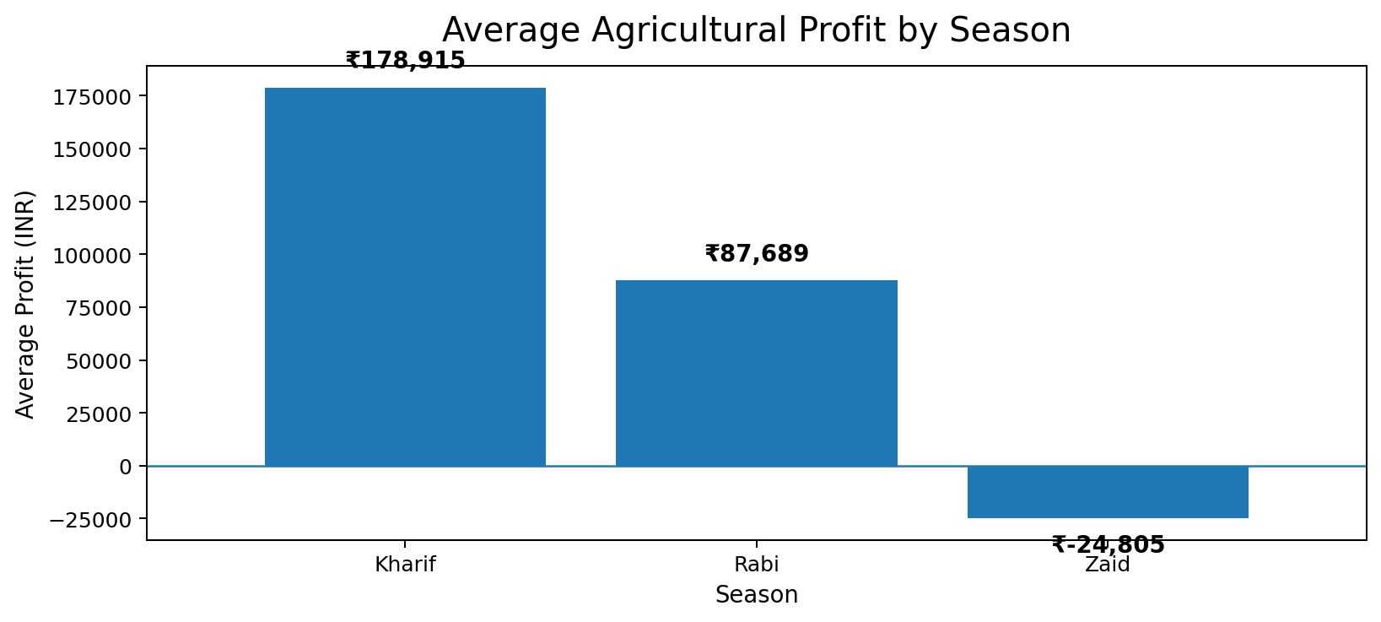

RESULTS — Seasonal Profit Analysis
KEY INSIGHT
Kharif: ₹178,915 | Rabi: ₹87,689 | Zaid: −₹24,805
Zaid records an average loss.

Slide 8
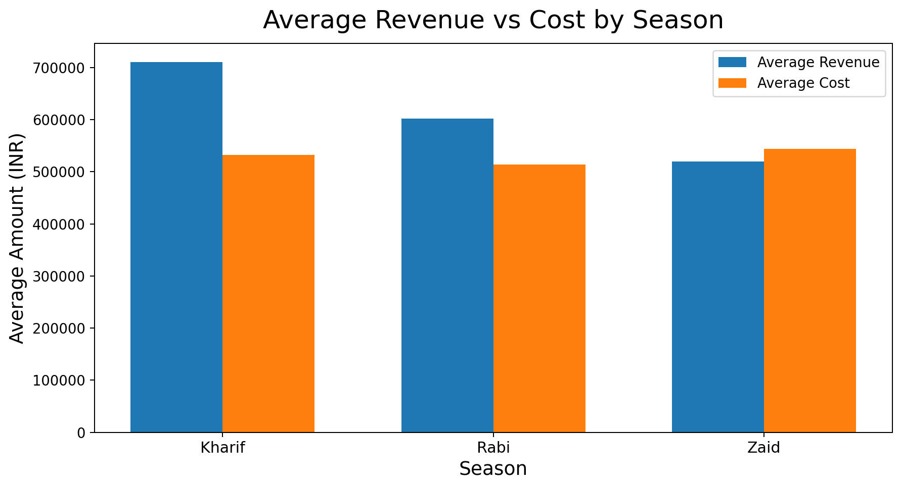
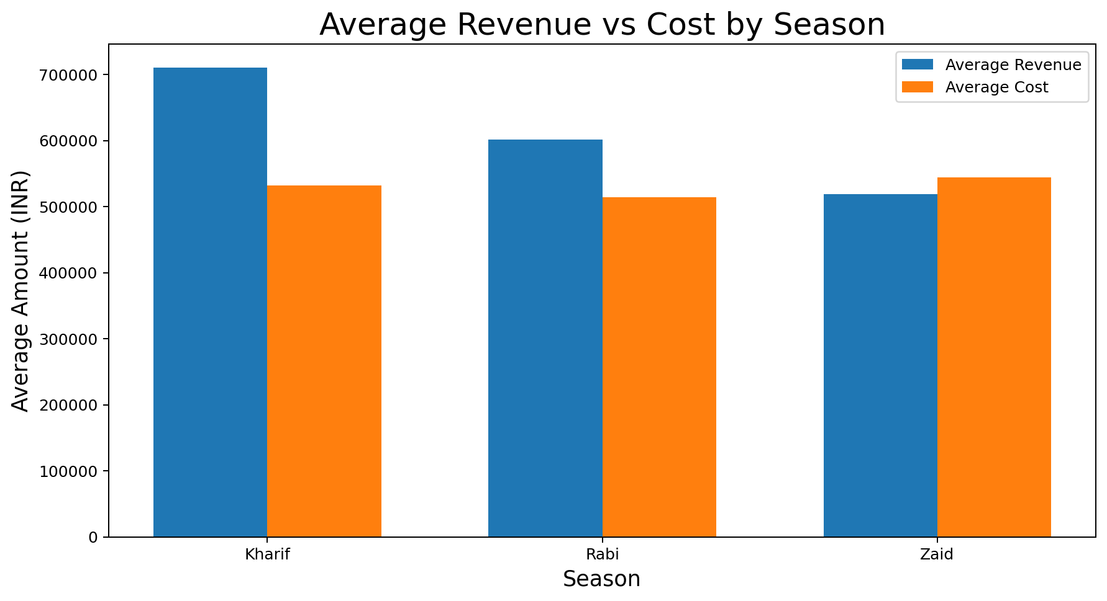
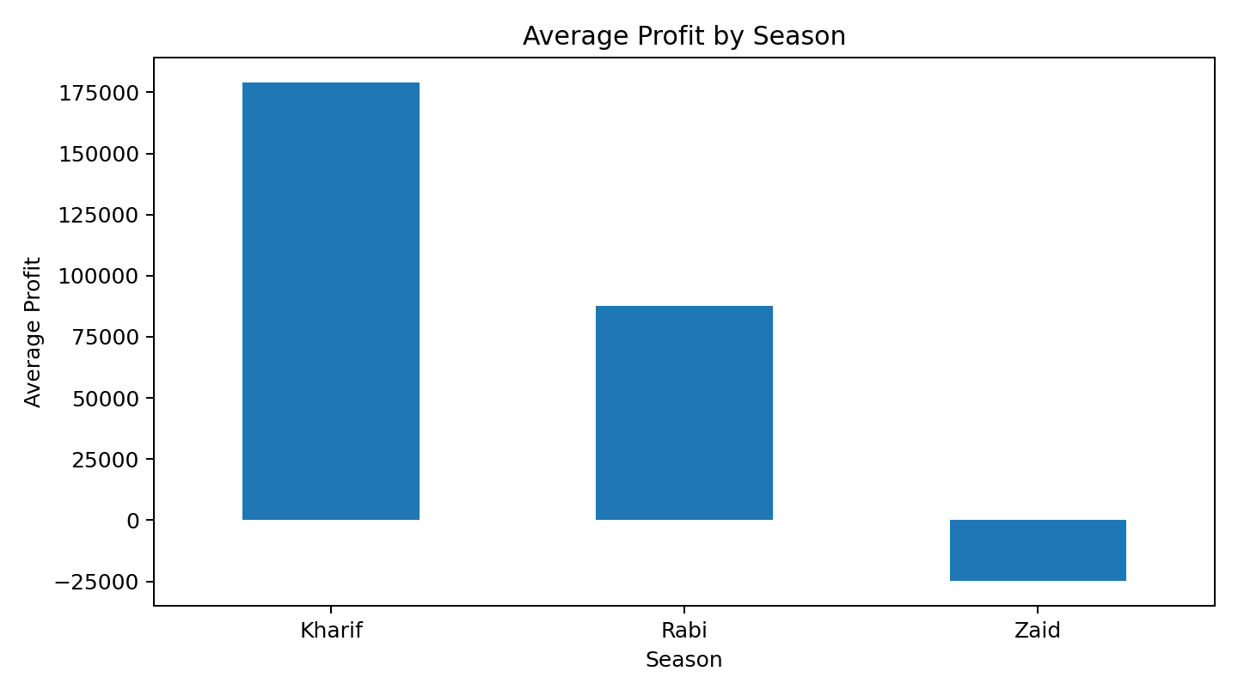
RESULTS — Revenue vs Cost by Season
KEY INSIGHT
Kharif: Revenue ₹7.11L | Cost ₹5.32L Rabi: Revenue ₹6.02L | Cost ₹5.14L Zaid: Revenue ₹5.19L | Cost ₹5.44L Zaid is the only season where average cost exceeds revenue.

Slide 9
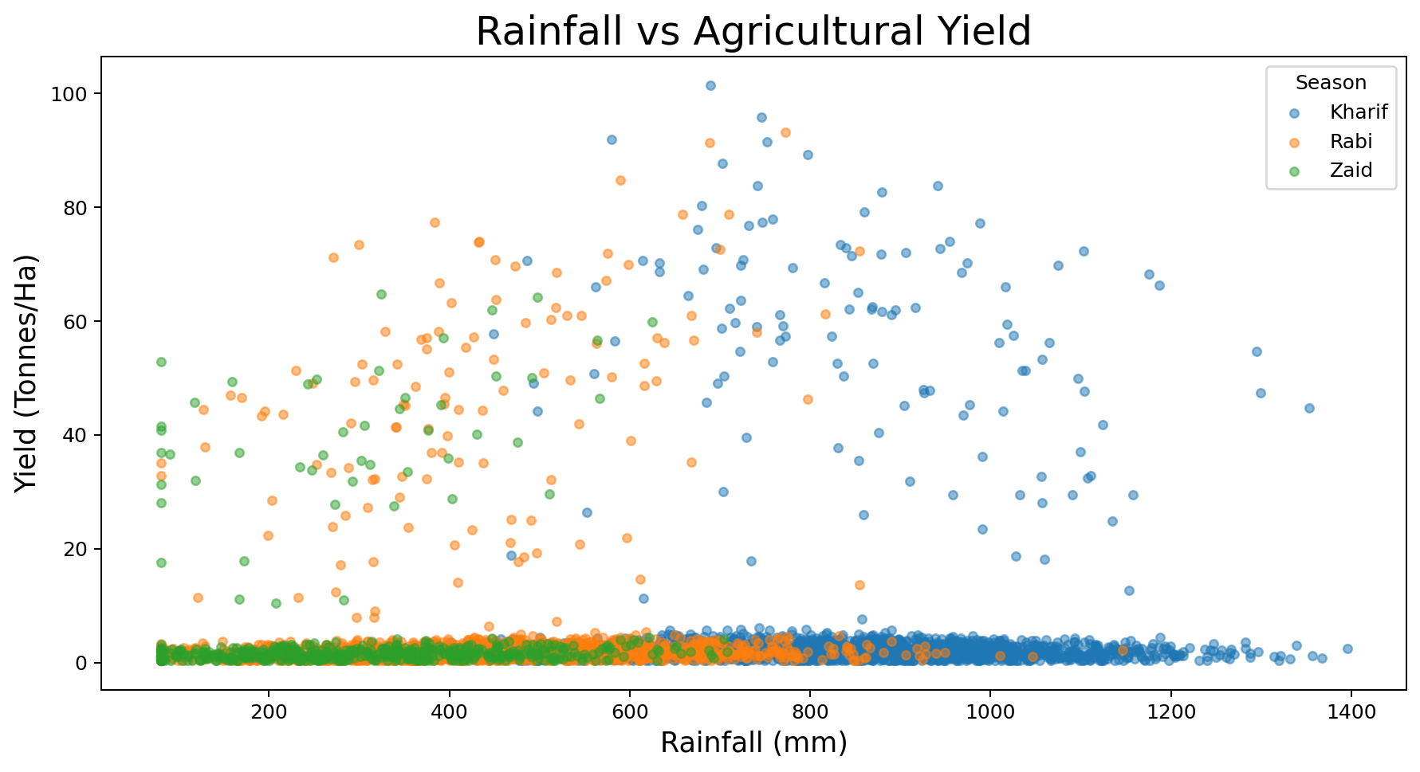
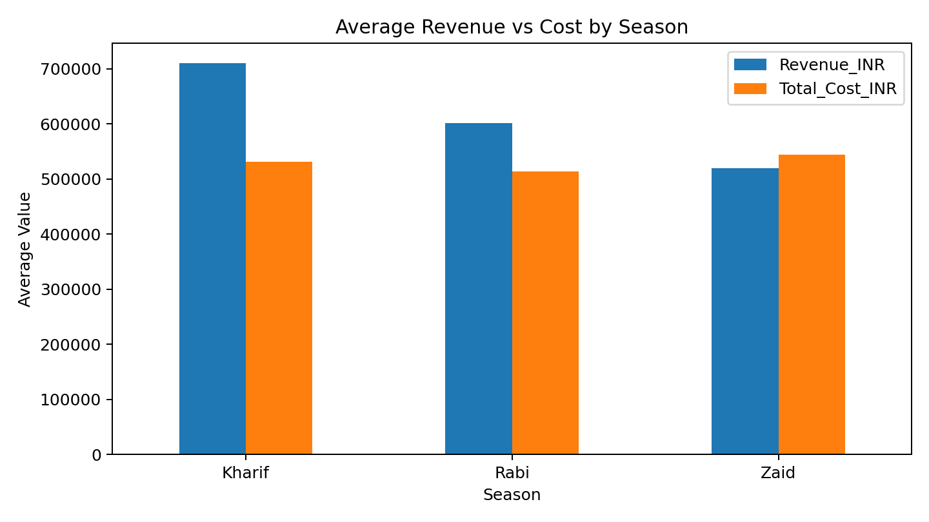
RESULTS — Rainfall vs Agricultural Yield
KEY INSIGHT
Correlation with yield: 0.03 The plot shows a widely scattered relationship. Rainfall has a very weak linear association with yield.

Slide 10
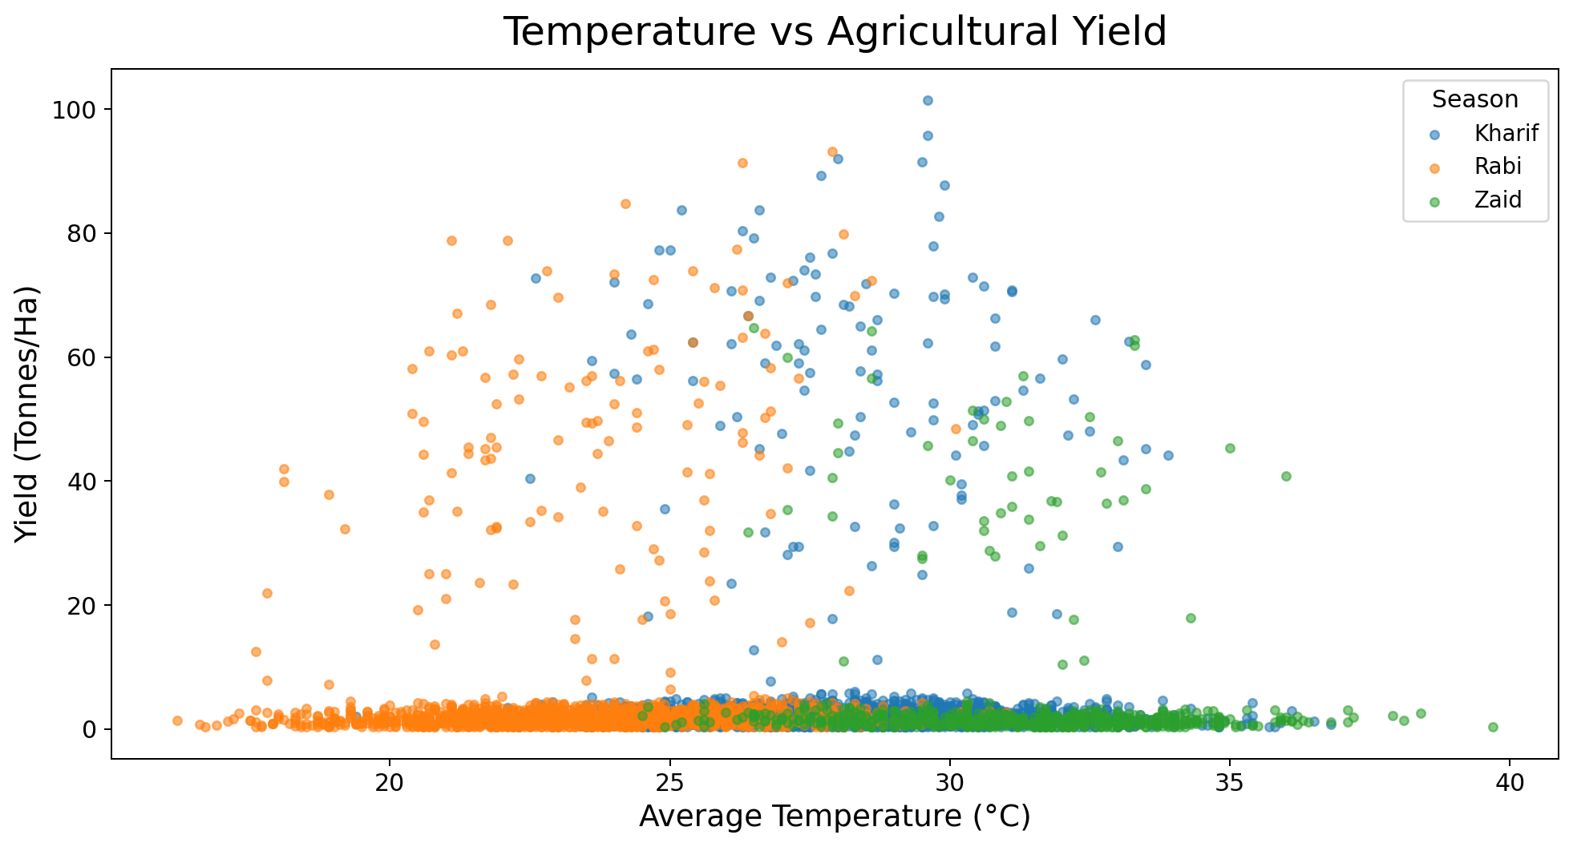
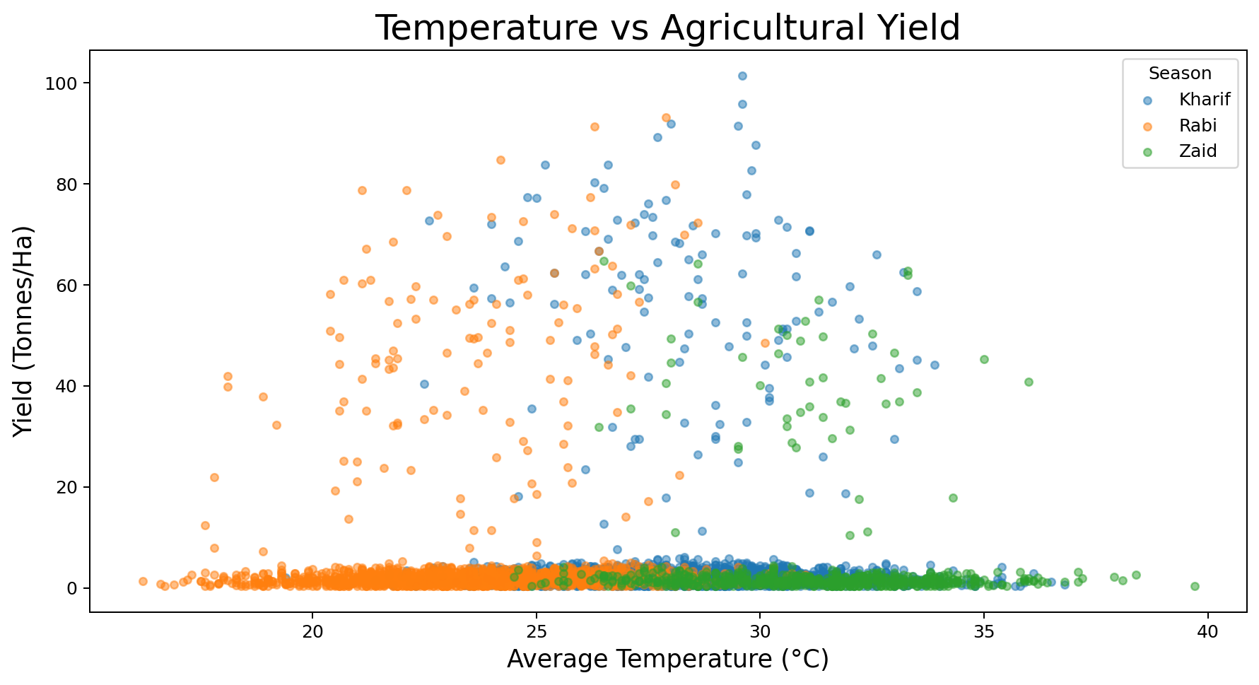
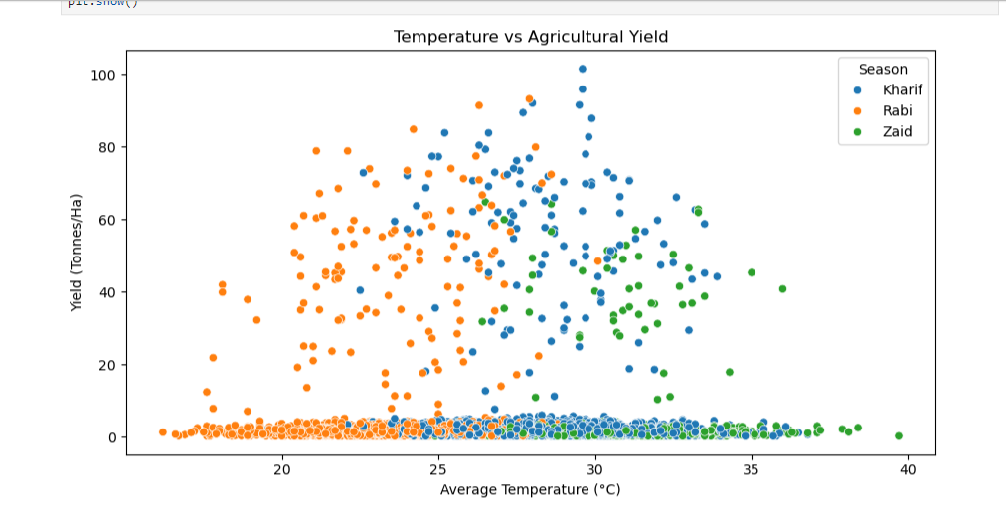
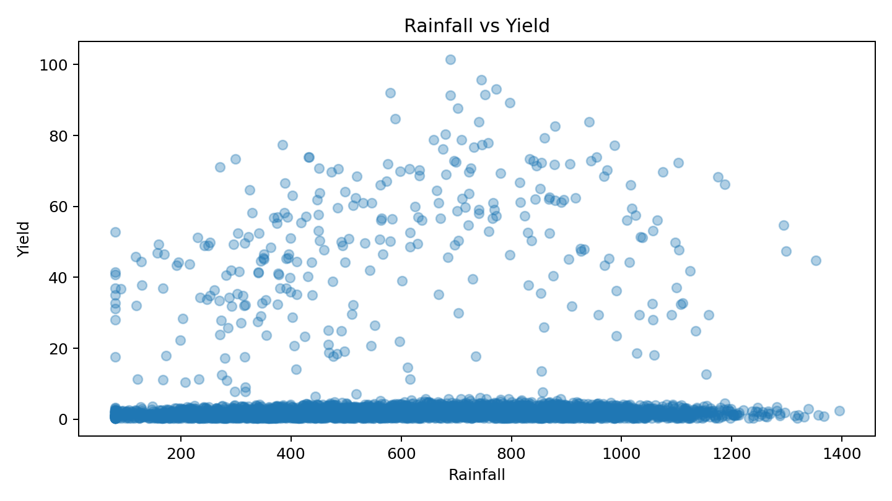
RESULTS — Temperature vs Agricultural Yield
KEY INSIGHT
Correlation with yield: 0.01 The plot shows a widely scattered relationship. Temperature has a very weak linear association with yield.

Slide 11
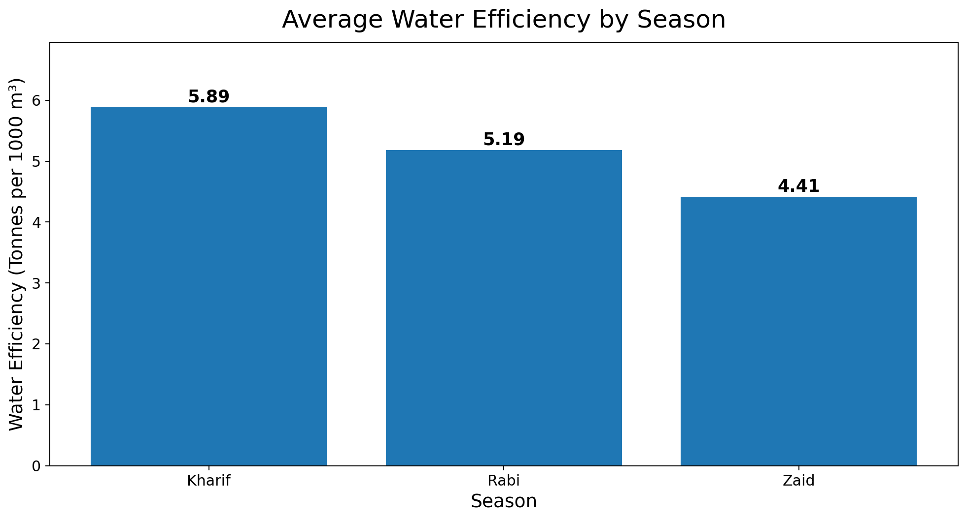
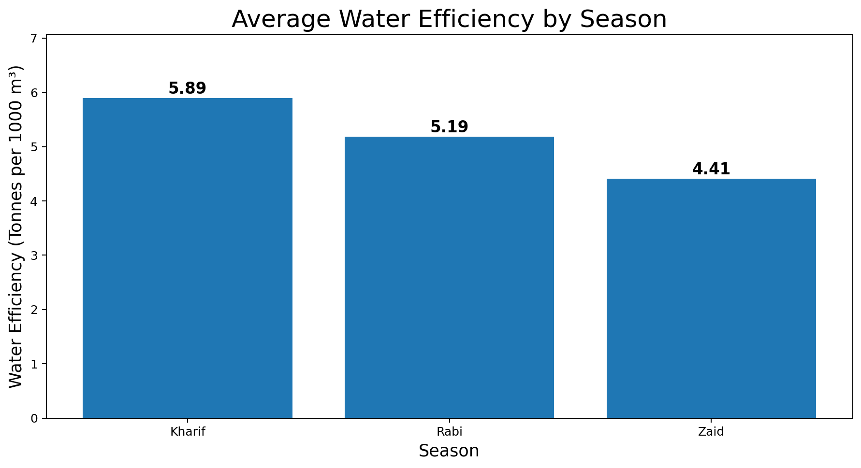
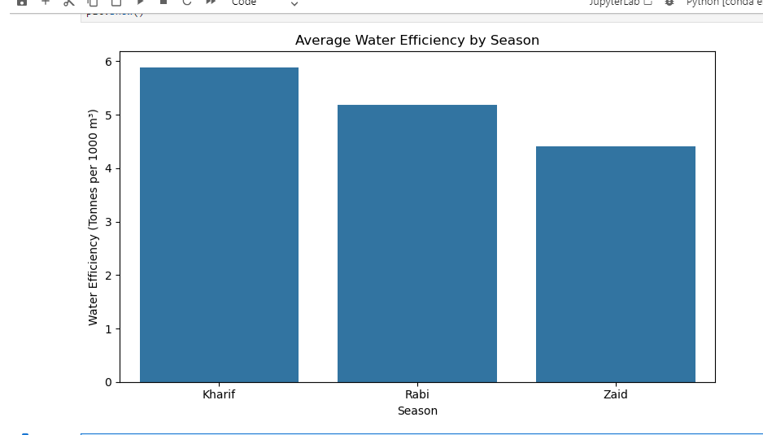
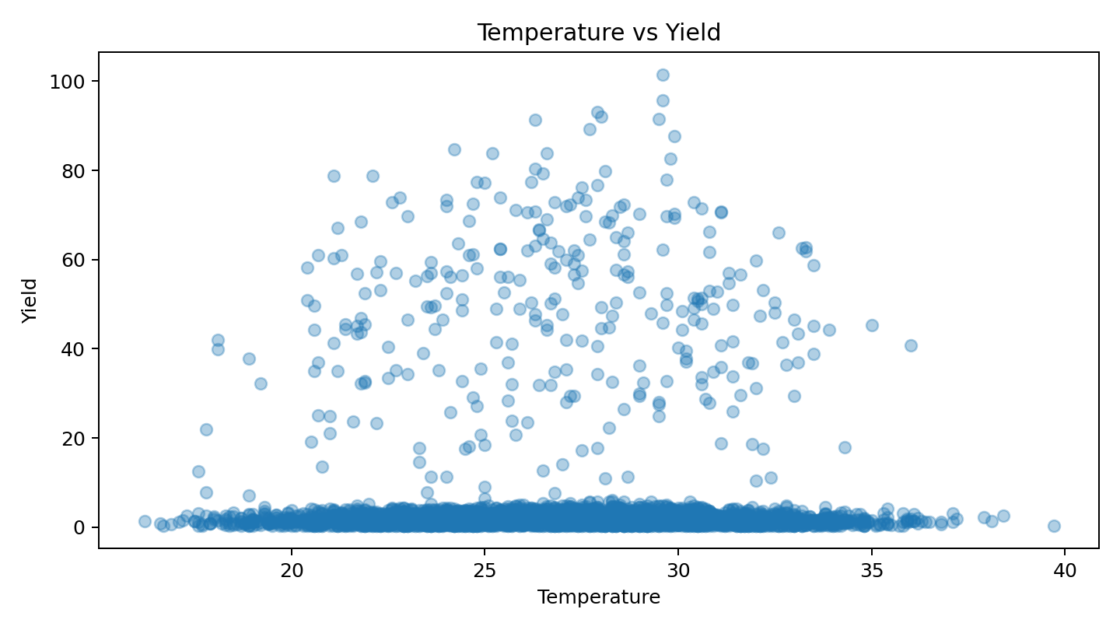
RESULTS — Average Water Efficiency by Season
KEY INSIGHT
Kharif: 5.89 tonnes/1000 m³ Rabi: 5.19 tonnes/1000 m³ Zaid: 4.41 tonnes/1000 m³ Kharif records the highest average water efficiency.

Slide 12
GitHub Link & Future Scope
Project Repository
https://github.com/Surabhikushwaha/Seasonal-Agriculture-Performance-Analysis
Project Files: Jupyter Notebook • Dataset • README Documentation
Future Scope
• Machine-learning based yield and profit prediction • Real-time weather integration • Interactive agricultural dashboard • Crop- and district-level recommendations

Slide 13

VOIS Course Completion Certificate
Course Name: Data Visualization

Slide 14
Thank You
Seasonal Agriculture Performance Analysis
Surabhi Kushwaha | Gautam Buddha University

