Slide 1
Project Overview

Slide 2
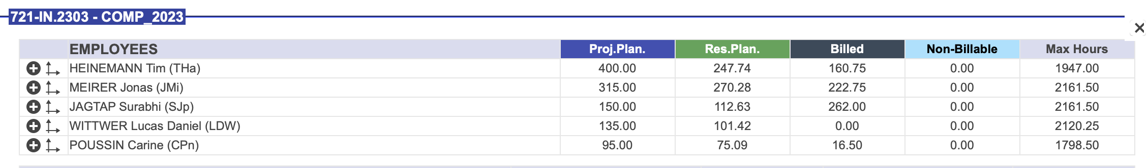
PatStrat: Current Status of the project
Project started Feb 2024
Project manager= Karolina (gave notice of leaving at the end of Feb 2024, left end of April 2024)
Total hours CLAMP+ PatStrat = 1200h (perhaps, 400h + 800h or, 600h + 600h )
Hours booked, Karolina’s hours??
I have overbooked hours for PatStrat,
*I need to dedicate myself to ChronoType as soon as IP agreement is settled*

Slide 4
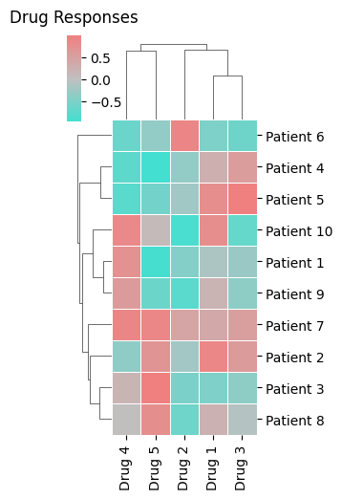
























Concept
Patient Features
3
2
Patient Embeddings
$$P_{1}$$
Biomarkers
$$P_{2}$$
$$P_{1}$$
Predictions
1
$$P_{3}$$
$$P_{2}$$
Joint-SVD
GraphSAGE
$$P_{3}$$
Multi-Modal Data
$$⋮$$
[…]
$$⋮$$
$$P_{1}$$
$$P_{n}$$
[…]
[…]
$$P_{2}$$
[…]
$$P_{n}$$
6
$$P_{3}$$
$$P_{1}$$
[…]
$$P_{2}$$
5
[…]
[…]
$$P_{3}$$
[…]
$$+$$
Regression
model
$$⋮$$
$$⋮$$
A
B
C
$$P_{1}$$
Sample Neighborhood
Aggregate feature information from neighbors
Predict graph context and label using aggregated information
$$P_{2}$$
$$P_{n}$$
$$P_{n}$$
SNF
$$P_{3}$$
Positive Response
4
$$⋮$$
No Effect
$$P_{n}$$
Patient Similarity Network
Adverse Effects
Drug Responses
SVD: Singular Value Decomposition
SNF: Similarity Network Fusion

Slide 5
Concept

Slide 7
PatStrat: Patient Stratification Framework for Predicting Treatment Responses

Slide 8
1. Data Description
 | Total Samples | Samples | T_0 | T_1 | T_2+
Proteomics_CD138 |  | 76
Proteomics_myeloma cells |  | 76
Cytokines
Genomics
%Myeloma
%_Myeloma_cells_by_PCY
%_SmallPlasma_cells_by_PCY
%_M0_cells_by_PCY
%_Other_cells_by_PCY
%_T3_cells_by_PCY
Drug responses

Slide 9
Question to address
Drug response prediction
Bio-markers for patient-stratification
Added value of Multi-modal data integration

Slide 10
Possible Approach
Train and Test on ETHZ MM dataset treatment line 0
Train and Test on ETHZ MM dataset, treatment line 0, validation with another MM cohort
Train and Test on ETHZ MM dataset treatment line 0, validation on treatment line 1,2,3 datasets

Slide 11














2. Joint-SVD
$$K$$
$$K$$
Modality embeddings
Patients
$$P_{1}$$
$$P_{1}$$
$$P_{2}$$
$$K$$
$$K$$
$$P_{2}$$
$$P_{3}$$
$$P_{3}$$
$$⋮$$
$$⋮$$
$$P_{n}$$
$$P_{n}$$
Modalities
Patient embeddings
https://www.nature.com/articles/s41467-020-20430-7
https://academic.oup.com/bioinformatics/article/38/24/5383/6793849
Notes:
https://www.nature.com/articles/s41467-020-20430-7
https://academic.oup.com/bioinformatics/article/38/24/5383/6793849

Slide 12
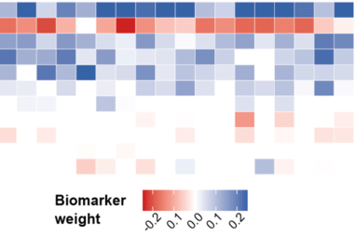
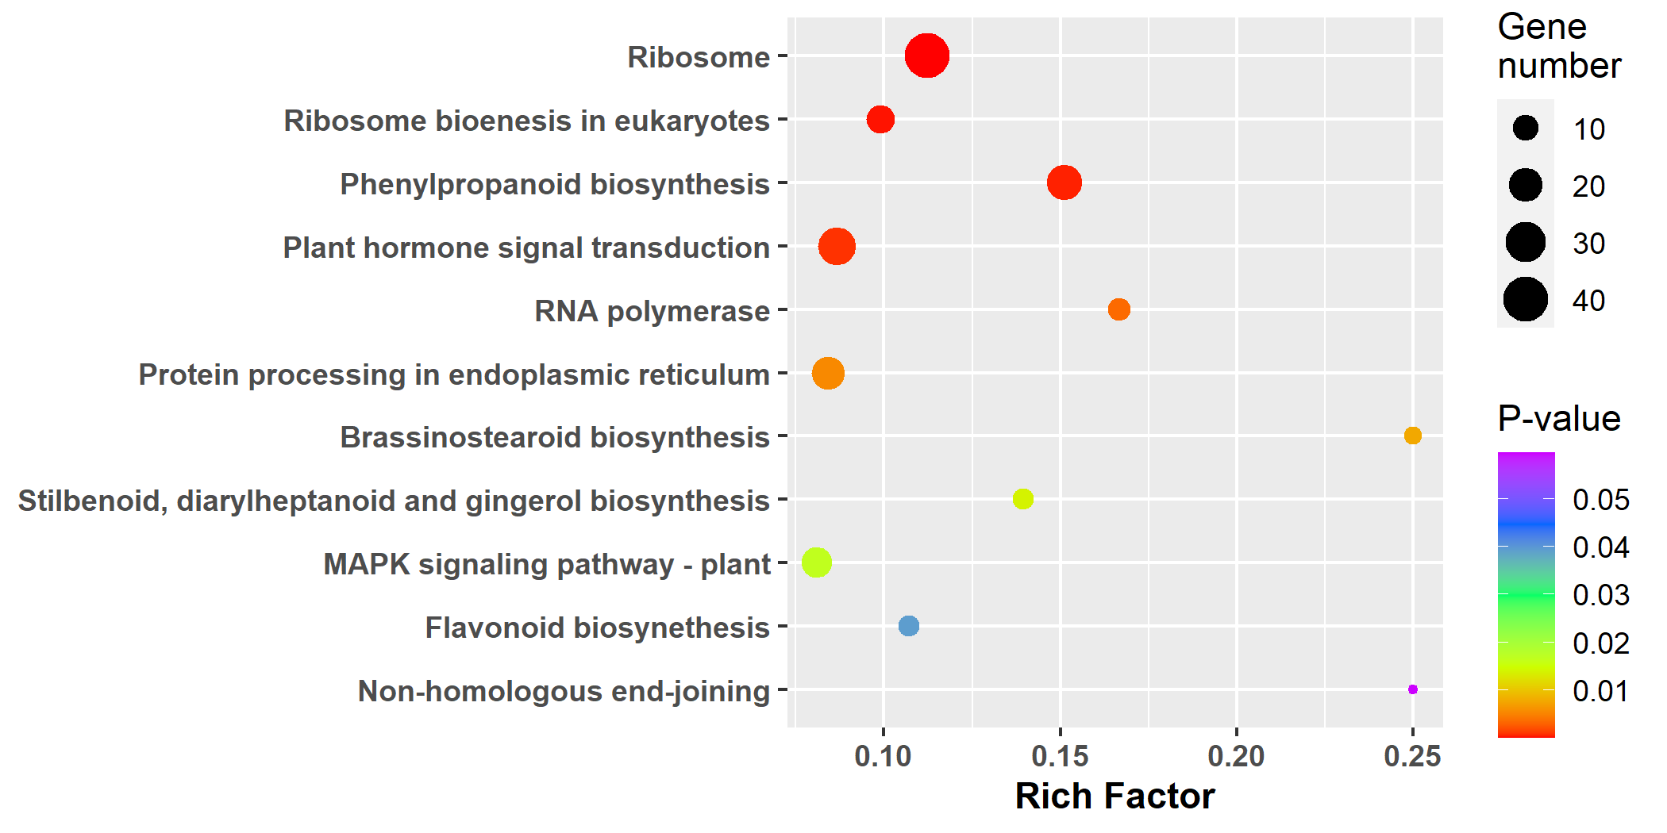

3. Biological Interpretation
Potential Biomarkers
Modality embeddings
$$K$$
Pathway and Biological processes

Slide 13
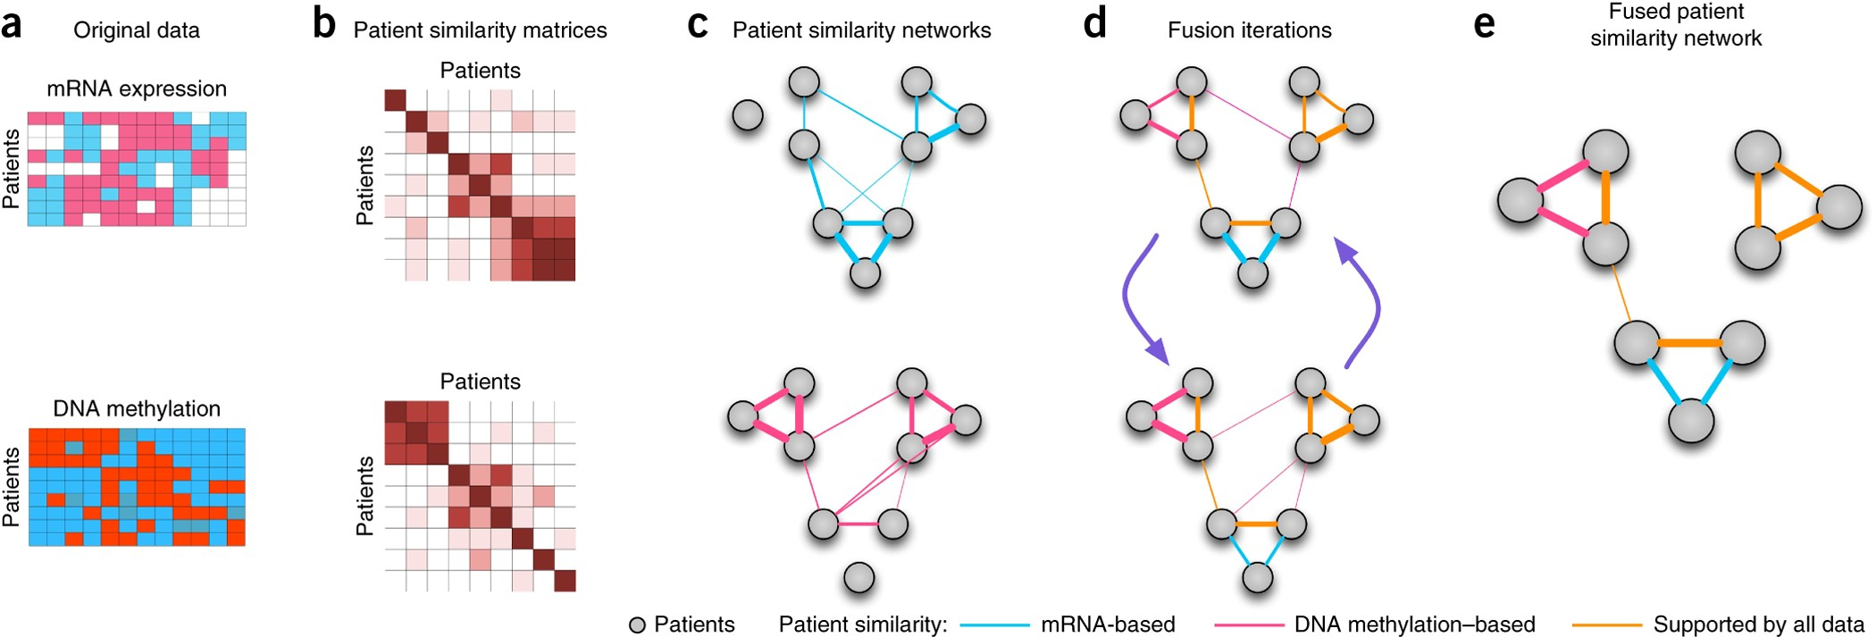
4. Similarity Network Fusion
https://www.nature.com/articles/nmeth.2810
Notes:
https://www.nature.com/articles/nmeth.2810

Slide 14
5. GraphSAGE
[…]
[…]
[…]
[…]
[…]
[…]
[…]
[…]
A
B
C
Sample Neighborhood
Aggregate feature information from neighbors
Predict graph context and label using aggregated information
https://arxiv.org/pdf/1706.02216
Notes:
https://arxiv.org/pdf/1706.02216

Slide 15
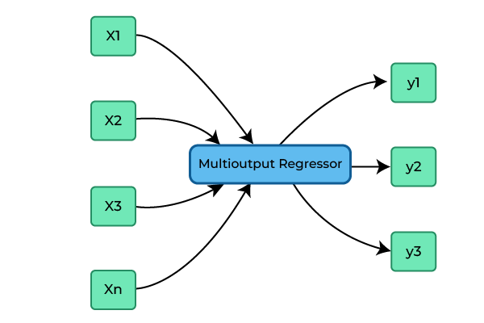
6. Predictions with regression model

Slide 16
Strategies for outreach
Conference poster
Poster and a conference paper

Slide 18
To-dos
Upgrade the code base
Testing for additional datasets
(at-least 2 more, pharmacoscopy, IC50, etc.)
2. Dataset from Tim’s paper
3. AML datasets: https://depmap.org/portal/ ?
Compiling results
Paper drafting
Paper review

Slide 19
To-dos
Upgrade the code base and test it for MM dataset (Surabhi)
Code review & Documentation (Surabhi /Jonas/Lucas)
Testing for additional datasets (Francesca/Lucas/Jonas)
(at-least 2 more, pharmacoscopy, IC50, etc.)
2. Dataset from Tim’s paper
3. AML datasets: https://depmap.org/portal/ ?
Compiling results (Surabhi)
Paper drafting (Surabhi)
Paper review (Tim & Carine)

Slide 24
PatStrat: Patient Statification Framework

Slide 25
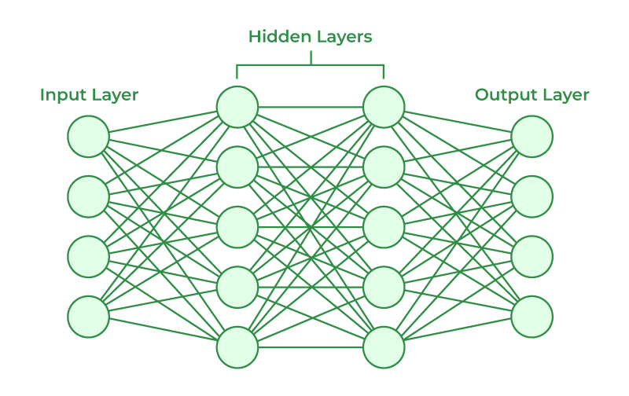














Multilayer Graph Embedding model
$$P_{1}$$
Similarity
Network
$$P_{2}$$
$$P_{3}$$
$$⋮$$
$$P_{n}$$
$$P_{1}$$
$$P_{2}$$
$$P_{3}$$
$$⋮$$
SNF
$$P_{n}$$
$$P_{1}$$
$$P_{2}$$
$$P_{3}$$
$$P_{1}$$
$$P_{2}$$
$$⋮$$
$$P_{3}$$
$$⋮$$
$$P_{n}$$
Drug responses
$$P_{n}$$
Multi-modal data
Relevant Features
Similarity
Networks

