Slide 1

Public Health Significance of Adolescents and Youth Health
Chapter 1

Slide 2
Learning Objectives
By the end of this session, you will be able to:
Describe the status of Adolescent and Youth health Globally and in Ethiopia
Describe the common health problems of Adolescents and Youth in Ethiopia
Understand the rationales for investing on adolescent and youth health

Slide 3
Individual reflections (5’)
Who are Adolescents, youth and young people ?

Slide 4
Adolescent and Youth Current Status
Definition
Adolescence: From Latin “adolescere” “to grow up” (Macmillan Dictionary for Students Macmillan, Pan Ltd. 1981)
Adolescence is a transitional stage of physical, cognitive, and psychological development that generally occurs during the period from puberty to legal adulthood
WHO definitions: Adolescence: 10-19 yrs., Young people: 10-24 yrs. and Youth: 15-24 yrs.
National AYHS definitions : Adolescent & Youth: 10-24 yrs.

Slide 5
Adolescent and Youth Current Status
The numbers …..
In 2021, globally AY Constitute
1.8 billion (24.3%) of the world’s population and 1/3rd (33%) of the Ethiopian population

Slide 6
Mortality trends in adolescent and youths
A decline in the overall mortality rate of AY 10-24 years
A decline in adolescent mortality of all-cause
Relative increase in all-cause mortality for males against female counterparts
A rate of 2.4 male and 1.9 female deaths pern for urban 3.2 male deaths and 2.4 female rural deaths per 1,000 populations
Higher pregnancy-related mortality rate for age group of 15-24 years compared to other age group
Notes:
The relative increase in all-cause mortality for males against their female counterparts might be due to exposure to road traffic accidents, injuries, and other interpersonal violence
In urban areas, there were 2.4 male deaths and 1.9 female deaths per 1,000 populations in the previous seven years.
. In rural areas, there were 3.2 male deaths and 2.4 female deaths per 1,000 populations (EDHS, 2016)
. Female mortality 15-19 years dropped by more than half from about 4.89 deaths per 1000 population in 2000 to 2.2 deaths per 1,000 populations in 2016.
The risk of mortality in females was found to increase as they enter the reproductive age because of pregnancy-related health problems such as unsafe abortion, pregnancy, and birth complications. Pregnancy-related mortality is 0.39 per 1,000 women for age 15-19 years and 0.64 per 1,000 women for age 20-24 years, which translates to MMR of 293 and 320 per 100,000 live births according to the 2016 EDHS

Slide 7
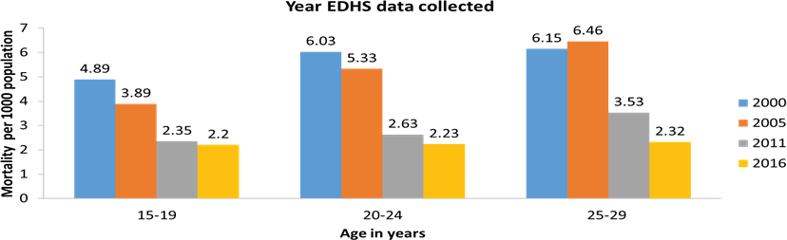
Female : Trends of mortality with age group
Notes:
Let the participants read and brainstorm on the questions on the slides
Causes of poor quality:
Inadequate resources
Inadequate knowledge/skills
Lack of accountability e.t.c.
All of the above?

Slide 8
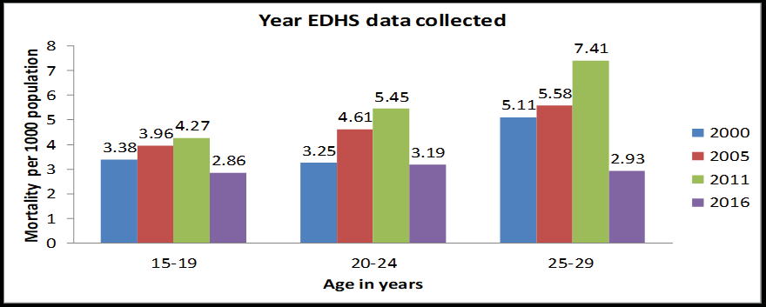
Male: Adolescent and youth mortality trend with age group

Slide 9
1. What are the common health problems of AY observed in your health facility? Time 5’
Pair share

Slide 10
Epidemiology of Adolescents and Youth Health Problems
Global common causes of AY morbidity: injuries/violence; HIV/AIDS, SRH problems; substance use; mental health problems, nutritional problems, non-communicable diseases, and other infectious diseases
Boys have higher mortality rates from unintentional injuries and violence compared to girls
Decline mortality rate among girls and increment mortality rate among boys progressively

Slide 11
Epidemiology of Adolescents and Youth Health Problems…
Injuries
Road traffic injuries, physical fights, and burns are the most common injuries
Physical fight and substance abuse are more common among boys than girls
Road Traffic Accidents (RTA) cause 22.9% of the mortality or injury among adolescents and youth in Ethiopia
Notes:
Injuries are among the leading causes of death and disability among adolescents and youth with unintentional injuries such as road traffic injuries, physical fight, and burns being the most common.
Physical fight, often associated with substance use and other behaviours, is common among younger adolescents, more so among boys than girls leading to severe injuries
In Ethiopia, injuries due to Road Traffic Accidents (RTA) account for 22.9% of the mortality or injury among adolescents and youth (15-29), the prevalence of RTAs is 2.7% (3.2% male and 2% female) and that of non-RTAs is 2.4% (3% male and 1.6% female)

Slide 12
Gender-Based Violence
The GBV is a major problem in Ethiopia.
Common, with 23% physical, 10% sexual violence
Only a few (25%) sought help (EDHS 2016).

Slide 13
Epidemiology of Adolescents and Youth Health Problems…
Adolescent Nutrition
Men are generally thinner(32.3%) (BMI <18.5) than women( 22.4%) This figure is much high for adolescent boys aged 15-19 years of age (59%) than adolescent girls (29%).
Nearly twice (31%)high underweight among rural adolescents than urban(17%).
High (11,3) obesity among children and adolescents
Notes:
Malnutrition affects a large portion of the adolescent and youth population in Ethiopia. According to the EDHS 2016, men are generally thinner than women showing a national average of 32.3% prevalence (BMI <18.5) against 22.4% for women. This figure is much high for adolescent boys aged 15-19 years of age (59%) than adoSubstance Use
Harmful substance use (tobacco, alcohol and illicit substances) will increase the risk of cancers, cardiovascular diseases, and respiratory illnesses later in life.
Use of such substance has shown increment in the last decade. About 37% of girls and 43% of boys aged 15-19 year consume alcohol. About 57% of boys and 37% of girls also chew Khat
lescent girls (29%).
the prevalence of underweight is also very high among rural adolescents (31%) compared to their urban counterparts (17%). The pooled prevalence of overweight and obesity among children and adolescents in Ethiopia is substantially high (11.3%) and becoming an emerging nutrition-linked problem.

Slide 14
Epidemiology of Adolescents and Youth Health Problems…
Substance Use
Harmful substance use (tobacco, alcohol, and illicit substances) increases the risk for cancers, CVD, and respiratory illnesses later in life.
Among 15-19 years -Alcohol is used by 37% of girls and 43% of boys
Chat is used by 57% of boys and 37% of girls

Slide 15
Epidemiology of Adolescents and Youth Health Problems…
Mental Health
Most mental disorders begin during adolescence and youth
The 75% of mental disorders in adulthood have their onset in youth
Mental health problem in children and adolescents is estimated to be between 17% and 23%,
Notes:
Mental health disorders account for a large proportion of the disease burden in young people in all societies.
Most mental disorders begin during adolescence and youth, although they are often first detected later in life. Poor mental health is strongly related to other health and development concerns in young people.
Evidence indicates that about 75% of mental disorders in adulthood have their onset in youth, particularly among that 12 – 24 years of age.
In Ethiopia, mental illness in children and adolescents is estimated to be between 17% and 23%, with lower prevalence in rural settings.
the major sexual and reproductive health problems of adolescents and youth in Ethiopia include early sexual debut, risky sexual practices, child marriage, early child bearing, unintended pregnancy, unsafe abortion and STIs including HIV.
Adolescent and youth morbidity in connection to early engagement in sexual activity has been detrimental. According to the PMA survey result from 2019, the median age at first sex is at 16.4years and the median age for first marriage is 17.8 years for rural girls which are lower compared to adolescent girls in urban areas.
In Ethiopia, there has been a uniform decline in the Age-Specific-Fertility-Rate (ASFR). In 2019, the ASFR for the age group 15-19 years is 72 births per 1,000 women and peaks to 202 births per 1,000 women in the age group of 25-29 years and then drops to 14 births per 1,000 women in the age group of 45-49 years.
The adolescent fertility rate also varies across the regions of Ethiopia. According to the EDHS 2016, the adolescent fertility rate for the age group 15-19 years is highest in Afar at 152 births per 1,000 women and lowest in Addis Ababa at 13 births per 1,000 women.
ASFRs are lower in urban areas compared to rural areas among women in all age groups. On average, rural women have 1.3 more children than urban women (4.5 versus 3.2 children), the disparity between urban and rural has narrowed over the last 3 years

Slide 16
Epidemiology of Adolescents and Youth Health Problems…
SRH problem
Early sexual debut, risky sexual practices, child marriage, early childbearing, unintended pregnancy, unsafe abortion, and STIs including HIV are their problem
Girls started sex earlier (16.4years) and married as teens ( 17.8 years ), more in rural that urban areas
High adolescent fertility rate with regional variation

Slide 17
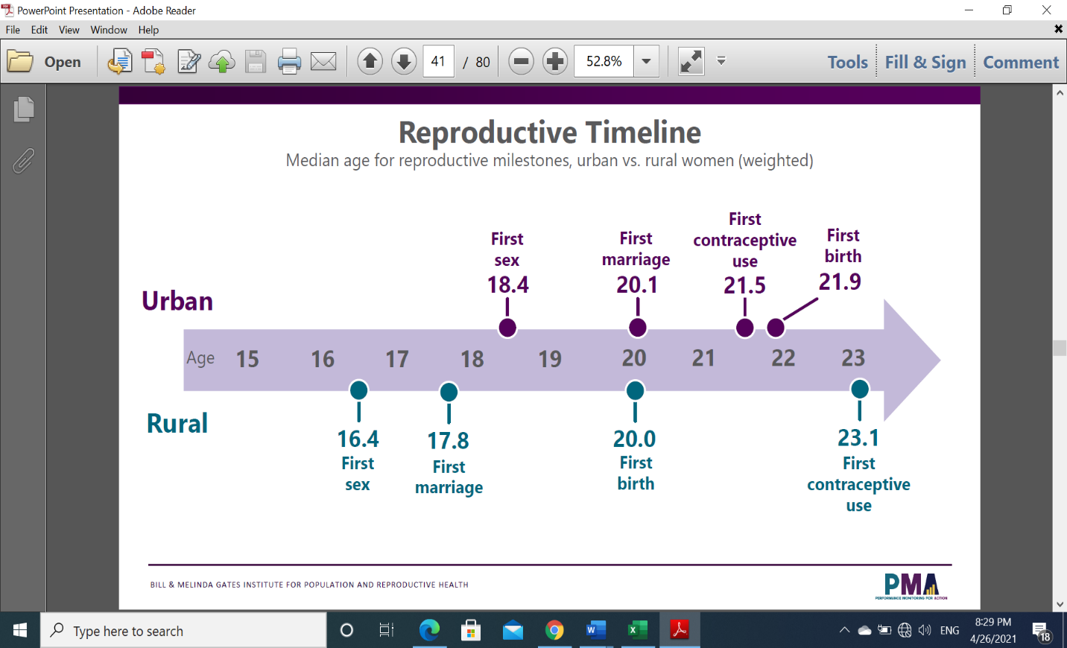

Slide 18
Epidemiology of Adolescents and Youth Health Problems…
SRH problem…
Higher unmet need despite relatively higher CPR( EDHS 2016)
Lower maternity service uptake
Higher STIs and new HIV infection among the population group
Low level of comprehensive knowledge on HIV
Common use of alcohol and substance which contribute to risky behavior
Notes:
The current CPR, EDHS 2016, for adolescents 15-19 years and youth 20-24 years is 57.5% and 52.5% respectively while unmet need for FP for same age groups is 20.5% and 18.5% respectively.
Lack of skilled care during pregnancy and delivery in this age group also poses significant health risk to the mothers and their children compared to older women in the reproductive age group. The coverage of ANC4+ and ANC8+ for Ethiopian adolescent age below 20 years is 36.4% and 1.3% respectively and only 53.6% of adolescent deliveries are by skilled health personnel.
Evidence indicates that there is increased risk of acquiring STIs and HIV among adolescents and youth due to the early initiation of sexual intercourse and higher-risk sexual behavior such as having sexual intercourse with multiple partners or somebody who is neither a spouse nor a cohabiting partner without use of condom.
Studies indicate that NCDs is an emerging epidemic in Ethiopia and other low- and middle-income countries because of the increasing urbanization and the related changes in lifestyle and dietary habits.
In Ethiopia, Non-communicable diseases (NCDs) are recognized as emerging public health problems which accounts for 30% of deaths in 2014. In a study conducted among working adults in Addis Ababa, the prevalence of diabetes mellitus was 6.5% and the prevalence of hypertension was 19.1% with a higher proportion among males (22%)

Slide 19
Epidemiology of Adolescents and Youth Health Problems…
Non-Communicable Diseases (NCDs)
Emerging epidemic because of the increasing urbanization and the related changes in lifestyle and dietary habits.
In Ethiopia, accounts for 30% of deaths in 2014.
Diabetes mellitus ( 6.5%) and hypertension (19.1% ) are common with a higher proportion among males (22%)

Slide 20
Epidemiology of Adolescents and Youth Health Problems…
Harmful Traditional Practices (HTPs)
HTPs that are classified as serious crimes by the Ethiopian Law
Female genital mutilation/cutting (FGM/C), child marriage, forceful abduction and domestic violence are the most widely practiced
FGM prevalence is declining but universally practiced in some regions (Somali and Afar) i(91%-99%)
Notes:
Female genital mutilation/cutting (FGM/C), child marriage, forceful abduction and domestic violence are the most widely practiced forms of HTPs that are classified as serious crimes by the Ethiopian Law.
There are indications that attitudes towards FGM are changing and its prevalence is declining in Ethiopia. Similarly, the prevalence of FGM in some regions (Somali and Afar) is almost universal (91%-99%), giving the national prevalence rate of 65% among women of 15-49 years.
The promising part is that the national prevalence of FGM in children aged 0-14 years has declined to 16%, but far from ending. The prevalence of FGM in aged 15-19 years has also declined from 71% in 2000 to 47% in 2016.

Slide 21
Trends in HTPs

Slide 22
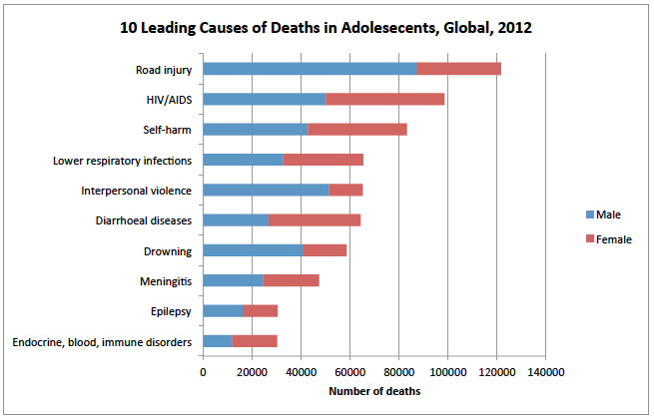
Epidemiology of Priority Health problems
Globally, the most common causes of morbidity among adolescents and youth are:
Injuries/violence;
sexual and reproductive health Problems;
substance use;
mental health problems;
non-communicable diseases.
Notes:
Injuries: In Ethiopia, injuries due to road traffic accidents (RTA), physical fights and drowning account for 9% of the mortality caused by NCDs. Among adolescents and youth (15-29), the prevalence of RTAs is 2.7% (3.2% male and 2% female) and that of non-RTAs is 2.4% (3% male and 1.6% female). The common non road traffic accidents are fall, burn, poisoning, cut, drowning, animal bites and violent injuries
For instance, according to the EDHS 2011, 68% of married women accept that a husband is justified for beating his wife. Moreover, more than half of married adolescent women aged 15-19 do not know that there is law against domestic violence; which is consistent in all age groups.

Slide 23
Why do you think it is important to invest in adolescent and youth health?
Brainstorming (5’ )

Slide 24
Why invest on adolescent and youth Health
Five reasons why investing in adolescent health is indispensable for 2030 SGDs.
1. Adolescents have fundamental right to health
Adolescents, like all people, have fundamental rights to life, development, the highest achievable standards of health and access to health services.
Notes:
The 2030 Agenda for Sustainable Development cannot be achieved without investment in adolescent health and well-being. There are at least five arguments why investing in adolescent health is indispensable.
1. Adolescents have the fundamental right to health
Adolescents, like all people, have fundamental rights to life, development, the highest achievable standards of health and access to health services. Yet they suffer a high burden of disease from preventable causes, mainly related to unintentional injuries; violence; sexual and reproductive health, including HIV; communicable diseases such as acute respiratory infections and diarrheal diseases; non-communicable diseases, poor nutrition and lack of physical activity; mental health, substance use and self-harm
For adolescents now: adolescent health is immediately benefited by promotion of positive behaviours and by prevention, early detection and treatment of problems.
For adolescents’ future lives: to help set a pattern of healthy lifestyles and reduce morbidity, disability and premature mortality later in adulthood, support is needed to establish healthy behaviours in adolescence and reduce harmful exposures, conditions and behaviours.
For the next generation: the health of future off-springs can be protected by promoting emotional well-being and healthy practices in adolescence and preventing risk factors and burdens.
Gains made through substantial investment in maternal and child health programmes over recent decades are at risk of being lost if there is insufficient investment in adolescent health programming today. Investment in adolescent health will build on earlier gains in young child health, and will sustain those investments.
Adolescence is one of the most rapidly changing, formative phases of human development. The range of determinants that influence human health take particular forms and have unique impacts in adolescence.
Adolescents are one sixth of the world’s population and account for 6% of the world’s global burden of disease and injury. In 2015, more than 1.2 million adolescents died. Causes of death and disability-adjusted life years (DALYs) lost differ between younger (10-14 year old) and older (15-19 year old) adolescents and between males and females. Overall rates of death and DALYs lost are higher for males than females and are particularly high for older adolescent boys and young males.

Slide 25
Why invest on adolescent and youth Health…
2. Investments in adolescent health bring a triple dividend of health benefits
For adolescents now: promotion of positive behaviors
For adolescents’ future lives – to help set a pattern of healthy lifestyles
For the next generation –promoting emotional well-being and healthy practices in adolescence

Slide 26
Why invest on adolescent and youth Health…
4.Investments in adolescent health reduce present and future health costs and enhance social capital
Investment in adolescent health will build on earlier gains in young child health, and will sustain those investments
5.Adolescents are not simply old children or young adults; they have particular needs
The ranges of determinants that influence human health take particular forms and have unique impacts in adolescence

Slide 27
Why invest on adolescent and youth Health
6. Adolescents bear a substantial proportion of the global disease and injury burden
In 2000, 43% of all deaths among those aged 5 to 24 years in the world

Slide 28
Summary
Adolescent and youth make significant proportion of the world population
Rationales for investing in adolescent and youth health are
Adolescents have the fundamental right to health
Investments in adolescent health bring a triple dividend of health benefits
Investments in adolescent health reduce present and future health costs and enhance social capital
Adolescents are not simply old children or young adults; they have particular needs
Adolescents bear a substantial proportion of the global disease and injury burden

Slide 29
Thank You!

