Slide 1
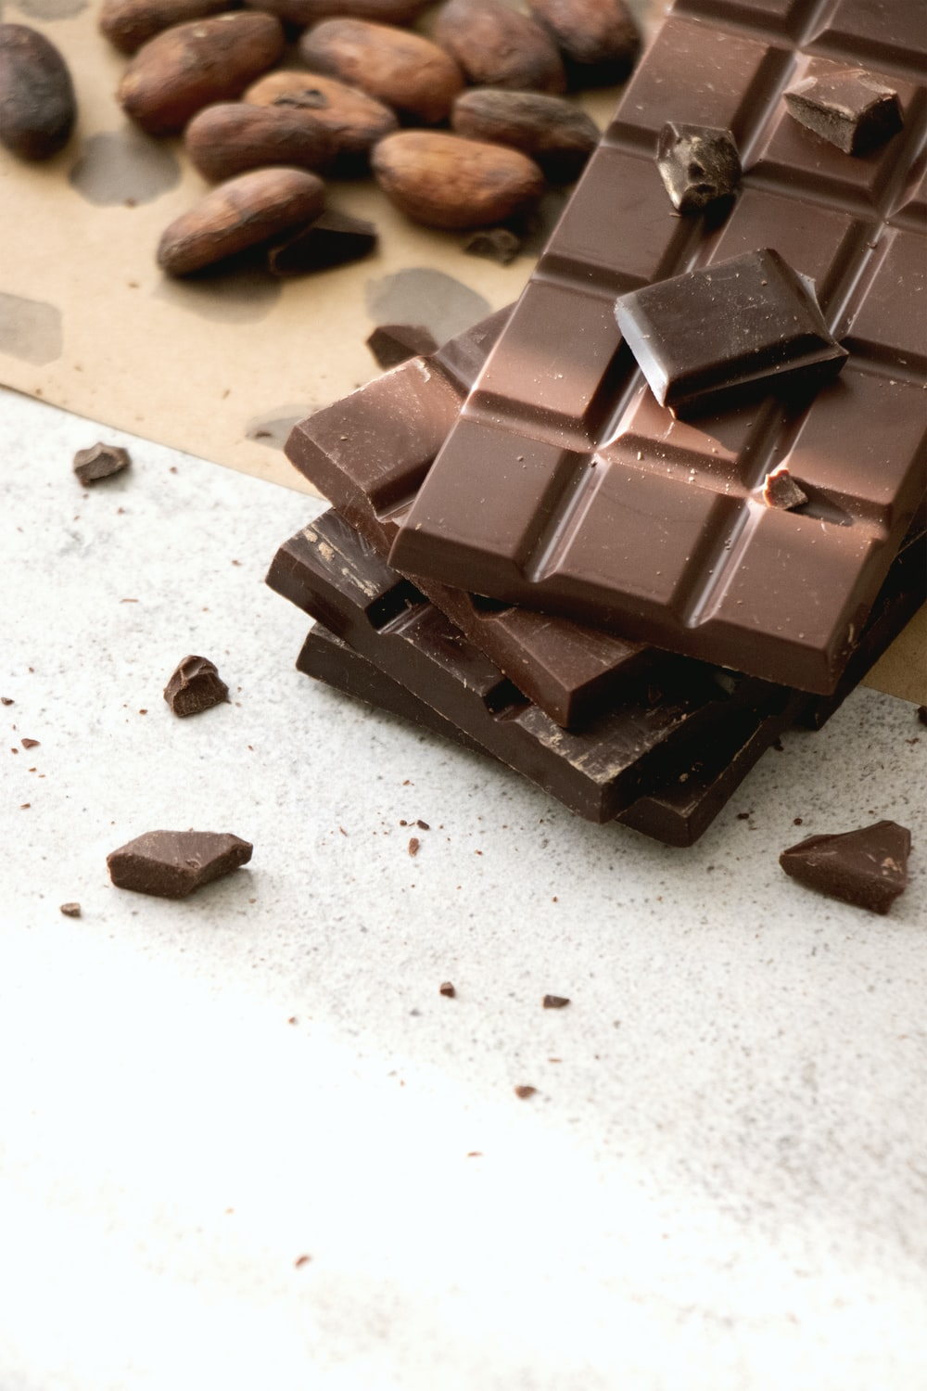
Sales analysis for Awesome Chocolates Company
- Suraj Surendran
-By Suraj Surendran

Slide 2
Problem statement
We are a company called Awesome Chocolates and are selling different products across the globe. Our aim is to decide which products to discontinue. The sales details alongwith cost per unit is provided for all the products.

Slide 3
Approach:
The data available with us, should be analyzed thoroughly to imbibe what its trying to convey.
To do this, a sequence of actions were followed

Slide 4

Raw data to Table
Conclusion
Process
Quick statistics
Category Report
Exploratory data analysis
Profit analysis
Anomaly detection
Top 5 products by sale
Salesperson by Country
Sales by country analysis

Slide 5
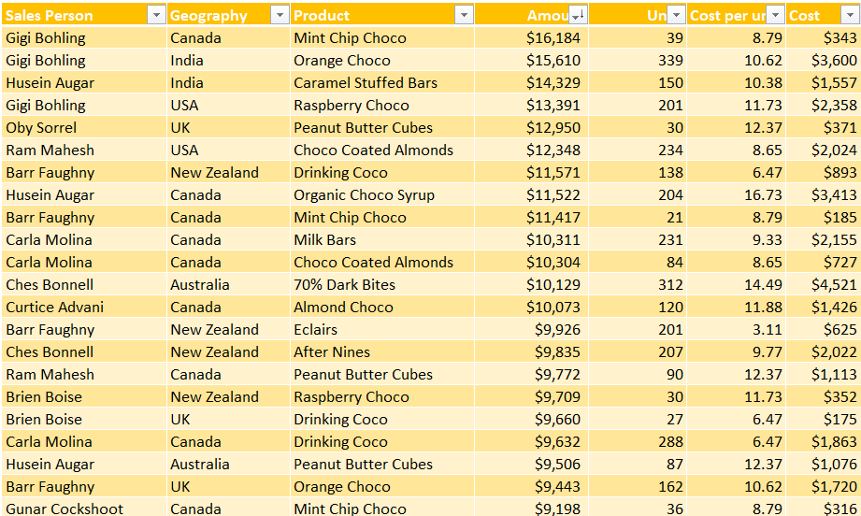
Raw data to Table
This is a good step to do in the beginning, because if we want to add new data later the formatting will be applied automatically.

Slide 6
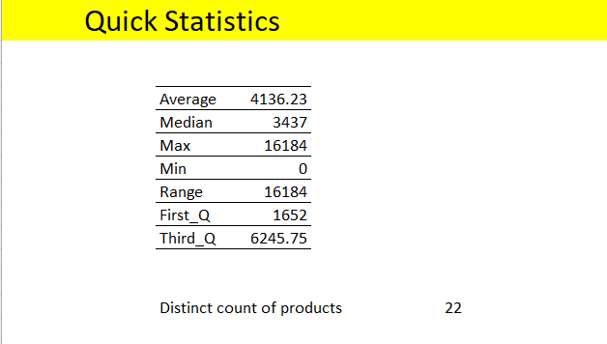
Quick statistics
- To understand the data better, we can use statistical metrics like average, median, minimum value, maximum value, first quartile, third quartile,count etc.
We can decipher the following:
Since, the average is greater than the median it implies that there are more values greater than 3437 in our data
We observe that the minimum value is zero. To verify the same we can filter the columns and check for the correctness of the data
First quartile =1652 indicates that the first 25% values for the sorted data(Amount, in this case) are less than equal to 1652
Third quartile=6245.75 suggests that bottom 25% values are greater than 6245.75
Many more details can be understood by simply using basic statistics.

Slide 7
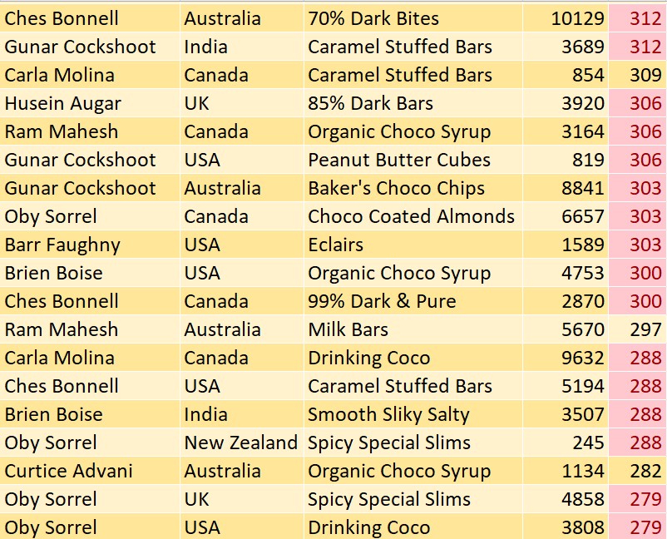
Exploratory Data Analysis(EDA)
After calculating some statistical metrics, the data can be explored further to understand better
Sorting can be used, using filters like Top 10 , greater than or less than average/median etc. are some of the options that can be used
In the figure, after applying sorting, duplicate values are highlighted.
Variation in the data can be understood quickly by using colour scale.

Slide 8
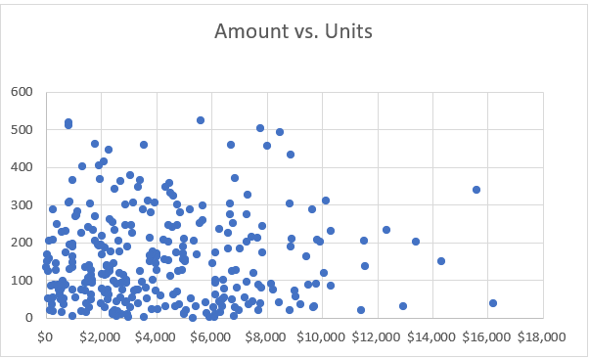
Anomaly detection
-This helps in detecting any outliers.
For instance, if the sales for products barely sold turn out to be on the higher end, then that data is suspicious.
-Hence, it is crucial to be aware of such data.
- In this scatter plot, the highlighted points are the outliers.
Scatter plot

Slide 9
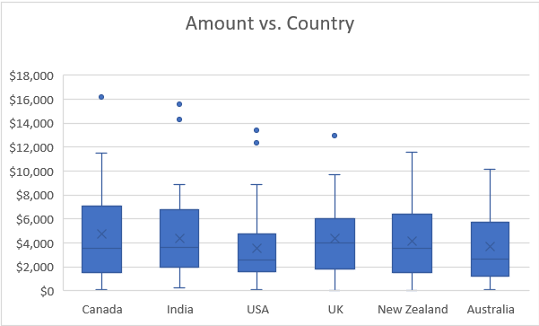
-In this box plot the highlighted values are possible outliers.
Box plot

Slide 10
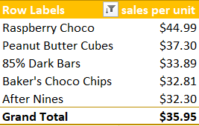
Top five products by $ per unit
This can be easily analyzed with the help of Pivot Table.
Pivot Table is popularly used because of its interactive nature of data representation.

Slide 11
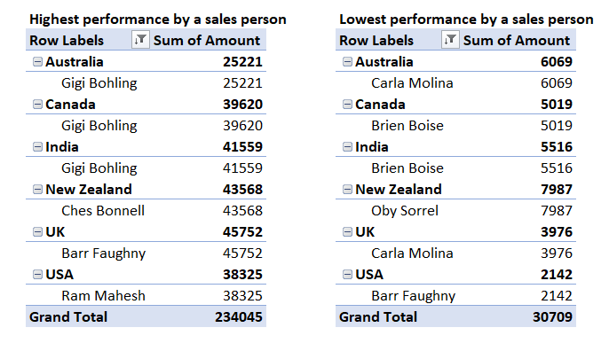
Sales person by country analysis
- Analysis of highest and lowest performing sales persons in different Countries.

Slide 12
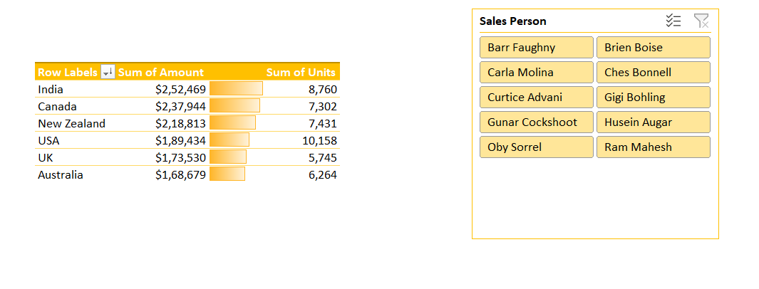
Sales by Country Analysis
This table represents sales in different countries.
For faster analysis, data bars are used additionally.

Slide 13
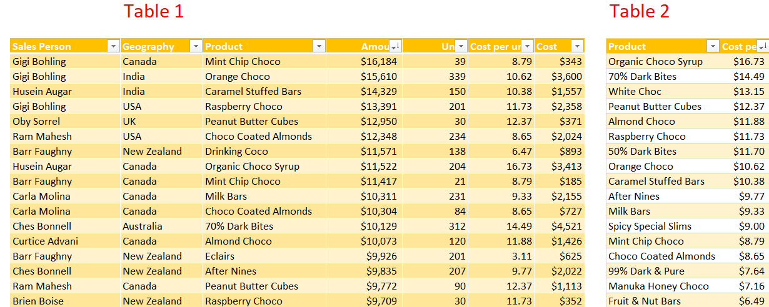
Combining Two tables
Table 1 and Table 2 can be combined using XLOOKUP for calculation of Cost

Slide 14
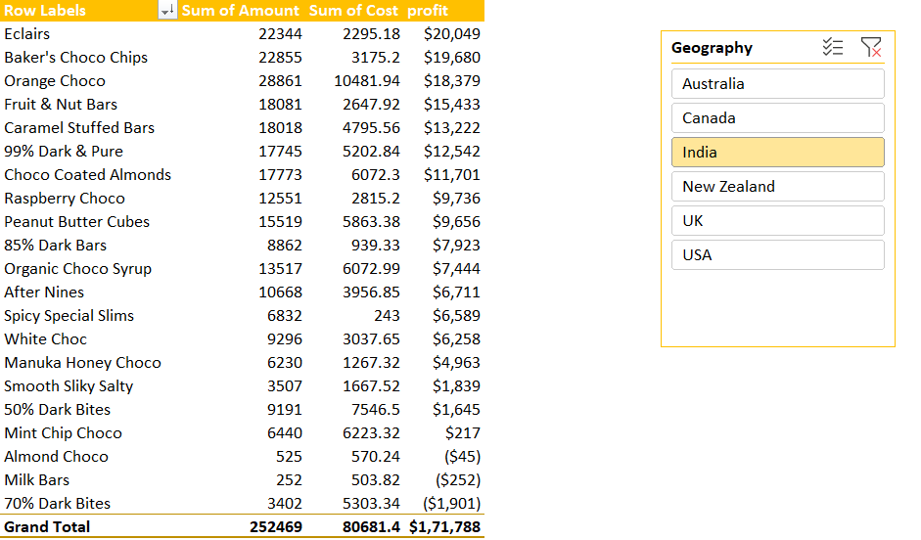
Profit Analysis
Using Pivot Table, profit was calculated as (Amount-Cost).
Additionally, using Geography as a slicer makes it interactive and helps in analyzing the profit incurred for different products in different Countries.

Slide 15
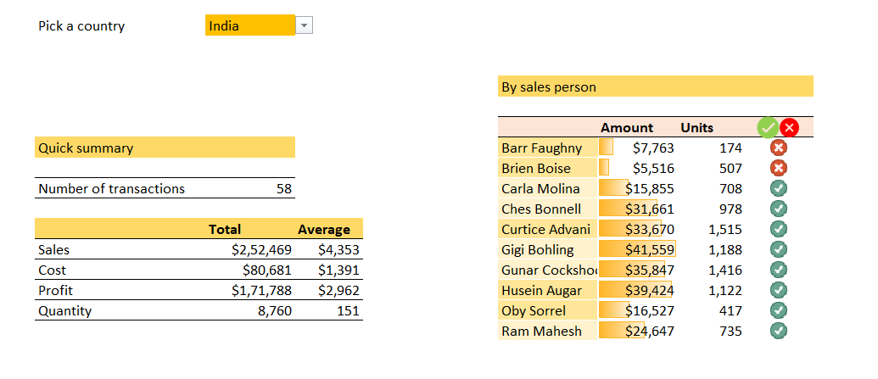
Category Report
A dropdown list is created for different Countries
IF amount>12,000 , then that product can be retained
Different metrics for comparison

Slide 16
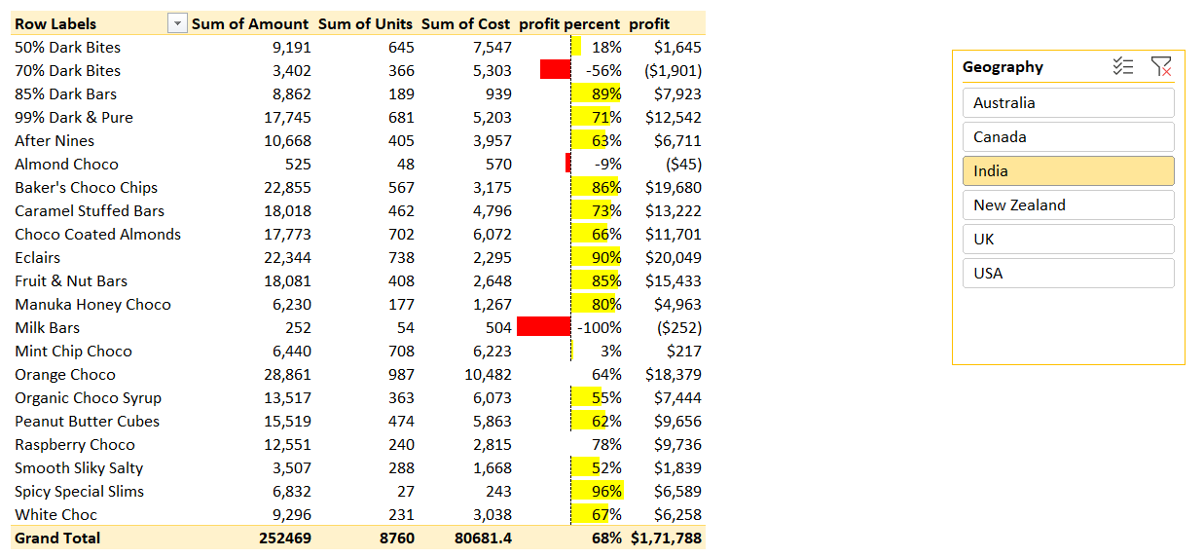
Conclusion

Slide 17
With the help of Pivot Table, all the necessary metrics are enlisted.
Profit per cent is given prime importance for this analysis.
One logical move would be to discontinue the products that contributed to losses /little profits depending on the geography.
Considering 25% as the minimum profit per cent, we can discontinue products with profit per cent less than 25%.
Geography | Products to be discontinued
India | 70% Dark Bites, 50%Dark Bites,Milk Bars, Almond Choco,Mint Chip Choco,
Canada | Baker’s Choco Chips,Caramel Stuffed Bars,Organic Choco Syrup, Spicy Special Slims
Australia | Organic Choco Syrup,50% Dark Bite, Drinking Coco
New Zealand | Spicy Special Slims, 70% Dark Bites,Almond Choco,Mint Chip Choco
UK | Mint Chip Choco,White Choco
USA | Baker’s Choco Chips, Organic Choco Syrup, Spicy Special Slims , 70% Dark Bites, Almond Choco, Peanut Butter Cubes,White Choco, Orange Choco

Slide 18
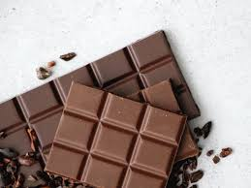
Credits:
Chandoo.org
Images:
-pinterest.com
-greenqueen.com

Slide 19


