Slide 1
Design And Development Of Hydraulic Soft Actuator For SDOF
Name: Suraj Santram Varma
Student Intern at ATRC
Guide: Mr. Shivdas Prasad (Sc. E)
R&DE (Engrs), DRDO, Pune

Slide 2
Assigned work in internship Period:
Objective: Design of Hydraulic Soft Actuator (HSA) for SDOF arm.
Duration: Six Months
Tasks:
Literature Survey
Selection of Configuration for HSA
Design of key parameters for HSA like: diameter, internal pressure, open length, close length, etc.
FEA/FEM simulation
Prototype development (Possible)
Report generation

Slide 3
The Work That I did Recently:
Introduction: Introduce to problem statement and normal Introduction
Literature Survey: Concept of Hydraulic Soft Actuator (HSA) and finding the research gap
Derivation: Derived the Formula for Pressure – Force Relationship, rather than relying on the given Formula in the research paper.
Calculation: Calculated the required pressure for lifting the atleast of 5kg of payload and also by the maximum pressure calculated the force value.
CAD Model: Designed the 3D CAD Model of Actuator
The Part I have to do after this:
ANSYS Simulation
Kinematic Simulation
Designing of Test Setup
Verify by Practical Test
Documentation

Slide 4
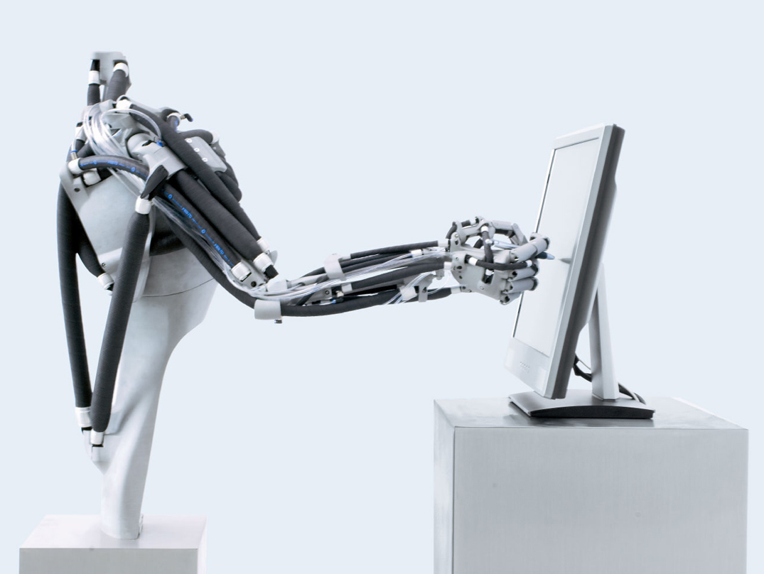
Problem Statement:
To design and develop a single-degree-of-freedom robotic elbow joint using a HSA in an antagonistic biceps-triceps configuration, capable of lifting a minimum 5 kg load while providing the required joint torque, motion, and structural safety.
Objective:
To study the working principle and characteristics of HSA for robotic applications.
To design a single-DOF robotic elbow joint using a biceps-triceps type HSA arrangement for a minimum 5 kg load.
To analyze the required joint torque, actuator force, pressure, and braided sheath parameters.
Image Reference: Research on Key Technologies of Pneumatic Flexible Joints for Robot

Slide 5
Introduction:
Soft robotics has become an important area of robotics because compliant structures can deform continuously, adapt to irregular surfaces, and distribute contact forces during interaction. These properties are especially useful for handling delicate objects, operating in uncertain environments, and interacting safely with the human body, where compliance is a basic design requirement rather than an added feature.
In these systems, the actuator is central to performance because it not only produces motion but also influences the load path, deformation mode, stiffness distribution, and contact behavior of the robot.
First, we discuss about Pneumatic Soft Actuator (PAM), like PAM is a soft actuator which has great potential in the field of bio-inspired robotics.
But PAM have lots of limitations such less loading capacity, losses, leakages, etc.
So, for that we are going to discussed about Designing and Modeling of Hydraulic Soft Actuator.
And we have to design for 5kg of lift.

Slide 6
Literature Survey:
Year | Author(s) | Research Paper / Topic | Publication | Key Finding | Limitation | Relevance
2025 | A. Zhagiparova et al. | Recent Developments in Pneumatic Artificial Muscle Actuators | Actuators - MDPI | Identified friction between braided fibers and the bladder, elastic energy storage, and geometric nonlinearity as major sources of hysteresis and force deviation in McKibben actuators. | Primarily focused on pneumatic artificial muscles and reviewed multiple actuator designs rather than developing a dedicated hydraulic McKibben force model. | Highly relevant for estimating force losses, hysteresis, braid friction, and nonlinear behavior that should be considered when correcting the theoretical McKibben force equation.
2024 | Y. Zhang et al. | Dynamic Modelling and Inverse Compensation for Coupled Hysteresis in Pneumatic Artificial Muscle Actuated Soft Manipulator with Variable Stiffness | ISA Transactions | Developed a dynamic model to account for stiffness-dependent and rate-dependent hysteresis. | Focuses on a complete manipulator system rather than a single actuator force model. | Relevant for understanding hysteresis when your actuator operates under changing loads or in an antagonistic configuration.
2022 | M. G. Antonelli et al. | Design and Characterization of a McKibben Pneumatic Muscle Prototype with an Embedded Capacitive Length Transducer | Machines, MDPI | Developed an embedded capacitive sensor capable of measuring muscle-length changes below 1 mm. | Requires a specialized embedded sensing arrangement. | Useful for future actuator displacement measurement and feedback.
2022 | Hu Shi, Kun Tan, Boyang Zhang and Wenqiao Liu | Review on Research of Hydraulic Powered Soft Actuators | Energies, MDPI | Reviewed different hydraulic soft actuator designs-configurations and highlighted their high force, power density, flexibility, and potential for complex robotic applications. | Mainly focused on hydraulic actuators, which require pumps, valves, and fluid systems, increasing overall system complexity and limiting compactness. | Relevant to the study of fluid-powered soft actuators, providing insights into actuator design, materials, performance, and control challenges.

Slide 7
Literature Survey:
Year | Author(s) | Research Paper / Topic | Publication | Key Finding | Limitation | Relevance
2019 | A. Camp et al. | Modeling and Analysis of Hydraulic Piston Actuation of McKibben Fluidic Artificial Muscles for Hand Rehabilitation | The International Journal of Robotics Research | Developed and experimentally validated a hydraulic McKibben muscle model. The study compared fixed-end and cylindrical models and included correction for strain prediction. | Mainly focused on displacement and strain prediction for rehabilitation applications, not a complete force-loss model. | Highly relevant for hydraulic McKibben actuator geometry, volume change, strain prediction, and improving the accuracy of actuator calculations.
2019 | T. Hassan et al. | Finite Element Modeling and Design of a Pneumatic Braided Muscle Actuator with Multifunctional Capabilities | IEEE/ASME Transactions on Mechatronics | Developed a bidirectional braided actuator with more than 40% stroke and demonstrated it in a 1-DOF variable-stiffness joint. | More complex sheath configuration and pneumatic operation. | Highly relevant to our 1-DOF robotic elbow and antagonistic actuator concept.
2018 | M. G. Antonelli et al. | An Analytical Formula for Designing McKibben Pneumatic Muscles | International Journal of Mechanical Engineering and Technology | Developed an analytical force formula based on pressure, geometry, and contraction using FEM results. | Valid only within the investigated parameter ranges. | Useful for preliminary sizing of our actuator.
2017 | M. G. Antonelli et al. | Numerical Modelling and Experimental Validation of a McKibben Pneumatic Muscle Actuator | Journal of Intelligent Material Systems and Structures | Developed nonlinear FEM considering hyperelastic tube behaviour and validated it experimentally. | Thread friction and initial tube-braid gap were not modelled. | Provides a basis for nonlinear FEM and experimental validation.

Slide 8
Literature Survey:
Year | Author(s) | Research Paper / Topic | Publication | Key Finding | Limitation | Relevance
2017 | A. K. P. Ashwin, A. Ghosal | Mathematical Model for Pressure-Deformation Relationship of Miniaturized McKibben Actuators | iNaCoMM 2017 | Developed a pressure-deformation model with less than 10% standard error and predicted the locking angle near 54.7°. | Focused on miniaturized actuators and specific modelling assumptions. | Useful for understanding pressure, deformation, and braid-angle relationships.
2014 | T. Nozaki, T. Noritsugu | Motion Analysis of McKibben Type Pneumatic Rubber Artificial Muscle with Finite Element Method | International Journal of Automation Technology | Developed a 3D FEM model and investigated the influence of braid angle on actuator motion. | Friction between tube, fibers, and fiber strands was not directly modelled. | Useful for braid-angle analysis and FEA methodology.
2013 | I. da Paz Lopes, W. Scaff, O. Horikawa | Development A Nonconducting Manipulator, McKibben Pneumatic Artificial Muscle | COBEM 2013 | Developed and experimentally tested a nonconducting McKibben actuator for a robotic manipulator. | Relatively low force and force reduction was observed, possibly due to leakage. | Useful for actuator fabrication and robotic integration.
2012 | K. Iwata, K. Suzumori, S. Wakimoto | A Method of Designing and Fabricating McKibben Muscles Driven by 7 MPa Hydraulics | International Journal of Automation Technology | Developed a hydraulic McKibben muscle and achieved about 8 kN contraction force at 7 MPa. FEM was used to optimize the sleeve angle. | Focused on high-pressure hydraulic operation. | The most directly relevant paper to our hydraulic McKibben actuator and sheath design.
2005 | R. Ramasamy et al. | An Application of Finite Element Modelling to Pneumatic Artificial Muscle | American Journal of Applied Sciences | Established FEM-based analysis for studying PAM deformation and force behaviour. | General PAM modelling with limited detailed McKibben-specific nonlinear analysis. | Provides the basic FEM foundation for our actuator analysis.

Slide 9
Literature Survey:
Many researchers have studied McKibben artificial muscles using mathematical models, FEM, and experiments. Early studies focused on understanding how pressure, braid angle, and material properties affect actuator force and deformation. Later studies developed nonlinear models and experimentally tested the actuators. However, some models did not consider friction between the fibers and the rubber tube, which can affect the actual actuator performance.
For hydraulic McKibben actuators, researchers have shown that they can produce high forces. Iwata et al. developed a hydraulic McKibben muscle and achieved about 8 kN force at 7 MPa pressure. Camp et al. developed and tested a hydraulic McKibben model to study actuator geometry, volume change, and strain. However, their work mainly focused on deformation and strain prediction, not on calculating the actual force losses.

Slide 10
Literature Survey:
Recent studies have focused more on problems such as hysteresis, friction, and nonlinear behavior. Zhang et al. studied how changing stiffness and operating speed affect hysteresis. Zhagiparova et al. identified friction between the braided sleeve and bladder, elastic deformation, and actuator geometry as major reasons for force differences between theoretical and actual values.
Research Gap: Most existing studies focus either on actuator design, deformation, or ideal force prediction. Very few studies combine the main factors that reduce the actual force of a hydraulic McKibben actuator, such as braid friction, rubber deformation, hysteresis, and structural losses. Therefore, there is a need to develop and experimentally validate a force model that compares the theoretical force with the actual output force and identifies the major causes of force loss.

Slide 11
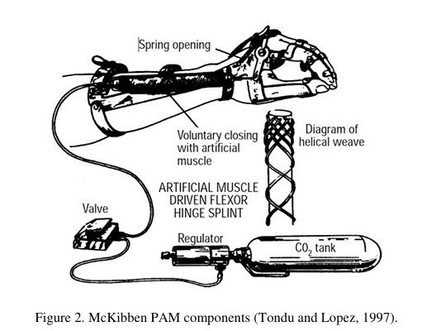
Derivation For Pressure and Force Relation:
By taking reference with the “Development A Nonconducting Manipulator, McKibben Pneumatic Artificial Muscle” this research paper I have to derive the formula whether it is mathematically correct or not?
In a first approach toward the model of a McKibben type PAM, losses are not considered and thus, the gas enters the PAM and expands, generating a traction force and a work. To generate the volume increase, the gas performs a work input (Win) that can be described.
dWin = ∫(P − Pex )dli.dSi
= (P − Pex) ∫dli.dSi
dWin = P’dV
Where, Pex = External Force,
P = Absolute Pressure
P’ = Relative Pressure

Slide 12
Derivation For Pressure and Force Relation:
As the pressure performs work by volume expansion and it is assumed that the system has no loss, all the work is converted into traction and can be expressed by Wout,
dWout = -FdL
Where, F is the axial tension and dL is the displacement.
The Conservation of Energy gives:
dWin = dWout
P’dV = -FdL
F = - (P’ dV)/dL ........................ (1)
With the strength defined in terms of the volume change, just missing define the volume variation permitted by the mesh. The variation stops when volume reaches its maximum. At this moment, the muscle reaches the largest contraction.

Slide 13
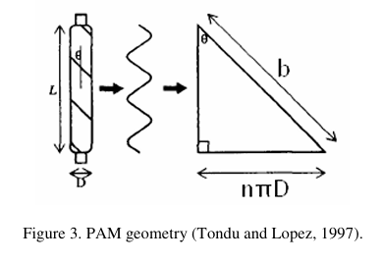
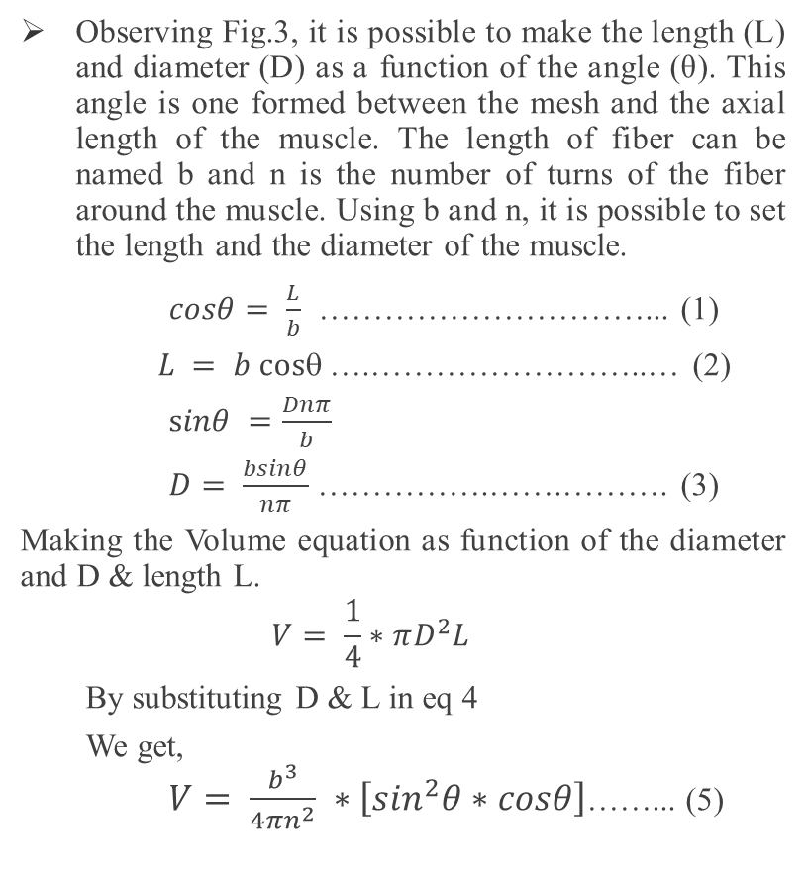
Derivation For Pressure and Force Relation:
Observing Fig.3, it is possible to make the length (L) and diameter (D) as a function of the angle (θ). This angle is one formed between the mesh and the axial length of the muscle. The length of fiber can be named b and n is the number of turns of the fiber around the muscle. Using b and n, it is possible to set the length and the diameter of the muscle.
$cosθ= \frac{L}{b}$ …………………………... (1)
$L = b cos$….……………………..… (2)
$sinθ =\frac{Dnπ}{b}$
$D= \frac{bsinθ}{nπ}$ …………….…….………. (3)
Making the Volume equation as function of the diameter and D & length L.
$$V= \frac{1}{4}∗πD^{2}L$$
By substituting D & L in eq 4
We get, $V= \frac{b^{3}}{4πn^{2}} ∗\left[\sin^{2}θ∗cosθ\right]$……... (5)

Slide 14
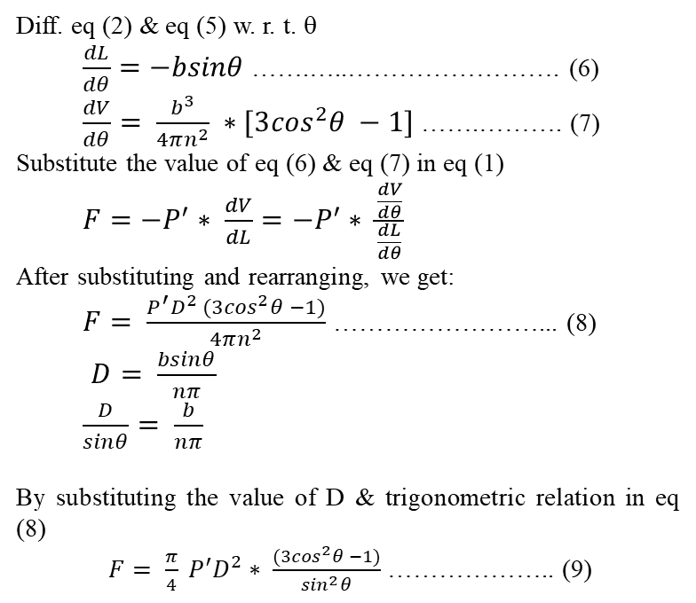
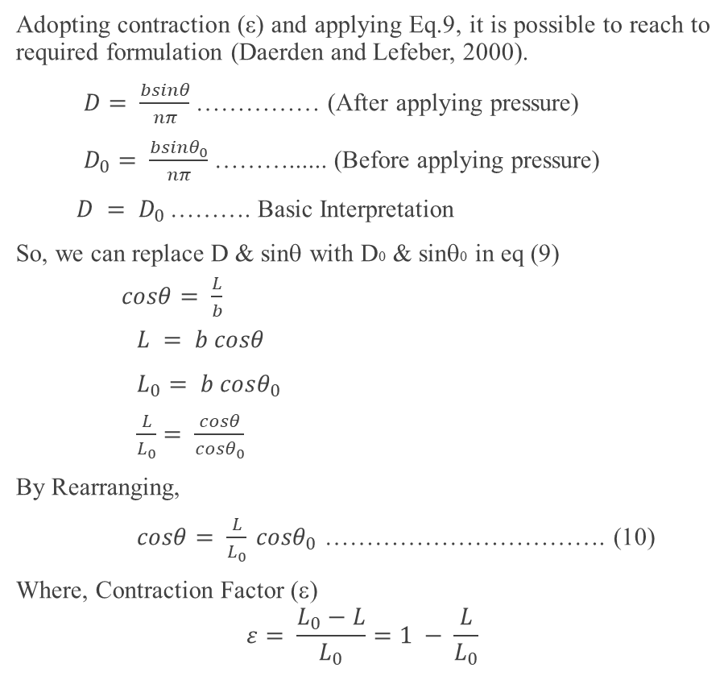
Derivation For Pressure and Force Relation:
Diff. eq (2) & eq (5) w. r. t. θ
$\frac{dL}{dθ}=−bsinθ$ …….…..……………………. (6)
$\frac{dV}{dθ}= \frac{b^{3}}{4πn^{2}} ∗[3\cos^{2}θ −1]$ …….………. (7)
Substitute the value of eq (6) & eq (7) in eq (1)
$F=−P^{′}∗ \frac{dV}{dL}=−P^{′}∗ \frac{\frac{dV}{dθ}}{\frac{dL}{dθ}}$
After substituting and rearranging, we get:
$F= \frac{P^{′}D^{2} (3\cos^{2}θ −1)}{4πn^{2}}$ ……………………... (8)
$D= \frac{bsinθ}{nπ}$
$\frac{D}{sinθ}= \frac{b}{nπ}$
By substituting the value of D & trigonometric relation in eq (8)
$F= \frac{π}{4} P^{′}D^{2}∗ \frac{(3\cos^{2}θ −1)}{\sin^{2}θ}$ ……………….. (9)
Adopting contraction (ε) and applying Eq.9, it is possible to reach to required formulation (Daerden and Lefeber, 2000).
$D= \frac{bsinθ}{nπ}$ …………… (After applying pressure)
$D_{0}= \frac{bsinθ_{0}}{nπ}$ ………...... (Before applying pressure)
$D = D_{0}$………. Basic Interpretation
So, we can replace D & sinθ with D0 & sinθ0 in eq (9)
$cosθ= \frac{L}{b}$
$L = b cosθ$
$L_{0}= b cosθ_{0}$
$\frac{L}{L_{0}}= \frac{cosθ}{cosθ_{0}}$
By Rearranging,
$cosθ= \frac{L}{L_{0}} {cosθ}_{0}$ ……………………………. (10)
Where, Contraction Factor (ε)
$$ε= \frac{L_{0}−L}{L_{0}}=1 − \frac{L}{L_{0}}$$

Slide 15
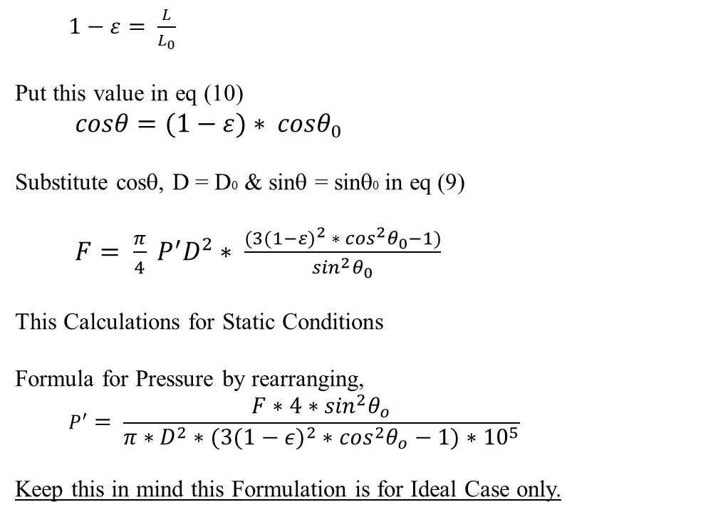
Derivation For Pressure and Force Relation:
$1−ε= \frac{L}{L_{0}}$
Put this value in eq (10)
$cosθ=(1−ε){ ∗ cosθ}_{0}$
Substitute cosθ, D = D0 & sinθ = sinθ0 in eq (9)
$F= \frac{π}{4} P^{′}D^{2}∗ \frac{(3{(1−ε)}^{2}{ ∗ \cos^{2}θ}_{0}−1)}{\sin^{2}θ_{0}}$
This Calculations for Static Conditions
Formula for Pressure by rearranging,
$$P^{′}= \frac{F∗4∗\sin^{2}θ_{o}}{π∗D^{2}∗\left(3{\left(1−ε\right)}^{2}∗\cos^{2}θ_{o}−1\right)∗{10}^{5}}$$
Keep this in mind this Formulation is for Ideal Case only.

Slide 16
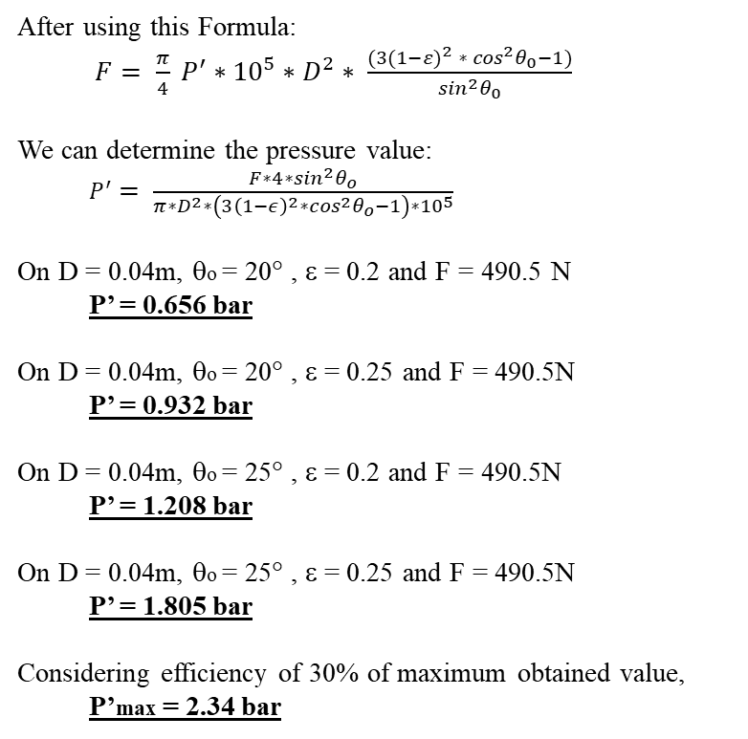
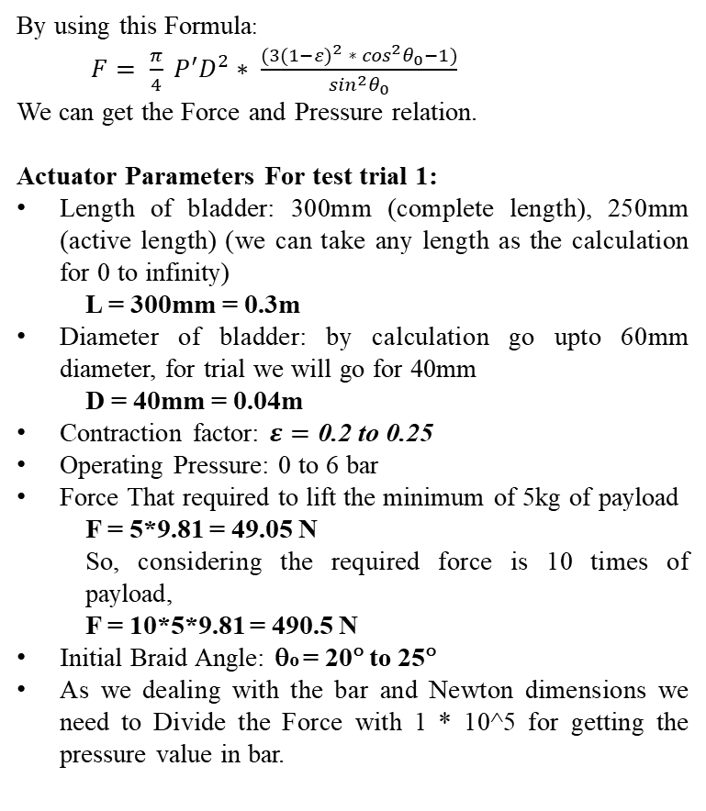
Calculation and Dimensions for HSA:
By using this Formula:
$F= \frac{π}{4} P^{′}D^{2}∗ \frac{(3{(1−ε)}^{2}{ ∗ \cos^{2}θ}_{0}−1)}{\sin^{2}θ_{0}}$
We can get the Force and Pressure relation.
Actuator Parameters For test trial 1:
Length of bladder: 300mm (complete length), 250mm (active length) (we can take any length as the calculation for 0 to infinity)
L = 300mm = 0.3m
Diameter of bladder: by calculation go upto 60mm diameter, for trial we will go for 40mm
D = 40mm = 0.04m
Contraction factor: $ε=\text{0.2 to 0.25}$
Operating Pressure: 0 to 6 bar
Force That required to lift the minimum of 5kg of payload
F = 5*9.81 = 49.05 N
So, considering the required force is 10 times of payload,
F = 10*5*9.81 = 490.5 N
Initial Braid Angle: θo = 20° to 25°
As we dealing with the bar and Newton dimensions we need to Divide the Force with 1 * 10^5 for getting the pressure value in bar.
After using this Formula:
$F= \frac{π}{4} P^{′}∗{10}^{5}∗D^{2}∗ \frac{(3{(1−ε)}^{2}{ ∗ \cos^{2}θ}_{0}−1)}{\sin^{2}θ_{0}}$
We can determine the pressure value:
$P^{′}= \frac{F∗4∗\sin^{2}θ_{o}}{π∗D^{2}∗\left(3{\left(1−ε\right)}^{2}∗\cos^{2}θ_{o}−1\right)∗{10}^{5}}$
On D = 0.04m, θo = 20° , ε = 0.2 and F = 490.5 N
P’ = 0.656 bar
On D = 0.04m, θo = 20° , ε = 0.25 and F = 490.5N
P’ = 0.932 bar
On D = 0.04m, θo = 25° , ε = 0.2 and F = 490.5N
P’ = 1.208 bar
On D = 0.04m, θo = 25° , ε = 0.25 and F = 490.5N
P’ = 1.805 bar
Considering efficiency of 30% of maximum obtained value,
P’max = 2.34 bar

Slide 17
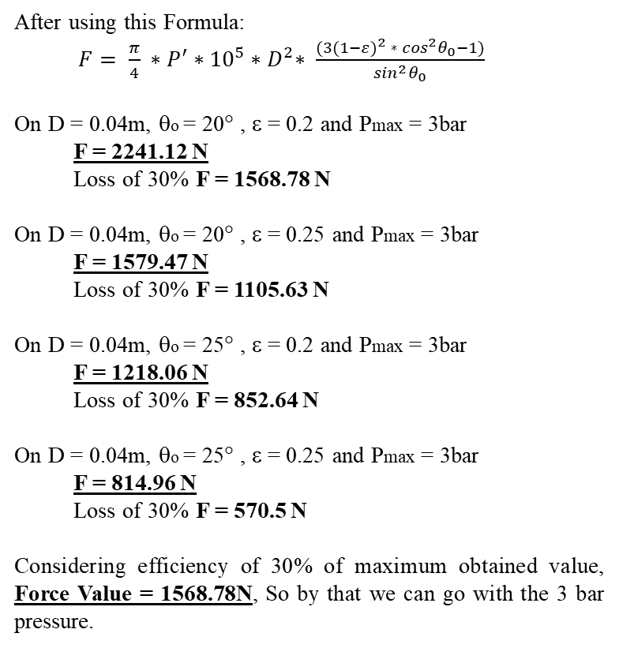
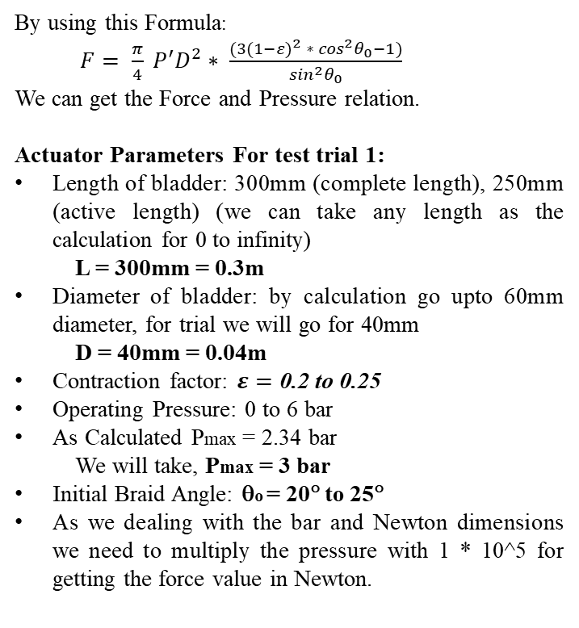
Calculation and Dimensions for HSA:
By using this Formula:
$F= \frac{π}{4} P^{′}D^{2}∗ \frac{(3{(1−ε)}^{2}{ ∗ \cos^{2}θ}_{0}−1)}{\sin^{2}θ_{0}}$
We can get the Force and Pressure relation.
Actuator Parameters For test trial 1:
Length of bladder: 300mm (complete length), 250mm (active length) (we can take any length as the calculation for 0 to infinity)
L = 300mm = 0.3m
Diameter of bladder: by calculation go upto 60mm diameter, for trial we will go for 40mm
D = 40mm = 0.04m
Contraction factor: $ε=\text{0.2 to 0.25}$
Operating Pressure: 0 to 6 bar
As Calculated Pmax = 2.34 bar
We will take, Pmax = 3 bar
Initial Braid Angle: θo = 20° to 25°
As we dealing with the bar and Newton dimensions we need to multiply the pressure with 1 * 10^5 for getting the force value in Newton.
After using this Formula:
$F= \frac{π}{4} ∗P^{′}{∗{10}^{5}∗D}^{2}∗ \frac{(3{(1−ε)}^{2}{ ∗ \cos^{2}θ}_{0}−1)}{\sin^{2}θ_{0}}$
On D = 0.04m, θo = 20° , ε = 0.2 and Pmax = 3bar
F = 2241.12 N
Loss of 30% F = 1568.78 N
On D = 0.04m, θo = 20° , ε = 0.25 and Pmax = 3bar
F = 1579.47 N
Loss of 30% F = 1105.63 N
On D = 0.04m, θo = 25° , ε = 0.2 and Pmax = 3bar
F = 1218.06 N
Loss of 30% F = 852.64 N
On D = 0.04m, θo = 25° , ε = 0.25 and Pmax = 3bar
F = 814.96 N
Loss of 30% F = 570.5 N
Considering efficiency of 30% of maximum obtained value, Force Value = 1568.78N, So by that we can go with the 3 bar pressure.

Slide 18
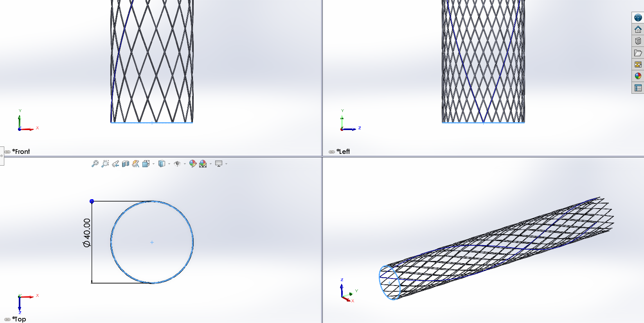
CAD Model of HSA:
SolidWorks: McKibben Muscle Sheath

Slide 19
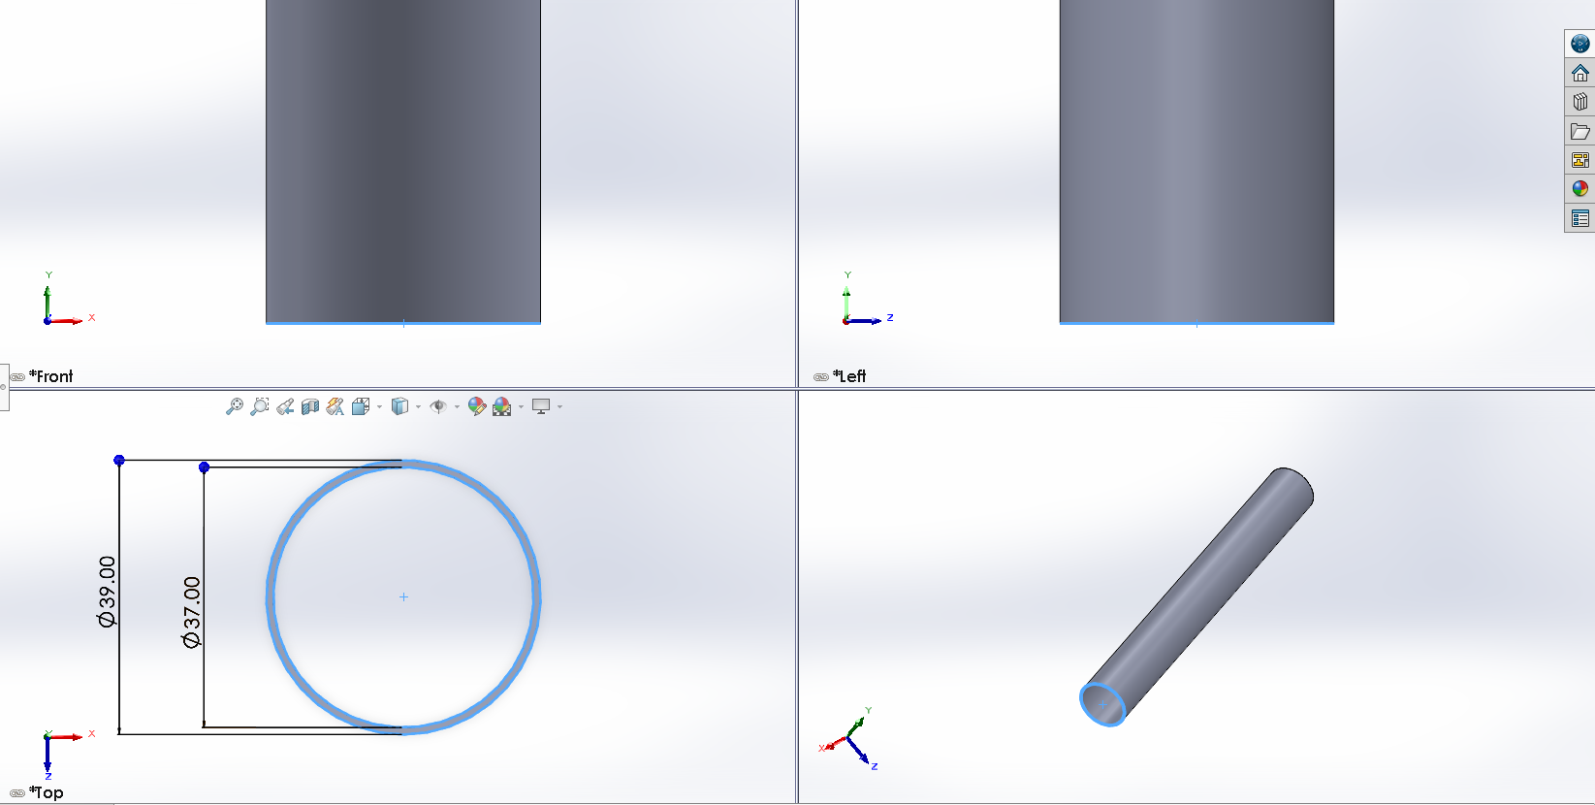
CAD Model of HSA:
SolidWorks: McKibben Muscle Sheath

Slide 20
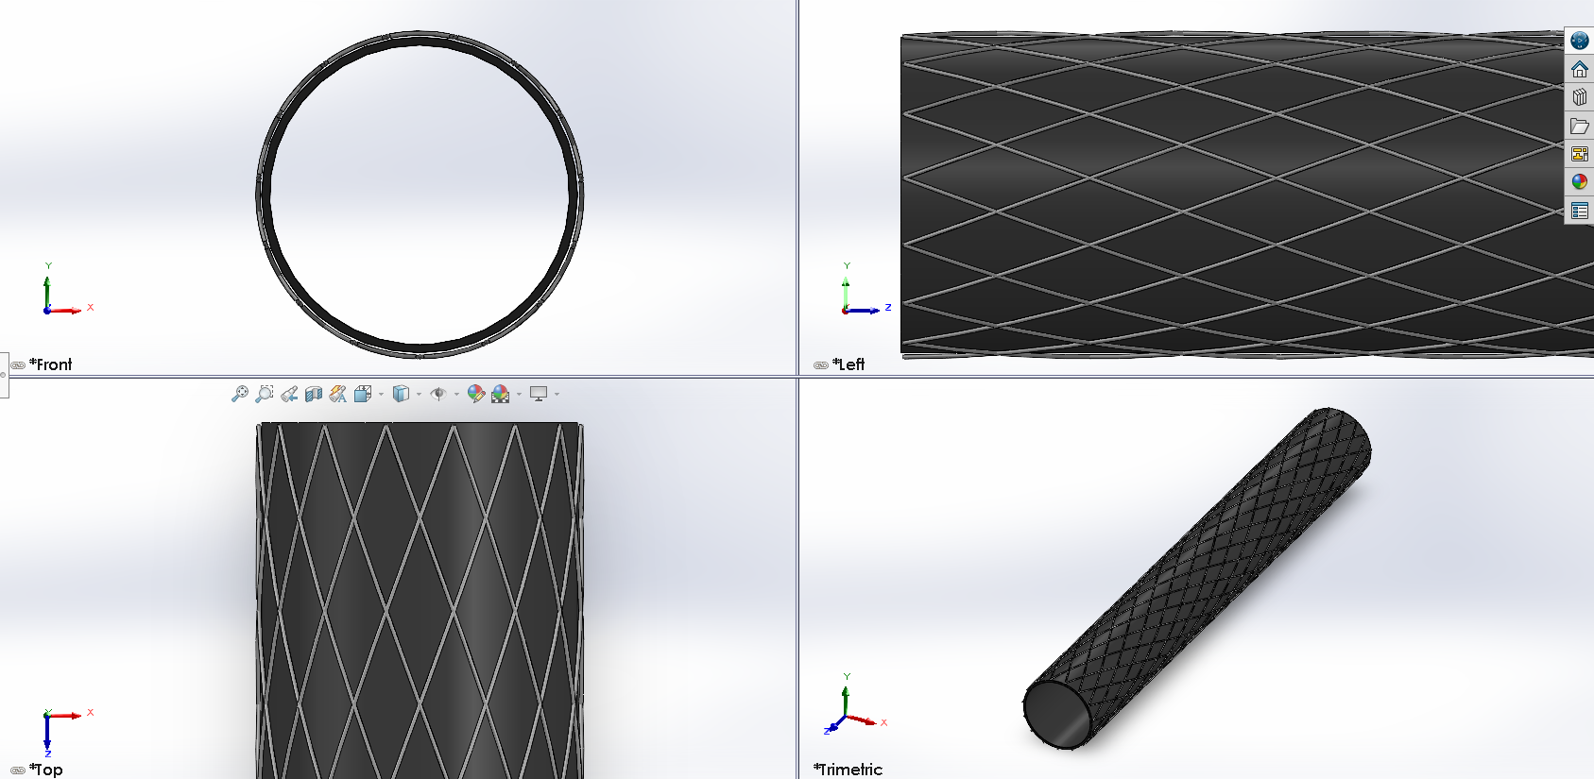
CAD Model of HSA:
SolidWorks: McKibben Muscle Sheath

Slide 21
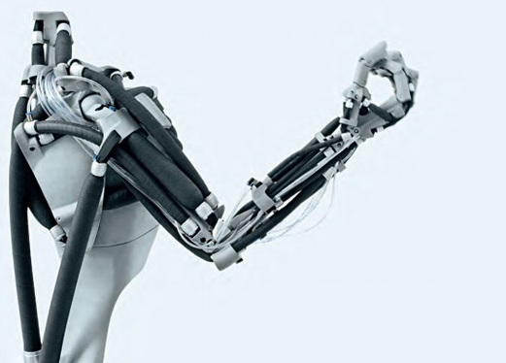
CAD Model of HSA:
This Kind of assembly we have to make:
Like mostly of Biceps and triceps, using hydraulic (Water/Oil) as a working fluid for actuate the muscle.
Hence forth the mechanism and hydraulic power pack we have to design requiring for this actuator.
And enabling it’s SDOF lifting.
Reference Image: Research on Key Technologies of Pneumatic Flexible Joints for Robot

Slide 22
Further Updates are to be done:
Thank You

