Slide 1
DESIGN AND DEVELOPMENT OF HYDRAULIC SOFT ACTUATOR FOR SDOF
Suraj Santram Varma (Student Intern)
- Under guidance of Mr. Shivdas Prasad (Sc. E)
R&DE (Engrs), DRDO, Pune

Slide 2
History:
Research & Development Establishment (Engineers), R&DE(Engrs), became operational on 9 February 1962 with the objective of developing advanced engineering solutions for the Indian Armed Forces. Over the years, the laboratory has contributed to several major engineering programs, including mobile and modular bridging systems, composite structures, sonar domes, unmanned aerial vehicles, NBC protection systems, and ground-based launch systems. It has also contributed to the Indian Antarctic Programme, including the establishment and maintenance of Maitri Research Station.
R&DE(Engrs) has developed expertise in composite materials, MEMS, robotics, advanced manufacturing, and radar-absorbent materials. The laboratory has contributed to major missile and launch infrastructure programs and continues to work on advanced engineering technologies. In June 2025, R&DE(E) signed a technology transfer agreement with NIBE Limited for the indigenous production of Modular Bridging Systems ranging from 14 m to 46 m.

Slide 3
Technology centers:
R&DE(E) is changing from being a systems engineering organization to a technology-focused research center starting in 2025. The laboratory has divided its research into six distinct verticals.
Center for Systems & Technologies for Advanced Robotics (C-STAR) - focuses on the development of humanoids and robotic mules. Studies on swarm intelligence, AI & ML applications, biomimetic robots, and cognition-based robotics.
Composite Research Center (CRC) - specializes in using composite materials for airframes, aircraft radomes, sonar domes, armored hulls, and bridges. Stealth technology, fatigue analysis in composites, and structural health monitoring are important areas of focus.
Centre for Electromagnetic System Research (CEMSR) - electromagnetic launch systems are the focus. Developing military aircraft launchers and arresting systems.
Advanced Technology Research Center (ATRC) - centered on subsurface blast mitigation, smart structures, and land-mine detection.
Center for Renewable Energy & Storage Technology (CREST) - constructing small energy storage devices, energy harvesting, and wireless power transmission.
Center for Strategic and Tactical Systems (CSTS) - oversees the creation of ground support systems and launchers for strategic and tactical missile programs.

Slide 4
Humanoid Robots:
In May 2025, R&DE(E) achieved an important milestone in development of humanoid robots for defense applications. Prototypes for the robot's upper and lower bodies have been created by the Center for Systems & Technologies for Advanced Robotics, and during internal testing, some applications were successfully achieved. By participating in high-risk military missions under human supervision, the robot seeks to lessen the likelihood that soldiers may encounter potentially fatal situations. With closed-loop gripping, the humanoid's upper body system would be capable of carrying out intricate autonomous tasks. Additionally, it will be able to push obstacles, open valves, turn, push, pull, or slide doors, as well as operate in high-risk areas.
In this the work which I had given is Hydraulic Soft Actuator.

Slide 5
Introduction:
Soft robotics has become an important area of robotics because compliant structures can deform continuously, adapt to irregular surfaces, and distribute contact forces during interaction. These properties are especially useful for handling delicate objects, operating in uncertain environments, and interacting safely with the human body, where compliance is a basic design requirement rather than an added feature.
In these systems, the actuator is central to performance because it not only produces motion but also influences the load path, deformation mode, stiffness distribution, and contact behavior of the robot.
First, we discuss about Pneumatic Soft Actuator (PAM), like PAM is a soft actuator which has great potential in the field of bio-inspired robotics.
But PAM have lots of limitations such less loading capacity, losses, leakages, etc.
So, for that we are going to discussed about Designing and Modeling of Hydraulic Soft Actuator.
And we have to design for 5kg of lift.

Slide 6
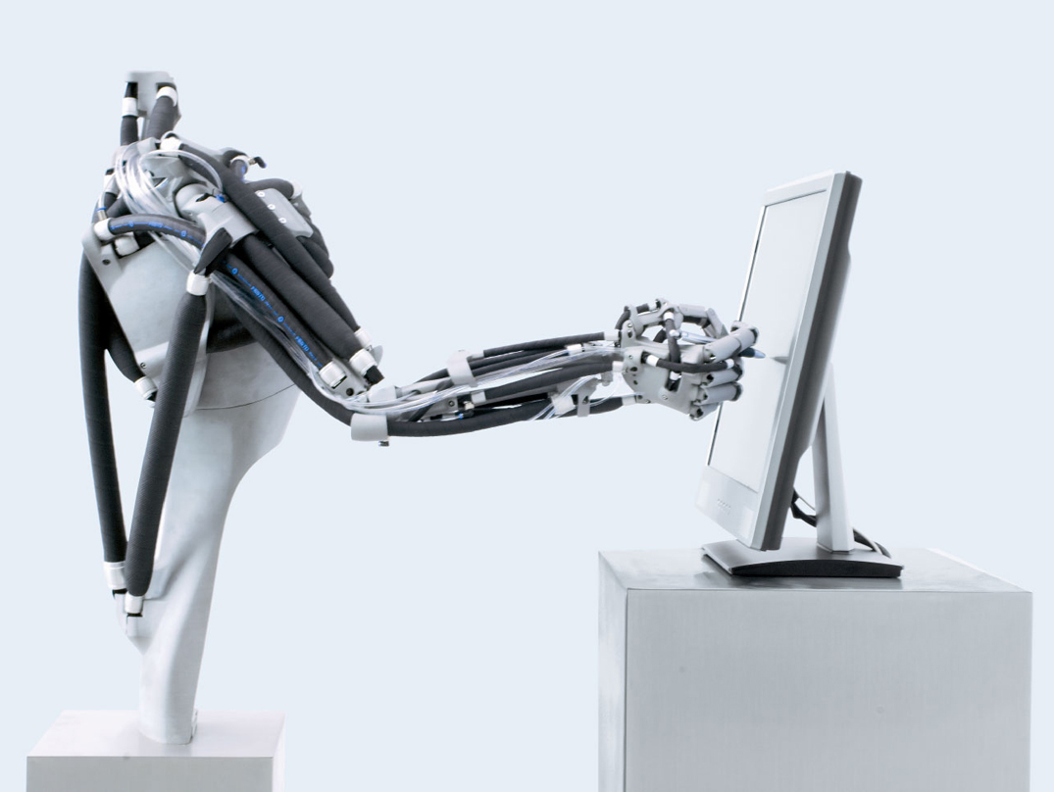
Problem Statement:
To design and develop a single-degree-of-freedom robotic elbow joint using a hydraulic McKibben muscle actuator in an antagonistic biceps-triceps configuration, capable of lifting a minimum 5 kg load while providing the required joint torque, motion, and structural safety.
Objective:
To study the working principle and characteristics of hydraulic McKibben muscle actuators for robotic applications.
To design a single-DOF robotic elbow joint using a biceps-triceps type McKibben actuator arrangement for a minimum 5 kg load.
To analyze the required joint torque, actuator force, pressure, and braided sheath parameters.

Slide 7
Literature Survey:
Year | Author(s) | Research Paper / Topic | Publication | Key Finding | Limitation | Relevance
2022 | M. G. Antonelli et al. | Design and Characterization of a McKibben Pneumatic Muscle Prototype with an Embedded Capacitive Length Transducer | Machines, MDPI | Developed an embedded capacitive sensor capable of measuring muscle-length changes below 1 mm. | Requires a specialized embedded sensing arrangement. | Useful for future actuator displacement measurement and feedback.
2018/2019 | T. Hassan et al. | Finite Element Modeling and Design of a Pneumatic Braided Muscle Actuator with Multifunctional Capabilities | IEEE/ASME Transactions on Mechatronics | Developed a bidirectional braided actuator with more than 40% stroke and demonstrated it in a 1-DOF variable-stiffness joint. | More complex sheath configuration and pneumatic operation. | Highly relevant to our 1-DOF robotic elbow and antagonistic actuator concept.

Slide 8
Literature Survey:
Year | Author(s) | Research Paper / Topic | Publication | Key Finding | Limitation | Relevance
2018 | M. G. Antonelli et al. | An Analytical Formula for Designing McKibben Pneumatic Muscles | International Journal of Mechanical Engineering and Technology | Developed an analytical force formula based on pressure, geometry, and contraction using FEM results. | Valid only within the investigated parameter ranges. | Useful for preliminary sizing of our actuator.
2017 | M. G. Antonelli et al. | Numerical Modelling and Experimental Validation of a McKibben Pneumatic Muscle Actuator | Journal of Intelligent Material Systems and Structures | Developed nonlinear FEM considering hyperelastic tube behaviour and validated it experimentally. | Thread friction and initial tube-braid gap were not modelled. | Provides a basis for nonlinear FEM and experimental validation.

Slide 9
Literature Survey:
Year | Author(s) | Research Paper / Topic | Publication | Key Finding | Limitation | Relevance
2017 | A. K. P. Ashwin, A. Ghosal | Mathematical Model for Pressure-Deformation Relationship of Miniaturized McKibben Actuators | iNaCoMM 2017 | Developed a pressure-deformation model with less than 10% standard error and predicted the locking angle near 54.7°. | Focused on miniaturized actuators and specific modelling assumptions. | Useful for understanding pressure, deformation, and braid-angle relationships.
2014 | T. Nozaki, T. Noritsugu | Motion Analysis of McKibben Type Pneumatic Rubber Artificial Muscle with Finite Element Method | International Journal of Automation Technology | Developed a 3D FEM model and investigated the influence of braid angle on actuator motion. | Friction between tube, fibers, and fiber strands was not directly modelled. | Useful for braid-angle analysis and FEA methodology.

Slide 10
Literature Survey:
Year | Author(s) | Research Paper / Topic | Publication | Key Finding | Limitation | Relevance
2013 | I. da Paz Lopes, W. Scaff, O. Horikawa | Development A Nonconducting Manipulator, McKibben Pneumatic Artificial Muscle | COBEM 2013 | Developed and experimentally tested a nonconducting McKibben actuator for a robotic manipulator. | Relatively low force and force reduction was observed, possibly due to leakage. | Useful for actuator fabrication and robotic integration.
2012 | K. Iwata, K. Suzumori, S. Wakimoto | A Method of Designing and Fabricating McKibben Muscles Driven by 7 MPa Hydraulics | International Journal of Automation Technology | Developed a hydraulic McKibben muscle and achieved about 8 kN contraction force at 7 MPa. FEM was used to optimize the sleeve angle. | Focused on high-pressure hydraulic operation. | The most directly relevant paper to our hydraulic McKibben actuator and sheath design.

Slide 11
Literature Survey:
Year | Author(s) | Research Paper / Topic | Publication | Key Finding | Limitation | Relevance
2005 | R. Ramasamy et al. | An Application of Finite Element Modelling to Pneumatic Artificial Muscle | American Journal of Applied Sciences | Established FEM-based analysis for studying PAM deformation and force behaviour. | General PAM modelling with limited detailed McKibben-specific nonlinear analysis. | Provides the basic FEM foundation for our actuator analysis.

Slide 12
Literature Survey:
Previous studies on McKibben artificial muscles have mainly focused on understanding their working principle, mathematical modeling, and the influence of braid geometry on actuator performance. Analytical and experimental studies have established relationships between internal pressure, braid angle, contraction, actuator dimensions, and generated force. The literature also shows that the braided sheath plays a major role in converting radial expansion of the bladder into axial contraction. Finite Element Analysis has therefore been widely used to study deformation, stress distribution, and the effect of braid angle before fabrication.
Further studies have focused on improving the design and functionality of McKibben actuators. FEM-based investigations have been used for design optimization, while analytical models have been developed for predicting force and pressure-contraction behavior. Researchers have also investigated multifunctional braided muscles capable of bidirectional motion and variable stiffness. These studies demonstrate that actuator geometry, braid configuration, and material properties strongly influence the final performance of the muscle.

Slide 13
Literature Survey:
For high-force applications, hydraulic actuation has also been investigated as an alternative to conventional pneumatic McKibben muscles. The hydraulic McKibben study by Iwata et al. demonstrated operation at pressures up to 7 MPa and investigated the design and fabrication of the braided muscle using FEM-based sleeve optimization. The reviewed hydraulic soft-actuator literature further identifies high force capability as an important advantage, while also highlighting challenges such as nonlinear deformation, hysteresis, leakage, and the need for systematic design methods.
Research Gap: Based on the reviewed literature, the present work focuses on applying a hydraulic McKibben muscle in a single-DOF robotic elbow joint using a biceps-triceps type arrangement, designed to lift a minimum 5 kg load. There is practical validation can also be done.

Slide 14
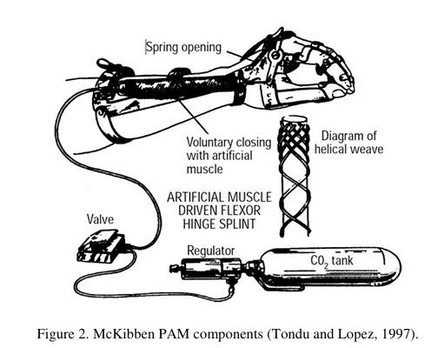
Derivation For Pressure and Force Relation:
In a first approach toward the model of a McKibben type PAM, losses are not considered and thus, the gas enters the PAM and expands, generating a traction force and a work. To generate the volume increase, the gas performs a work input (Win) that can be described.
dWin = ∫(P − Pex )dli.dSi
= (P − Pex) ∫dli.dSi
dWin = P’dV
Where, Pex = External Force,
P = Absolute Pressure
P’ = Relative Pressure

Slide 15
Derivation For Pressure and Force Relation:
As the pressure performs work by volume expansion and it is assumed that the system has no loss, all the work is converted into traction and can be expressed by Wout,
dWout = -FdL
Where, F is the axial tension and dL is the displacement.
The Conservation of Energy gives:
dWin = dWout
P’dV = -FdL
F = - (P’ dV)/dL ........................ (1)
With the strength defined in terms of the volume change, just missing define the volume variation permitted by the mesh. The variation stops when volume reaches its maximum. At this moment, the muscle reaches the largest contraction.

Slide 16
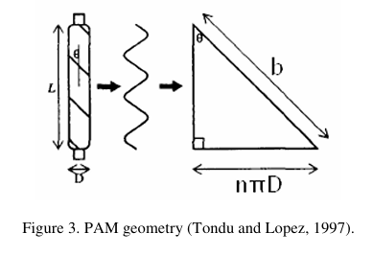
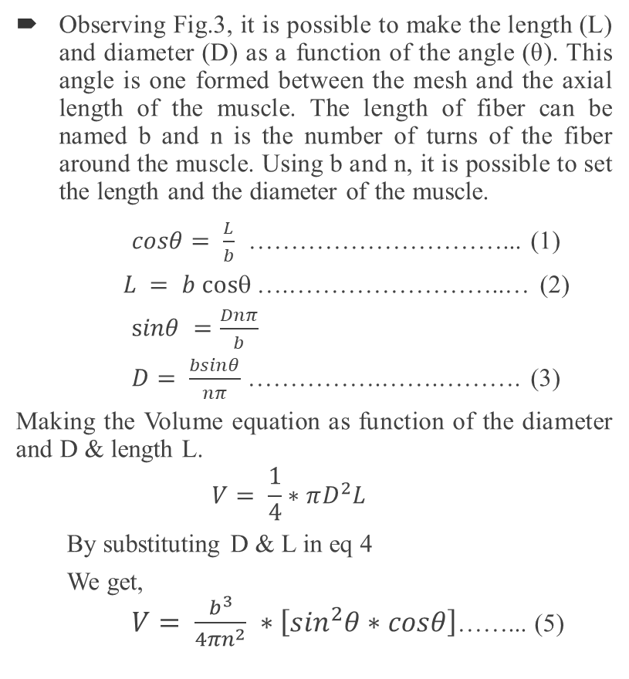
Derivation For Pressure and Force Relation:
Observing Fig.3, it is possible to make the length (L) and diameter (D) as a function of the angle (θ). This angle is one formed between the mesh and the axial length of the muscle. The length of fiber can be named b and n is the number of turns of the fiber around the muscle. Using b and n, it is possible to set the length and the diameter of the muscle.
$cosθ= \frac{L}{b}$ …………………………... (1)
$L = b cos$….……………………..… (2)
$sinθ =\frac{Dnπ}{b}$
$D= \frac{bsinθ}{nπ}$ …………….…….………. (3)
Making the Volume equation as function of the diameter and D & length L.
$$V= \frac{1}{4}∗πD^{2}L$$
By substituting D & L in eq 4
We get, $V= \frac{b^{3}}{4πn^{2}} ∗\left[\sin^{2}θ∗cosθ\right]$……... (5)

Slide 17
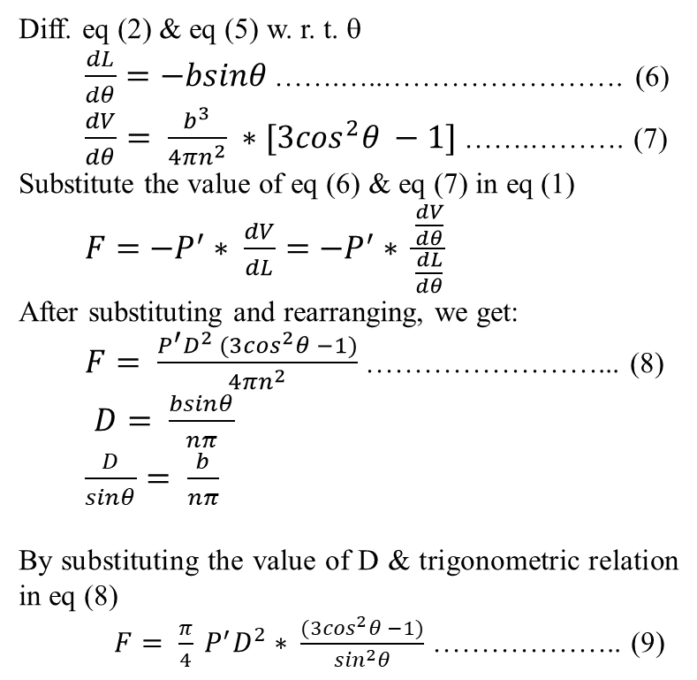
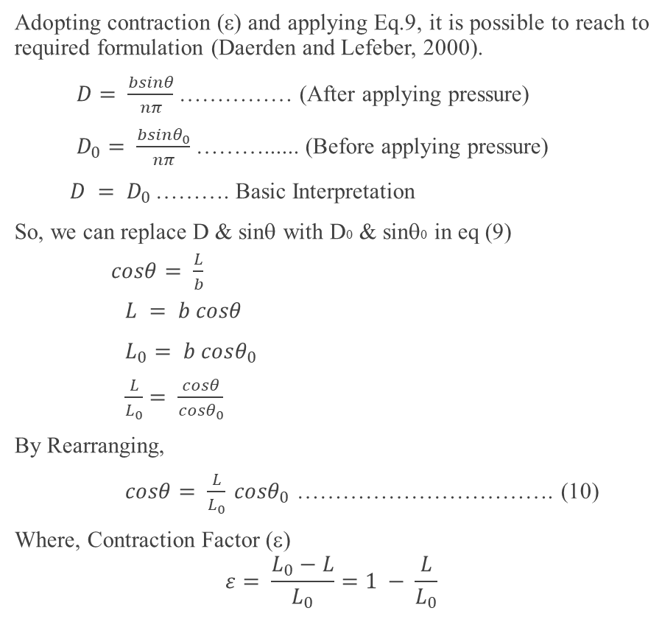
Derivation For Pressure and Force Relation:
Diff. eq (2) & eq (5) w. r. t. θ
$\frac{dL}{dθ}=−bsinθ$ …….…..……………………. (6)
$\frac{dV}{dθ}= \frac{b^{3}}{4πn^{2}} ∗[3\cos^{2}θ −1]$ …….………. (7)
Substitute the value of eq (6) & eq (7) in eq (1)
$F=−P^{′}∗ \frac{dV}{dL}=−P^{′}∗ \frac{\frac{dV}{dθ}}{\frac{dL}{dθ}}$
After substituting and rearranging, we get:
$F= \frac{P^{′}D^{2} (3\cos^{2}θ −1)}{4πn^{2}}$ ……………………... (8)
$D= \frac{bsinθ}{nπ}$
$\frac{D}{sinθ}= \frac{b}{nπ}$
By substituting the value of D & trigonometric relation in eq (8)
$F= \frac{π}{4} P^{′}D^{2}∗ \frac{(3\cos^{2}θ −1)}{\sin^{2}θ}$ ……………….. (9)
Adopting contraction (ε) and applying Eq.9, it is possible to reach to required formulation (Daerden and Lefeber, 2000).
$D= \frac{bsinθ}{nπ}$ …………… (After applying pressure)
$D_{0}= \frac{bsinθ_{0}}{nπ}$ ………...... (Before applying pressure)
$D = D_{0}$………. Basic Interpretation
So, we can replace D & sinθ with D0 & sinθ0 in eq (9)
$cosθ= \frac{L}{b}$
$L = b cosθ$
$L_{0}= b cosθ_{0}$
$\frac{L}{L_{0}}= \frac{cosθ}{cosθ_{0}}$
By Rearranging,
$cosθ= \frac{L}{L_{0}} {cosθ}_{0}$ ……………………………. (10)
Where, Contraction Factor (ε)
$$ε= \frac{L_{0}−L}{L_{0}}=1 − \frac{L}{L_{0}}$$

Slide 18
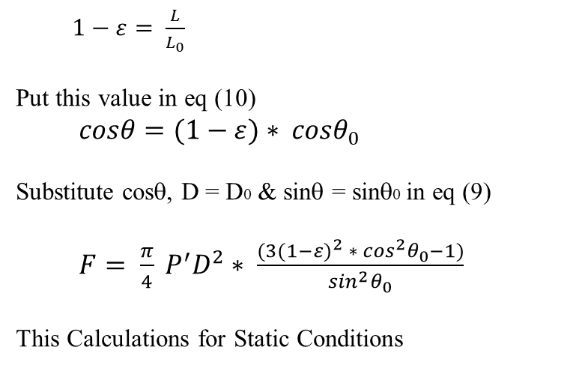
Derivation For Pressure and Force Relation:
$1−ε= \frac{L}{L_{0}}$
Put this value in eq (10)
$cosθ=(1−ε){ ∗ cosθ}_{0}$
Substitute cosθ, D = D0 & sinθ = sinθ0 in eq (9)
$F= \frac{π}{4} P^{′}D^{2}∗ \frac{(3{(1−ε)}^{2}{ ∗ \cos^{2}θ}_{0}−1)}{\sin^{2}θ_{0}}$
This Calculations for Static Conditions

Slide 19
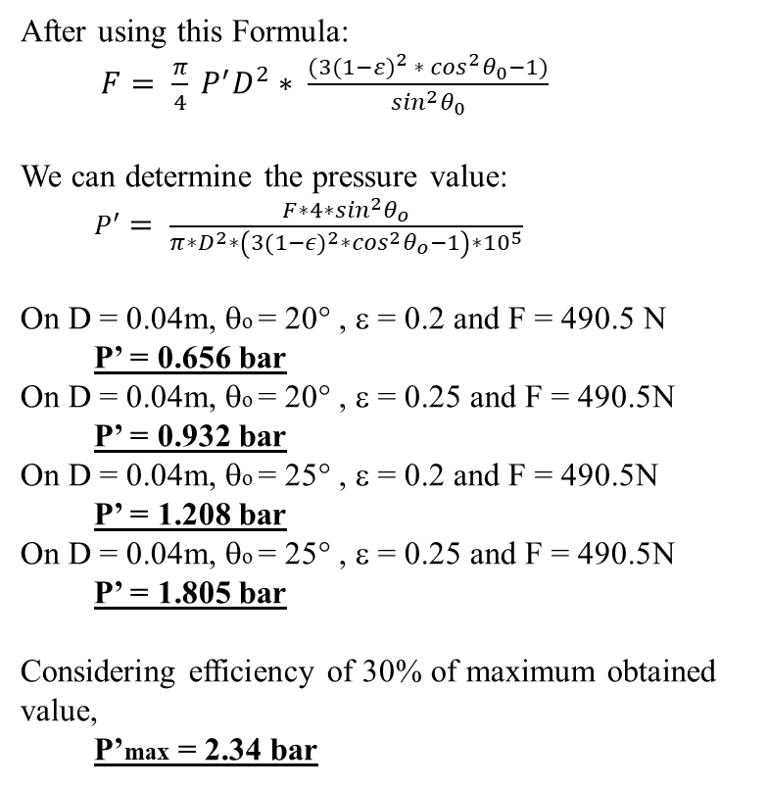
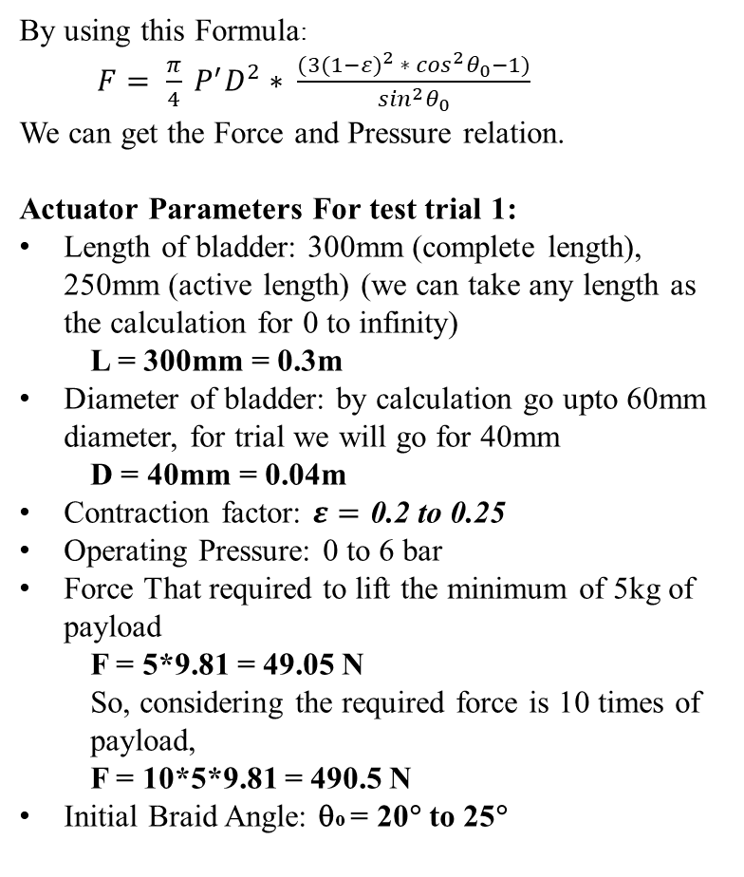
Calculation and Dimensions for McKibben Muscle:
By using this Formula:
$F= \frac{π}{4} P^{′}D^{2}∗ \frac{(3{(1−ε)}^{2}{ ∗ \cos^{2}θ}_{0}−1)}{\sin^{2}θ_{0}}$
We can get the Force and Pressure relation.
Actuator Parameters For test trial 1:
Length of bladder: 300mm (complete length), 250mm (active length) (we can take any length as the calculation for 0 to infinity)
L = 300mm = 0.3m
Diameter of bladder: by calculation go upto 60mm diameter, for trial we will go for 40mm
D = 40mm = 0.04m
Contraction factor: $ε=\text{0.2 to 0.25}$
Operating Pressure: 0 to 6 bar
Force That required to lift the minimum of 5kg of payload
F = 5*9.81 = 49.05 N
So, considering the required force is 10 times of payload,
F = 10*5*9.81 = 490.5 N
Initial Braid Angle: θo = 20° to 25°
After using this Formula:
$F= \frac{π}{4} P^{′}D^{2}∗ \frac{(3{(1−ε)}^{2}{ ∗ \cos^{2}θ}_{0}−1)}{\sin^{2}θ_{0}}$
We can determine the pressure value:
$P^{′}= \frac{F∗4∗\sin^{2}θ_{o}}{π∗D^{2}∗\left(3{\left(1−ε\right)}^{2}∗\cos^{2}θ_{o}−1\right)∗{10}^{5}}$
On D = 0.04m, θo = 20° , ε = 0.2 and F = 490.5 N
P’ = 0.656 bar
On D = 0.04m, θo = 20° , ε = 0.25 and F = 490.5N
P’ = 0.932 bar
On D = 0.04m, θo = 25° , ε = 0.2 and F = 490.5N
P’ = 1.208 bar
On D = 0.04m, θo = 25° , ε = 0.25 and F = 490.5N
P’ = 1.805 bar
Considering efficiency of 30% of maximum obtained value,
P’max = 2.34 bar

Slide 20
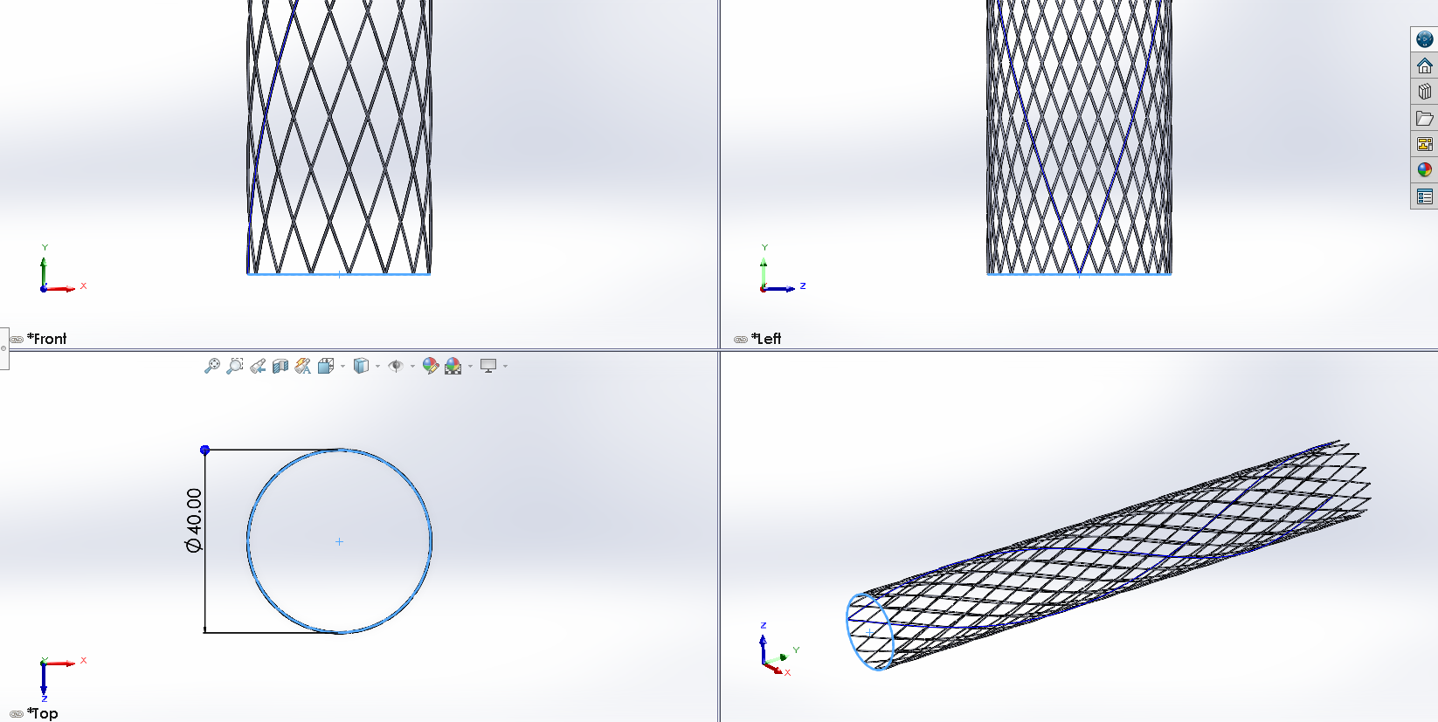
CAD Model of McKibben Muscle:
McKibben Muscle Sheath

Slide 21
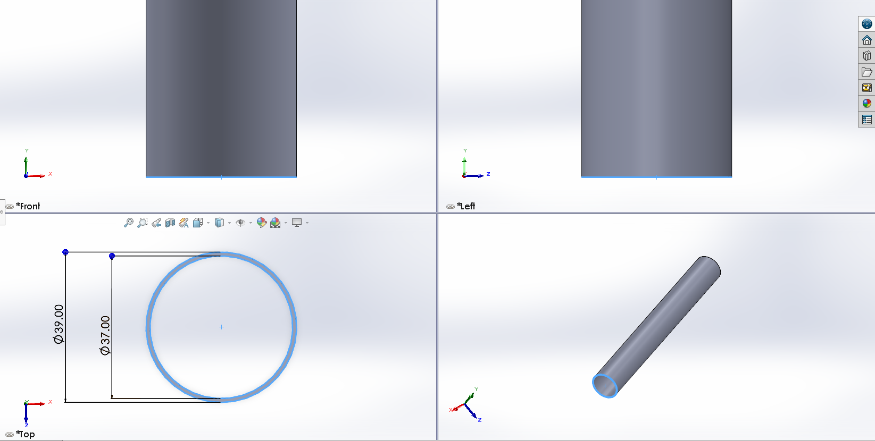
CAD Model of McKibben Muscle:
McKibben Muscle Bladder

Slide 22
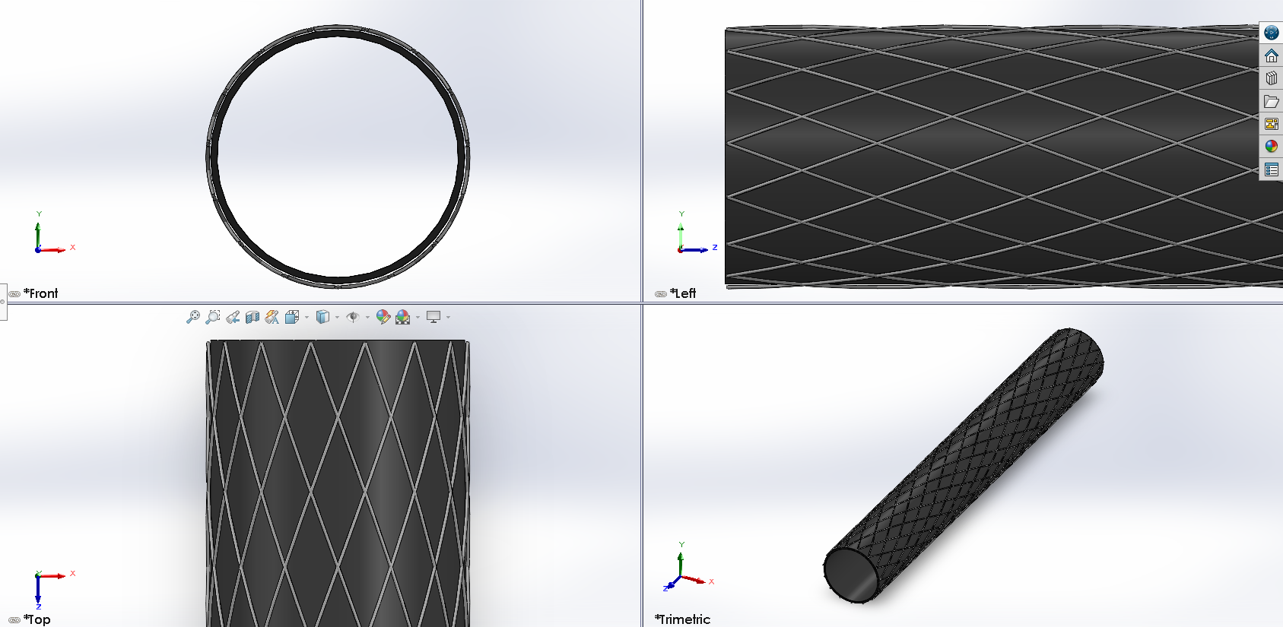
CAD Model of McKibben Muscle:
McKibben Muscle Assembly

Slide 23
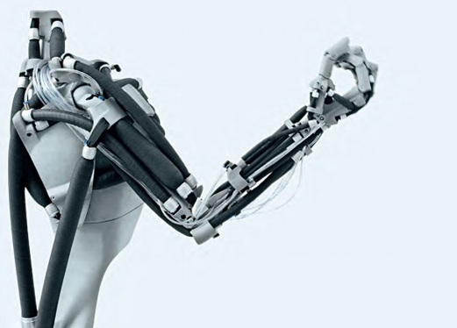
CAD Model of McKibben Muscle:
This Kind of assembly we have to make:
Like mostly of Biceps and triceps, using hydraulic (Water/Oil) as a working fluid for actuate the muscle.
Hence forth the mechanism and hydraulic power pack we have to design requiring for this actuator.
And enabling it’s SDOF lifting.

Slide 24
Further Updates are to be done:
Thank You

