Slide 1
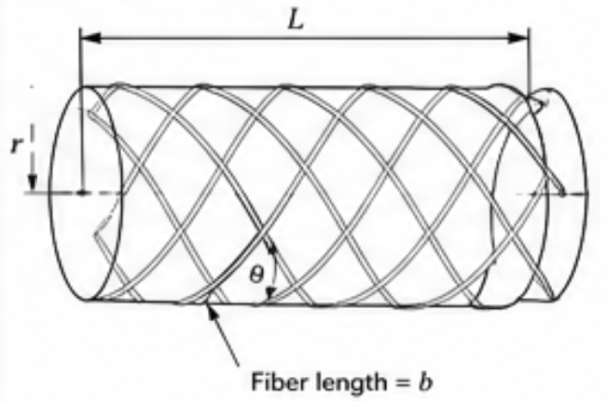
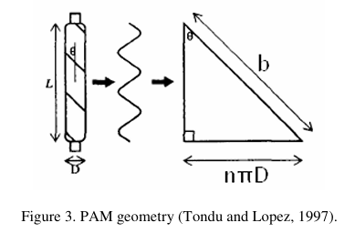
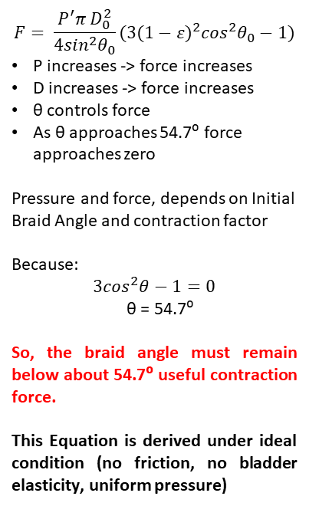
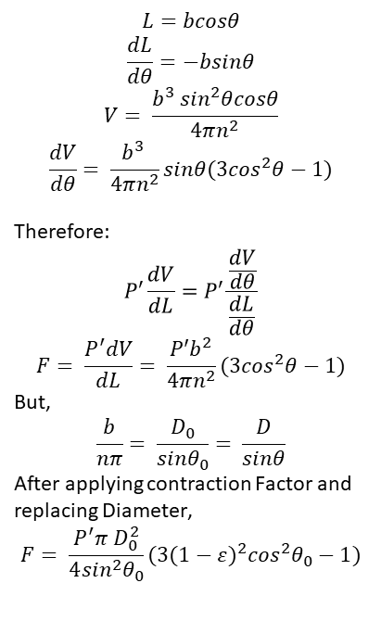
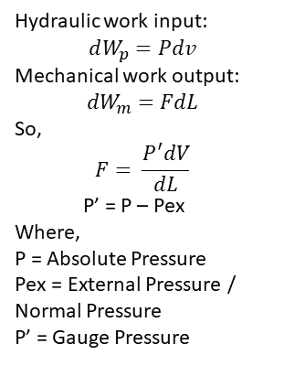
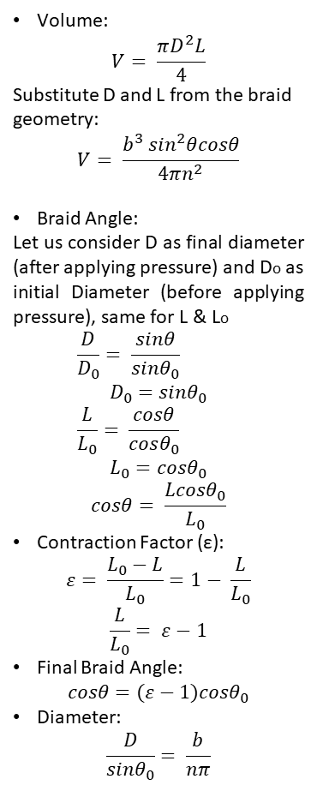
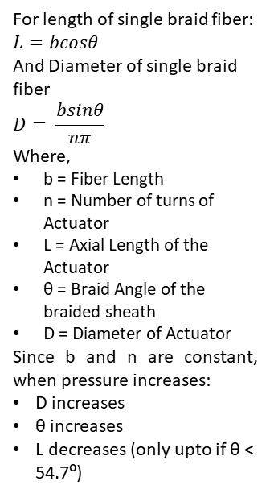
Derivation of Force and Pressure Relationship
1. Basic Geometry of Braided Actuator
2. Volume of Actuator Contraction Factor & Braiding Angle
3. Work Balance
4. Differentiating
5. Significance
Volume:
$$V= \frac{πD^{2}L}{4}$$
Substitute D and L from the braid geometry:
$$V= \frac{b^{3} \sin^{2}θcosθ}{4πn^{2}}$$
Braid Angle:
Let us consider D as final diameter (after applying pressure) and Do as initial Diameter (before applying pressure), same for L & Lo
  $$\frac{D}{D_{0}}= \frac{sinθ}{sinθ_{0}}$$
$$D_{0}=sinθ_{0}$$
  $$\frac{L}{L_{0}}= \frac{cosθ}{cosθ_{0}}$$
$$L_{0}=cosθ_{0}$$
$$cosθ= \frac{L{cosθ}_{0}}{L_{0}}$$
Contraction Factor (ε):
$$ε= \frac{L_{0}−L}{L_{0}}=1− \frac{L}{L_{0}}$$
$$\frac{L}{L_{0}}= ε−1$$
Final Braid Angle:
$$cosθ=(ε−1){cosθ}_{0}$$
Diameter:
$$\frac{D}{sinθ_{0}}= \frac{b}{nπ}$$
$$L=bcosθ$$
$$\frac{dL}{dθ}=−bsinθ$$
$$V= \frac{b^{3} \sin^{2}θcosθ}{4πn^{2}}$$
$$\frac{dV}{dθ}= \frac{b^{3} }{4πn^{2}}sinθ(3\cos^{2}θ−1)$$
Therefore:
$$P′\frac{dV}{dL}=P′\frac{\frac{dV}{dθ}}{\frac{dL}{dθ}}$$
$$F= \frac{P^{′}dV}{dL}= \frac{{P′b}^{2}}{4πn^{2}}(3\cos^{2}θ−1)$$
But,
$$\frac{b}{nπ}= \frac{D_{0}}{{sinθ}_{0}}= \frac{D}{sinθ}$$
After applying contraction Factor and replacing Diameter,
$$F= \frac{P^{′}π D_{0}^{2}}{4\sin^{2}θ_{0}}(3{(1−ε)}^{2}\cos^{2}θ_{0}−1)$$
$$F= \frac{P^{′}π D_{0}^{2}}{4\sin^{2}θ_{0}}(3{(1−ε)}^{2}\cos^{2}θ_{0}−1)$$
P increases -> force increases
D increases -> force increases
θ controls force
As θ approaches 54.7⁰ force approaches zero
Pressure and force, depends on Initial Braid Angle and contraction factor
Because:
$$3\cos^{2}θ−1=0$$
θ = 54.7⁰
So, the braid angle must remain below about 54.7⁰ useful contraction force.
This Equation is derived under ideal condition (no friction, no bladder elasticity, uniform pressure)
Hydraulic work input:
$$dW_{p}=Pdv$$
Mechanical work output:
$${dW}_{m}=FdL$$
So,
$$F= \frac{P^{′}dV}{dL}$$
  P’ = P – Pex
Where,
P = Absolute Pressure
Pex = External Pressure / Normal Pressure
P’ = Gauge Pressure
For length of single braid fiber:
$$L=bcosθ$$
And Diameter of single braid fiber
$$D= \frac{bsinθ}{nπ}$$
Where,
b = Fiber Length
n = Number of turns of Actuator
L = Axial Length of the Actuator
θ = Braid Angle of the braided sheath
D = Diameter of Actuator
Since b and n are constant, when pressure increases:
D increases
θ increases
L decreases (only upto if θ < 54.7⁰)

Slide 2

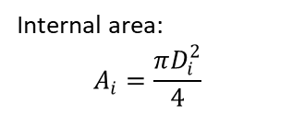
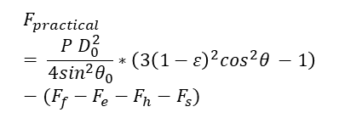

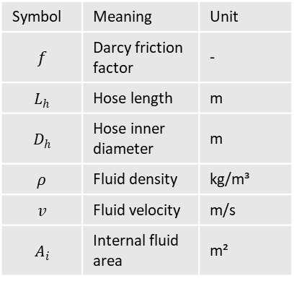


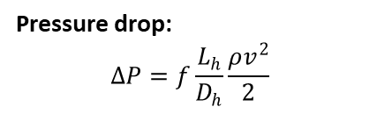
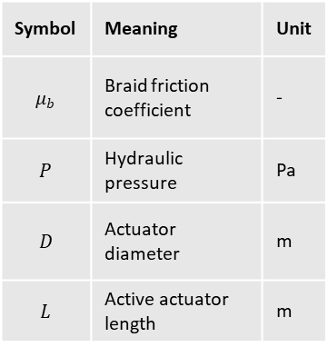
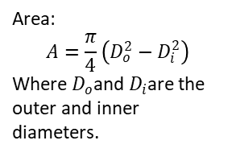

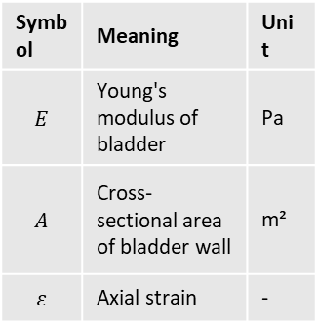
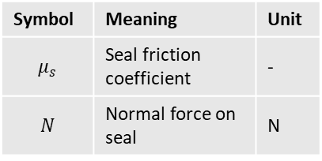
Derivation of Force and Pressure Relationship
Losses
1. Braid friction loss
2. Bladder elasticity loss
3. Hydraulic pressure loss
4. End fitting and seal loss
$$F_{loss}​=Ff​+Fe​+Fh​+Fs​$$
$$F_{f}​=μ_{b}​PπDL$$
$$F_{e}​=EAε$$
$$F_{h}​=ΔPA_{i}$$
$$F_{s}=μ_{s}​N$$
Constants
Constants
Constants
Loss term | Description
Ff | Braid friction loss
Fe | Bladder elasticity loss
Fh | Hydraulic pressure loss
Fs | End fitting and sealing loss
Pressure drop:
$$ΔP=f\frac{L_{h}}{D_{h}}\frac{ρv^{2}}{2}$$
Symbol | Meaning | Unit
$$μ_{b}$$ | Braid friction coefficient | -
$$P$$ | Hydraulic pressure | Pa
$$D$$ | Actuator diameter | m
$$L$$ | Active actuator length | m
Symbol | Meaning | Unit
$$E$$ | Young's modulus of bladder | Pa
$$A$$ | Cross-sectional area of bladder wall | m²
$$ε$$ | Axial strain | -
Symbol | Meaning | Unit
$$μ_{s}$$ | Seal friction coefficient | -
$$N$$ | Normal force on seal | N
Constants
Symbol | Meaning | Unit
$$f$$ | Darcy friction factor | -
$$L_{h}$$ | Hose length | m
$$D_{h}$$ | Hose inner diameter | m
$$ρ$$ | Fluid density | kg/m³
$$v$$ | Fluid velocity | m/s
$$A_{i}$$ | Internal fluid area | m²
Final Practical Equation
$$F_{practical}= \frac{P D_{0}^{2}}{4\sin^{2}θ_{0}}∗\left(3{\left(1−ε\right)}^{2}\cos^{2}θ −1\right)−(F_{f}−F_{e}−F_{h}−F_{s})$$
Area:
$$A=\frac{π}{4}\left(D_{o}^{2}−D_{i}^{2}\right)$$
Where $D_{o}$and $D_{i}$are the outer and inner diameters.
Internal area:
$$A_{i}=\frac{πD_{i}^{2}}{4}$$

Slide 3
Braiding Angle
Required Actuator Force, F | 500 | Newton
Considering bladder dia., D | 30 | Mm
Area of Bladder, A | 0.00071 | m²
Initial Braid Angle (Degree) | Final Braid Angle
 | (Contraction Factor ( ε ) )
 | 0.2 | 0.25 | 0.3 | 0.35
5 | 37.16 | 41.66 | 45.79 | 49.64
10 | 38.02 | 42.39 | 46.42 | 50.20
15 | 39.40 | 43.58 | 47.46 | 51.11
20 | 41.26 | 45.19 | 48.87 | 52.35
25 | 43.53 | 47.18 | 50.62 | 53.91
30 | 46.15 | 49.49 | 52.68 | 55.74
35 | 49.06 | 52.09 | 55.01 | 57.83
40 | 52.21 | 54.93 | 57.57 | 60.14
45 | 55.55 | 57.97 | 60.33 | 62.64
50 | 59.05 | 61.18 | 63.26 | 65.30
54 | 61.95 | 63.84 | 65.70 | 67.54
54.7 | 62.47 | 64.32 | 66.14 | 67.94
Conclusion:
Workable: 15⁰, 20⁰ and 25⁰ -> good response at ε ≤ 0.35
Can use 20⁰ -> at ε ≤ 0.2

Slide 4
Relation in Angle, Pressure and Contraction Factor
Diameter: 30mm
Initial Braid Angle (Degree) | Relative Internal Pressure Value in bar |  |  |  | Pressure Logarithmic Value in bar
 | 0.2 | 0.25 | 0.3 | 0.35 | 0.2 | 0.25 | 0.3 | 0.35
5 | 0.059 | 0.080 | 0.117 | 0.208 | -1.227 | -1.099 | -0.931 | -0.681
10 | 0.247 | 0.335 | 0.501 | 0.930 | -0.607 | -0.475 | -0.300 | -0.031
15 | 0.599 | 0.825 | 1.275 | 2.595 | -0.223 | -0.084 | 0.106 | 0.414
20 | 1.190 | 1.688 | 2.776 | 6.940 | 0.076 | 0.227 | 0.443 | 0.841
25 | 2.189 | 3.272 | 6.090 | 30.727 | 0.340 | 0.515 | 0.785 | 1.488
30 | 4.019 | 6.657 | 17.253 | -35.815 | 0.604 | 0.823 | 1.237 | 1.554
35 | 8.071 | 17.586 | -170.921 | -15.567 | 0.907 | 1.245 | 2.233 | 1.192
40 | 23.067 | -300.238 | -21.276 | -11.408 | 1.363 | 2.477 | 1.328 | 1.057
45 | -88.419 | -22.635 | -13.346 | -9.657 | 1.947 | 1.355 | 1.125 | 0.985
50 | -20.082 | -13.710 | -10.572 | -8.715 | 1.303 | 1.137 | 1.024 | 0.940
54 | -13.752 | -11.103 | -9.408 | -8.237 | 1.138 | 1.045 | 0.973 | 0.916
54.7 | -13.129 | -10.794 | -9.254 | -8.169 | 1.118 | 1.033 | 0.966 | 0.912
Conclusion
Pressure becomes negative when the braid angle is 54.7° or more.
The actuator works safely below 54.7°.
A 25° initial braid angle is selected because it remains safe up to 35% contraction strain.
The actuator shows linear contraction below 54.7° and tends to expand above 54.7°.
Theoretical analysis was also carried out for actuator diameters of 16, 20, 25, 30, 40, 50, and 60 mm.

Slide 5
Iteration & Conclusion on different Diameter
Conclusion from Iteration
35° braid angle with ε = 0.25 requires 61.83 bar, not feasible.
Market tubes are available in 4 to 16 mm OD.
Selected actuator size: 16 mm OD, 12 mm ID.
At 20° and ε = 0.20, required pressure is 10.71 bar.
Considering 30% losses, operating pressure is 14 bar.
Final design: D = 16 mm, L = 250 mm, θ = 20°, P = 14 bar, ε ≤ 0.35.

Slide 6
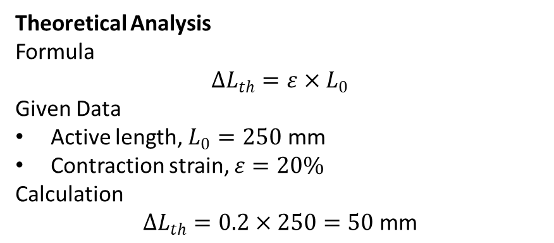
Theoretical & Practical Length Change Comparison
Theoretical Analysis
Formula
$$ΔL_{th}=ε×L_{0}$$
Given Data
Active length, $L_{0}=250\text{ mm}$
Contraction strain, $ε=20\%$
Calculation
$$ΔL_{th}=0.2×250=50\text{ mm}$$
Practical Results
Pressure (bar) | NBR-Aramid (mm) | Silicone-Nylon (mm)
2 | 0 | 2
3 | 0 | 5
4.5 | — | 15
5 | 10 | 20
6 | 25 | —
10 | 30 | 20
Parameter | Value
Initial active length | 250 mm
Theoretical length change | 70 mm
Final contracted length | 200 mm
Contraction strain | 20%
Maximum Length Change Comparison
Type | Length Change (mm)
Theoretical | 70
NBR-Aramid | 30
Silicone-Nylon | 20

Slide 7
Theoretical & Practical Length Change Comparison

Slide 8
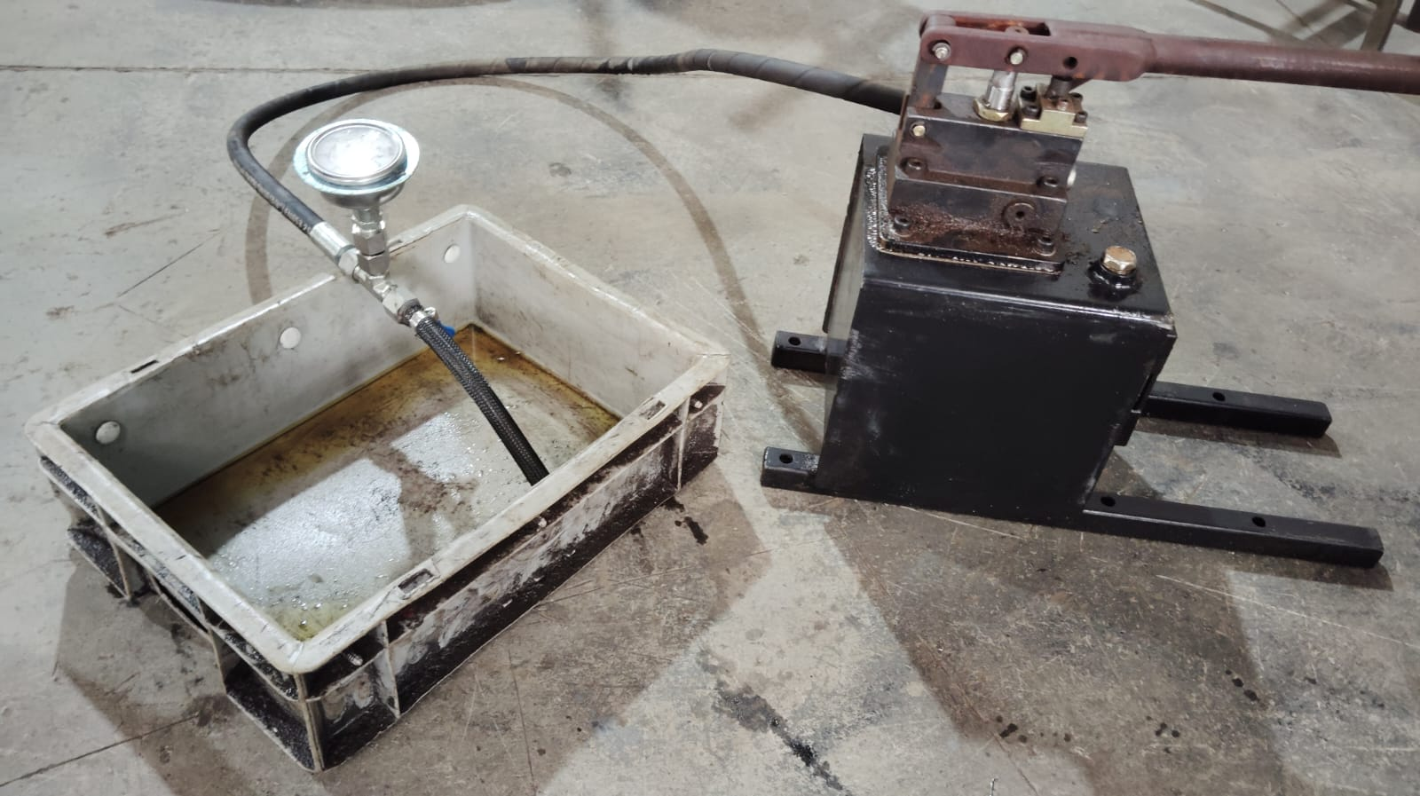
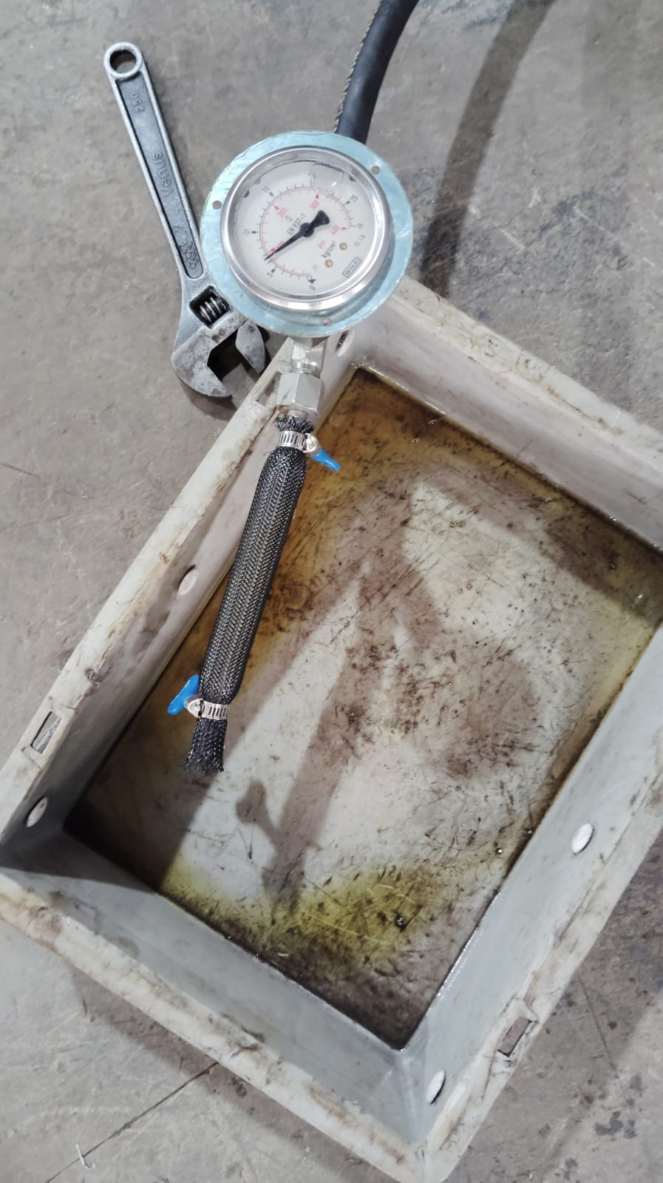
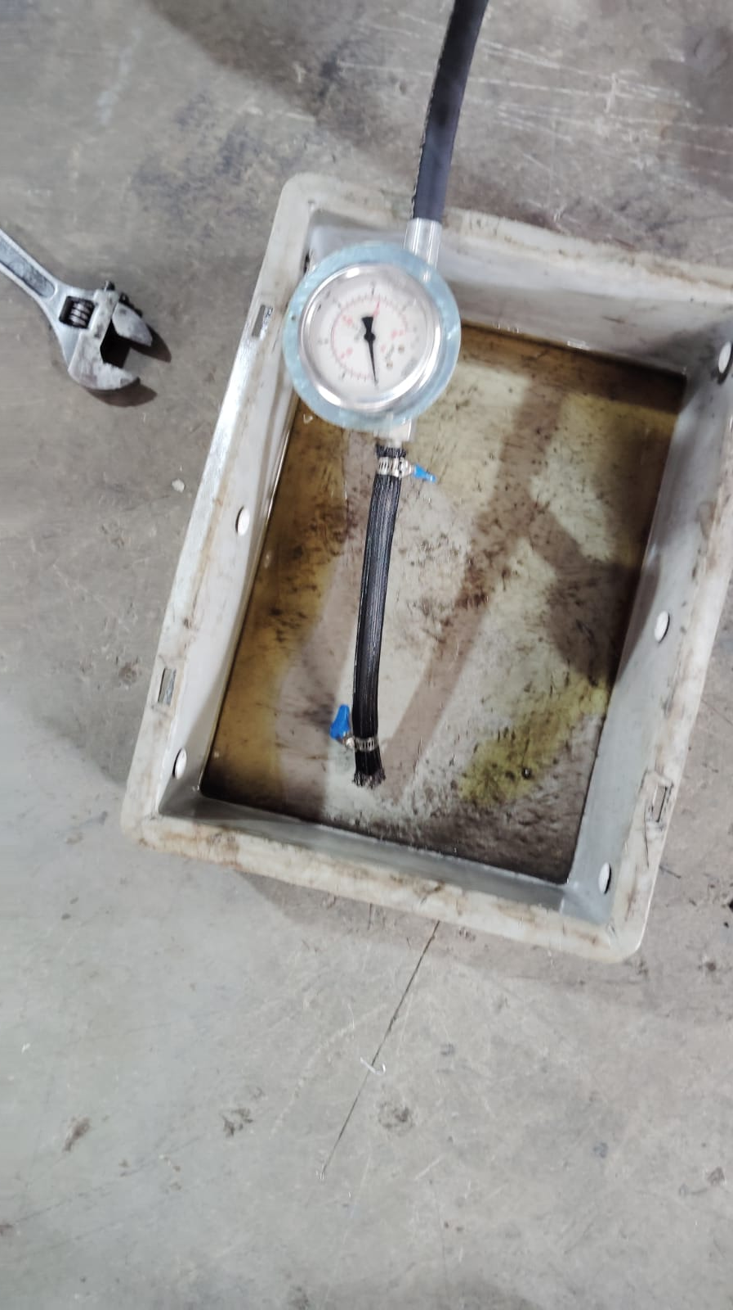
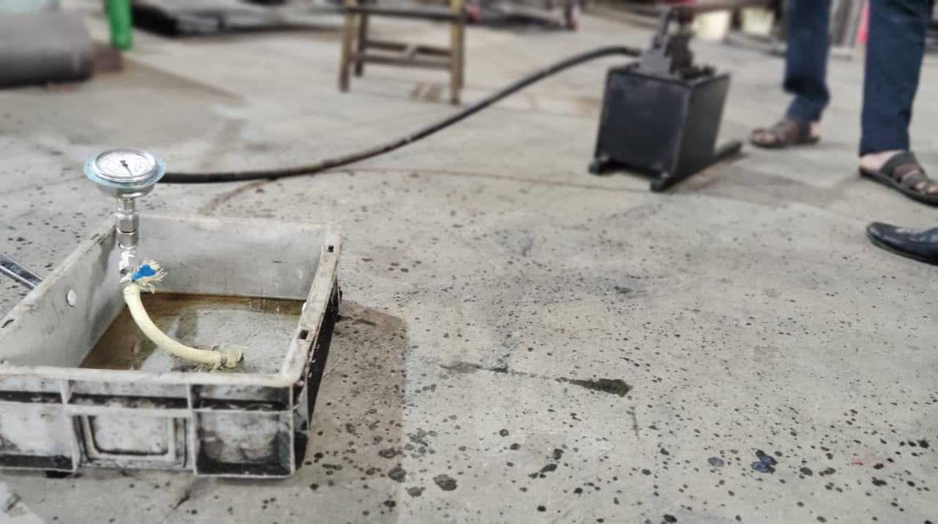
Theoretical & Practical Length Change Comparison

Slide 9
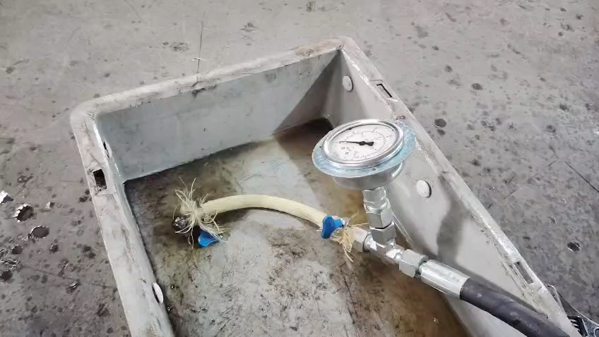
Theoretical & Practical Length Change Comparison

