Slide 1

A Seminar Presentation On SQL Joins
Presented By : Suraj S

Slide 2
SQL JOINS
Definition :
An SQL join is used to combine rows from two or more tables based on a related column between them.

Slide 3
WHY WE USE SQL JOIN?
Flexibility - It allows the user to access and manage records from more than one table
Data redundancy - SQL join allows us to keep data redundancy low so that we can reduce the amount of data anomalies.
Efficiency - Executes faster and shows results much more quickly than any other sub query.

Slide 4
TYPES OF JOINs
Inner Join
Outer Join
Left Join
Right Join

Slide 5
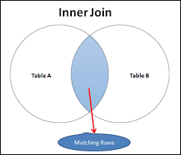
Inner Join
Definition : Inner join returns a new table by combining records that only have matching values in both the tables.

Slide 6
SYNTAX
SELECT table1.col_name, table2.col_name,
FROM table l
INNER JOIN table 2
ON table1.column = table2.column;
Example Question :
List all books name that are low on stock (less than 5 units) ?

Slide 7
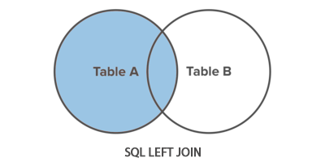
LEFT JOIN
Definition : Left join returns all the rows from the left table and matching rows from the right table.

Slide 8
SYNTAX
SELECT table1.col_name, table2.col_name
FROM table l
LEFT JOIN table2
ON table1.column = table2.column;
Example Question :
How can I identify and add newly arrived books to the inventory table?

Slide 9
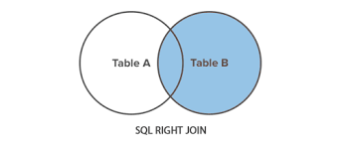
RIGHT JOIN
Definition : Right join returns all the rows from the right table and all the matching records from the left table.

Slide 10
SYNTAX
SELECT tablel.col_name, trable2.ml_name
FROM tablel
RIGHT JOIN table2
ON tablel.column = table2.column;
Example Question :
List all customers who have not made any purchases (i.e., do not appear in the Sales table), along with their names and contact information.

Slide 11
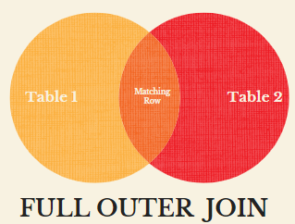
OUTER JOIN
Definition : Outer join returns all those records which are in either the left table or right table.

Slide 12
SYNTAX
SELECT table1.col_name, table2.col_name
FROM table1
LEFT JOIN table2 ON table1.column = table2.column
UNION
SELECT table1.col_name, table2.col_name
FROM table1
RIGHT JOIN table2 ON table1.column = table2.column;
Example Question :
List all customers along with any sales they have made, if available. Include all sales, even those without corresponding customers, indicating that there are no customers for those sales.

Slide 13
THANK YOU.

